Slide 1
New Horizons LORRI KEM Cruise 1
New Horizons Extended Mission (KEM) and PDS4/Comet Review
2018 Oct 10/11
Michael S. P. Kelley
University of Maryland

Slide 2
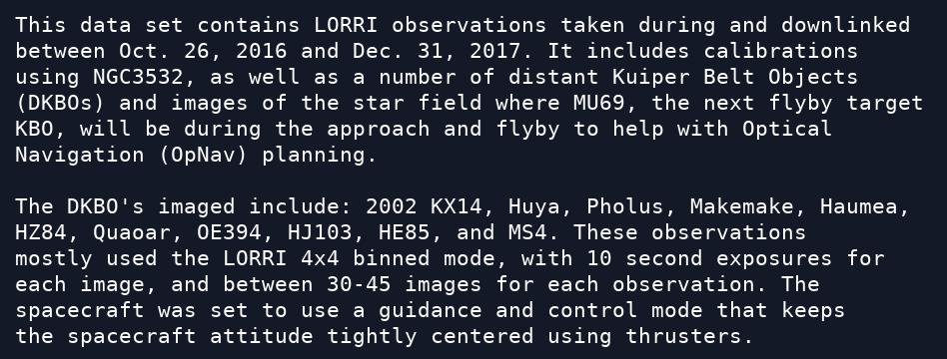
1. catalog/dataset.cat
Lien
Some target abbreviations are used in DATA_SET_DESC and in ABSTRACT_DESC, but full designations are preferred at the time of their first use: MU69, HZ84, OE394, HJ103, HE85, and MS4.

Slide 3
2. catalog/dataset.cat
Lien
In CONFIDENCE_LEVEL_NOTE:
But this document does not exist. Resolve according to our discussions yesterday.

Slide 4
3. catalog/nh_kem.cat
Looks good
New Horizons Kuiper Belt Extended Mission catalog file.

Slide 5
4. document/
Looks good
Lots of detailed documentation, as expected at this point in New Horizons's history.
I did not review these documents, but inspected to see what has been updated since the Pluto encounter.
NH_MISSION_TRAJECTORY.TAB: Table of spacecraft x, y, and z, including KEM Cruise 1.
Soc_inst_icd.pdf: Interface Control Document, dated Sep 2017. Updates are not relevant for LORRI.

Slide 6
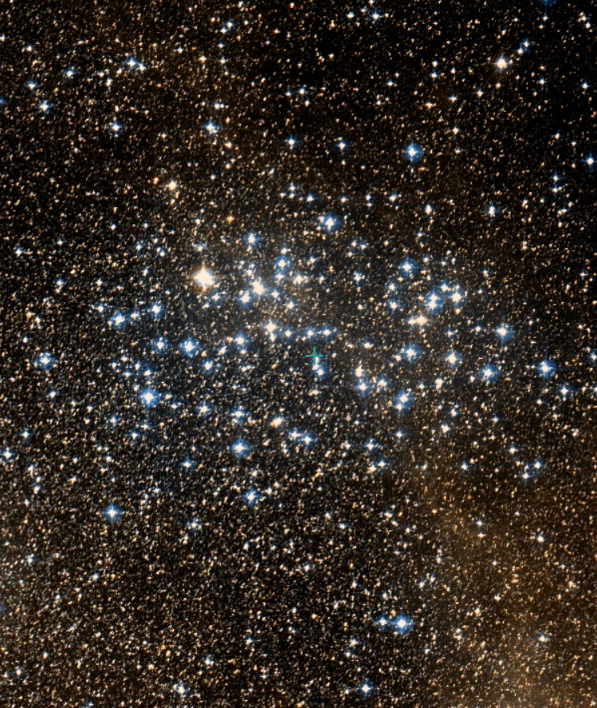
5. Inspect NGC 3532
Identify relevant data with index.tab.
Measure brightness of sources.
Compare with Tycho 2 catalog.
Estimate calibration constants.

Slide 7
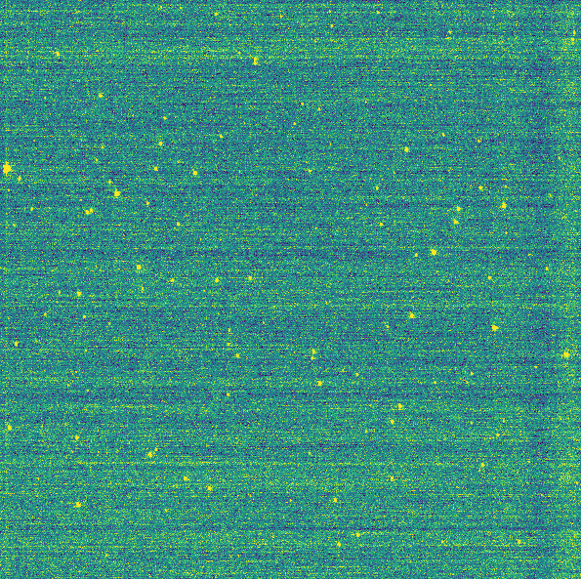
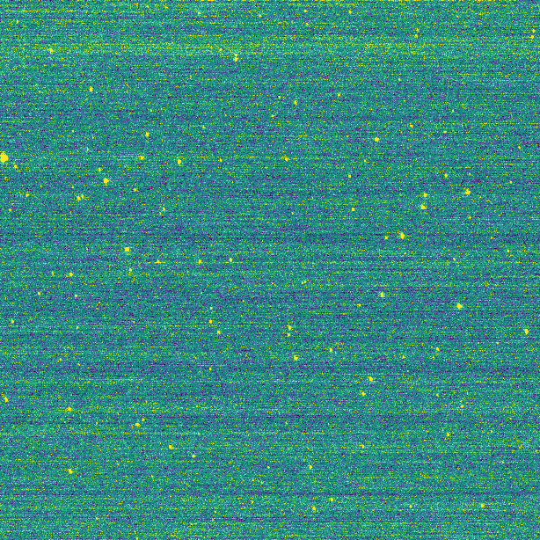
lvl2
DSS
lvl3
Bias removed
Orientation via PDS label: Looks good

Slide 8
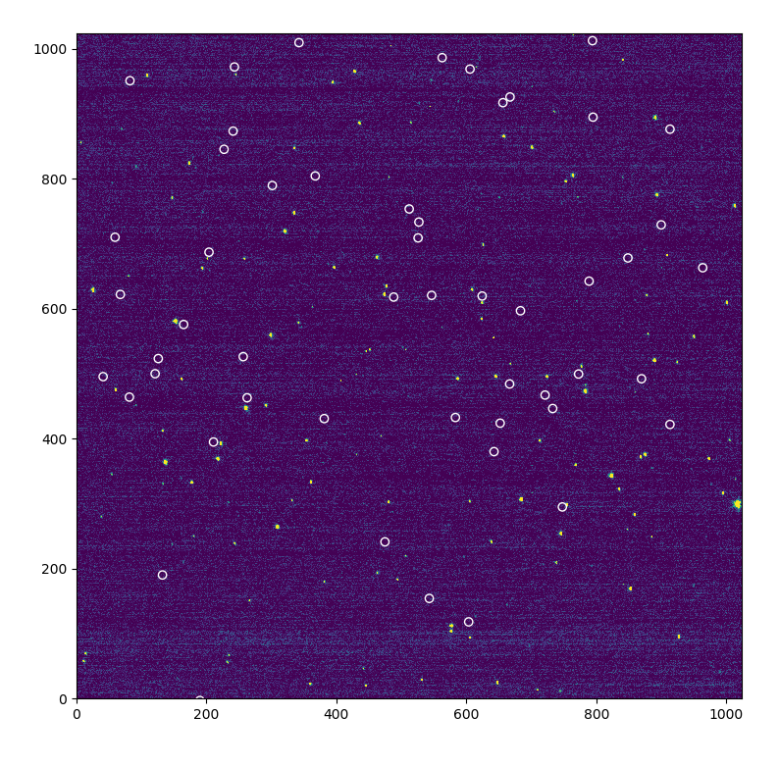
First attempt at photometry using PDS label and Tycho 2 catalog coordinates.
A moderate linear offset, but rotation is good.

Slide 9
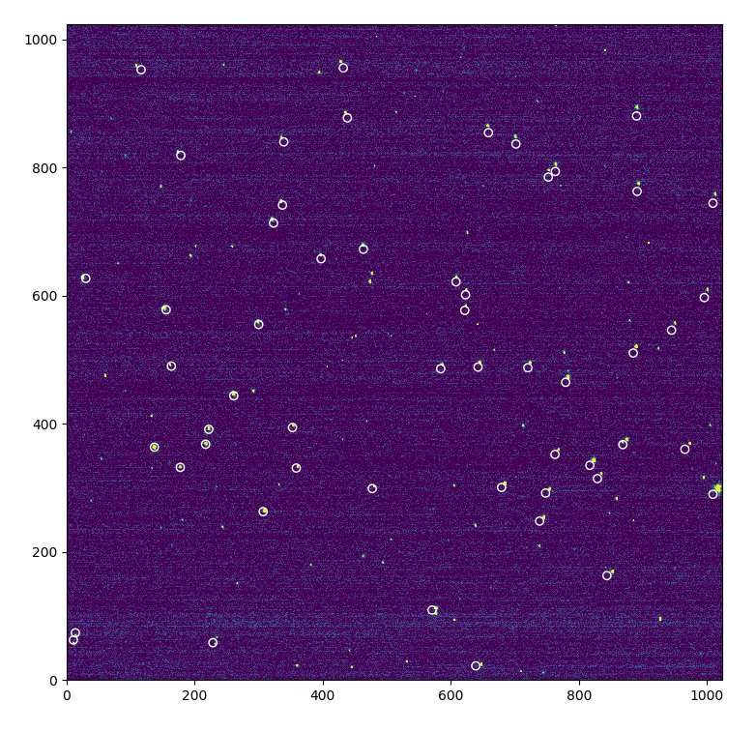
Second attempt: closer.
Need to adjust pixel scale ~0.8%.

Slide 10
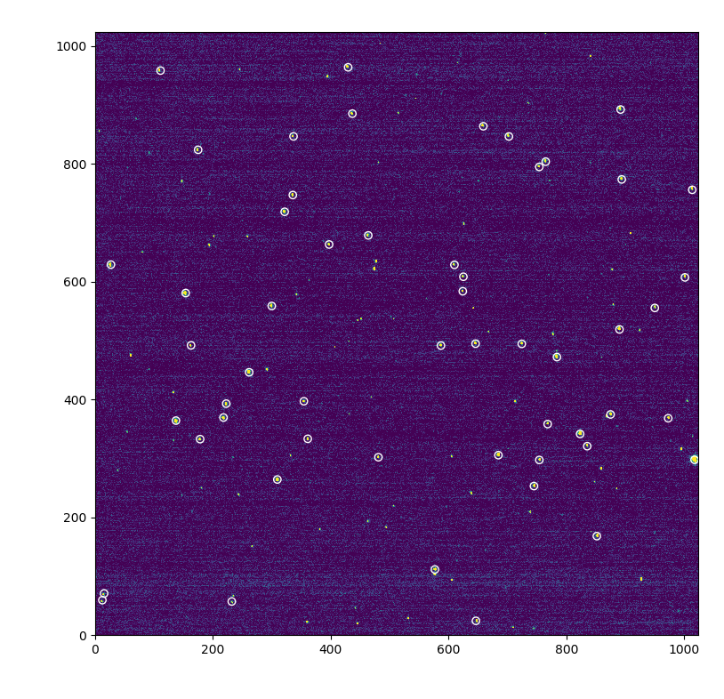
Final adjustments include 0.5 deg rotation.

Slide 11
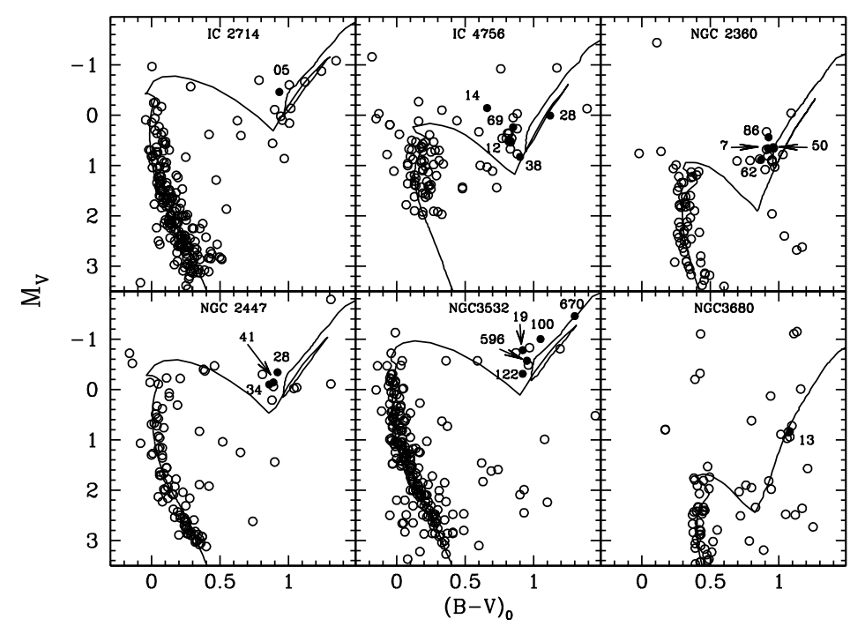
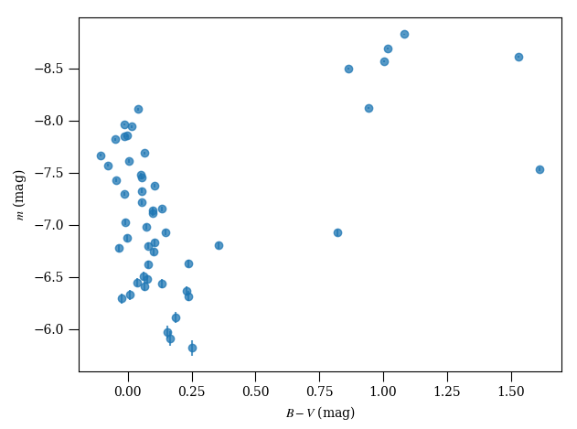
Smiljanic et al. 2009

Slide 12
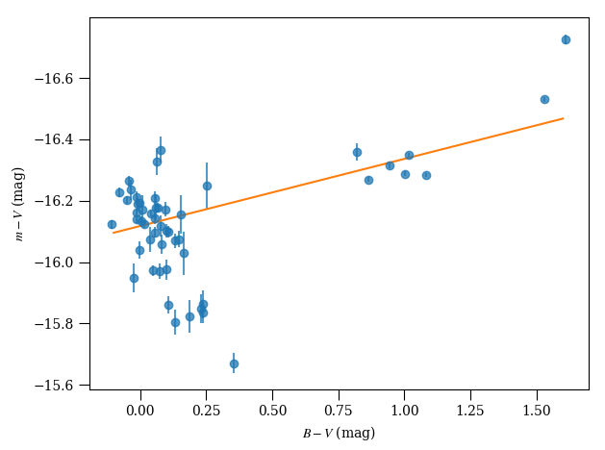
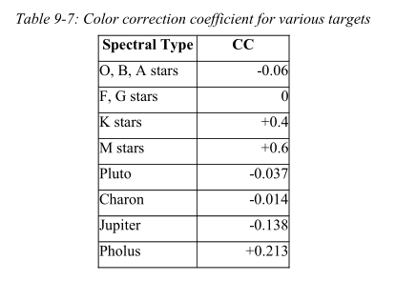
Instrumental calibration: zero-point and color correction: 16.12 mag, -0.219 mag/mag.
Solar (Colina et al. 1996)
B-V = 0.63
Vega (Bohlin 2014)
V = 0.03 mag
F_{λ} = 3.54e-9 erg/s/cm2/Å
Exposure time: 0.1 s
16.12 + 2.5 + 0.03 = 18.65 mag
Pipeline value = 18.87 mag
Looks good

Slide 13
6. Find Quaoar
Inspect images with TARGET == Quaoar
Find it.

Slide 14
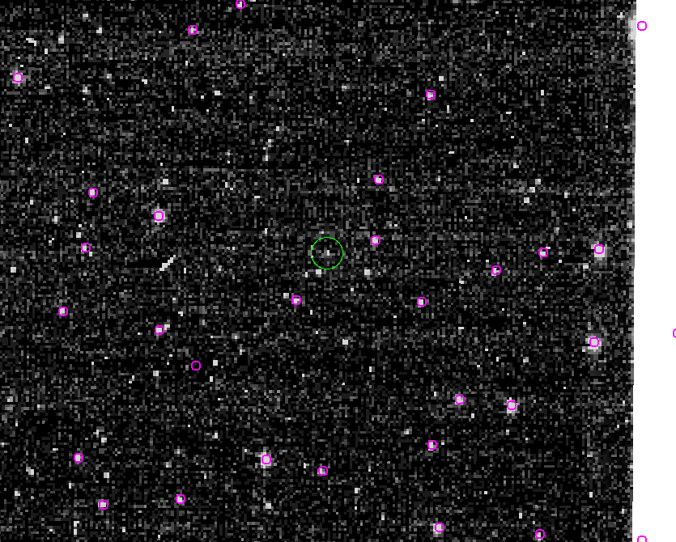
Magenta: Star coordinates after WCS adjustment.
Green: Ephemeris position of Quaoar

Slide 15
Point source near Quaoar ephemeris position moving in the correct direction.
Looks good

