Slide 1
New Horizons MVIC KEM Cruise 1
New Horizons Extended Mission (KEM) and PDS/Comet Review
2018 Oct 10/11
Michael S. P. Kelley
University of Maryland

Slide 2
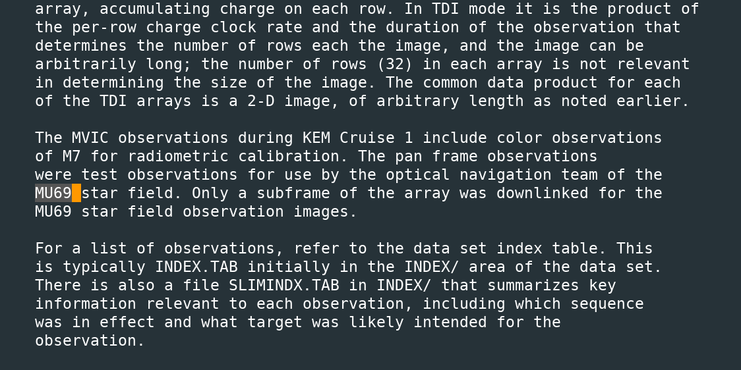
1. catalog/dataset.cat
Lien
First use of MU69 in the DATA_SET_DESC and ABSTRACT_DESC should use the full designation of the object.

Slide 3
2. catalog/dataset.cat
Lien
In CONFIDENCE_LEVEL_NOTE:
But this document does not exist. Resolve according to our discussions yesterday.

Slide 4
data/
12 images taken September 2017:
8 of open cluster M7
4 of 2014 MU69 starfield

Slide 5
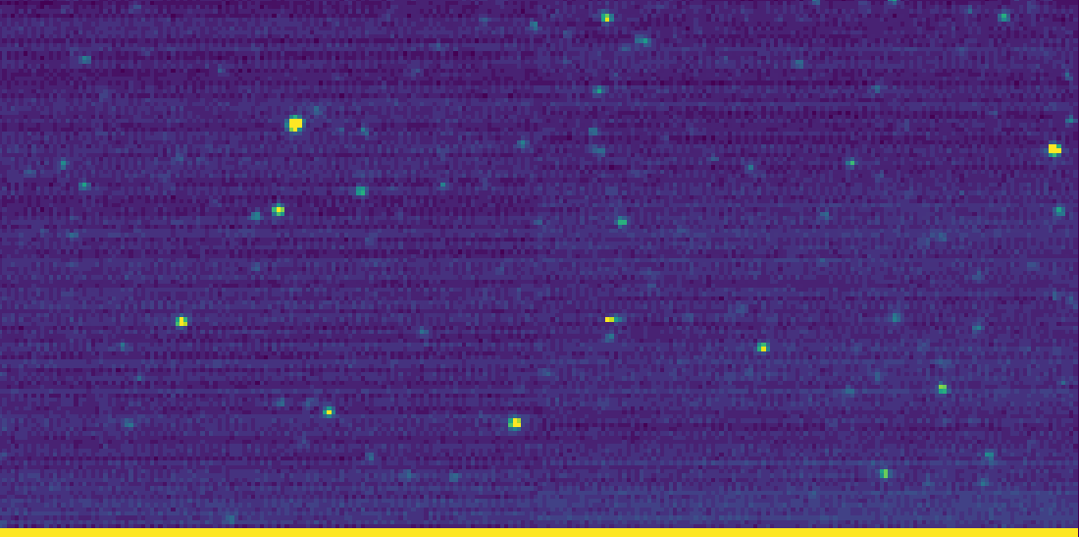
3. 2014 MU69 Field
Uses Panchromatic Framing Channel, lossless compression, windowed.
Data include a time series of images taken over ~5 min with associated housekeeping data and a table of the window parameters.

Slide 6
Window parameters agree with the image I checked: starfield with 2 apparent overscan regions.
Looks good

Slide 7
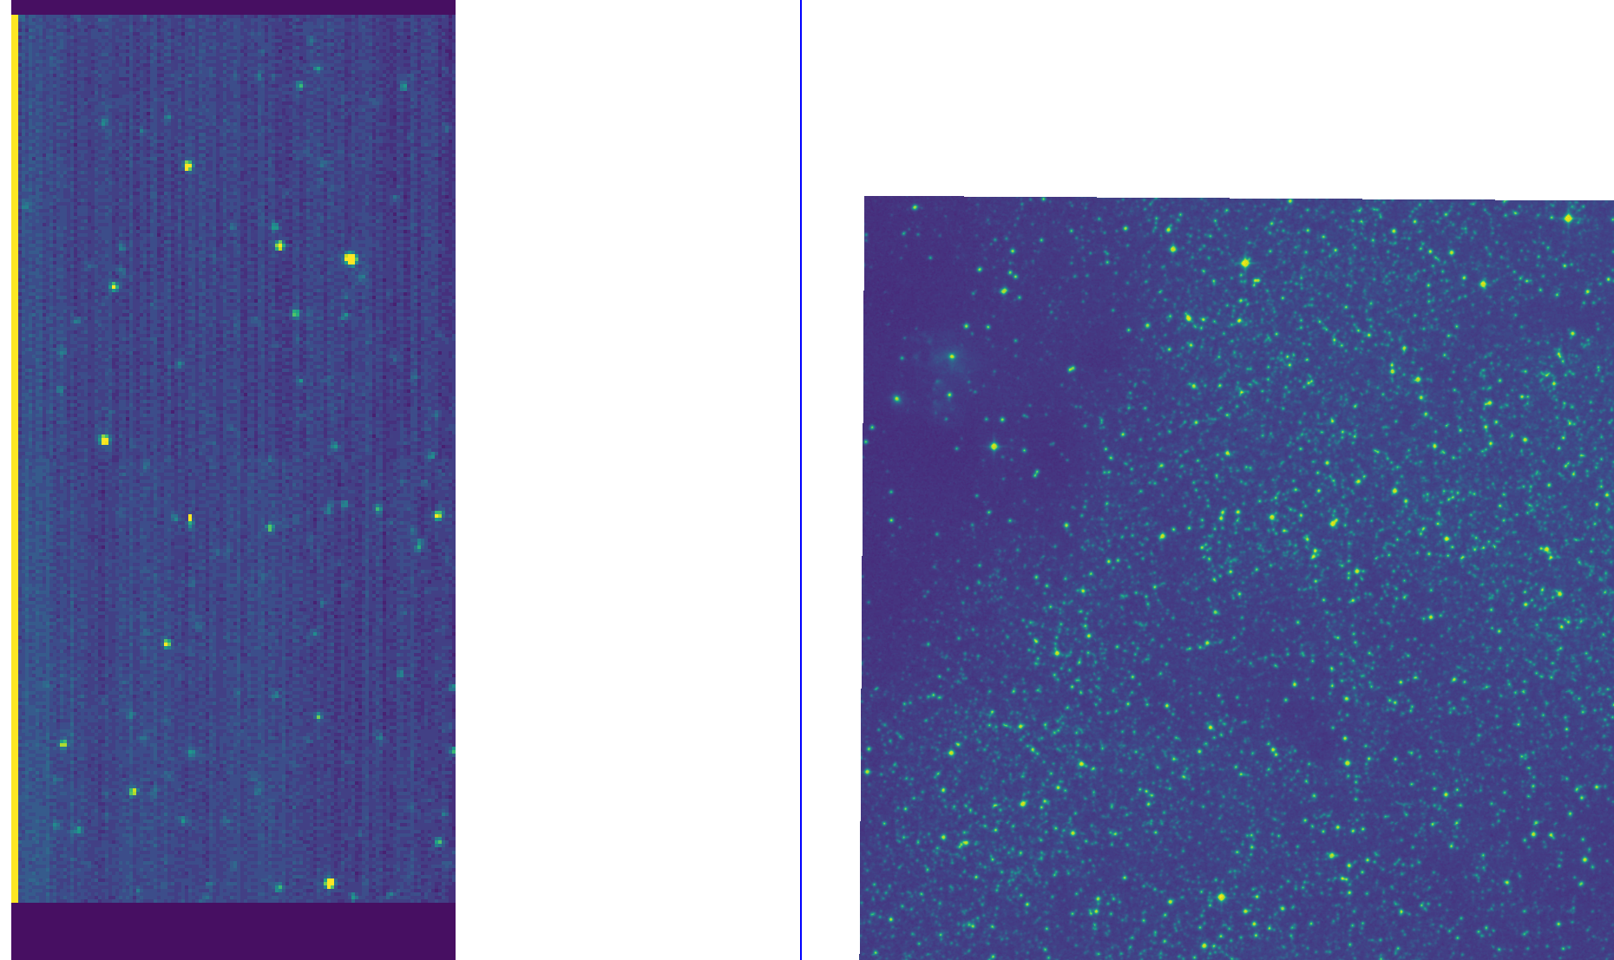
Looks good

Slide 8
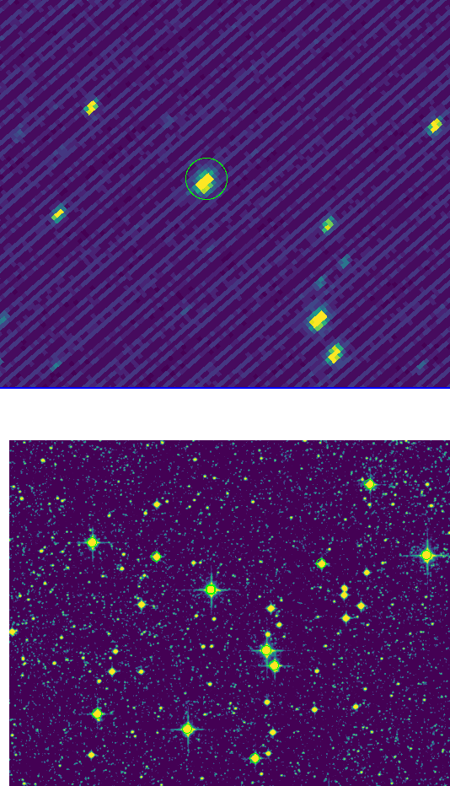
4. Check M7 photometry
Looks good
Just checking a single V=5.97, B-V=0.0 star.
→ 1e-11 W/m2/μm
Using calibration for the Sun I measure:
→ 1e-11 W/m2/μm

