Slide 1
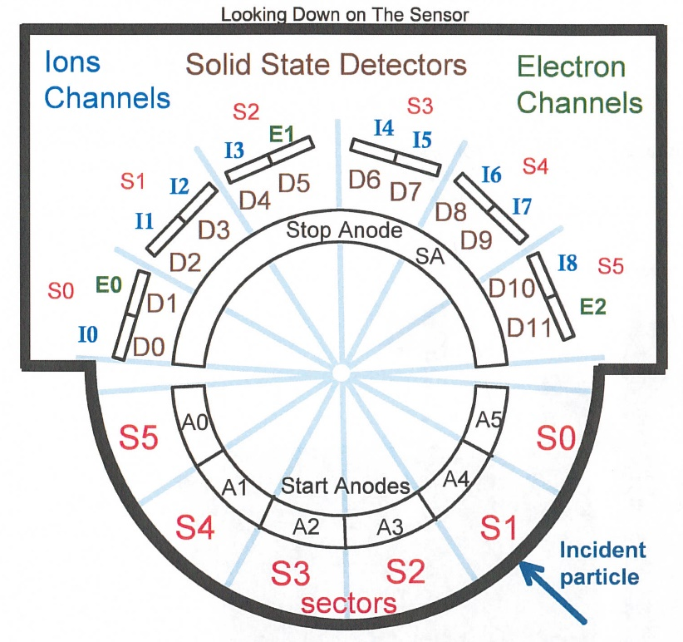
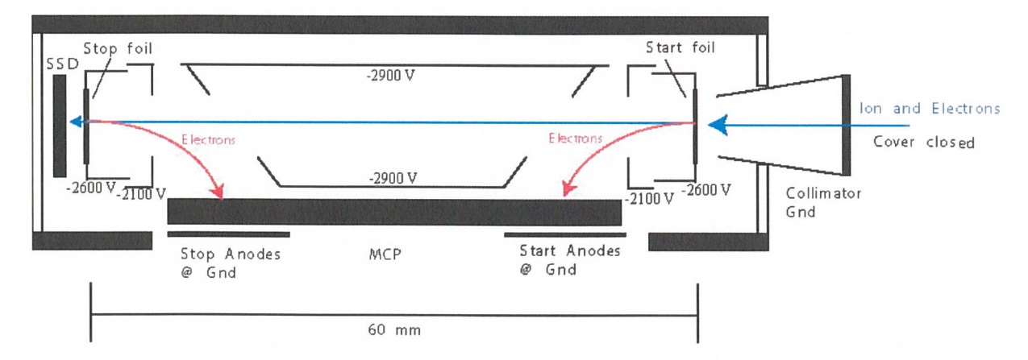
New Horizons Pluto Energetic Particle Spectrometer Science Investigation (PEPSSI)
Reviewed by S. Joy (primary)
PRINCIPAL INVESTIGATOR: Ralph McNutt, APL
DESCRIPTION: Medium Energy Particle Spectrometer
ENERGY RANGE: 25-1000 keV (protons)
60-1000 keV (atomic ions)
25-500 keV (electrons)
FIELD OF VIEW: 160 deg x 12 deg
ANGULAR RESOLUTION: 25 deg x 12 deg
ENERGY RESOLUTION: 0.25 keV
SENSOR SIZE: 7.6 cm dia. x 2.5 cm thick
POWER: 1.4 watt
MASS: 1.5 kg

Slide 2
New Horizons PEPSSI Data Sets
Derived Data ->
nh-x-pepssi-2-kemcruise1-v1.0
nh-x-pepssi-3-kemcruise1-v1.0

Slide 3
New Horizons PEPSSI Data Set Evaluation Tools
All Data Processing and Evaluation -
Machine: Dell Precision M4800
Operating System: Windows 10

Slide 4
Documentation
Evaluation

Slide 5
Root level files
AAREADME No issues found VOLDESC No issues found

Slide 6
Catalog files
CATINFO.TXT – no changes required
All multi-volume catalog files except appear to be latest versions (nh, nhsc, pepssi)
NH_KEM.cat – Line 225 regolity→ regolith
DATASET.CAT (nh-x-pepssi-2-kemcruise1-v1.0)
Although mostly generic, this file is generally acceptable. There are a few minor corrections…
line 498 spaceecraft -> spacecraft
line 485-486 “This dataset was peer reviewed and certified for scientific use on
TBD.” - Might consider removing date by replacing “on TBD.” with “by the PDS.”
DATASET.CAT (nh-x-pepssi-3-kemcruise1-v1.0)
Effectively identical to -2- dataset.cat, down to spelling errors/lines.

Slide 7
Document files
DOCINFO.TXT – no changes required
All PDS documents are properly formatted as PDF/A All document labels appear to be valid
Most of these document files have been reviewed many times and have not changed recently. They appear to be the latest versions of each.
The most recent entry in the “bad time intervals” file (pep_bti.tab) is 2015-11-05T21:15:00 to 2015-11-05T21:55:00. Were there really no BTIs in 2016 or 2017 or is this file out-of-date?
The time conversion file (nh_met2utc.tab) appears to be out-of-date. The last entry is 2016-01-02 and the data cover through the end of 2017.
The trajectory data file (nh_mission_trajectory.tab) has been updated to include daily entries through the end of 2017.
Missing calibration parameters files/labels PEP_nnnnnnnnnn_0X69n_CALPAR.TAB (.LBL). These files are described in calpinfo.txt, in the “calib/calpars” subdirectory.

Slide 8
Data
Evaluation

Slide 9
nh-x-pepssi-2-kemcruise1-v1.0
Files open with both NASAVIEW and FV suggesting that the PDS and FITS labels are well-formed.
All of the files selected for spot inspection appeared nominal.

Slide 10
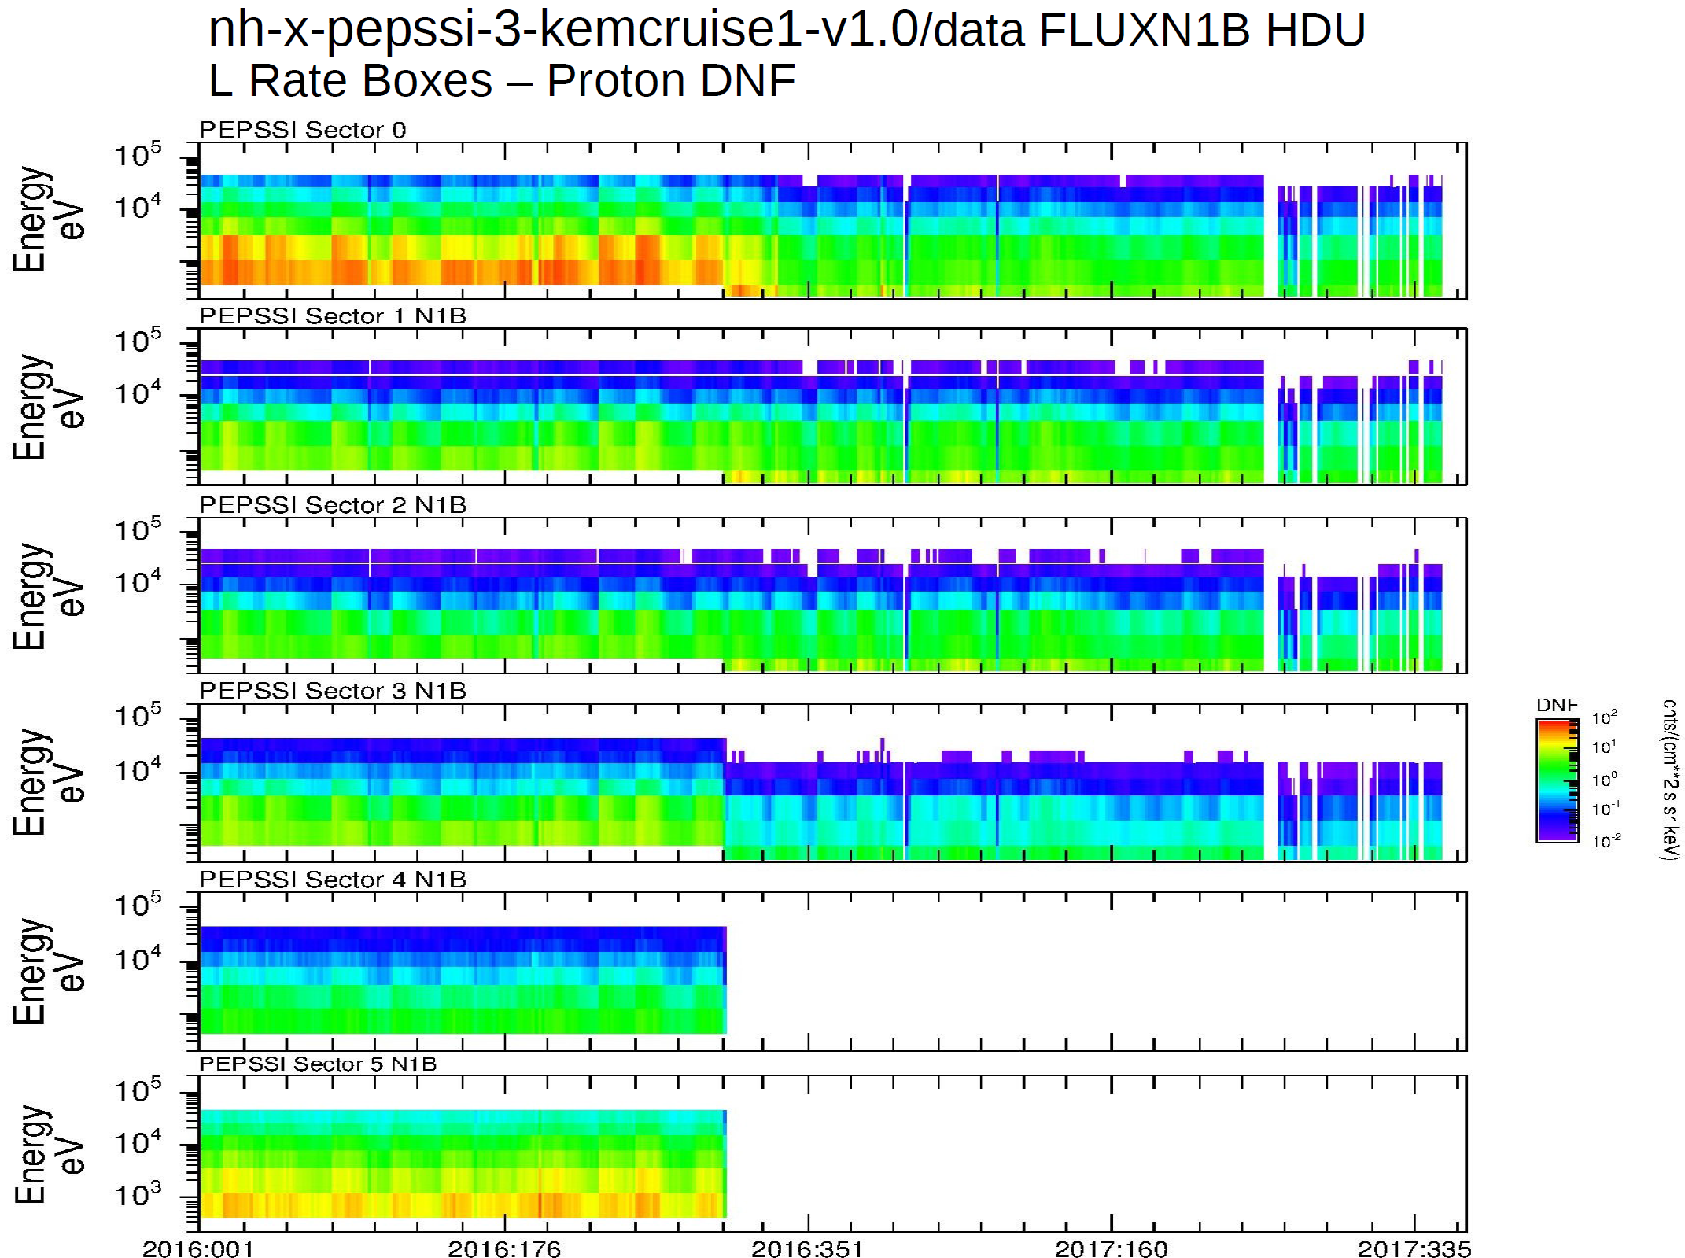
nh-x-pepssi-3-kemcruise1-v1.0
Plot from R. Frahm Presentation
Energy range appears to shift lower around day 300 in sectors 0-3 and bad sectors 4 and 5 are removed. This reason for change needs to be documented.

Slide 11
nh-x-pepssi-3-kemcruise1-v1.0
Files open with both NASAVIEW and FV suggesting that the PDS and FITS labels are well-formed. However, NASAVIEW won’t allow the user to scan through the various tables in these files, the software seems to have an issue showing tables that follow an image object (this isn’t done in the -2- data file labels).
All of the files selected for spot inspection appeared nominal in FV.
Rudy’s presentation shows and discusses many data plots, and some potential issues with the data, first around day 300 of 2016, and then again around day 300 of 2017. Please refer to his discussion for details

Slide 12
Summary of Liens
In general, the documentation is a bit sparse, particularly the dataset.cat files which are generic, not specific to the datasets. This is just a comment and there is no associated lien, however, should the team decide to update the -3- dataset.cat file,
it would improve the archive. That said, there does appear to be a change in the instrument response before/after ~day 300 in 2016 and again around day 300, 2017. The reason for these changes needs to be described in at least one location in the -3- documentation and it is probably easier to update the dataset.cat than the “soc_inst_icd”, or creating a new calibration description document.
Liens:
Update the PEPSSI documentation to include a description of what/when/why the instrument response appears to change around days 300 in 2016 and again in 2017. It’s possible that these changes might be associated with calibration parameter changes. Documentation should go beyond just providing missing files.
Provide the missing calibration parameter files that should be found in the calib/calpars directory. Verify that the labels correctly describe the new parameter files.
Update the nh_met2utc.tab and probably the pep_bti.tab files to cover the time intervals of these datasets.

