Slide 1
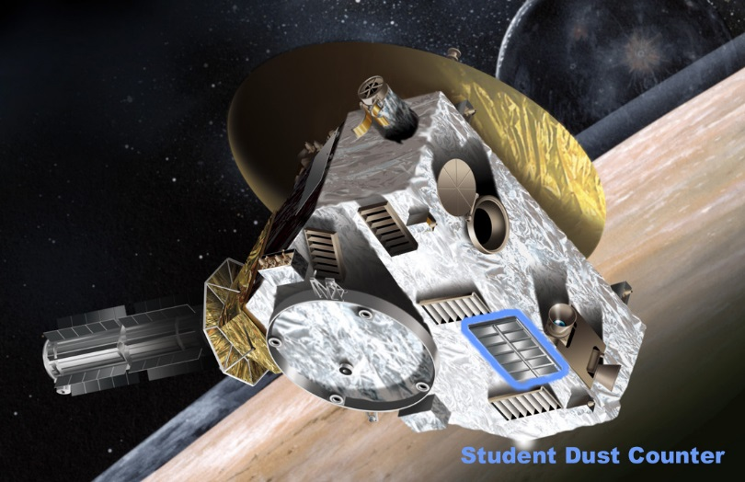
PDS Data Review
New Horizons Pluto Encounter
Student Dust Counter
October 10, 2018
Jim Gaier
NASA Glenn Research Center

Slide 2
Documentation
No new problems were identified outside of missing sequence file but some questions arose:
Catalog/SDC
Operational Considerations
2) Stimulus calibrations generate false positives
Last documented July 2016 so not in this data set
Have there been any calibrations since July 2016?
4) No particle events over 2.8E-10 g (3 μm) as of late 2016
Reason under active discussion by science team and eventually addressed in a future delivery of SDC data sets
Any larger particles found in this data set?
Status of these discussions?
Plan to address?

Slide 3
Raw Data → Calibrated data
Used NASAView to look at first data set
Calibrated data was consistent with raw data
2σ mass ≈ 4% DN “above” threshold value
4σ mass ≈ 8% DN “above” threshold value
Data sparse (28 hits over 92.4 hr)
10 occurred within same MET sec
All 10 greater than 2σ mass
Of rest of data
1 above 4σ mass
2 above 2σ mass
11 below 2σ mass

Slide 4
Calibrated Data
Many hits come in clusters of many channels at same time – quality flag of “OK”
“OK” implies no thruster firing

Slide 5
Problem
SOC to Instrument Pipeline ICD
“The maximum number of recorded hits in one second on a given channel for SDC is in general 3. The way the timing works it is possible to get up to 5 hits/second. However, if more than one hit is recorded in one second (instrument wide) this is considered a coincident event and will be flagged. The science processing interprets such an event as s/c noise and removes it.”
The Raw Data contain many of these coincident events that are not being removed.

Slide 6
Calibrated Data
Used NASAView to look at 4 data sets
Beginning, end, 2 in between
Distribution of data among channels relatively even
Data sparse (150 hits in 150 hr)
No channel bias seen in limited data
8 non-coincident data > 2σ
Only 8 solid hits in 150 hr
4 hits > 4σ

