Slide 1
SOHO SWAN
PDS Data Review
Water Production Rates
Collection v2.0
Cesare Grava
Southwest Research Institute

Slide 2
Overview
Dataset includes water production rates of 12 comets observed from 1996 to 2017 by SWAN instrument onboard SOHO
Water production rates (Q) are obtained from column densities (N):
  Q ~ 4vNR [Combi et al., 2004], where R is distance from nucleus and v is outflow velocity (from model)
Column densities (N) are obtained from brightness (I) at Lyman-alpha and from solar flux (g) at Lyman-alpha: N = I/g

Slide 3
Overview
Column densities (N) are obtained from brightness (I) at Lyman-alpha and from solar flux (g) at Lyman-alpha: N = I/g
Brightness (I) comes from SOHO. Lyman-alpha (121.6 nm) comes from photo-dissociation and excitation of water molecules: H₂O + γ → H + OH and then OH + γ → H + O. Both H atoms produce Lyman-alpha.
Solar flux (g) comes from LISIRD database at LASP (Univ. of Colorado). Instrument not specified, but presumably it’s SOHO’s SUMER.
Exhaustive explanation in the overview.txt file. They have taken into account all relevant factors, including the motion of SOHO (not exactly at L1 Lagrangian point), and the difference in solar flux between the Earth (where it is measured) and the location of the comet.
With the caveat that it was not possible to reproduce the derived production rate, values are reasonable – see next slides with comparison with published values (when existing)

Slide 4
Parameters: 7 columns
Time in UTC when the comet nucleus was sampled.
That same time given in fractional days from the comet's perihelion day and time.
The heliocentric distance of the comet at the time of the observation in AU
The spacecraft-to-comet distance in AU
The photon emission rate, or g-factor, in photons per atom per second at a distance of 1 AU.
The water production rate in 1.0e27 molecules per second.
1-sigma uncertainty
Not provided:
  Assumed outflow velocity (v)
  Column densities (N)
  Brightness (I)

Slide 5
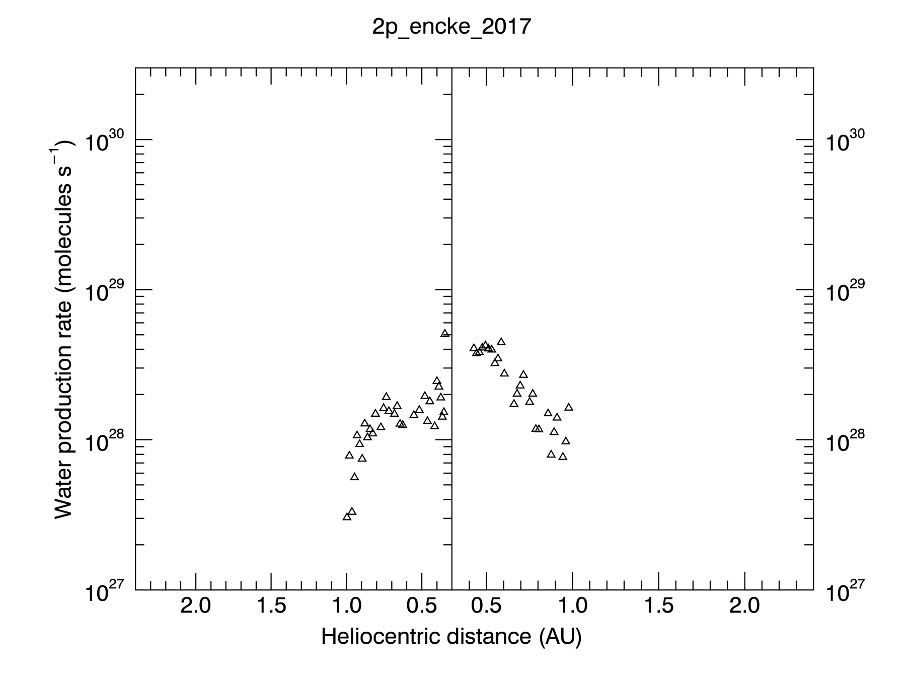
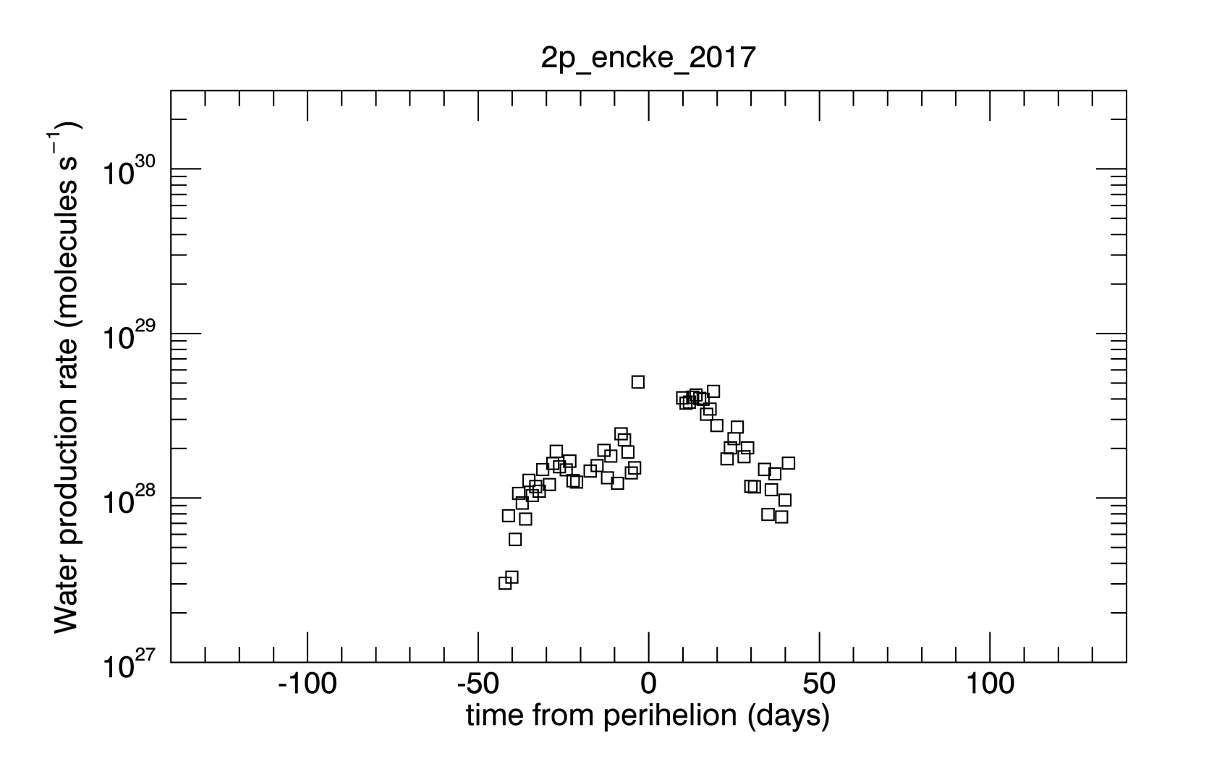
Plotting the data: 1
Compare with Makinen+ [2001]: ~2d28 s⁻¹.

Slide 6
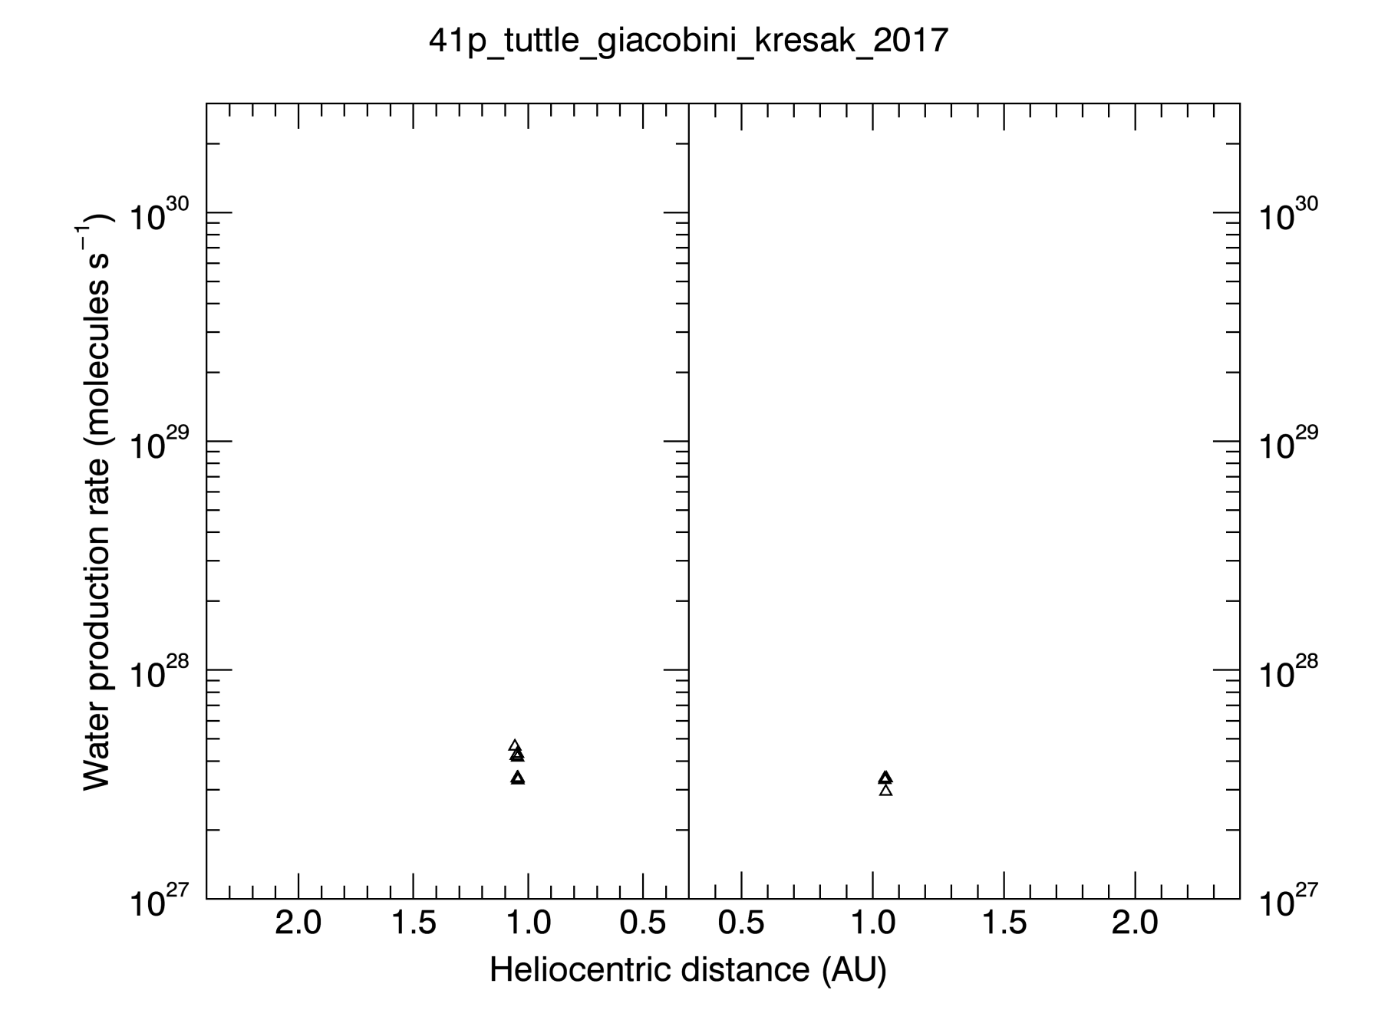
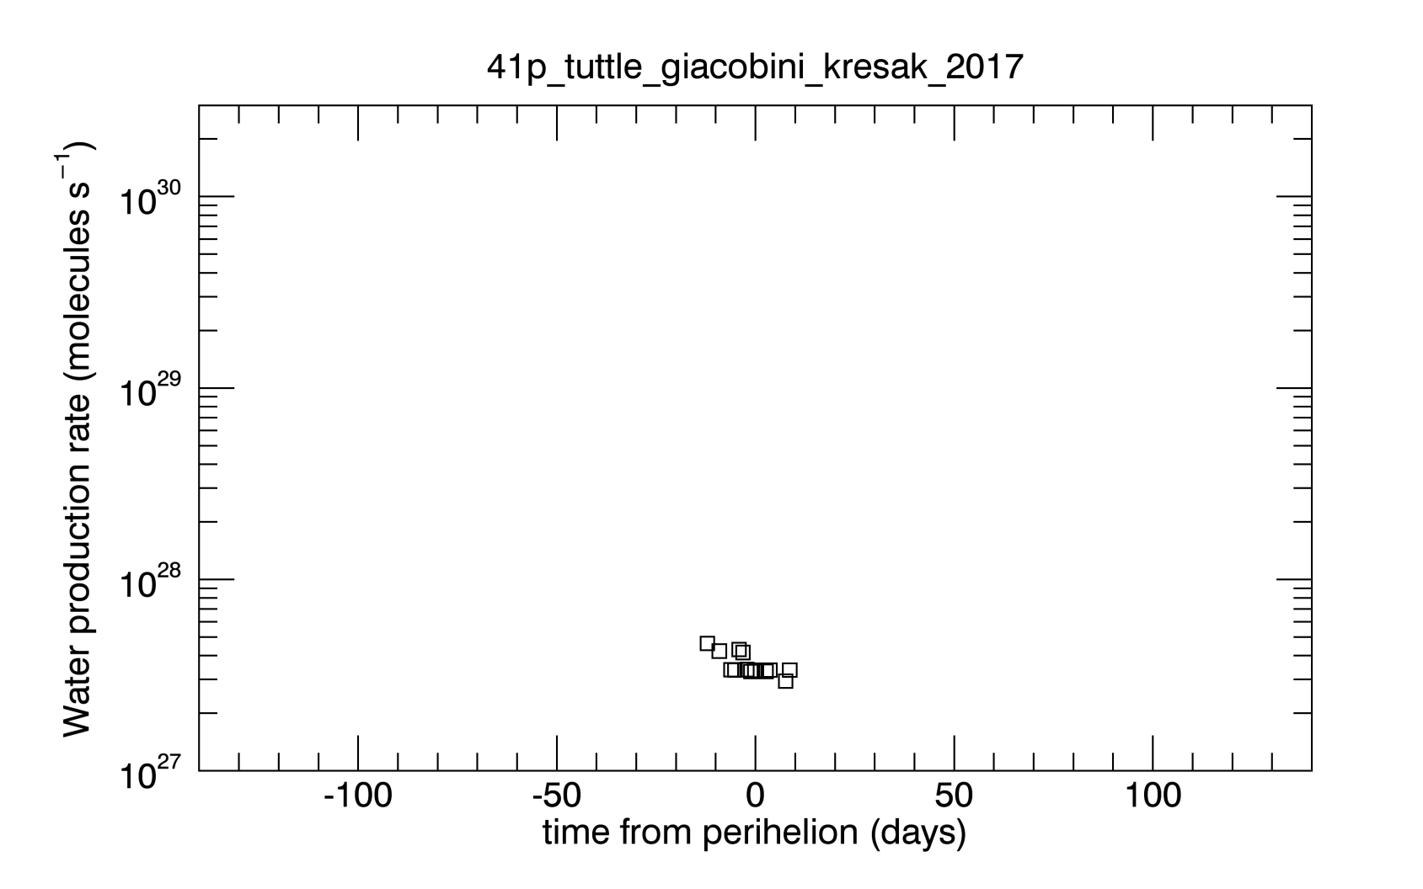
Plotting the data: 2

Slide 7
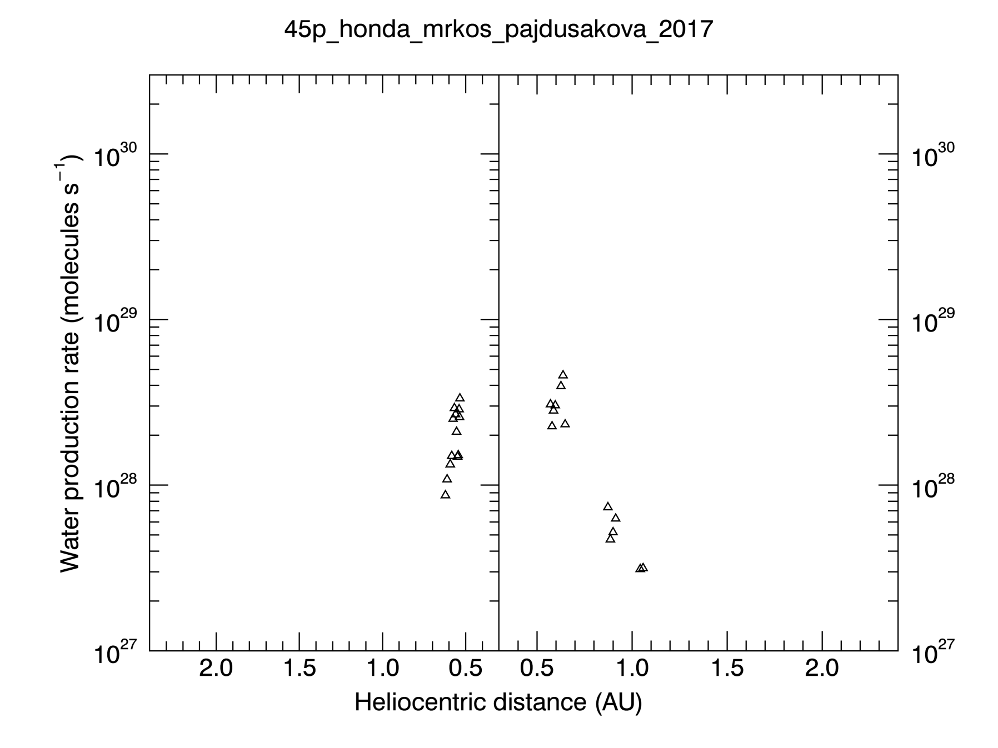
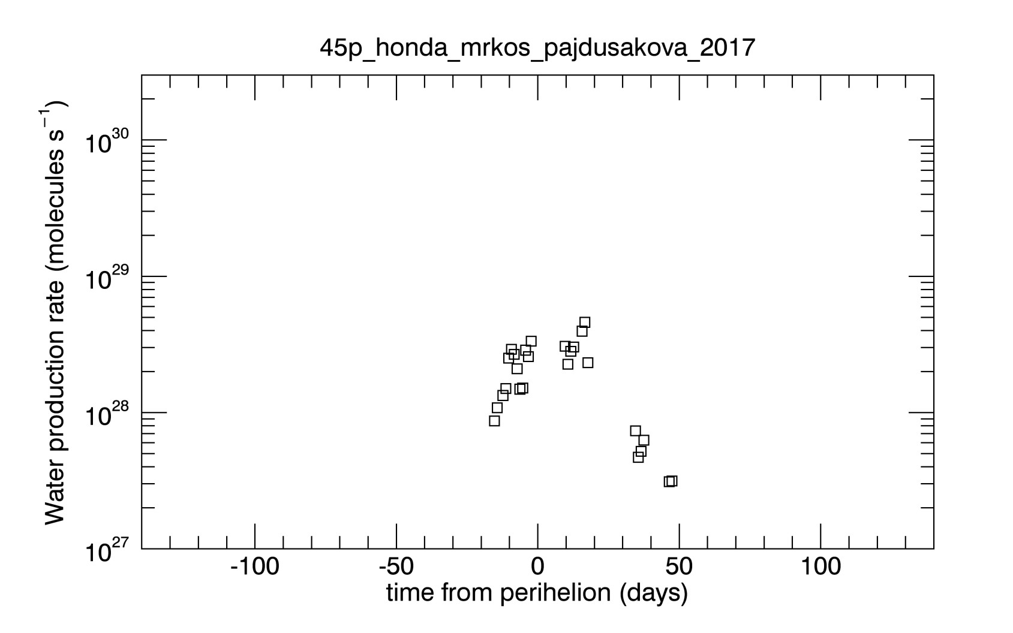
Plotting the data: 3
Compare with Lis+ [2013]: ~9d26 s⁻¹.

Slide 8
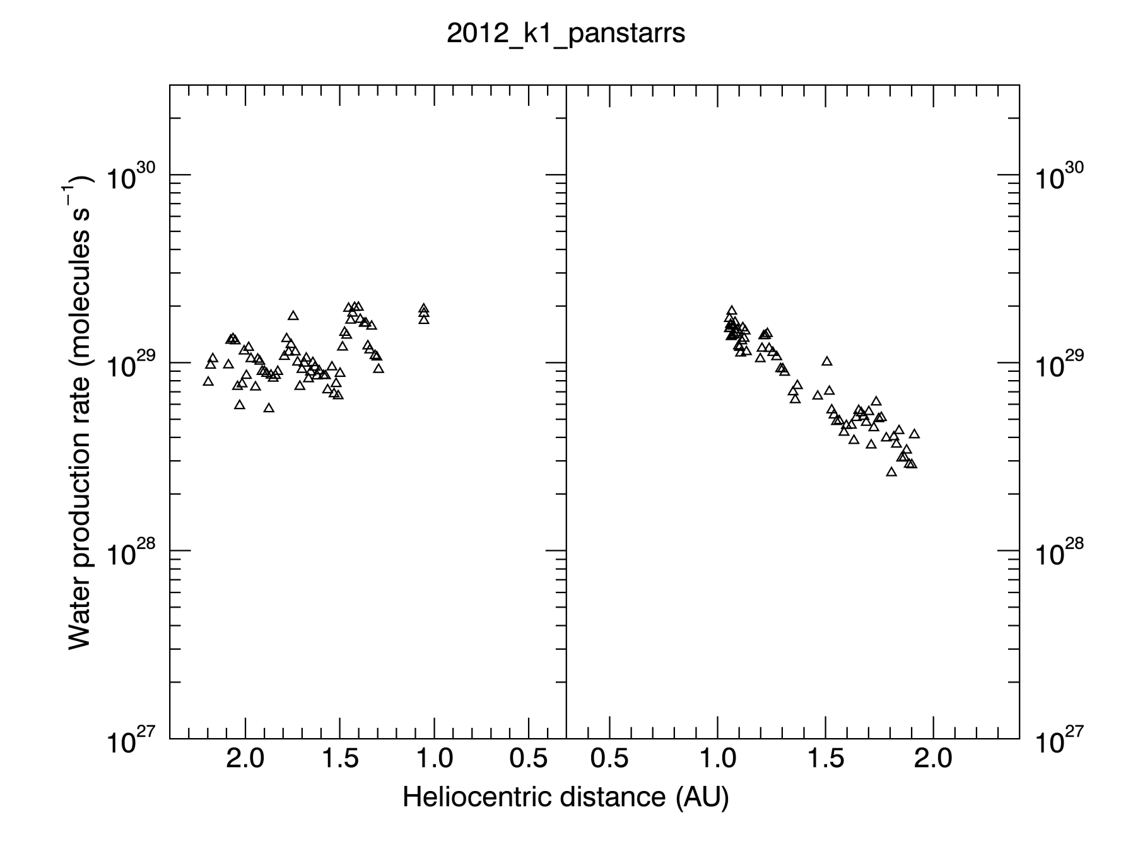
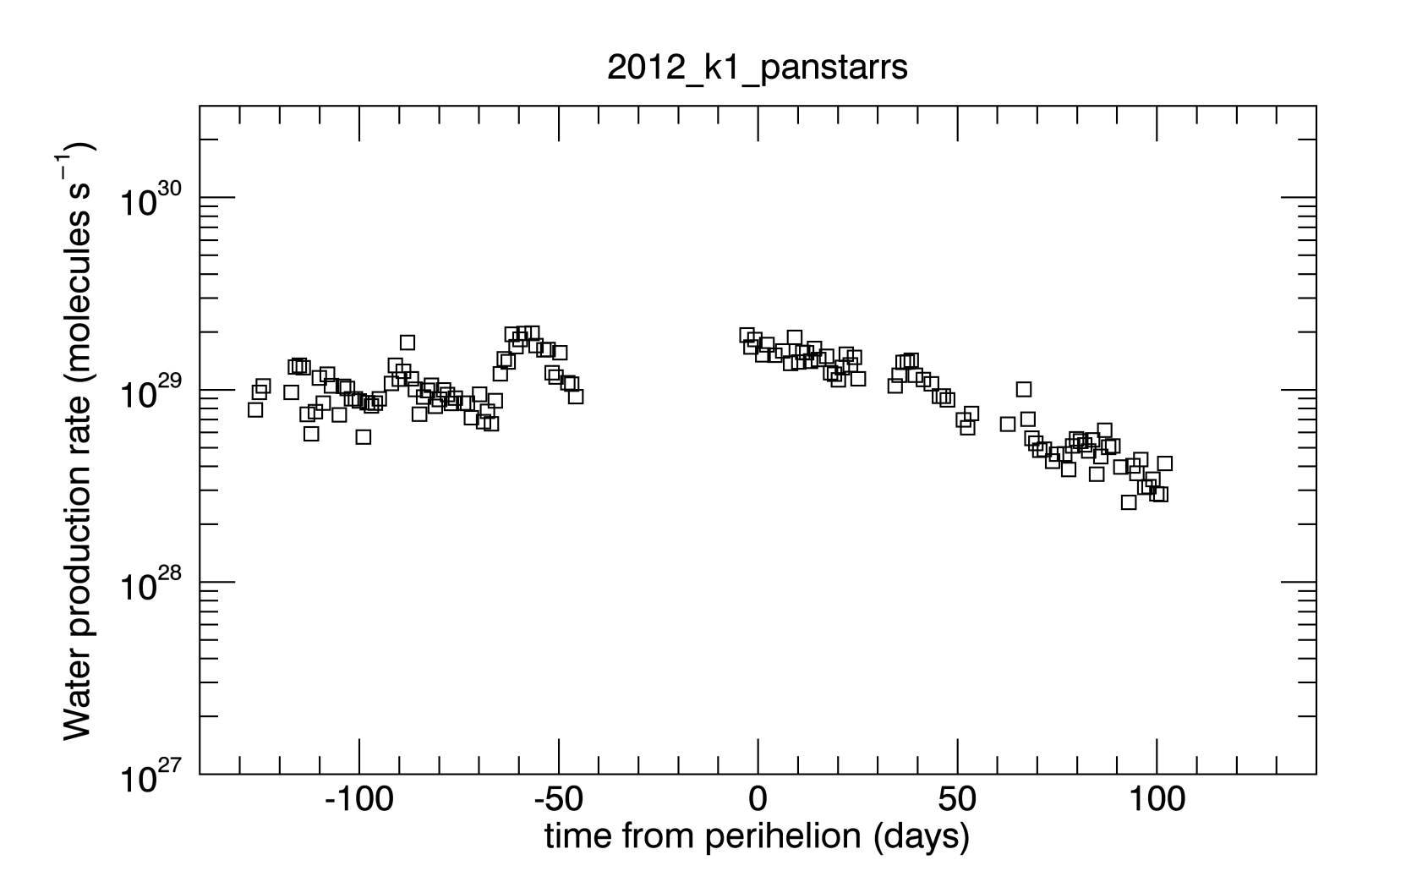
Plotting the data: 4
Compare with Roth+ [2017] Tab 2: ~4d28 s⁻¹.

Slide 9
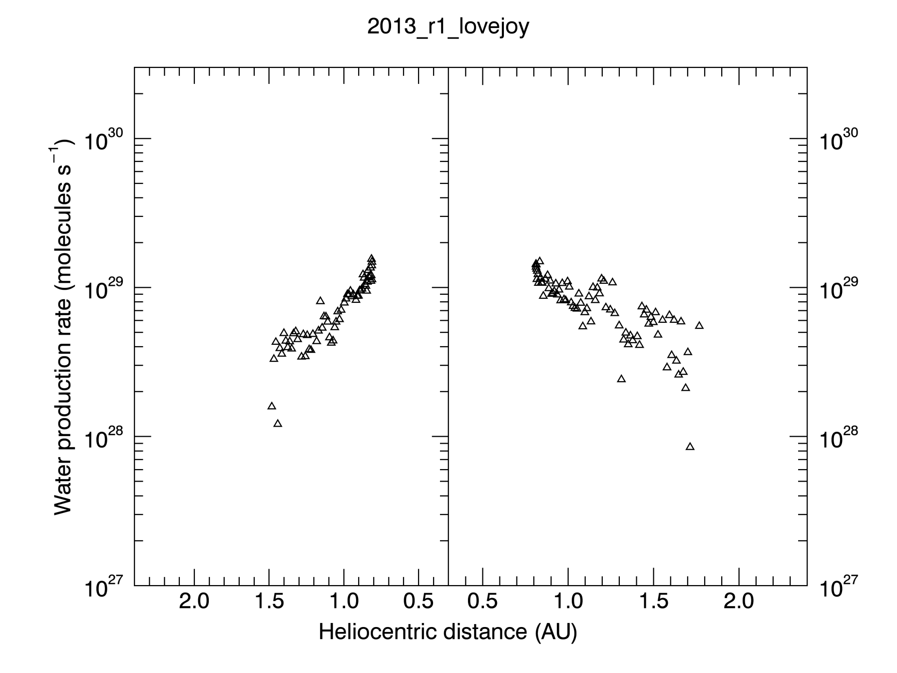
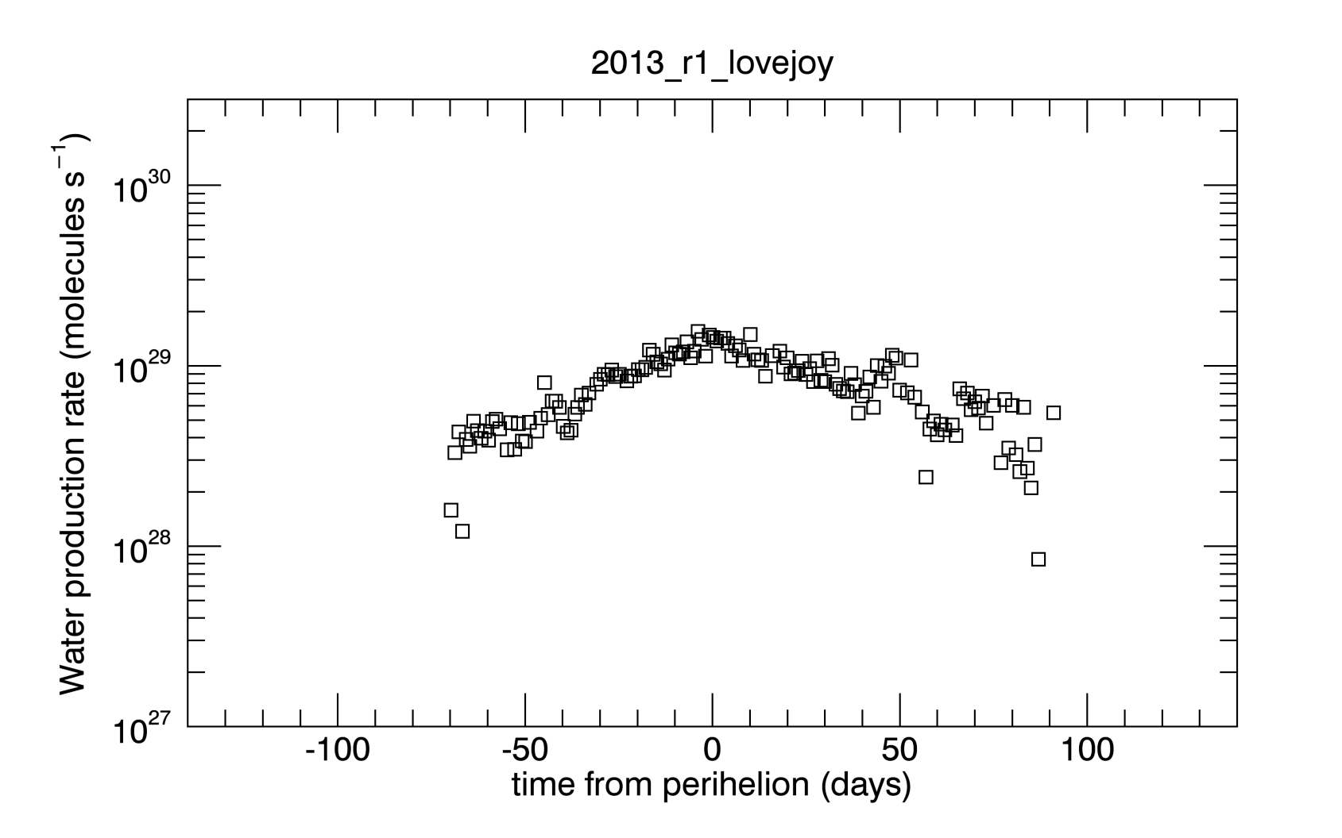
Plotting the data: 5
Compare with Paganini+ [2014] Tab 1: ~2d28 s⁻¹.

Slide 10
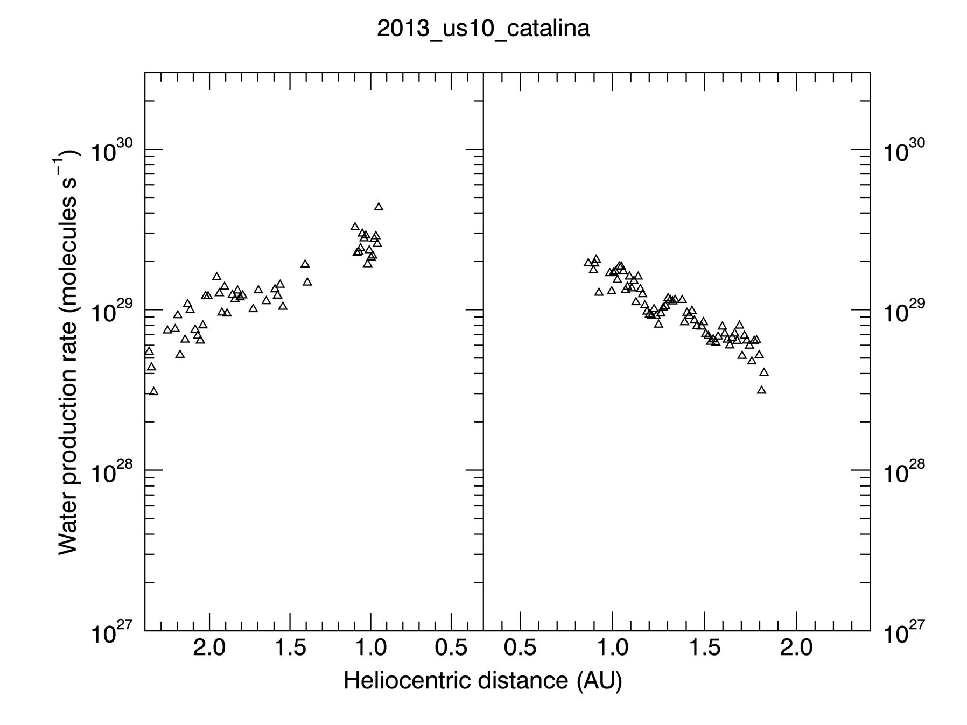
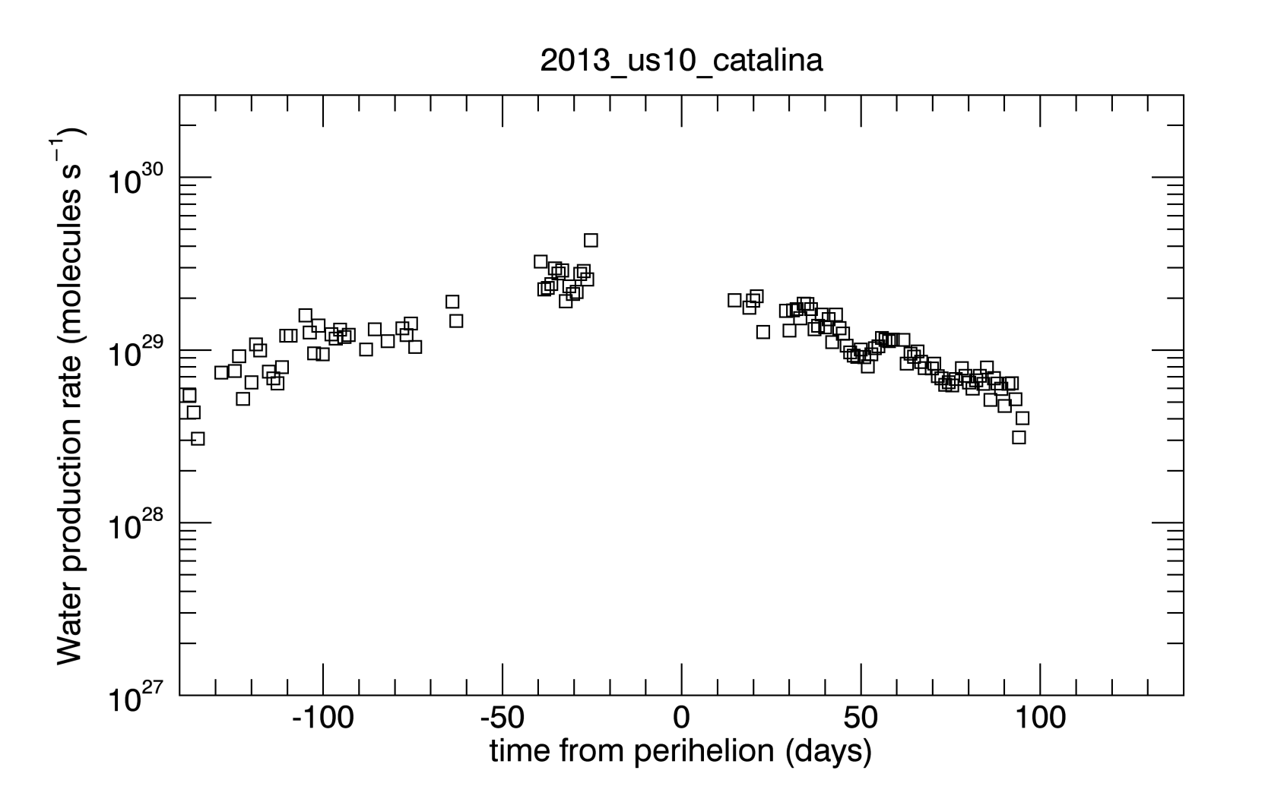
Plotting the data: 6
Compare with Wang+ [2017]: ~5d29 s⁻¹.

Slide 11
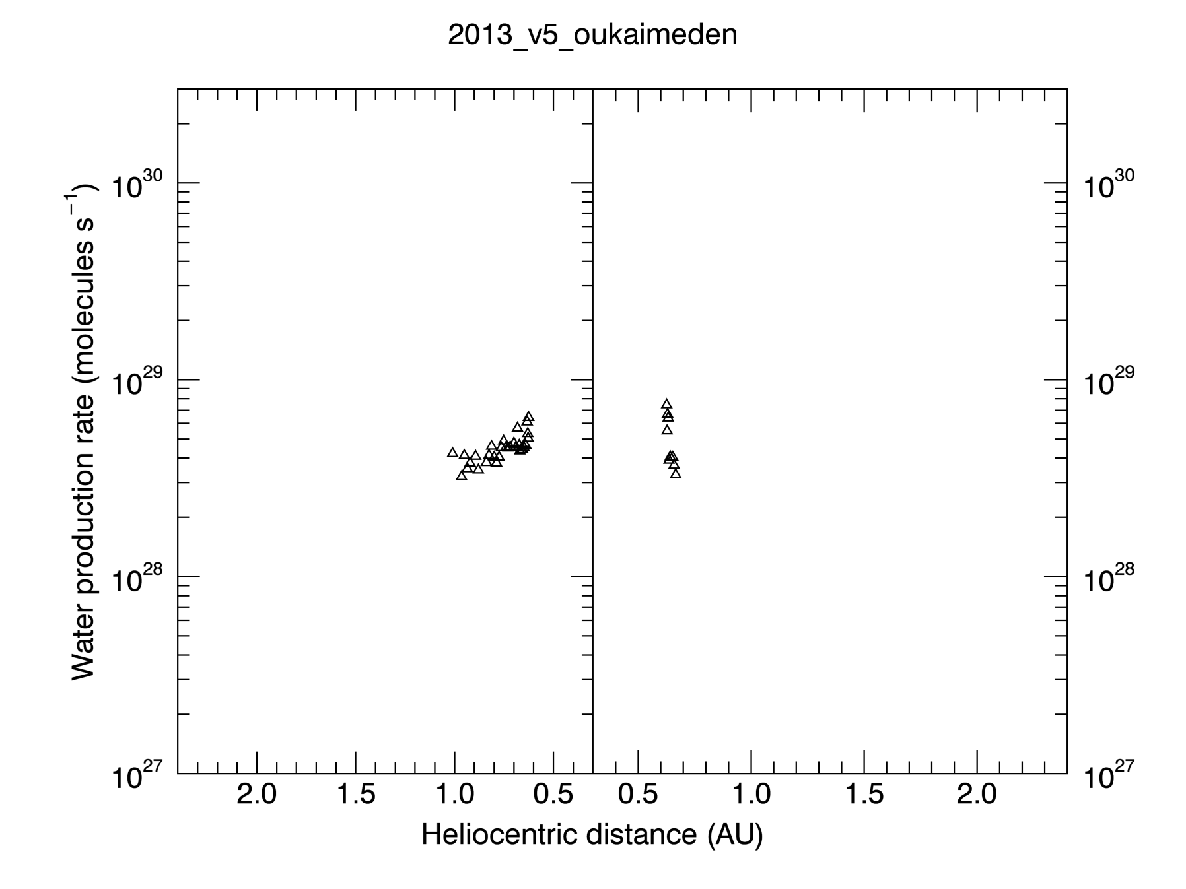
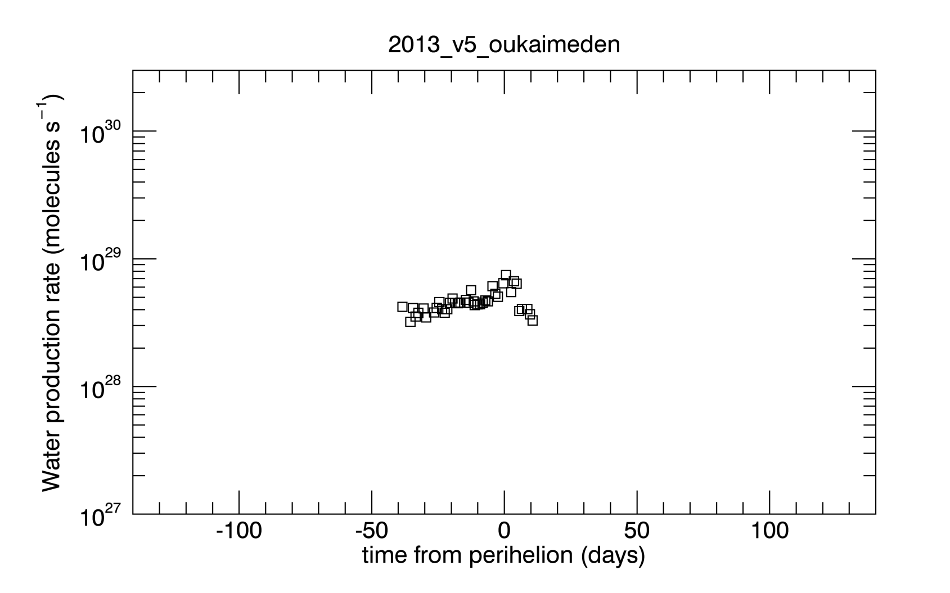
Plotting the data: 7

Slide 12
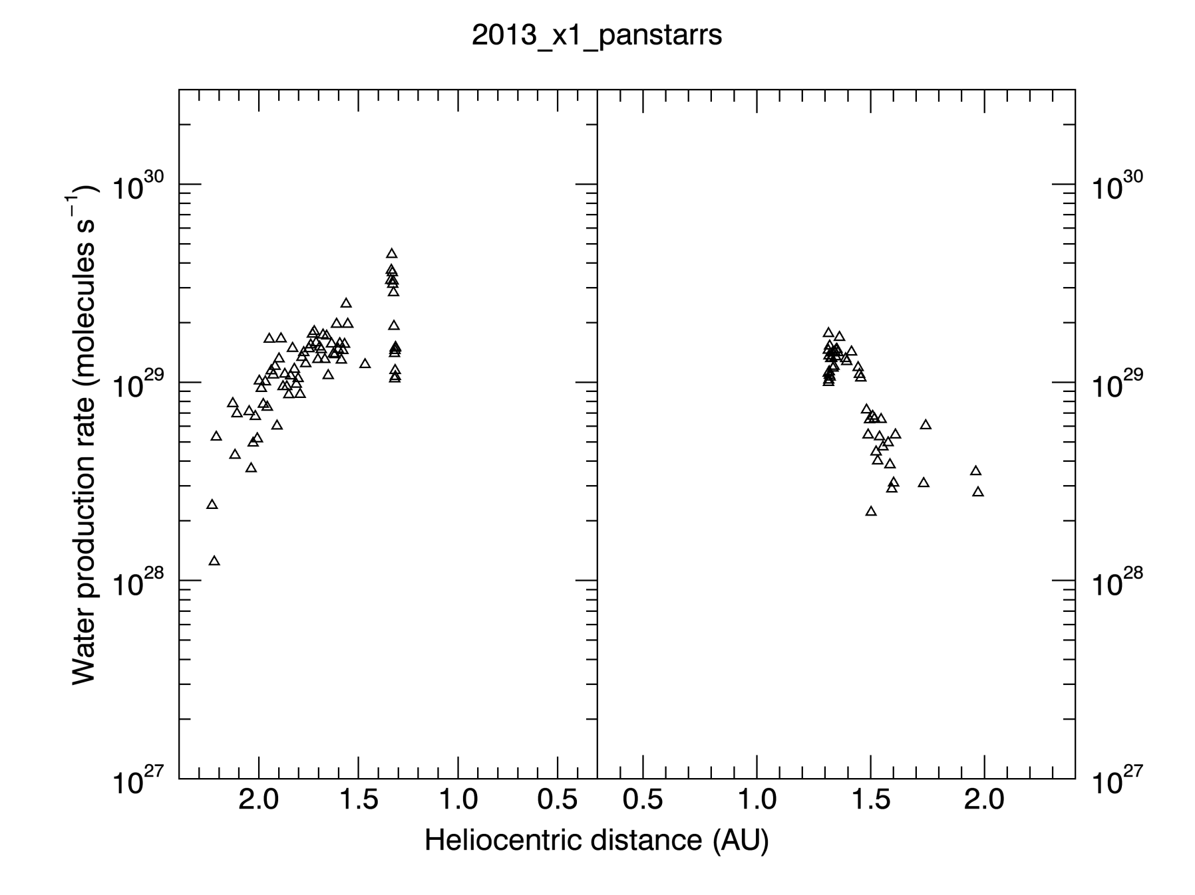
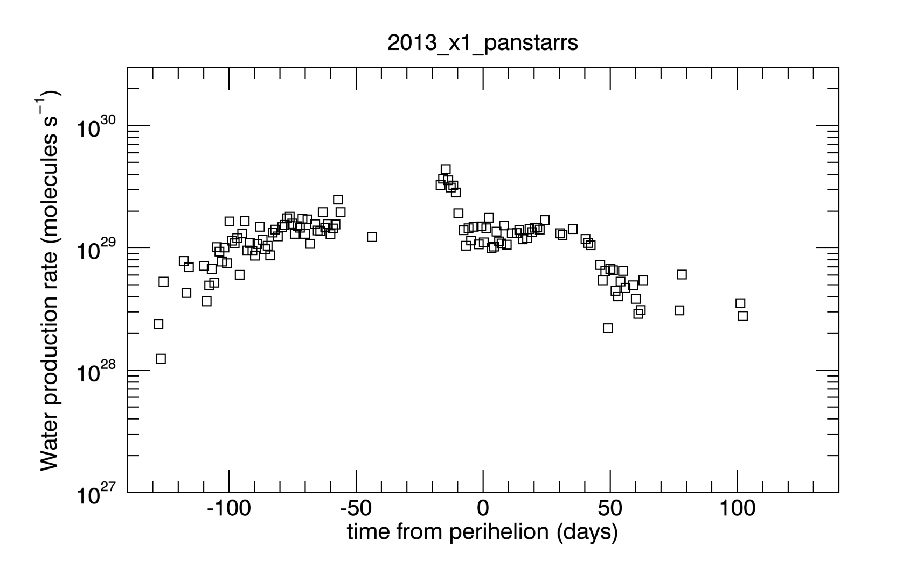
Plotting the data: 8

Slide 13
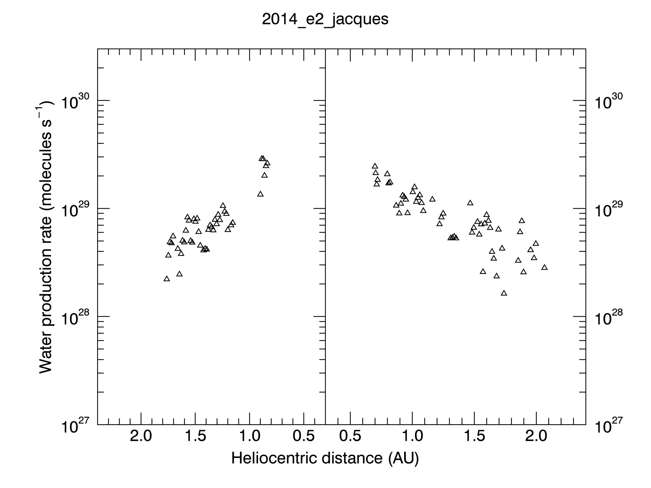
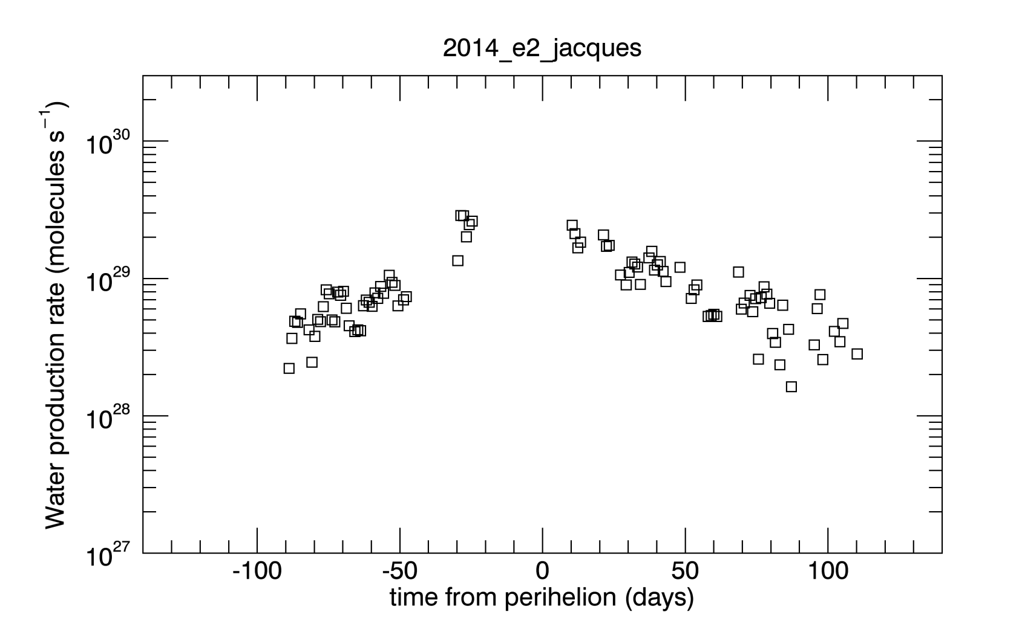
Plotting the data: 9

Slide 14
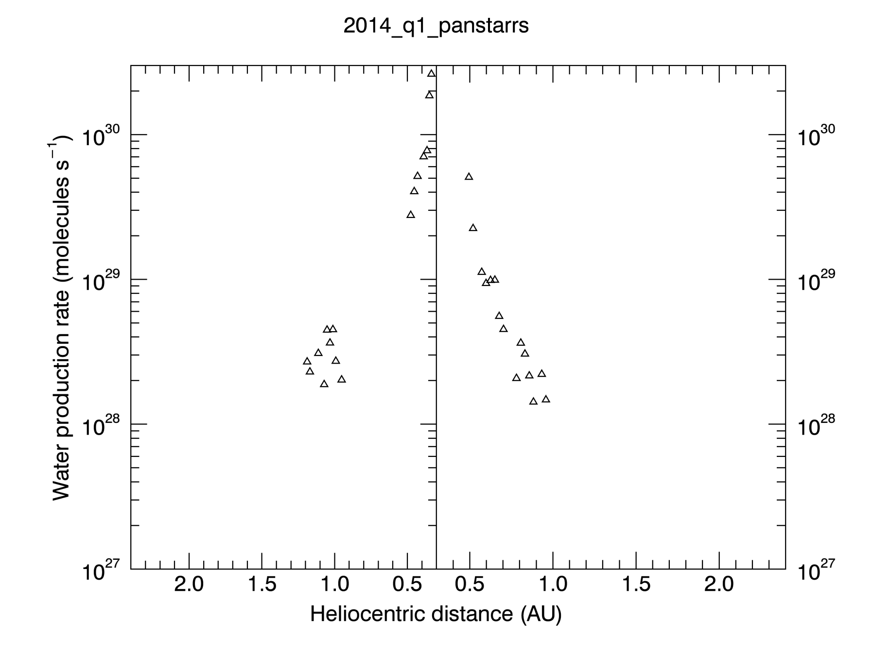
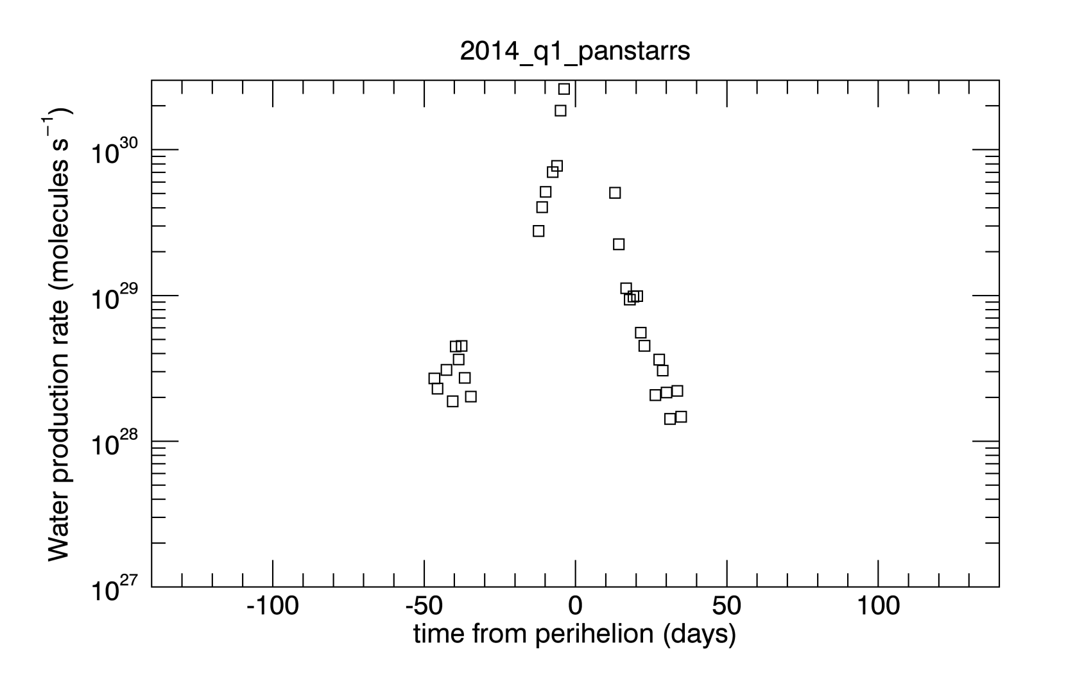
Plotting the data: 10

Slide 15
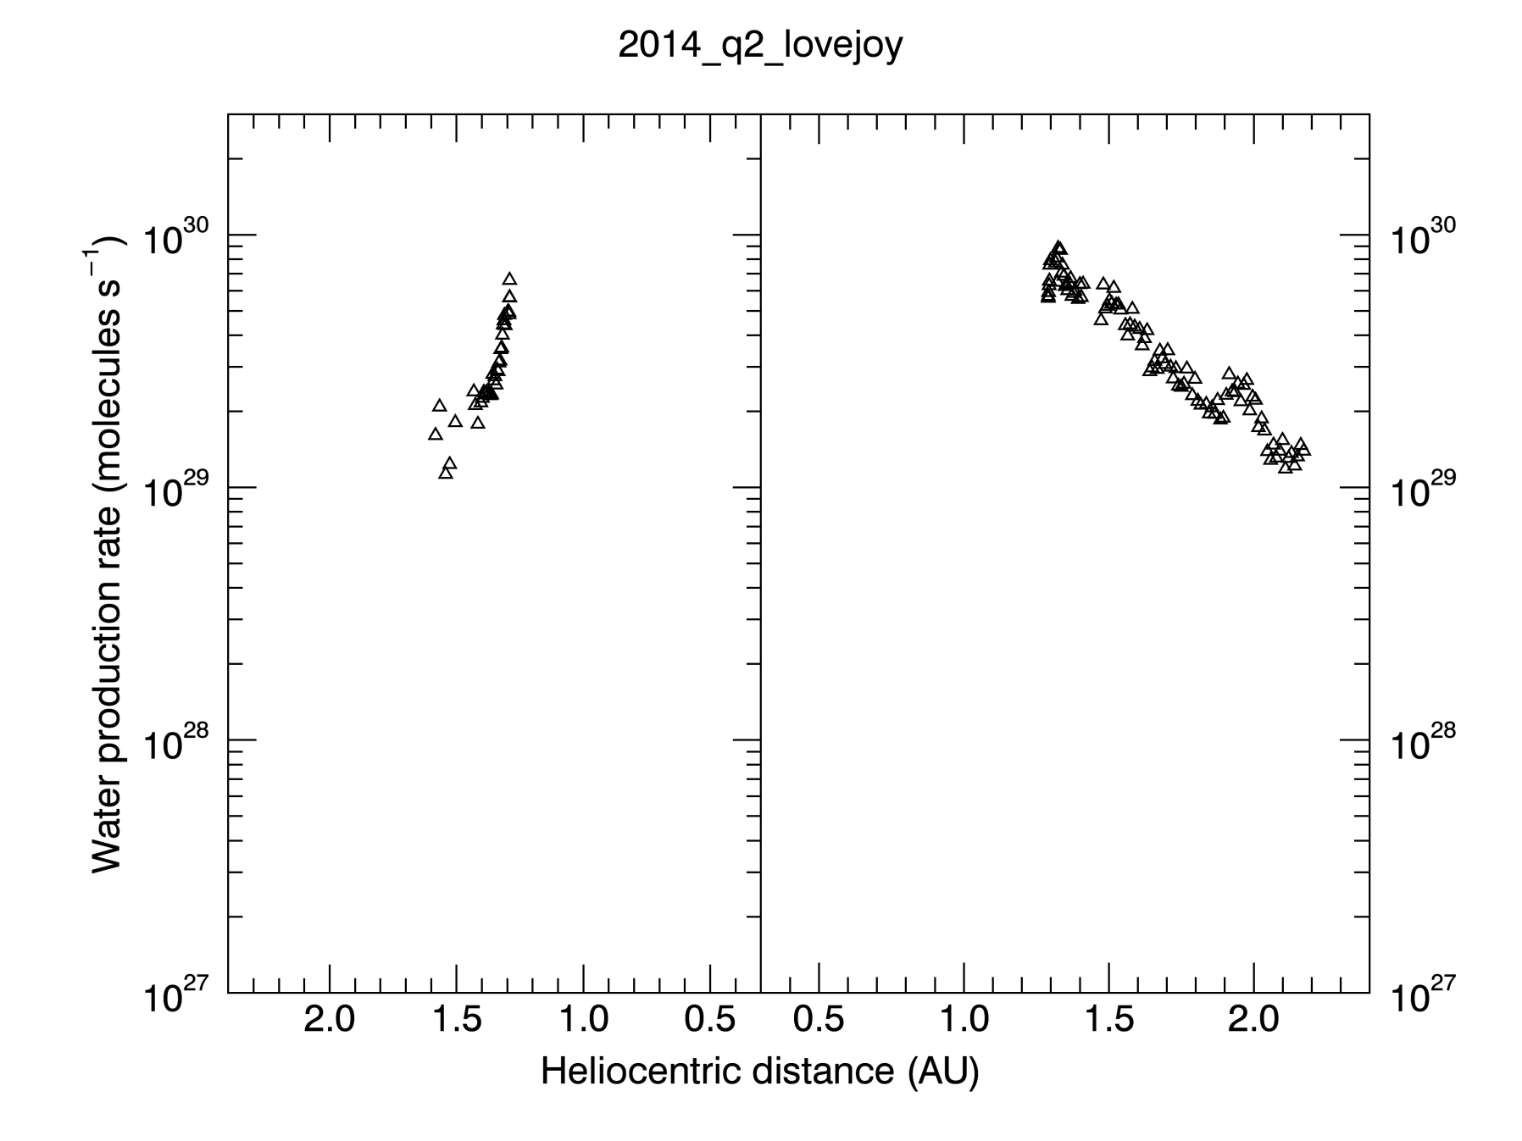
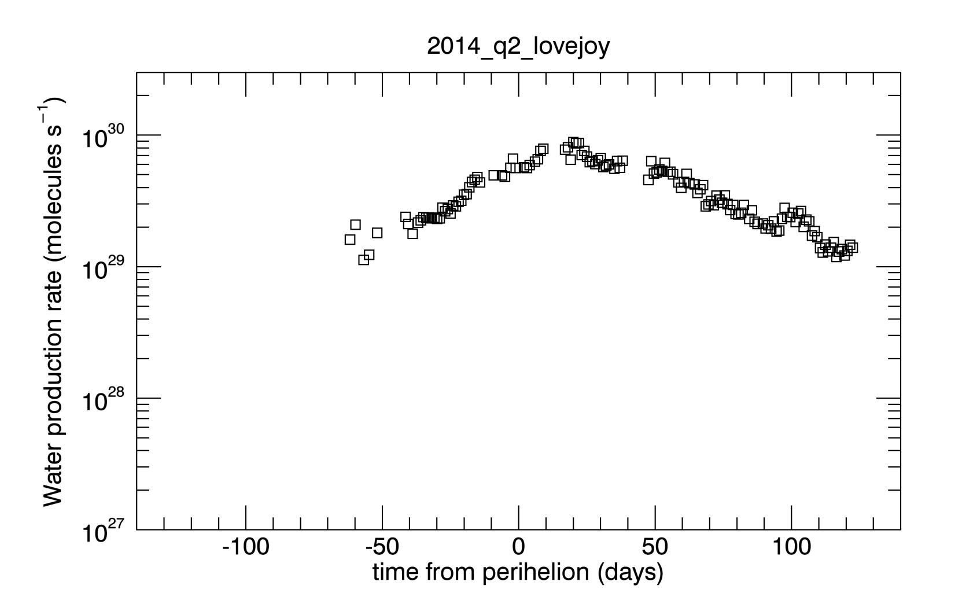
Plotting the data: 11
Compare with Faggi+ [2016] Tab 3: ~3d29 s⁻¹.

Slide 16
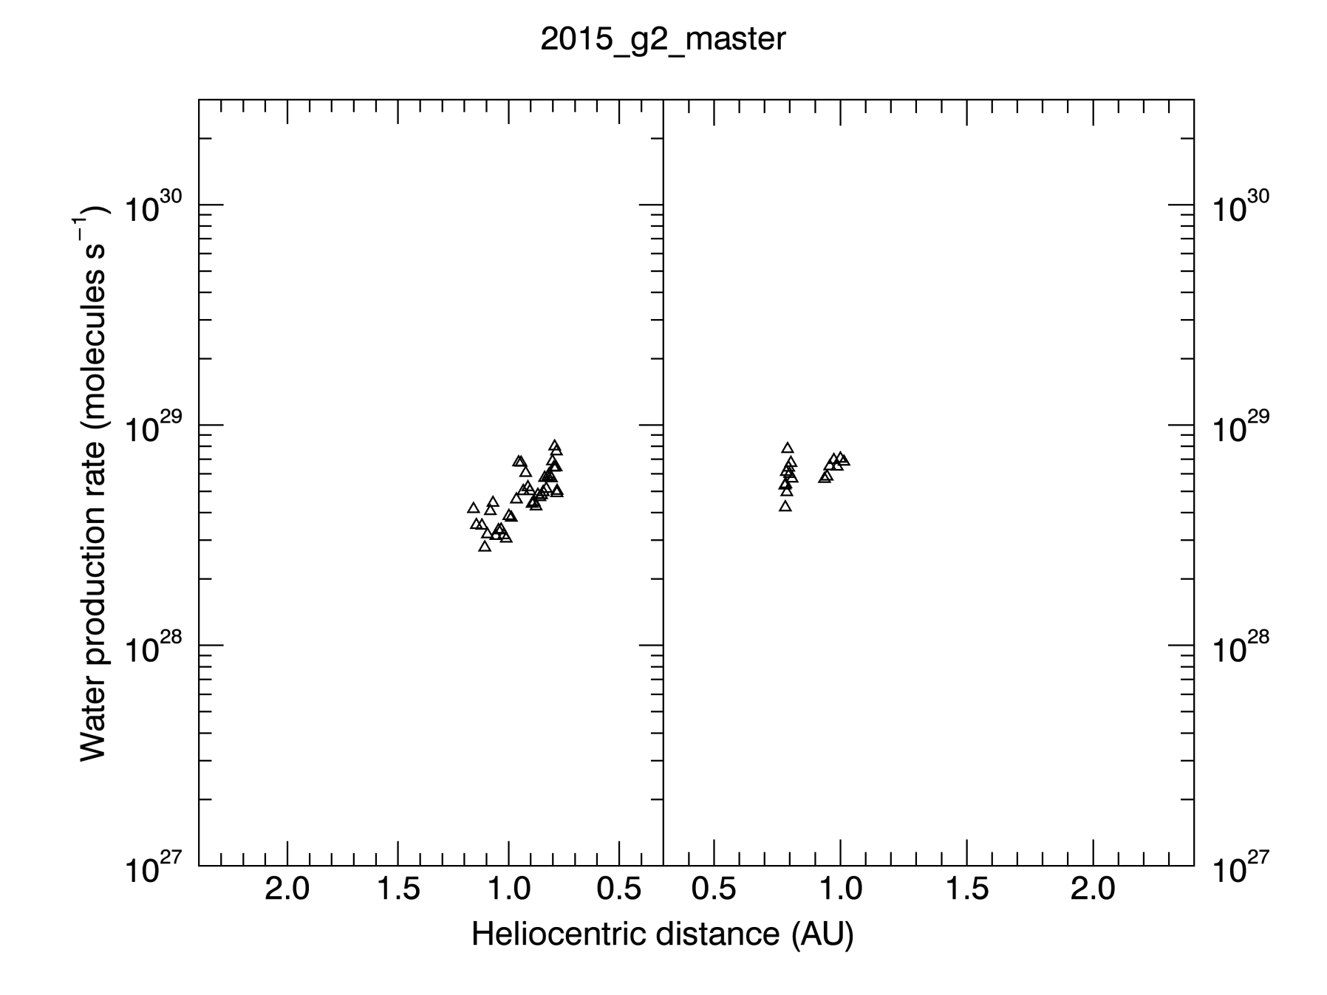
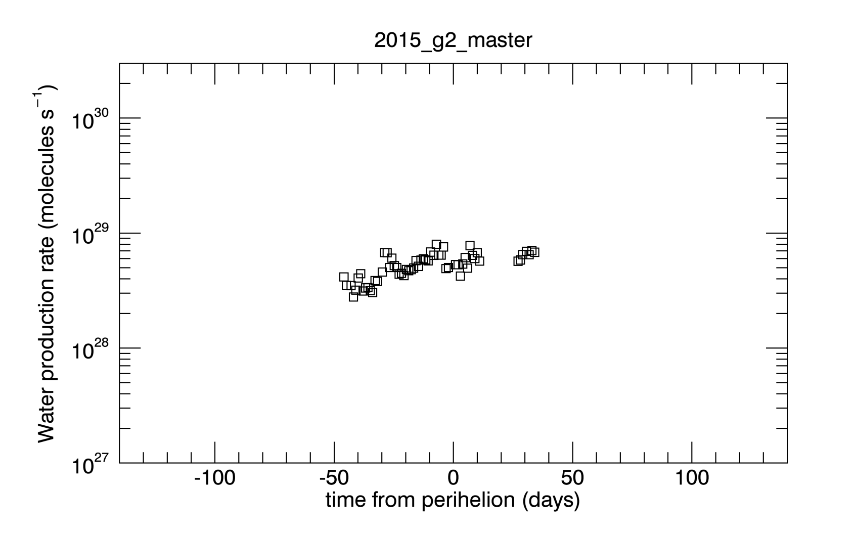
Plotting the data: 12

Slide 17
Conclusions
Water production rates are consistent with values published in literature (whenever present)
Some of the data go as close as 0.3 AU in heliocentric distance, often impossible to observe due to solar-avoidance zones. Good! The advantage of using a solar observatory…
It might be useful to add a column with brightness measured in Rayleighs units.

