Slide 1
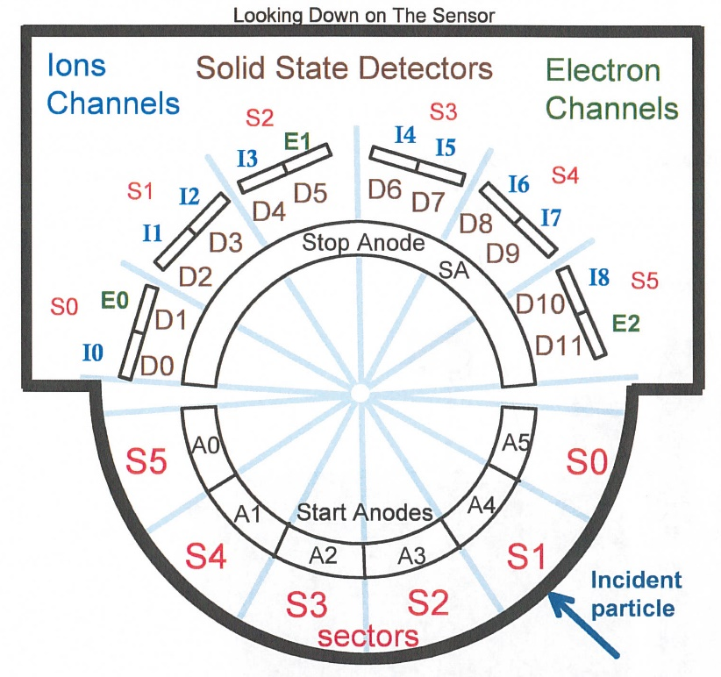
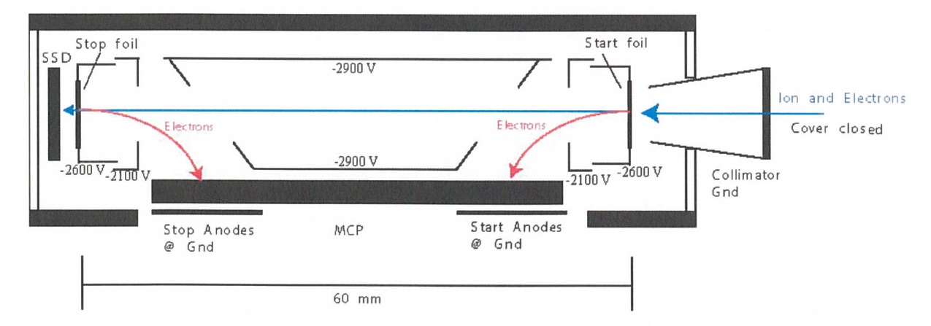
New Horizons Pluto Energetic Particle Spectrometer Science Investigation (PEPSSI)
Reviewed by S. Joy (primary)
PRINCIPAL INVESTIGATOR: Ralph McNutt, APL
DESCRIPTION: Medium Energy Particle Spectrometer
ENERGY RANGE: 25-1000 keV (protons)
60-1000 keV (atomic ions)
25-500 keV (electrons)
FIELD OF VIEW: 160 deg x 12 deg
ANGULAR RESOLUTION: 25 deg x 12 deg
ENERGY RESOLUTION: 0.25 keV
SENSOR SIZE: 7.6 cm dia. x 2.5 cm thick
POWER: 1.4 watt
MASS: 1.5 kg

Slide 2
New Horizons PEPSSI Data Sets
Derived Data ->
nh-x-pepssi-2-kemcruise1-v2.0
nh-x-pepssi-3-kemcruise1-v2.0
nh-x-pepssi-2-kem1-v1.0
nh-x-pepssi-3-kem1-v1.0

Slide 3
New Horizons PEPSSI Data Set Evaluation Tools
All Data Processing and Evaluation -
Machine: Dell XPS 15 9560
Operating System: Windows 10

Slide 4
Comments on review procedure
The catalog, documents, and calib directories of these volumes are nearly identical, and most of their contents have been previously reviewed many times.
I have taken advantage of this fact to reduce the review effort.
I used the folder compare option in BeyondCompare 3.3.13 to compare like folders across the four volumes, and then compare files contained in the folders. Most of the time, the only variation in the directory contents or the
file therein were the file time stamps and the data_set_id’s in the label files.
Once this information was available to me, I only reviewed unique files

Slide 5
Documentation
Evaluation

Slide 6
Root level files
AAREADME No issues found VOLDESC No issues found

Slide 7
Catalog files
CATINFO.TXT – no changes required
nh_kem.cat – good
nhsc.cat – good pepssi.cat – minor spelling error line 390 dependant -> dependent ref.cat - good DATASET.CAT (nh-x-pepssi-2-kemcruise1-v2.0 and nh-x-pepssi-3-kemcruise1-v2.0)
previously reported spelling errors have been corrected includes discussion of versioning - good
DATASET.CAT (nh-x-pepssi-2-kem1-v1.0 and nh-x-pepssi-3-kem1-v1.0) – good
Within a mission phase, the -2- and -3- dataset catalogs are effectively identical with the only changes being -2- becoming -3- and Raw becoming Calibrated. Between phases, there are a few more minor differences in the phase name, and in this case, the explanation of version 2.

Slide 8
Calib files
calinfo.txt –
“rateboxdefinitionplanes.lit Label for "; read label for description”
Must be an error in the code generating this file. Should read:
“rateboxdefinitionplanes.lbl Label for rateboxdefinitionplanes.lbl; read label for description”
hk_stat_input_20041016.tab (lbl) – good
hk_n1_input_20050228.tab (lbl) – good
calpars folder on -3- volumes only
calpinfo.txt – good
calpar_columns.fmt – good
pep_*_0x691_calpar.tab – ok, contents clear and self-explanatory. No corresponding .lbl file but that has been the case throughout the mission and has been previously accepted.

Slide 9
Document files
DOCINFO.TXT – good
All PDS documents (codmac_level_definitions, lunineetal1995, payload_ssr, pepssi_ssr, soc_inst_icd) are properly formatted as PDF/A and the document labels appear to be valid. Most of these document files have been reviewed many times and have not changed recently. They appear to be the latest versions of each.
nh_fov.png (.lbl) – good nh_met2utc.tab (.lbl) – complete, good
nh_mission_trajectory.tab (.lbl) – complete, good nh_pepssi_v110_ti.txt – good
pep_bti.tab (.lbl) – complete, good
quat_axyz_instr_to_j2k.asc (.lbl) – good
seq_pepssi_kemcruise1.tab (.lbl) – complete, good
seq_pepssi_kem1.tab (.lbl) – probably complete (last entry 2018-12-25), good

Slide 10
Data
Evaluation

Slide 11
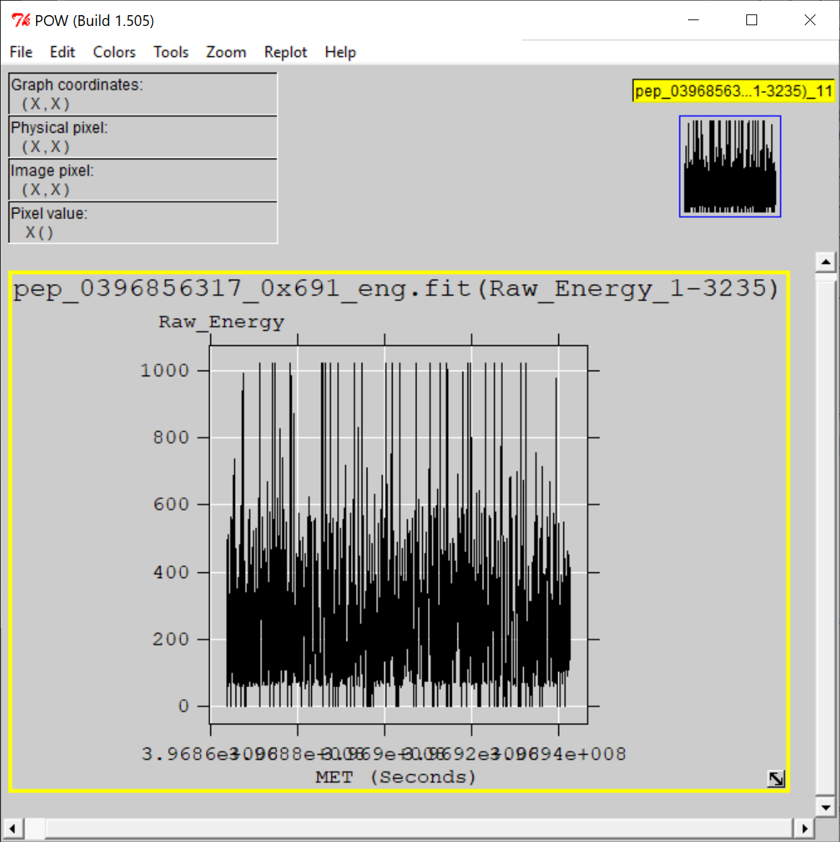
nh-x-pepssi-2-kemcruise1-v2.0
Files open with both NASAVIEW and FV suggesting that the PDS and FITS labels are well-formed.
All of the files selected for spot inspection appeared nominal.
All tables and columns accessible in NASAVIEW, listings look as expected
FV allow the user to plot data from any table versus time (MET or ET) and the plots look nominal

Slide 12
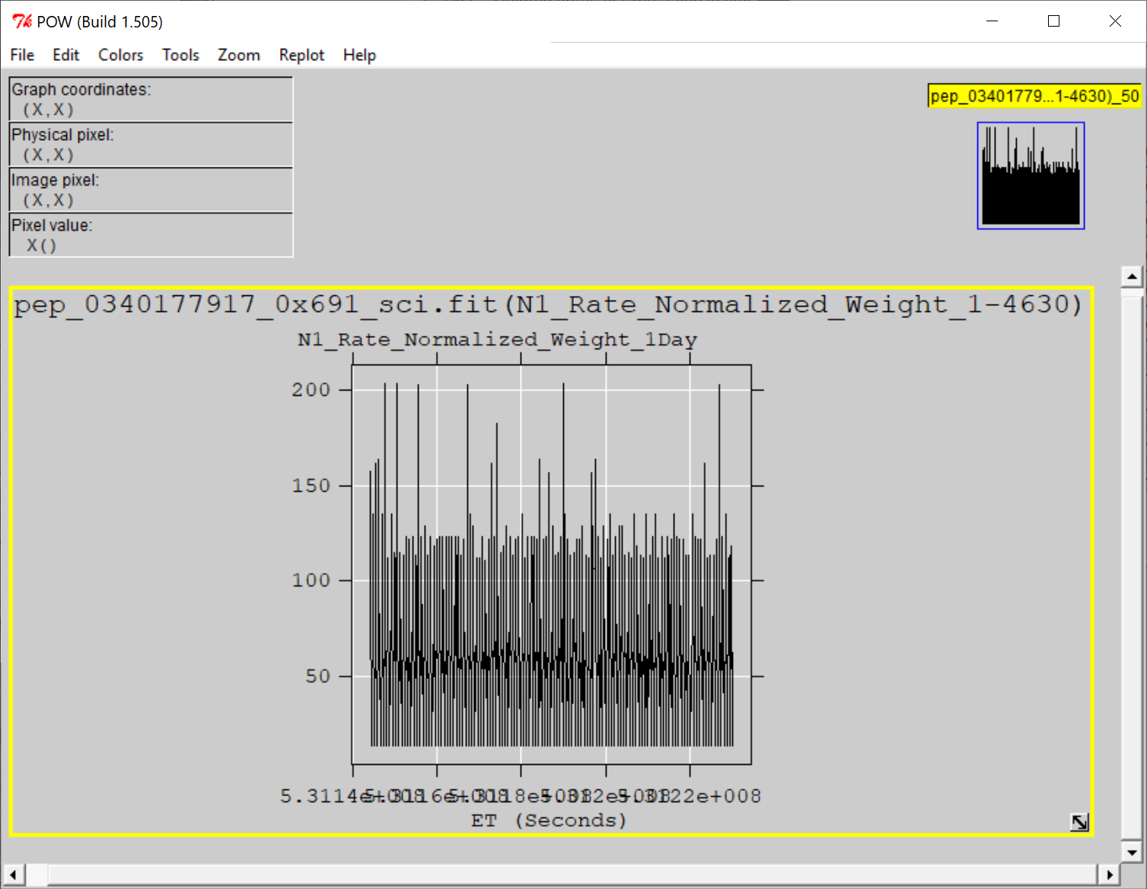
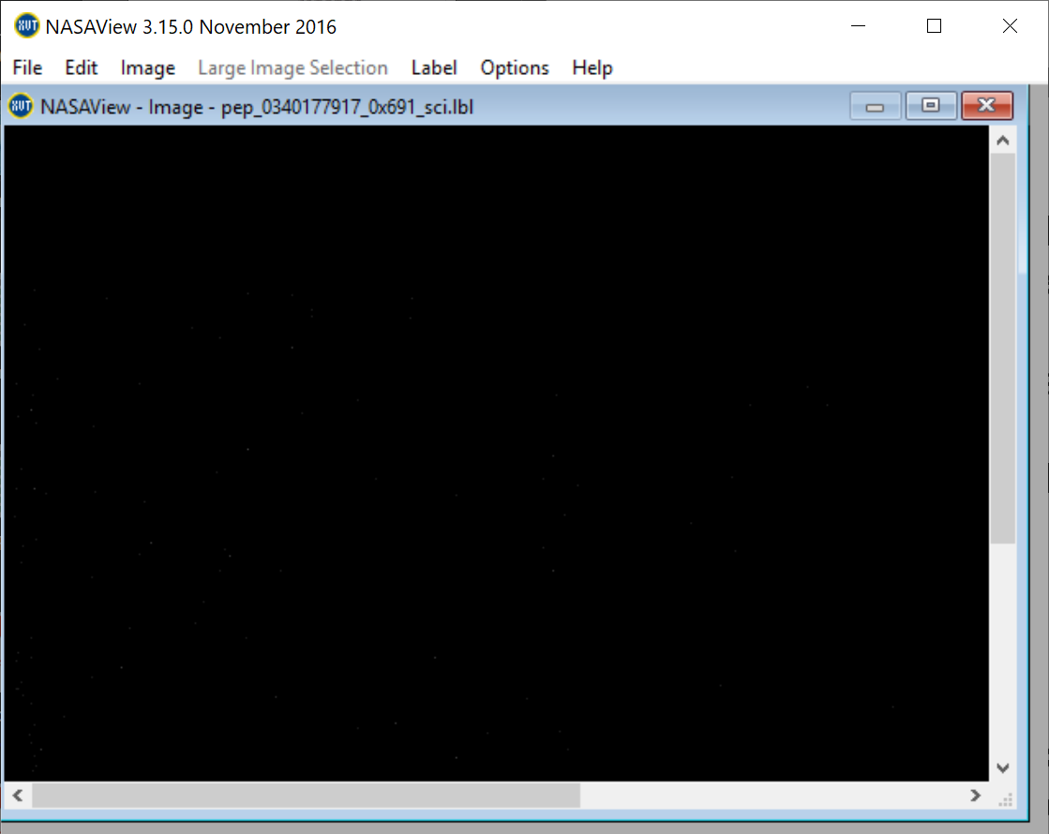
nh-x-pepssi-3-kemcruise1-v2.0
Files open with both NASAVIEW and FV suggesting that the PDS and FITS labels are well-formed.
All of the files selected for spot inspection appeared nominal. NASAView has some display issues with these data/labels
All tables and columns accessible in NASAVIEW, listings look as expected
FV allow the user to plot data from any table versus time (MET or ET) and the plots look nominal
NASAView gets confused by the initial “image” object and won’t let the user step past this object to the table data that follows.
NASAView does not report any errors in the label

Slide 13
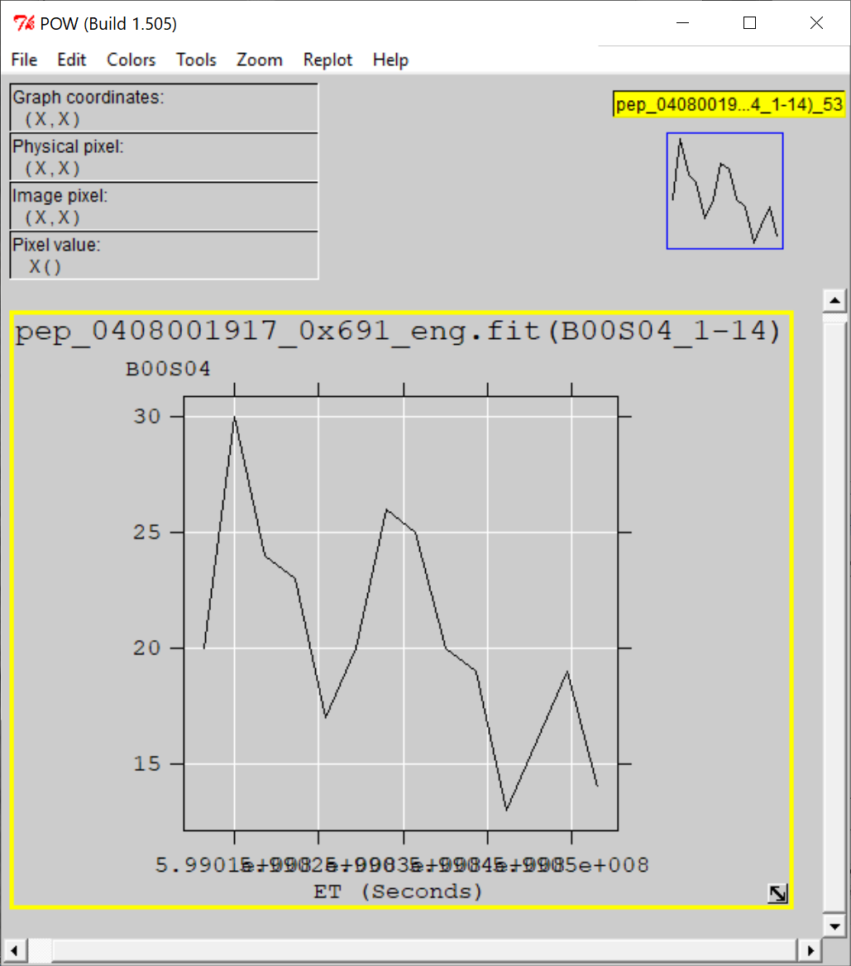
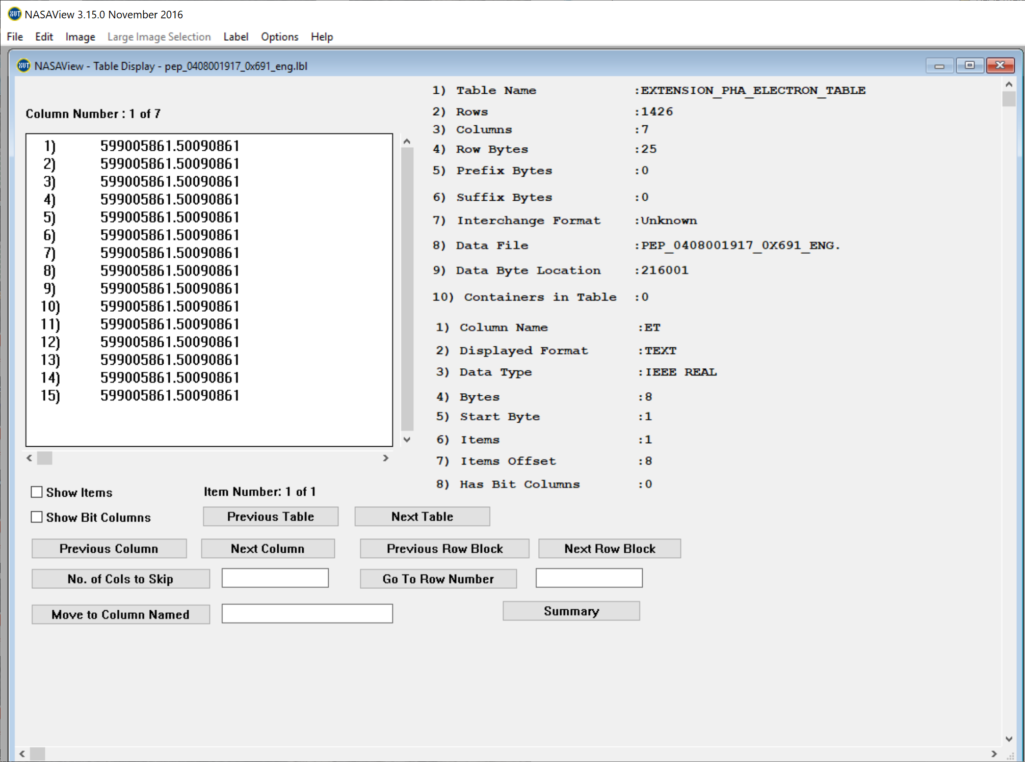
nh-x-pepssi-2-kem1-1.0
Files open with both NASAVIEW and FV suggesting that the PDS and FITS labels are well-formed.
All of the files selected for spot inspection appeared nominal.
All tables and columns accessible in NASAVIEW, listings look as expected
FV allow the user to plot data from any table versus time (MET or ET) and the plots look nominal

Slide 14
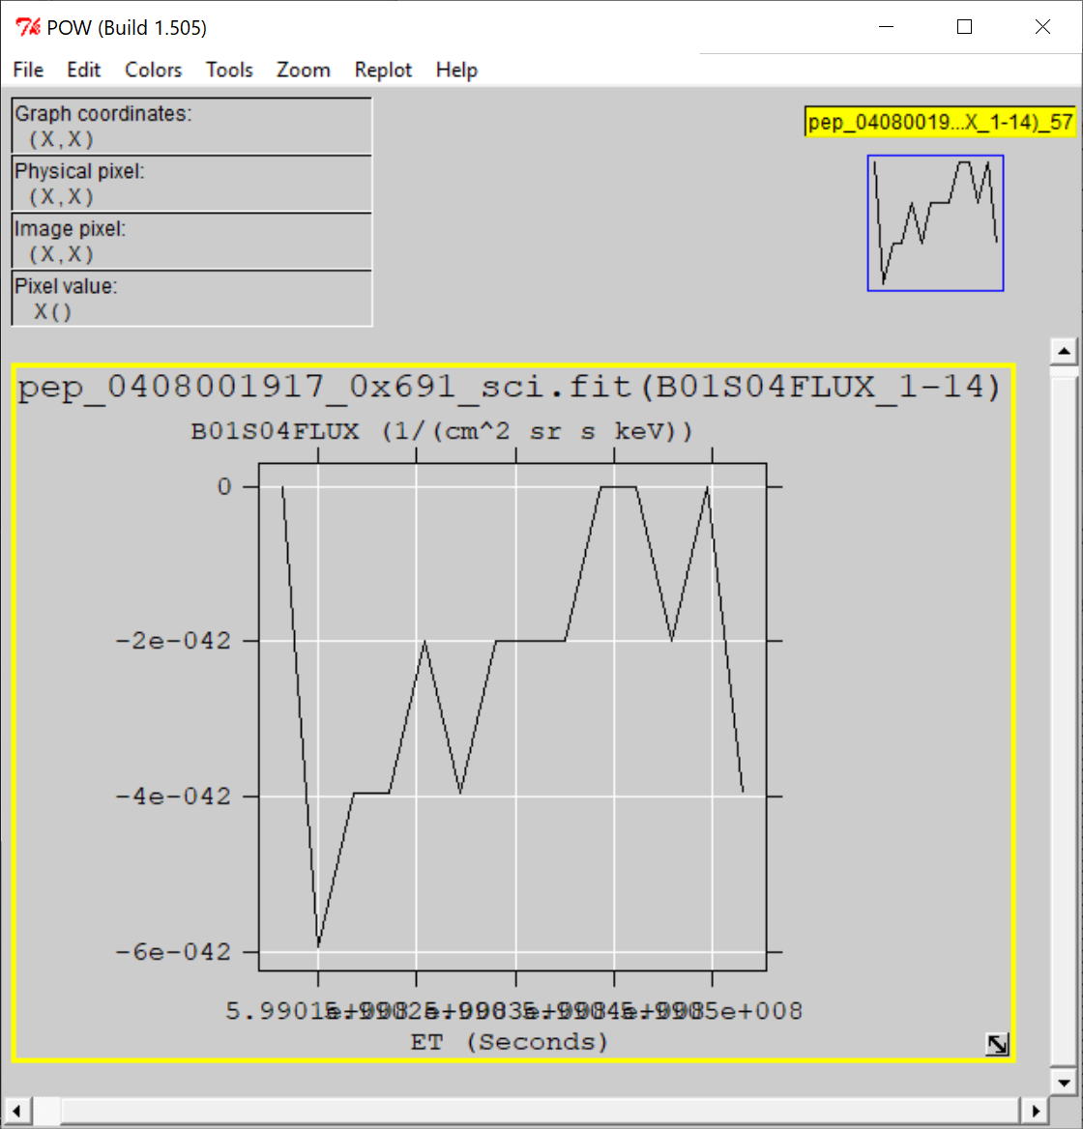
nh-x-pepssi-3-kem1-v1.0
Files open with both NASAVIEW and FV suggesting that the PDS and FITS labels are well-formed.
All of the files selected for spot inspection appeared nominal. NASAView has some display issues with these data/labels
All tables and columns accessible in NASAVIEW, listings look as expected
FV allow the user to plot data from any table versus time (MET or ET) and the plots look nominal
NASAView gets confused by the initial “image” object and won’t let the user step past this object to the table data that follows.
NASAView does not report any errors in the label

Slide 15
Summary of Liens
In general, the documentation is a bit sparse, particularly the dataset.cat files which are generic, not specific to the datasets. This is just a comment and there is no associated lien, however, should the team decide to update the -3- dataset.cat file,
it would improve the archive.
Liens:
Correct the spelling error in pepssi.cat (independent -> independent)
Correct the minor issue with the calinfo.txt files (rateboxdefinitionplanes)
The data files appear to be nominal and the documentation and supporting files are complete.
These data can be certified with liens.

