Slide 1
LEISA Review
Adam McKay

Slide 2
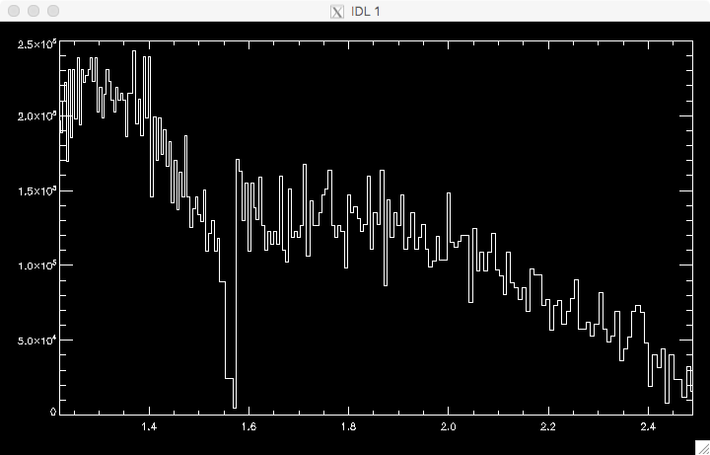
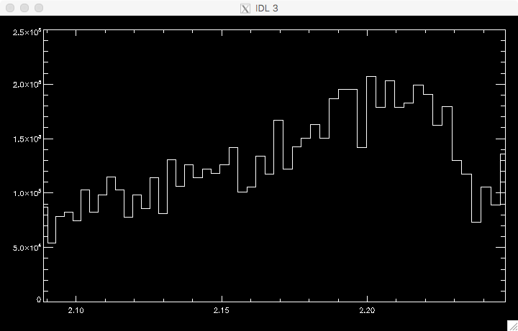
Example spectrum-Arcturus

Slide 3
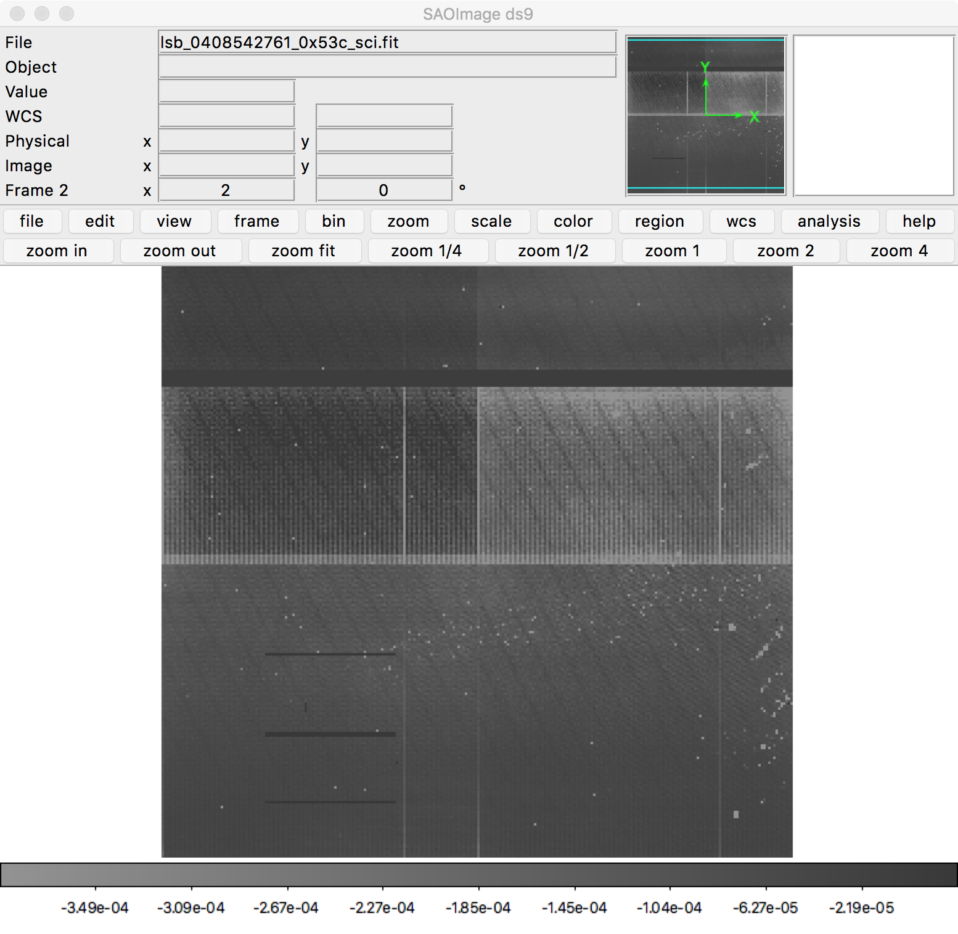
MU69?

Slide 4
Other Comments
In some sequences star bounces back and forth, is this an issue?
All aareadme.txt are identical, contain reference to subdirectories and errata.txt that don’t exist, can these be made more dataset specific?
No description of what data actually is (need to dig into .lbl file to figure out what the target is)

