Slide 1
Spitzer IRS Review
Adam McKay

Slide 2
Data
5-40 micron spectra of 32 comets obtained with Spitzer IRS
Fully reduced, extracted spectra, raw data available on Spitzer Heritage Archive
Comma delimited .csv files with context information and data
Wavelength, bin width, flux, uncertainty, spectral setup, scale factor used for matching different wavelength regions sampled with different spectral setups, and estimated nucleus contribution

Slide 3
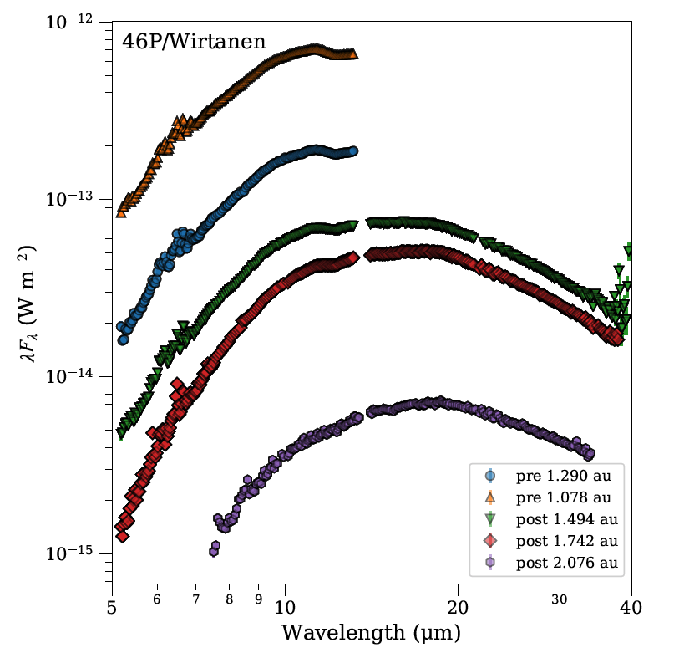
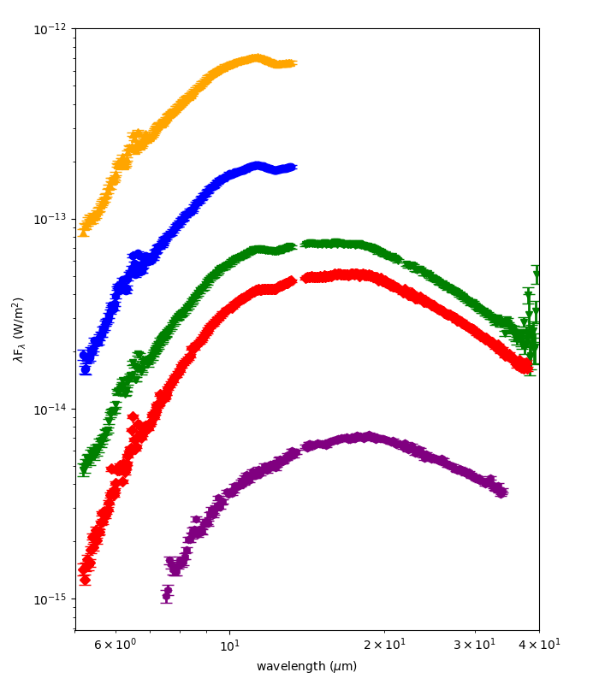
Data Look Good!
My replotting of data
Plot from documentation

Slide 4
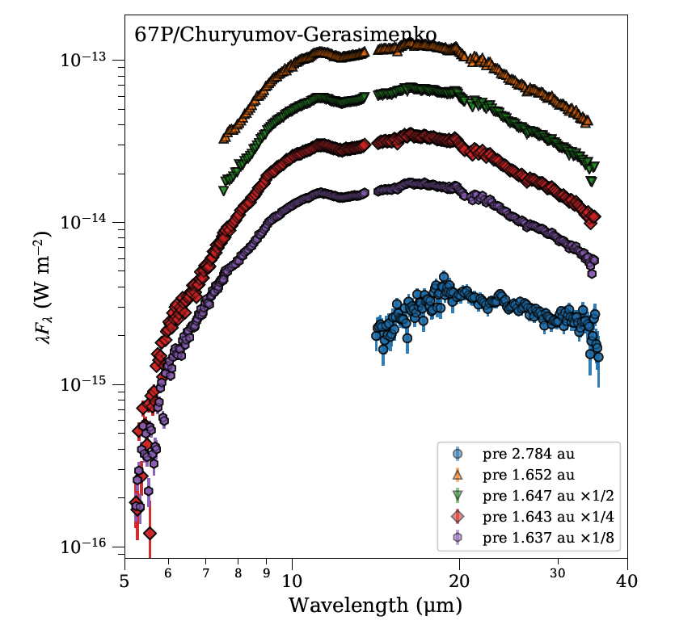
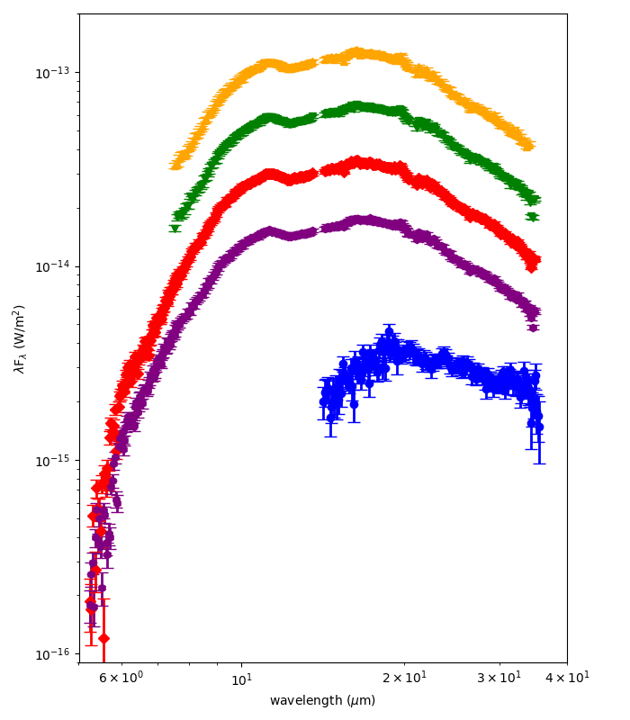
Data Look Good!
Plot from documentation
My replotting of data

Slide 5
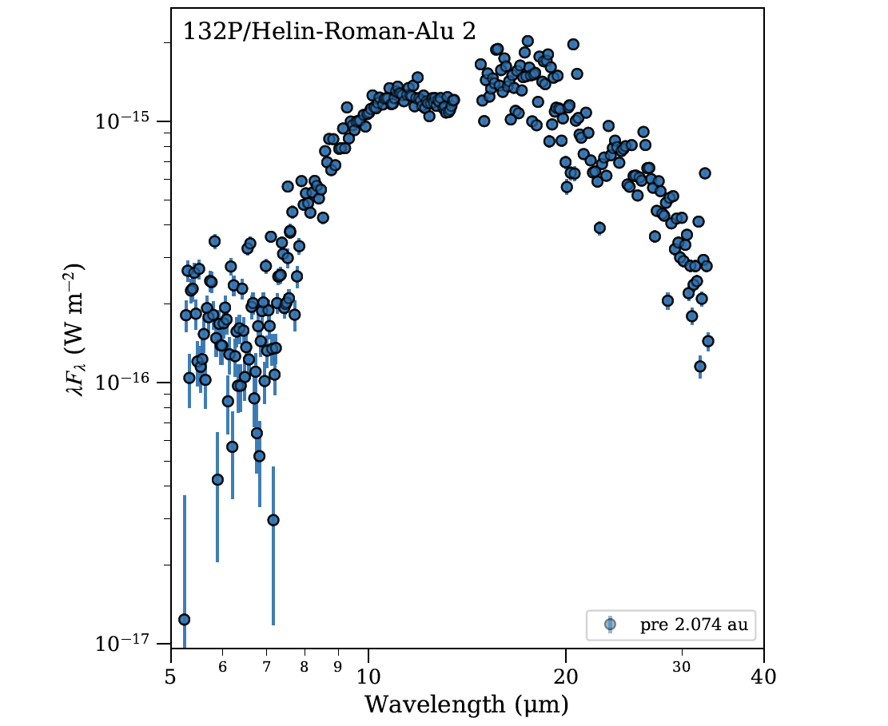
Errors too small?

Slide 6
Critiques of Documentation
Overall overview.pdf provides good description of data on how it was reduced to derive final data products
Table 2 could be more explicit about what “. . .” ,means in aperture column
In Table 3 I assume “ . . .” means no observation, but this isn’t explicit
Units on example plots are not those for the data, made comparison more difficult
Should context info in .csv files be in separate file?

