Slide 1
New Horizons KEM Alice Instrument PDS-SBN Review
Lori Feaga
September 5, 2019

Slide 2
NH KEM CRUISE 1 (Level 2 & 3) and KEM 1 (Level 2 & 3) Alice Data
Overall – not much data, but data in really good shape
Data are readable and well explained
START_TIME issue in one file + label for both levels
Typo in docinfo.txt in all 4 datasets
Was able to take one .ENG file through calibration to within 2% error

Slide 3
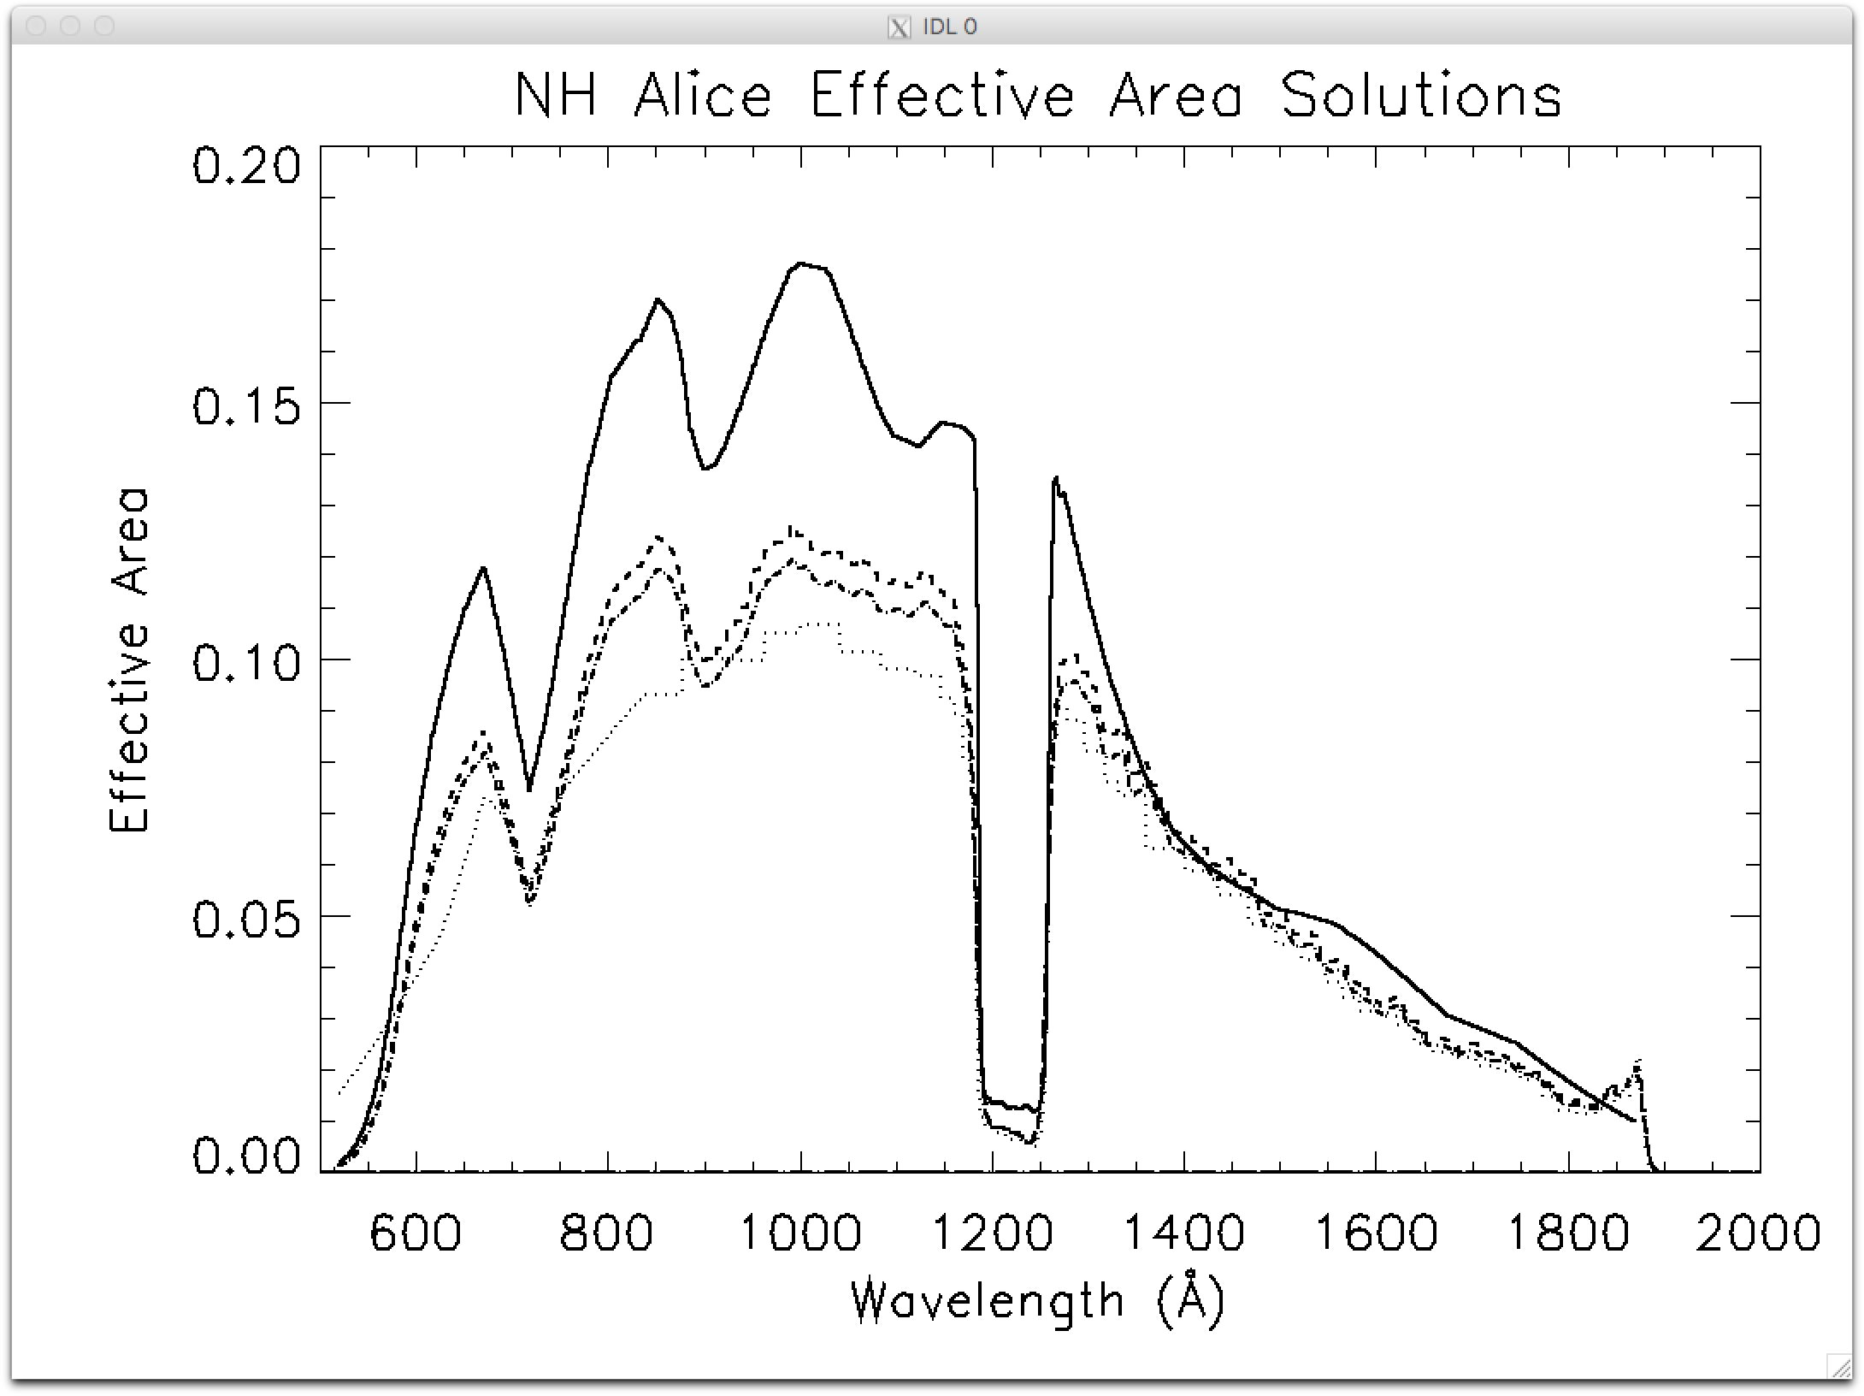
Examining the effective areas – look good
004 Launch + Jupiter
005 Superseded
006 Superseded
007 Pluto + KEM

Slide 4
Data are readable
Checked data with NASAView, SAOImage ds9, IDL ReadPDS, IDL Readfits
could display data with labels as expected for all cases, tables + FITS files

Slide 5
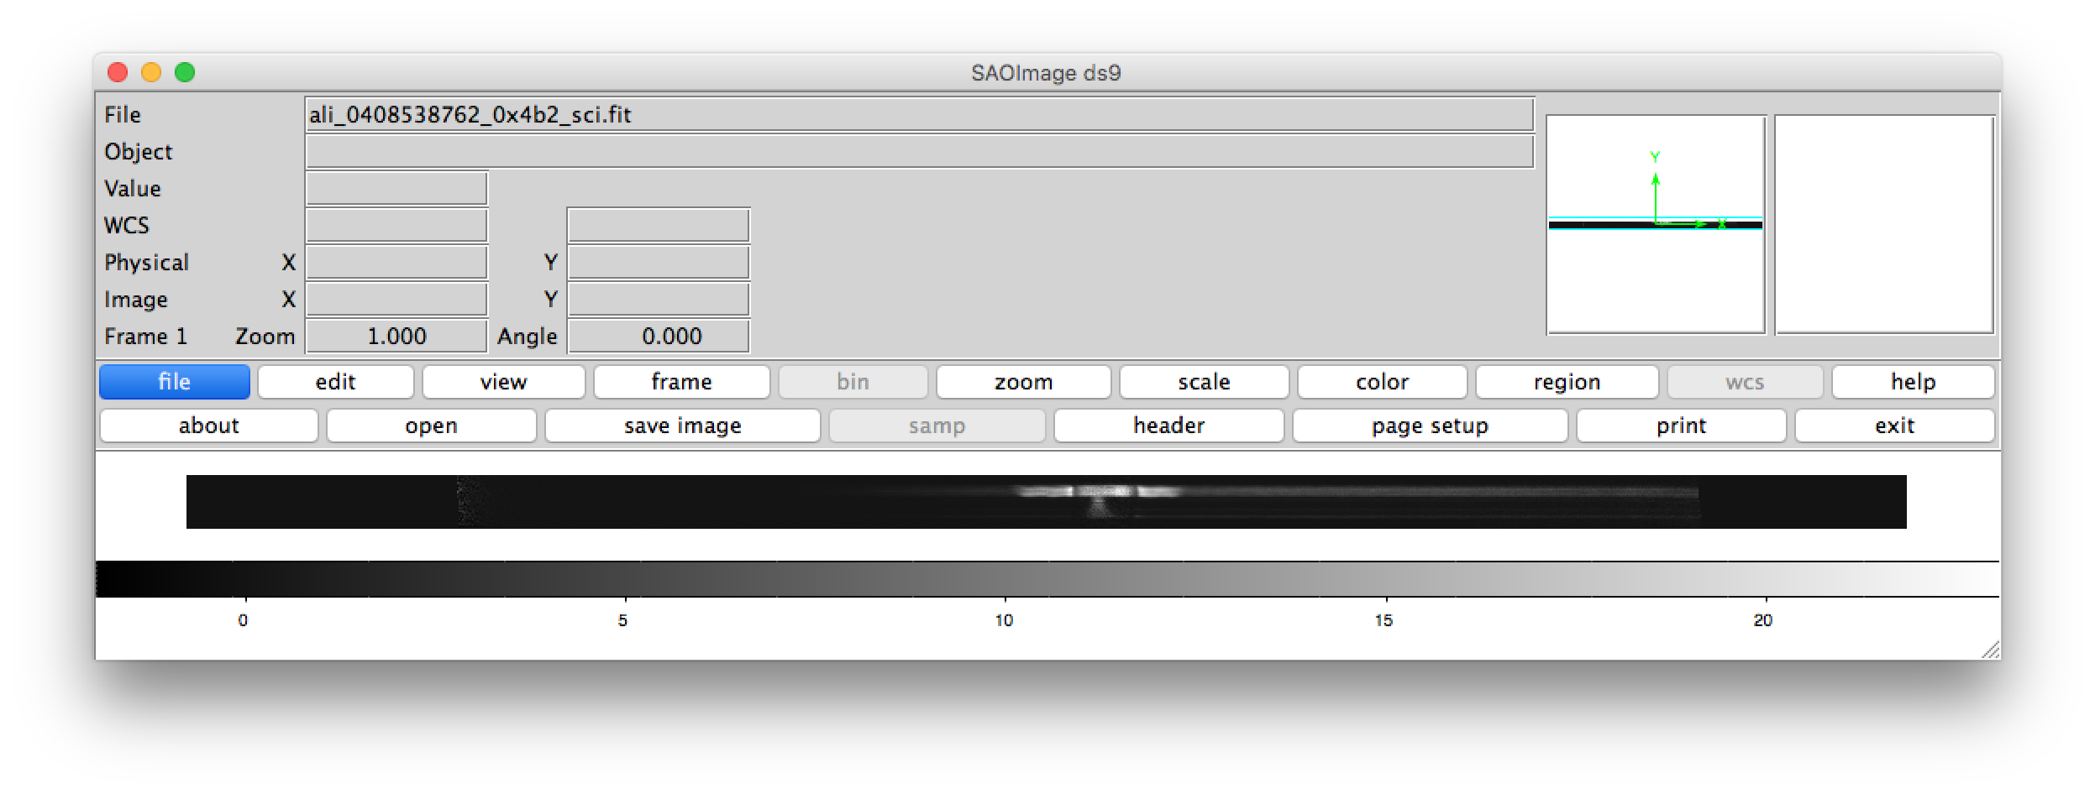
Example with 4 different tools
ReadPDS
ReadFits

Slide 6
nh-x-alice-2/3-kemcruise1-v2.0
document/seq_alice_kemcruise1.lbl
document/seq_alice_kemcruise1.tab
START_TIME = 2017-01-15T20:10:43
when in fact dataset.cat, index, and data have earliest data start time of 2017-01-11T09:08:01
Please fix the sequence file and label

Slide 7
nh-x-alice-*-kem*-v*.0
document/docinfo.txt
Typo in the document directory tree – in all 4 datasets
Fix so that the file extension for the label file is .LBL and not .TAB

Slide 8
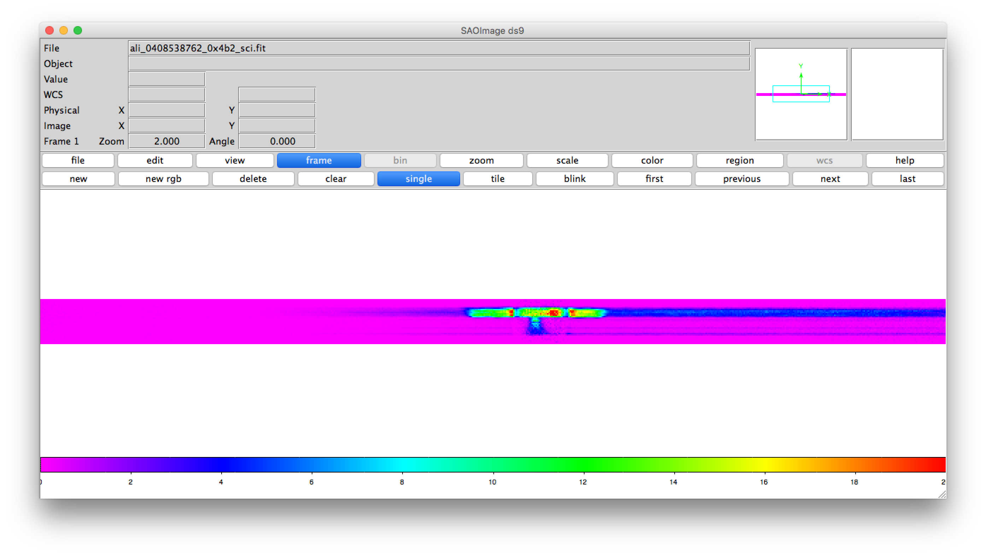
Quick by hand calibration within 2% of calibrated data (NH)

Slide 9
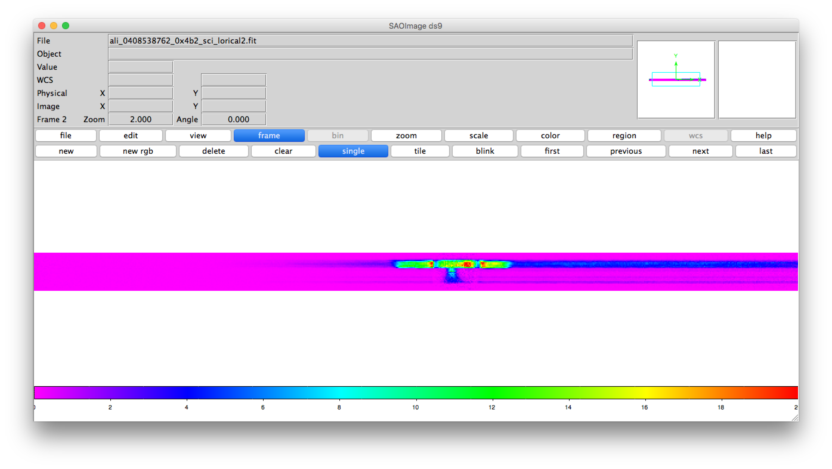
Quick by hand calibration within 2% of calibrated data (Feaga)

