Slide 1
Alice Data Review
New Horizons KEM Cruise/ KEM
John Noonan

Slide 2
Overview
No major issues preventing database from use and data look good
Minor issues include updating revision logs, odd spacing in rows, updating Science Objectives where necessary, etc.
PDS SBN Review September 5-6

Slide 3
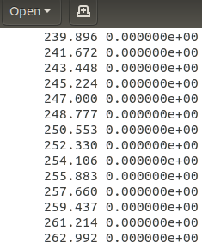
Extra Whitespace in calib/pa_aeff_*.tab (all 4 submissions)
Files contain extra 6 spaces at start of each row but are space delimited
Caused table generation to choke in Python, but quickly found a work around.
PDS SBN Review September 5-6

Slide 4
Need Updated Reference in calib/pa_eff_socc_002.lbl (all 4 submissions)
Label states that the values from “pa_aeff_005.tab” are used
“Shortward of 1181 A, the curve is that of the airglow channel (pa_aeff_005.tab)”
Recommend update to use of pa_aeff_007.tab
PDS SBN Review September 5-6

Slide 5
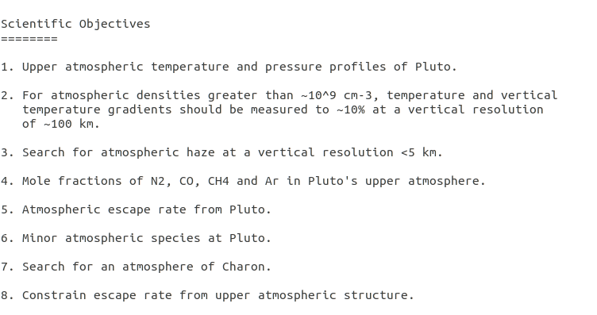
Science Objectives in alice.cat (all 4 submissions)
catalog/alice.cat section “Science Objectives” only contains objectives relevant to Pluto encounter.
Unclear if other objectives were added for KEM Cruise/KEM
Recommend subsection for KEM, clarification if there were new Alice objectives
PDS SBN Review September 5-6

Slide 6
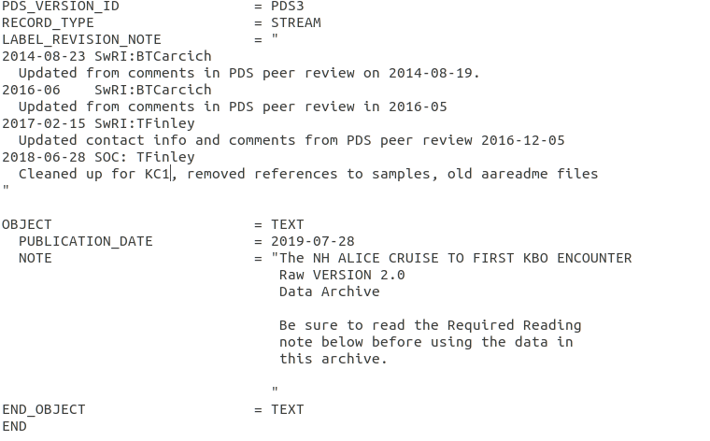
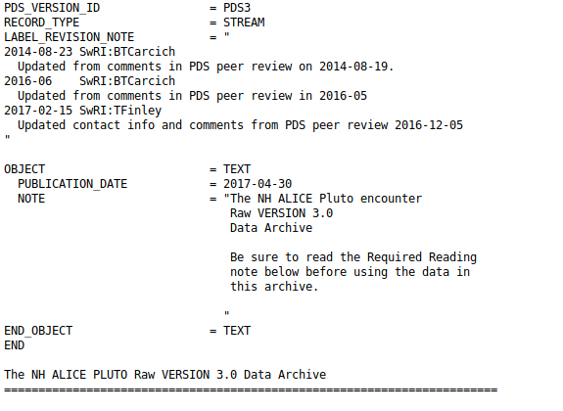
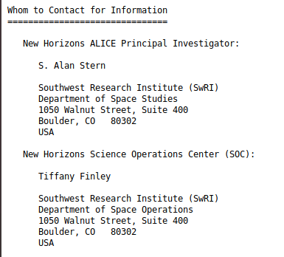
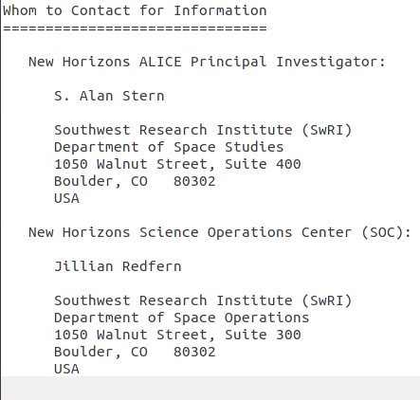
Missing Revision Log entry in aareadme.txt? (all 4 submissions)
The aareadme.txt files looks like they might be missing a revision log entry, contact info changed between last version on PDS, not mentioned in revision
PDS SBN Review September 5-6

Slide 7
Usability
All .fits files accessed using Python script
All eng files calibrated according to ICD
All sci files accessed, both data and headers
Log file with machine readability available
PNGs with both user-calibrated, science files, and differences available on request
Python code available as well
All .lbl files checked with Python script for machine readability
Log available upon request
Select files checked in DS9 to ensure _eng.fits files matched _sci.fits files
PDS SBN Review September 5-6

Slide 8
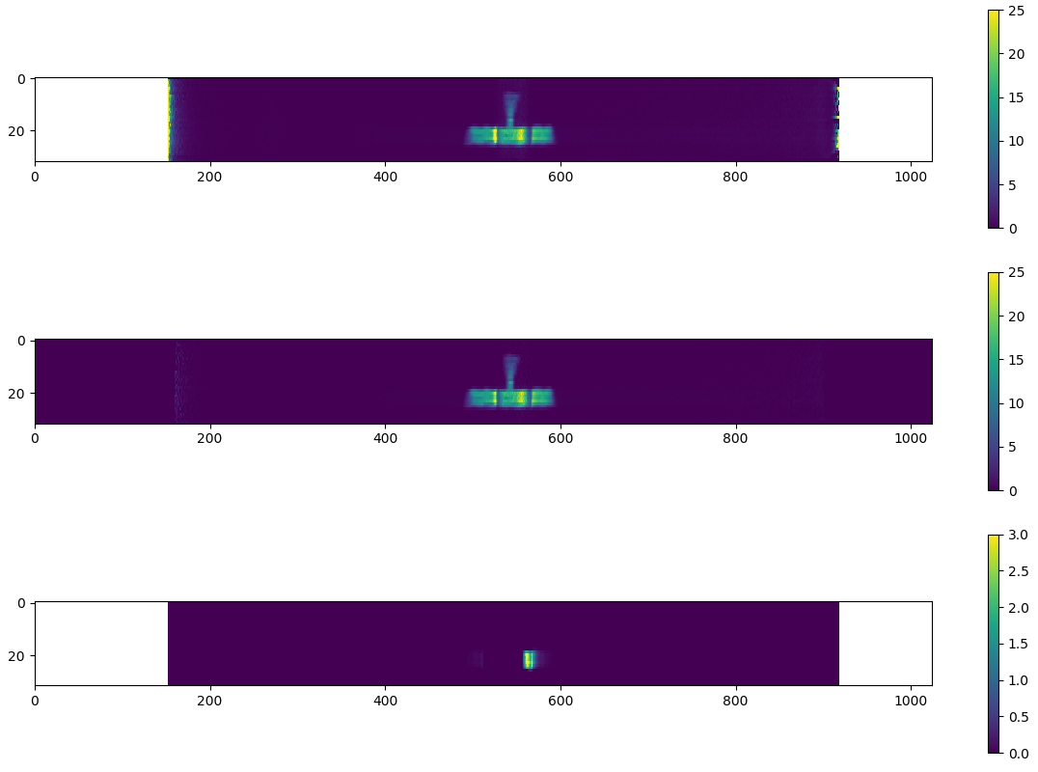
Alice Calibration Tests
User Calibrated Flux (pa_aeff_007.tab)
Provided Calibrated Flux
Difference % (provided/user)
Typical area for difference in SOCC
PDS SBN Review September 5-6

Slide 9
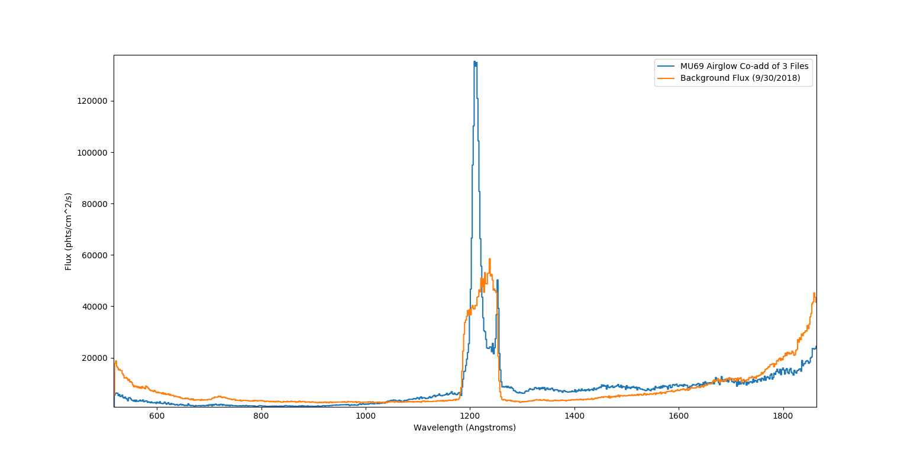
MU69 Airglow Co-Add
Lyman-α
PDS SBN Review September 5-6

Slide 10
Major Issues
None
PDS SBN Review September 5-6

Slide 11
Minor Issues
Odd 6-spacing at start of calib/pa_aeff_*.tab file rows
Update reference for blueward component of calib/pa_aeff_socc_002.lbl
Update “Science Objectives” components with KEM objectives in catalog/alice.cat
aareadme.txt should be updated with contact info made following last PDS Review
PDS SBN Review September 5-6

Slide 12
Summary
PDS SBN Review September 5-6

