Slide 1
PDS-SBN Review of New Horizons LEISA (Cruise) Data
M. DiSanti
10 October 2018

Slide 2
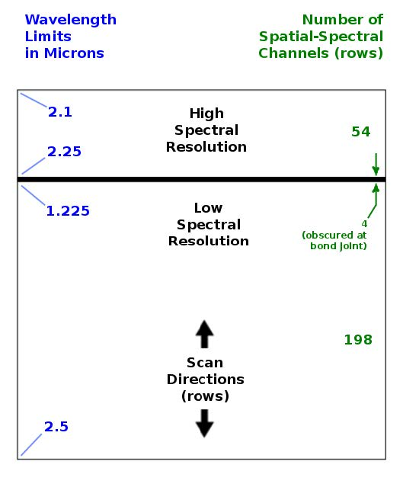
LEISA
A near-IR (1.2 – 2.5 micron) spectrometer that uses a 256x256 Rockwell PICNIC array, with 40 micron square pixels.
It produces low-resolution (λ/Δλ ~ 240) and higher-resolution (λ/Δλ ~ 540) spectra over separate sections (ranges of 54 and 199 rows) that are separated by 4 rows obscured by a bond joint.
Note: “Hi-res” λ/Δλ ~ 425 for Pluto
flyby data, but 540 for cruise phase

Slide 3
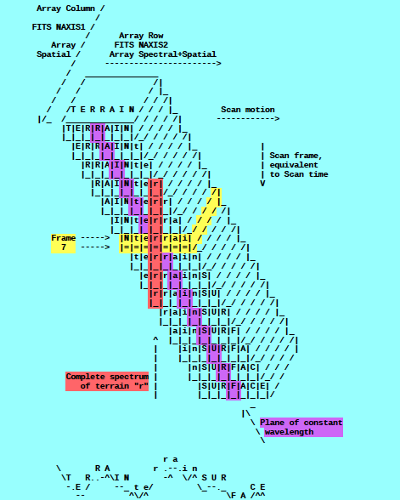
A spatial-spectral data cube is created by scanning the FOV across the target in a “push-broom” fashion. The data cube is a 3-dimensional array having 256x256xN elements, where N is the number of 256x256 files accumulated over the scan.
e.g., read in calibrated FITS file = ‘nh-x-leisa-2-kemcruise1-v1.0/data/20170921_036833/lsb_0368336219_0x53c_eng.fit’
file = file(x,y,z),
x=spatial (256 elements),
y=lambda(256 elements),
z=spectral/spatial
(N=elements; e.g., N=350)
(i.e., lambda varies spatially)
[figure from ‘leisa_data.pdf’ in
folder ‘document’]

Slide 4
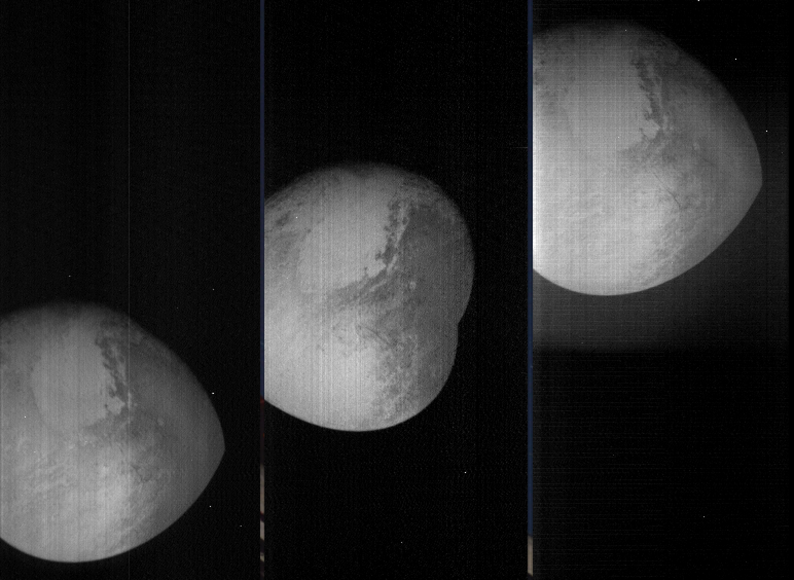
LEISA Pluto flyby Data
Transpose file(x,y,z) [256,256,N] → file_tr(x,z,y) [256,N,256]
→
shift -
register
file(0:255,0:N-1,0)
file(0:255,0:N-1,127)
file(0:255,0:N-1,255)
file_tr_sh(0:255,0:N-1,Σ[0:255])
(i.e., over all lambda)
(Some residual wobble in x-dim)

Slide 5
LEISA CRUISE DATA
/data/20170921_036833/lsb_0368336219_0x53c_eng.fit
Arcturus
Unregistered images
Arcturus
Registered image
λ = 2.144 μm (high resln)
λ = 2.08 μm (high resln)
λ = 2.49 μm (low resln)

Slide 6
LEISA CRUISE DATA
/data/20171103_037203/lsb_0372030719_0x53c_eng.fit
“Calibration”/Alpha Lyrae
Channel 44 (2.13 μm)
Channel 81 (1.86 μm)
Channel 255 (2.088 μm)

Slide 7
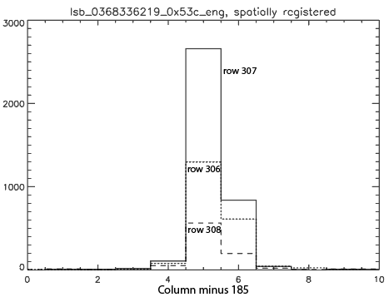
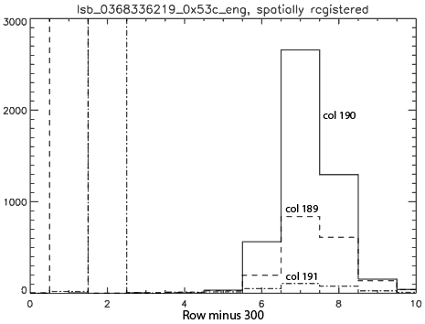
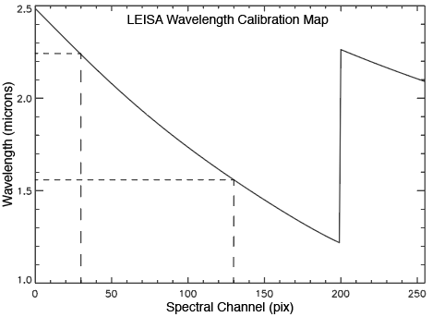
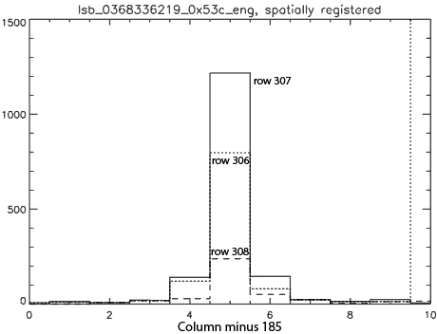
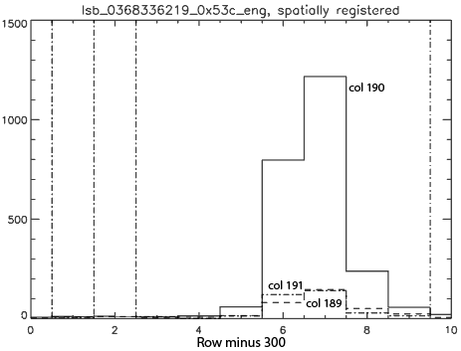
Arcturus: spatial profiles near 2.2 and 1.6 µm
(/data/20170921_036833/lsb_0368336219_0x53c_eng.fit)
λ $≅$ 2.24 µm
peak 190,307
λ $≅$ 1.56 µm
peak 190,307

Slide 8
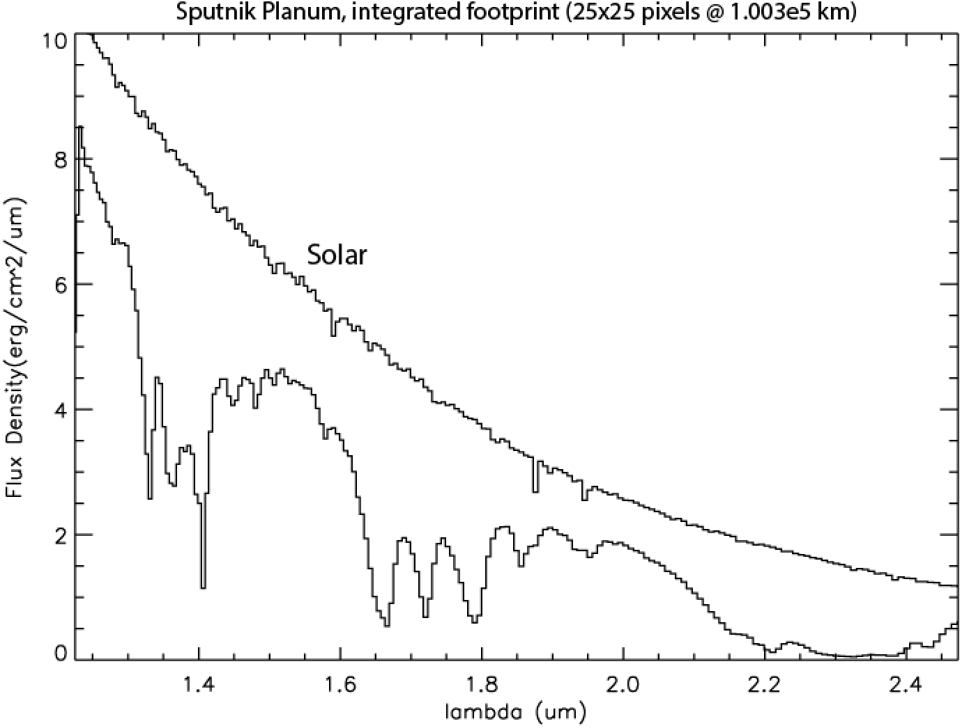
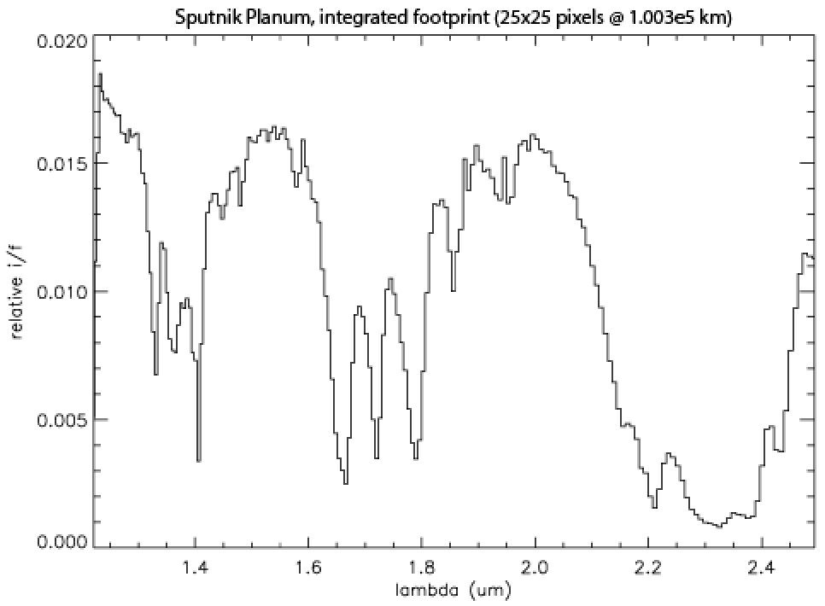
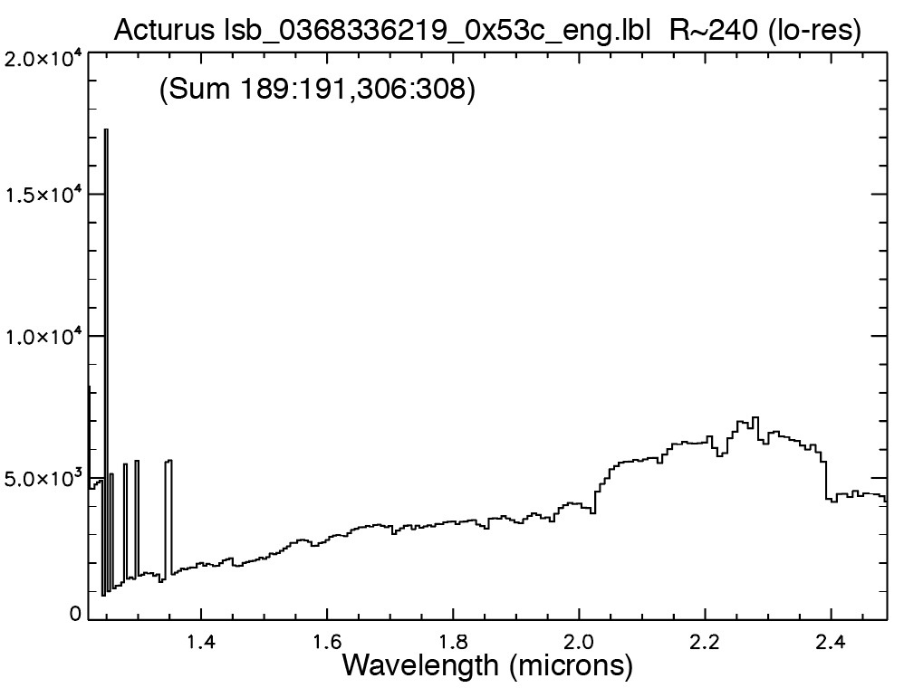
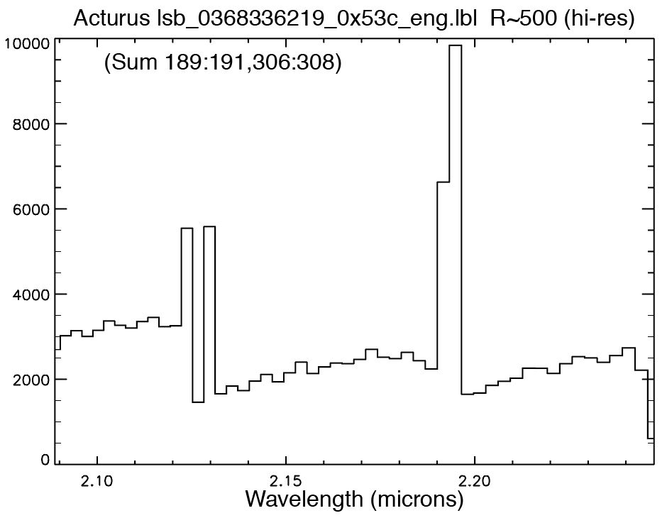
Pluto/Sputnik Planatia; Arcturus

Slide 9
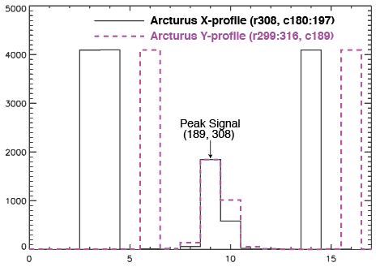
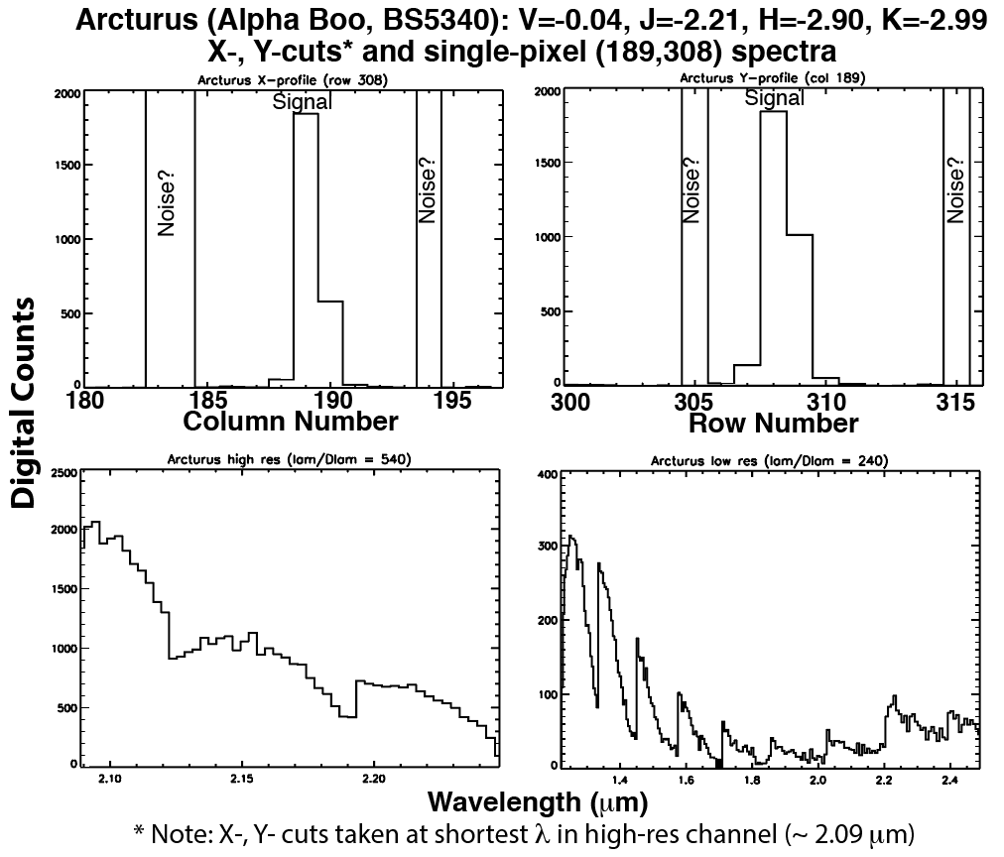
Arcturus: stellar profile and spectral extracts
(/data/20170921_036833/lsb_0368336219_0x53c_eng.fit)
centered at pixel (189,308)

Slide 10
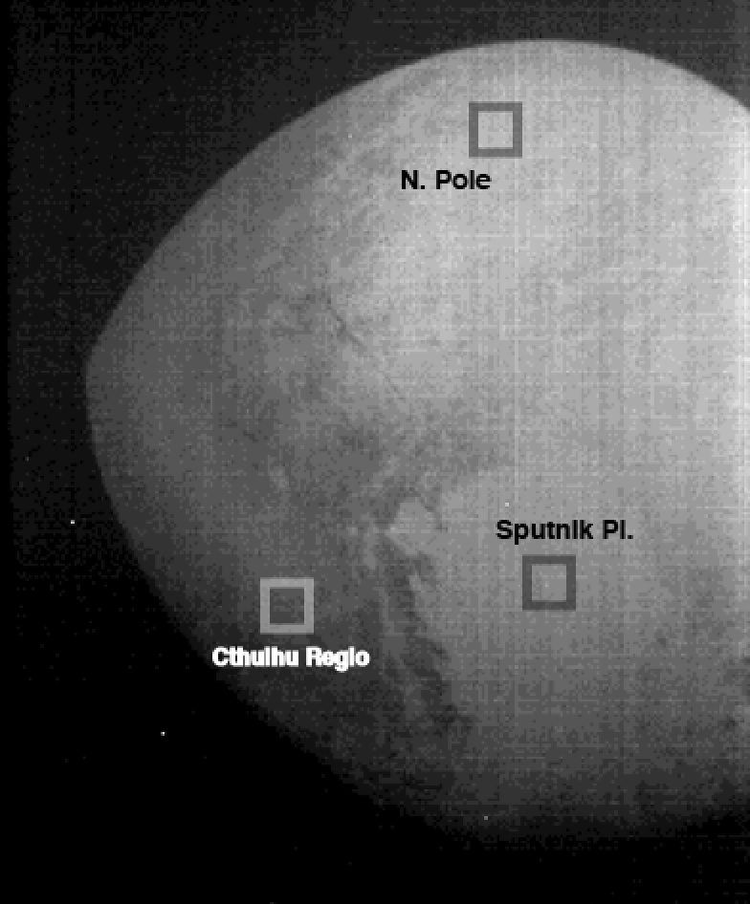
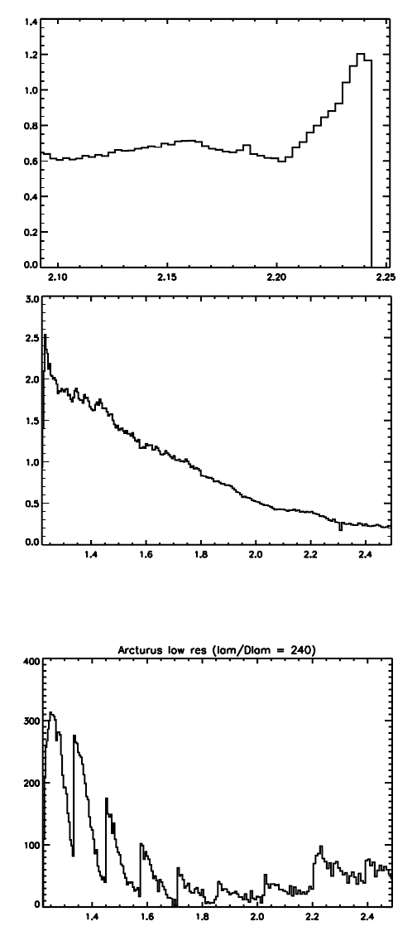
Cthulhu Regio – Arcturus Spectral Comparison
Cthulhu high resolution (λ/Δλ ~ 420)
Cthulhu low resolution (λ/Δλ ~ 240)
Arcturus low resolution (λ/Δλ ~ 240)
Bottom line: Navigation seems good for (some of) the Arcturus observations, but the spectrum is affected by (likely instrumental?) “noise” (and slight wobble in X).

Slide 11
MU69 Approach 31 Dec 2018
unregistered
“registered”
Bottom line: Unable to see anything, regardless of stretch. Seems to be instrumental noise.

Slide 12
MU69 Approach 31 Dec 2018
unregistered
“registered”
lambda100
“registered”
lambda256
Bottom line: Unable to see anything, regardless of stretch. Seems to be instrumental noise.

