Slide 1
Review of Spitzer-IRS Data
M. DiSanti
5 September 2019

Slide 2
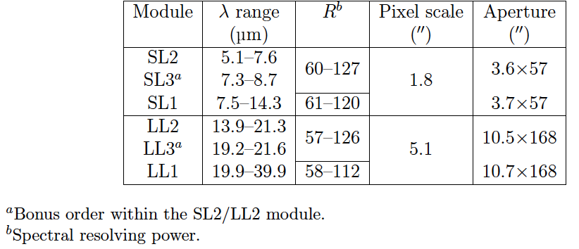
Spitzer IR Spectrometer
Observation modes

Slide 3
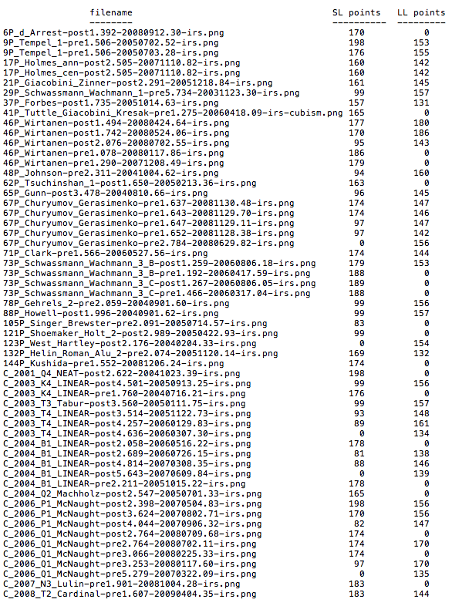
Spitzer IR Spectrometer
Scope of archive:
Total of 57 spectral files provided
21 JFCs
10 LPCs
33/57 files: SL and LL modes
”Teardrop” near 14 µm
“Wiggles” @ ~21-25 µm
Total and “nucleus” contributions plotted for all spectra
Total numbers of spectral points recorded for all files (at right)
19/57 files: SL mode only
5/57 files: LL mode only

Slide 4
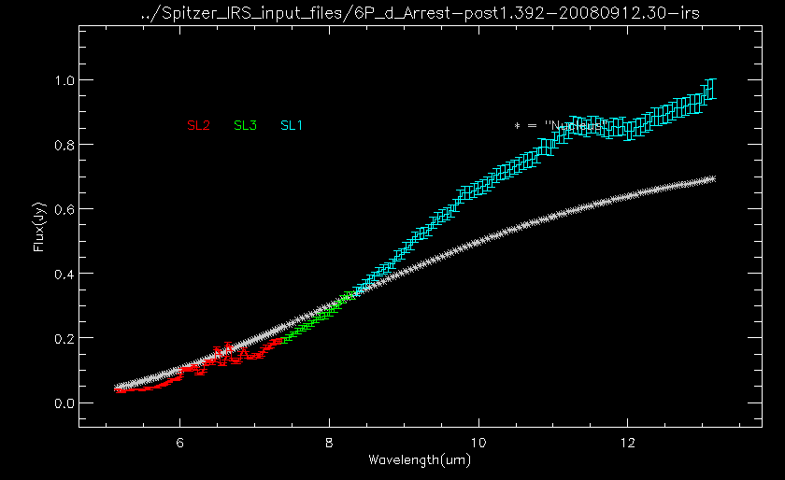
Sample Spectra

Slide 5
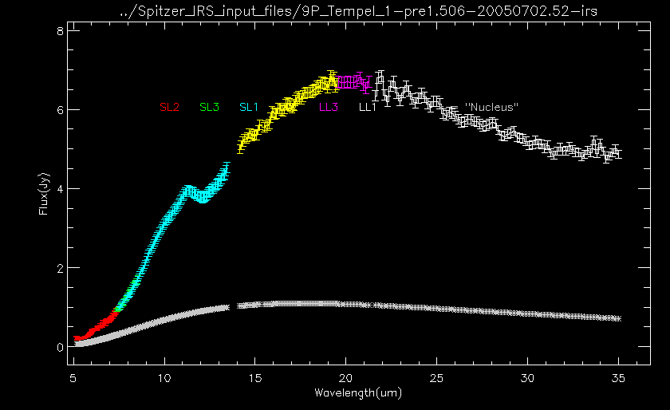
Sample Spectra (cont’d)

Slide 6
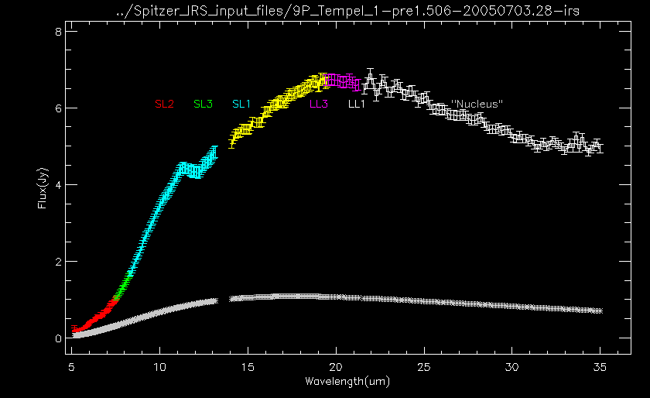
Sample Spectra (cont’d)

Slide 7
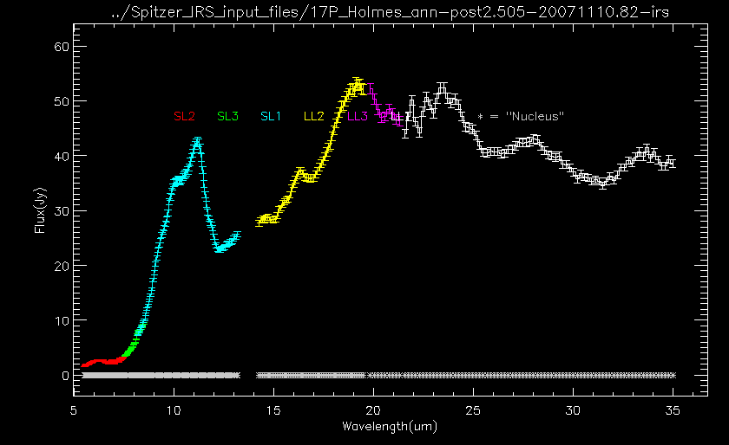
Sample Spectra (cont’d)

Slide 8
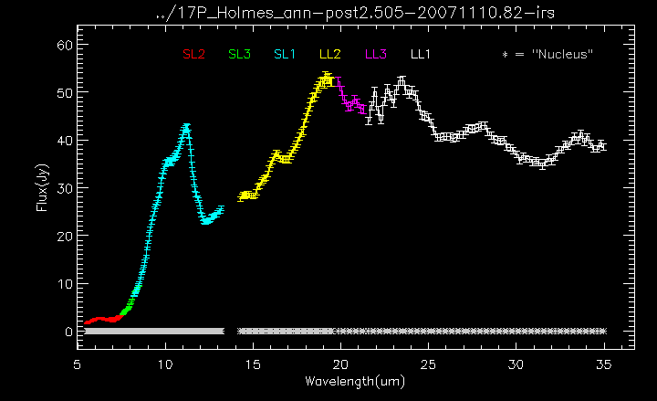
Sample Spectra (cont’d)

Slide 9
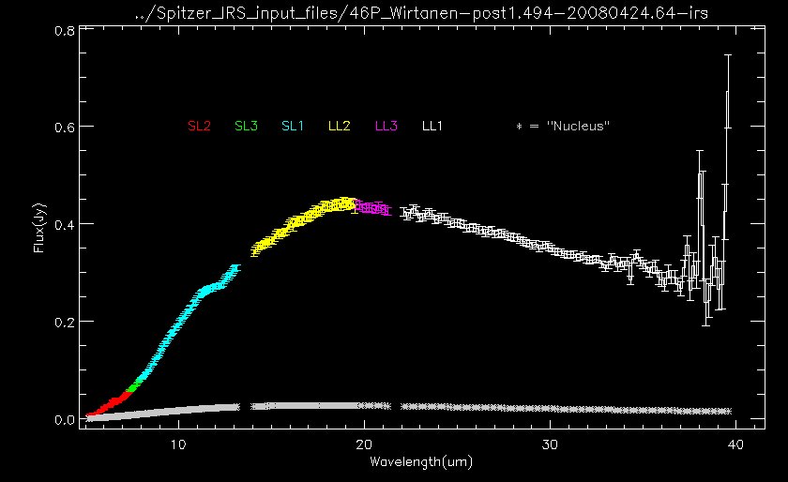
Sample Spectra (cont’d)

Slide 10
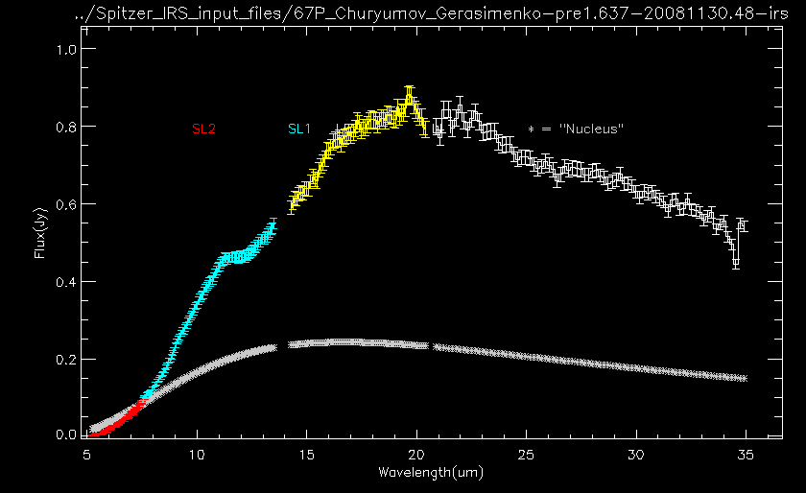
Sample Spectra (cont’d)

Slide 11
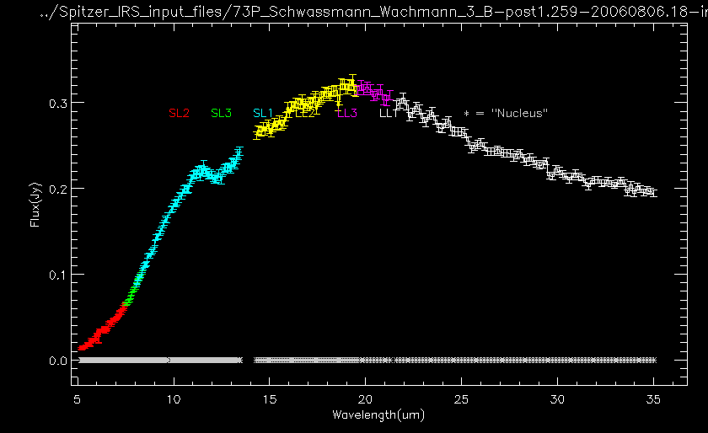
Sample Spectra (cont’d)

Slide 12
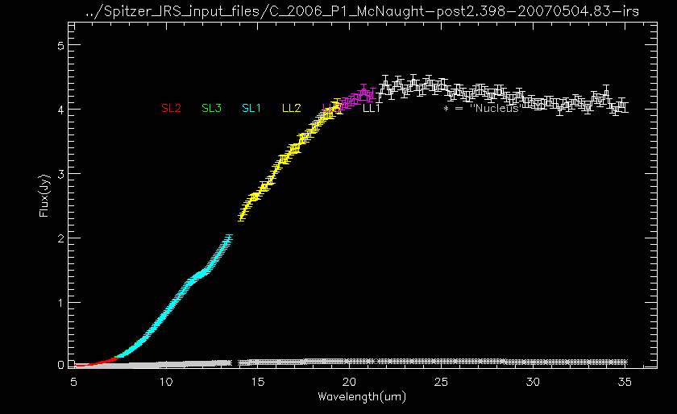
Sample Spectra (cont’d)

Slide 13
Summary of IRS Review
Very nice archive! 31 comets observed from both JFC and LPC dynamical populations, between 2004 and 2009.
Instrumental artifacts: “14-µm teardrop,” and “wiggles” between ~21 and 25 µm were seen.
Thermal slope of cometary dust appears generally consistent with blackbody.
Centered “circle” (0-10”) and ”annulus” (10-20”) results noted for 17P. Interesting that the “annulus” file has higher flux level.
”10-µm” emission feature apparent, particularly in 9P (pre-DI event) and (especially) 17P following its outburst.
In some cases “nucleus” flux > total flux at some wavelengths. Perhaps the assumed albedo (0.05) is over-estimated?
Suggestion: Add a short “readme.txt” file, describing the 7 columns contained in the .csv files. Although in the csv header information, this would make it easier for users.
Particularly that inter-order/inter-module scaling factor (“scales”) is already included, so spectra can be plotted without further scaling.

