Slide 1
New Horizons Long Range Reconnaissance Imager (LORRI) Data Review
Reviewer: Xiao-Duan Zou
Planetary Science Institute
09/2019 @UMD

Slide 2
LORRI Dataset Overview
PDS version: PDS3
4 data sets:
nh-x-lorri-2-kemcruise1-v2.0 (total: 1863 images, 1028x1024 or 257x256)
nh-x-lorri-3-kemcruise1-v2.0 (total: 1863 images, 1024x1024 or 256x256)
nh-x-lorri-2-kem1-v1.0 (total: 1648 images, 1028x1024 or 257x256)
nh-x-lorri-3-kem1-v1.0 (total: 1648 images, 1024x1024 or 256x256)
Level:
Level 2
Level 3
Mission phases:
KEMCRUISE1 v2.0
KEM1 v1.0 New
but no Jan 01 flyby data
2014 MU69 in lorri-3-kem1

Slide 3
Review Process
Read all .fit and label files (all can be read correctly).
Check the headers and labels
Compare catalog files in all datasets, and analyze the difference
Check all catalog files
Read documents in document/directory
Collect aspect data from all image headers, check consistency between levels

Slide 4
DATA
All .fit files can be read by readfits.pro and readpds
Also readable with DS9
Header
Long list of SPICE kernel names
101 kernels listed in both kem1 and kemcruise1 fits headers
kernel range: 2006~2025
observation range:
2017-01-28 ~ 2017-12-06 KEMCRUISE1
2018-08-15 ~ 2018-12-31 KEM1
Units
the units are not mentioned in level 2 header or label, DN? not integer
the units in level 3 header are NOT clear, (calibrated DN)

Slide 5
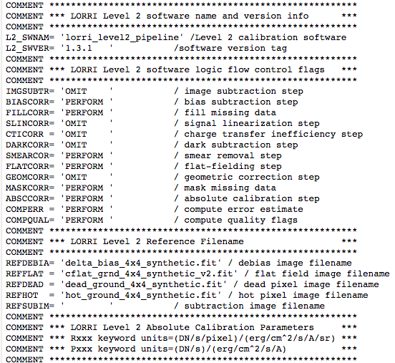

Slide 6
Catalog Files
Identical in all datasets:
nh_kem.cat, nhsc.cat, lorri.cat, ref.cat
units description of lorri.cat
physical meaning of the value in images from level 2 and 3
dataset.cat:
add the imaged DKBOs list to the “data set overview”
There is this statement in level 3 dataset. cat “The first 34 pixels (51 bytes) of each LORRI image contain housekeeping information.” Are they still in level 3 image?
no divisor from fits header and label

Slide 7
New Horizons Multispectral Visible Imaging Camera (MVIC) Data Review

Slide 8
MVIC Dataset Overview
PDS version: PDS3
4 data sets:
nh-x-mvic-2-kemcruise1-v2.0 (total: 19 fits)
nh-x-mvic-3-kemcruise1-v2.0 (total: 19 fits)
nh-x-mvic-2-kem1-v1.0 (total: 11 fits)
nh-x-mvic-3-kem1-v1.0 (total: 11 fits)
Level:
Level 2
Level 3
Mission phases:
KEMCRUISE1 v2.0
KEM1 v1.0 New

Slide 9
Review Process
Read all .fit and label files (all can be read correctly).
Check the headers and labels
Compare catalog files in all datasets, and analyze the difference
Check all catalog files
Read documents in document/directory
Collect aspect data from all image headers, check consistency between levels
Check the geometry

Slide 10
DATA
All .fit files can be read by readfits.pro
Also readable with DS9
most are “Functional Test” or “instrument check”
Header
Long list of SPICE kernel names
101 kernels listed in both kem1 and kemcruise1 fits headers, kernel range: 2006~2025
observation range:
2017-09-21 ~ 2018-07-13 KEMCRUISE1
2018-08-30 ~ 2018-12-30 KEM1
Units
the units are not mentioned in level 2 header or label
the units in level 3 header are NOT clear
SAPDESC = 'First Opnav Observation for Ultima Thule' / Science Activity Plan des…

Slide 13
DN vs calibrated DN
mpf_0397980475_0x539_*.fit
layer 1
leve2
leve3
layer 10
leve2
leve3
Physically reasonable?

Slide 14
Catalog Files
Identical in all datasets:
nh_kem.cat, nhsc.cat, mvic.cat, ref.cat
units description of dataset.cat
physical meaning of the value in images regarding MU69 observation: both level 2 and 3

Slide 15
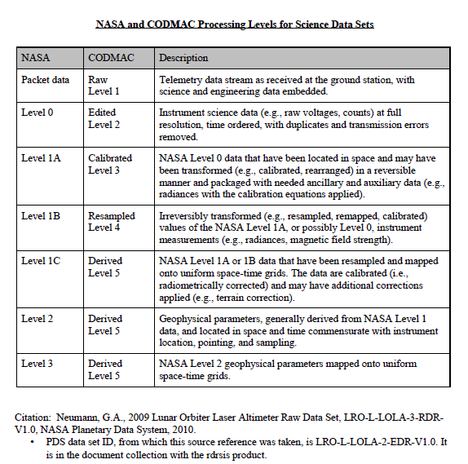
Documents
Well documented.
level confusion
seq_mvic_*1.tab:
not consistent with /DATA
19 files / 26 in seq KEMCRUISE1
11 files / 60 in seq KEM1
codmac_level_definitions.pdf

Slide 16
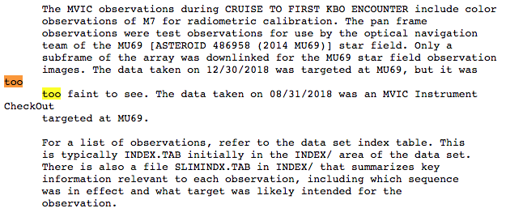
other stuff
nh-x-mvic-3-kemcruise1-v2.0/catalog/dataset.cat:

