Slide 1
SDC PDS Review KEM Cruise Data: 2016-10-17 to 2018-08-14 & KEM Encounter Data: 2018-08-14 to 2018-12-01
A.R. Poppe
U.C. Berkeley
September 6, 2019

Slide 2
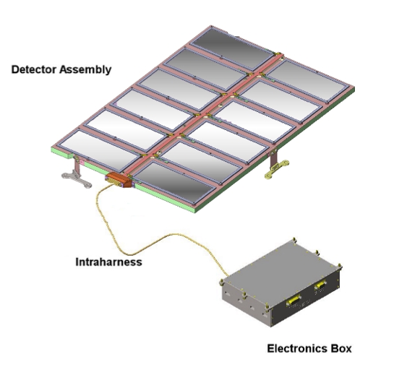
SDC Instrument
SDC instrument:
- 14 detectors: 12 science (with 1 defunct), 2 reference
- electronics box for signal processing, telemetry/commands

Slide 3
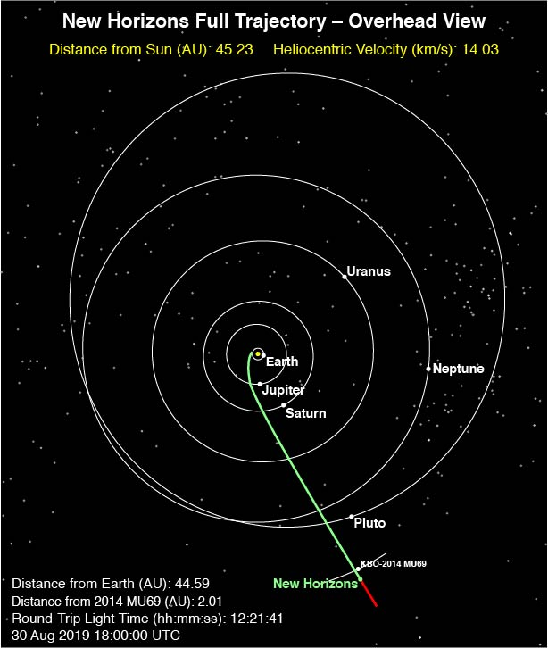
Previous & Current Releases
Four main data periods previously released by SDC:
Launch: March 2006 – Dec 2006, mainly testing and checkout of instrument
Jupiter: Dec 2006 – June 2007, small chunk of data taken post-Jupiter fly-by (note SDC was not on during close approach of Jupiter)
Pluto-cruise: June 2007 – July 2014, main period of scientific data collection by SDC between the orbits of Jupiter and Pluto
Pluto Encounter: Jan 2015 – Oct 2016, Pluto approach, encounter, post-encounter
Current dataset:
KEM Cruise & KEM Encounter, Oct 2016 to Dec 2018 (combined)

Slide 4
KEM Cruise

Slide 5
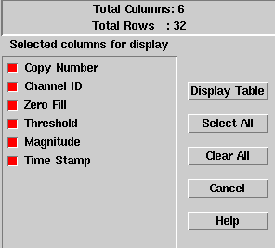
KEM Cruise: SDC Raw Data
Includes SDC raw scientific data, SDC housekeeping (engineering telemetry), New Horizons spacecraft housekeeping (0x004, 0x00D, 0x00A), and New Horizons thruster firing fata
The SDC raw scientific data includes channel (detector) number, data threshold, data magnitude, and time stamp

Slide 6
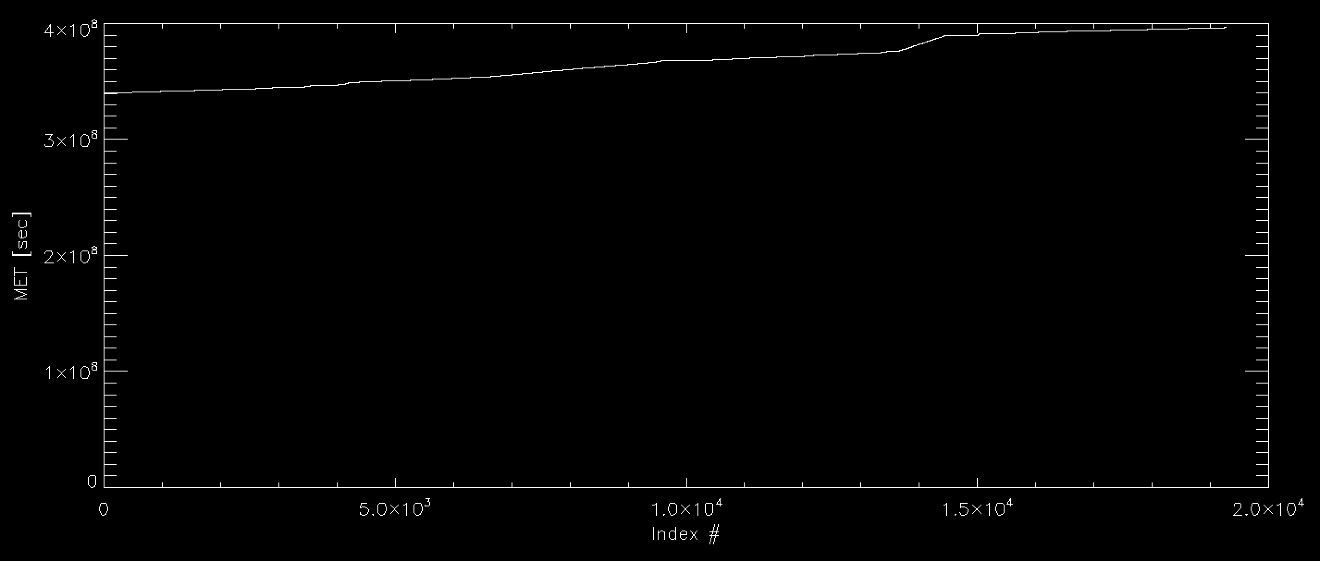
KEM Cruise: SDC Raw Data
Plot of Mission Elapsed Time vs. entry looks good
Total number of events: 19,268
Time period covers: Oct 17, 2016 – Aug 14, 2018

Slide 7
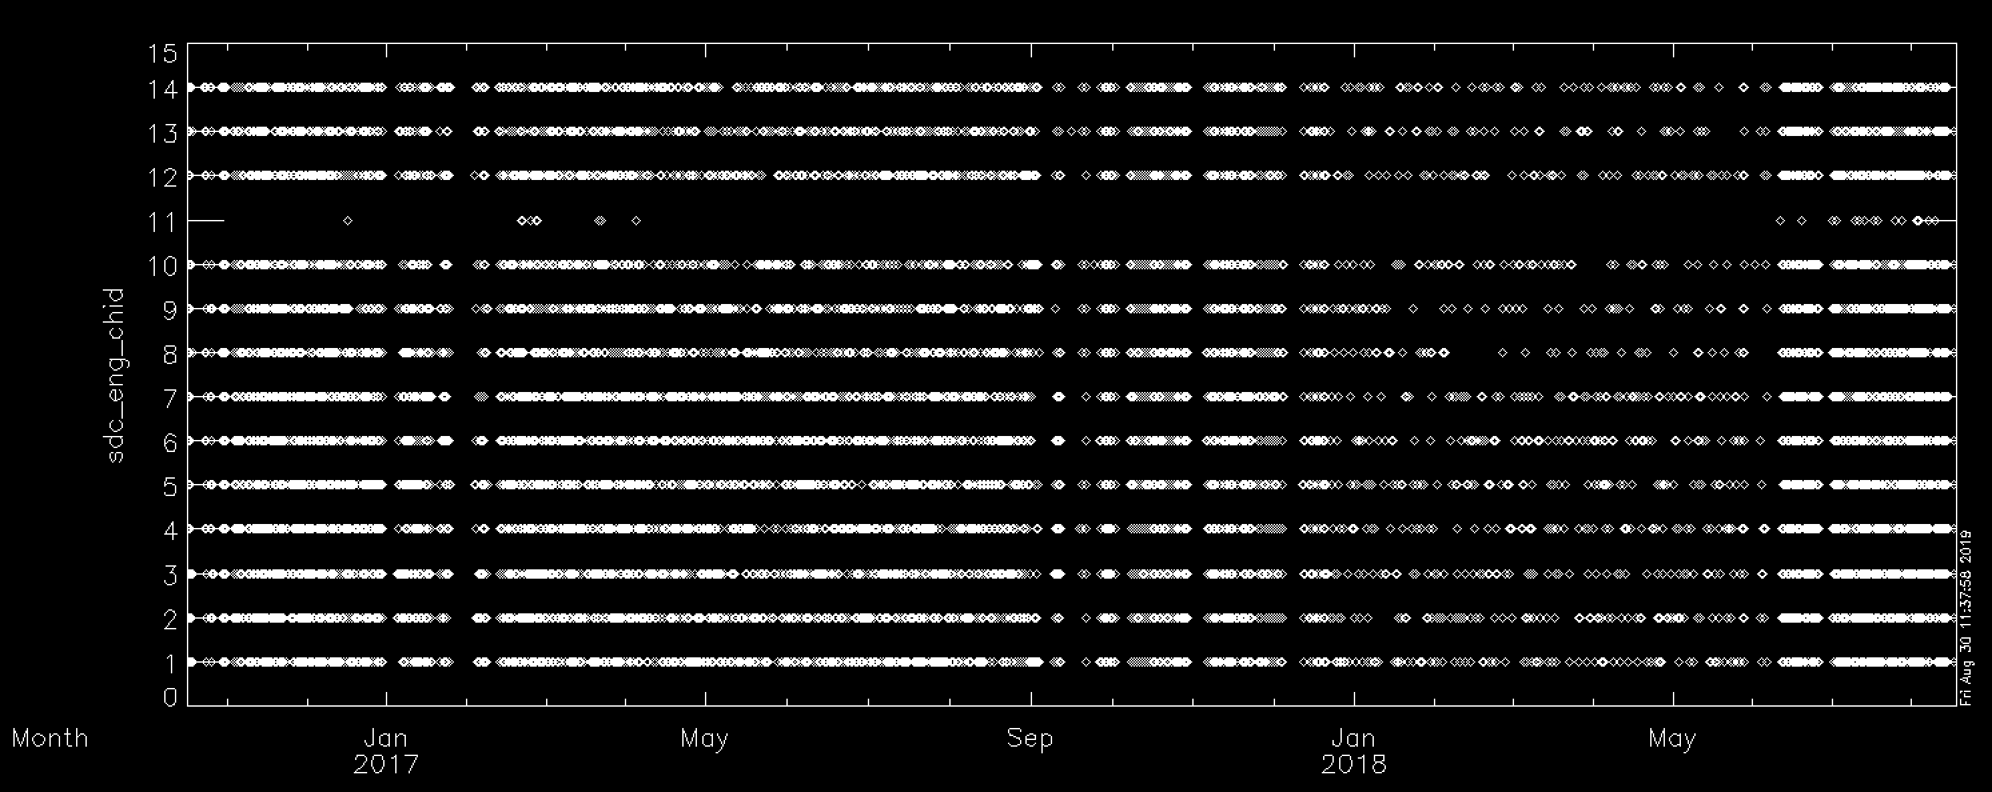
KEM Cruise: SDC Raw Data
Channel ID# versus Time looks good
Total number of events: 19,268
Time period covers: Oct 17, 2016 – Aug 14, 2018

Slide 8
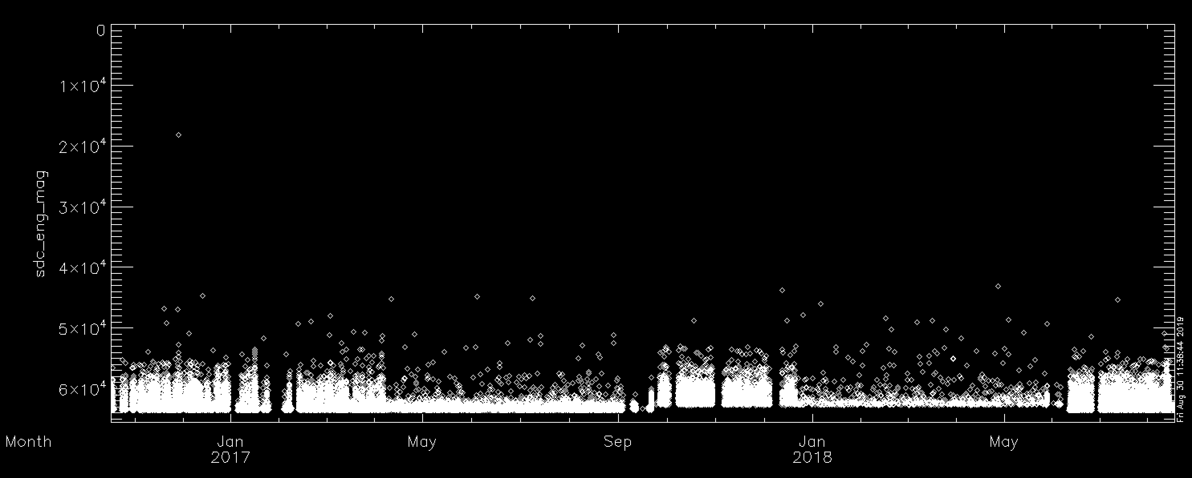
KEM Cruise: SDC Raw Data
Magnitude versus Time looks good – note threshold change Sep 2017 – June 2018
- consistent with description of threshold change in dataset.cat
Total number of events: 19,268
Time period covers: Oct 17, 2016 – Aug 14, 2018

Slide 9
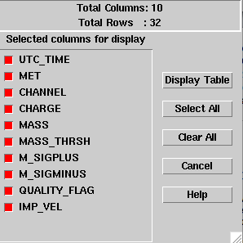
KEM Cruise: SDC Calibrated Data
Includes SDC calibrated scientific data
The SDC calibrated scientific data includes time, channel, charge, mass, mass threshold, error bars, quality flag, and theoretical SDC-dust relative impact velocity

Slide 10
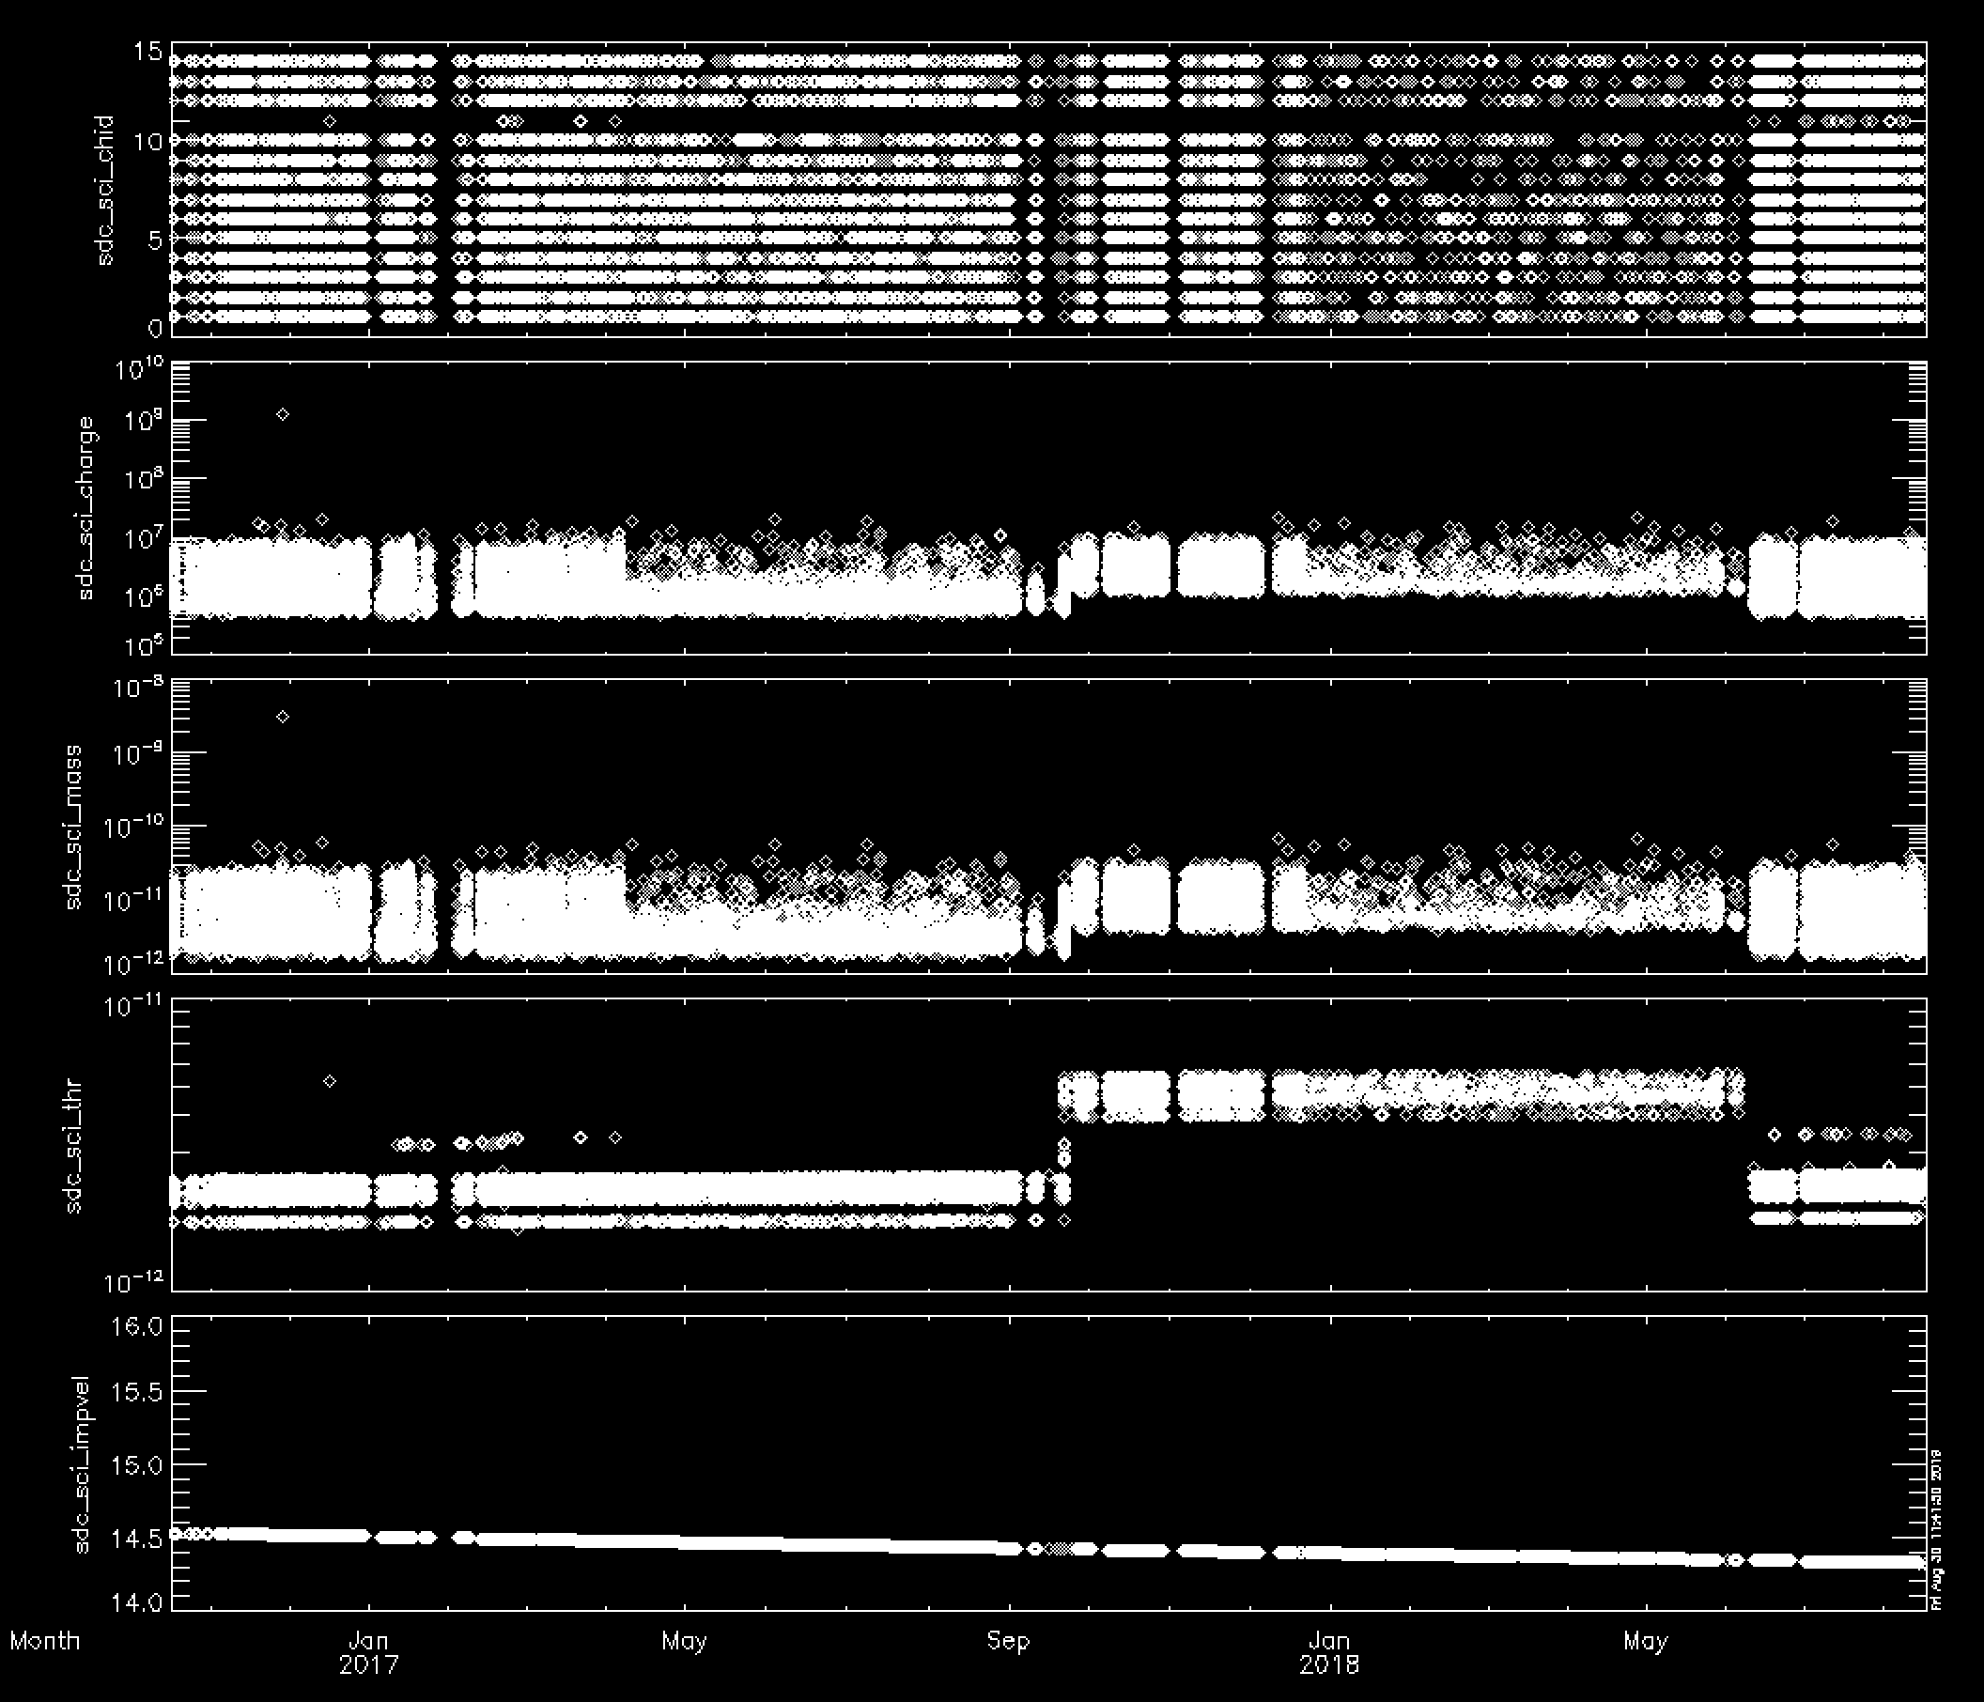
KEM Cruise: SDC Calibrated Data

Slide 11
Textual Edits: nh-p-sdc-[2,3]-kemcruise-v2
None noted.
Query to NH SDC Team:
The dataset.cat file has the paragraph below. I’m concerned that the data are being released when they may be potentially incomplete. Thus, are there truly future data to be added to this dataset?
Also, the start date of December 07, 2017 noted below is inconsistent with the date range specified elsewhere, and the dataset itself.

Slide 12
KEM Encounter

Slide 13
KEM Encounter: SDC Raw Data
Includes SDC raw scientific data, SDC housekeeping (engineering telemetry), New Horizons spacecraft housekeeping (0x004, 0x00D, 0x00A), and New Horizons thruster firing fata
The SDC raw scientific data includes channel (detector) number, data threshold, data magnitude, and time stamp

Slide 14
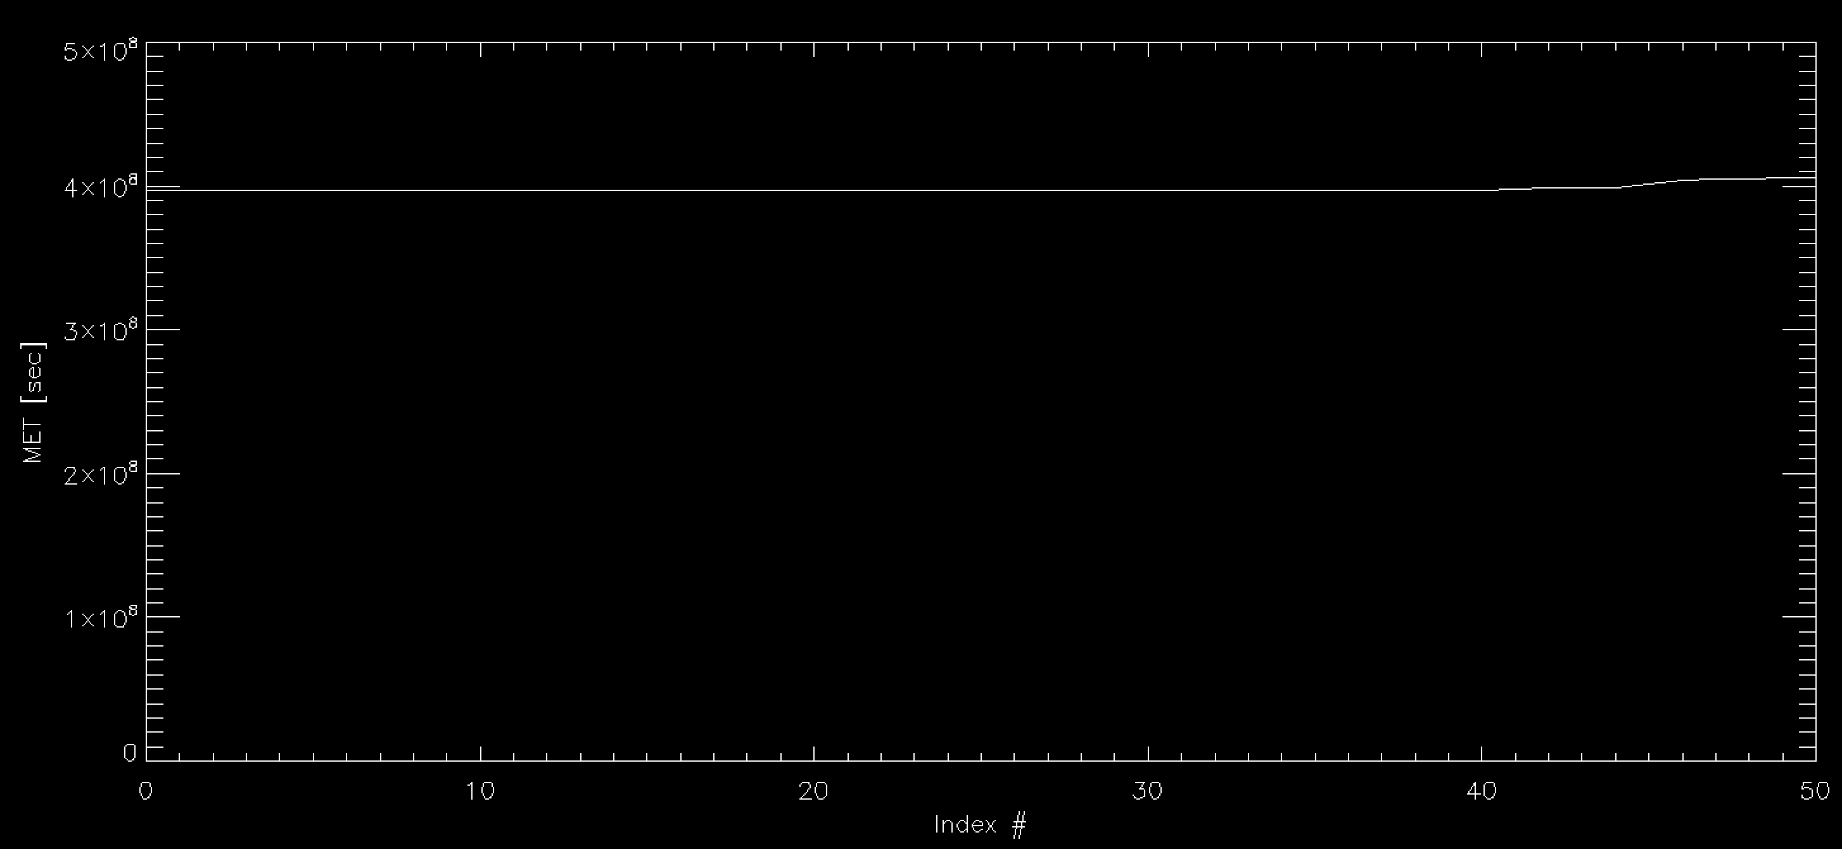
KEM Encounter: SDC Raw Data
Plot of Mission Elapsed Time vs. entry looks ok – but very few hits in the time period (?)
Total number of events: 51
Time period covers: Aug 14, 2018 – Dec 01, 2018

Slide 15
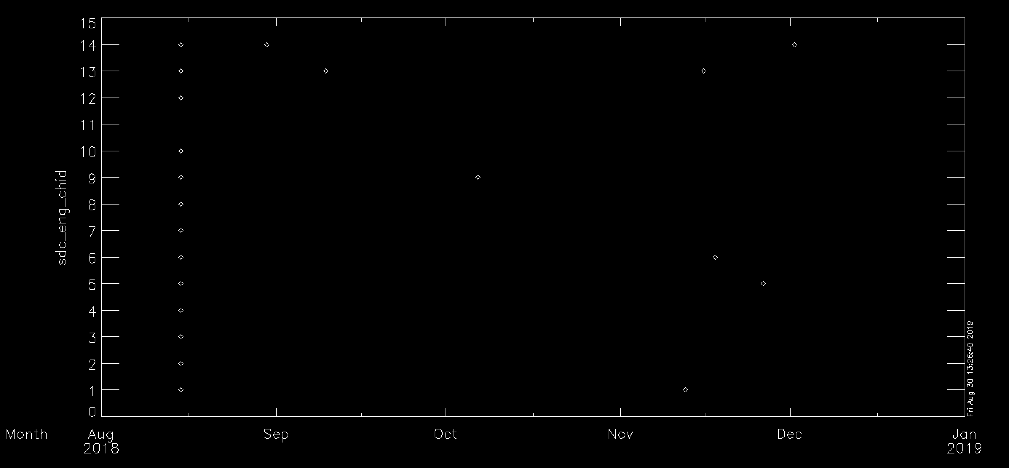
KEM Encounter: SDC Raw Data
Channel ID# versus Time looks good
Total number of events: 51
Time period covers: Aug 14, 2018 – Dec 01, 2018

Slide 16
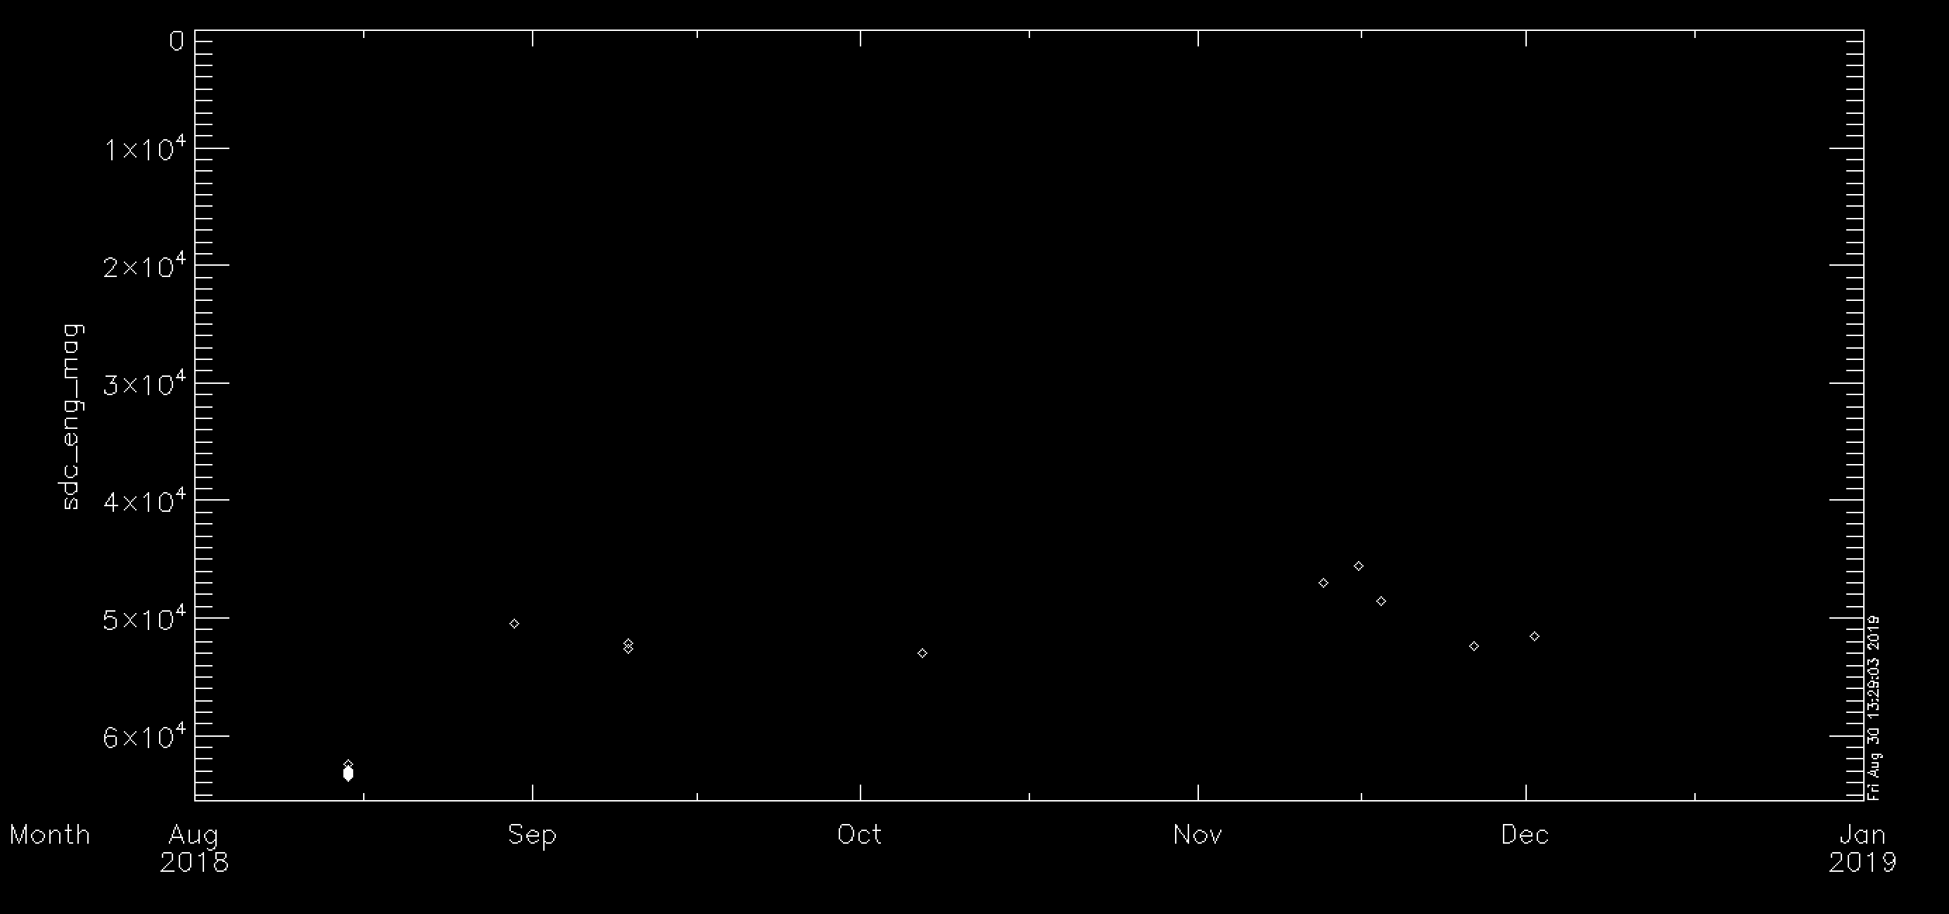
KEM Encounter: SDC Raw Data
Magnitude versus Time looks good – appears to be a threshold change in late Aug 2018
Total number of events: 51
Time period covers: Aug 14, 2018 – Dec 01, 2018

Slide 17
KEM Encounter: SDC Calibrated Data
Includes SDC calibrated scientific data
The SDC calibrated scientific data includes time, channel, charge, mass, mass threshold, error bars, quality flag, and theoretical SDC-dust relative impact velocity

Slide 18
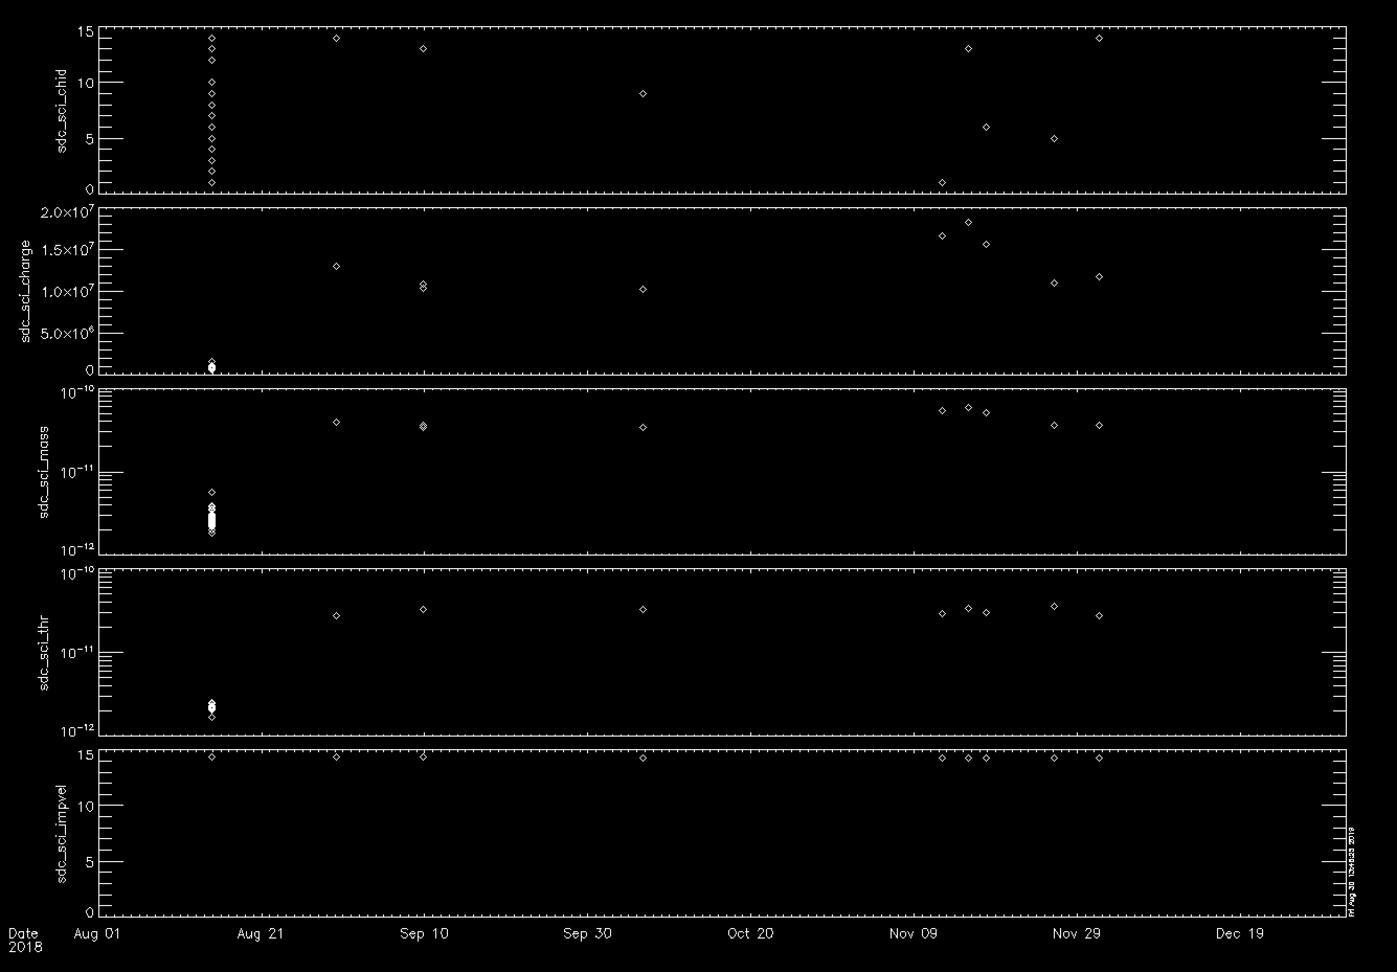
KEM Encounter: SDC Calibrated Data

Slide 19
Textual Edits: nh-p-sdc-[2,3]-kemencounter-v2
None noted.
Query to NH SDC Team:
The dataset.cat file has the paragraph below. I’m concerned that the data are being released when they may be potentially incomplete. Thus, are there truly future data to be added to this dataset?

Slide 20
Another point to consider:
How to determine threshold of various channels when there aren’t hits in the dataset?
We haven’t necessarily had this issue before because we’ve had enough hits, but here, one can’t necessarily reconstruct a minimum detectable dust grain size without the threshold information.

Slide 21
Completeness:
The delivered dataset has a complete set of files and documentation
Adequate completeness of each data record (i.e., one dust hit)
Intelligibility:
Documentation is adequate and straightforward
SDC data are intelligibly formatted through FITS files, both raw and calibrated
Metadata are straightforward through ASCII implementation
Interpretability:
Given the relatively simple nature of SDC operations, the data are straightforwardly interpretable; no issues noted here
Issues:
Are the data complete in the KEM Cruise and KEM Encounter datasets?
Fix date range in KEM Cruise ‘dataset.cat’
How to report thresholds when there aren’t events?

