Slide 1
New Horizons KEM1 V2.0 Alice Instrument PDS-SBN Review
Lori Feaga
February 26, 2020

Slide 2
NH KEM 1 V2.0 (Level 2 & 3) Alice Data
Overall – not much data, but more than V1.0
Biggest change over V1.0 other than adding incremental data is that binary housekeeping tables have been added to many of the data files (.fit files)**
Some data are readable with readpds in IDL, i.e. described correctly in PDS labels, while others are not
It appears that the binary housekeeping tables are what cause the problem in some files, but not all
Was able to take one .ENG file through calibration with an average of 2% error as compared to .SCI file
Expecting a new calibration for Alice??? Documentation leads me to believe yes

Slide 3
DATASET.CAT file suggests new calibration, but the calibration directory hasn’t changed
From dataset.cat, within the confidence level note:
CONFIDENCE_LEVEL_NOTE = "
...
Data coverage and quality
=========================
...
The Alice team plans to provide an update to their calibration for the
second KEM Cruise 1 delivery. The current calibration uncertainty is
5 percent for data around and post the Pluto encounter. The calibration
change is due to the gain sag during that encounter, particularly from
the Solar Occultation.
Lien: please correct the dataset.cat note assuming no calibration update at this time.

Slide 4
Documentation
I used the document/nh_mission_trajectory.lbl to read in the corresponding table with readpds and then did a quick estimate of the heliocentric distance with time based on the X,Y, and Z coordinates given in the table.
Data read in well, no problems.
Data values look reasonable.
NH Spacecraft Heliocentric Distance (AU)
Time (yrs since launch)

Slide 5
Not all data are readable
Checked data with SAOImage ds9, IDL ReadPDS, IDL Readfits
Able to display image data with fits headers as expected for all cases with ds9 and readfits, able to read in binary table extensions with fits headers
However, generated error statements and aborted code when using readpds on some of the FITS files with binary housekeeping tables
Lien: please look over these examples, determine the problem,
and correct in all data files if necessary.

Slide 6
Example of IDL readpds error messages
The data in this particular file could still be accessed.
ali_0400644769_0x4b2_sci.lbl

Slide 7
Non-fatal errors
ali_0408620627_0x4b2_sci.lbl

Slide 8
Using readpds, I run into the following error when reading ALL of the data files via their
PDS labels, but the process still completes and I can manipulate the data:
IDL> test=readpds('/Users/lorifeaga/PDS/REVIEWS/NH_Winter2020/nh-a-alice-2-kem1-v2.0/data/20180930_040064/ali_0400644769_0x4b2_eng.lbl')
% Compiled module: READPDS.
% Compiled module: FILE_WHICH.
% Compiled module: HEADPDS.
Now reading header: /Users/lorifeaga/PDS/REVIEWS/NH_Winter2020/nh-a-alice-2-kem1-v2.0/data/20180930_040064/ali_0400644769_0x4b2_eng.lbl
% Compiled module: ADDEOBJ.
% Compiled module: CLEAN.
% Compiled module: PDSPAR.
% Compiled module: OBJPDS.
% Compiled module: STR2NUM.
% Compiled module: CLEANARR.
% Compiled module: GET_INDEX.
% Compiled module: IMAGEPDS.
% Compiled module: REMOVE.
% Compiled module: POINTPDS.
Now reading 1024 by 32 image
% Compiled module: APPLY_BITMASK.
% Compiled module: ARRCOLPDS.
Now constructing ARRAY/COLLECTION structure to be read
% Compiled module: ARRCOL_STRUCT.
% Compiled module: ARR_STRUCT.
Error: invalid AXIS_ITEMS value specified: 0
% Compiled module: TBINPDS.
Now reading table with 117 Columns and 102 Rows
% Compiled module: BTABVECT2.
** Structure <2766a48>, 4 tags, length=147232, data length=147228, refs=1:
OBJECTS INT 3
IMAGE LONG Array[1024, 32]
EXTENSION_PHD_ARRAY
INT -1
EXTENSION_HK_TABLE
STRUCT -> <Anonymous> Array[1]

Slide 9
Errors that cause readpds to abort
IDL> test=readpds('/Users/lorifeaga/PDS/REVIEWS/NH_Winter2020/nh-a-alice-2-kem1-v2.0/data/20190101_040862/ali_0408625719_0x4b1_eng.lbl')
% Compiled module: FILE_WHICH.
% Compiled module: HEADPDS.
Now reading header: /Users/lorifeaga/PDS/REVIEWS/NH_Winter2020/nh-a-alice-2-kem1-v2.0/data/20190101_040862/ali_0408625719_0x4b1_eng.lbl
% Compiled module: ADDEOBJ.
% Compiled module: CLEAN.
% Compiled module: PDSPAR.
% Compiled module: OBJPDS.
% Compiled module: STR2NUM.
% Compiled module: CLEANARR.
% Compiled module: GET_INDEX.
% Compiled module: IMAGEPDS.
% Compiled module: REMOVE.
% Compiled module: POINTPDS.
Now reading 1024 by 32 image
% Compiled module: APPLY_BITMASK.
% Compiled module: ARRCOLPDS.
Now constructing ARRAY/COLLECTION structure to be read
% Compiled module: ARRCOL_STRUCT.
% Compiled module: ARR_STRUCT.
Error: invalid AXIS_ITEMS value specified: 0
Now constructing ARRAY/COLLECTION structure to be read
Error: invalid AXIS_ITEMS value specified: 0
% Compiled module: TBINPDS.
Now reading table with 117 Columns and 1 Rows
% Compiled module: BTABVECT2.
% Specified offset to array is out of range: ELEM.
% Execution halted at: $MAIN$
IDL>
IDL> help,test
TEST UNDEFINED = <Undefined>
IDL>
% Specified offset to array is out of range: ELEM.
% Execution halted at $MAIN$

Slide 10
Files affected
nh-a-alice-2-kem1-v2.0/data/20190101_040862:
ali_0408625719_0x4b1_eng.fit
ali_0408625719_0x4b1_eng.lbl
ali_0408625752_0x4b1_eng.fit
ali_0408625752_0x4b1_eng.lbl
ali_0408625765_0x4b1_eng.fit
ali_0408625765_0x4b1_eng.lbl
ali_0408625801_0x4b1_eng.fit
ali_0408625801_0x4b1_eng.lbl
ali_0408625823_0x4b1_eng.fit
ali_0408625823_0x4b1_eng.lbl
ali_0408625852_0x4b1_eng.fit
ali_0408625852_0x4b1_eng.lbl
ali_0408625900_0x4b1_eng.fit
ali_0408625900_0x4b1_eng.lbl
ali_0408625937_0x4b1_eng.fit
ali_0408625937_0x4b1_eng.lbl
ali_0408625952_0x4b1_eng.fit
ali_0408625952_0x4b1_eng.lbl
Corresponding *_sci files in
Level 3 data sets affected too

Slide 11
Files affected (cont’d)
nh-a-alice-2-kem1-v2.0/data/20190101_040863:
ali_0408630805_0x4b1_eng.fit
ali_0408630805_0x4b1_eng.lbl
ali_0408630839_0x4b1_eng.fit
ali_0408630839_0x4b1_eng.lbl
ali_0408630940_0x4b1_eng.fit
ali_0408630940_0x4b1_eng.lbl
ali_0408630973_0x4b1_eng.fit
ali_0408630973_0x4b1_eng.lbl
ali_0408631007_0x4b1_eng.fit
ali_0408631007_0x4b1_eng.lbl
ali_0408631040_0x4b1_eng.fit
ali_0408631040_0x4b1_eng.lbl
ali_0408631074_0x4b1_eng.fit
ali_0408631074_0x4b1_eng.lbl
ali_0408631108_0x4b1_eng.fit
ali_0408631108_0x4b1_eng.lbl
ali_0408631141_0x4b1_eng.fit
ali_0408631141_0x4b1_eng.lbl
ali_0408631209_0x4b1_eng.fit
ali_0408631209_0x4b1_eng.lbl
ali_0408631243_0x4b1_eng.fit
ali_0408631243_0x4b1_eng.lbl
ali_0408631276_0x4b1_eng.fit
ali_0408631276_0x4b1_eng.lbl
ali_0408631309_0x4b1_eng.fit
ali_0408631309_0x4b1_eng.lbl
ali_0408631344_0x4b1_eng.fit
ali_0408631344_0x4b1_eng.lbl
ali_0408631376_0x4b1_eng.fit
ali_0408631376_0x4b1_eng.lbl
ali_0408631408_0x4b1_eng.fit
ali_0408631408_0x4b1_eng.lbl
ali_0408631439_0x4b1_eng.fit
ali_0408631439_0x4b1_eng.lbl
ali_0408631471_0x4b1_eng.fit
ali_0408631471_0x4b1_eng.lbl
ali_0408631535_0x4b1_eng.fit
ali_0408631535_0x4b1_eng.lbl
ali_0408631569_0x4b1_eng.fit
ali_0408631569_0x4b1_eng.lbl
ali_0408631604_0x4b1_eng.fit
ali_0408631604_0x4b1_eng.lbl
ali_0408631636_0x4b1_eng.fit
ali_0408631636_0x4b1_eng.lbl
ali_0408631670_0x4b1_eng.fit
ali_0408631670_0x4b1_eng.lbl
ali_0408631703_0x4b1_eng.fit
ali_0408631703_0x4b1_eng.lbl
ali_0408631736_0x4b1_eng.fit
ali_0408631736_0x4b1_eng.lbl
ali_0408631769_0x4b1_eng.fit
ali_0408631769_0x4b1_eng.lbl
ali_0408631801_0x4b1_eng.fit
ali_0408631801_0x4b1_eng.lbl
ali_0408631867_0x4b1_eng.fit
ali_0408631867_0x4b1_eng.lbl
ali_0408631900_0x4b1_eng.fit
ali_0408631900_0x4b1_eng.lbl
ali_0408631933_0x4b1_eng.fit
ali_0408631933_0x4b1_eng.lbl

Slide 12
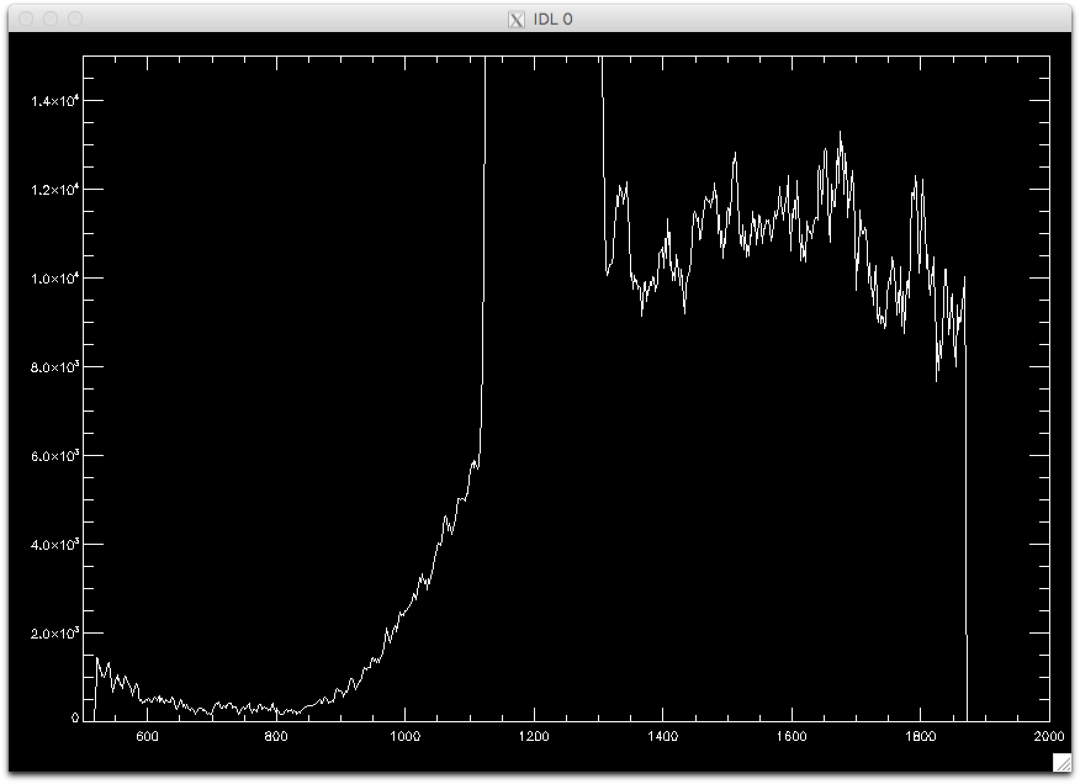
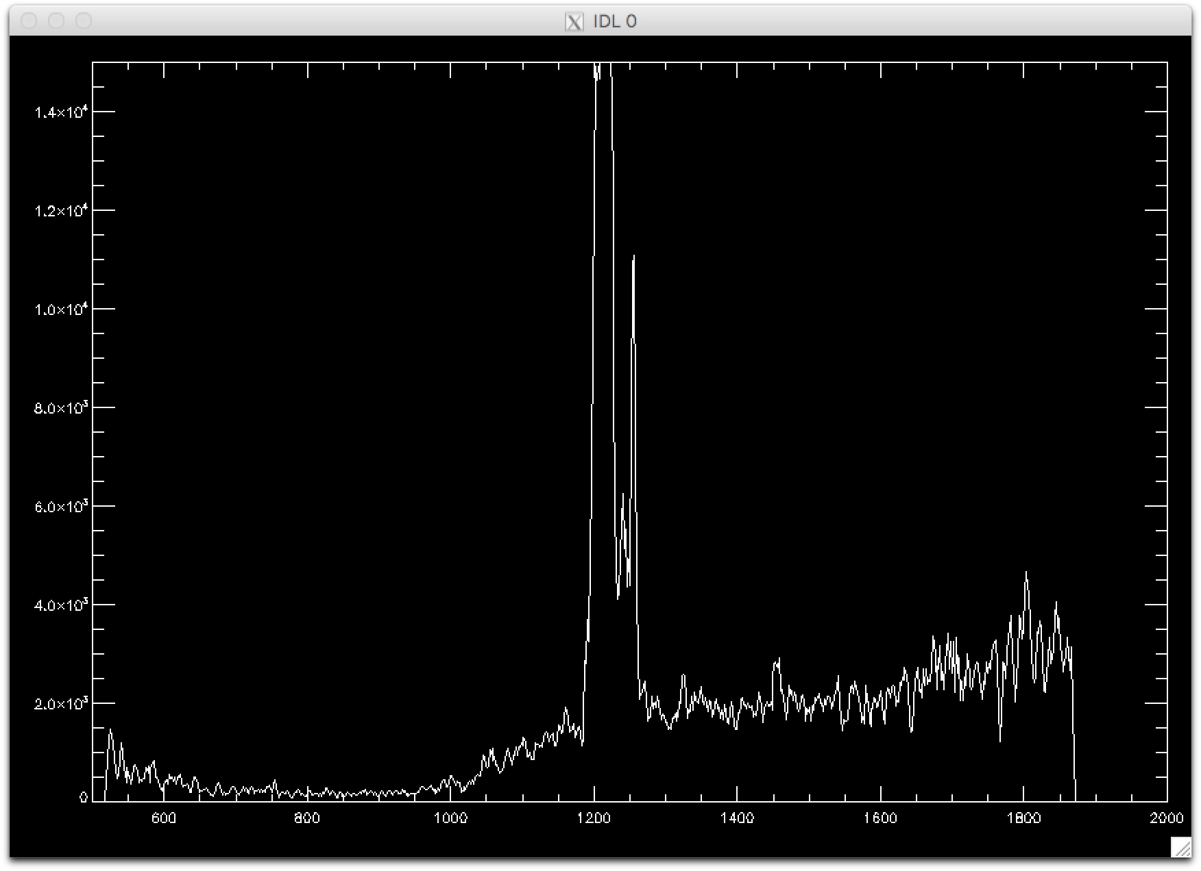
Data file with MU69 as target

