Slide 1
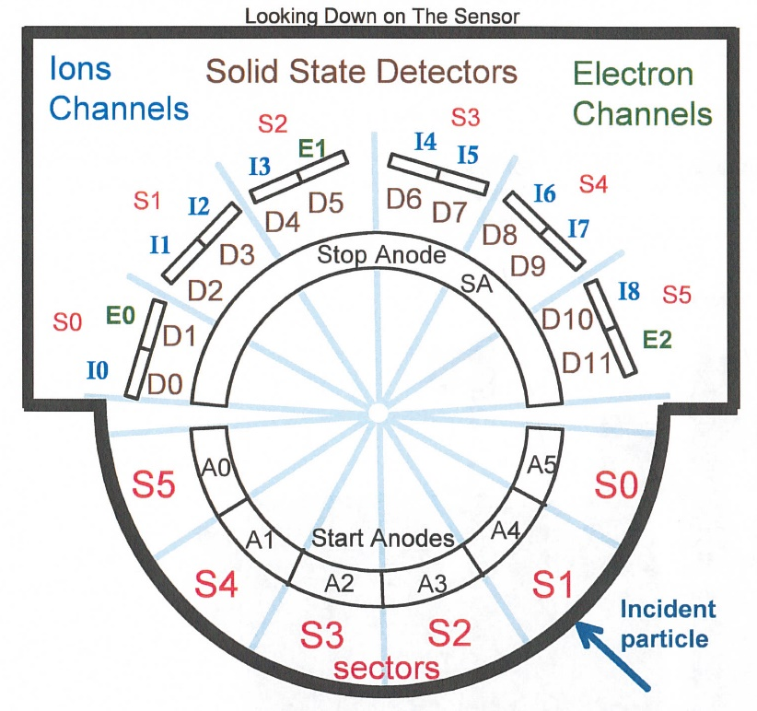
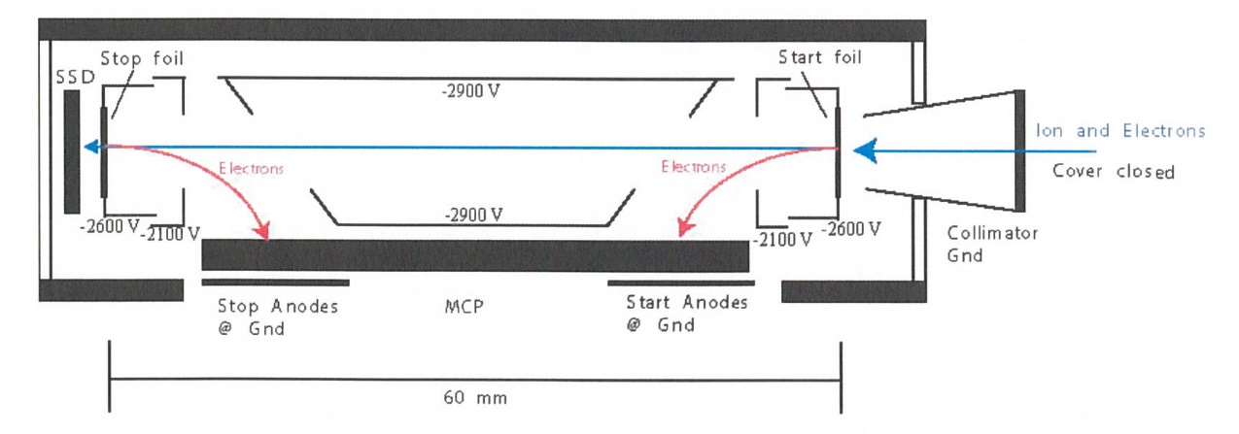
New Horizons Pluto Energetic Particle Spectrometer Science Investigation (PEPSSI)
Reviewed by S. Joy (primary)
PRINCIPAL INVESTIGATOR: Ralph McNutt, APL
DESCRIPTION: Medium Energy Particle Spectrometer
ENERGY RANGE: 25-1000 keV (protons)
60-1000 keV (atomic ions)
25-500 keV (electrons)
FIELD OF VIEW: 160 deg x 12 deg
ANGULAR RESOLUTION: 25 deg x 12 deg
ENERGY RESOLUTION: 0.25 keV
SENSOR SIZE: 7.6 cm dia. x 2.5 cm thick
POWER: 1.4 watt
MASS: 1.5 kg

Slide 2
New Horizons PEPSSI Data Sets
Data ->
nh-x-pepssi-2-kem1-v2.0
nh-x-pepssi-3-kem1-v2.0

Slide 3
New Horizons PEPSSI Data Set Evaluation Tools
All Data Processing and Evaluation -
Machine: Dell XPS 15 9560
Operating System: Windows 10

Slide 4
Comments on review procedure
The catalog, documents, and calib directories of these volumes are nearly identical, and most of their contents have been previously reviewed many times.
I have taken advantage of this fact to reduce the review effort.
I used the folder compare option in BeyondCompare 3.3.13 to compare like folders across the four volumes, and then compare files contained in the folders. Most of the time, the only variation in the directory contents or the
file therein were the file time stamps and the data_set_id’s in the label files.
Once this information was available to me, I only reviewed unique files

Slide 5
Documentation
Evaluation

Slide 6
Root level files
AAREADME No issues found VOLDESC No issues found

Slide 7
Catalog files
CATINFO.TXT – no changes required
nh_kem.cat – good
nhsc.cat – good pepssi.cat – good, previously reported spelling errors corrected, thanks! ref.cat – good
There are no differences between files that should be identical on the two volumes (pepssi.cat, ref.cat, etc.) – good, correct versions included DATASET.CAT (nh-x-pepssi-2-kem1-v2.0 and nh-x-pepssi-3-kem1-v2.0)
includes discussion of versioning - good
Within a mission phase, the -2- and -3- dataset catalogs are effectively identical with the only changes being -2- becoming -3- and Raw becoming Calibrated.
This has been true and accepted for the previous PEPSSI datasets

Slide 8
Calib files
calinfo.txt –
“rateboxdefinitionplanes.lit Label for "; read label for description”
Must be an error in the code generating this file. Should read:
“rateboxdefinitionplanes.lbl Label for rateboxdefinitionplanes.lbl;”
This problem occurs on both volumes. This issue remains from the last review.
hk_stat_input_20041016.tab (lbl) – good
hk_n1_input_20050228.tab (lbl) – good
calpars folder on -3- volumes only
calpinfo.txt – good
calpar_columns.fmt – good
pep_*_0x691_calpar.tab – ok, contents clear and self-explanatory. No corresponding .lbl file but that has been the case throughout the mission and has been previously accepted.

Slide 9
Document files
DOCINFO.TXT – good
All PDS documents (codmac_level_definitions, lunineetal1995, payload_ssr, pepssi_ssr, soc_inst_icd) are properly formatted as PDF/A and the document labels appear to be valid. Most of these document files have been reviewed many times and have not changed recently. They appear to be the latest versions of each.
nh_fov.png (.lbl) – good nh_met2utc.tab (.lbl) – complete (last entry 2020-01-05), good
nh_mission_trajectory.tab (.lbl) – complete (last entry 2019-01-31), good nh_pepssi_v110_ti.txt – good
pep_bti.tab (.lbl) – probably complete (last entry 2019-01-12), good
quat_axyz_instr_to_j2k.asc (.lbl) – good
seq_pepssi_kem1.tab (.lbl) – good, complete (last entry 2019-01-30)

Slide 10
Data
Evaluation

Slide 11
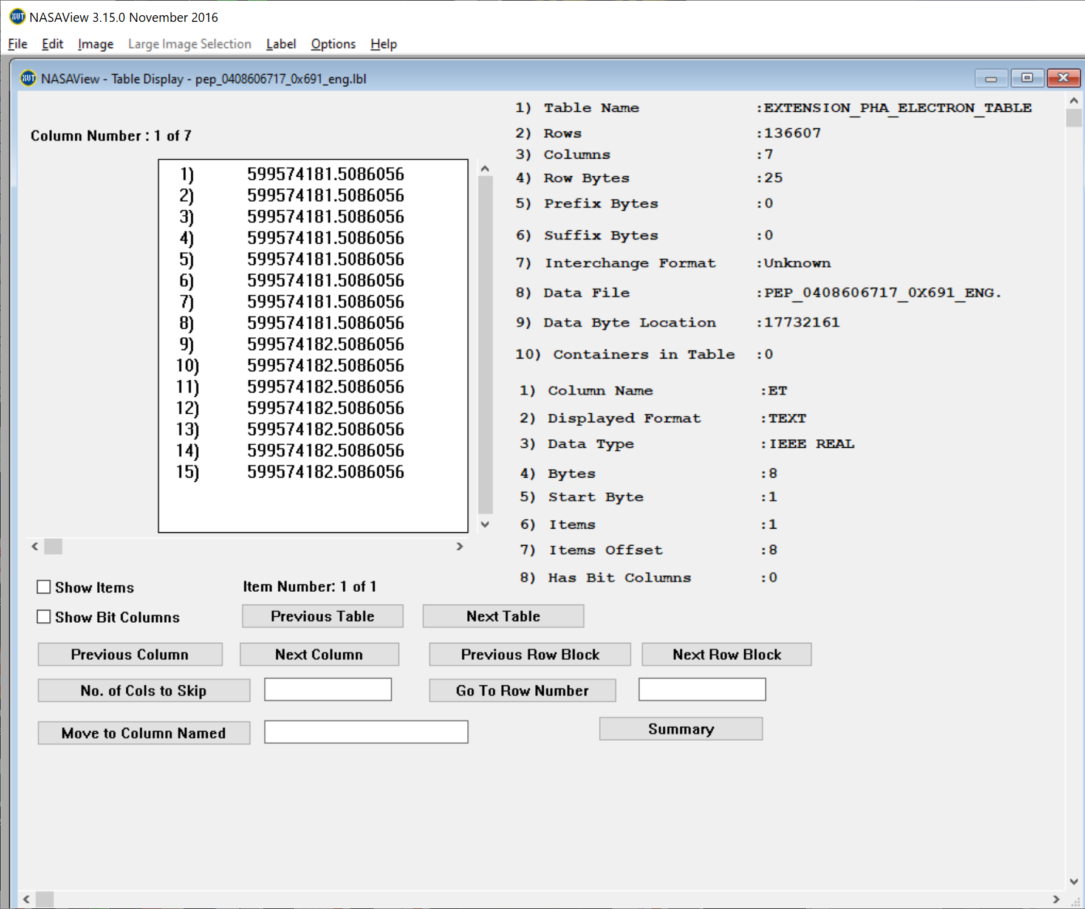
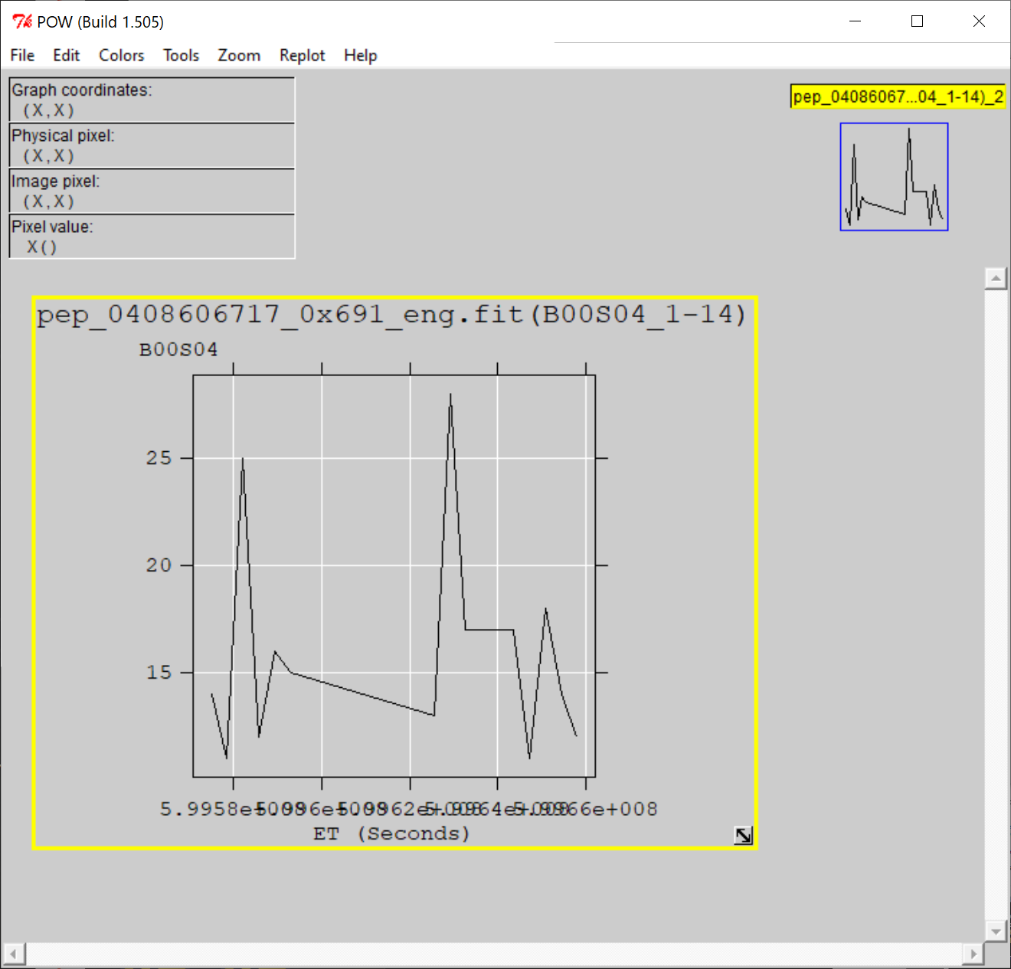
nh-x-pepssi-2-kem1-2.0
Files open with both NASAVIEW and FV suggesting that the PDS and FITS labels are well-formed.
All of the files selected for spot inspection appeared nominal.
All tables and columns accessible in NASAVIEW, listings look as expected
FV allow the user to plot data from any table versus time (MET or ET) and the plots look nominal

Slide 12
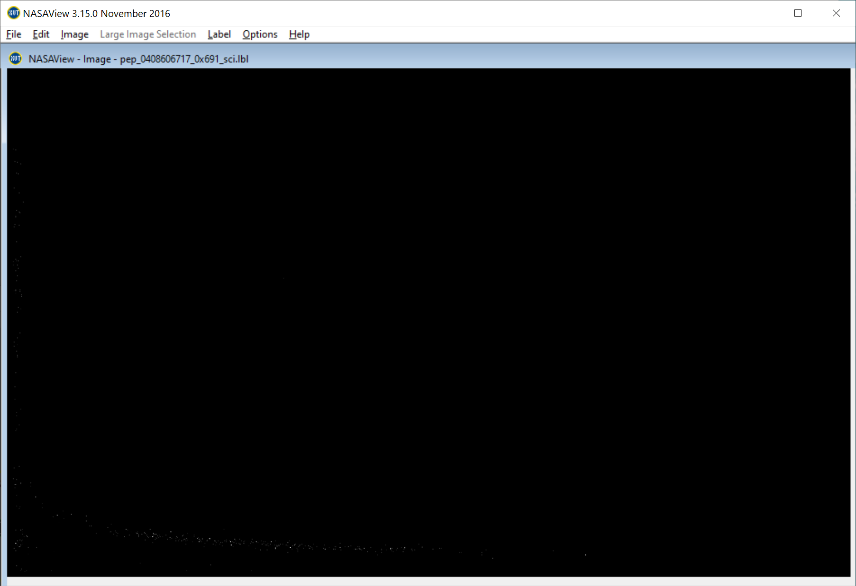
nh-x-pepssi-3-kem1-v2.0
Files open with both NASAVIEW and FV suggesting that the PDS and FITS labels are well-formed.
All of the files selected for spot inspection appeared nominal. NASAView has some display issues with these data/labels
FV allow the user to plot data from any table versus time (MET or ET) and the plots look nominal
NASAVIEW won’t allow users to navigate past the first image in the file – known s/w problem
Low Ions from Jan 1, 2019 (FV)
Weak TOF vs Energy signal matches similar PHA result from FV for this data file

Slide 13
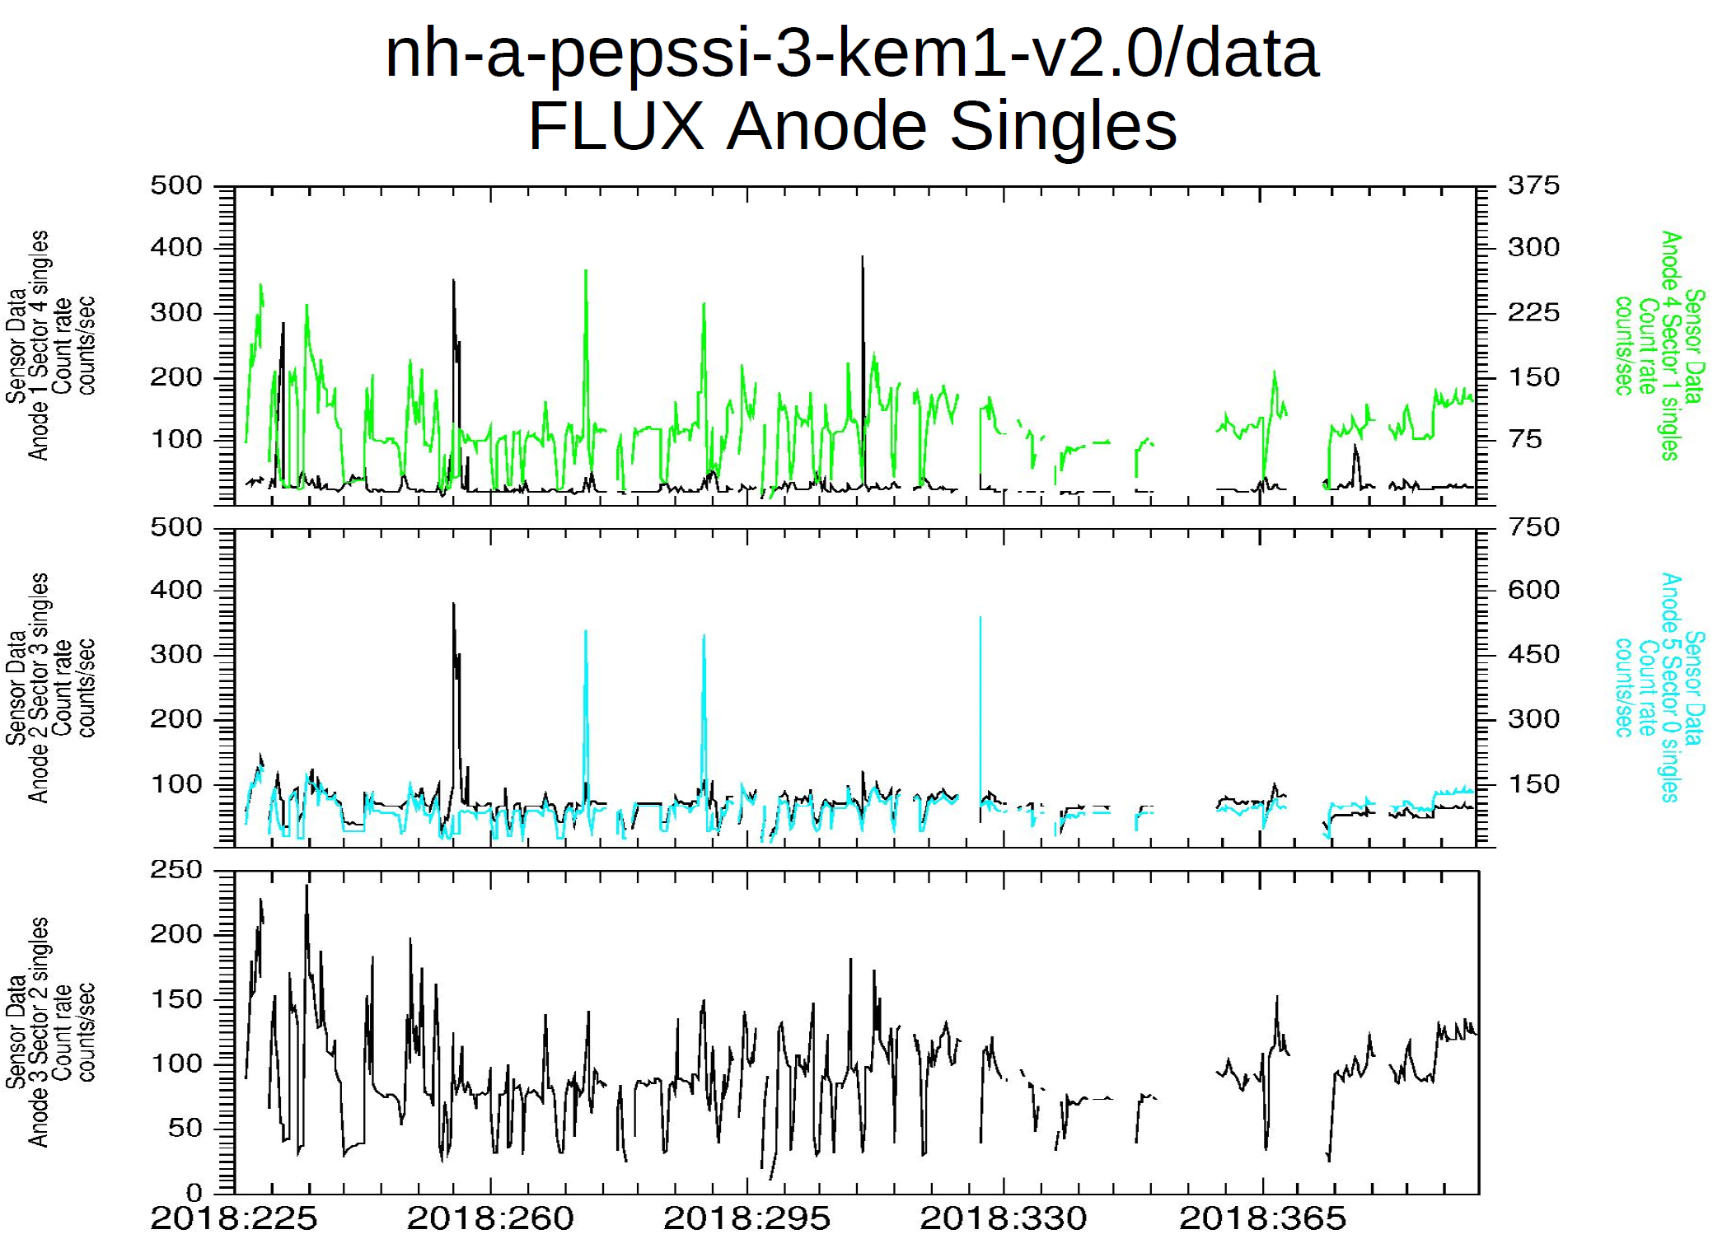
Plot courtesy of R. Frahm
Plot shows that the flux data are nominal, but that there is a drop in the continuity beginning late in 2018 in all selected sectors/anodes – these are likely data gaps, not poor observing geometry giving zero counts.

Slide 14
Summary of Liens
In general, the documentation is a bit sparse, particularly the dataset.cat files which are generic, not specific to the datasets. This is just a comment and there is no associated lien, however, should the team decide to update the -3- dataset.cat file,
it would improve the archive.
Liens:
Correct the minor issue with the calinfo.txt files (rateboxdefinitionplanes)
Strong Recommendations:
1) Add a little more detail to the “Version” section of the dataset.cat files that explains what data were acquired in the KEM1 phase that were not returned in time to be included in this version of the dataset. A lot of the data from Oct or Nov 2018 to the end of Jan 2019 are missing. It’s not clear how much of this data was acquired but not downlinked in time versus data that were acquired in an unusable geometry.
2) Somewhere in the documentation (nh_kem.cat, maybe elsewhere) the details of the timing and geometry of closest approach should be defined (user shouldn’t have to go to Google). Similarly, there should be some mention of “common names” including Ultima Thule and Arrokoth.
The data files appear to be nominal and the documentation and supporting files are mostly complete. These data can be certified with minor liens.

