Slide 1
New Horizons LEISA PDS Review
Adam McKay

Slide 2
MU69!

Slide 3
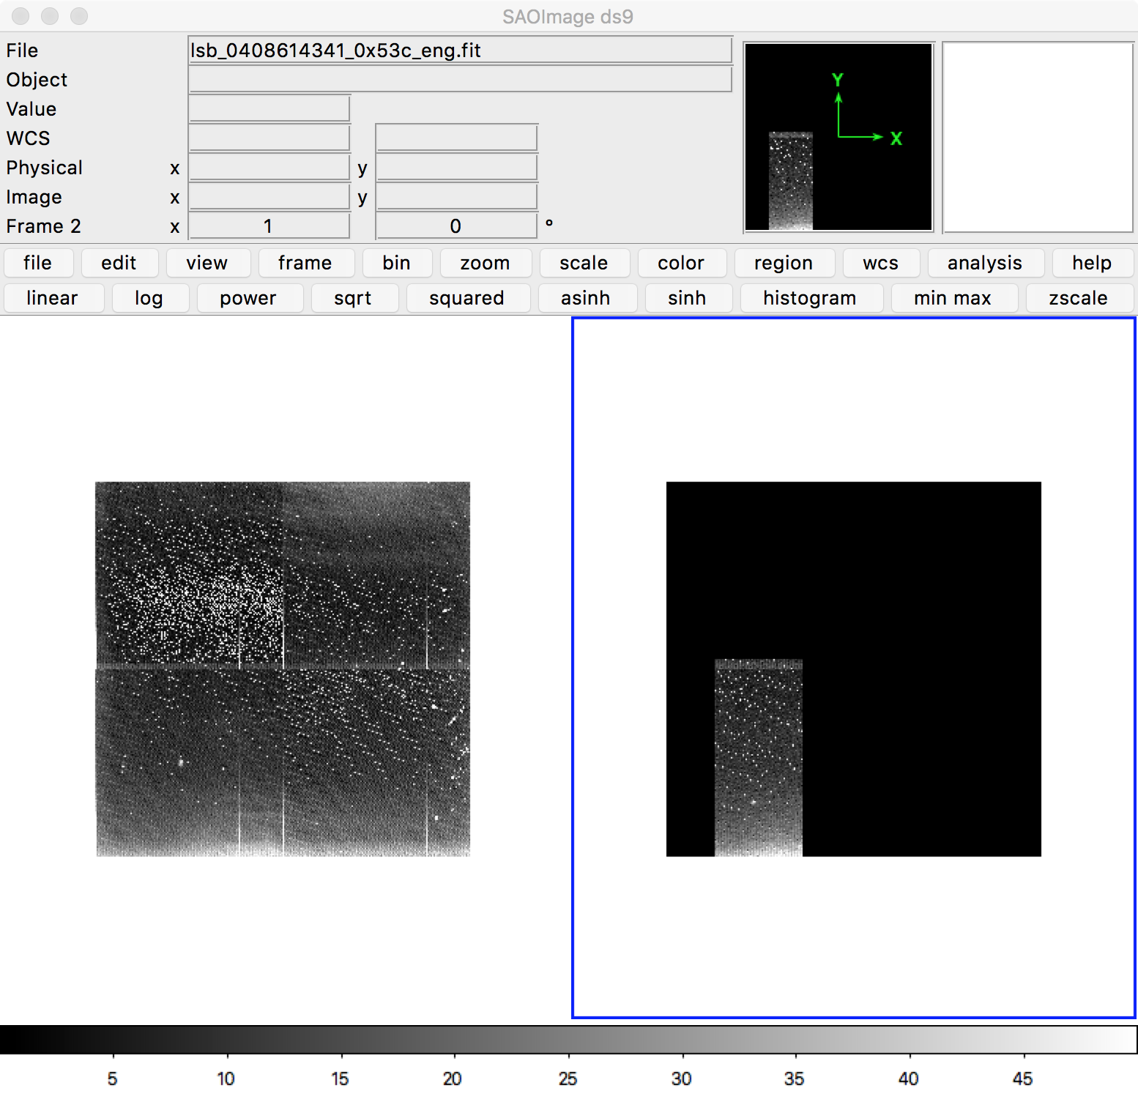
Issues (?)
lsb_0408619338_0x53c_eng.fit looks different from others, although it clearly contains data

Slide 4
Issues (?)

