Slide 1
New Horizons Long Range Reconnaissance Imager (LORRI) Data Review
Reviewer: Xiao-Duan Zou
Planetary Science Institute
02/2020 @UMD

Slide 2
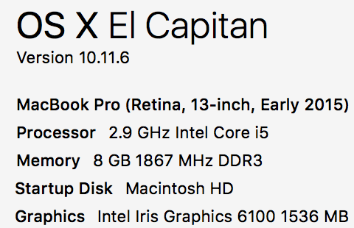
LORRI Dataset Overview
All processing and evaluation:
Data PDS version: PDS3
2 data sets:
nh-x-lorri-2-kem1-v2.0 (total: 2119 images, 1028x1024 or 257x256)
nh-x-lorri-3-kem1-v2.0 (total: 2119 images, 1024x1024 or 256x256)
Level:
Level 2
Level 3
Mission phases:
KEM1 v2.0 New
Difference from v1.0:
with Jan 01 flyby data
2014 MU69 in lorri-3-kem1

Slide 3
Review Process
Compare difference from V1.0 sets with tools:
FileMerge 2.9.3
Beyond Compare 4.3.3
Read all .fit and label files (all can be read correctly).
Check the headers and labels
Compare catalog files in all datasets, and analyze the difference
Check all catalog files
Read documents in document/directory
Collect aspect data from all image headers, check consistency between levels

Slide 4
DATA
All .fit files can be read by readfits.pro and readpds
images can be read and shown correctly
Also readable with DS9 and Astropy

Slide 5
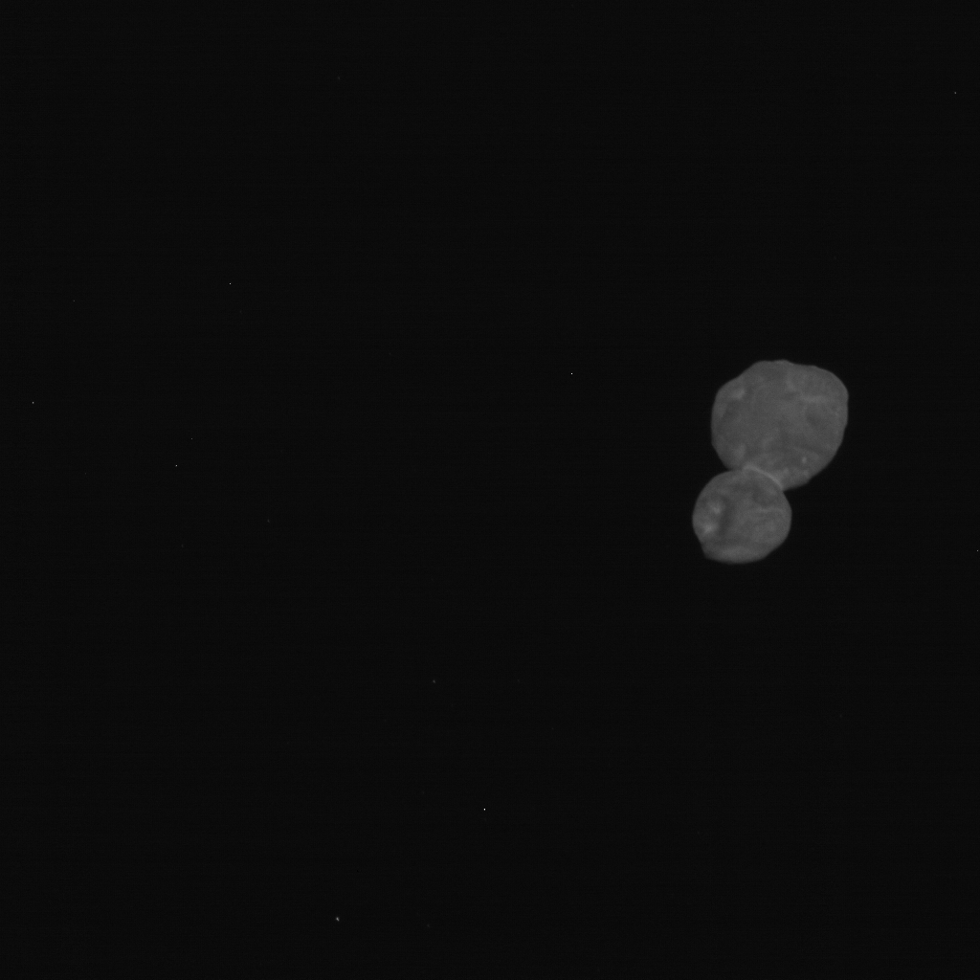
Images generally look good
20190101_040862/lor_0408624684_0x630_sci.fit

Slide 6
20190101_040862/lor_0408624684_0x630_sci.fit
20190101_040862/
lor_0408624612_0x630_sci.fit

Slide 7
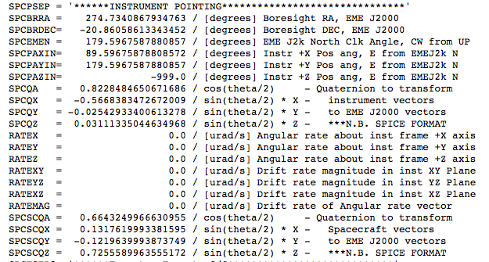
Image header
Header: MET_HK = -999

Slide 8
Catalog/Document/Index
Identical in all datasets:
nh_kem.cat, nhsc.cat, lorri.cat, ref.cat
Double checked a few items from last review of v1.0 data: (All GOOD)
units description added in lorri.cat
add the imaged DKBOs list to the “data set overview” of KEM1 in dataset.cat
Most difference from previous version are the version and date changes.
No issues found

