Slide 1
PDS-SBN Review of New Horizons LEISA Data (2014 MU₆₉ Approach)
M. DiSanti
27 February 2020

Slide 2

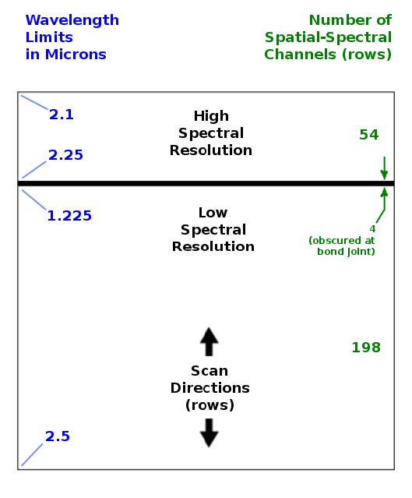
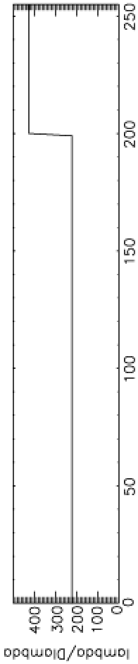

LEISA
A near-IR (1.2 – 2.5 micron) spectrometer that uses a 256x256 Rockwell PICNIC array, with 40-micron square pixels.
It produces low-resolution (λ/Δλ ~ 240) and higher-resolution (λ/Δλ ~ 540) spectra over separate sections (ranges of 54 and 199 rows) that are separated by 4 rows obscured by a bond joint.
Note: “Hi-res” λ/Δλ was ~ 425 for Pluto flyby data,
but is ~ 540 for cruise & 2014 MU₆₉ approach phases

Slide 3
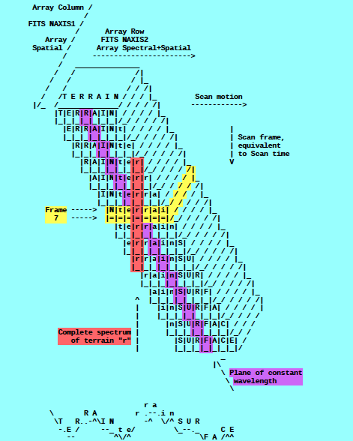
A spatial-spectral data cube is created by scanning the FOV across the target in a “push-broom” fashion. The data cube is a 3-dimensional array having 256x256xN elements, where N is the number of 256x256 files accumulated over the scan.
e.g., read in calibrated FITS file = ‘nh-p-leisa-3-pluto-v2.0/data/20150714_029917/lsb_0299172889_0x53c_sci.fit’
file = file(x,y,z),
x=spatial (256 elements),
y=lambda(256 elements),
z=spectral/spatial
(N=elements; e.g., N=371)
(i.e., lambda varies spatially)
[figure from ‘leisa_data.pdf’ in
folder ‘document’]

Slide 4
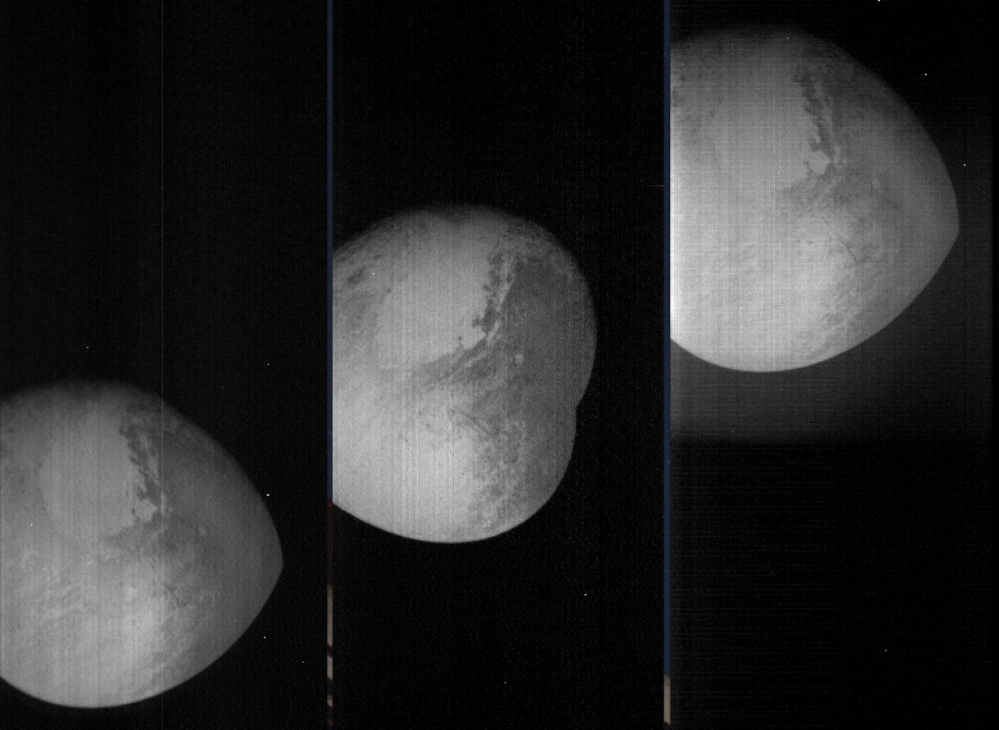
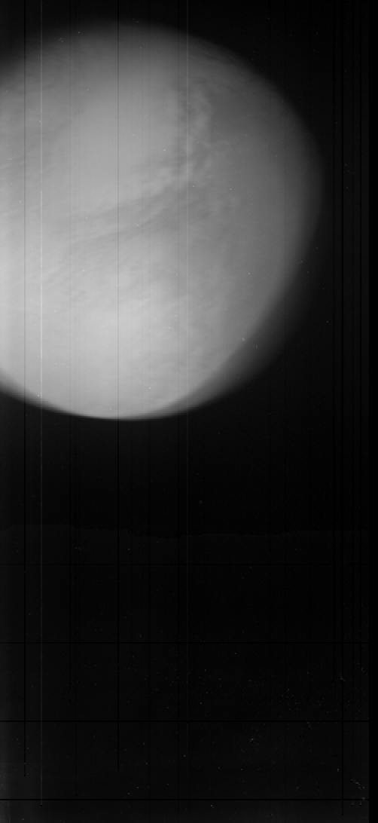
LEISA Pluto flyby Data
Transpose file(x,y,z) [256,256,N] → file_tr(x,z,y) [256,N,256]
→
shift -
register
file(0:255,0:N-1,0)
file(0:255,0:N-1,127)
file(0:255,0:N-1,255)
file_tr_sh(0:255,0:N-1,Σ[0:255])
(i.e., over all lambda)
(Some residual wobble in x-dim)

Slide 5
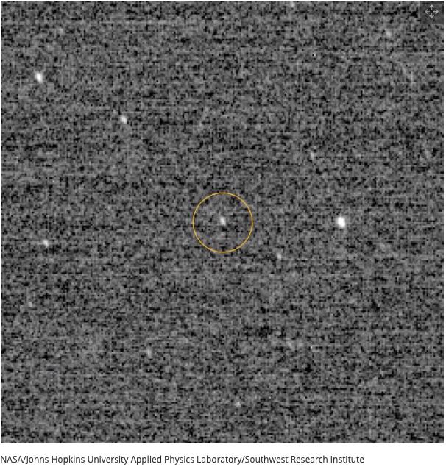
2014 MU₆₉ Approach
“First Look” at MU69, at
d~10⁶ km (with LORRI)

Slide 6
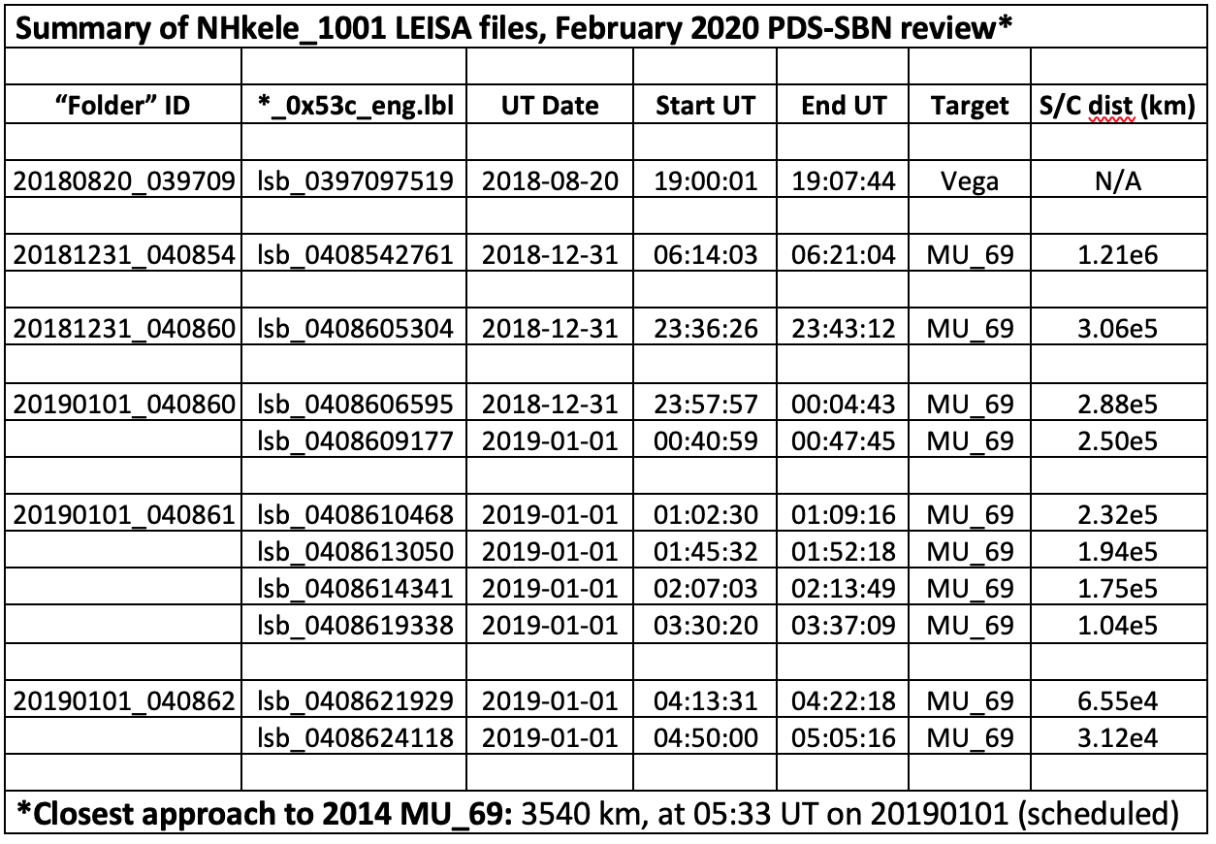
LEISA MU₆₉ Approach DATA

Slide 7
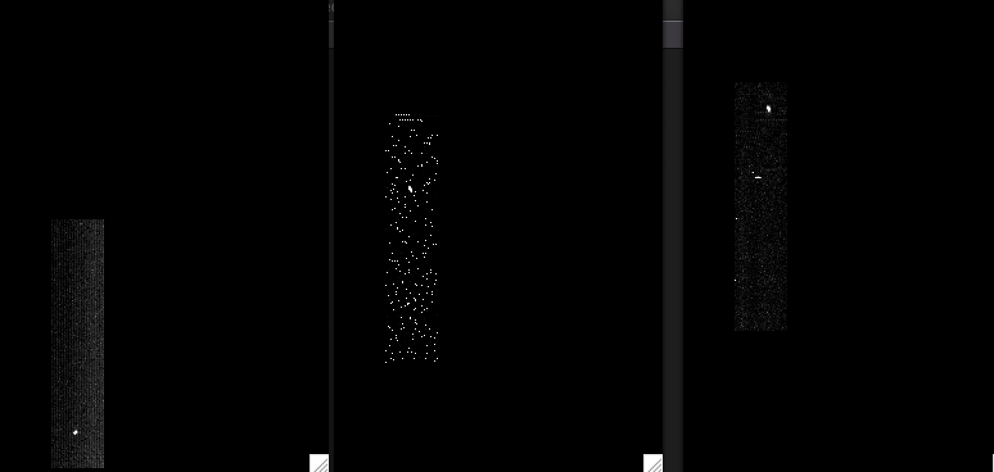
LEISA CRUISE DATA (20aug2018)
/data/20180820_039709/lsb_0397097519_0x53c_eng.fit (Alpha Lyrae)
Channel 9 (2.4088 μm)
Channel 194 (1.2384 μm)
Channel 250 (2.1038 μm)
|<-------------------------------------------------------------------------------->|
Low-res (λ/Δλ ~ 243)
High-res (λ/Δλ ~ 542)
(Spatially unregistered)

Slide 8
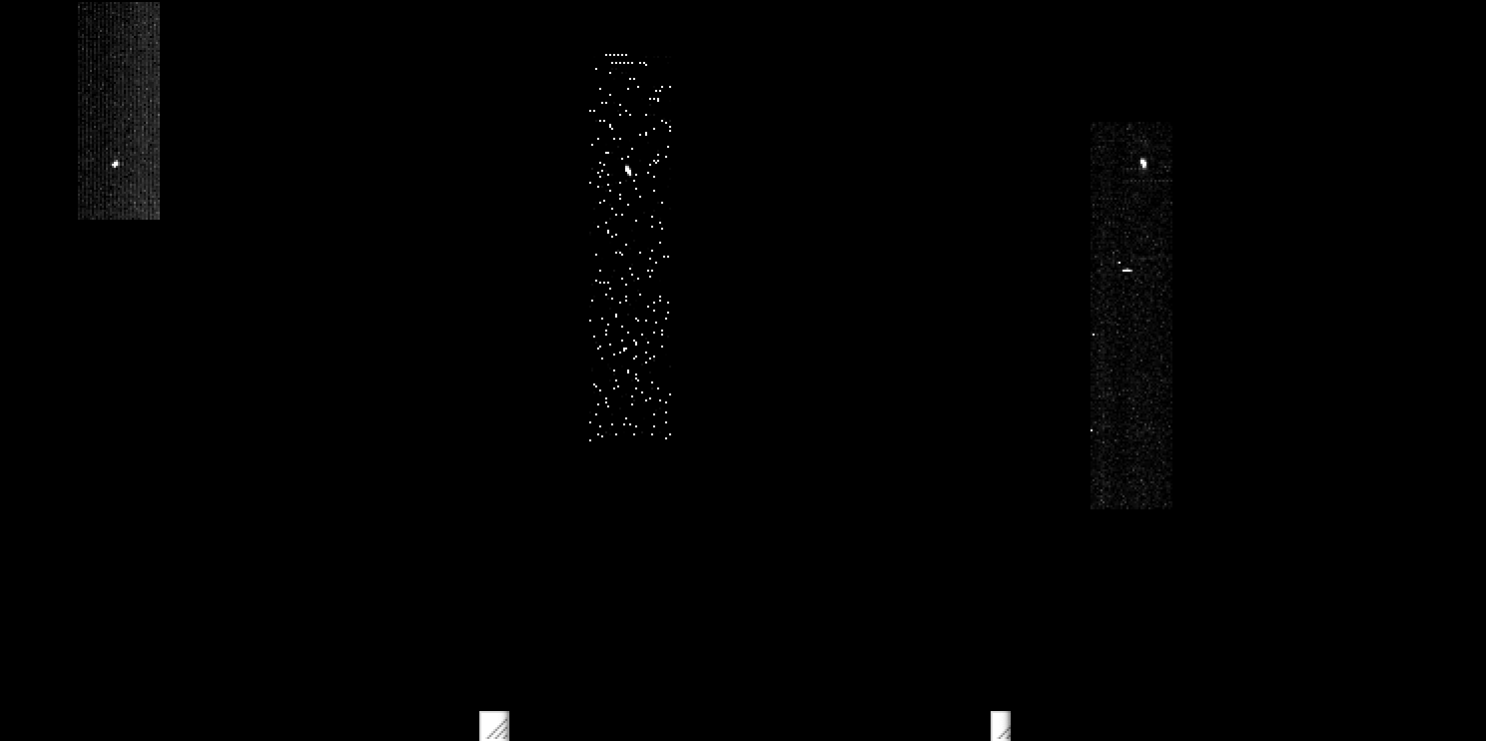
LEISA CRUISE DATA (20aug2018)
/data/20180820_039709/lsb_0397097519_0x53c_eng.fit (Alpha Lyrae)
Channel 9 (2.4088 μm)
Channel 194 (1.2384 μm)
Channel 250 (2.1038 μm)
|<-------------------------------------------------------------------------------->|
Low-res (λ/Δλ ~ 243)
High-res (λ/Δλ ~ 542)
(Spatially registered)

Slide 9
LEISA CRUISE DATA (20aug2018)
/data/20180820_039709/lsb_0397097519_0x53c_eng.fit (Alpha Lyrae)
Channel 9 (2.4088 μm)
Channel 194 (1.2384 μm)
Channel 250 (2.1038 μm)
|<-------------------------------------------------------------------------------->|
Low-res (λ/Δλ ~ 243)
High-res (λ/Δλ ~ 542)
(Spatially registered)

Slide 10
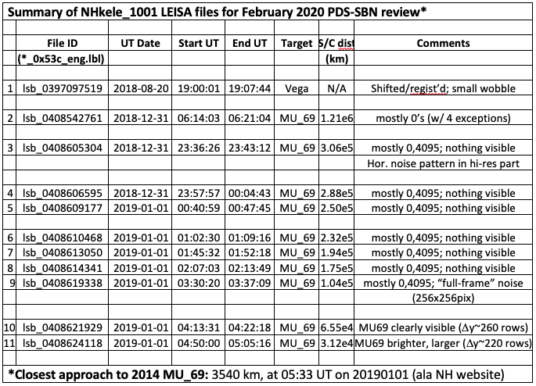
LEISA MU₆₉ Approach

Slide 11
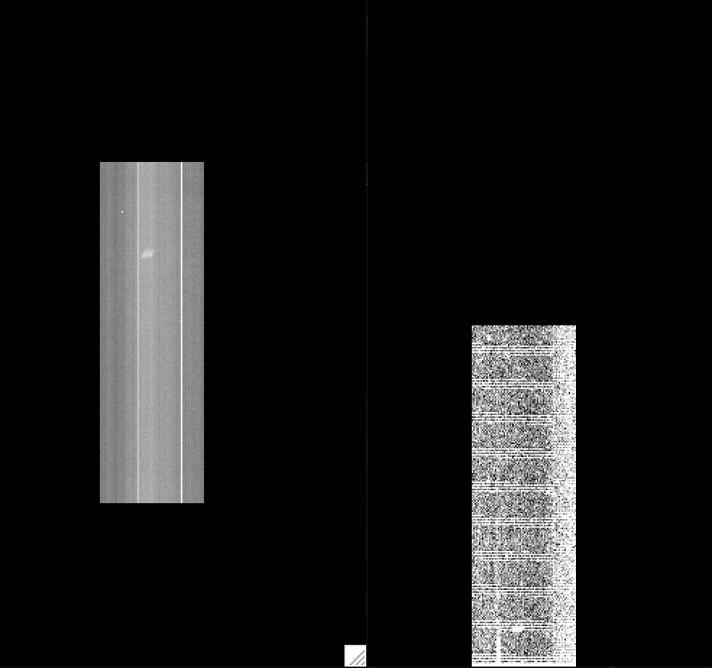
LEISA approaching MU69 (01jan2019)
/data/20190101_040862/lsb_0408621929_0x53c_eng.fit (04:14 - 04:22 UT), 65.5e3 km
Channel 0 (2.4842 μm, low_res)
Channel 255 (2.0895 μm, high_res)
Start: peak row=285 →
←End: peak row = 26
(Spatially unregistered)

Slide 12
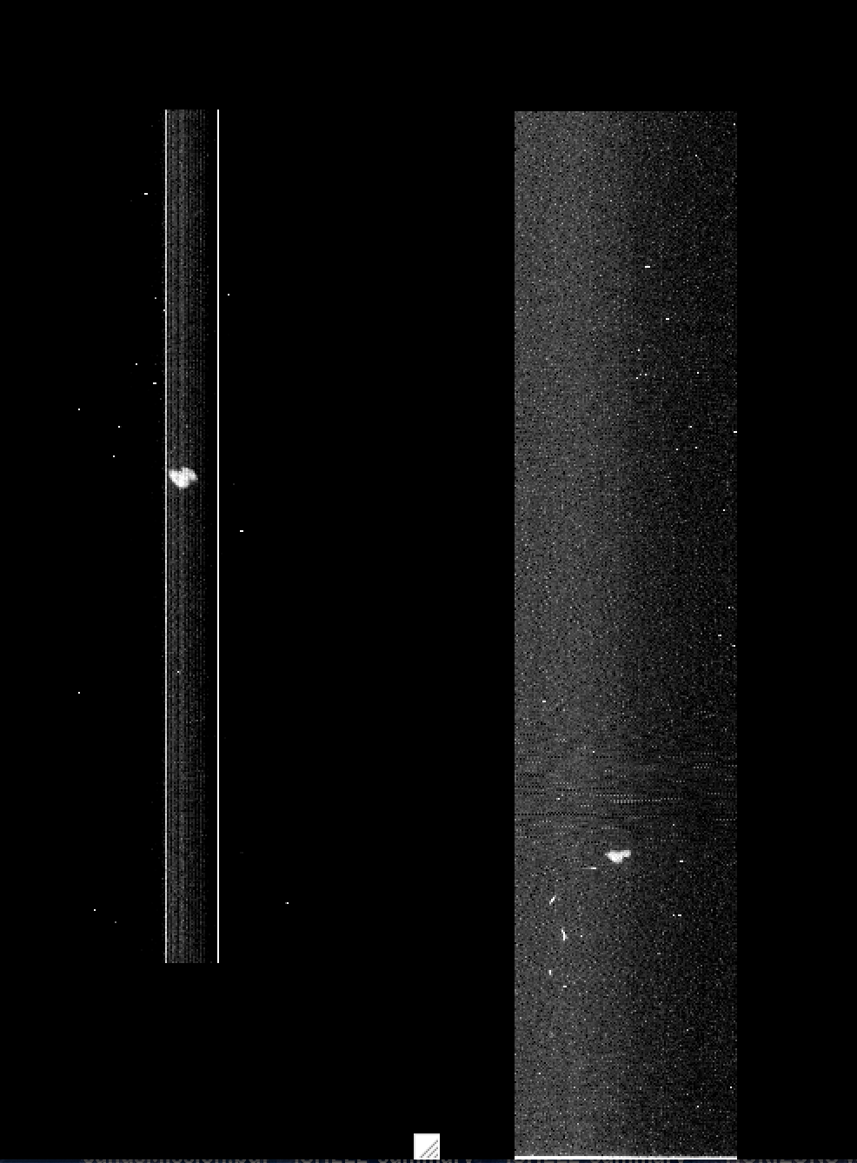
LEISA approaching MU69 (01jan2019)
/data/20190101_040862/lsb_0408624418_0x53c_eng.fit (04:50 – 05:05 UT), 31.2e3 km
Channel 1 (2.4744 μm, low_res)
Channel 255 (2.0895 μm, high_res)
Start: peak row=392 →
←End: peak row = 173
(Spatially unregistered)

Slide 13
Summary/Suggestions
Leisa frames read in fine.
lambda 2.5-1.225um (rows0 thru 199, low res), 2.25-2.10um (rows204 thru 255, hi res)
Asteroid 2014 MU69 is clearly detected at 65e3 and 31e3 km, but not visible previously
While Vega scan direction is as expected (target moved upward through lambda), MU69 scan direction is reversed (target moved downward through lambda).
(Is this due to S/C roll? Is there a key word indicator in the .lbl file?)
Spatial Registration
Both Vega and MU69 data show some “wobble” in the x-direction, more so for Vega, less so for MU69.
Difficult to extract Vega spectrum, due to spatial smearing.
Will be less important for MU69, especially toward closest flyby approach of ~3500 km.
Owing to the reversal in scan direction for MU69, the algorithm to register MU69 data toward closest approach needs revision. Certainly feasible though as downward drift rate appears constant, as expected.
Definitely, looking forward to MU69 flyby data!

