Slide 1
PDS-SBN Review of New Horizons LEISA Data (2014 MU₆₉ Approach)
M. DiSanti
28 May 2020

Slide 2
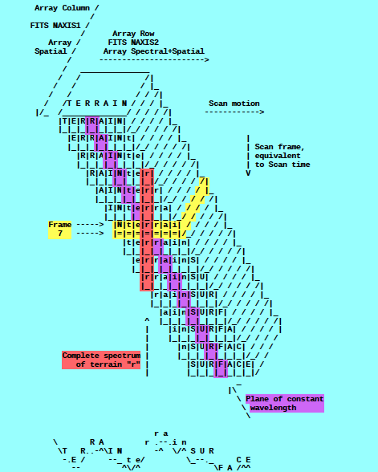
A spatial-spectral data cube is created by scanning the FOV across the target in a “push-broom” fashion. The data cube is a 3-dimensional array having 256x256xN elements, where N is the number of 256x256 files accumulated over the scan.
e.g., read in calibrated FITS file = ‘nh-p-leisa-3-pluto-v2.0/data/20150714_029917/lsb_0299172889_0x53c_sci.fit’
file = file(x,y,z),
x=spatial (256 elements),
y=lambda(256 elements),
z=spectral/spatial
(N=elements; e.g., N=371)
(i.e., lambda varies spatially)
[figure from ‘leisa_data.pdf’ in
folder ‘document’]

Slide 3

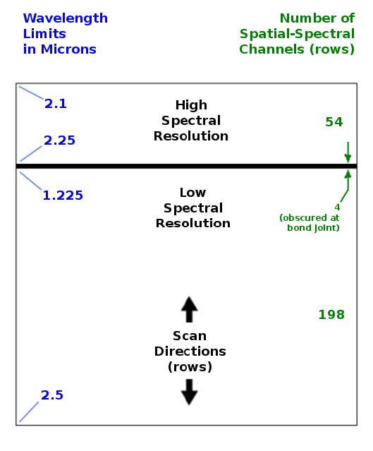
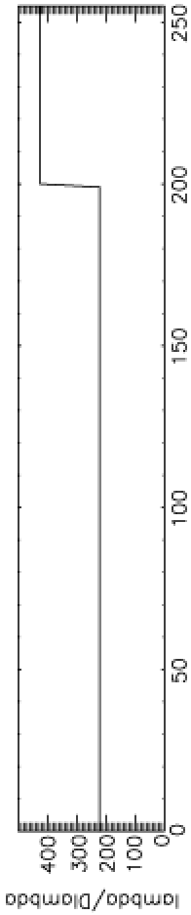

LEISA
A near-IR (1.2 – 2.5 micron) spectrometer that uses a 256x256 Rockwell PICNIC array, with 40-micron square pixels.
It produces low-resolution (λ/Δλ ~ 240) and higher-resolution (λ/Δλ ~ 540) spectra over separate sections (ranges of 54 and 199 rows) that are separated by 4 rows obscured by a bond joint.
Note: “Hi-res” λ/Δλ was ~ 425 for Pluto flyby data (as below) but is ~ 540 for cruise & 2014 MU₆₉ approach phases (recalibration)

Slide 4
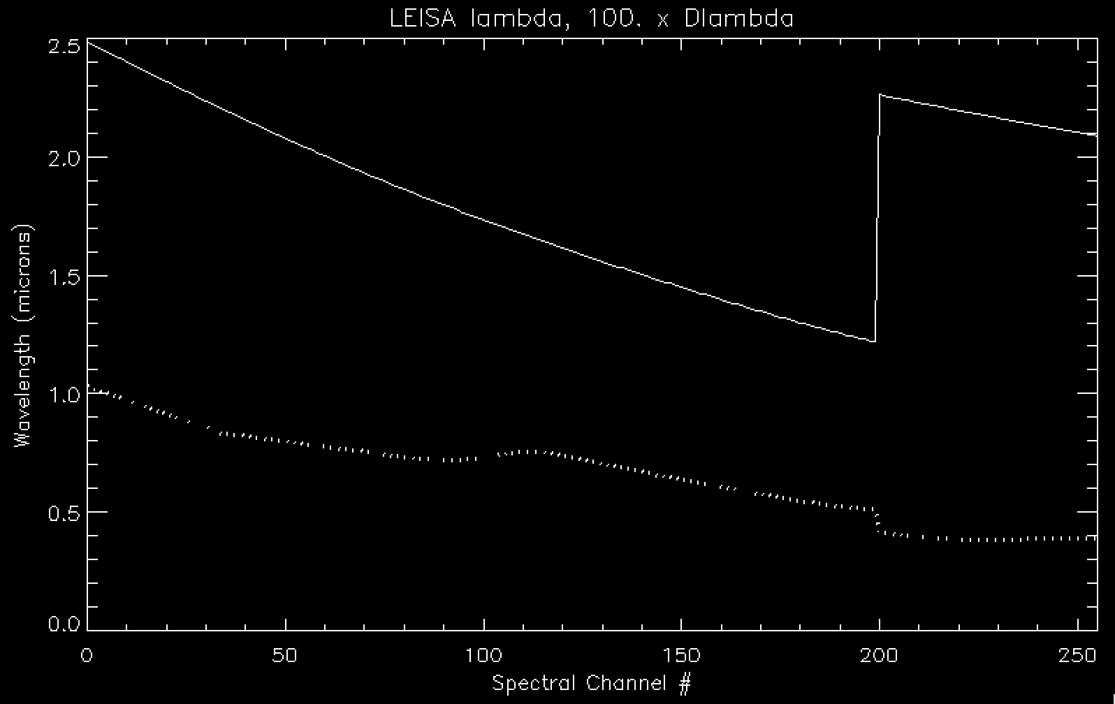
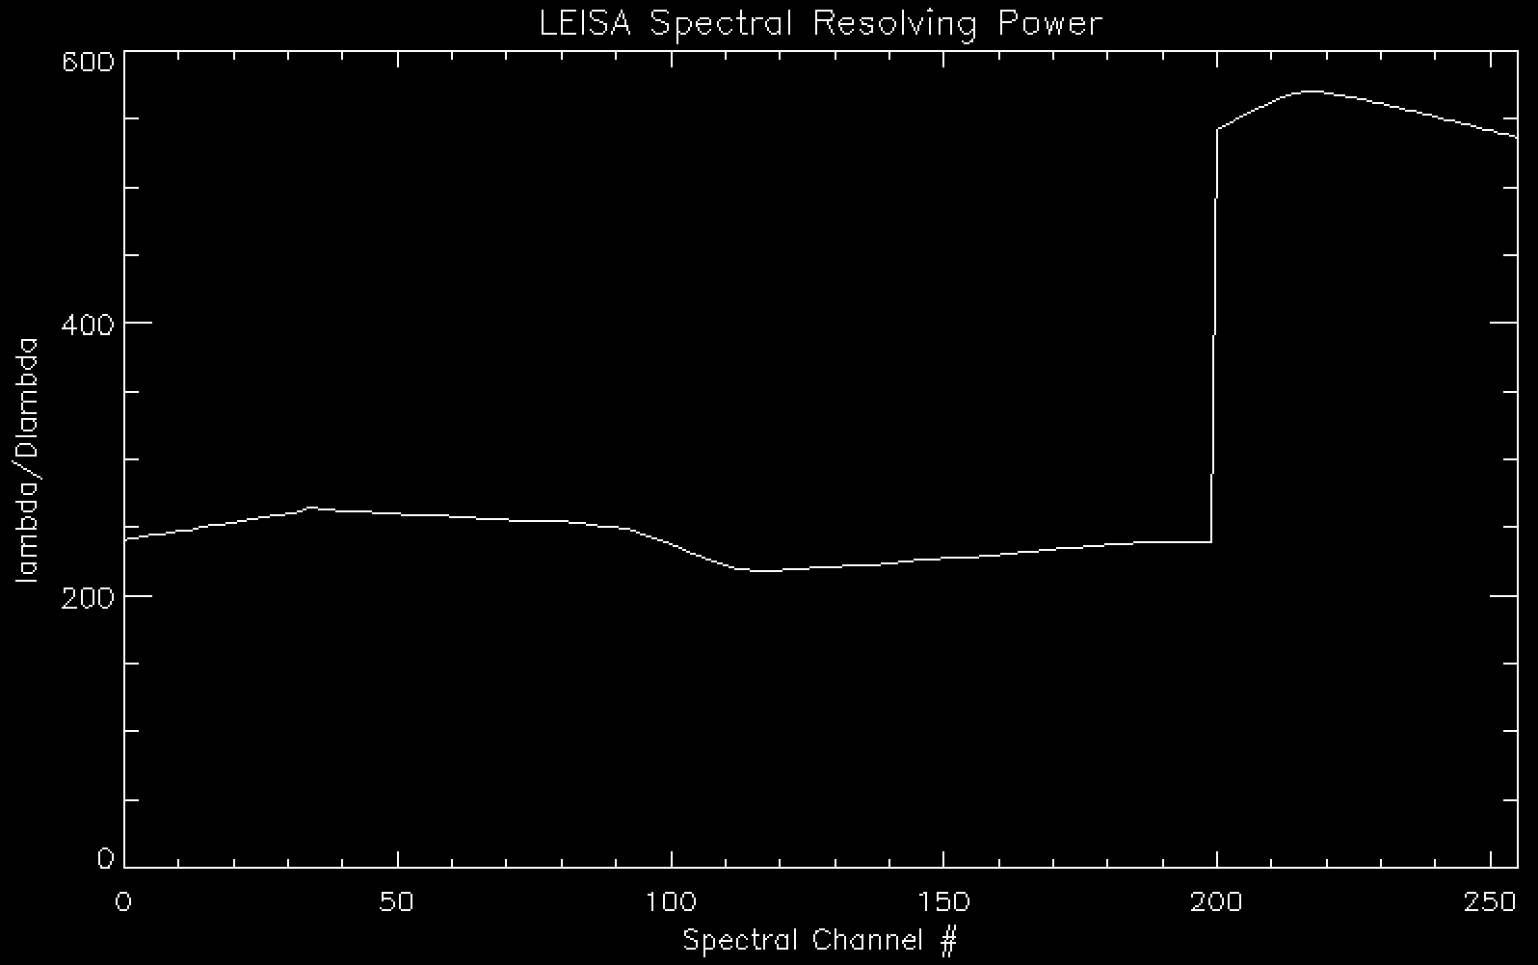
LEISA Wavelength Calibration
lambda
Delta-lambda x 100
Lambda / Delta-lambda

Slide 5
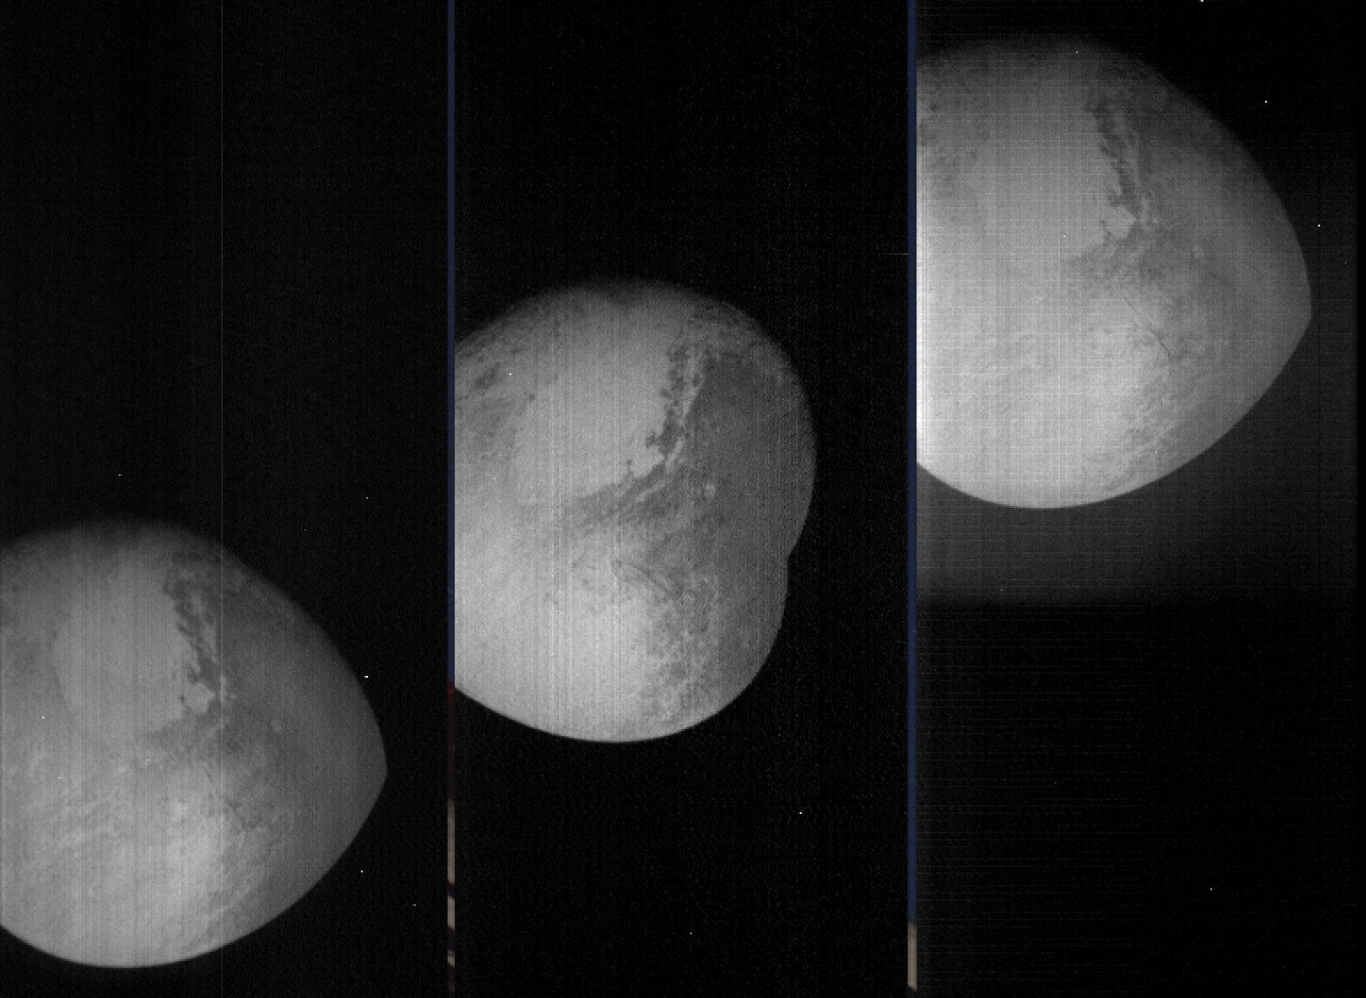
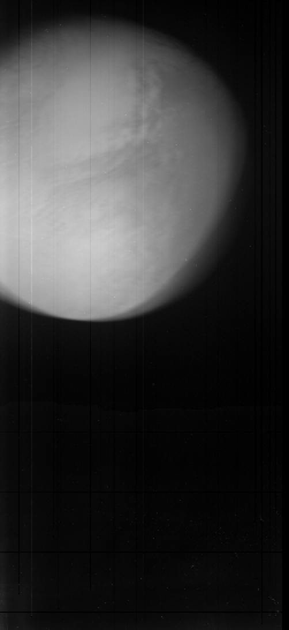
LEISA Pluto flyby Data
Transpose file(x,y,z) [256,256,N] → file_tr(x,z,y) [256,N,256]
→
shift -
register
file(0:255,0:N-1,0)
file(0:255,0:N-1,127)
file(0:255,0:N-1,255)
file_tr_sh(0:255,0:N-1,Σ[0:255])
(i.e., summed over all lambdas)
(Some residual wobble in x-dim)

Slide 6
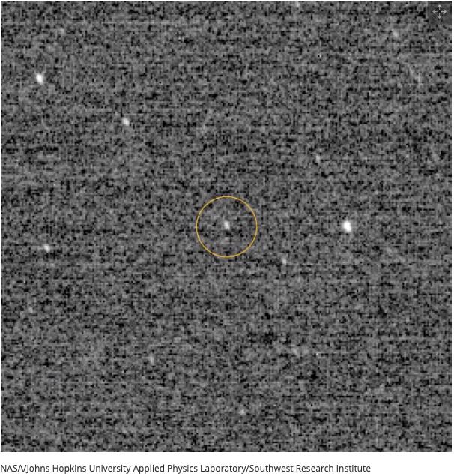
Arrokoth (2014 MU₆₉) Approach
“First Look” at MU69, at
d~10⁶ km (with LORRI)

Slide 7
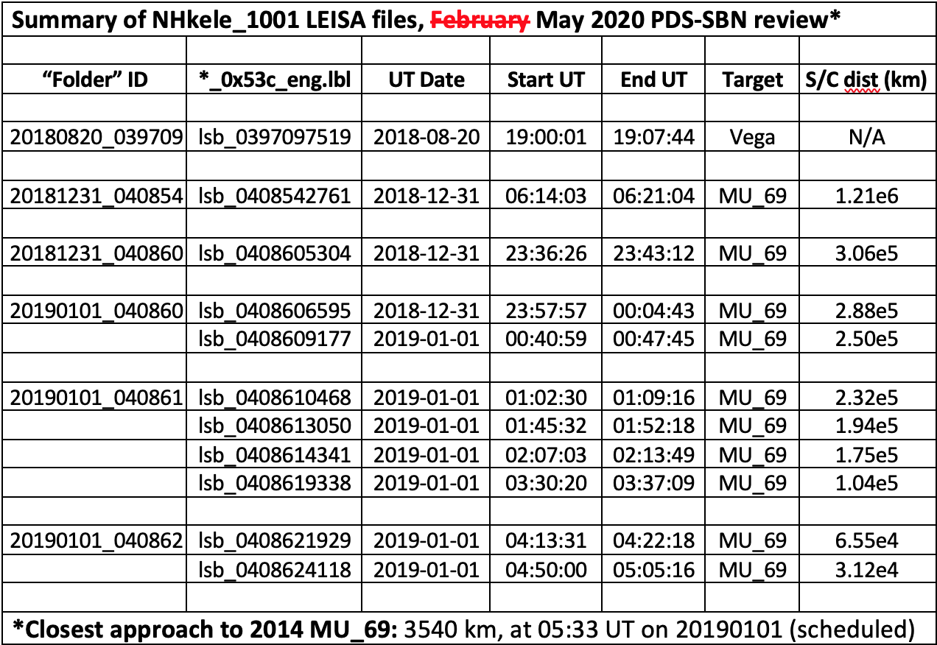
LEISA MU₆₉ Approach DATA

Slide 8
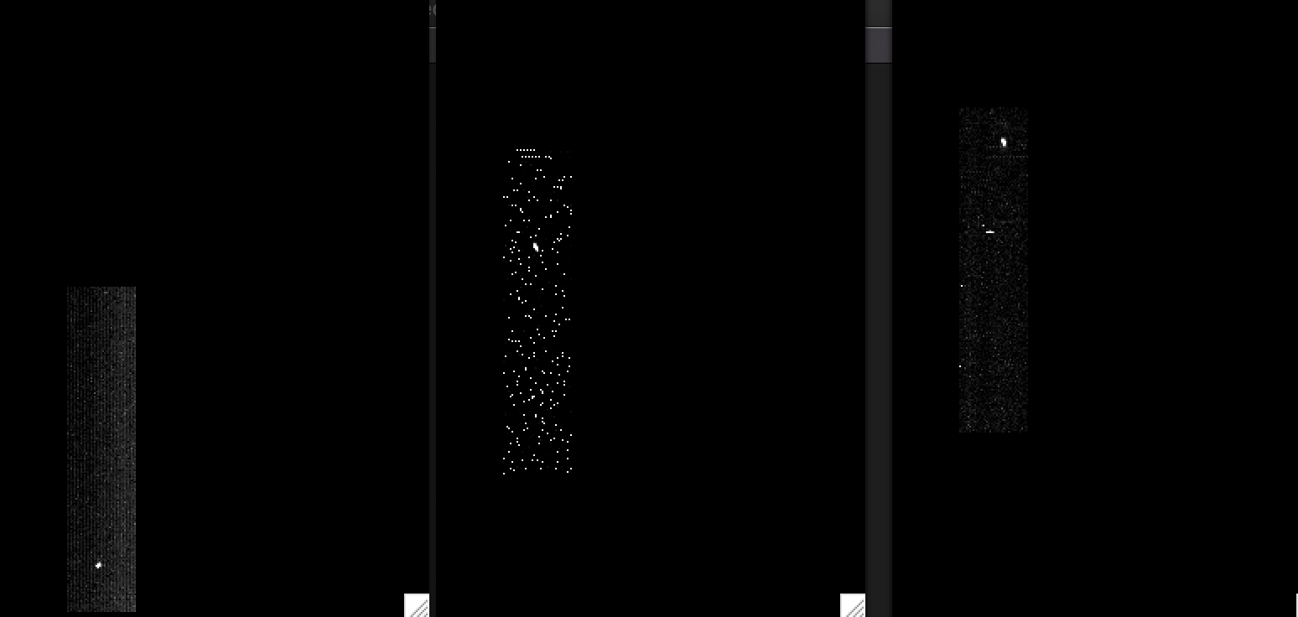
LEISA CRUISE DATA (20aug2018)
/data/20180820_039709/lsb_0397097519_0x53c_eng.fit (Alpha Lyrae)
Channel 9 (2.4088 μm)
Channel 194 (1.2384 μm)
Channel 250 (2.1038 μm)
|<-------------------------------------------------------------------------------->|
Low-res (λ/Δλ ~ 243)
High-res (λ/Δλ ~ 542)
(Spatially unregistered)

Slide 9
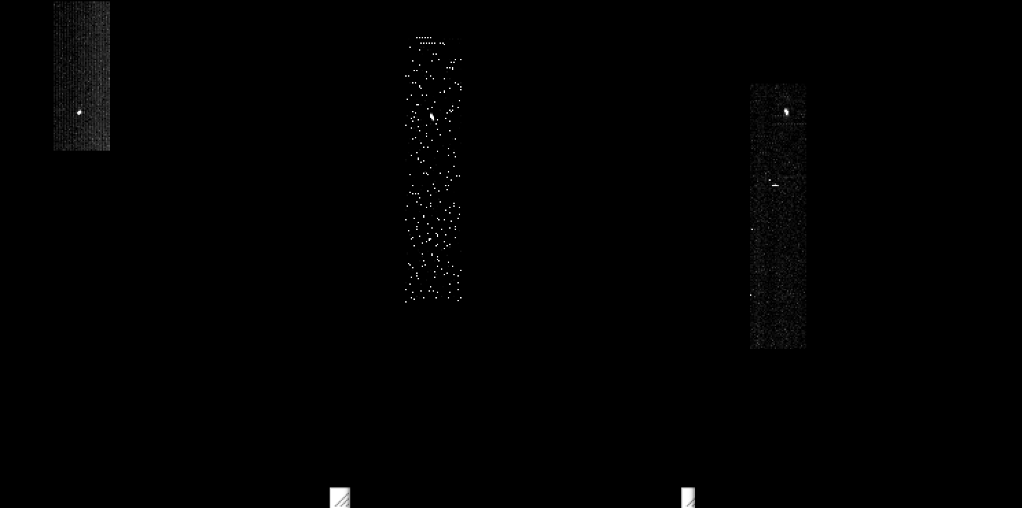
LEISA CRUISE DATA (20aug2018)
/data/20180820_039709/lsb_0397097519_0x53c_eng.fit (Alpha Lyrae)
Channel 9 (2.4088 μm)
Channel 194 (1.2384 μm)
Channel 250 (2.1038 μm)
|<-------------------------------------------------------------------------------->|
Low-res (λ/Δλ ~ 243)
High-res (λ/Δλ ~ 542)
(Spatially registered)

Slide 10
LEISA CRUISE DATA (20aug2018)
/data/20180820_039709/lsb_0397097519_0x53c_eng.fit (Alpha Lyrae)
Channel 9 (2.4088 μm)
Channel 194 (1.2384 μm)
Channel 250 (2.1038 μm)
|<-------------------------------------------------------------------------------->|
Low-res (λ/Δλ ~ 243)
High-res (λ/Δλ ~ 542)
(Spatially registered)

Slide 11
LEISA MU₆₉ Approach

Slide 12
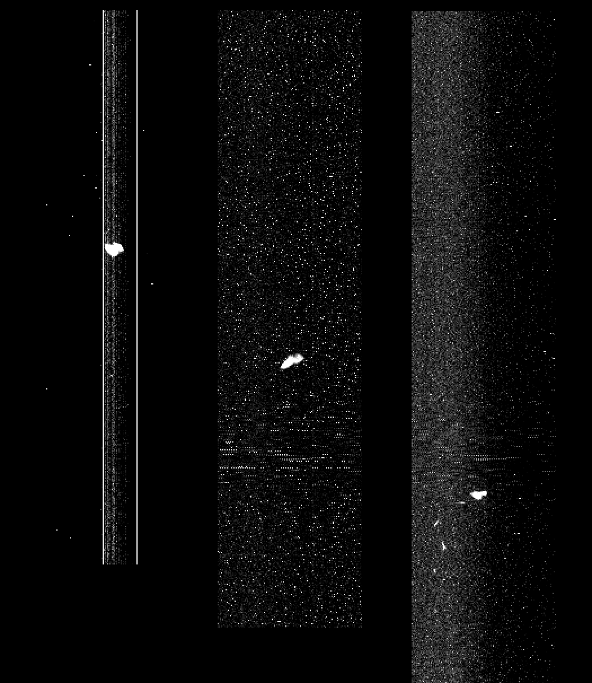
LEISA approaching MU69 (01jan2019)
lsb_0408624418_0x53c_eng.fit (04:50 – 05:05 UT), <d> = 31.2e3 km
Ch1
(low_res2.4744 μm)
Ch127
(low_res1.5748 μm)
Ch255
(high_res2.0895 μm)
Spatially
Unregistered
(Raw)
Start: row392 →
Mid: row290 →
←End: row173
Subtract median
at each step in λ

Slide 13
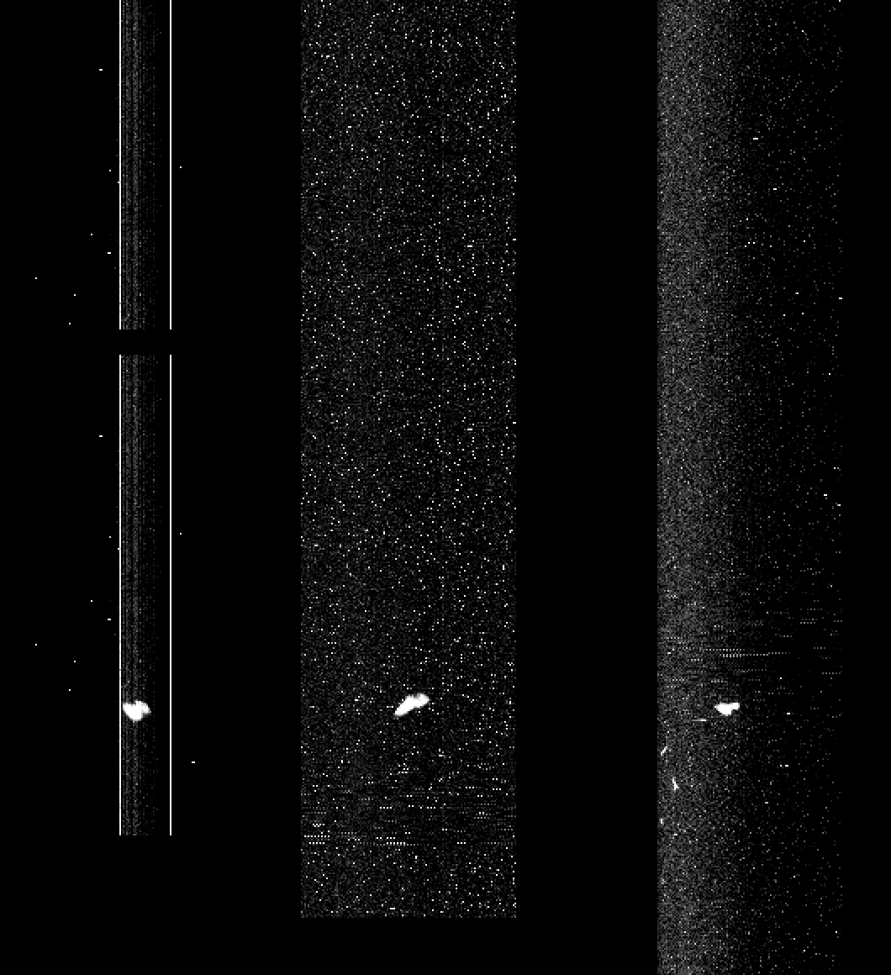
LEISA approaching MU69 (01jan2019)
lsb_0408624418_0x53c_eng.fit (04:50 – 05:05 UT), <d> = 31.2e3 km
Ch1
(low_res2.4744 μm)
Ch127
(low_res1. μm)
Ch255
(high_res2.0895 μm)
Spatially
Registered
(Raw)
Start: row392 →
Mid: row290 →
← Row173

Slide 14
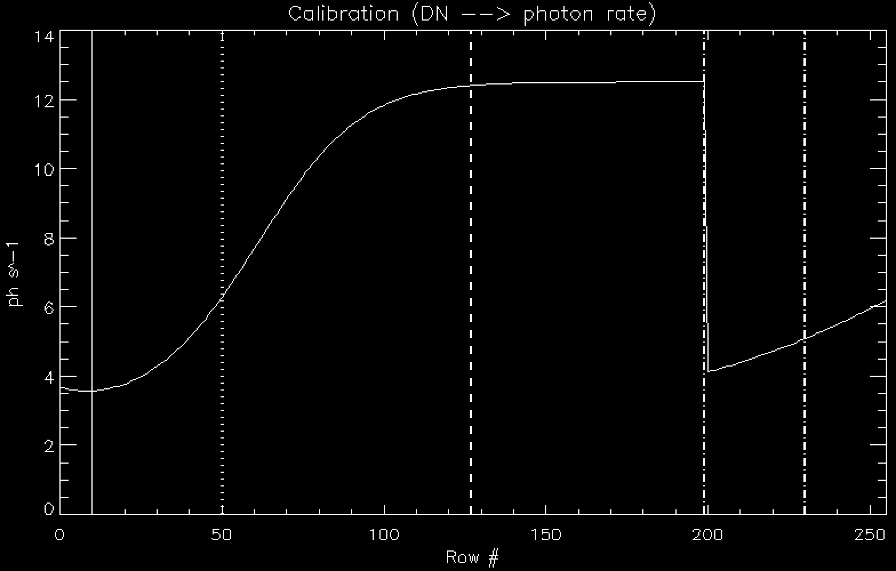
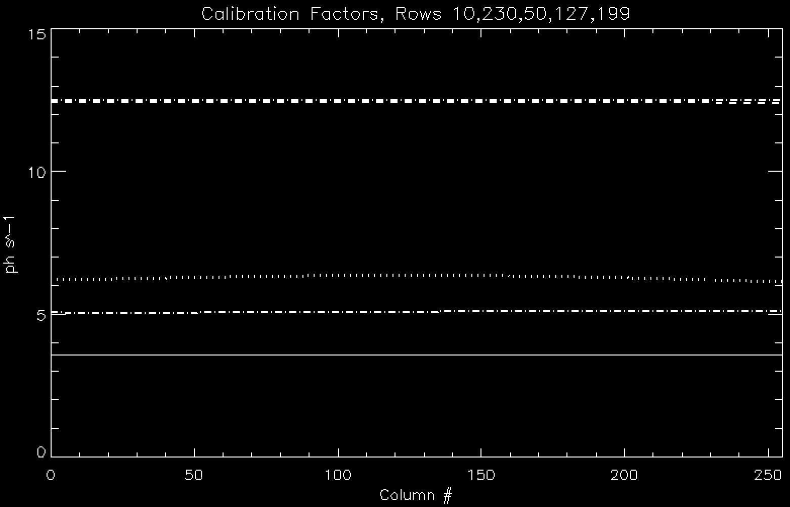
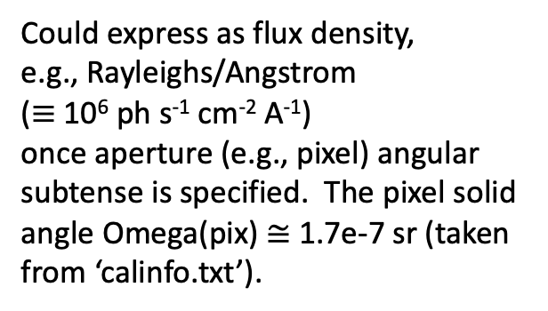
LEISA Intensity Calibration
Could express as flux density,
e.g., Rayleighs/Angstrom
($≡$10⁶ ph s⁻¹ cm⁻² A⁻¹)
once aperture (e.g., pixel) angular subtense is specified. The pixel solid angle Omega(pix) $≅$ 1.7e-7 sr (taken from ‘calinfo.txt’).
←
Row199
Row127
←Row50
←Row230
←Row10

Slide 15
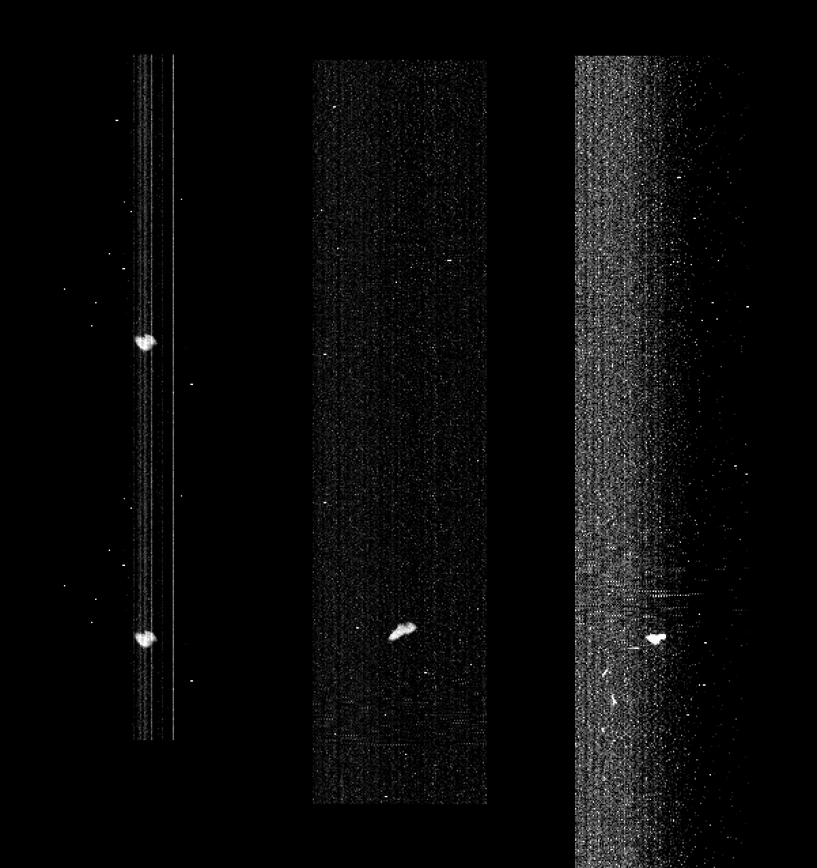
LEISA approaching MU69 (01jan2019)
lsb_0408624418_0x53c_eng.fit (04:50 – 05:05 UT), <d> = 31.2e3 km
Ch1
(low_res2.4744 μm)
Ch127
(low_res1. μm)
Ch255
(high_res2.0895 μm)
Spatially
Registered
(Calibrated)
Start: row392 →
Mid: row290 →
← Row173

Slide 16
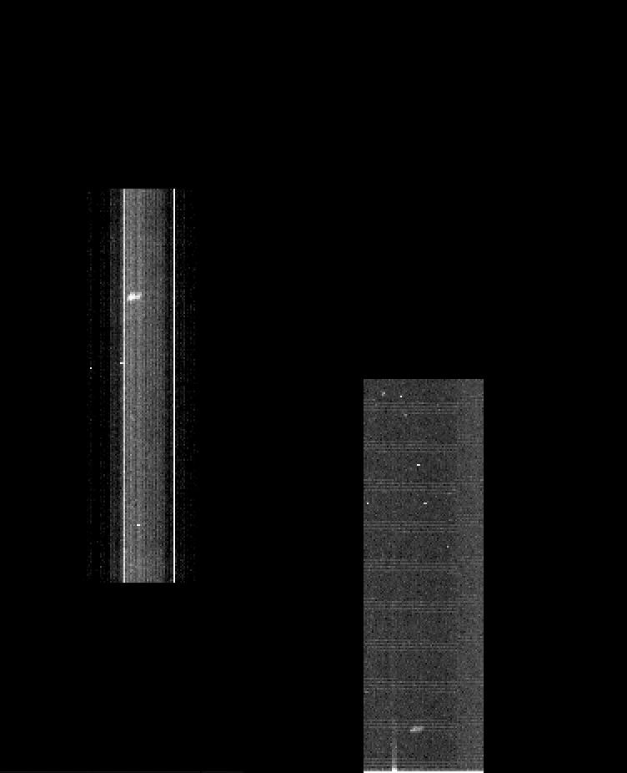
LEISA approaching MU69 (01jan2019)
/data/20190101_040862/lsb_0408621929_0x53c_eng.fit (04:14 - 04:22 UT), 65.5e3 km
Ch1
(low_res2.4842 μm)
Ch255
(high_res2.0895 μm)
Start: peak row=285 →
←End: peak row = 26
(Spatially unregistered)

Slide 17
Summary/Suggestions
LEISA frames read in fine, for both raw and calibrated) data.
lambda 2.5-1.225um (rows0 thru 199, low res), 2.25-2.10um (rows204 thru 255, hi res).
Asteroid Arrokoth (2014 MU₆₉) is clearly detected at 65e3 and 31e3 km, but tough to see at 102e3km.
While Vega scan direction is “as expected” (target moved upward through lambda, as w/ Pluto scans), MU₆₉ scan direction is reversed (target moved downward through lambda). In each case it was ~1 row per step in λ.
(Question: Is this due to S/C roll? If so, is there a keyword indicator in the .lbl files?)
Spatial Registration
Both Vega and MU₆₉ data show some “wobble” in the x-direction, more so for Vega, less so for MU₆₉.
Difficult to extract spectra for Vega or MU₆₉, due to spatial smearing (not so critical for Pluto).
Should be less important for MU₆₉, near closest flyby approach of ~3500 km.
Owing to the reversal in scan direction for MU₆₉, the algorithm to register MU₆₉ data toward closest approach was revised; downward drift rate seems constant, as expected.
Typo in “calinfo.txt’, “I is the **intergration** time, seconds.”
Looking forward to seeing the actual MU₆₉ flyby data.

