Slide 1
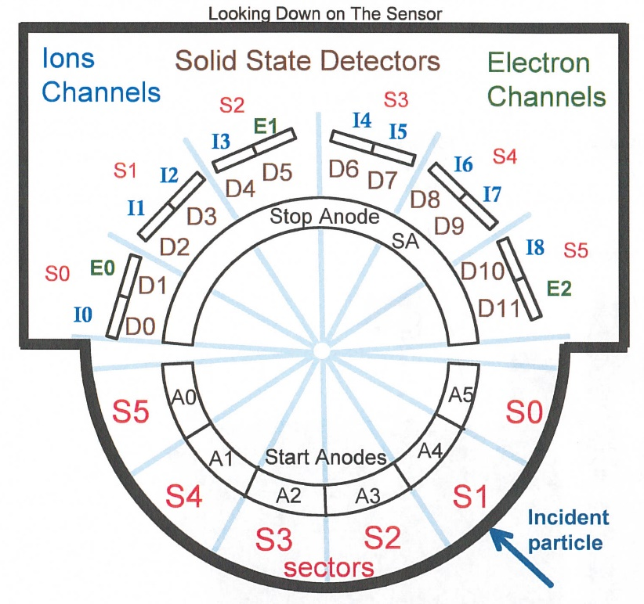
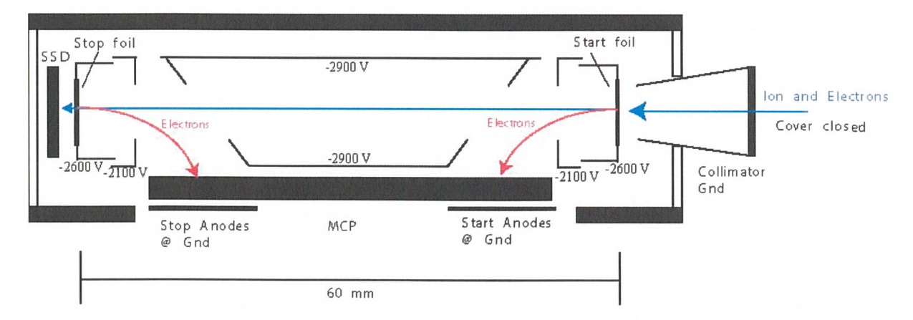
New Horizons Pluto Energetic Particle Spectrometer Science Investigation (PEPSSI)
Reviewed by S. Joy (primary)
PRINCIPAL INVESTIGATOR: Ralph McNutt, APL
DESCRIPTION: Medium Energy Particle Spectrometer
ENERGY RANGE: 25-1000 keV (protons)
60-1000 keV (atomic ions)
25-500 keV (electrons)
FIELD OF VIEW: 160 deg x 12 deg
ANGULAR RESOLUTION: 25 deg x 12 deg
ENERGY RESOLUTION: 0.25 keV
SENSOR SIZE: 7.6 cm dia. x 2.5 cm thick
POWER: 1.4 watt
MASS: 1.5 kg

Slide 2
New Horizons PEPSSI Data Sets
Data ->
nh-x-pepssi-2-kem1-v4.0
nh-x-pepssi-3-kem1-v4.0

Slide 3
New Horizons PEPSSI Data Set Evaluation Tools
All Data Processing and Evaluation -
Machine: Dell XPS 15 9560
Operating System: Windows 10

Slide 4
Comments on review procedure
The catalog, documents, and calib directories of these volumes are nearly identical, and most of their contents have been previously reviewed many times.
I have taken advantage of this fact to reduce the review effort.
I used the folder compare option in BeyondCompare 3.3.13 to compare like folders across the four volumes, and then compare files contained in the folders. Most of the time, the only variation in the directory contents or the
file therein were the file time stamps and the data_set_id’s in the label files.
Once this information was available to me, I only reviewed unique files
Lastly, I looked at issues raised in the May 2020 review to make sure that they had been addressed in this release.

Slide 5
Documentation
Evaluation

Slide 6
Root level files
AAREADME No issues found – files essentially identical VOLDESC No issues found – files essentially identical

Slide 7
Catalog files
CATINFO.TXT – no changes required
nh_kem.cat – ok (Frahm 5/20 review comments about KEM1 encounter addressed) nhsc.cat – ok (Frahm 5/20 review comments about KBO observations, payload not addressed) pepssi.cat – good
ref.cat – good
There are no differences between files that should be identical on the two volumes (pepssi.cat, ref.cat, etc.) – good, correct versions included DATASET.CAT (nh-x-pepssi-2-kem1-v4.0 and nh-x-pepssi-3-kem1-v4.0)
includes discussion of versioning – good
Within a mission phase, the -2- and -3- dataset catalogs are effectively identical with the only changes being -2- becoming -3- and Raw becoming Calibrated.
This has been true and accepted for the previous PEPSSI datasets

Slide 8
Calib files
calinfo.txt – good
hk_stat_input_20041016.tab (lbl) – good
hk_n1_input_20050228.tab (lbl) – good
rateboxdefinitionplanes.fit (lbl) – good
calpars folder on -3- volumes only
calpinfo.txt – good
calpar_columns.fmt – good
pep_*_0x691_calpar.tab – ok, contents clear and self-explanatory. No corresponding .lbl file but that has been the case throughout the mission and has been previously accepted.

Slide 9
Document files
DOCINFO.TXT – good
All PDS documents (codmac_level_definitions, lunineetal1995, payload_ssr, pepssi_ssr, soc_inst_icd) appear to be properly formatted as PDF/A and the document labels appear to be valid. Most of these document files have been reviewed many times and have not changed recently. They appear to be the latest versions of each.
There have been no changes to any PDF files since the May 2020 review (Beyond Compare)
nh_fov.png (.lbl) – good nh_met2utc.tab (.lbl) – complete (last weekly entry 2020-12-28), good
nh_mission_trajectory.tab (.lbl) – complete (last entry 2020-04-30), good nh_pepssi_v110_ti.txt – good
pep_bti.tab (.lbl) – good, complete
quat_axyz_instr_to_j2k.asc (.lbl) – good
seq_pepssi_kem1.tab (.lbl) – good, complete (last entry 2020-04-30)

Slide 10
Index files
INDXINFO.TXT – good
Index.tab (lbl) - both files good
Slimindx.tab (lbl) ) - both files good
Checksum.tab (lbl) - both files good

Slide 11
Data
Evaluation

Slide 12
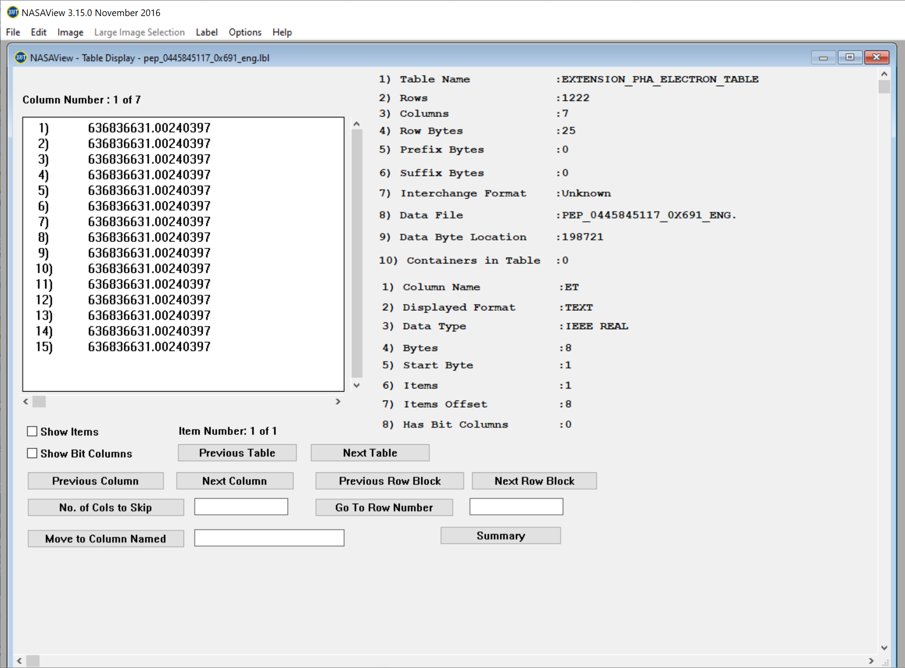
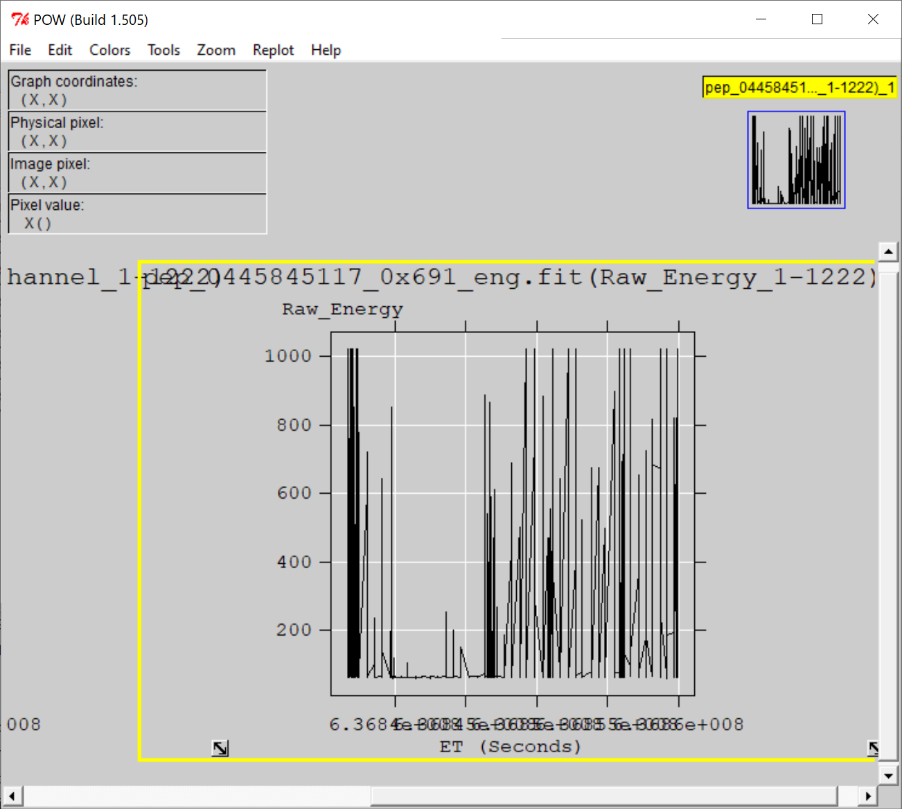
nh-x-pepssi-2-kem1-4.0
Files open with both NASAVIEW and FV suggesting that the PDS and FITS labels are well-formed. Validate tool did not catch any errors with labels. All of the files and labels selected for spot inspection appeared nominal.
All tables and columns accessible in NASAVIEW, listings look as expected
FV allow the user to plot data from any table versus time (MET or ET) and the plots look nominal

Slide 13
nh-x-pepssi-3-kem1-v4.0
Files open with both NASAVIEW and FV suggesting that the PDS and FITS labels are well-formed. Validate tool did not catch any errors with labels. However, Rudy found errors in the column description fields that are not inspected by any software validation tools.
Issue with labels (Auto description failed, Sulfur described as protons) reported in May 2020 review are all corrected here.
All of the data files selected for spot inspection appeared nominal. NASAView has some display issues with these data/labels
FV allow the user to plot data from any table versus time (MET or ET) and the plots look nominal.
New Data Files
NASAVIEW won’t allow users to navigate past the first image in the file – known s/w problem
Spec Electrons from 2020-03-07 (FV)
Weak TOF vs Energy signal matches similar PHA result from FV for this data file (2020-03-07)

Slide 14
nh-x-pepssi-3-kem1-v4.0
New Solar Wind Data
FV plot of “Low Ion Spectra” From 12/11/19
Count rates were too low to get a useful TOF plot out of NASAVIEW for any of the new solar wind files that I tried to view. Plot “stretching” is limited in NASAVIEW. Program opened files just fine and allowed me to view labels and histograms, which are not useful for these data.

Slide 15
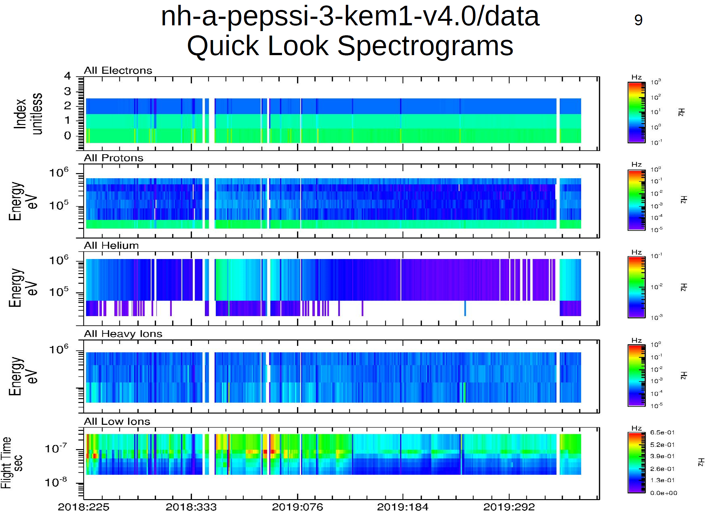
Plot courtesy of R. Frahm
Plot shows that the flux data are nominal, and that the continuity issues present in previous versions of the data have mostly been resolved. The remaining gaps are likely to be real, as described in the documentation, and not the result of data not having been returned yet.

Slide 16
Summary of Liens
In general, the documentation is a bit sparse, particularly the dataset.cat files which are generic, not specific to the datasets. This is just a comment and there is no associated lien, however, should the team decide to update the -3- dataset.cat file,
it would improve the archive.
Liens: None
Comment:
Neither the DS.CATs nor the labels for the Jan 1, 2019 file list MU69 (Arrokoth) as a TARGET (TARGET = “SOLAR WIND”). It’s mentioned in the dataset description of the DS.CAT but wouldn’t show up in a search for data associated with this target.
Certification: Both data sets can be certified

