Slide 1
New Horizons LEISA PDS Review
Adam McKay

Slide 2
MU69!
New data includes post-encounter data
Of Arcturus and Sun/flat/dark (?)

Slide 3
Issues (?)
Image in folder 20181231_040854 seems to have no data (same as last couple reviews)

Slide 4
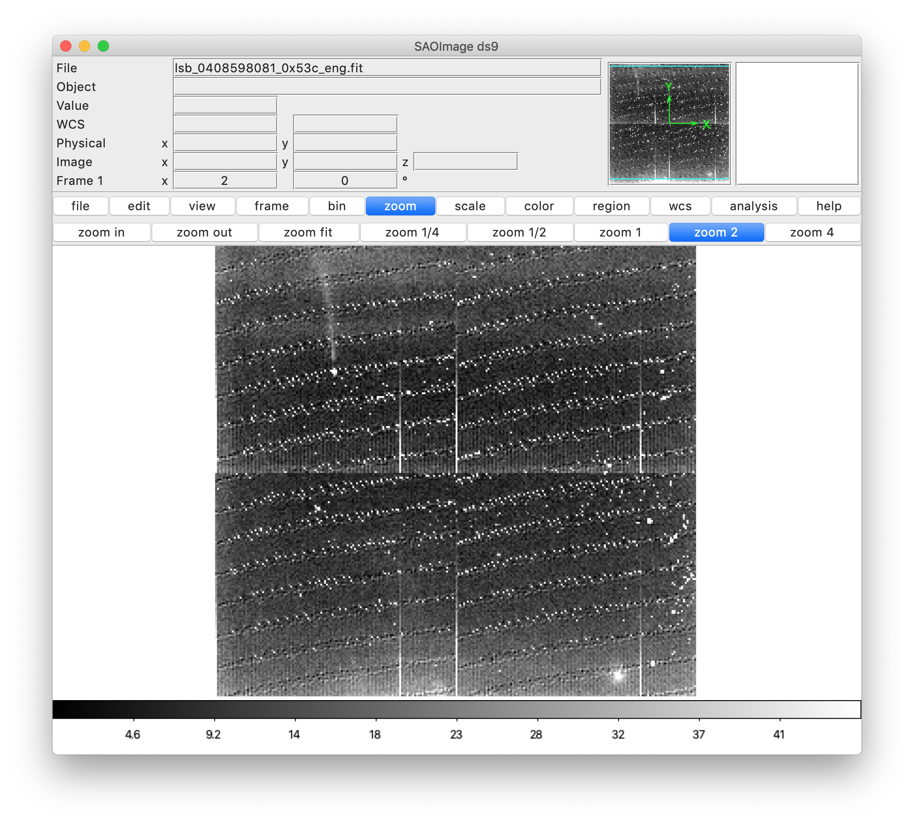
Issues (?)
Not sure what image in folder 20181231_040859 should be, label file says MU69, but don’t see consistent object present in stack (same as last review)

Slide 5
Arcturus Data (042960 and 042961)
Last image (lsb_0429609779_0x53c_eng) star position drifts from right to left instead of bottom to top
This also is the case for all images in 042961

Slide 6
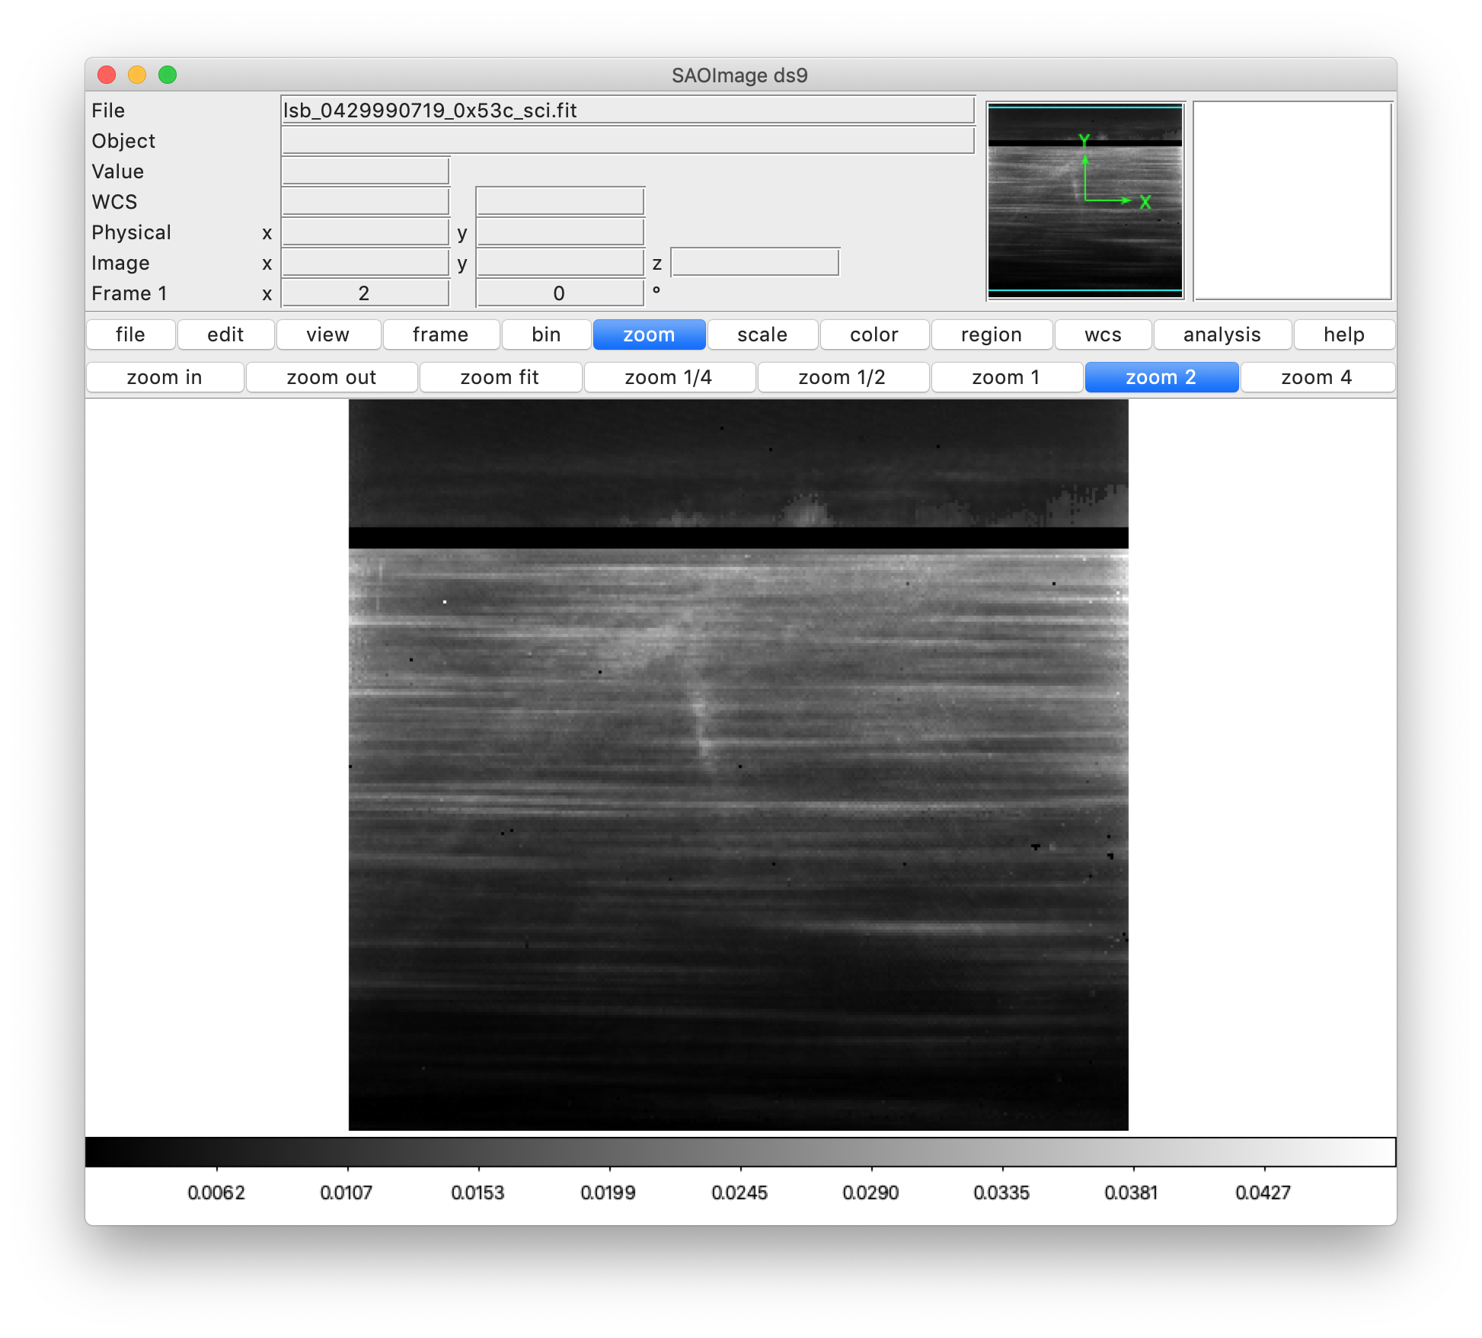
20190905_042999
lsb_0429990719_0x53c_eng has target name listed as “Sun”, is this correct? Other information in the .lbl file suggests this a flat using the Sun as a target.
Other image in this folder has image name “Dark”, which makes sense based on the appearance

Slide 7
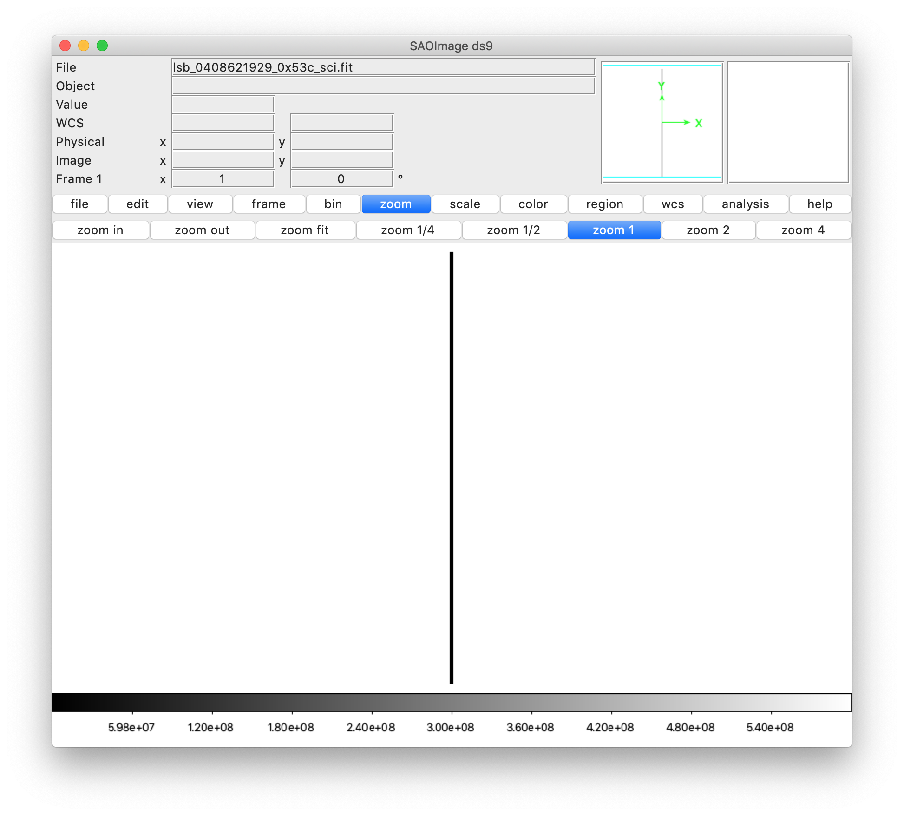
File Extension 7
Took a look at file extension 7 at specific request of Ludmilla
Related to coordinate transformation
values seem to be in .lbl files
Not sure if fits extension looks like it should
Other file extensions seem OK

