Slide 1
New Horizons KEM1 V4.0 Alice Instrument PDS-SBN Review
Lori Feaga
Dec 2, 2020

Slide 2
NH KEM 1 V4.0 (Level 2 & 3) Alice Data
Overall – a lot more data than V1, V2, and V3
V1 = 4 data files (3 of MU69)
V2 = 75 data files (~40 of MU69, some of cal star)
V3 = 493 data files (~165 of MU69, some of the Sun, and some of a cal star)
V4 = 726 data files (184 of MU69, 279 of the Sun, 240 of cal stars, 4 of the sky, and 19 N/A)
Data are readable with readpds in IDL, i.e. described correctly in PDS labels
No problems!

Slide 3
MU69 Pointings 30 mins apart near closest approach
Difference

Slide 4
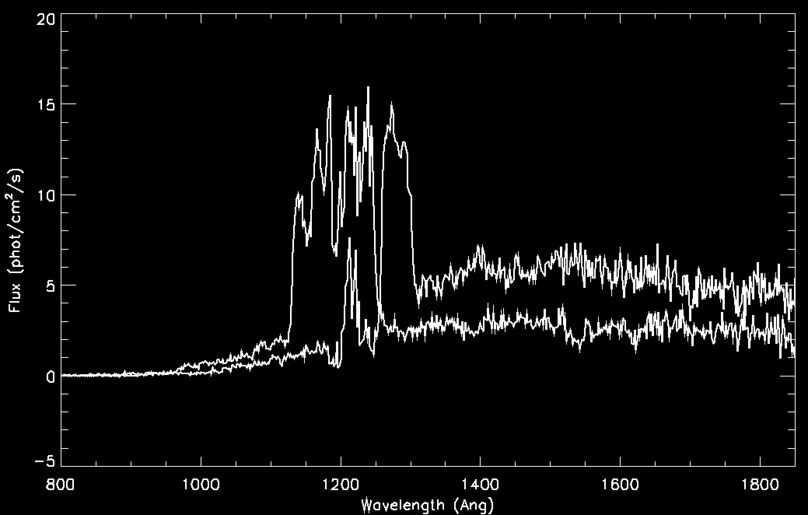
MU69 from previous slide plotted

Slide 5
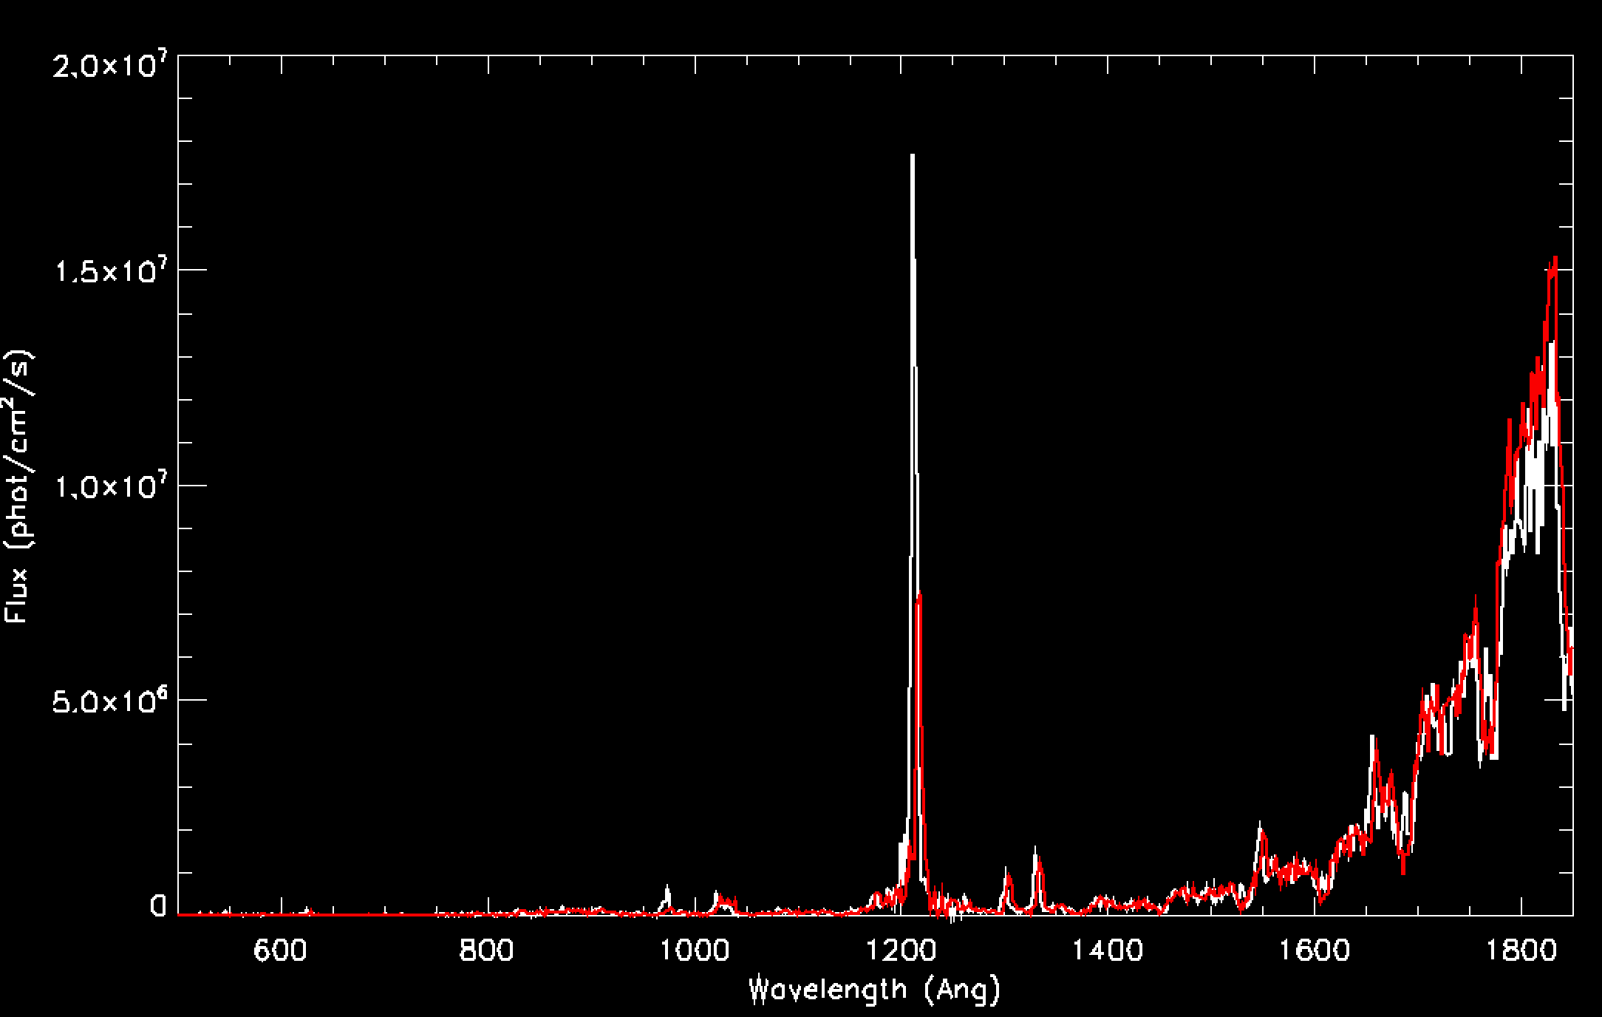
Sun pointings (3 days apart)
---- Pixel list
---- Histogram

Slide 6
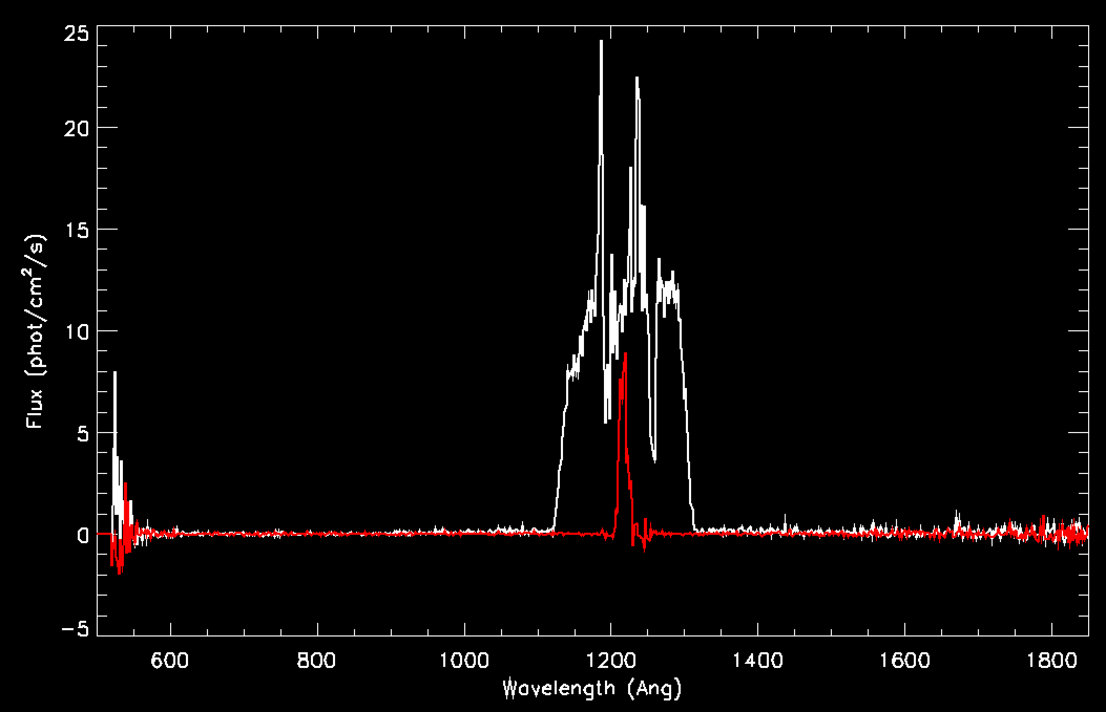
Interplanetary HI Ly-α

