Slide 1
New Horizons REX KEM1 Encounter
Data Review
Ashok Kumar Verma
University of California, Los Angeles
December 04, 2020

Slide 2
General Comments
Except for the radiometer data, the raw (nh-a-rex-2-kem1-v3.0) and calibrated (nh-a-rex-3-kem1-v3.0) datasets look identical, so my comments will apply to both datasets.
The both catalog and document are very comprehensive and appear to be adopted from the previous REX delivery with the appropriate modifications required for this delivery.
I have not found any auxiliary data files, in particular TRK-2-23 media files, in the archive. Such files may be needed for the accurate processing of the TNF data.
The datainfo.txt file is absent from the top-level data subdirectory. This file should contain specific information about the files under the data directory.

Slide 3
Data: TNF (TRK-2-34 Files)
Raw Data Review Method:
To spot the erroneous points in the file, I unpacked the data and plotted the time history of the raw observables. I then compared these observables with their predicted value based on available spacecraft and planetary ephemerides.
I used the “nh_recon_arrokoth_od147_v01.bsp” trajectory file, which is the primary SP-Kernel for the Arrokoth encounter and contains Kuiper Belt cruise data and Arrokoth approach, encounter, and departure data from 2015-09-27 to 2019-02-14.
Outcomes:
I found very large residuals with a systematic signature, especially for the 2-Way Doppler, which is not foreseen if the spacecraft trajectory is already adapted to these observations.
I am wondering if it is an expected behavior or if there is a lack of supporting information to correctly interpret the data?
Uplink ramp data is missing for 55 and 63 DSNs, making it impossible to process some of the 3-way Doppler and Range datasets. These two stations hold a total of 40% of the 3-way Doppler data and approximately 14% of the total data.

Slide 4
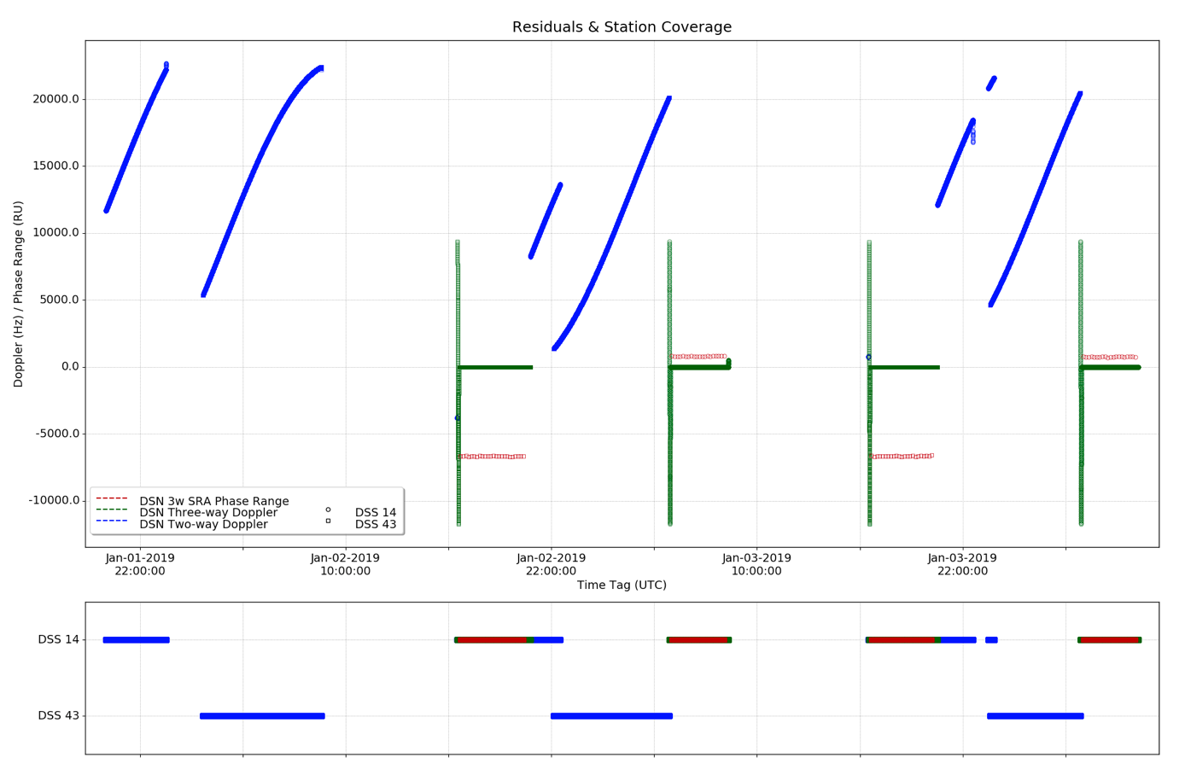
Data: TNF (TRK-2-34 Files)
The plot below shows the Doppler 2/3-way and Phase Range residuals obtained during the period of the KEM1 encounter.

Slide 5
Data: TNF (TRK-2-34 Files)
PDS3 Labels:
The version of the reference document (TNFSIS.ANC or TNFSIS.PDF) is not the right one for this archive. The latest version (DSN No. 820-013, TRK-2-34, Rev. P, 2017) is more relevant to this archive and should be included in place.
The DSN_STATION_NUMBER is missing in the label.
The start and stop times indicated on the PDS3 labels appears incorrect (see sample Table below).
File Name | Start Time (PDS3 Label) | Start Time (Expected) | Stop Time (PDS3 Label) | Stop Time (Expected)
nh_rex_2018251_dss14.lbl | 2018-251T23:25:00 | 2018-09-08T23:25:17 | 2018-251T23:59:59 | 2018-09-09T07:45:51
nh_rex_2018252_dss25.lbl | 2018-252T02:20:00 | 2018-09-09T02:20:16 | 2018-252T23:59:59 | 2018-09-09T07:35:01
nh_rex_2018292_dss14.lbl : : : | 2018-292T23:00:00 : : : | 2018-10-19T21:55:02 : : : | 2018-292T23:59:59 : : : | 2018-10-20T03:20:02 : : :
nh_rex_2020070_dss26.lbl | 2020-070T10:45:00 | 2020-03-10T10:45:20 | 2020-070T23:59:59 | 2020-03-10T12:44:08
nh_rex_2018251_dss14.lbl | 2018-251T23:25:00 | 2018-09-08T23:25:17 | 2018-251T23:59:59 | 2018-09-09T07:45:51

Slide 6
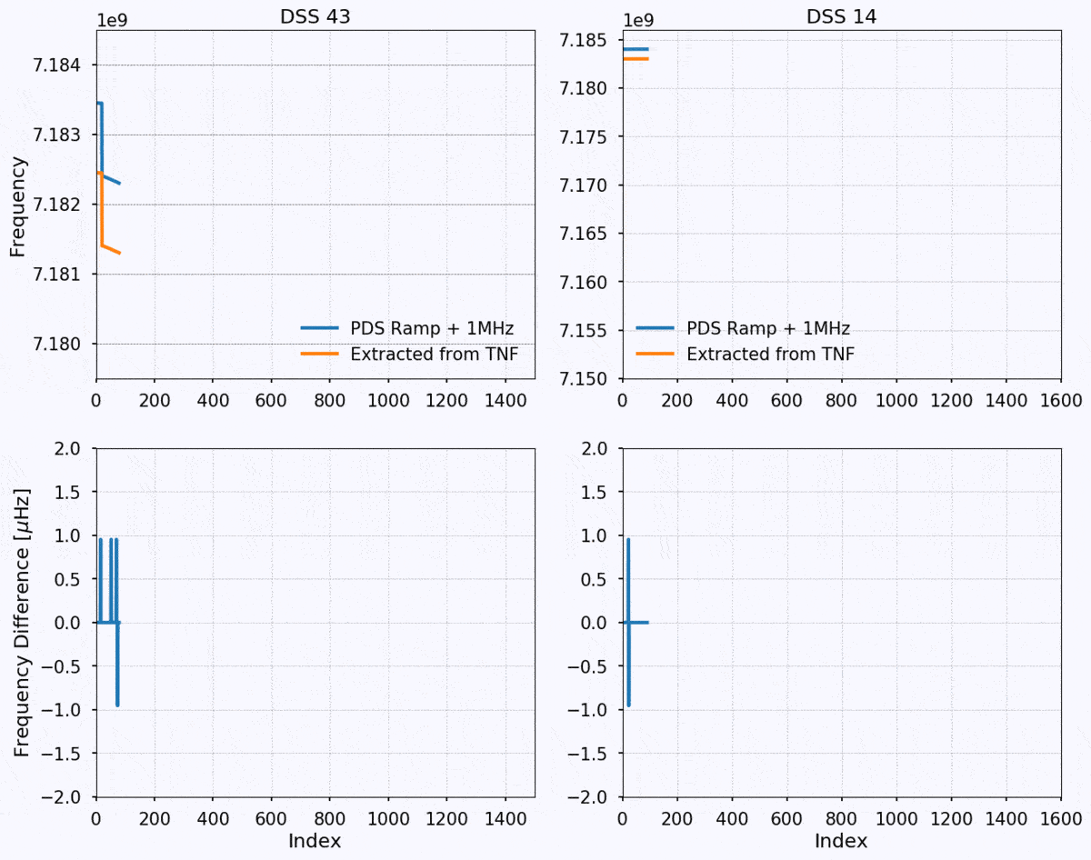
Data: Ramp Data (Uplink Files)
Raw Data Review Method:
To spot the erroneous points in the file, I extracted the ramp data from the TNF files and compared it against the values given in the uplink data files.
I checked all the files.
Outcomes:
I found the same values with a few very low aberrant values (< 2 mHz), possibly a numerical noise (see lower panel of the Figure).
The start and stop time indicated on the PDS3 labels appears incorrect.

Slide 7
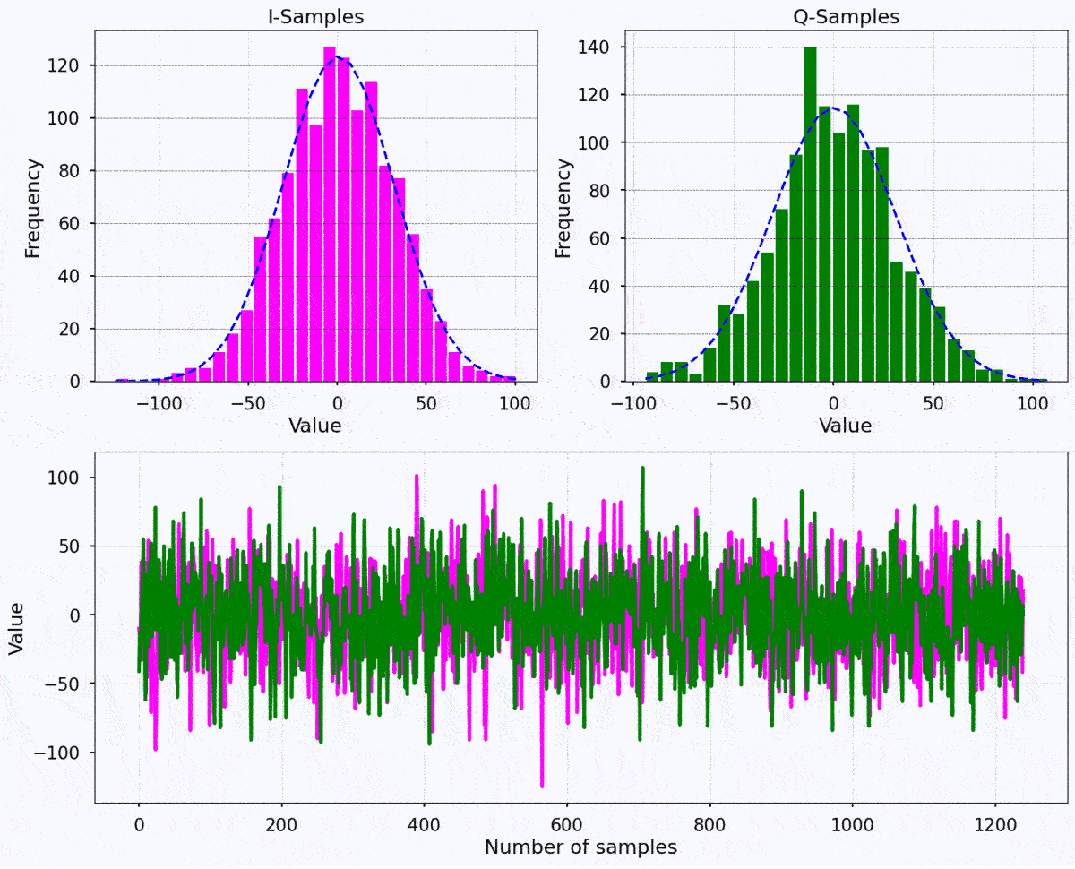
Data: Radiometer Data (Fit Files)
Raw Data Review Method:
I'm not familiar with this kind of data. To the best of my knowledge, this is not a conventional Radio Science data format, though the I/Q samples of the fit files look similar to the open loop RS-RSR data.
So, at a minimum, I randomly selected about 100 files and plotted the sample distribution with Gaussian adjustments to identify outliers.
Outcomes:
In most cases, I found the expected distribution (see the Figure).
In a couple of cases, I found all I/Q samples set to zero. I don't know, if it is expected, and the reason for archiving these files?

