Slide 1
PDS-SBN Review of New Horizons LEISA Data (2014 MU₆₉ Flyby Approach)
M. DiSanti
04 Dec 2020

Slide 2
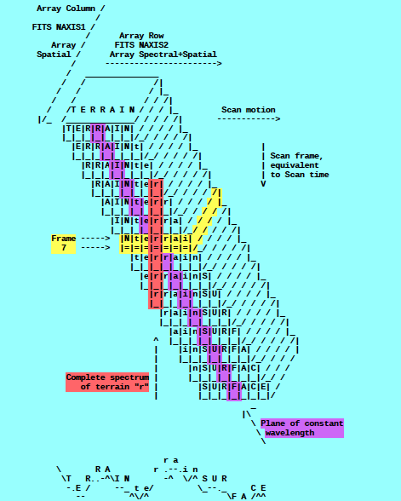
A spatial-spectral data cube is created by scanning the FOV across the target in a “push-broom” fashion. The data cube is a 3-dimensional array having 256x256xN elements, where N is the number of 256x256 files accumulated over the scan.
e.g., read in calibrated FITS file = ‘nh-p-leisa-3-pluto-v2.0/data/20150714_029917/lsb_0299172889_0x53c_sci.fit’
file = file(x,y,z),
x=spatial (256 elements),
y=lambda(256 elements),
z=spectral/spatial
(N=elements; e.g., N=371)
(i.e., lambda varies spatially)
[figure from ‘leisa_data.pdf’ in
folder ‘document’]

Slide 3

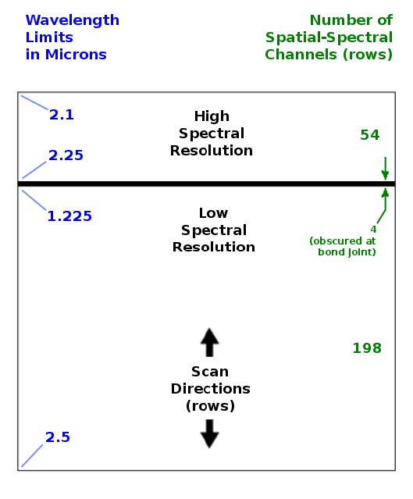
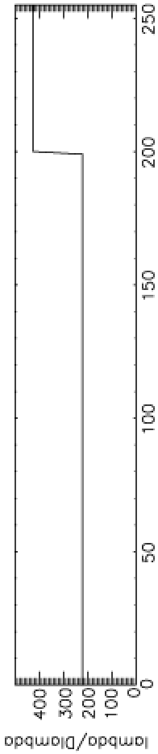

LEISA
A near-IR (1.2 – 2.5 micron) spectrometer that uses a 256x256 Rockwell PICNIC array, with 40-micron square pixels.
It produces low-resolution (λ/Δλ ~ 240) and higher-resolution (λ/Δλ ~ 540) spectra over separate sections (ranges of 54 and 199 rows) that are separated by 4 rows obscured by a bond joint.
Note: “Hi-res” λ/Δλ was ~ 425 for Pluto flyby data (as below) but is ~ 540 for cruise & 2014 MU₆₉ approach phases (recalibration)

Slide 4
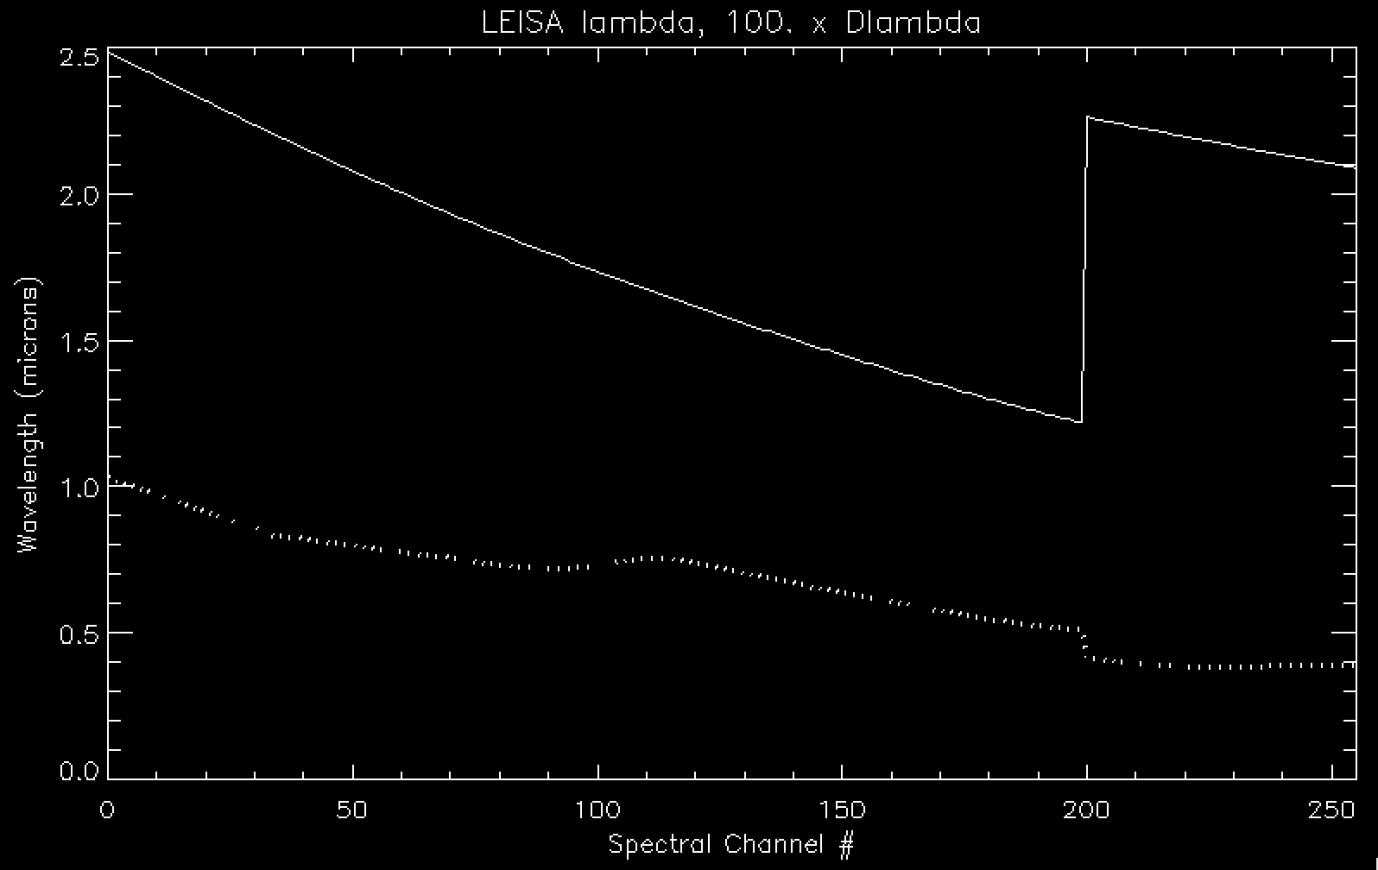
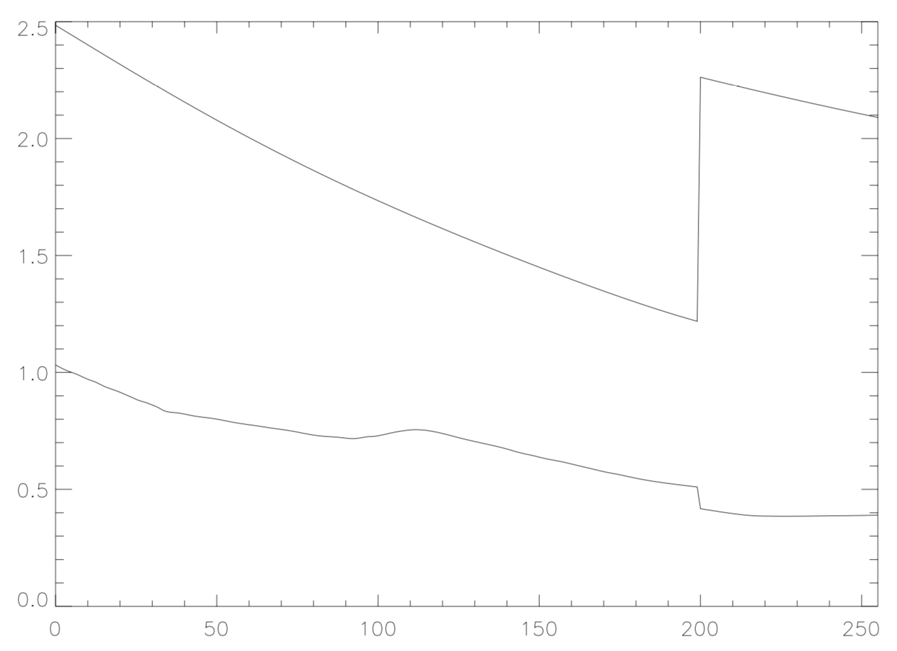
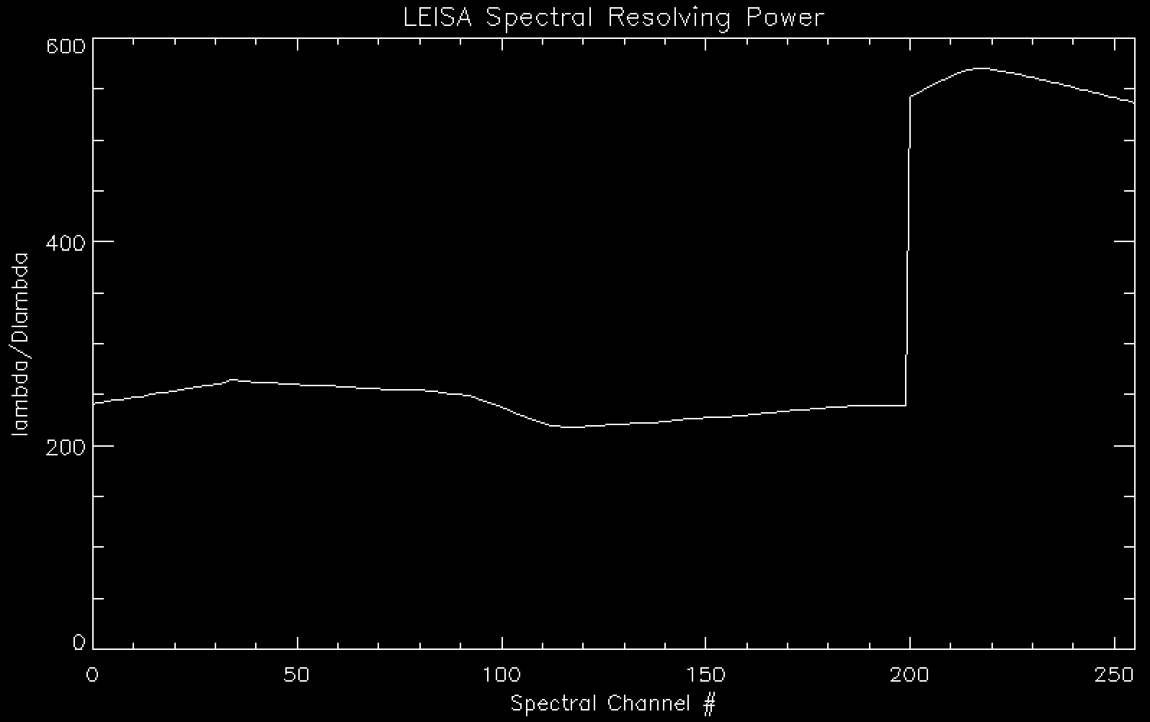
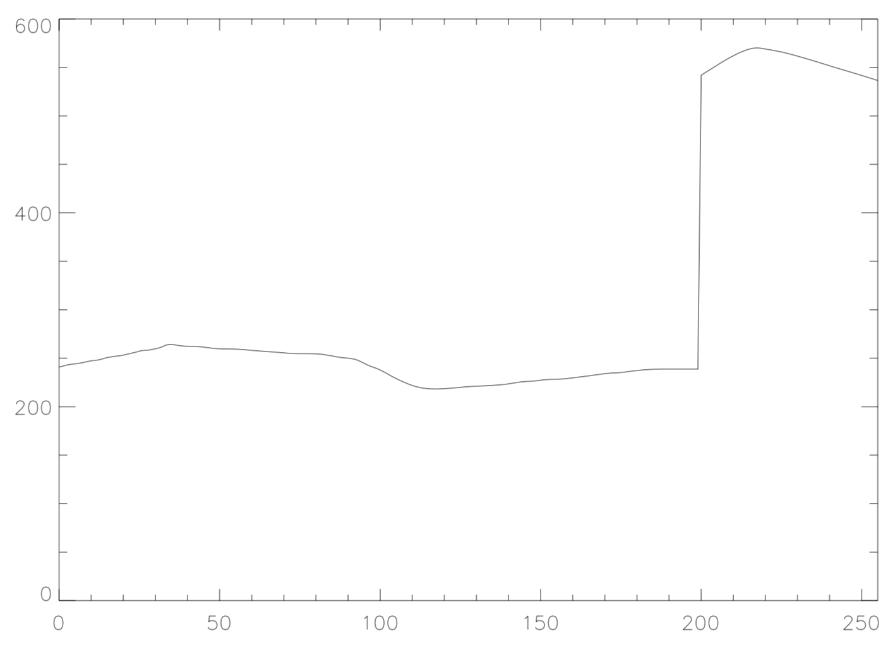
LEISA Wavelength Calibration
lambda
Delta-lambda
(x 100)
Lambda / Delta-lambda
v3.0
v4.0

Slide 5
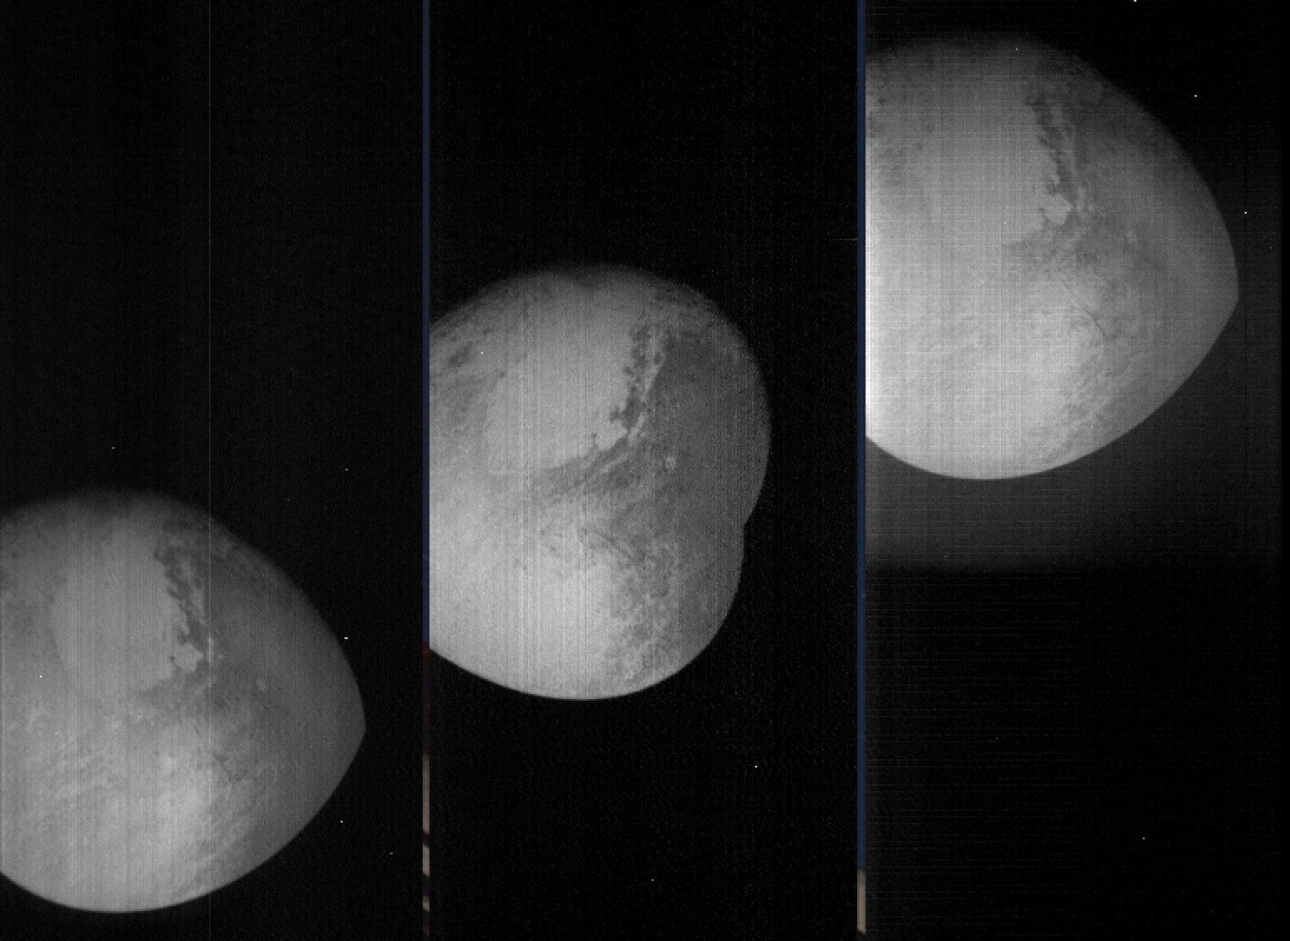
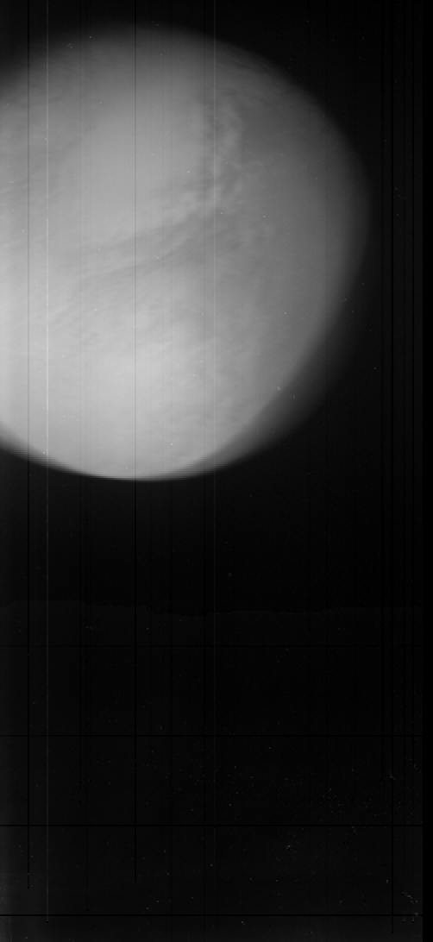
LEISA Pluto flyby Data
Transpose file(x,y,z) [256,256,N] → file_tr(x,z,y) [256,N,256]
→
shift -
register
file(0:255,0:N-1,0)
file(0:255,0:N-1,127)
file(0:255,0:N-1,255)
file_tr_sh(0:255,0:N-1,Σ[0:255])
(i.e., summed over all lambdas)
(Some residual wobble in x-dim)

Slide 6
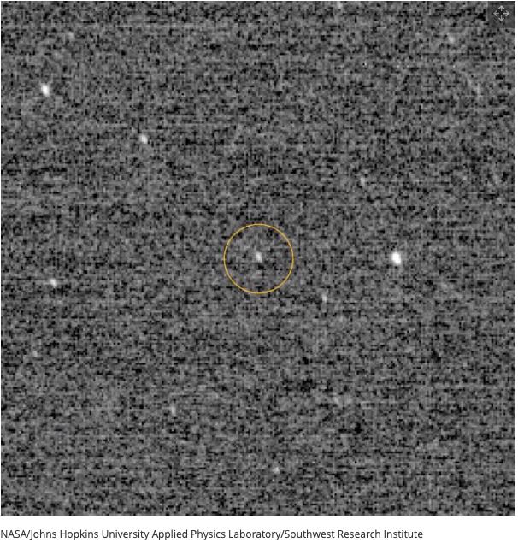
Arrokoth (2014 MU₆₉) Approach
“First Look” at MU69, at
d~10⁶ km (with LORRI)

Slide 7
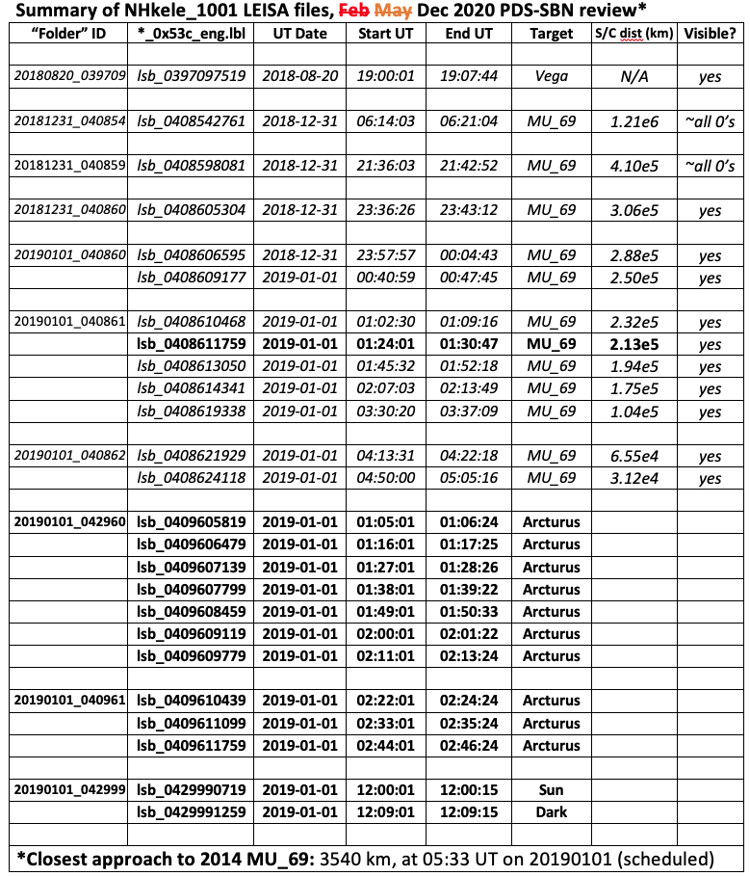
DATA

Slide 8
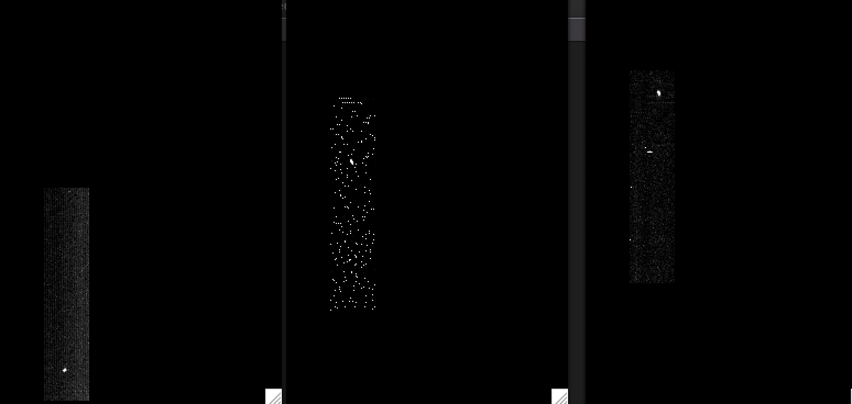
LEISA CRUISE DATA (20aug2018)
/data/20180820_039709/lsb_0397097519_0x53c_eng.fit (Alpha Lyrae)
Channel 9 (2.4088 μm)
Channel 194 (1.2384 μm)
Channel 250 (2.1038 μm)
|<-------------------------------------------------------------------------------->|
Low-res (λ/Δλ ~ 243)
High-res (λ/Δλ ~ 542)
(Spatially unregistered)

Slide 9
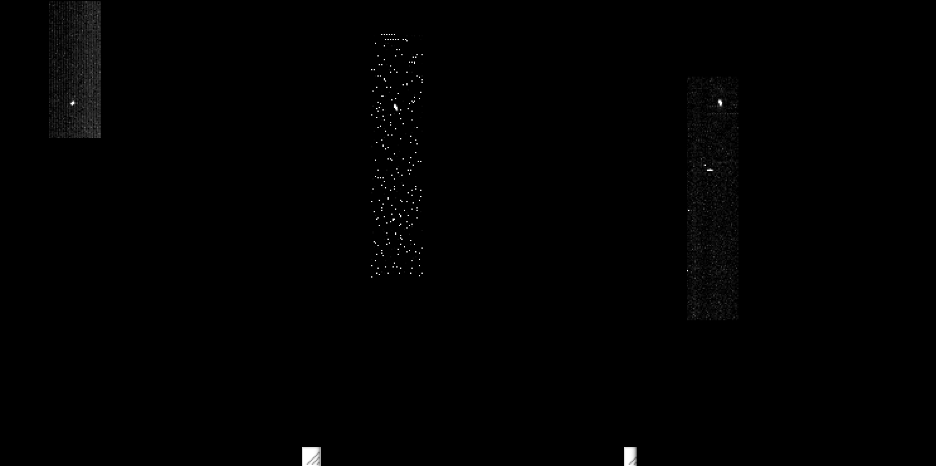
LEISA CRUISE DATA (20aug2018)
/data/20180820_039709/lsb_0397097519_0x53c_eng.fit (Alpha Lyrae)
Channel 9 (2.4088 μm)
Channel 194 (1.2384 μm)
Channel 250 (2.1038 μm)
|<-------------------------------------------------------------------------------->|
Low-res (λ/Δλ ~ 243)
High-res (λ/Δλ ~ 542)
(Spatially registered)

Slide 10
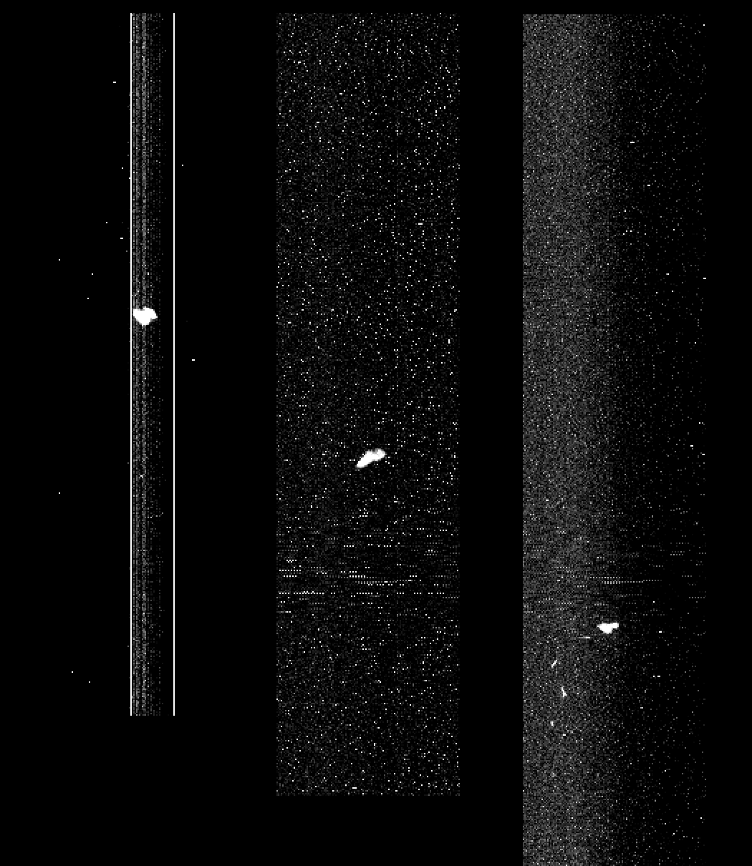
LEISA approaching MU69 (01jan2019)
lsb_0408624418_0x53c_eng.fit (04:50 – 05:05 UT), <d> = 31.2e3 km
Ch1
(low_res2.4744 μm)
Ch127
(low_res1.5748 μm)
Ch255
(high_res2.0895 μm)
Spatially
Unregistered
(Raw)
Start: row392 →
Mid: row290 →
←End: row173
Subtract median
at each step in λ

Slide 11
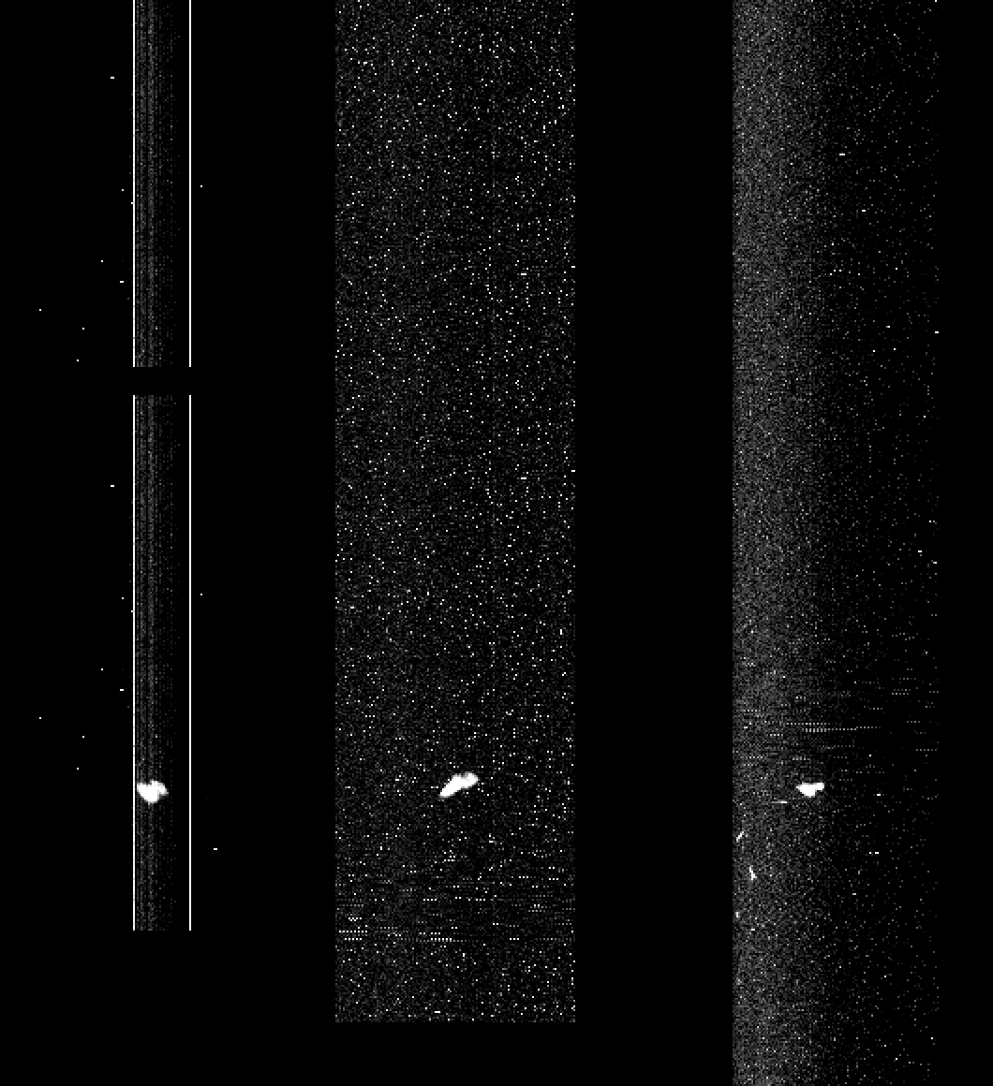
LEISA approaching MU69 (01jan2019)
lsb_0408624418_0x53c_eng.fit (04:50 – 05:05 UT), <d> = 31.2e3 km
Ch1
(low_res2.4744 μm)
Ch127
(low_res1. μm)
Ch255
(high_res2.0895 μm)
Spatially
Registered
(Raw)
Start: row392 →
Mid: row290 →
← Row173

Slide 12



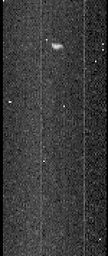

LEISA approaching MU69 (31dec2018/01jan2019)
lsb_04086*_0x53c_eng.fit near 2.1 µm (~ channel 50)
* = 05304
(3.06e5 km)
* = 14341
(1.75e5 km)
* = 19338
(1.04e5 km)
* = 21929
(6.55e4 km)
* = 24118
(3.12e4 km)

Slide 13
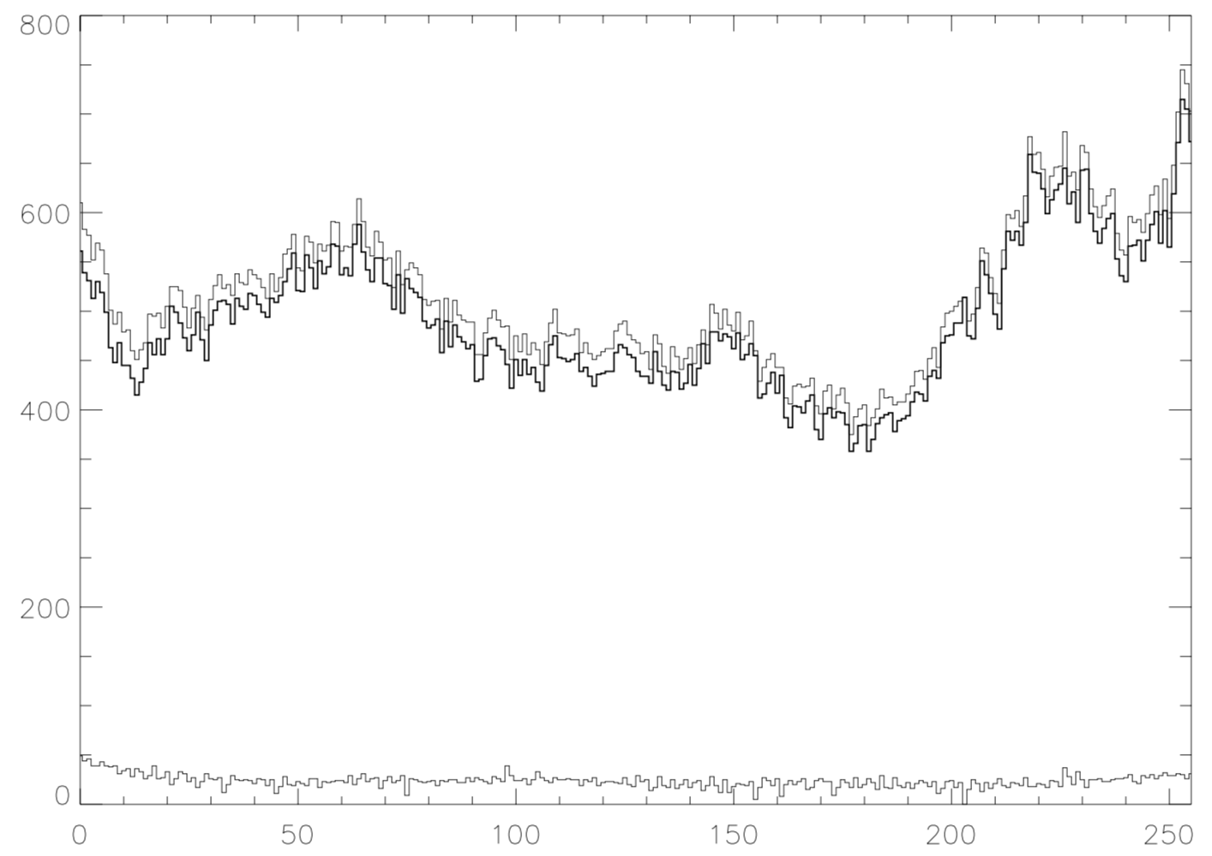
20190101_042999 (01jan2019, “calibrator” files)
“Sun” (row 8)
“Sun” – dark
(0759-1259)
dark (row 8)
(1259)

Slide 14
LEISA Wavelength Calibration
lambda
Delta-lambda
(x 100)
Lambda / Delta-lambda
v3.0
v4.0

Slide 15
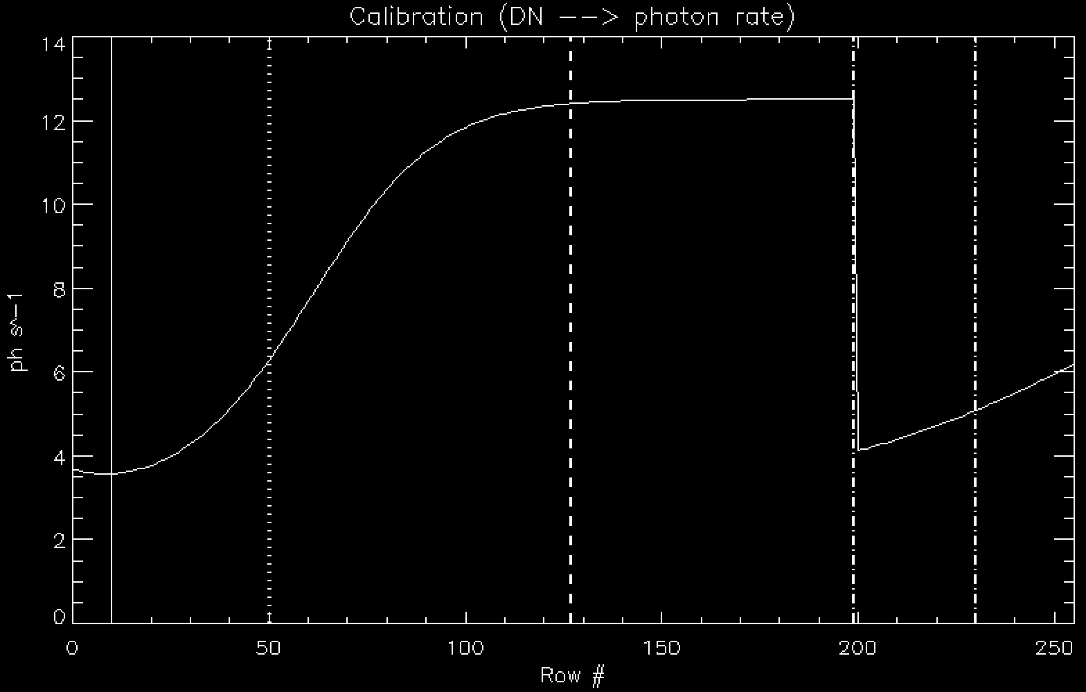
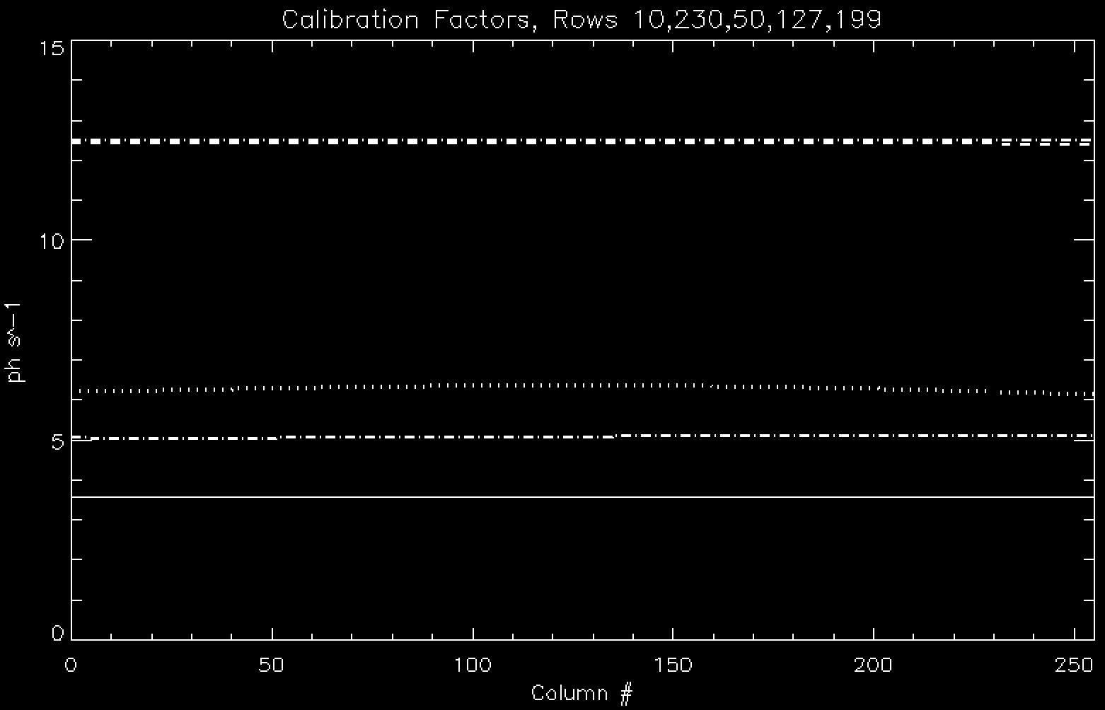
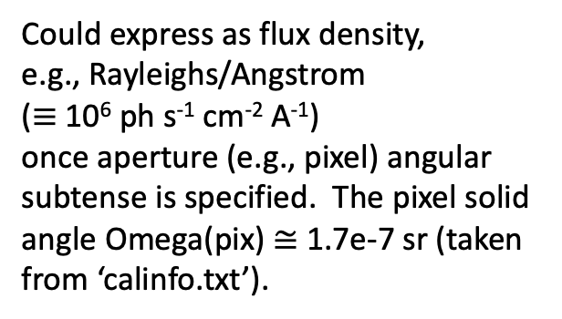
LEISA Intensity Calibration
Could express as flux density,
e.g., Rayleighs/Angstrom
($≡$10⁶ ph s⁻¹ cm⁻² A⁻¹)
once aperture (e.g., pixel) angular subtense is specified. The pixel solid angle Omega(pix) $≅$ 1.7e-7 sr (taken from ‘calinfo.txt’).
←
Row199
Row127
←Row50
←Row230
←Row10

Slide 16
Summary/Suggestions (v4.0)
LEISA frames read in fine, for both raw and calibrated) data.
lambda 2.5-1.225um (rows0 thru 199, low res), 2.25-2.10um (rows204 thru 255, hi res).
In v4.0, asteroid Arrokoth (2014 MU₆₉) is clearly detected from 3.06e5 km inward, but files from 4.10e5 and 1.21e6 km contain all zeroes.
MU₆₉ scan direction is “upward” for d = 1.04e5 km and larger. In each case it was ~1 row per step in λ. But it’s still downward for 6.55e4 and 3.12e4 km. Please check.
One file has ‘54b’ instead of ‘53c’ in its name. (20190101_040861/lsb_0408611759_0x54b_eng.fit’) Is this intentional?
Files 20190101_042999/* have only 16 rows. The first one (“Sun”) looks more like an internal lamp (flat field?). The second file (“dark”) looks reasonable.
Spatial Registration
Both Vega and MU₆₉ data show some “wobble” in the x-direction, more so for Vega, less so for MU₆₉ , especially in “closer” files (6.55e4 km, 3.13e4 km). Arcturus files look weird from
Difficult to extract spectra for Vega, Arcturus, and MU₆₉, due to spatial smearing (not so critical for Pluto). Arcturus files have less “wobble.” This should be less important for MU₆₉ near closest flyby approach of ~3500 km. Arcturus looks better in ‘calibrated’ data.
In ‘calinfo.txt’: pixel solid angle is denoted ‘aOmega’, but that is normally expressed as entendue (m^2 sr). This was not changed from v3.0, but this is a trivial distinction anyway. The typo flagged in the v3.0 review (“intergration time”) was addressed.
STILL looking forward to seeing the actual MU₆₉ flyby data!

Slide 17
DATA

