Slide 1
Spitzer IRS Review
Adam McKay

Slide 2
Data
5-40 micron spectra of 32 comets obtained with Spitzer IRS
Fully reduced, extracted spectra, raw data available on Spitzer Heritage Archive
Comma delimited .csv files with context information and data
Wavelength, bin width, flux, uncertainty, spectral setup, scale factor used for matching different wavelength regions sampled with different spectral setups, and estimated nucleus contribution

Slide 3
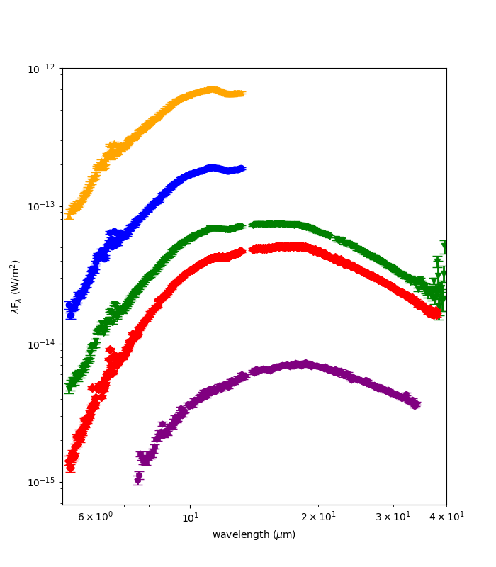
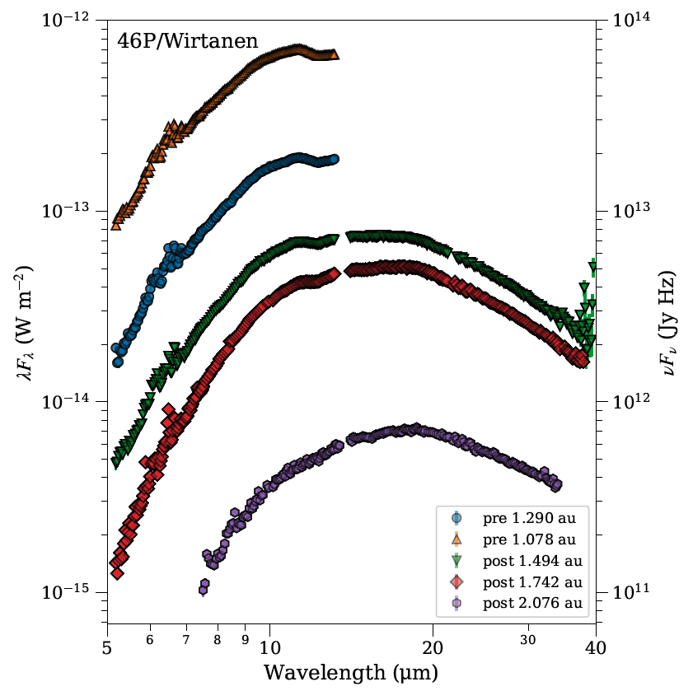
Data Look Good!
Plot from documentation
My replotting of data

Slide 4
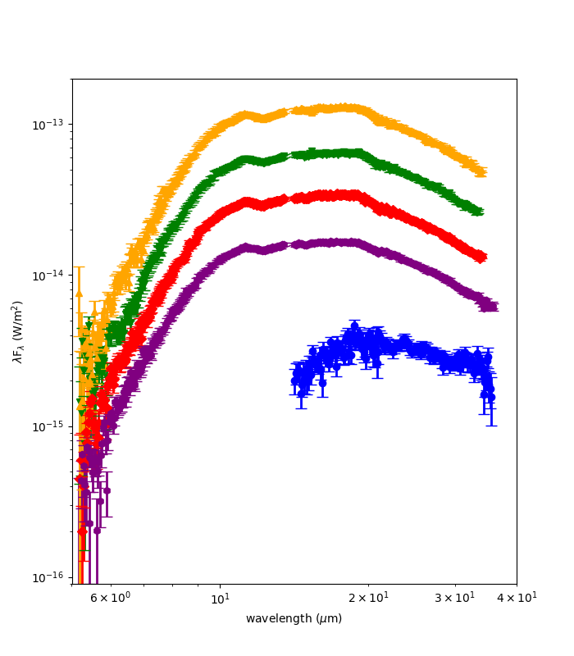
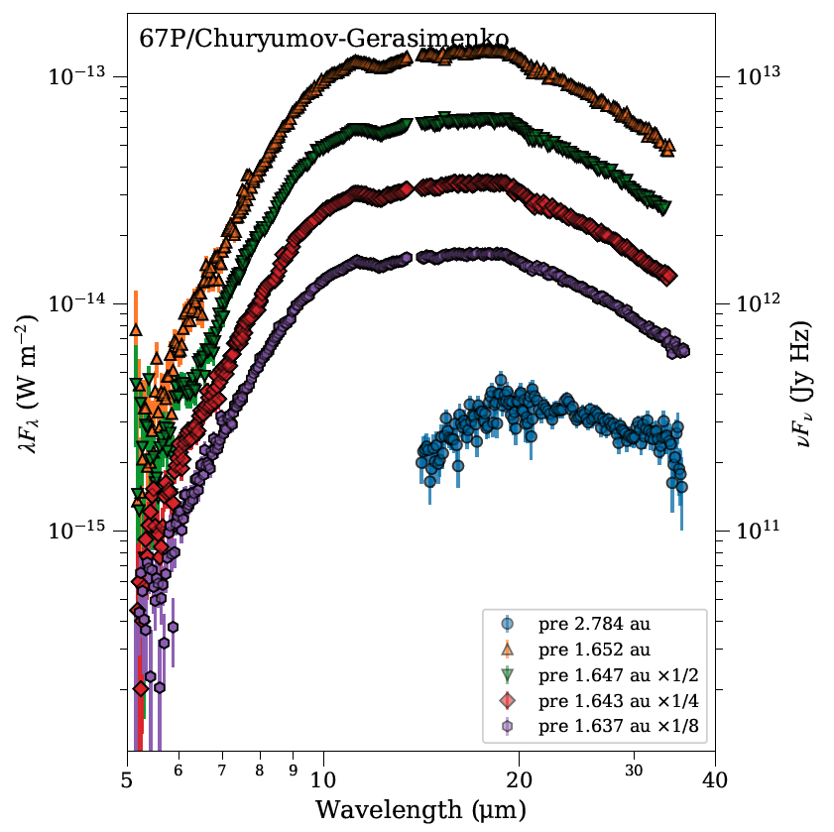
Data Look Good!
Plot from documentation
My replotting of data

Slide 5
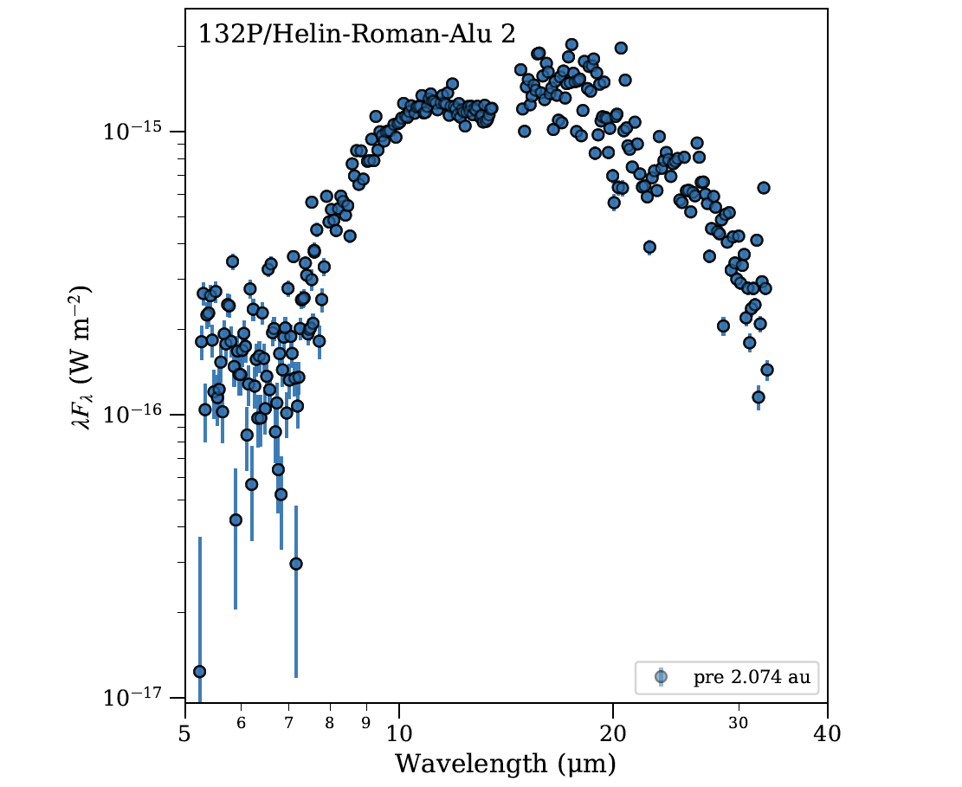
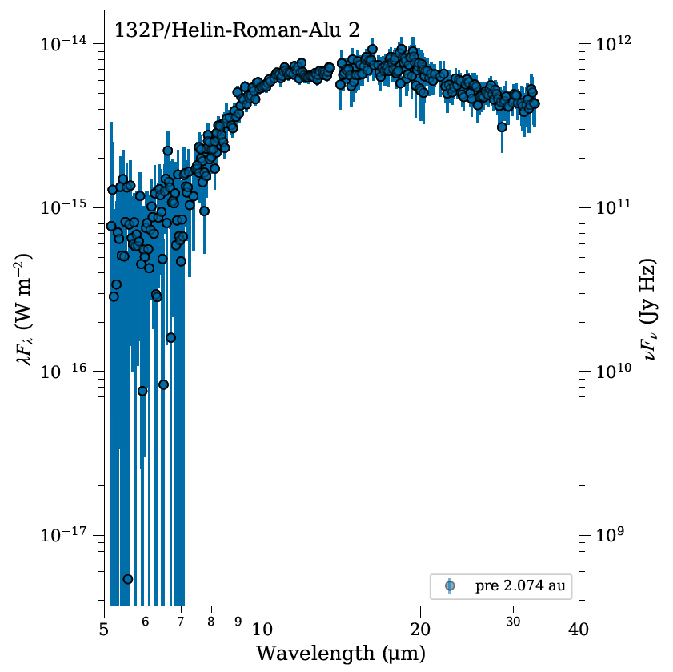
Corrections from last time
Last time
This time

Slide 6
Critiques of Documentation
Overall overview.pdf provides good description of data on how it was reduced to derive final data products
In Table 3 I assume “ . . .” means no observation, alluded to in footnote “a” that some don’t have observations, but could be more explicit, maybe N/A instead of “ . . .”
End of section 3.2.5, “We calibrate the data as an for extended source . . .”, remove the “for”
Section 5.18 title, Fig. 31: “Singer Brewster needs a hyphen”
Appendix A-typo in CUBISM in several spots, double “with” in second paragraph
Units on example plots are not those for the data, made comparison more difficult
For B1 LINEAR, blue and orange points are on top of each other, please offset
Should context info in .csv files be in separate file?

