Slide 1
Review of Rosetta ROSINA DFMS Time Series Abundances Data
Yinsi Shou
Univ. of Michigan

Slide 2
Does the dataset contain all documentation needed to use and understand its data without prior knowledge?
Can the dataset be understood without any external documentation it references, or should the information in said external references be incorporated into the dataset?
If reviewing calibrated data, does the documentation fully explain the calibration process and contain all necessary parameters needed to repeat it?
More information and external references should be provided to help users to understand how the data is derived and to show the usage of the data (e.g. sum of peaks, area under mass peaks).

Slide 3
Comments
In .xml files, a postfix Z in the time stamps can be a little confusing. Is it UTC?
<start_date_time>2014-0901T02:15:35.346Z</start_date_time>
What’s the difference between data XXX_hr_a.xml and XXX_hr_b.xml?
What’s the uncertainty in the quantities “sum of mass peaks”?

Slide 4
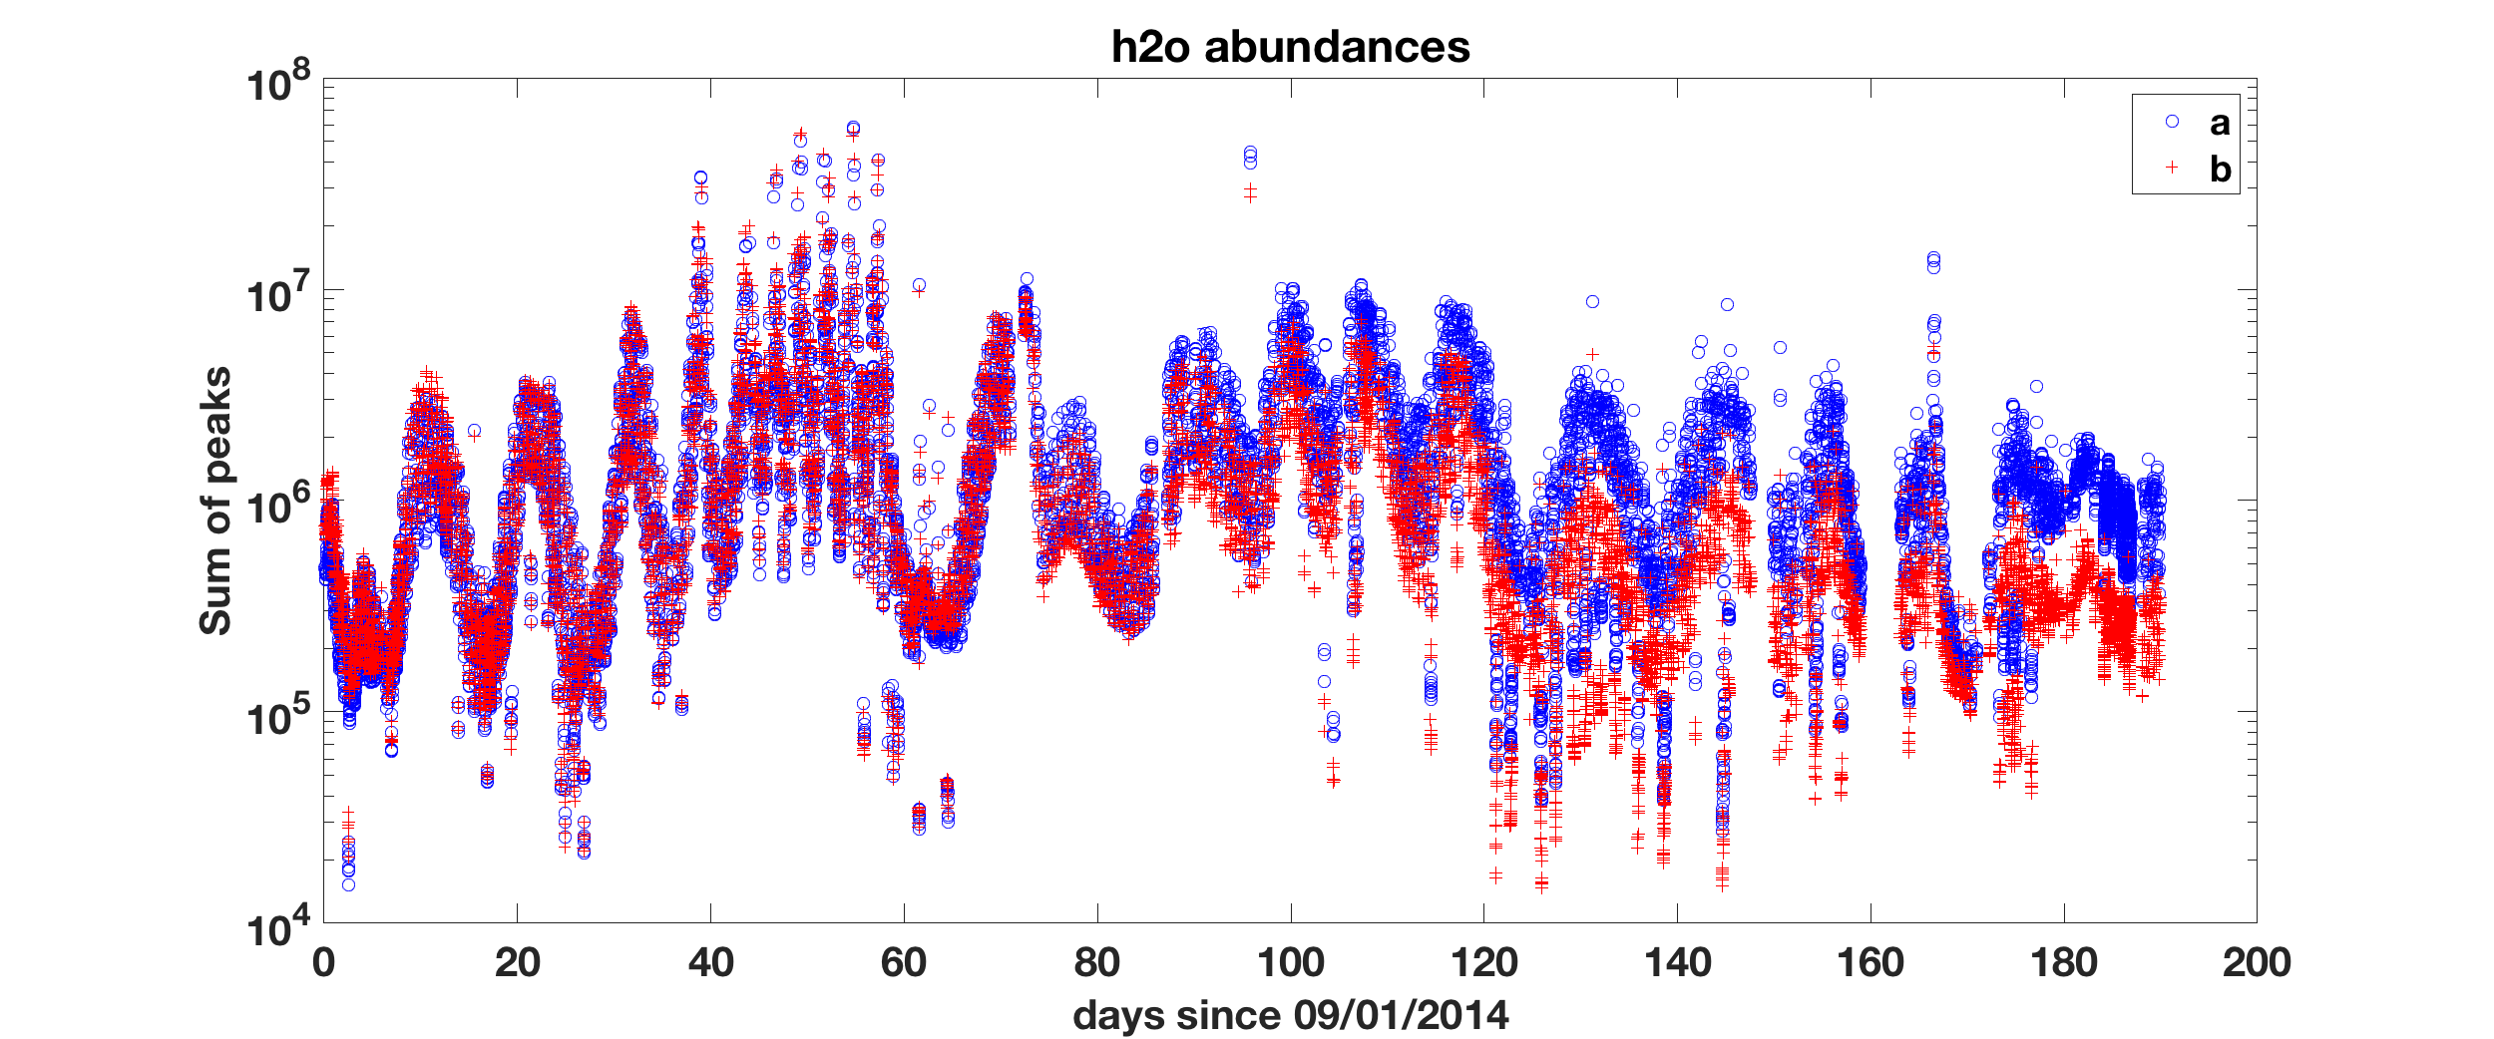
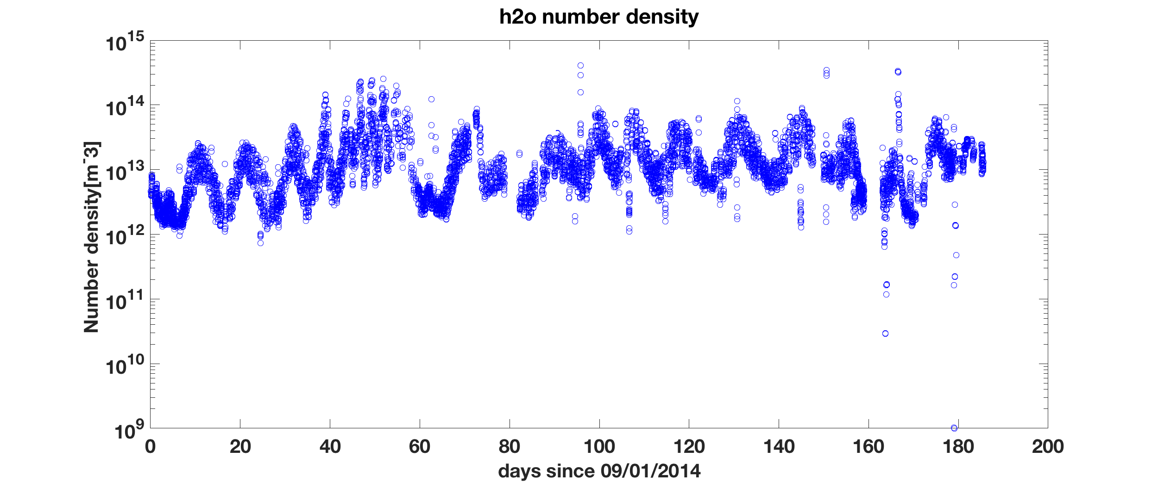
Plot of sum of peaks from XXX_a.xml and XXX_b.xml.
Data points from b are consistently lower than a after Day 80 (late Nov 2014).
Plot of ROSINA/DFMS number density currently on PDS/SBN.
Similar trend to the abundance data.

Slide 5
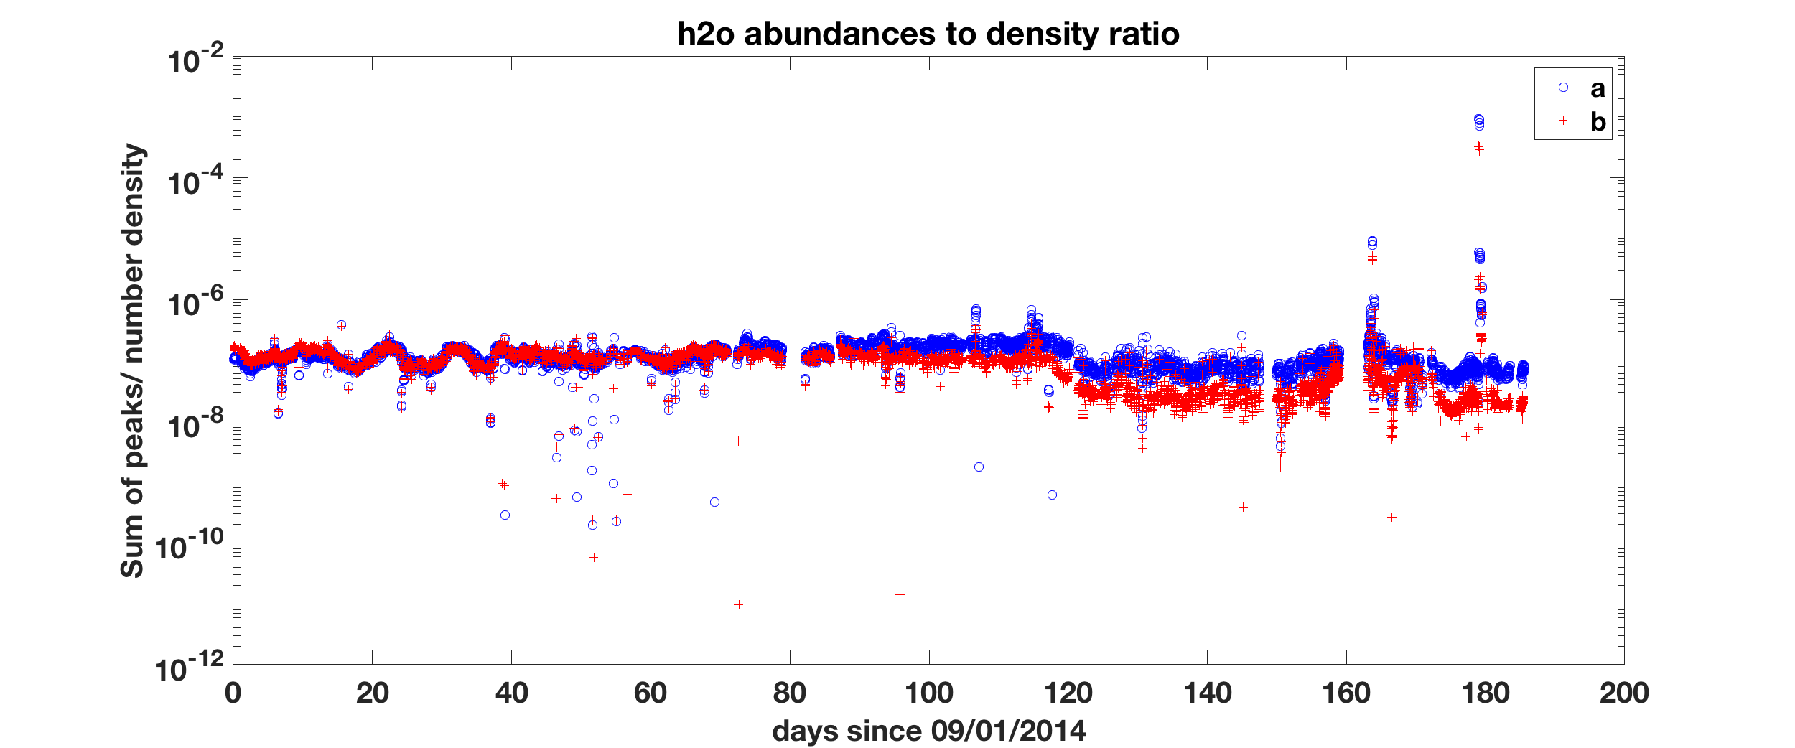
Plot of the ratio of the linearly interpolated abundance data to abundance data. The interpolation uses two closest abundance data points in time to the timestamps of each density point.
Sum of peaks (ions in 20 sec) ~ neutral particle flux
Number density (/m^3)
Sum of peaks/Number density ~ neutral gas velocity (100 m/s ~ 1 km/s)
The variation of the ratio is expected to be about one order of magntitude.

Slide 6
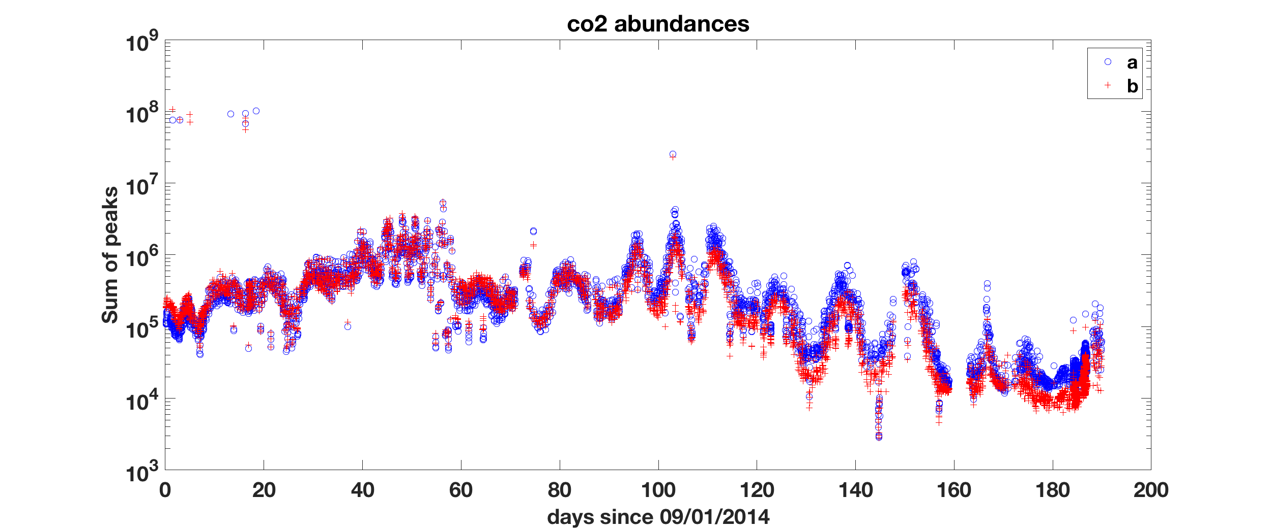
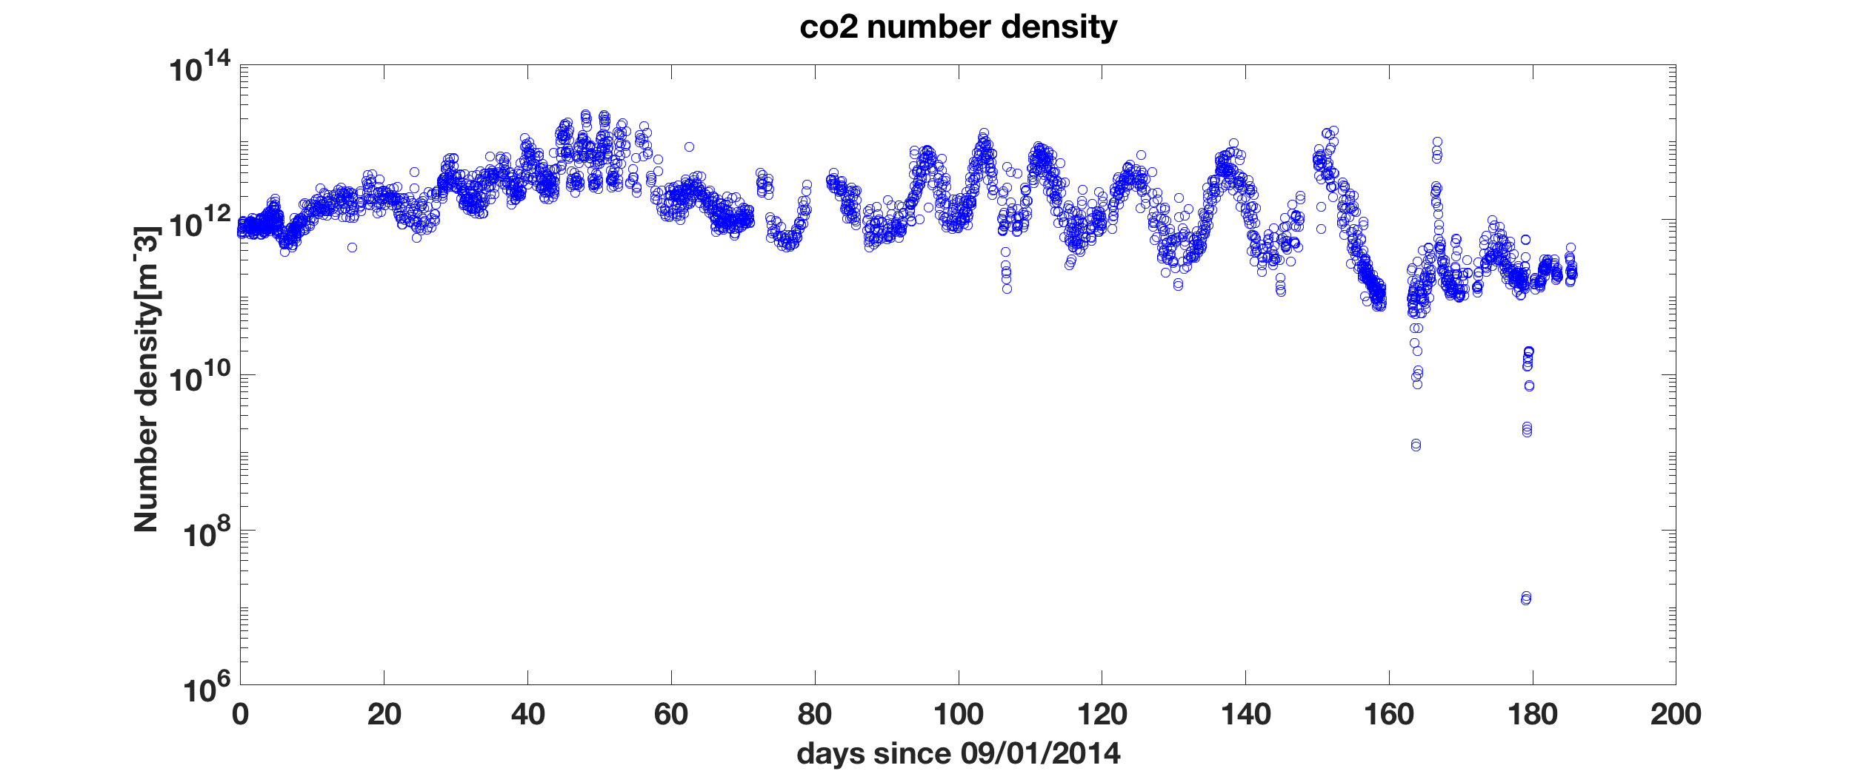

Slide 7
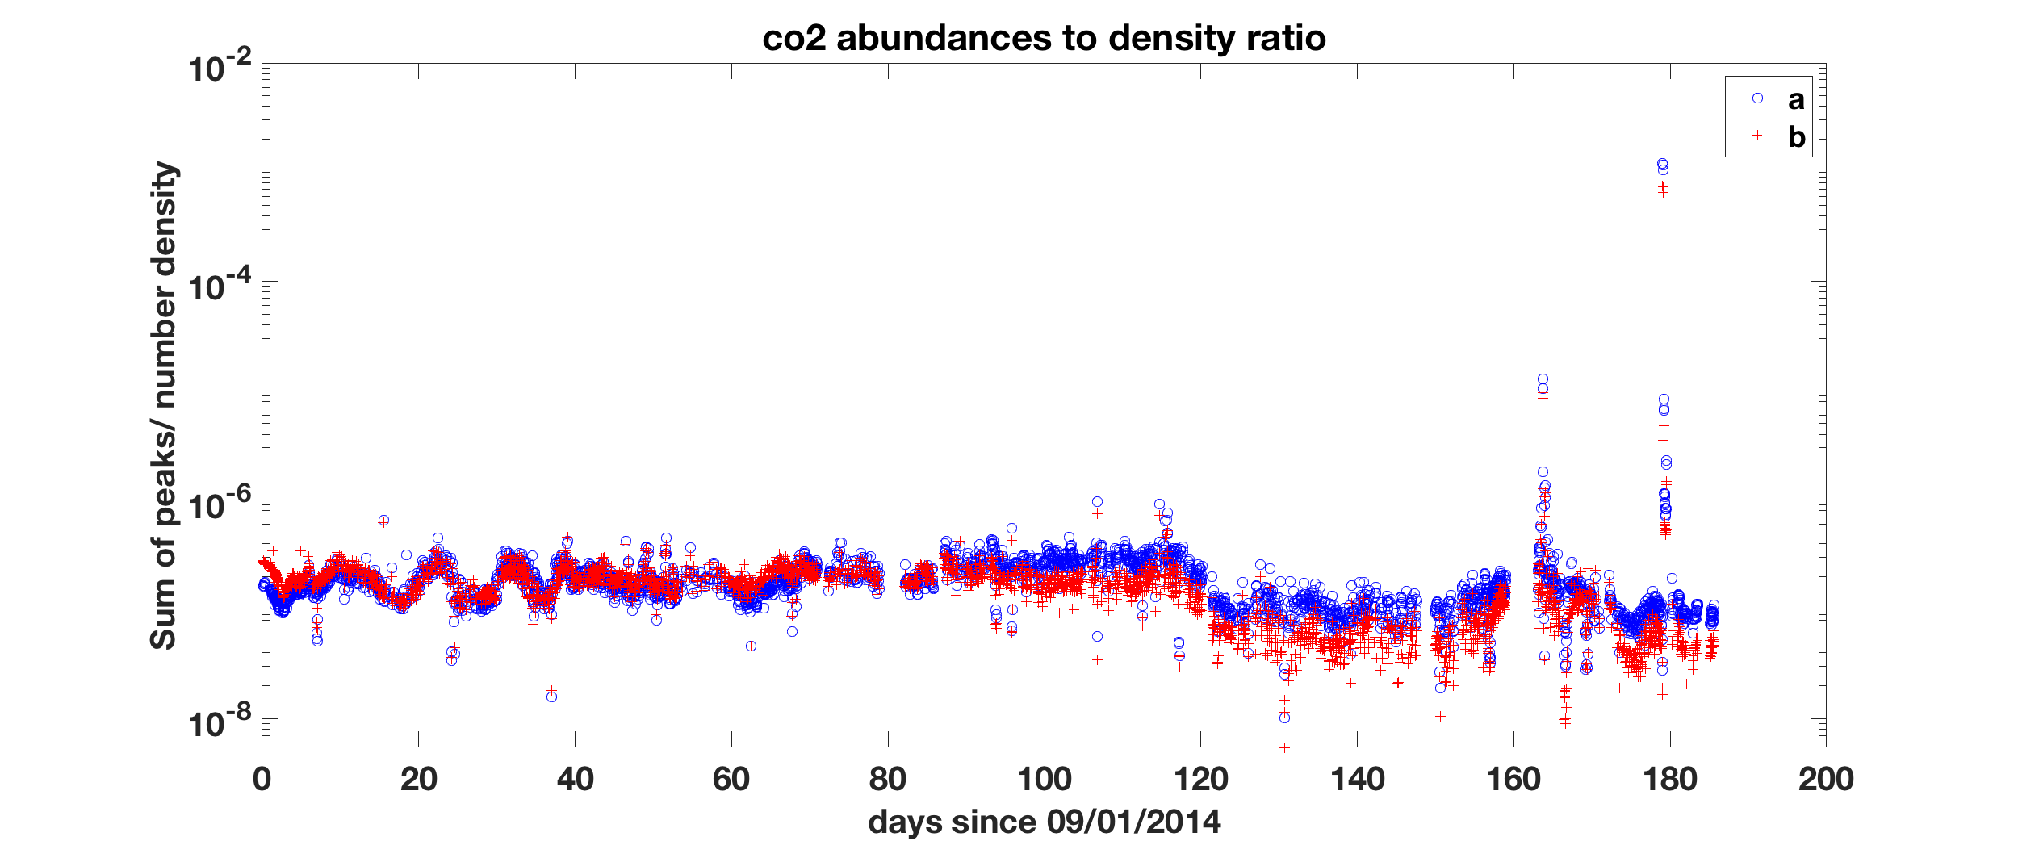

Slide 8
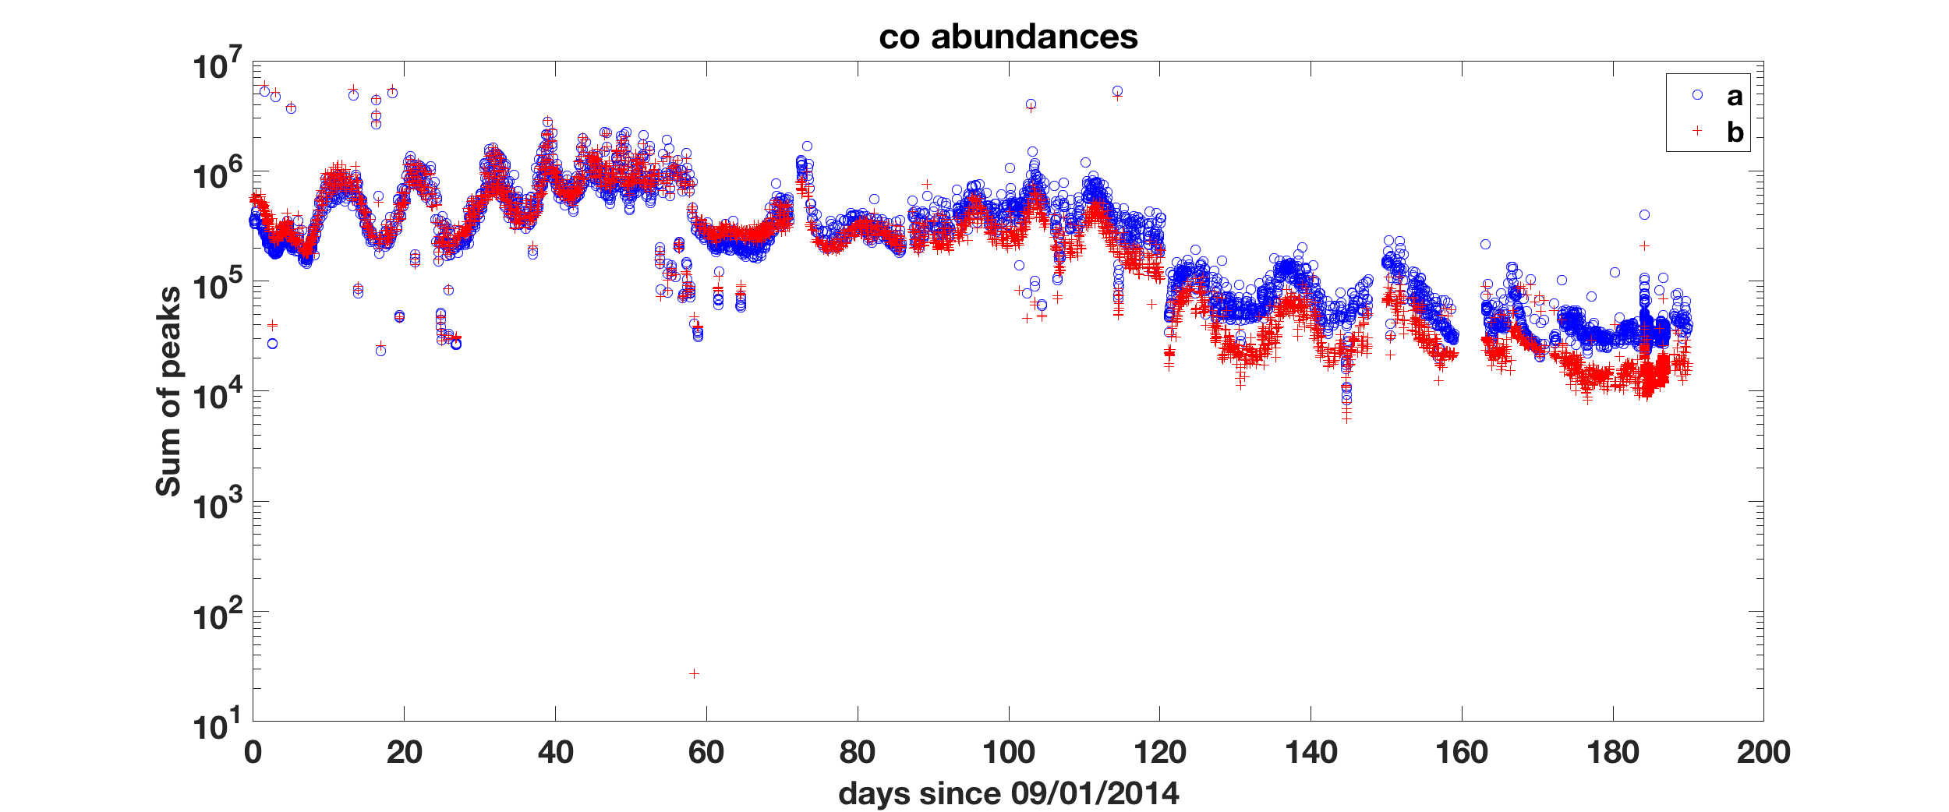
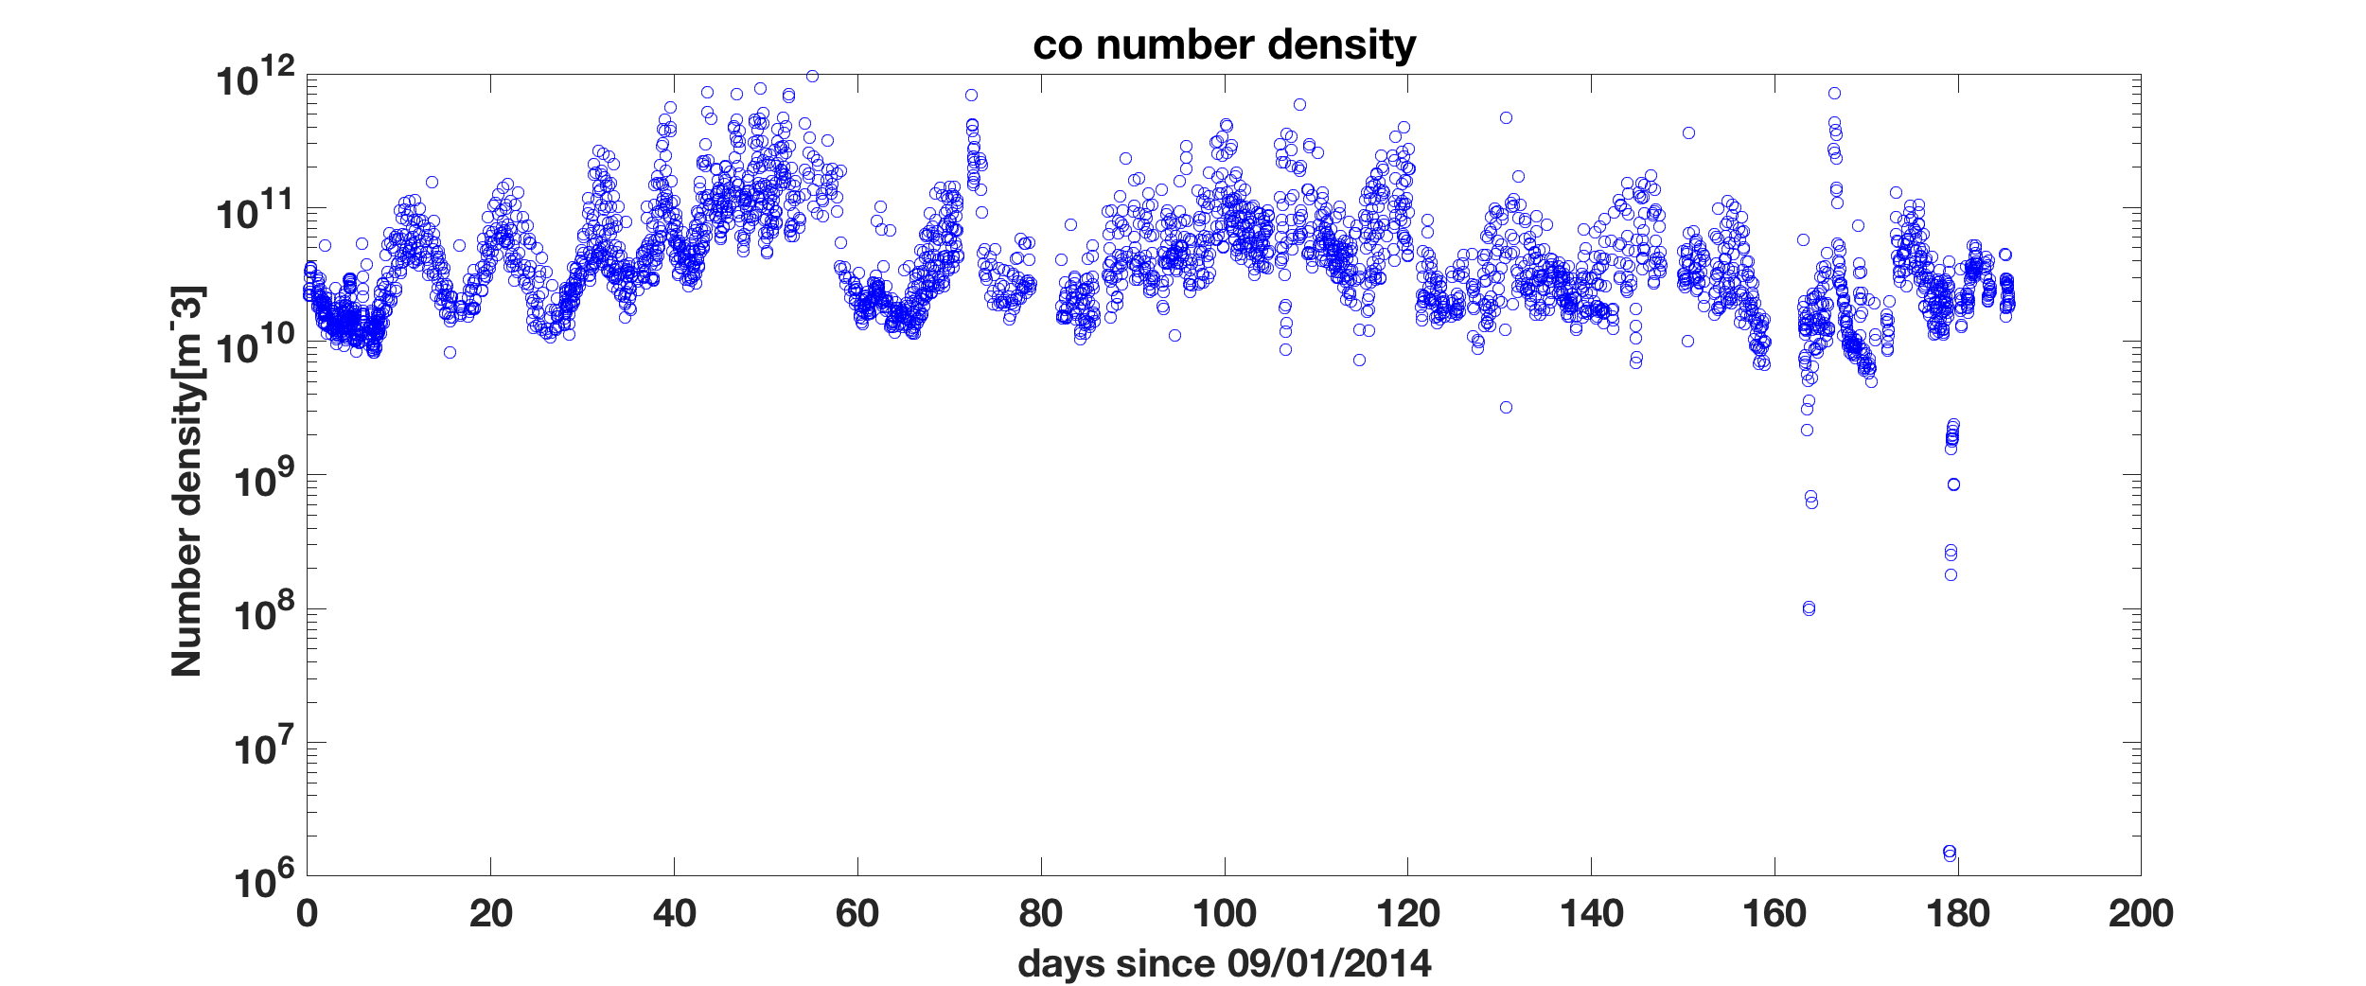

Slide 9
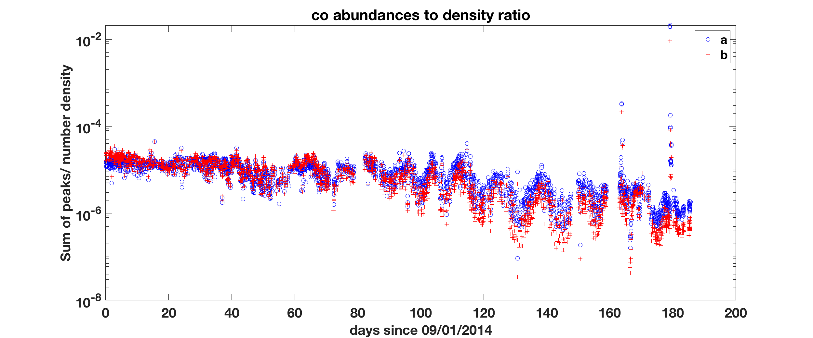

Slide 10
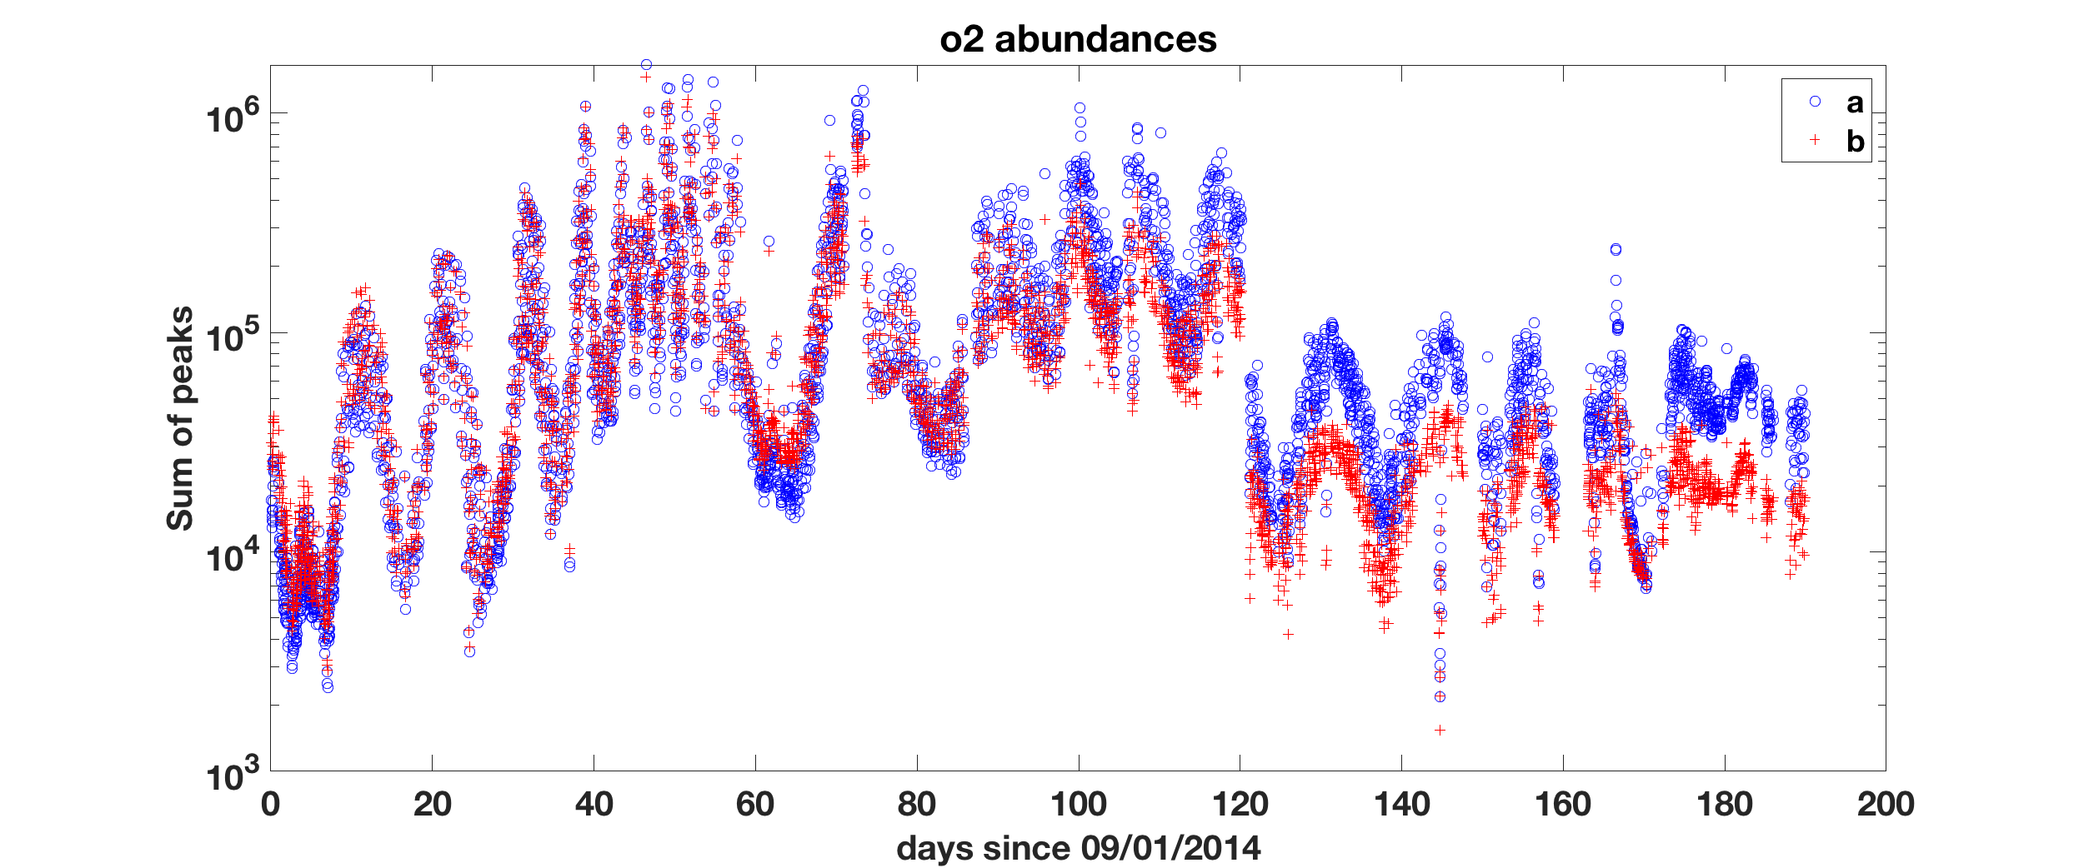
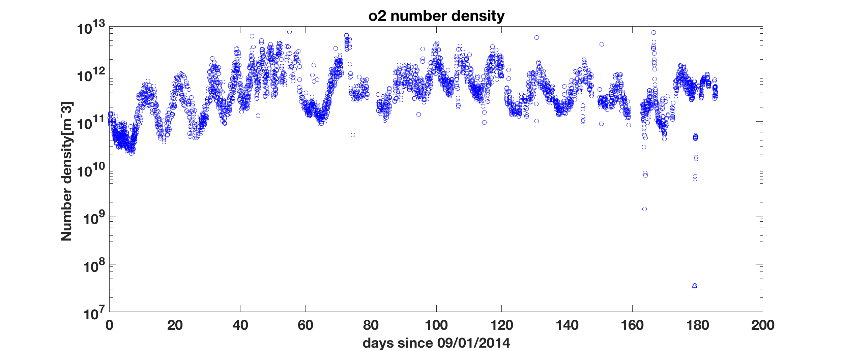

Slide 11
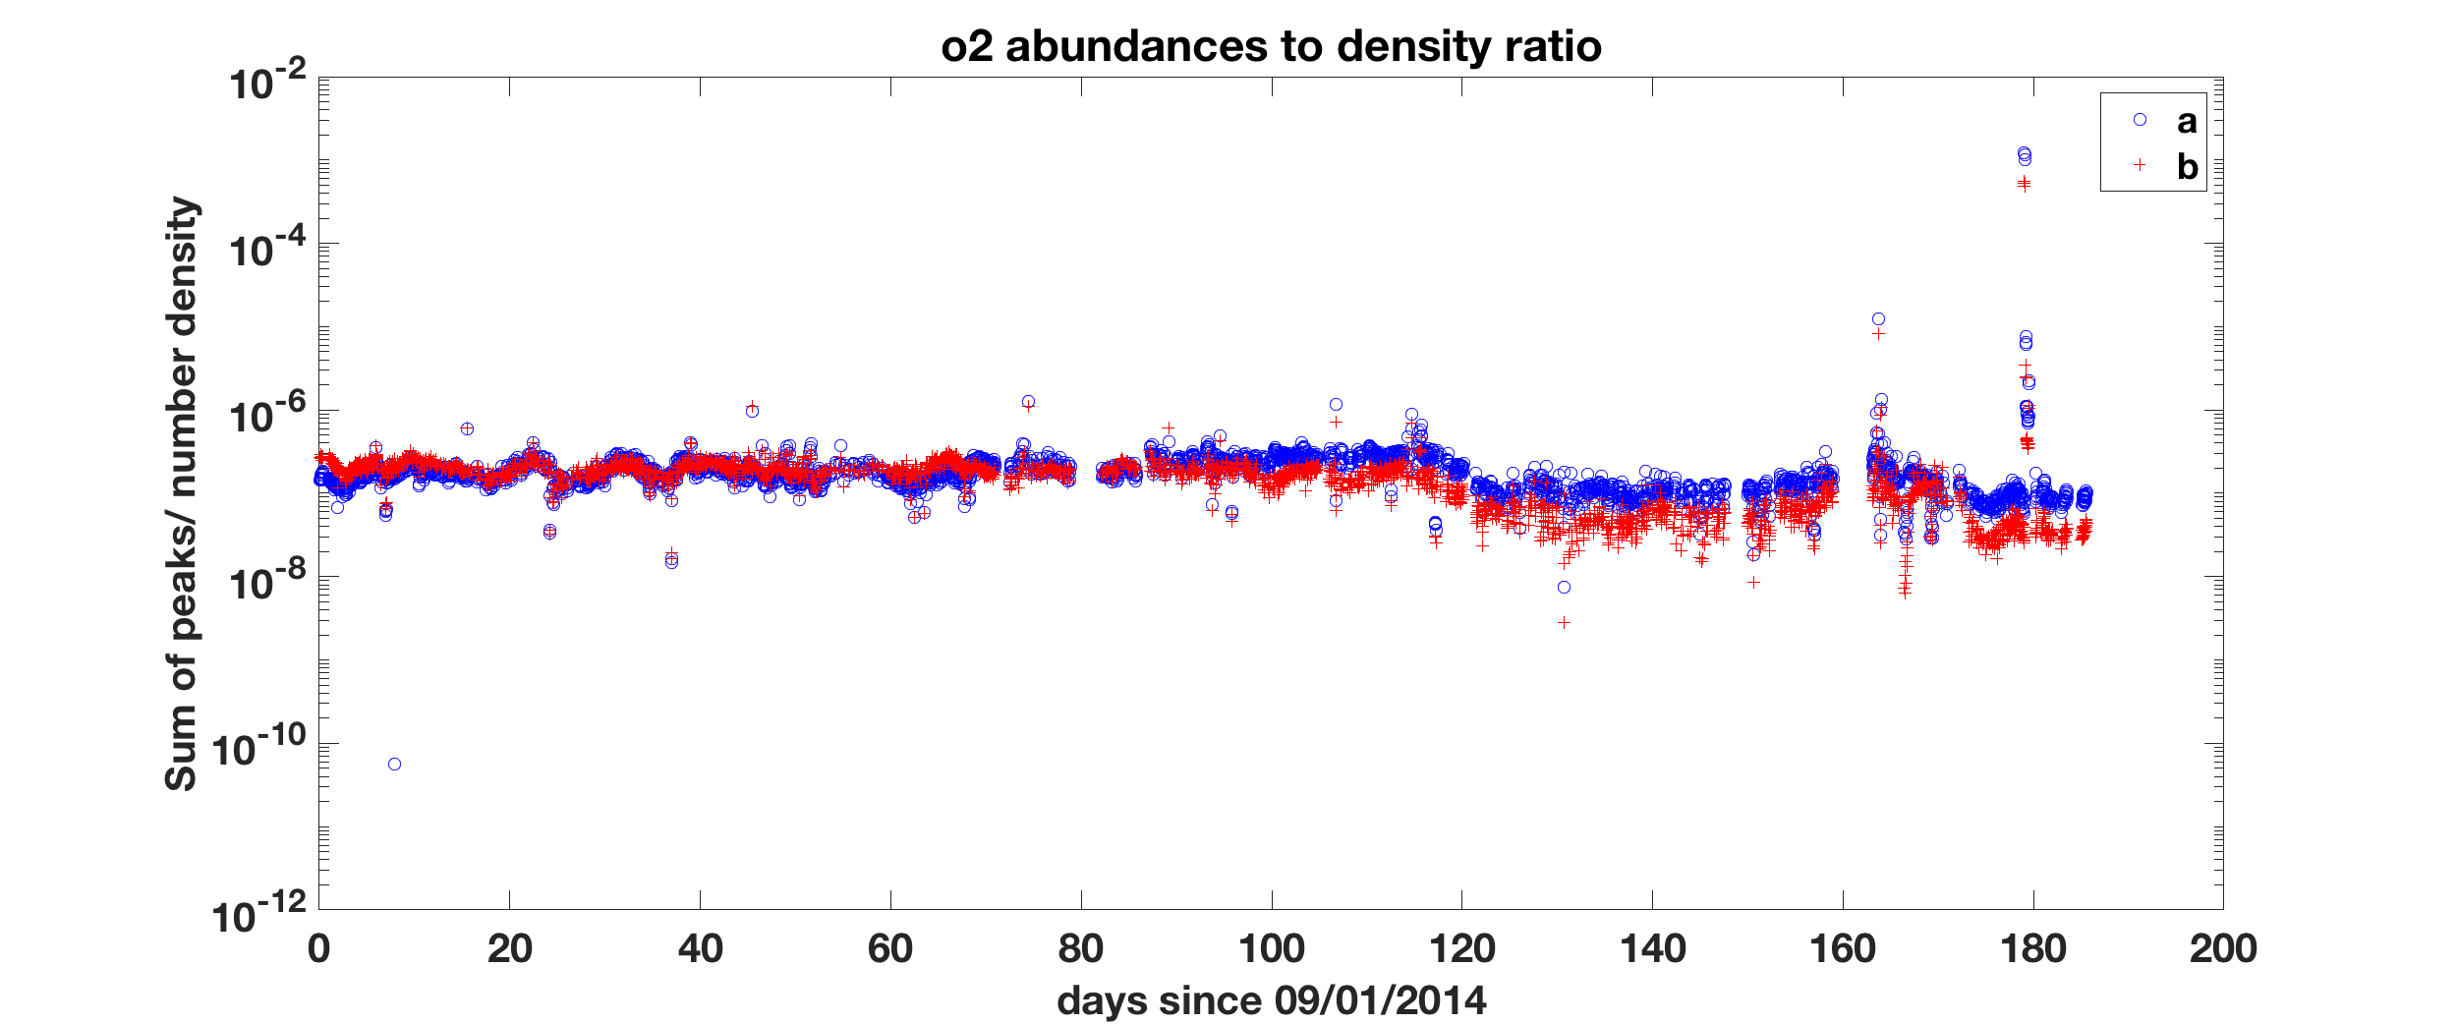

Slide 12
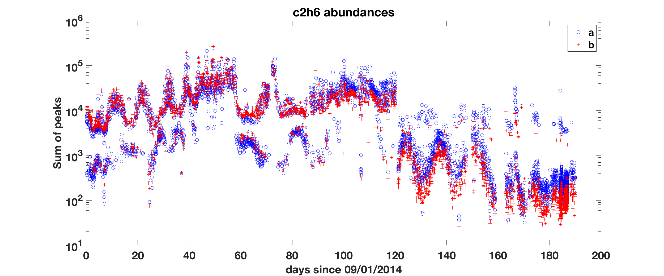
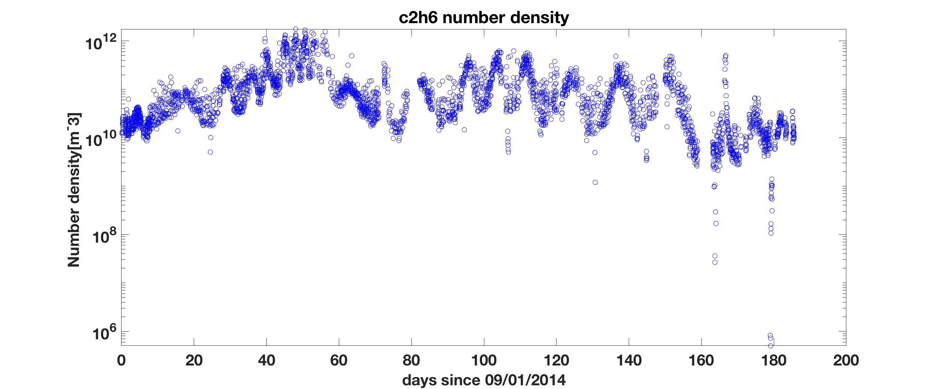
Looks like two lines appear in the abundance data

Slide 13
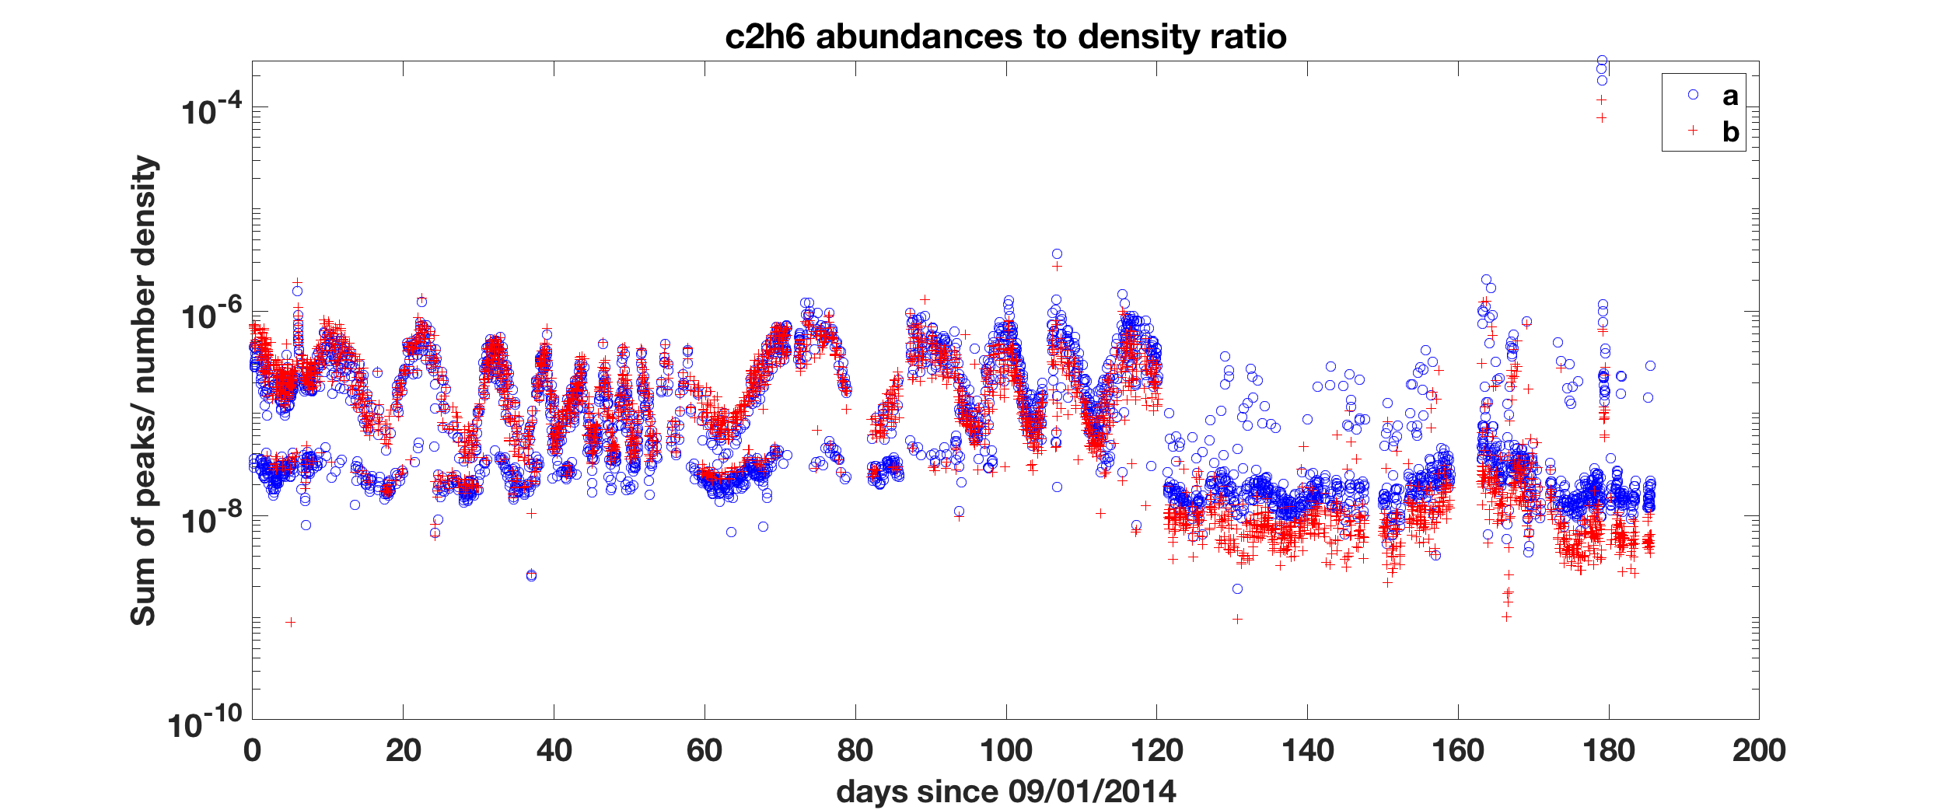

Slide 14
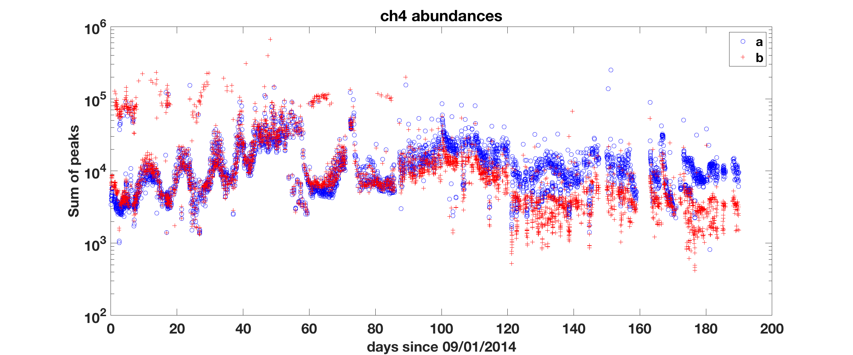
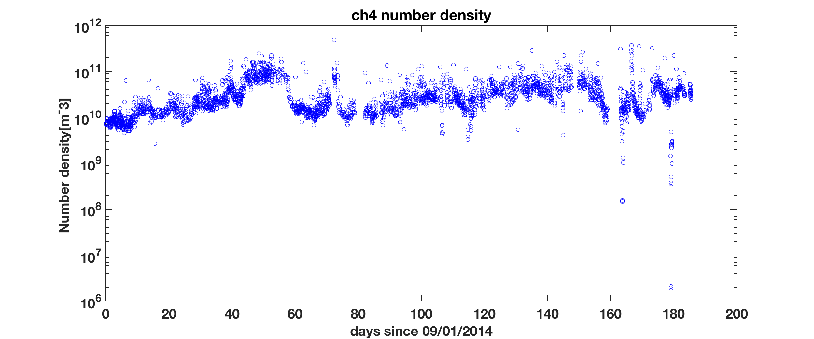

Slide 15
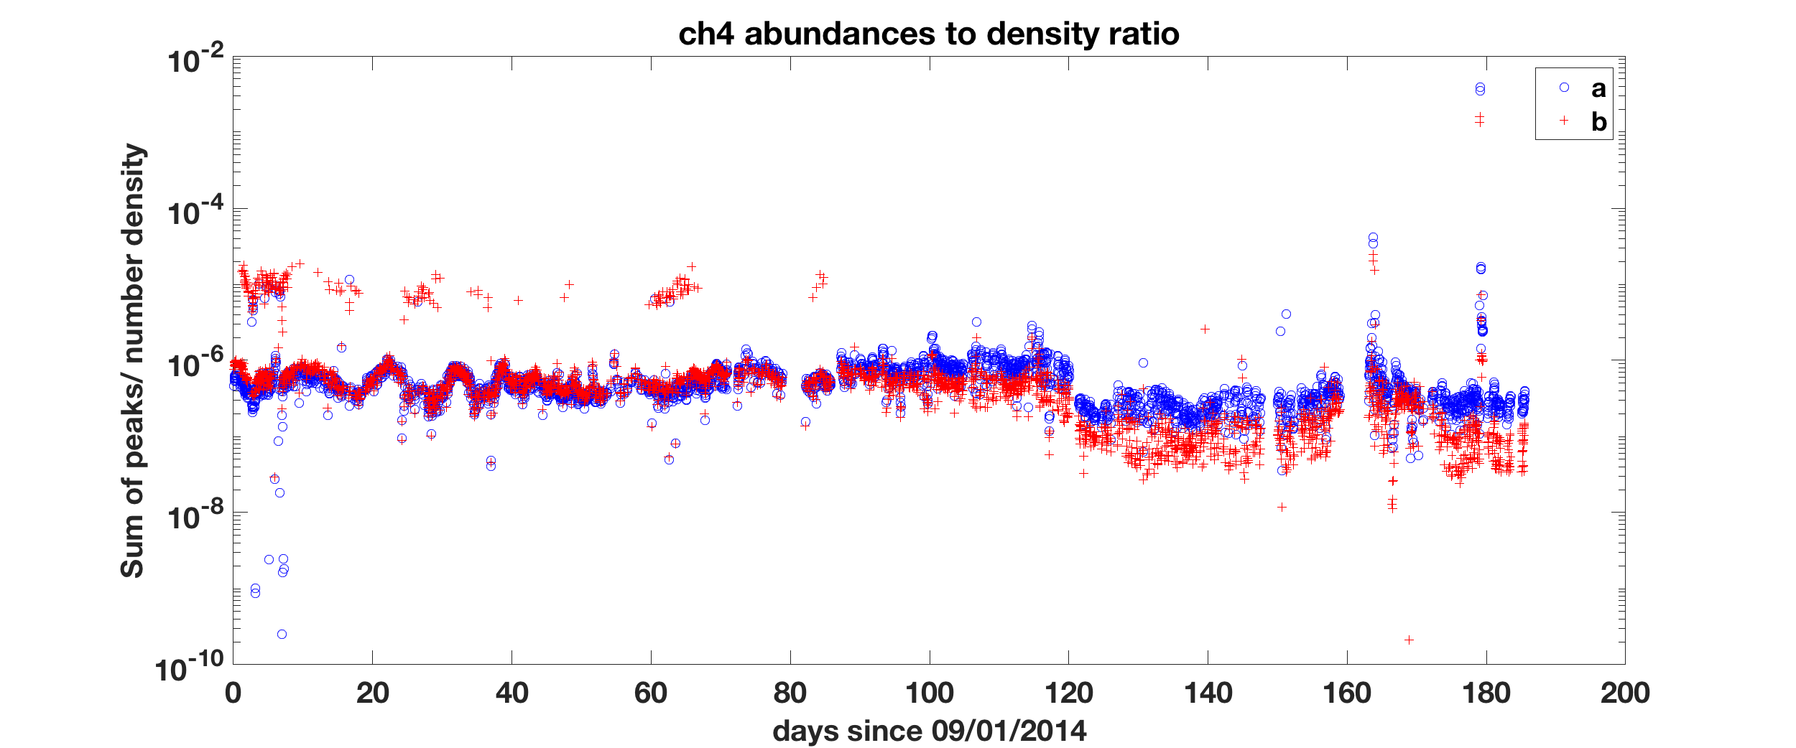

Slide 16
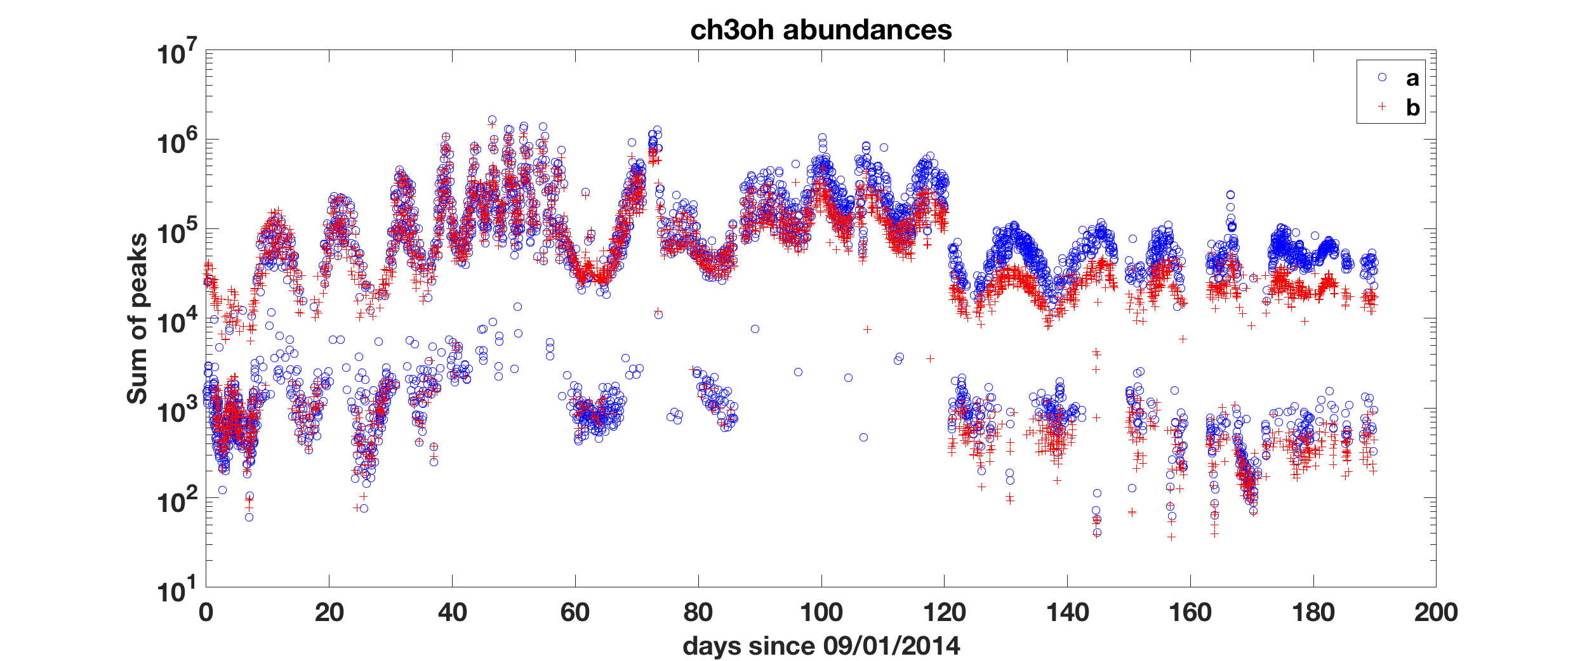
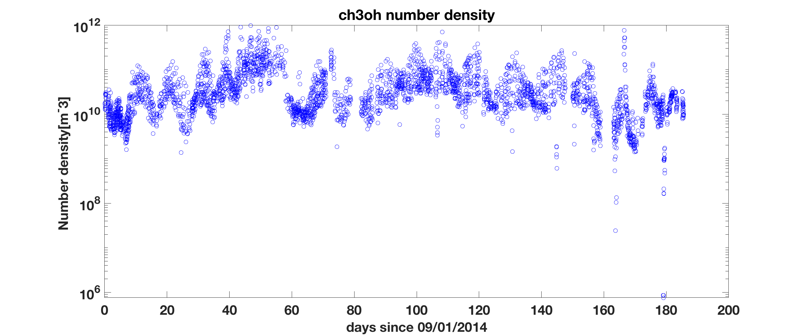
Similar to the case of C2H6, two lines appear in the abundance data

Slide 17
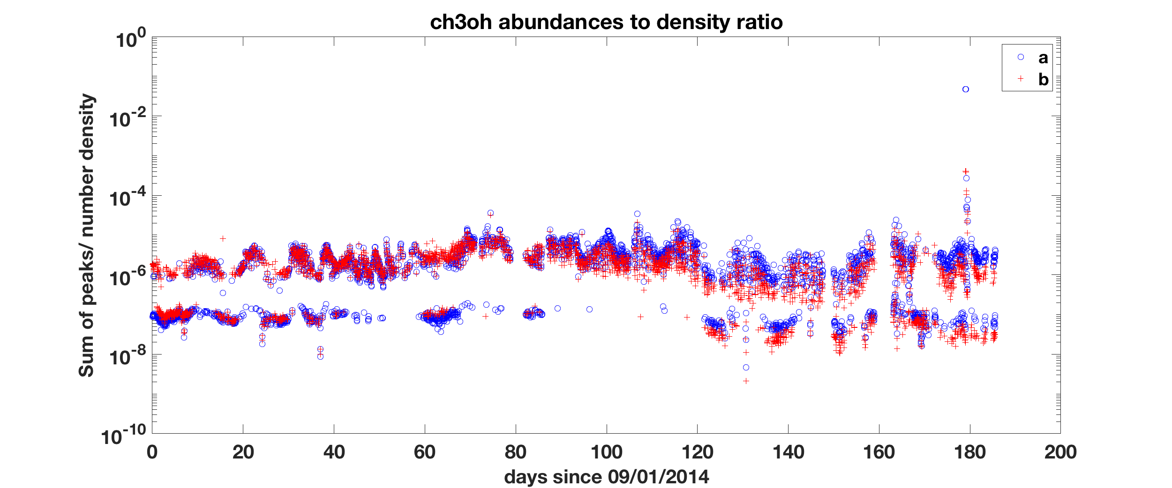

Slide 18
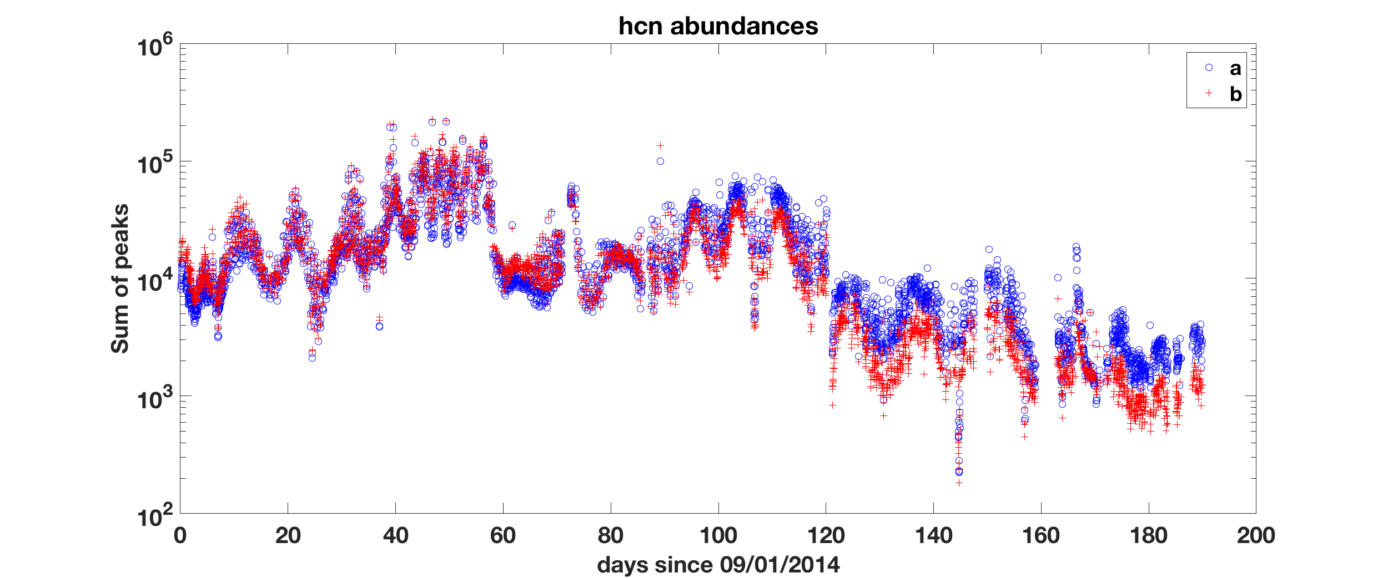
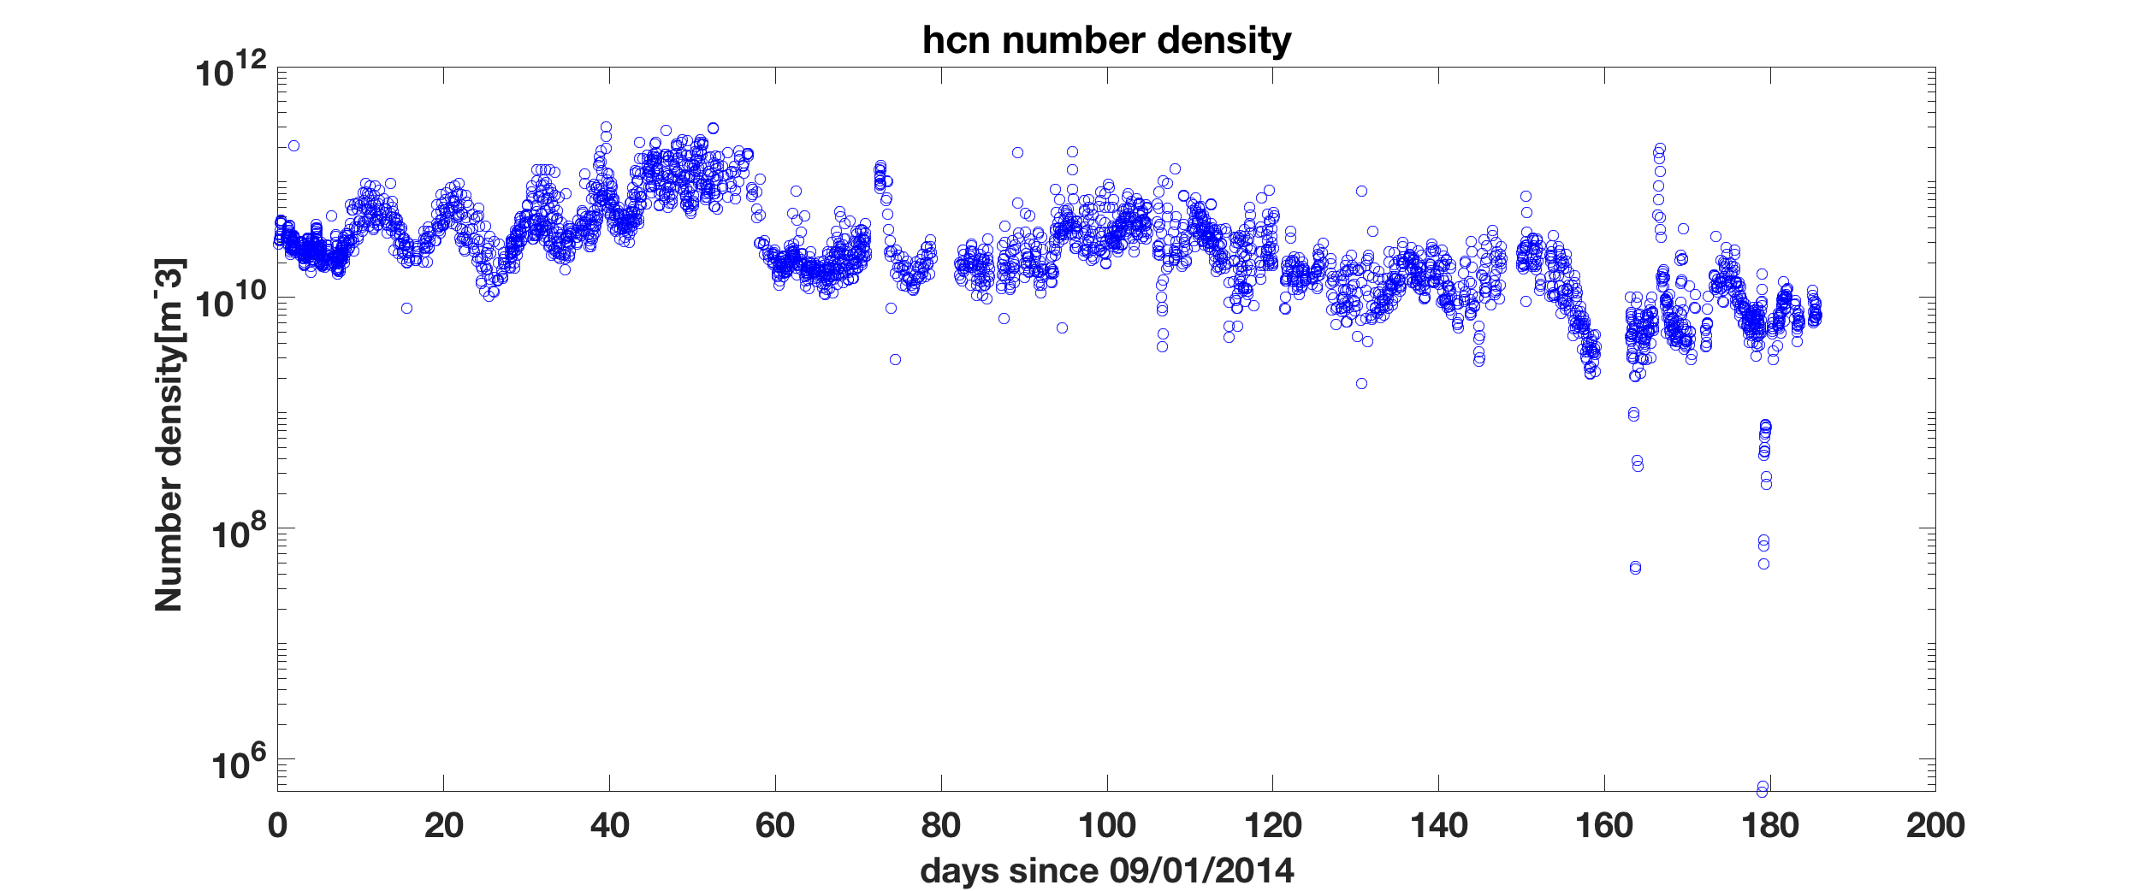

Slide 19
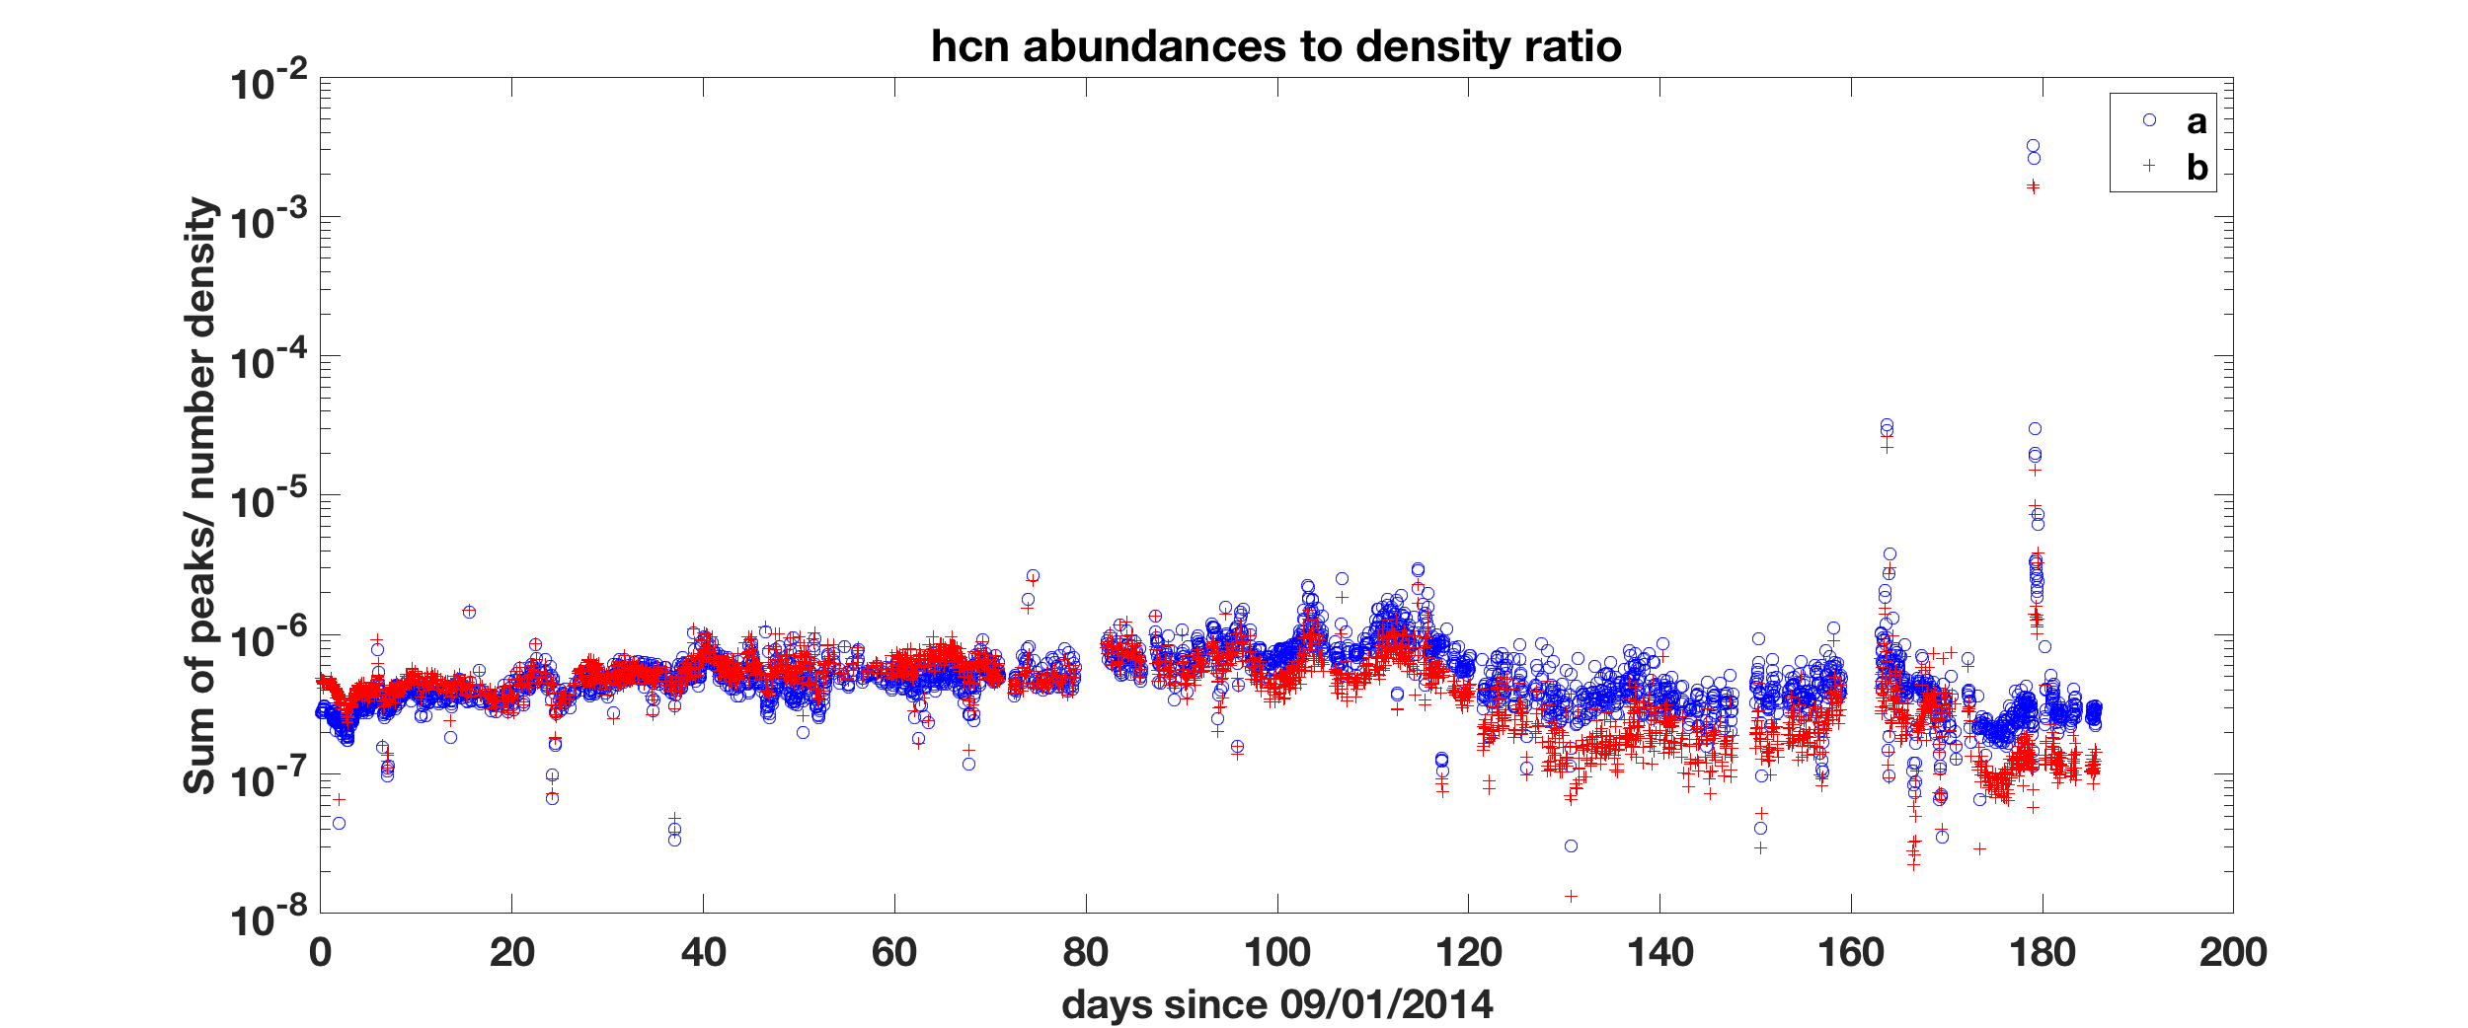

Slide 20
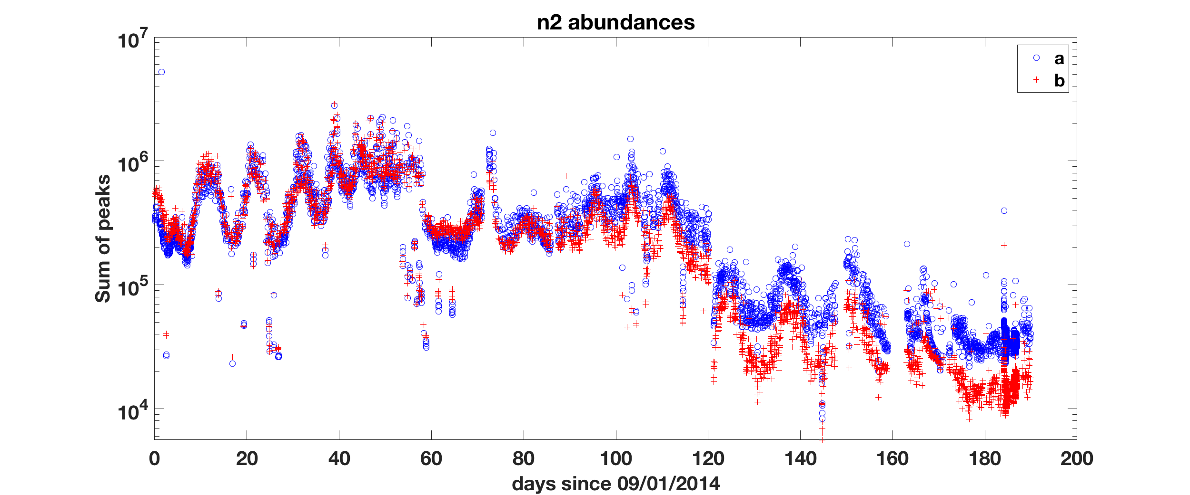
No DFMS number density data available for N2.

Slide 21
If the assumptions for gas velocities are the same for each species, the abundance to density ratios for each species should also be similar. The variations in the CO data is larger than expected.

Slide 22
Conclusion
More information and external references should be provided to help users to understand how the data is derived and to show the usage of the data.
Abundance data points (sum of peaks) from b are consistently lower than a after Day 80 (late Nov 2014), while they overlap with each other before that.
The abundance data (sum of peaks) for C2H6 and CH3OH needs to be checked. The data has two branches formed when plotted against time.
The larger variation in the ratio of abundance to number density data for CO should be investigated later.

