Slide 1
DART Ground-based Data Sample Dataset - Lowell Data
Jian-Yang Li
Planetary Science Institute
7/16/2021

Slide 2
Overview
Sample dataset from DART ground-based observations
Dataset content
145 ground-based images from Lowell Observatory collected on 2020-12-17, with processing levels of “raw” and “cal”, and derived lightcurve
Raw and calibrated images (including master bias and flatfield frames) are stored in FITS format, with accompany PDS4 labels in .xml. Also include .png images marking the astrometry and photometry calibration stars
Derived lightcurve data in an ASCII table with .xml labels
Documentation includes a SIS document in PDF and some high-level overviews for observatory, instrument, and ancillary information from calibration
Overall assessment
Good documentation, easy to follow, with comprehensive information
Image labels in FITS headers appear to be sufficient to understand and use the data
Some very minor suggestions for documentation

Slide 3
Documentation
lowell_dart_uncalibrated_calibrated_sis.pdf
Add page numbers. -- minor suggestion, but should be done
Section 3: Should the DART SOC/Lowell ICD be included in the dataset documentation. Probably not essential, but since it’s mentioned here, data users may want to track it down. Or alternatively, don’t mention it. -- minor suggestion
Section 4.4.7: the explanation of image number says “_0157_ is the 157th image generated on that UT date”. But it’s probably better not say this because otherwise you’ll need to explain the missing images in the data directory. -- minor suggestion
Section 5.1: example for documentation directory ‘documentation/lowell/…’ is different from the actual directory ‘documentation/lowell_doc/…’. Need to make them consistent. -- minor, but needs to be corrected
source_extractor_flags.txt:
Missing a value of 1. Some rows in the lightcurve table has flag values of 3. -- major because it affects the interpretation of data
It’ll be good to include observing log, which may include some detailed information about weather and any other factors that might affect data quality. Or mention this information somewhere for specific days. -- minor suggestion

Slide 4
Images
All raw and calibrated image can be loaded with `astropy.io.fits` and display with DS9 well. pds4_tools.view works fine, too, for images arbitrarily checked.
Display direction defined correctly and consistently.
Raw images contain all necessary information in the header to understand which images is for which purpose (object, bias, flat).
TRIMSEC value: Does the index range follow python style or IDL style? E.g., does [18:2063, 3:2052] include pixel (2063, 2052)? -- minor confusion
Other keyword values all look reasonable

Slide 5
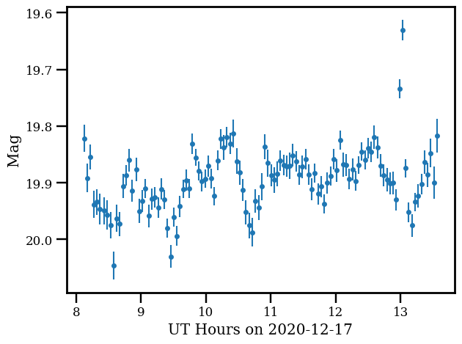
Lightcurve
Data table includes all necessary information to interpret the data
No problem found

Slide 6
Conclusion
Very well-prepared dataset with sufficient documentation
Labels appear to be sufficient to ingest and interpret the data
Small problems to be fixed, mostly minor

