Slide 1
Review of DART ground-based data
Matthew Knight
7/16/21

Slide 2
Overview
No major issues
Data processing appears to be accurate and data are easy to use
Supporting documents provide adequate information to understand the data and reproduce results. Organization is intuitive and easy to find what I’m looking for.
Some minor tweaks needed

Slide 3
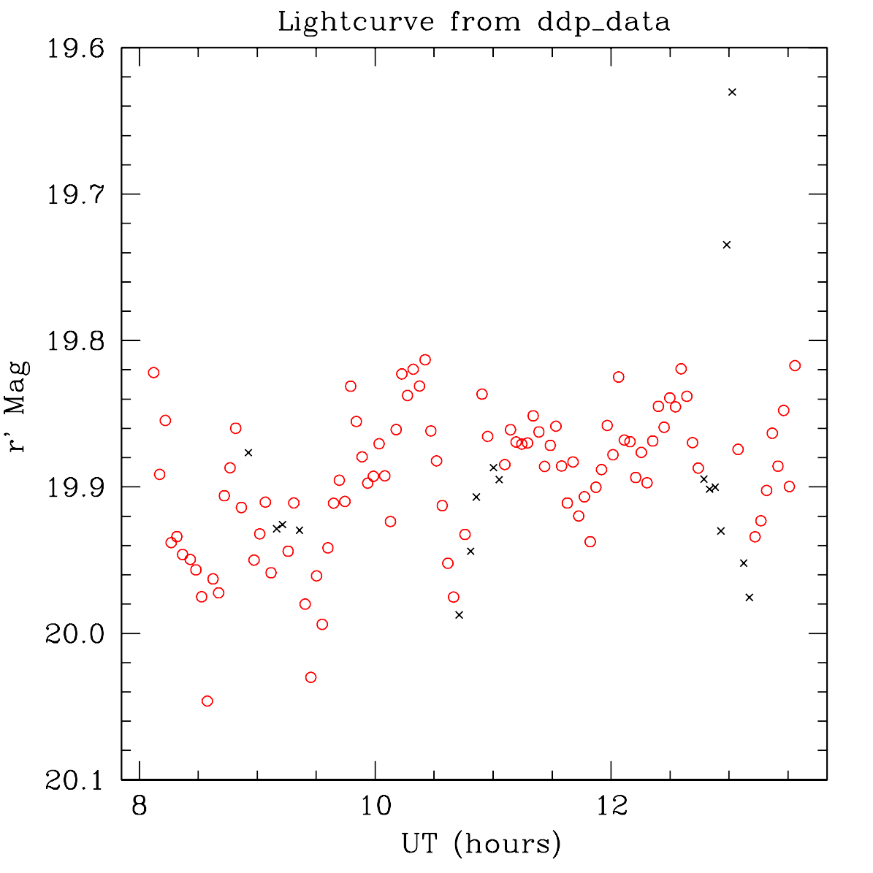
Do the data look reasonable?
Lightcurve looks as expected
Data plotted directly from archived photometry file
Used source extractor flag (field 9) to exclude questionable points (black crosses), improving coherence of lightcurve

Slide 4
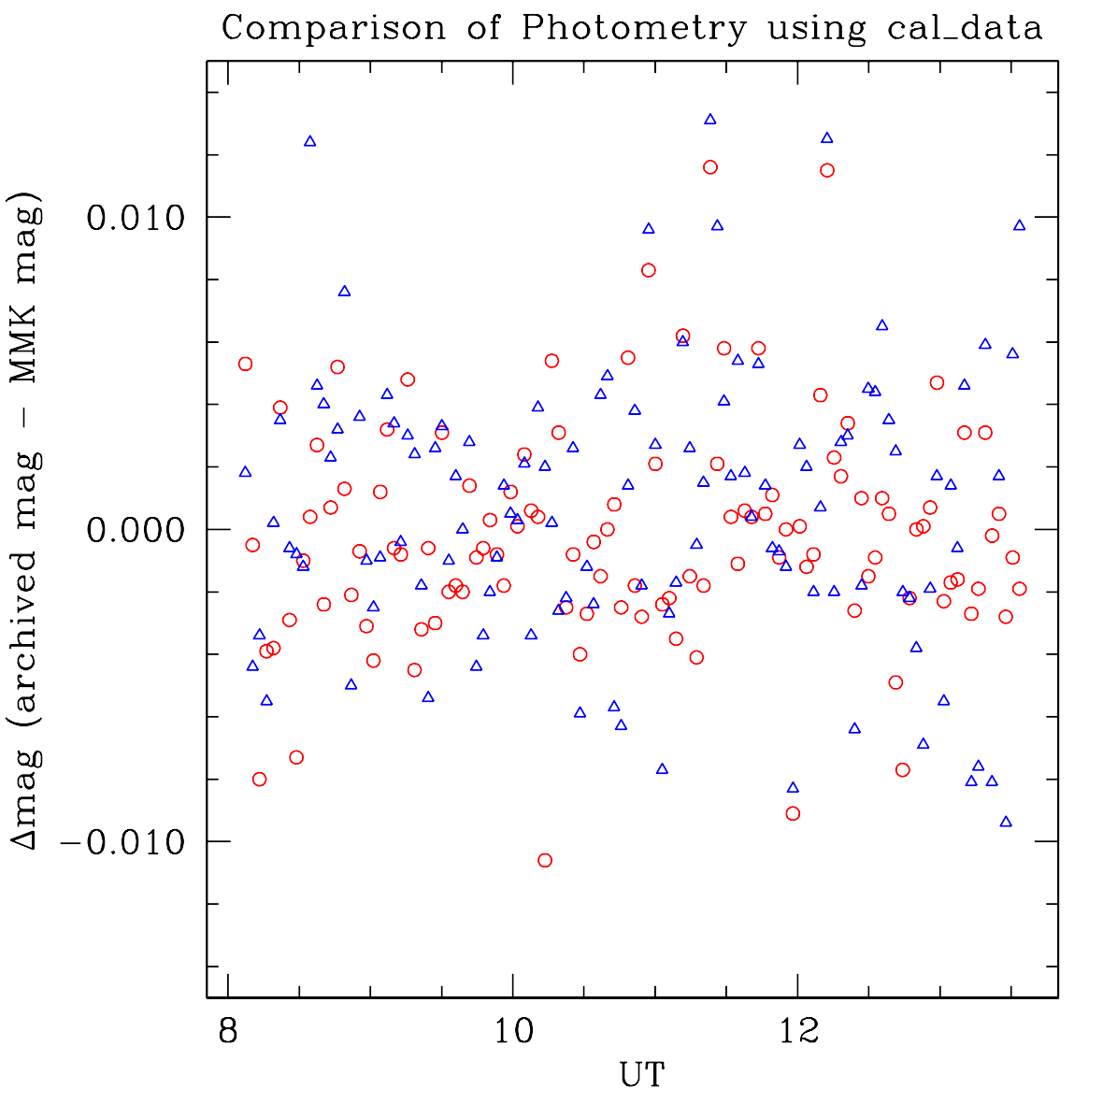
Can I replicate the results?
Results are reproducible
Red circles: difference between archived magnitudes and my photometry from provided calibrated images
Average is -0.0002 +/- 0.0036 mag
Blue circles: difference between archived magnitudes and my photometry from provided raw images which I calibrated following steps outlined in documentation
Average is +0.0006 +/- 0.0045 mag

Slide 5
Major comments 1 of 2
Key file is *_photometry.dat which is an ASCII table. I believe this is should be called *.tab rather than *.dat?
Also: trailing 0s were not printed in this table. Use same number of significant digits for all values in a column
Ambiguity about array indexing [wording fix needed in documentation]
TRIMSEC and BIASSEC both give arrays of pixels as [x1:x2, y1:y2]. To match the provided data, these should be interpreted as including pixels from x1 to x2-1 and y1 to y2-1.

Slide 6
Major comments 2
Documentation should note somewhere the tracking that was used during exposures (asteroid’s rate, sidereal rate, half-asteroid rate)
Is there a reason to include the “Example data product labels”?

Slide 7
Minor comments
Some minor comments included in annotated PDF of Lowell_dart_uncalibrated_calibrated_sis.pdf [Matthew will provide separately]
Minor inconsistencies between text and table in section 5.1.1
Units missing from a few entries in table in section 5.1.1
Lowell_data/collection_[cal,raw].csv – why are file names not in sequence?
Collection_lowelldoc.xml – [and probably elsewhere] “Lowell Discovery Telescope” and “Discovery Channel Telescope” are used. Try to standardize all uses or note at a high level that both are the same telescope (new vs old name)

