Slide 1
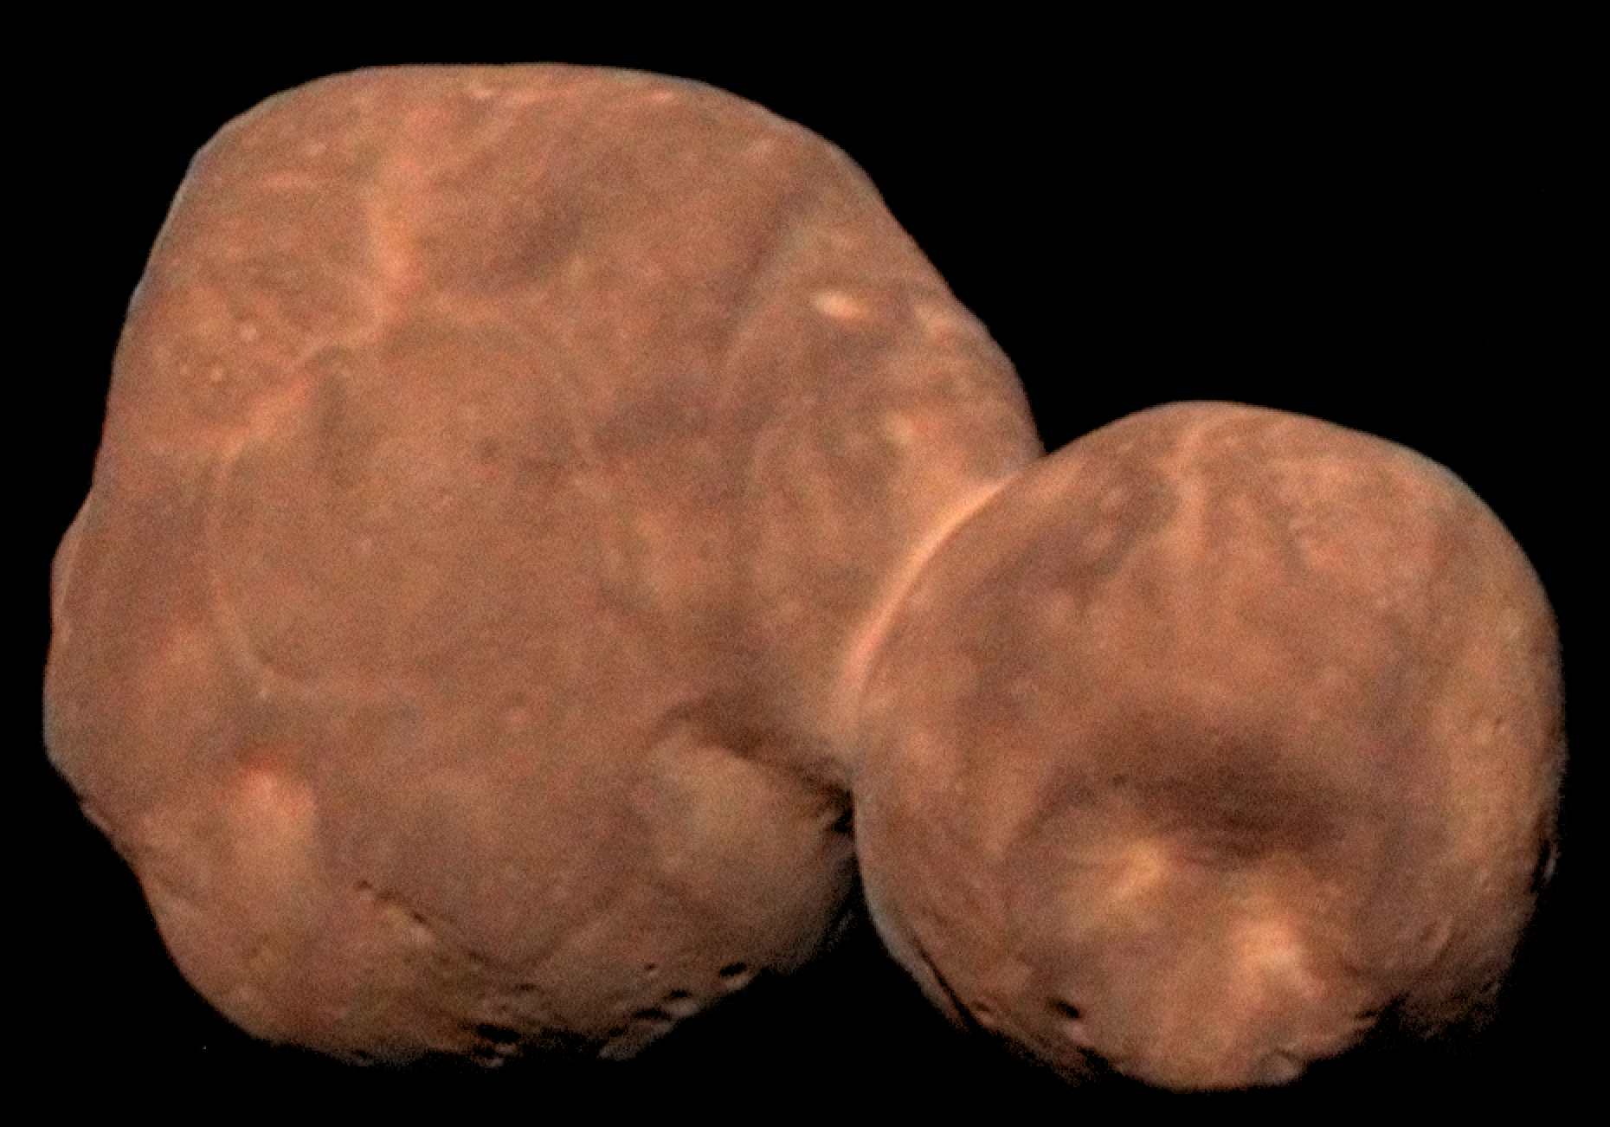
New Horizons KEM1 V5.0 Alice Instrument PDS-SBN Review
Lori Feaga (UMD)
Feb. 9, 2022

Slide 2
NH KEM 1 V5.0 (Level 2 & 3) Alice Data
Overall – just a little more data than V4, none of main target
V1 = 4 data files (3 of MU69)
V2 = 75 data files (~40 of MU69, some of cal star)
V3 = 493 data files (~165 of MU69, some of the Sun, and some of a cal star)
V4 = 726 data files (184 of MU69, 279 of the Sun, 240 of cal stars, 4 of the sky, and 19 N/A)
V5 = 738 data files (184 of MU69, 279 of the Sun, 242 of cal stars, 8 of the sky, and 25 N/A)
Data are readable with readpds in IDL, i.e. described correctly in PDS labels
Previous liens all fixed
No problems!

