Slide 1
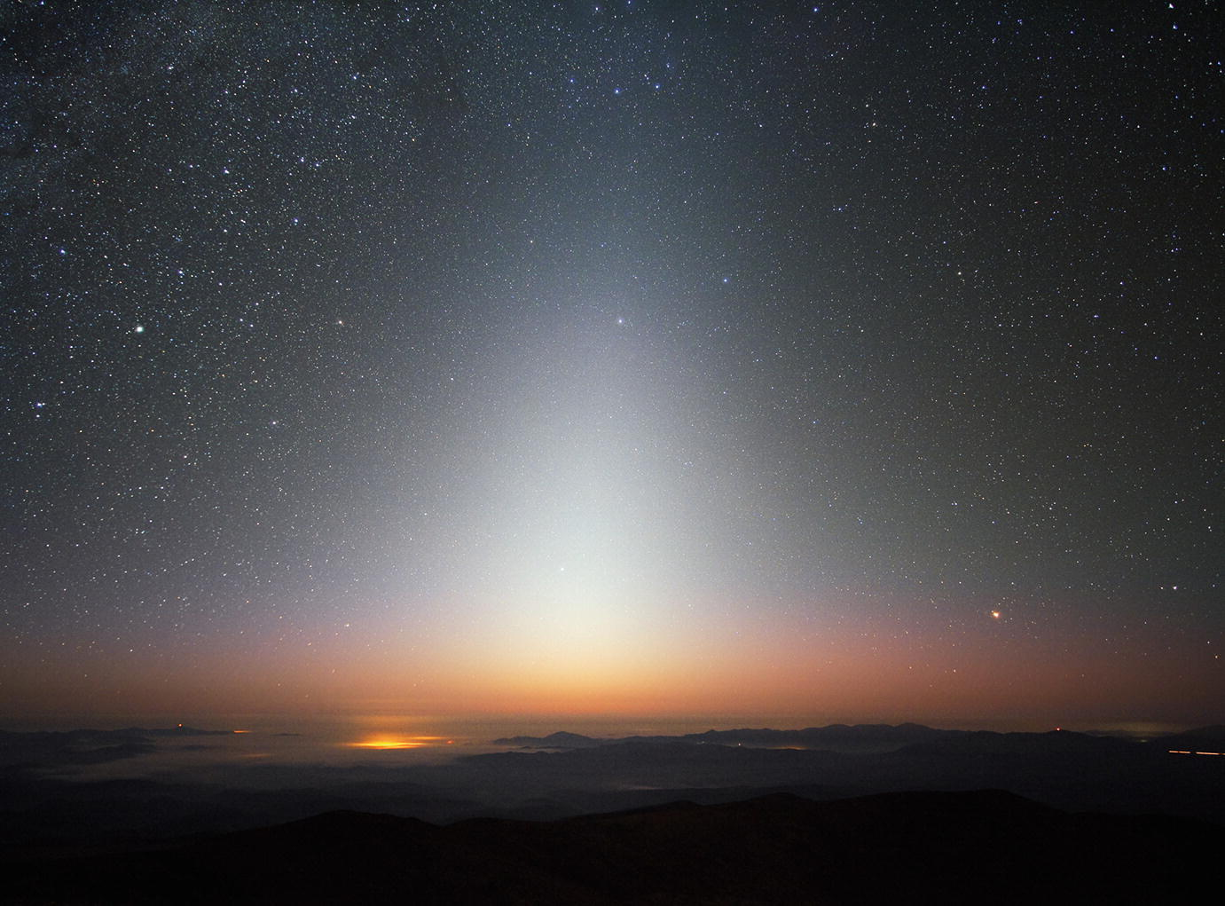
New Horizons KEM1 Data Set nh-x-alice-5-ipm-v1.0
Lori Feaga (UMD)
Feb. 9, 2022

Slide 2
Major formatting lien on data??
IDL> ipm=readpds(‘nh-x-alice-5-ipm-v1.0/data/nh_alice_ipm_scan_countrate.lbl')
Now reading header: nh-x-alice-5-ipm-v1.0/data/nh_alice_ipm_scan_countrate.lbl
Error in object SPREADSHEET: ROWS or ROW_BYTES or FIELDS <= 0.
** Structure <162de7b8>, 2 tags, length=4, data length=4, refs=1:
OBJECTS INT 1
SPREADSHEET INT -1
Get error when using readpds
Translates to possible error(s) in data label
NASAVIEW gives error on Field 2 bytes exceed 5
Fields 3-90 are all defined as F10.6 format, but some sig fig trailing 0’s are omitted, so the fields are not all F10.6 (see examples of F7.3, F8.4, and F9.5)
Data are readable by Excel and by eye

Slide 3
Minor liens
index.lbl: column 7 description, add “the” before target:
"This parameter identifies the target, defined as the active CB in the Guidance and Control System, at the time of the observation.”
ref.cat has one additional reference for PEPSSI: KOLLMANNETAL2019 that other Alice KEM1 V2 data do not have, should the ref.cat be uniform for all deliveries here or is this not a problem?
dataset.cat should give the full wavelength range used for the Ly-α integration/measurement

