Slide 1
Alice Data Review
New Horizons KEM 1 v5.0
Alice 5 IPM, Alice 5 Atmosphere
John Noonan
February 9, 2022

Slide 2
Overview: KEM1 v5.0
Review of nh_a_alice_2_KEM1_v5.0 and nh_a_alice_3_KEM1_v5.0
Previously reviewed nh_x_alice 2_KEM1_v1.0, nh_x_alice_3_KEM1_v1.0, nh_a_alice_2_KEM1_v2.0, nh_a_alice_3_KEM1_v2.0,nh_a_alice_2_KEM1_v3.0, nh_a_alice_3_KEM1_v3.0,nh_a_alice_2_KEM1_v4.0, nh_a_alice_3_KEM1_v4.0
New submission includes data through 04-30-2020 (S/C Time)
734 total eng/sci.fits files in each
V4.0 had 726 FITS files
8 new files are Alice dark exposure, IPM measurements
No major issues preventing database from use and data look good
No minor issues
PDS SBN Review February 9

Slide 3
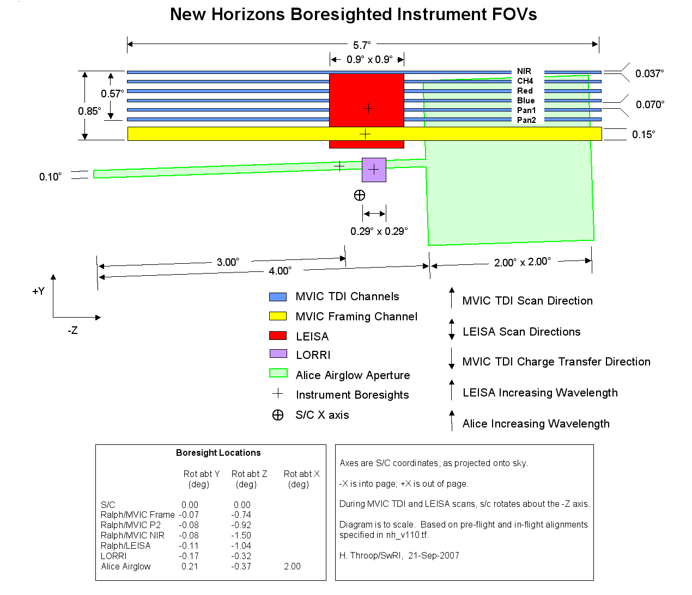
Brief P-Alice Instrument Overview
P-Alice is an ultraviolet spectrograph sensitive from 520 to 1870 Angstroms
A “lollipop” shaped slit is used (wide on top, narrow on bottom)
Detector has 1024 columns in the spectral dimension, 32 rows in the spatial dimension.

Slide 4
Data Review: Alice KEM1 v5.0

Slide 5
Usability
All .fits files accessed using Python and astropy.io.fits
All eng files calibrated according to ICD
All sci files accessed, both data and headers
Log file with machine readability available
PNGs with both user-calibrated, science files, and differences available on request
Python code available as well
All .lbl files checked with Python script for machine readability
Log available upon request
Select files checked in NASAView/DS9 to ensure _eng.fits files matched _sci.fits files
PDS SBN Review February 9

Slide 6
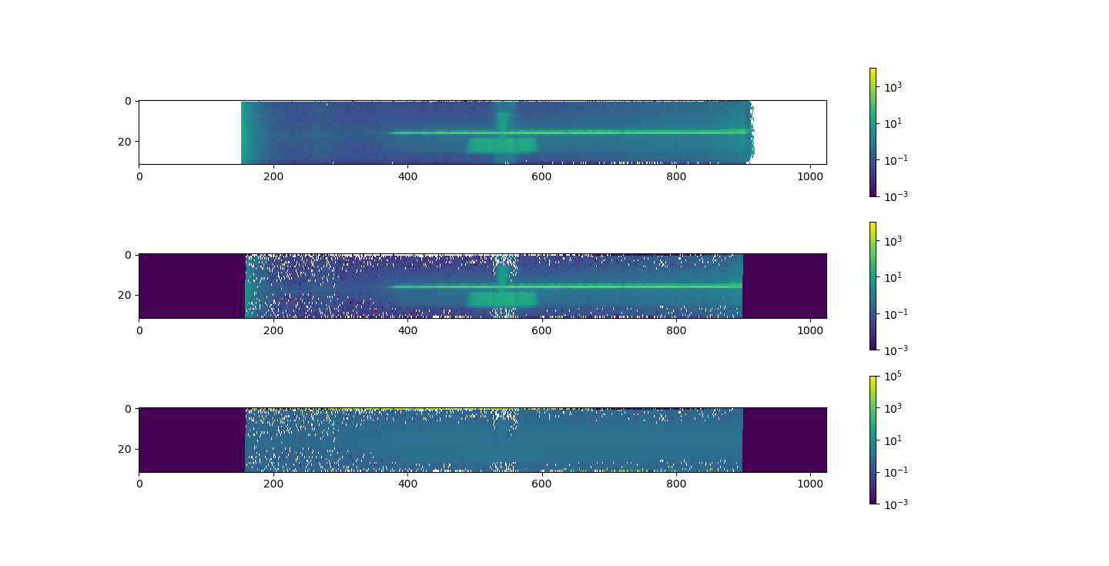
Example Difference Image: ali_0429588629_0x4b2_sci
User Calibrated
SOC Calibrated
Percent Difference

Slide 7
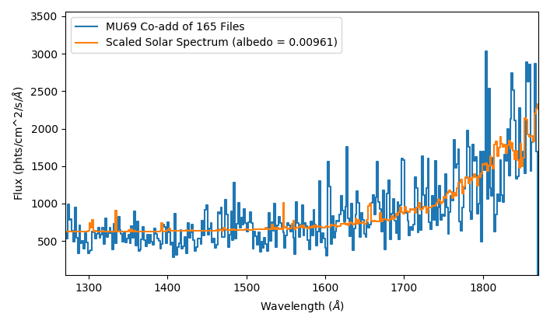
Arrokoth Solar Reflectance Fit (a_{UV}=0.01, v3.0)
PDS SBN Review February 9

Slide 8
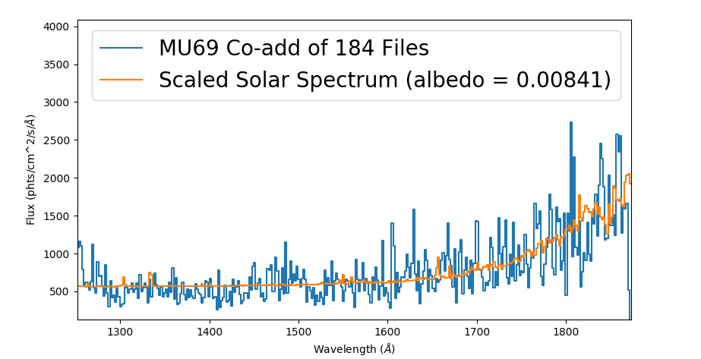
Arrokoth Solar Reflectance Fit (a_{UV}=0.01), v4.0
PDS SBN Review February 9

Slide 9
Major Issues
Minor Issues
None
None
PDS SBN Review February 9

Slide 10
Data Review: Alice IPM Scans

Slide 11
Overview: Alice IPM Scans
Review of NH-X-ALICE-5-IPM-V1.0
Submission includes data through 04-30-2020 (S/C Time)
1 Count rate CSV file, 10 IPM scans
No major issues preventing database from use and data look good
No minor issues
PDS SBN Review February 9

Slide 12
Usability
Manually accessed and read user files
Accessed and plotted 10 scans, data look good
Python code available as well
All .lbl files checked with Python script for machine readability
Log available upon request
PDS SBN Review February 9

Slide 13
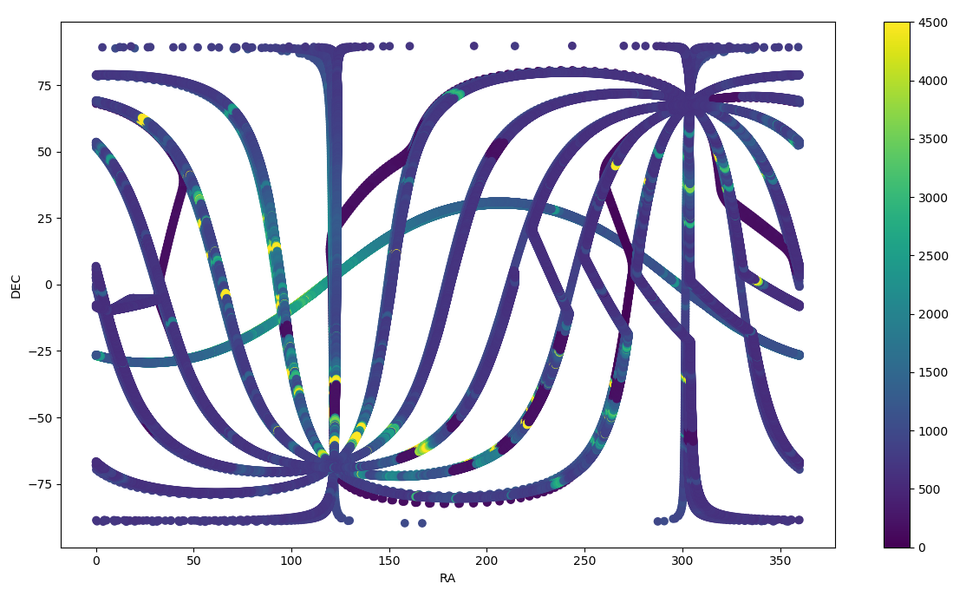
Data - IPM Scans
10 Scans
Similar to Fig. 6 in Gladstone et al. 2021
All processing info present in dataset.cat
Information for orientation of Alice slit present in CSV

Slide 14
Issues
No major issues
No minor issues

Slide 15
Data Review:
Pluto Encounter -Alice Atmosphere Data v.20

Slide 16
Overview: Pluto Encounter Atmospheric Data v2.0
Review of NH-P/PSA-ALICE-5-ATMOS-V2.0
Submission includes data through 04-30-2020 (S/C Time)
2 Fits files in Solar Occultation, 1 Fits file in Stellar Occultation
2 Composition abundance and density CSV
New to this version is /STAROCC, stellar occultation and appulse data
No major issues preventing database from use and data look good
No minor issues
PDS SBN Review February 9

Slide 17
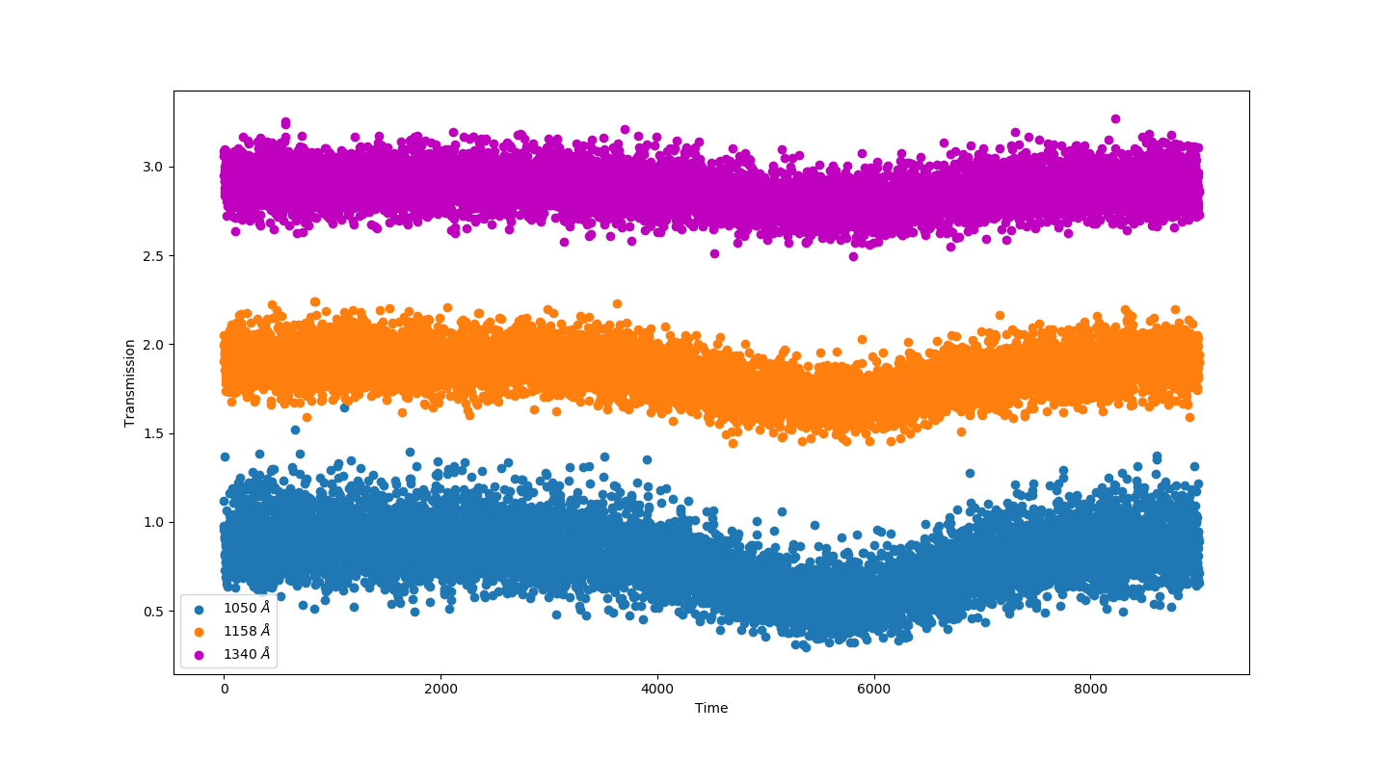
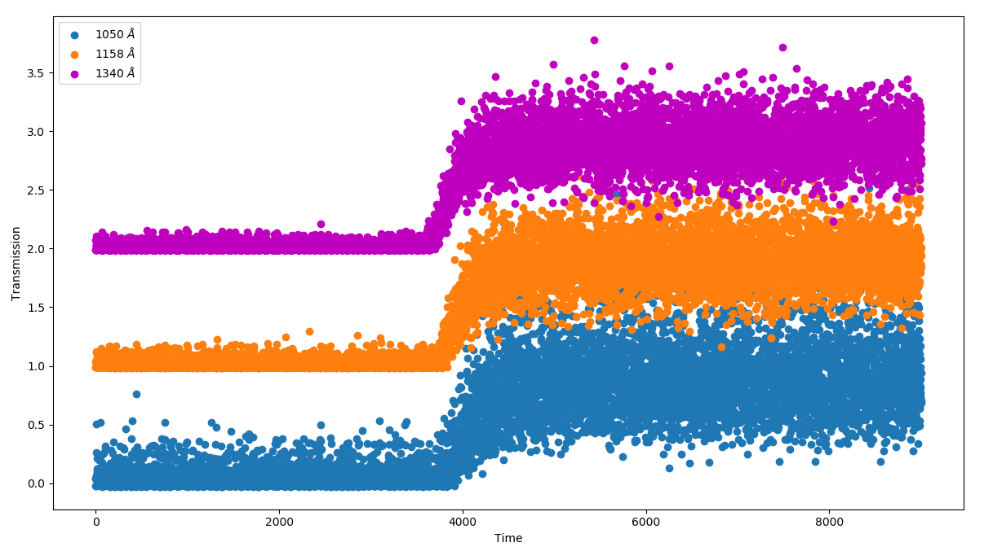
Data - Stellar Occultation/Appulse
Transmission lightcurves processed according to dataset.cat
Appulse and Occultation data match Kammer et al. 2020

Slide 18
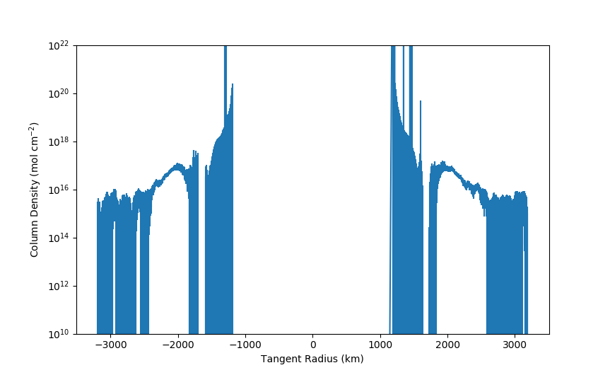
Data - Atmosphere Abundances
N₂ Column Density
Data look good and plot easily
Ample documentation in the FITS headers as well as supporting docs

Slide 19
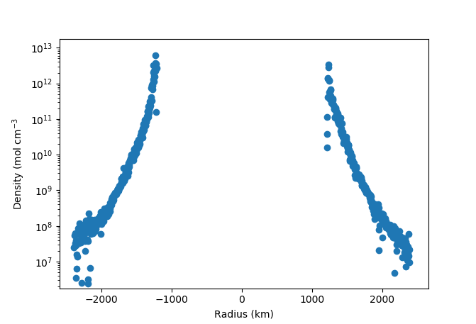
Data - Atmosphere Densities
CH₄ Number Density
Data look good and plot easily
Ample documentation in the FITS headers as well as supporting docs

Slide 20
Issues
No major issues
No minor issues
All data and documentation look good and are ready for release.

