Slide 1
PDS SBN review of:
New Horizons Arrokoth Encounter Surface Composition Maps
New Horizons Arrokoth Encounter Geology and Geophysical Maps
https://sbnreview.astro.umd.edu/revpro/nh_k4_202
Trent Hare, Feb. 1, 2022.
Overall, not much to say about documentation, labels and data.
Some minor spelling issues listed below. Documentation including PDFs are good (a few figures could be crisper (less jpeg-y) perhaps less compression used when creating PDF (specifically in soc_inst_icd.pdf)? Any “N.B.” comments can be removed. Note, I did not pick-over PDFs.
Filename case continues to be a common problem with PDS3. For example, all the labels list: ^IMAGE = ("CA05_MVIC_CUBE.FIT", 2) but the files are lowercase. This can cause some readers to choke. I don’t really have a recommendation here since this is rampant in labels.

Slide 2
nh-a-leisa_mvic-5-comp-v1.0/data/ca04_leisa_cube.lbl
I appreciate the FITS warning:
By mutual agreement with PDS-SBN, FITS headers are the domain of the NH
Project and were not part of the peer review beyond adherence to the
FITS standard. FITS header values, especially geometric conventions
regarding phase angle, direction of supplied vectors and sense of light
time and stellar aberration corrections, were chosen to serve
operational purposes and should be used with care.
But then the label describes using the FITS files (DESCRIPTION). Listing PDU, DU, EDUs…? Also, not sure what this means:
“The third axis (BAND) is image number and could also be thought of as time. ”
Suggestions:
No attempt to “mask” or define Nodata in the label (outside of the image). Just a little nicer for the user.
No keyword or comment in the label pointing to the ca04_leisa_wavelengths.lbl (*.tab)
Is 64bit float point bit type really warranted here or would 32bit floating point be enough?

Slide 3
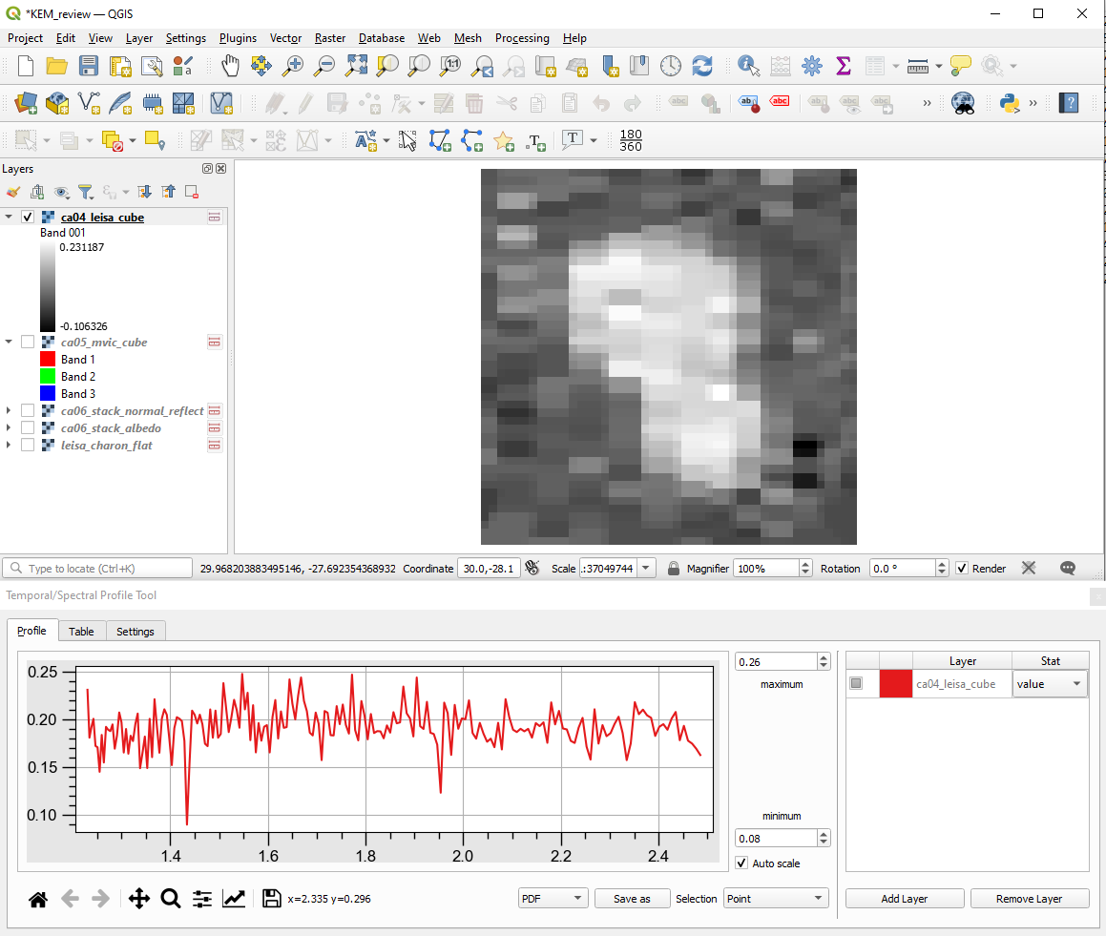

Slide 4
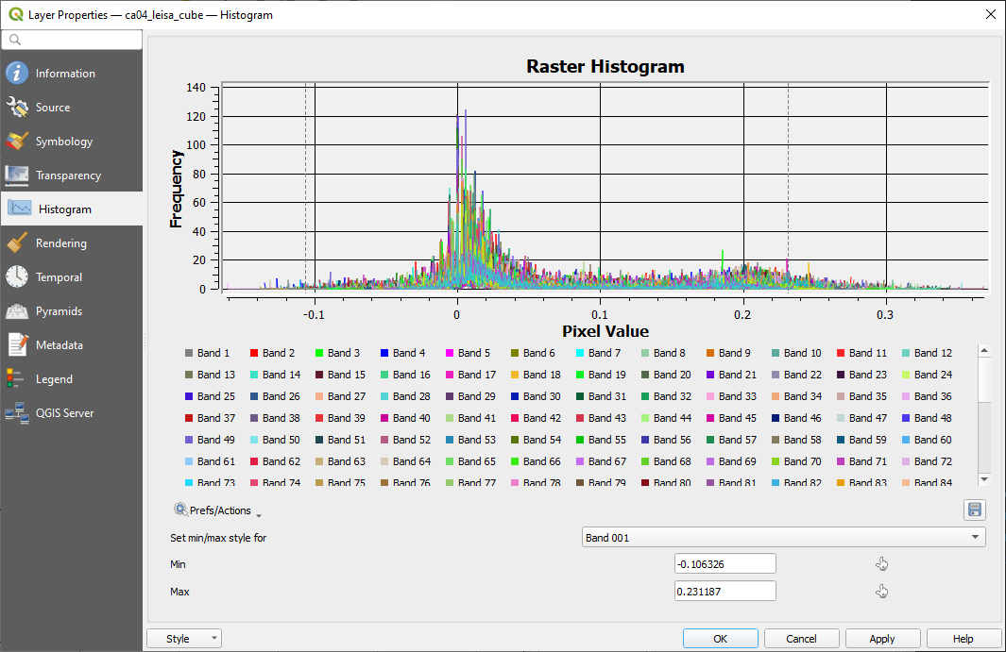

Slide 5
nh-a-leisa_mvic-5-comp-v1.0/data/ca05_mvic_cube.lbl
I appreciate the FITS warning again. But now the description is even more terse listing
“FITS PDU”. If the language stays talking to FITS files please spell out the acronyms
Suggestions:
No attempt to “mask” or define Nodata in the label (outside of the image). Just a little nicer for the user.
No keyword or comment in the label mapping the bands. Perhaps just listing:
The color filters are identified as 'BLUE' (400-550 nm), 'RED'
(540-700 nm), 'NIR' (780-975 nm) and 'CH4' (860-910 nm)

Slide 6
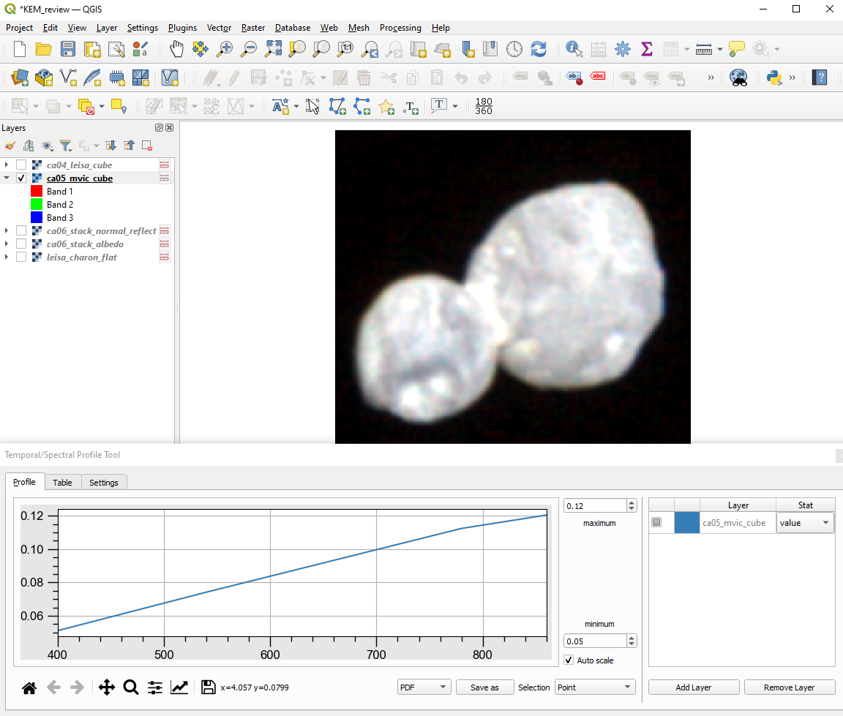

Slide 7
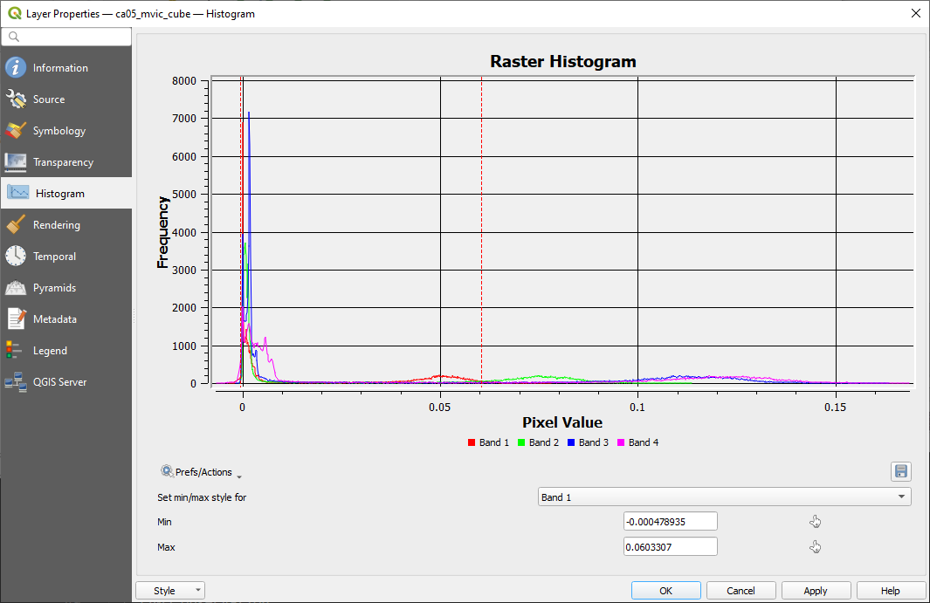

Slide 8
nh-a-leisa_mvic-5-comp-v1.0/data/leisa_charon_flat.lbl
Same FITS warnings.
Suggestions:
No attempt to “mask” or define Nodata in the label (outside of the image). Just a little nicer for the user.
No keyword or comment in the label mapping the bands. Perhaps just listing:
The color filters are identified as 'BLUE' (400-550 nm), 'RED'
(540-700 nm), 'NIR' (780-975 nm) and 'CH4' (860-910 nm)

Slide 9
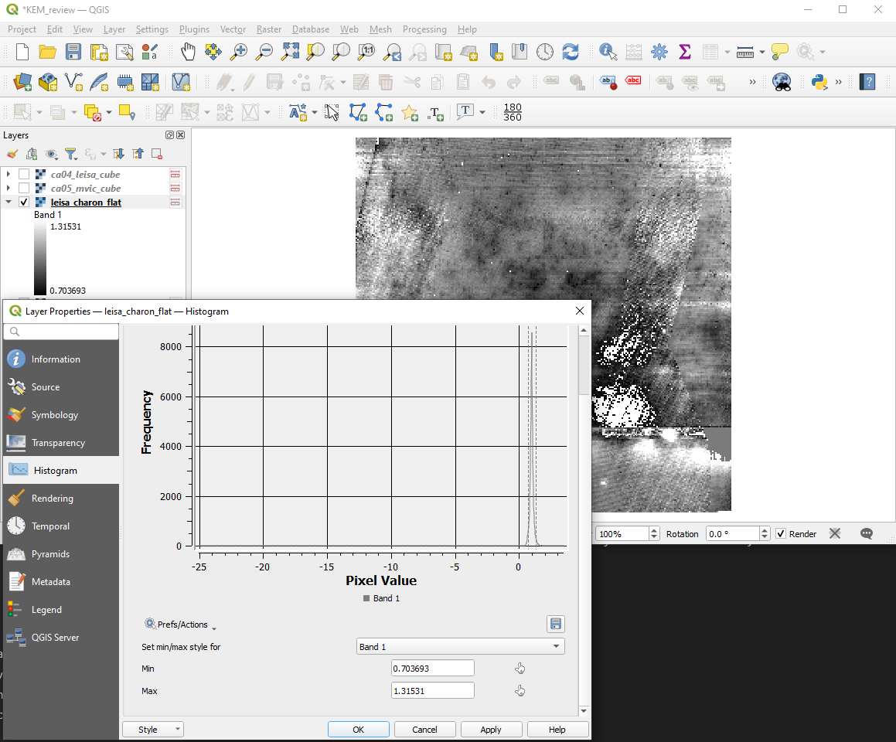

Slide 10
nh-a-lorri_mvic-5-geophys-v1.0/data/albedo/ca06_stack_albedo.lbl
Great looking image but with lots of collar noise.
Suggestions:
No attempt to “mask” or define Nodata in the label (outside of the image). Just a little nicer for the user. Label defines NULL and saturation values but not used?

Slide 11
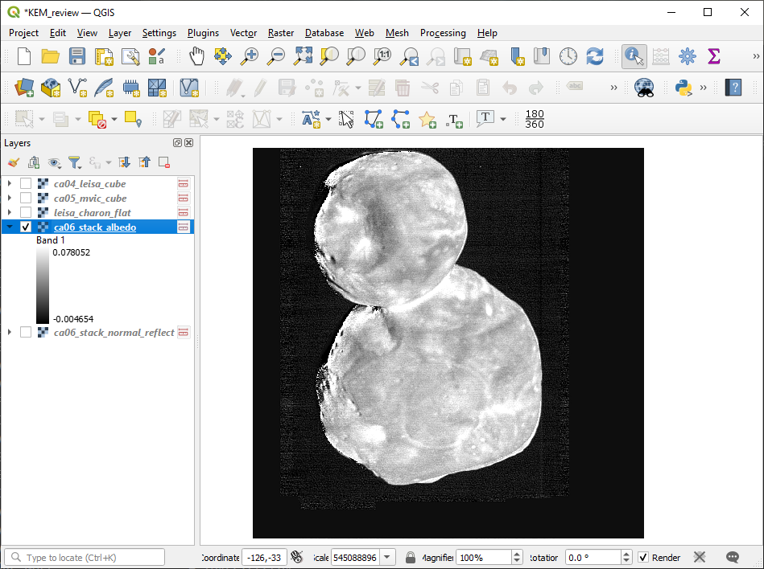

Slide 12
nh-a-lorri_mvic-5-geophys-v1.0/data/albedo/ca06_stack_albedo.lbl
Also, great looking image but maintains some collar noise.
Suggestions:
No attempt to “mask” or define Nodata in the label (outside of the image). Just a little nicer for the user. Label defines NULL and saturation values but not used?

Slide 13
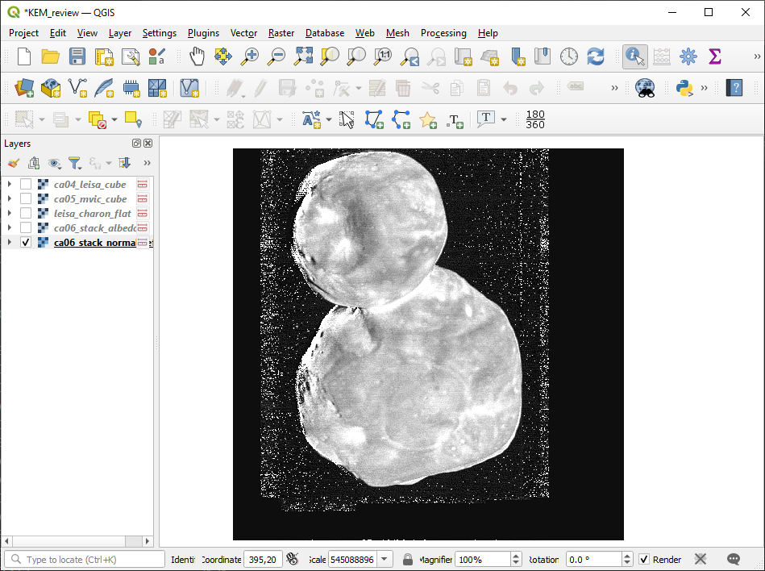

Slide 14
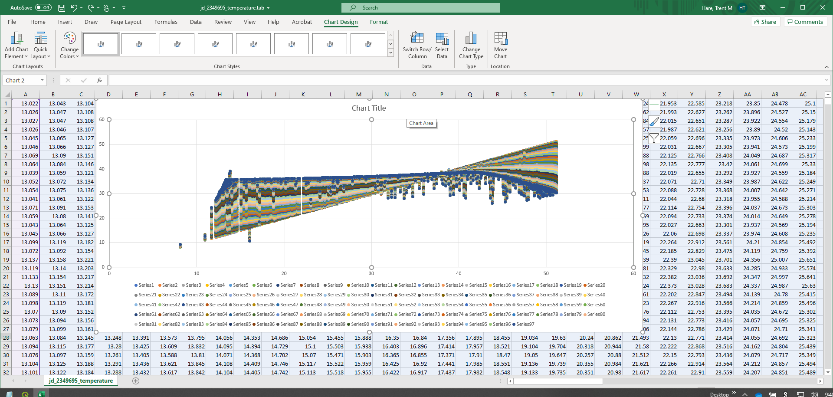
Simply spot-checked stats for temperatures and plotting

Slide 15
A couple probably non-issues with PDS3 labels (not in my review area but...).
(1) nhkedp_0002\data\shape_models\mu69_merged_browse.lbl
For browse PNG documents I have never seen ^PNG_DOCUMENT used. I assume that is valid. Seems fine, but most PDS3 viewers/reader I tested failed to open it. For example, NASAView will report “Only FILE, IMAGE, TABLE objects are supported” as do other readers.
nhkedp_0002\data\shape_models\mu69_merged_spice.lbl
asp_ca04_06_icp_smooth_spi.lbl, mu69_fr2kf_lopoly_spice.lbl, mu69_fr2kf_hipoly_spice.lbl
Same for ^SPICE_KERNEL (I assume okay, but new object type for me).
It would be great if OBJs had a texture applied.

Slide 16
Spelling updates:
nhkedp_0001\catalog\mvic.cat
sp – Intgration
nhkedp_0001\document\docinfo.txt
sp = Latutide

