Slide 1
New Horizons Arrokoth Encounter Shape Models NAIF Review
Navigation and Ancillary Information Facility
Marc Costa Sitja
NAIF / Jet Propulsion Laboratory, California Institute of Technology
Virtual Meeting
February 10, 2022
The research described in this publication was carried out at the Jet Propulsion Laboratory, California Institute of Technology, under a contract with the National Aeronautics and Space Administration.
© 2021 California Institute of Technology. Government sponsorship acknowledged.

Slide 2
Index
Opening Remarks
Documents
aareadme.txt
catalog/dataset.cat
catalog/mvic.cat
Shape Models
mu69_fr2kf_lopoly.obj
asp_ca04_06_icp_smooth_spi.bds
Reference frame
Missing DSK Surface names
Missing orientation information
File names
DSK comment area
PDS labels

Slide 3
Opening Remarks
Only the data and documentation in accordance to NAIF's area of expertise have been reviewed. This mainly excludes the data/temperature and data/albedo collections.
Items that are considered liens, and therefore required to be addressed to pass the review from NAIF side are marked with [LIEN], the other items are --strong-- suggestions.
Notes:
Only the data and documentation in accordance to NAIF's area of expertise have
been reviewed. This mainly excludes the data/temperature and data/albedo
collections.
Items that are considered liens, and therefore required to pass the review
from NAIF side are marked with [LIEN], the other items are --strong--
suggestions.

Slide 4
Documents
01 - aareadme.txt
Directory structure not outlined appropriately.
Suggested updated file provided, aareadme_mcosta.txt
02 - catalog/dataset.cat
Minor typo in line 44: 1962 to 1,962.
Suggested updated file provided, dataset_mcosta.cat
03 - catalog/mvic.cat
Minor update of a missing tab/spaces in lines 293 and 295.
Suggested updated file provided, mvic_mcosta.cat
Notes:
01-aareadme.txt
Directory structure not outlined appropriately.
Suggested updated file provided, aareadme_mcosta.txt
02-catalog/dataset.cat
Minor typo in line 44: 1962 to 1,962.
Suggested updated file provided, dataset_mcosta.cat
03-catalog/mvic.cat
Minor update of a missing tab/spaces in lines 293 and 295.
Suggested updated file provided, mvic_mcosta.cat

Slide 5
Shape Models
The DSK shape models have been loaded and quickly assessed with SPICE Enhanced Cosmographia, the OBJ models have been loaded and quickly assessed with SBMT.
In addition the DSK files have been checked using DSKBRIEF, converted to OBJ files with DSKEXP and the OBJ files have been converted to DSK files.
Everything has been cross-checked, all the results match. Nevertheless some LIENS and suggestions are provided.
Notes:
The DSK shape models have been loaded and quickly assessed with
SPICE Enhanced Cosmographia, the OBJ models have been loaded and quickly
assessed with SBMT.
In addition the DSK files have been checked using DSKBRIEF, converted to
OBJ files with DSKEXP and the OBJ files have been converted to DSK files.
Everything has been cross-checked, all the results match.

Slide 6
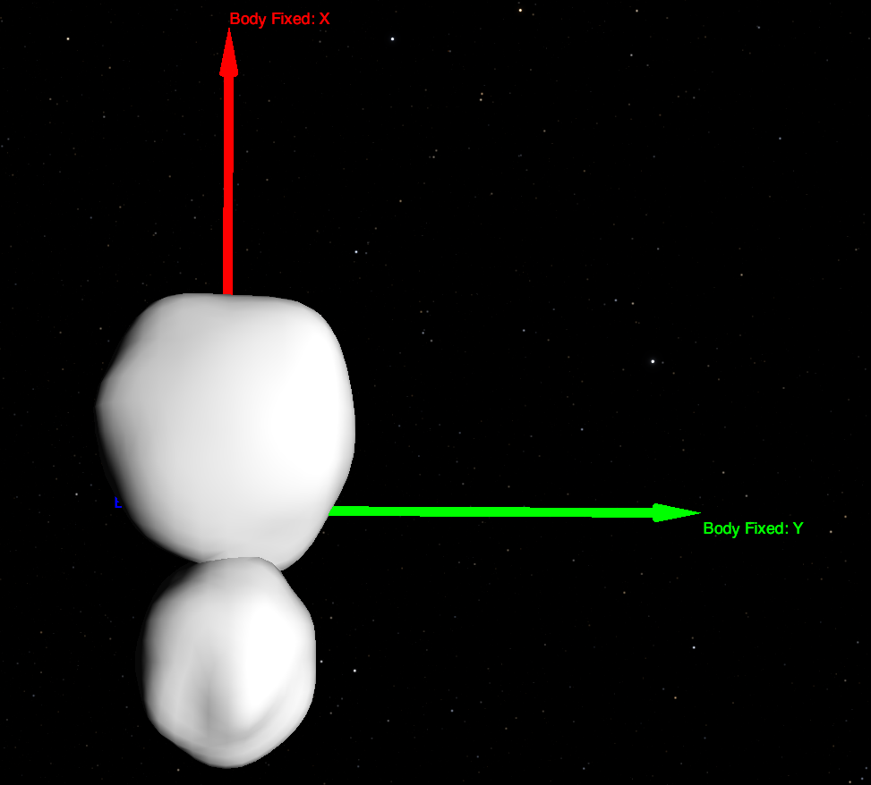
Shape Models
Lopoly Hipoly Mixed
Notes:
The DSK shape models have been loaded and quickly assessed with
SPICE Enhanced Cosmographia, the OBJ models have been loaded and quickly
assessed with SBMT.
In addition the DSK files have been checked using DSKBRIEF, converted to
OBJ files with DSKEXP and the OBJ files have been converted to DSK files.
Everything has been cross-checked, all the results match.

Slide 7
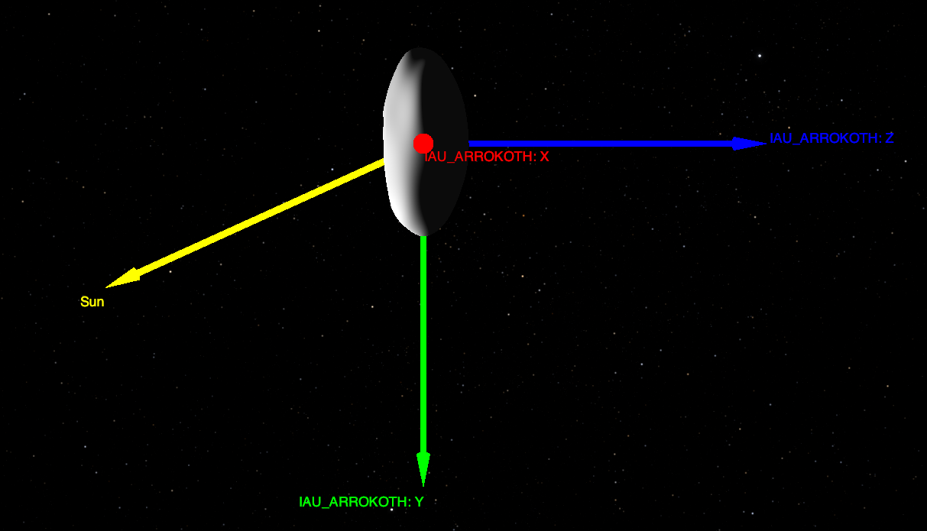
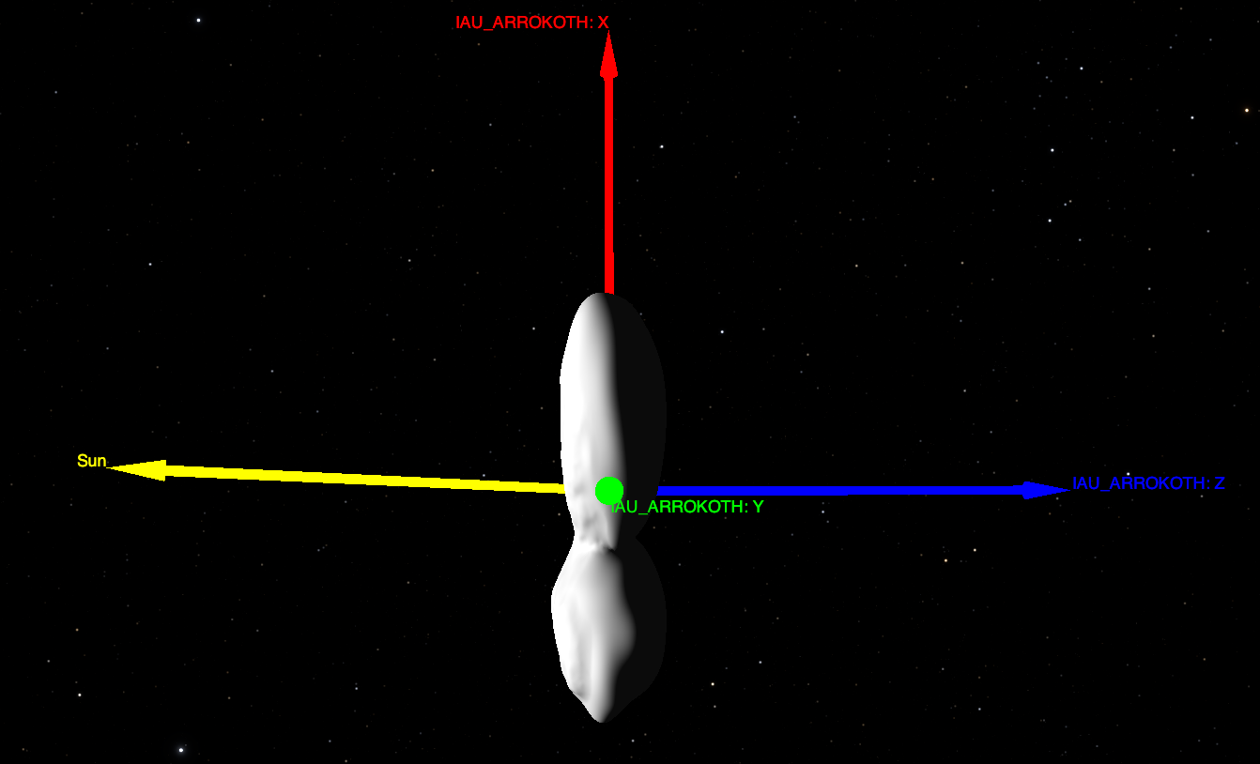
Shape Models
Mixed Mixed
Notes:
The DSK shape models have been loaded and quickly assessed with
SPICE Enhanced Cosmographia, the OBJ models have been loaded and quickly
assessed with SBMT.
In addition the DSK files have been checked using DSKBRIEF, converted to
OBJ files with DSKEXP and the OBJ files have been converted to DSK files.
Everything has been cross-checked, all the results match.

Slide 8
Shape Models
04 - mu69_fr2kf_lopoly.obj
The format of this OBJ file diverges from the other OBJs. Although this is documented appropriately in the label, it might lead to confusion.
In fact the format provided for this file, without faucet normal vectors is adequate for MKDSK to be used, otherwise the input needs to be processed to generate a DSK.
mu69_fr2kf_lopoly
v 5.837221 0.000000 4.794366
v 7.447428 0.000000 4.790668
(…)
f 1 2 3
f 1 3 4
o MU69_Merged
v -17.138798 2.494838 -2.254474
(…)
vn -0.3158 -0.2392 -0.9182
(…)
f 7433//1 7539//1 38254//1
Notes:
04-mu69_fr2kf_lopoly.obj
The format of this OBJ file diverges from the other OBJs. Although this is
documented appropriately in the label, it might lead to confusion.
In fact the format provided for this file, without faucet normal vectors is
adequate for MKDSK to be used, otherwise the input needs to be processed.

Slide 9
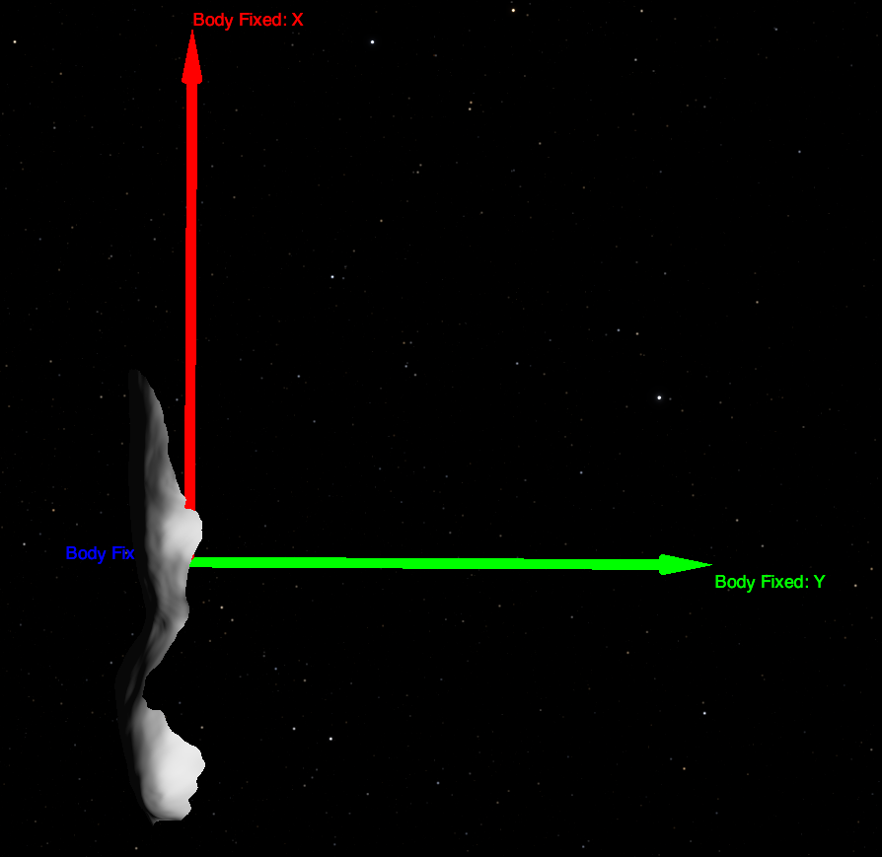
Shape Models
05 - asp_ca04_06_icp_smooth_spi.bds [LIEN]
This model is rotated -90 deg WRT the +X axis. The model should be aligned appropriately as the other models.
Mixed asp_ca04_icp

Slide 10
Shape Models
06 - Reference frame [LIEN]
We cannot find a MU69 coordinate system document that the project agreed upon with SBN.
Such document should exist and the frame definition should match the one in the models.
The DSKs have been generated using the reference frame 'MU69_FIXED'. This reference frame is not defined anywhere in the current NH SPICE data set.
Note that from the SPICE Toolkit N67 onwards (released on Jan 3 2022), the IAU_ARROKOTH frame is is built into the toolkit and its orientation data is defined via PCK from nh_stars_kbo_centaur_v003.tpc provided in the NH SPICE data set.
Notes:
06-Reference frame [LIEN]
We cannot find a MU69 coordinate system document that the project agreed
upon with SBN. If yes, it would be good to look at it in the context of this
review. If not, are there any plans to produce such document, and most
important of all, will it define the frame consistent with frames used in
the shape model data provided in this data set?
The DSKs have been generated using the reference frame 'MU69_FIXED'. This
reference frame is not defined anywhere in the current NH SPICE data set.
Our understanding is that this frame looks like something like:
\begindata
FRAME_MU69_FIXED = 2486958
FRAME_2486958_NAME = 'MU69_FIXED'
FRAME_2486958_CLASS = 2
FRAME_2486958_CLASS_ID = 2486958
FRAME_2486958_CENTER = 2486958
OBJECT_2486958_FRAME = 'MU69_FIXED'
\begintext
Note that from the SPICE Toolkit N67 onwards (released on Jan 3 2022),
the IAU_ARROKOTH frame is provided with the toolkit and its orientation
data is provided via PCK as provided in nh_stars_kbo_centaur_v003.tpc
This is further discussed below.

Slide 11
Shape Models
07 - Missing DSK Surface names [LIEN]
The ”surfaces” in the DSK shape models do not have “surface names”.
Surface ID/Names mappings should be defined by an auxiliary FK and the DSKs should be regenerated including the information.
Each shape model provided by each DSK consists of a single surface; each surface should have a unique NAIF_SURFACE_NAME. Using the DSK filename as the surface name is good enough -without extension and with capital letters.
FK files are recommended and they must be present in the SPICE data set.
Notes:
07-Missing DSK Surface names [LIEN]
The Arrokoth shape models are stored in the DSKs as surfaces"; as any other
SPICE "body", surfaces have a name and an ID. These surface names must be
defined either during the generation of the DSK or by an auxiliary Frames
Kernel (FK) that defines the surfaces. The surfaces can be added in the
MKSDSK setup file as indicaed in the MKDSK User Guide:
NAIF_SURFACE_NAME += 'surface name'
NAIF_SURFACE_CODE += integer surface ID code
NAIF_SURFACE_BODY += integer body ID code
These assignments are needed if
the surface name-ID association
is not defined in a kernel listed
in a KERNELS_TO_LOAD assignment.
The same text can be included in the auxiliary FK. This latter solution is
preferred. The OSIRSI-ReX Frames Kernel defining the Surface IDs can be used
as a template:
https://naif.jpl.nasa.gov/pub/naif/pds/pds4/orex/orex_spice/spice_kernels/fk/orx_shape_v03.tf
Surfaces names are used by SPICE APIs to use the shape models as inputs.
This auxiliary FK (e.g.: nh_shape_v01.tf) should be present in the data set
and must be present in the SPICE data set. We recommend that the names of the
surfaces are provided by this data set as defined by their authors. Each
shape model provided by each DSK consists of a single surface; each surface
should have a unique NAIF_SURFACE_NAME. Using the DSK filename as the surface
name is good enough.

Slide 12
Shape Models
08 - Missing orientation information [LIEN]
Within this data set the rotation model of MU69 is only present in referenced article [SPENCERETAL2020]
This article is not easy to access (requires at least a user at NATURE.)
The current orientation information available from the SPICE data set via PCK does not include the rotation period: nh_stars_kbo_centaur_v003.tpc
The recommendation is to either explicitly cite the SPICE kernel data set and indicate that the information will be available there or to include the updated/corrected PCK in the document collection
Notes:
08-Missing orientation information [LIEN]
In order to use the shape models, especially the SPICE DSK files, the
orientation model of MU69 is required.
In addition DSK files usually require extra files to be used.
Within this data set the rotation model of MU69 is only present in
the referenced article [SPENCERETAL2020]:
"Arrokoth’s rotational period is 15.92 ± 0.02 hours, with its
rotational pole pointing to right ascension = 317.5 +- 1deg,
declination = −24.9 +- 1deg, J2000 equinox"
This article is not easy to access (requires at least a user at NATURE.)
The current orientation information available from the SPICE data set
https://naif.jpl.nasa.gov/pub/naif/pds/data/nh-j_p_ss-spice-6-v1.0/nhsp_1000/data/pck/nh_stars_kbo_centaur_v003.tpc
is:
ASTEROID 486958 (2014 MU69); 2486958
\begindata
NAIF_BODY_NAME += ( 'ASTEROID 486958 (2014 MU69)' )
NAIF_BODY_CODE += ( 2486958 )
NH_TARGET_BODIES += ( 2486958 )
BODY2486958_POLE_RA = ( 317.4880752 0. 0. )
BODY2486958_POLE_DEC = ( -24.8876496 0. 0. )
BODY2486958_PM = ( 270. 0. 0. )
BODY2486958_RADII = ( 100. 100. 100. )
\begintext
The file is:
This model does not include the 15.92 hours rotation specified in
[SPENCERETAL2020], to include it the BODY2486958_PM value should be
corrected as in:
BODY2486958_PM = ( 270, 542.71, 0 )
The RADII should be corrected as well to fit the ellipsoidal approximation
of MU69.
But this file is not referenced in this data set.
The recommendation is to either explicitly cite the SPICE kernel data set
and indicate that the information will be available there, to include the
updated/corrected PCK in the document collection in a similar manner to the
included IKs:
document/nh_ralph_v100_ti.txt
document/nh_lorri_v201_ti.txt
or to include this information elsewhere within the data set.

Slide 13
Shape Models
09 – File names
It is suggested to drop the *_spice, suffix. It is understood that this is to differentiate the DSK with the OBJ file.
For the DSKs we recommend to version the file, to account for file updates and in accordance to the NAIF style for SPICE kernels names.
The suggestion would be:
mu69_asp_ca04_06_icp_smooth_v01.bds
mu69_fr2kf_hipoly_v01.bds
mu69_fr2kf_lopoly_v01.bds
mu69_merged_v01.bds
Notes:
09-File names
* It is suggested to drop the *_spice, *_spi suffix. It is understood that
this is to differentiate the DSK with the OBJ file, but since the DSK will
also be present in the SPICE data set maybe a differentiating suffix could
be added to the OBJ files instead. Also for the DSKs we recommend to
version the file, to account for file updates and in accordance to the NAIF
style for SPICE kernels names. The suggestion would be:
asp_ca04_06_icp_smooth_v01.bds
mu69_fr2kf_hipoly_v01.bds
mu69_fr2kf_lopoly_v01.bds
mu69_merged_v01.bds
* It is also suggested to include mu69 in asp_ca04_06_icp_smooth_spi.bds for
example:
mu69_asp_ca04_06_icp_v01.bds

Slide 14
Shape Models
10 – DSK Comment Area [LIEN]
Typically the comment area of binary kernels have the following sections:
1-Abstract
2-Objects
3-Pedigree
4-Related SPICE kernels
5-References
6-Contact Information
7-DSKBRIEF Summary
8-MKDSK Setup File and Run-time Traceback
The current comments only have section 8 and need to be augmented. All the information required to augment the comments should be available.
Notes:
10-DSK comment area [LIEN]
DSK binary files have a comment area accessible using NAIF's utility COMMNT.
The comment area contains important information to understand the DSK file.
We find that comment are included in the DSKs requires more work.
Typically comment areas for DSKs have different sections:
1-Abstract
2-Objects
3-Pedigree
4-Related SPICE kernels
5-References
6-Contact Information
7-DSKBRIEF Summary
8-MKDSK Setup File and Run-time Traceback
The current comments only contain section 8.
An example of a complete DSK comment is attached:
bennu_g_00880mm_alt_obj_0000n00000_v020.cmt
The comment area should be extended to include all the sections mentioned
above following the Bennu OSIRIS-ReX example. All the information required
to fill the comment should be present elsewhere in the data set.
We would like to emphasize that is very important to include in the comment
area a complete list of all the kernels needed to use the shape model. This
goes in section 4. A better example than the one for OSIRIS-ReX is provided
hereunder:
"
Related SPICE kernels
------------------------------------------------------------------------
This file should be used together with the kernel set
described below (*):
Kernel Comments
------------------------------- -------------------------------------
nh_shape_v01.tf is a mission specific Frame Kernel that
complements the mission's Frame Kernel
to complete the DSK Surface ID Codes for
the mission.
nh_stars_kbo_centaur_v003.tpc is the Planetary Constants Kernel
that provides the cartographic, physical
constants data, and Name/ID mapping for
bodies not covered by the project kernels
(including Arrokoth.)
nh_recon_arrokoth_od147_v01.bsp Contains ephemerides for the NH
Spacecraft, the Pluto system bodies, and
solar system bodies (including Arrokoth.)
naif0012.tls is a Leapseconds Kernel file used
in conversions between ephemeris time
and UTC (coordinated universal time.)
(*) or any higher version of the same kernels
"
Please note that the FK nh_shape_v01.tf does not yet exist so its generation
should be considered, it is recommended to use the
OSIRIS-ReX one as a template:
https://naif.jpl.nasa.gov/pub/naif/pds/pds4/orex/orex_spice/spice_kernels/fk/orx_shape_v03.tf
Note that as specified before, nh_stars_kbo_centaur_v003.tpc should be
updated.
In addition, either the 'MU69_FIXED' frame should be defined or the DSKs
should be re-generated using 'IAU_ARROKOTH'.
Since these prior items will have to be included in the SPICE data set please
coordinate with Brian Enke (SWI).

Slide 15
Shape Models
10 – PDS Labels
The DESCRIPTION field of the label is too poor, it is recommended to use the description provided in the catalog/dataset.cat, OSIRIS-ReX label descriptions are also a good reference.
Note that the DSK labels that will be included in the SPICE data set will be different. This should be OK.
Notes:
11-PDS labels
* The DESCRIPTION field of the label is too poor, it is recommended to use
the description provided in the catalog/dataset.cat following the style of
the OSIRIS-ReX DSKs the description of which is as follows:
SPICE DSK file containing shape model data for the surface of asteroid
(101955) Bennu, with Global coverage at .880 meter resolution,
ALT-based, version 020, created by the ORX Altimetry Working Group
(AltWG). The original name of this file was
g_00880mm_alt_obj_0000n00000_v020.bds.
From
https://naif.jpl.nasa.gov/pub/naif/pds/pds4/orex/orex_spice/spice_kernels/dsk/bennu_g_00880mm_alt_obj_0000n00000_v020.xml
* Note that the DSK labels that will be included in the SPICE data set will
be different. This should be OK.

