Slide 1
LDT Phaethon Campaign
Adam McKay

Slide 2
Phaethon
Near Earth Asteroid that exhibits comet-like activity near perihelion at ~0.1 AU
Made close passage to the Earth in 2017
Lowell Discovery Telescope campaign with imaging (LMI) in BC, CN, and r’, optical spectroscopy (DeVeny), and IR spectroscopy (NIHTS)
Only LMI and DeVeny Data being archived here

Slide 3
Overview
Spectroscopy-includes raw wavecals, flats, biases, object spectra, solar and flux standards (flux standard only on Dec 15), everything that should be needed for user to reduce data themselves
Imaging-includes biases, flats, images of Phaethon, and calibrator and solar analogs stars, should be everything needed to reduced and calibrate images

Slide 4
Calibrations-Spectroscopy
Cd Ar Ne Hg Lamp
Flat
Bias

Slide 5
Data-Spectroscopy
Phaethon-Image 139, Dec 15, 2017, raw
Phaethon, Image 139, Dec 15, 2017, reduced

Slide 6
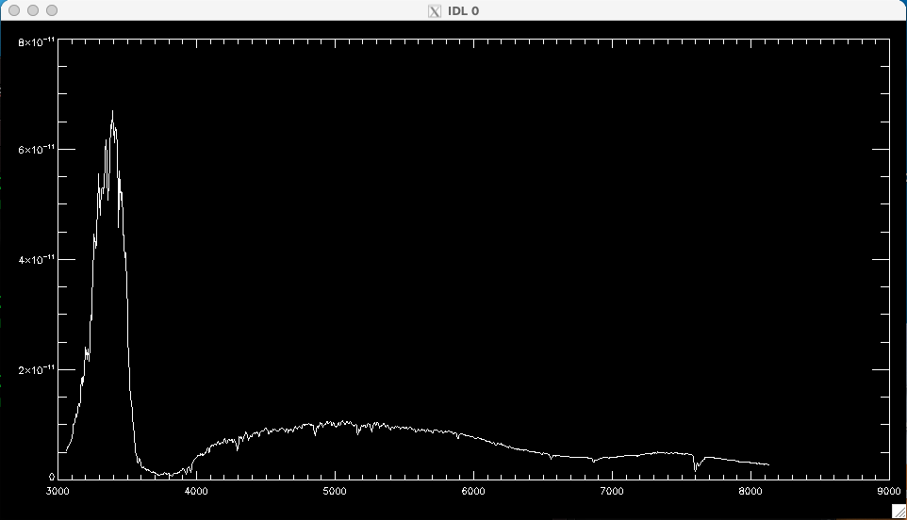
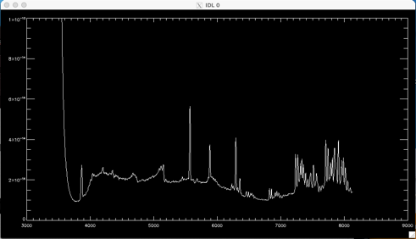
Extracted Spectra
Phaethon
Hyades 64
C/2017 O1 (ASSASN)

Slide 7
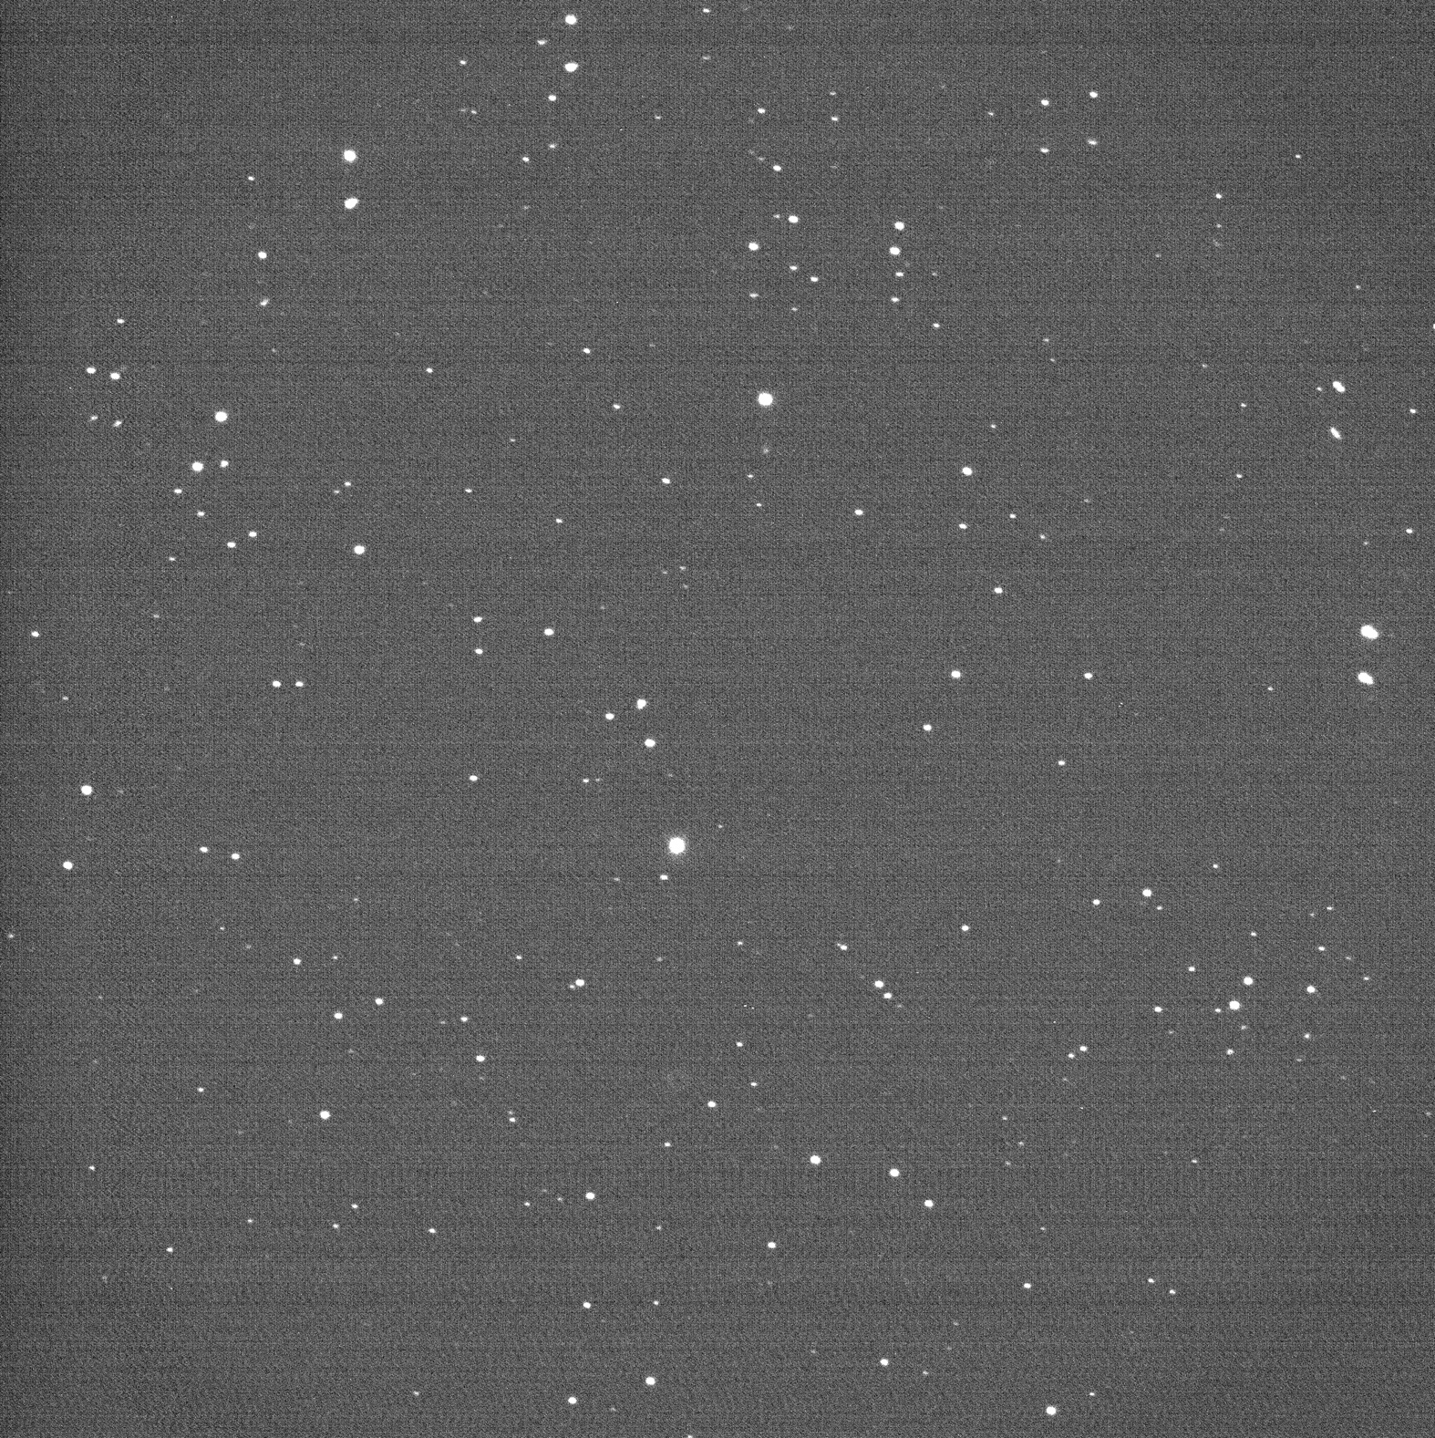
Data-Imaging
Phaethon-Dec 14, 2017, Raw, BC
Phaethon-Dec 14, 2017, Reduced, BC

Slide 8
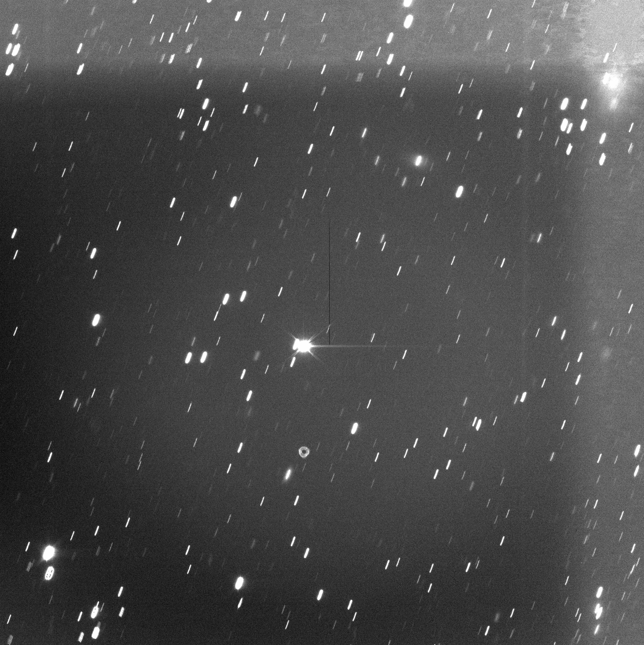
Odd background on Dec 16
Phaethon-Image 167, Dec 14, 2017, Raw, BC
Phaethon-Image 167, Dec 14, 2017, Reduced, BC
Seems related to flats . . .

Slide 9
Different Flat Formats
Flat on Dec 15-BC
Flat on Dec 16-r’
Difference between shape of HB and Sloan filters?

Slide 10
Suggestions
More detail in documentation about data, e.g. for DeVeny, is blue on the left or right? No darks included, so presumably not required, but could be explicitly stated.
More detail for reductions/extractions
Numerous flats and wavelength cals and various positions, were these necessary for the reduction/extractions or were the “generic” ones used?
There is only one extracted spectrum per object, so presumably multiple spectra were extracted and stacked, were they stacked in 2D and extracted, or were extracted 1D spectra averaged? No extracted spectrum for flux standard, apparently done on 2D spectrum?
Documentation claims reduced data were background subtracted, but I think I see sky lines in the O1 ASSASN spectrum . . .
Multiple instrument setups in the same log was somewhat confusing, possibly create digital version that only includes relevant instrument, maybe include logs closer to data in directory pathway (though maybe this would violate PDS requirements?)

