Slide 1
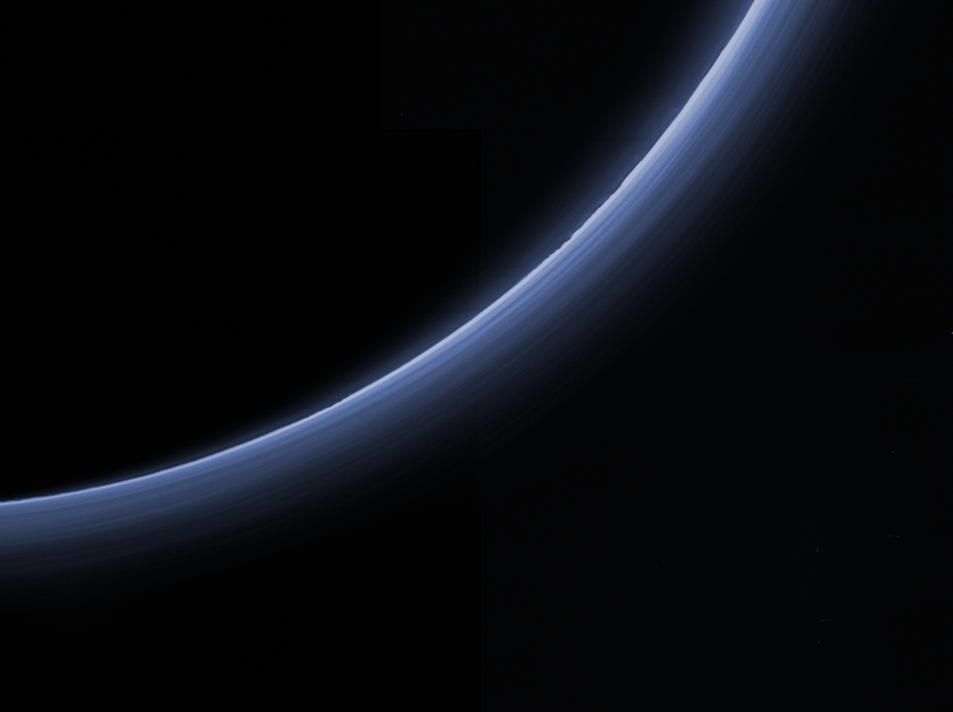
New Horizons KEM1 Data Set nh-p_psa-lorri_alice_rex-5-atmos-v2.0
Lori Feaga (UMD)
Feb. 9, 2022

Slide 2
Documentation check
All previous minor liens seem to be fixed
Same as Version 1, but why different collection of documents than all other datasets?
Some may not be applicable for derived data (Level 5), but nh_met2utc, nh_fov, and payload_ssr should be useful
New Data Check
Only addition to this data set is data/starocc/ directory according to dataset.cat and independent overview
Looked for proper versioning updates, seem to be in good shape
New data read in and manipulated with readpds
Compared with published data
All checks out, no suggested liens

Slide 3
Geometry of observations (Kammer et al. 2020, Fig. 5)
Appulse star
Occulting star
Expect very little signal decrease from appulse star
Expect clear signal decrease from occulting star

Slide 4
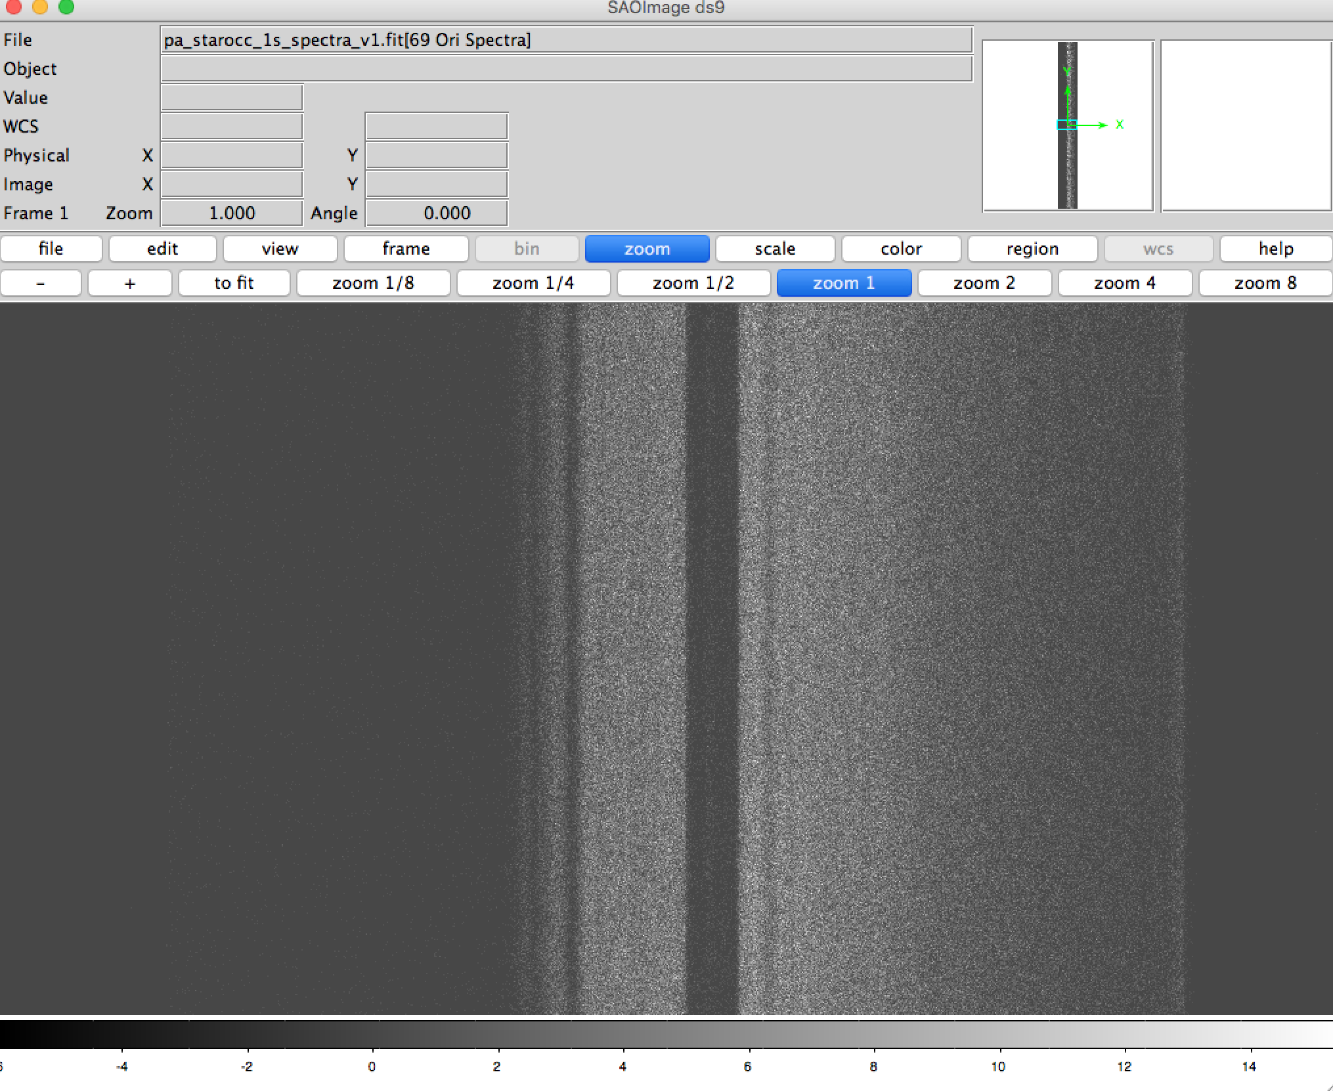
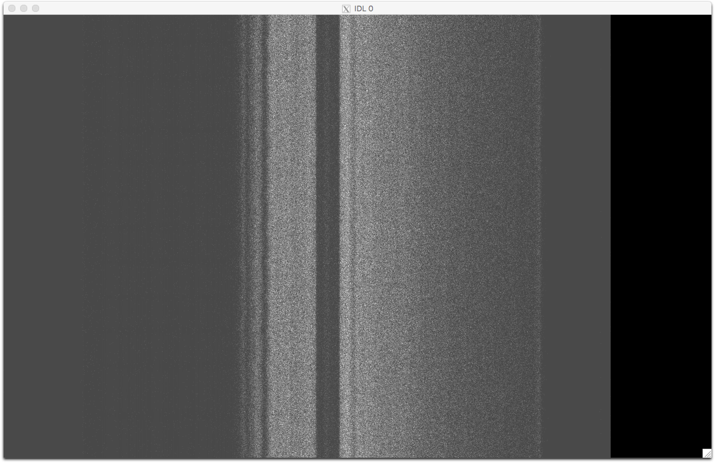
New Data Verification – Appulse Star
Opened multi-extension .fit file (pa_starocc_1s_spectra_v1.fit ) with ds9
Worked fine
Opened multi-extension .fit file
in IDL via its .lbl file (pa_starocc_1s_spectra_v1.lbl)
Worked fine

Slide 5
Multiple individual extracted spectra

Slide 6
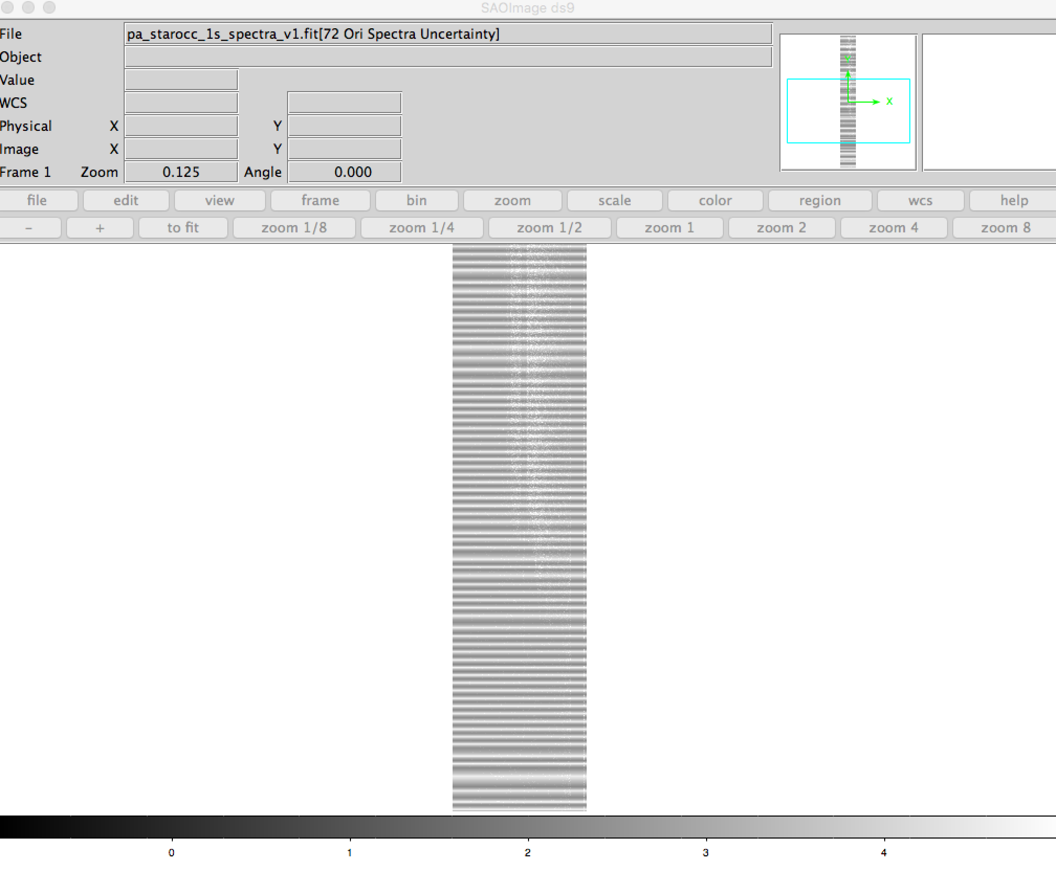
Data Verification – Occulting Star
Time increasing
Egress
Systematic
modulation
with time described in documentation
Occultation

Slide 7
Occultation time series plot
Egress
Occultation

Slide 8
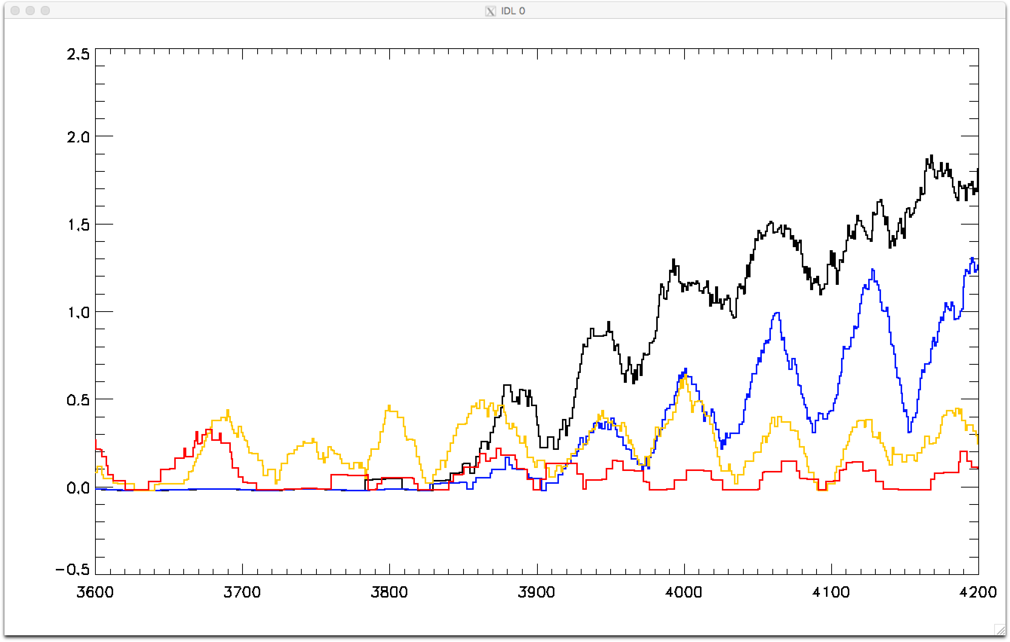
Wavelength response to occultation
Smoothed to show instrument modulation
Egress
Occultation
Modulation apparent

Slide 9
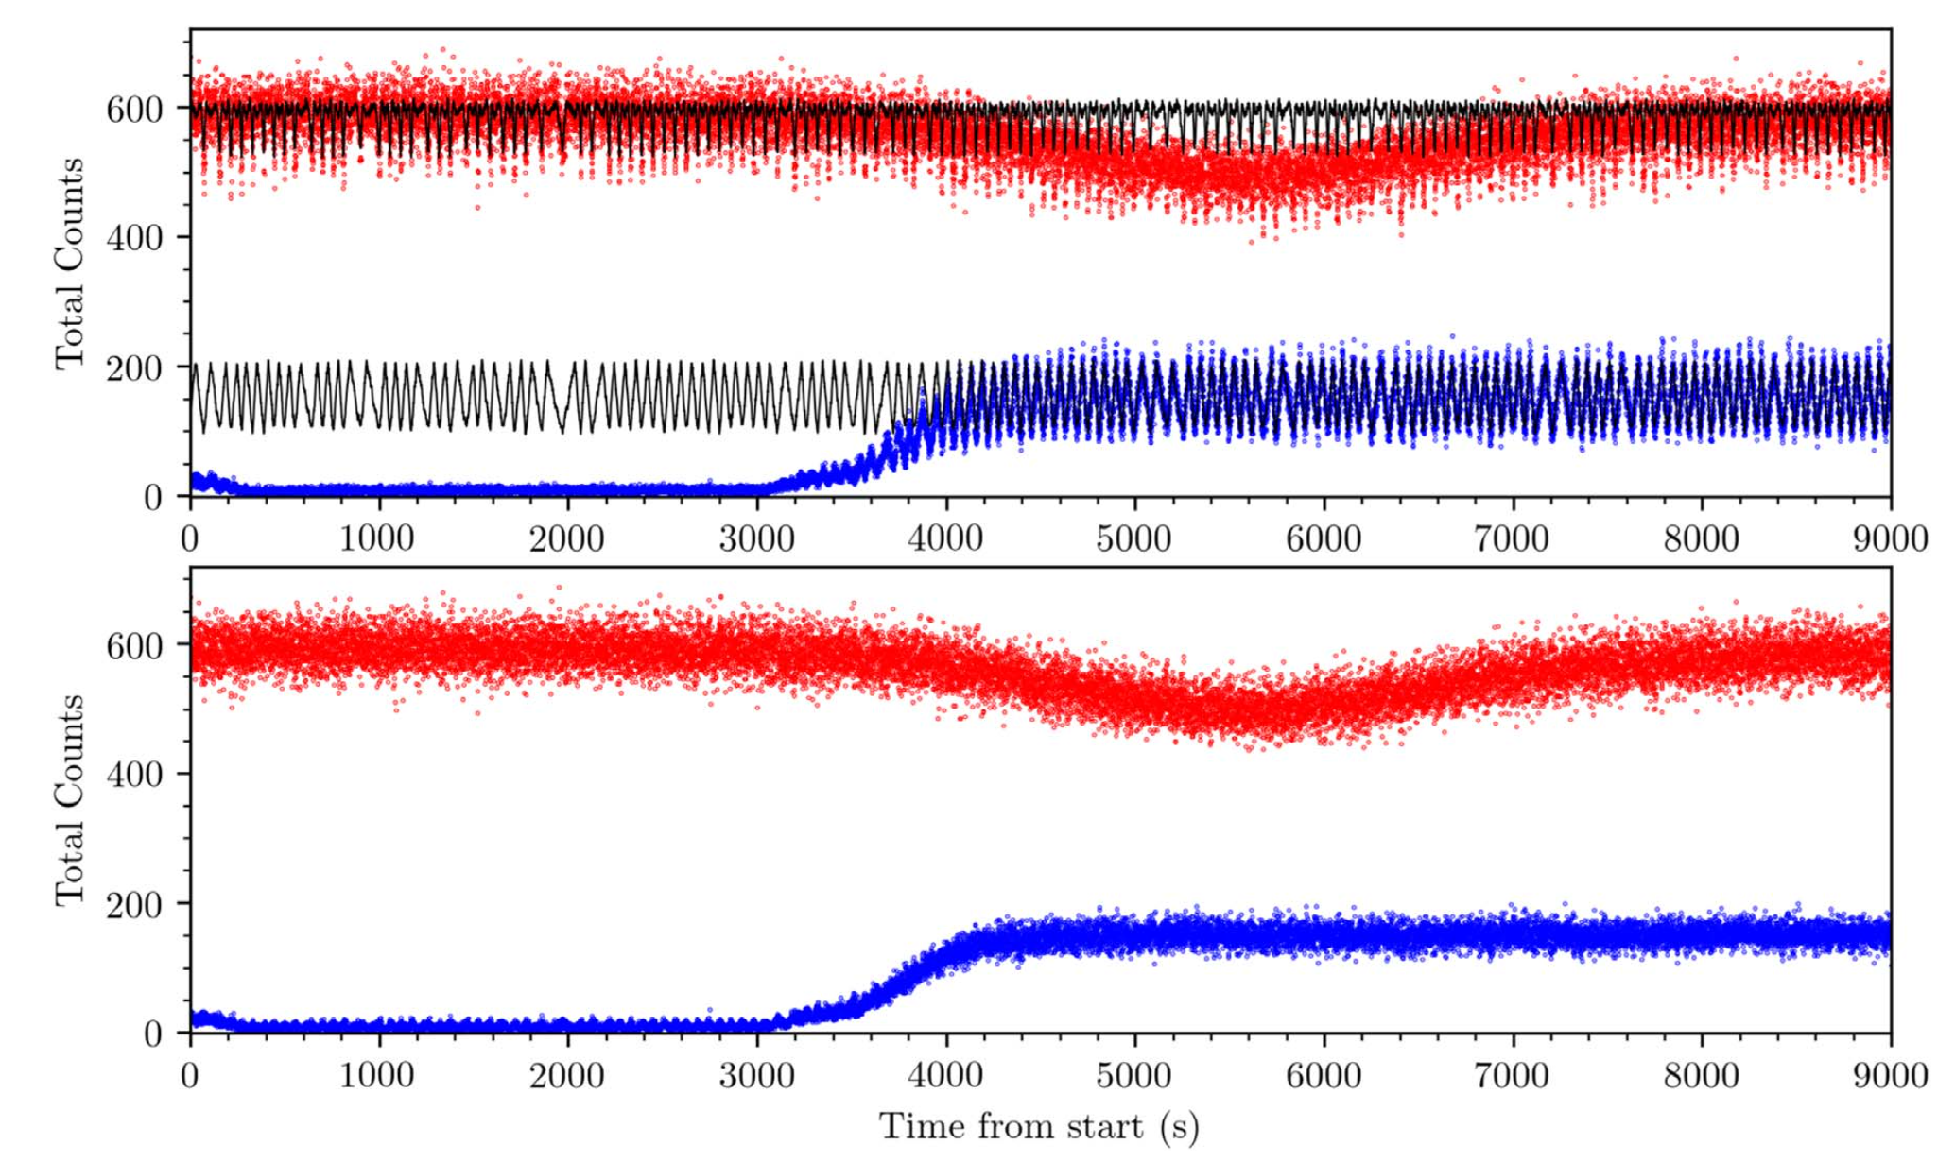
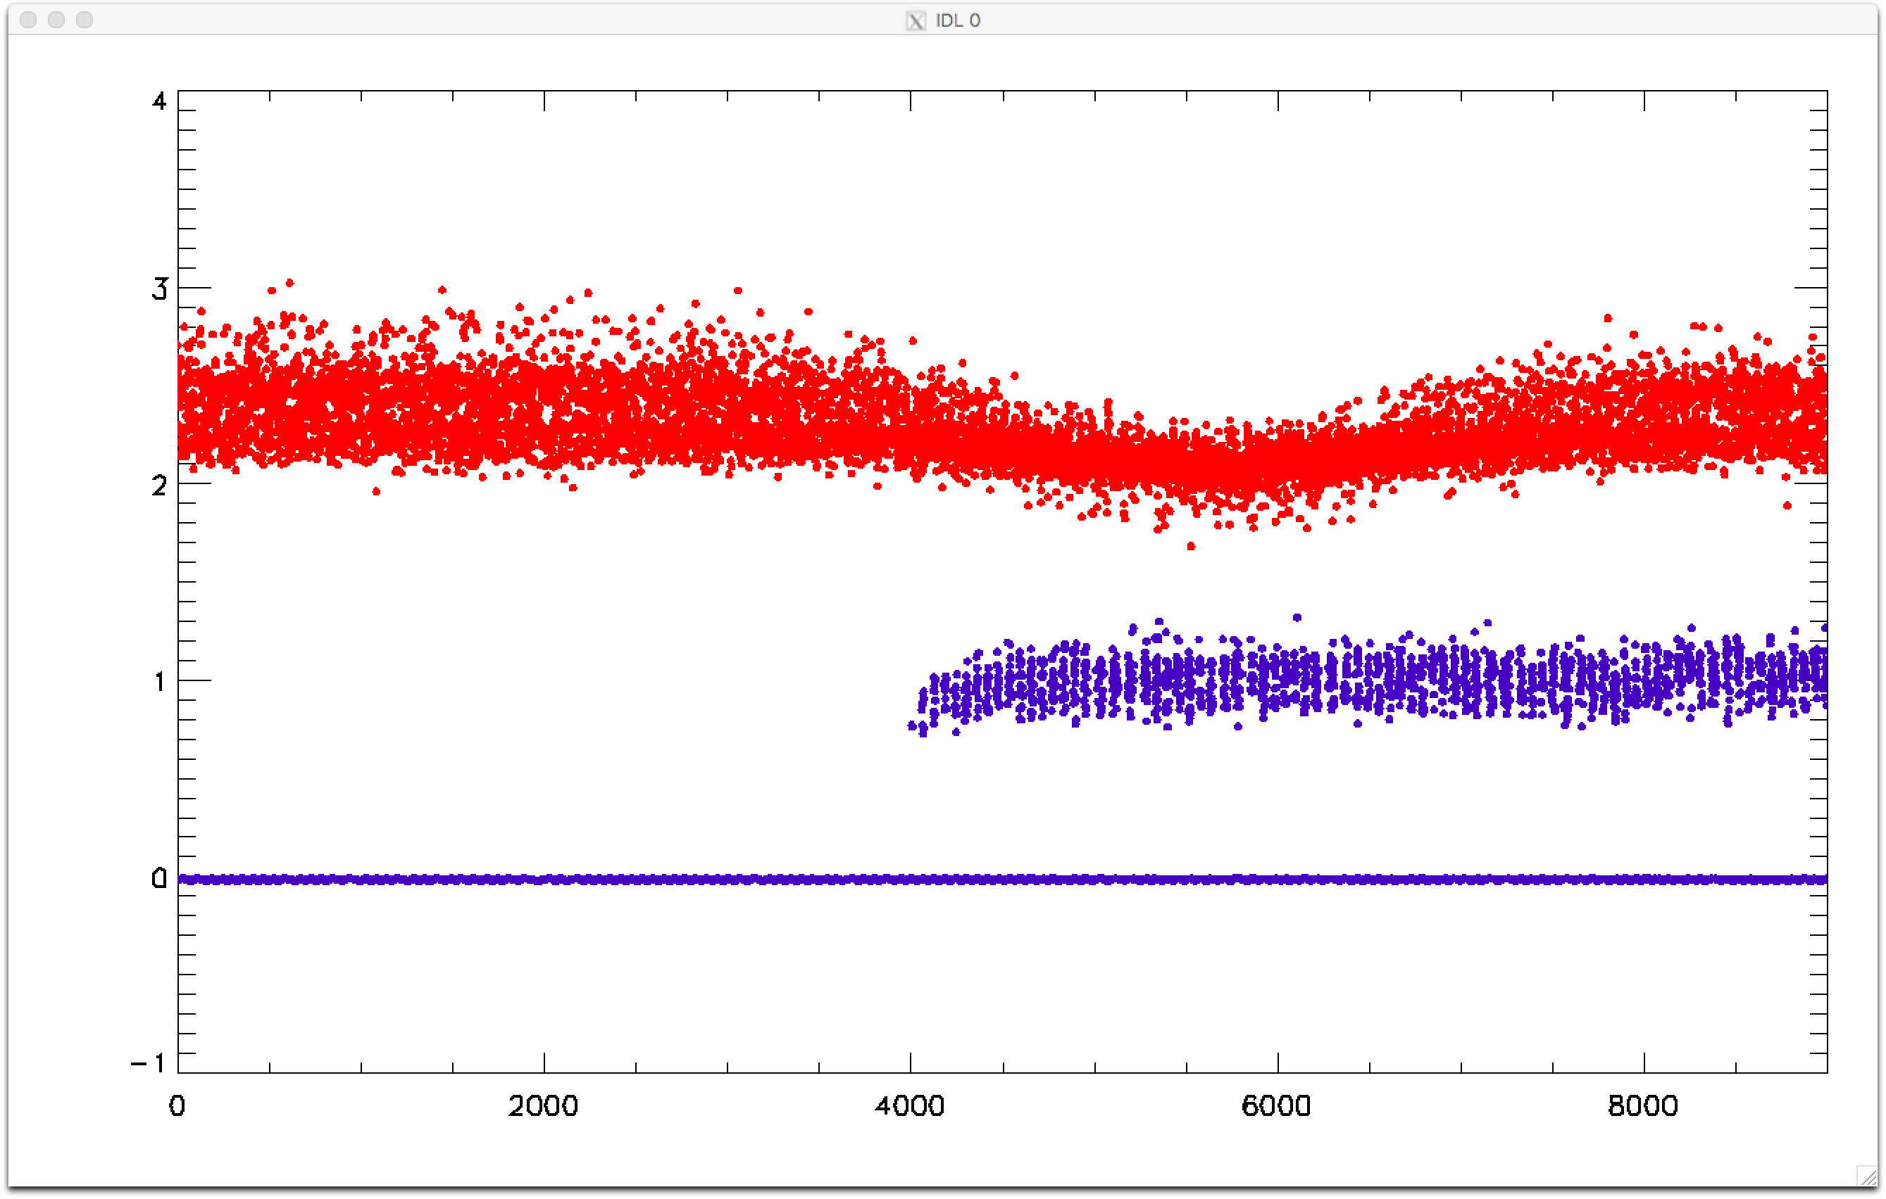
Data Verification Against Published Data
Kammer et al. (2020); Fig. 4
PDS Data

Slide 10
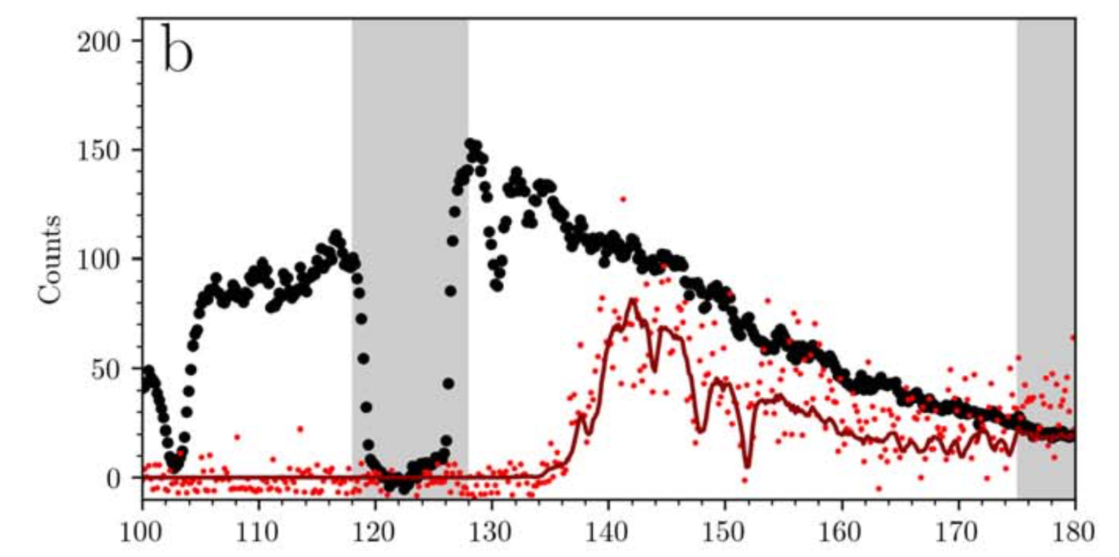
Data Verification Against Published Data (con’t)
Kammer et al. (2020); Fig. 10
Wavelength (nm)
PDS Data
Wavelength (Ang)

Slide 11
No Liens!

