Slide 1
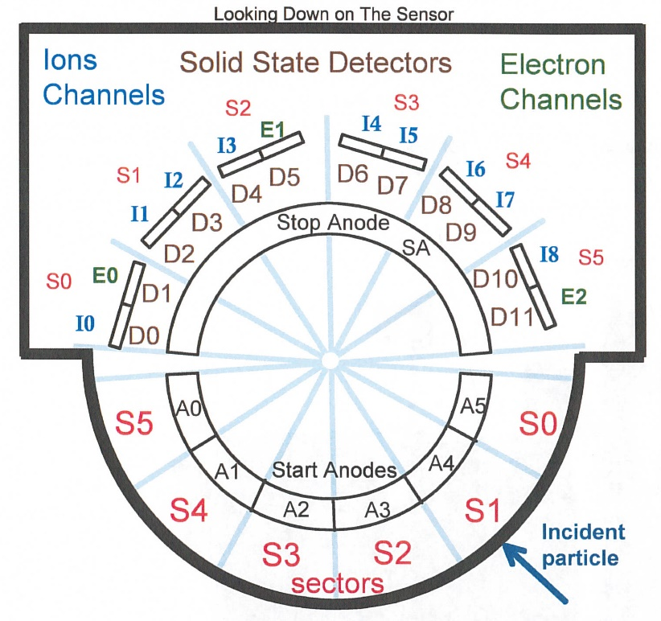
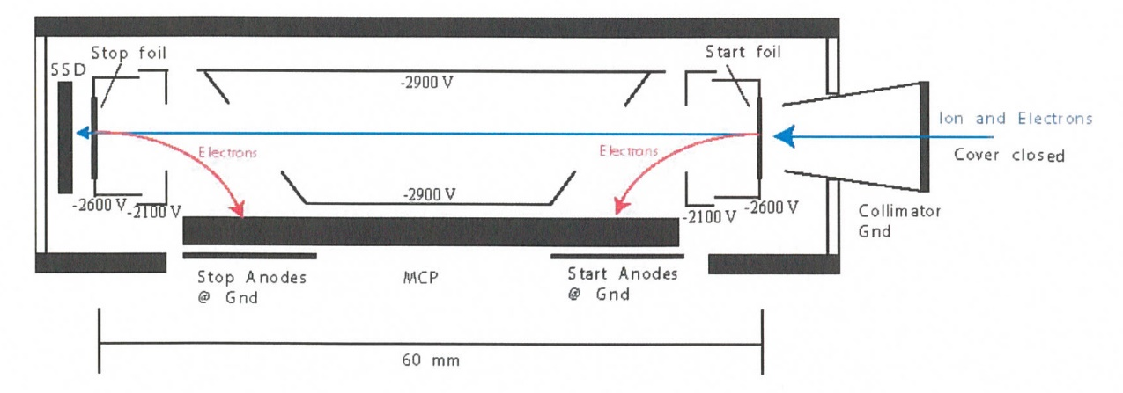
New Horizons
Pluto Energetic Particle Spectrometer Science Investigation
(PEPSSI)
Reviewed by S. Joy (primary)
PRINCIPAL INVESTIGATOR: Ralph McNutt, APL
DESCRIPTION: Medium Energy Particle Spectrometer
ENERGY RANGE: 25-1000 keV (protons)
60-1000 keV (atomic ions)
25-500 keV (electrons)
FIELD OF VIEW: 160 deg x 12 deg
ANGULAR RESOLUTION: 25 deg x 12 deg
ENERGY RESOLUTION: 0.25 keV
SENSOR SIZE: 7.6 cm dia. x 2.5 cm thick
POWER: 1.4 watt
MASS: 1.5 kg

Slide 2
New Horizons PEPSSI Data Sets
Data ->
nh-x-pepssi-2-kem1-v5.0
nh-x-pepssi-3-kem1-v5.0
nh-x-pepssi-4-plasma-v1.0

Slide 3
New Horizons PEPSSI
Data Set Evaluation Tools
All Data Processing and Evaluation -
Machine: Dell XPS 15 9560
Operating System: Windows 10

Slide 4
  Comments on review procedure
  The catalog, documents, and calib directories of these volumes are nearly identical, and most of their contents have been previously reviewed many times.
  I have taken advantage of this fact to reduce the review effort.
  I used the folder compare option in BeyondCompare 3.3.13 to compare like folders across the four volumes, and then compare files contained in the folders. Most of the time, the only variation in the directory contents or the
  file therein were the file time stamps and the data_set_id’s in the label files.
  Once this information was available to me, I only reviewed unique files
  Lastly, I looked at issues raised in the Dec 2020 review to make sure that they had been addressed in this release.

Slide 5
Documentation
Evaluation

Slide 6
Root level files
AAREADME
No issues found: -2- and -3- files essentially identical and are ok.
The new -4- file is also fine as is.
VOLDESC
No issues found – -2- and -3- files essentially identical and are ok.
The new -4- file is also fine as is.
Question: The SWRI address in the -4- file is listed as “suite 400” while
the -2- and -3- files use “suite 300”. Is this a mistake or are the products
created in slightly different locations?

Slide 7
Catalog files
CATINFO.TXT – no changes required
nh_kem.cat – ok, all 3 versions identical
nhsc.cat – ok, all 3 versions identical
pepssi.cat – good
ref.cat – Consider adding the KOLLMANNETAL2019 reference found in the -4- file to the -2- and -3- versions to keep all files identical.
DATASET.CAT (nh-x-pepssi-2-kem1-v5.0 and nh-x-pepssi-3-kem1-v5.0)
includes discussion of versioning – good
  The -2- and -3- dataset catalogs are effectively identical with the only changes being -2- becoming -3- and Raw becoming Calibrated.
  This has been true and accepted for the previous PEPSSI datasets
DATASET.CAT (nh-x-pepssi-4-plasma-v1.0)
The text does not provide a column naming convention and the data labels do
not provide that information in the descriptions. This should be corrected.
The text describes the units of the flux data files as counts per second while
the labels correctly list them as “c/s/ster/cm^2/keV”
BCPS: 'Triples', counts-per-second.
BFLUX: 'Triples', counts-per-second. Fix
LCPS: 'Doubles', counts-per-second
LFLUX: 'Doubles', counts-per-second Fix
This is most like a cut/paste error but it should be corrected.

Slide 8
Calib files
calinfo.txt – good
hk_stat_input_20041016.tab (lbl) – good
hk_n1_input_20050228.tab (lbl) – good
rateboxdefinitionplanes.fit (lbl) – good
calpars folder on -3- volumes only
calpinfo.txt – good
calpar_columns.fmt – good
pep_*_0x691_calpar.tab – ok, contents clear and self-explanatory. No
corresponding .lbl file but that has been the case throughout the mission and
has been previously accepted.
New version 5 dataset contains files not found on the previous version, including some back-fill of time intervals that were included in the v4 delivery

Slide 9
Document files
DOCINFO.TXT – good
All PDS documents (codmac_level_definitions, lunineetal1995, payload_ssr, pepssi_ssr, soc_inst_icd) appear to be properly formatted as PDF/A and the document labels appear to be valid. Most of these document files have been reviewed many times and have not changed recently. They appear to be the latest versions of each.
There have been no changes to any PDF files since the Dec 2020 review
(Beyond Compare)
nh_fov.png (.lbl) – good
nh_met2utc.tab (.lbl) – complete (last weekly entry 2022-01-03), good
nh_mission_trajectory.tab (.lbl) – complete (last entry 2021-04-30), good
nh_pepssi_v110_ti.txt – good
pep_bti.tab (.lbl) – good, complete
quat_axyz_instr_to_j2k.asc (.lbl) – good
seq_pepssi_kem1.tab (.lbl) – good, complete (last entry 2021-03-01)
Note: The nh-x-pepssi-4-plasma-v1.0 dataset is missing a few of the documents that are included in the other datasets. Most of this is fine, but you might consider including the “nh_mission_trajectory.*” as well as the bad time intervals (bti) and command history files (seq).

Slide 10
Index files
INDXINFO.TXT – good
Index.tab (lbl) - both files good in all datasets
Slimindx.tab (lbl) ) - both files good in all datasets
Checksum.tab (lbl) - both files good in all datasets

Slide 11
Data
Evaluation

Slide 12
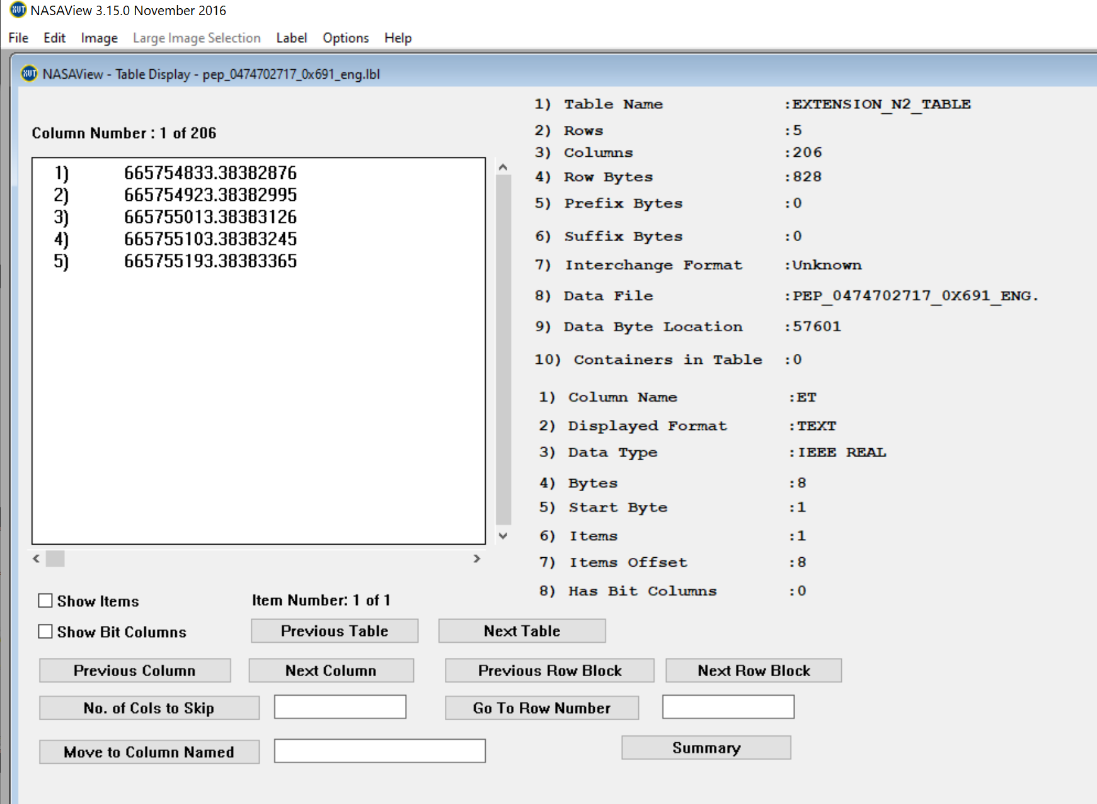
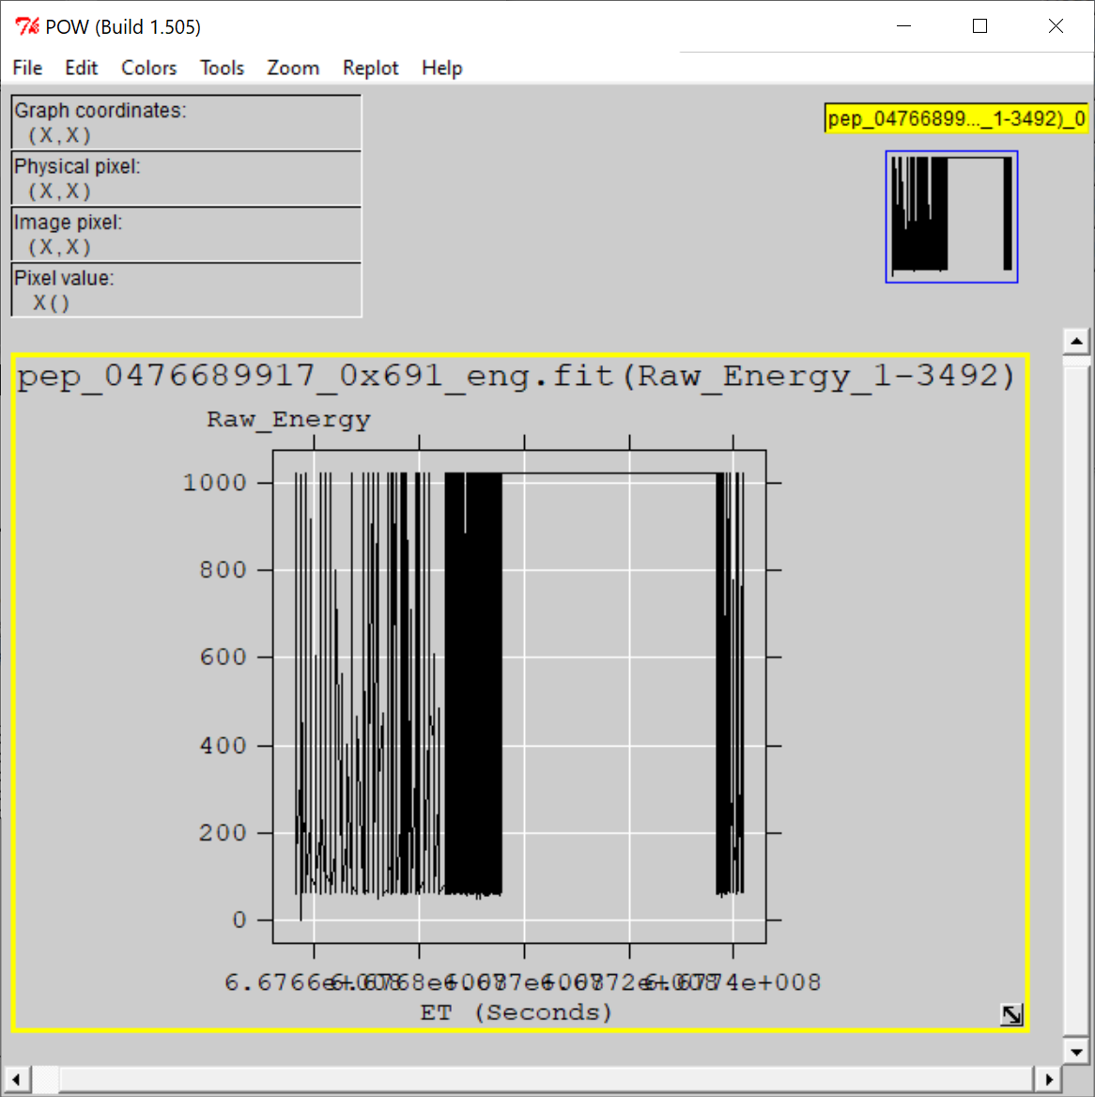
nh-x-pepssi-2-kem1-5.0
Files open with both NASAVIEW and FV suggesting that the PDS and FITS labels
are well-formed. Validate tool did not catch any errors with labels. All of the files and labels
selected for spot inspection appeared nominal.
All tables and columns accessible in NASAVIEW, listings look as expected
FV allow the user to plot data from any table versus time (MET or ET) and the plots
look nominal

Slide 13
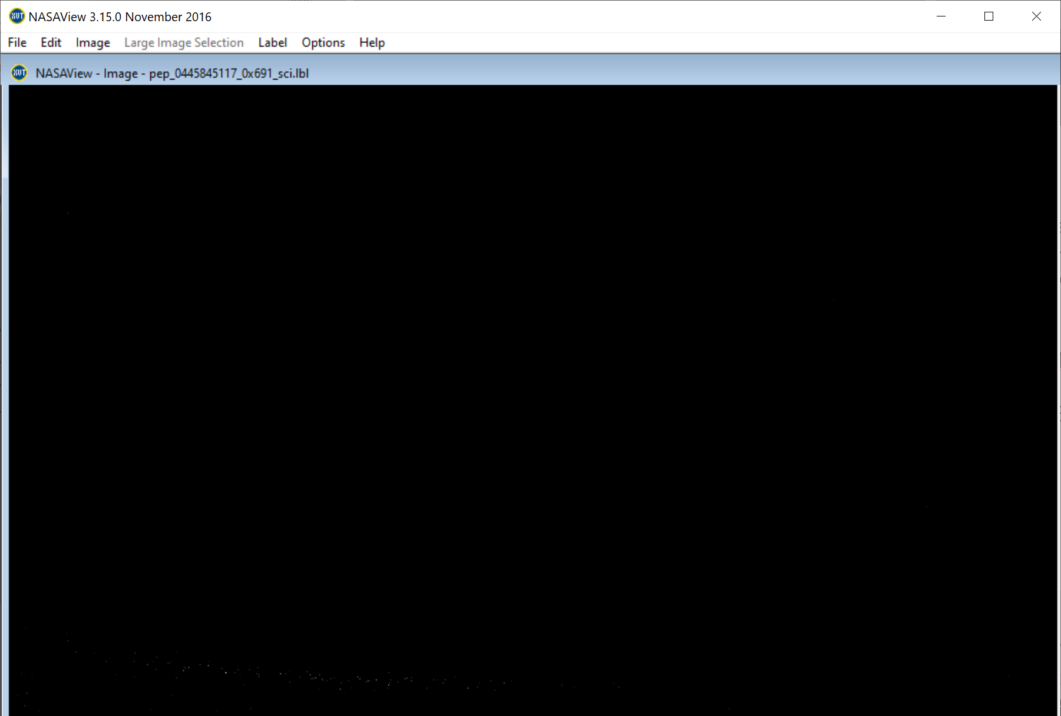
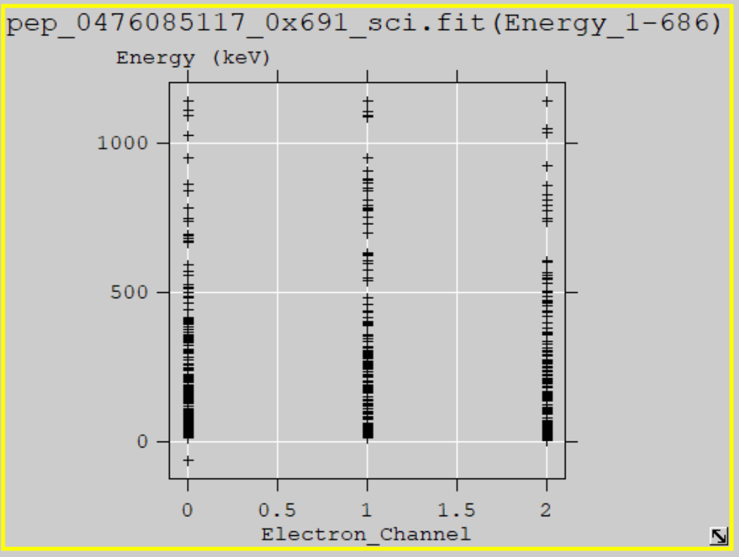
nh-x-pepssi-3-kem1-v5.0
Files open with both NASAVIEW and FV suggesting that the PDS and FITS labels
are well-formed. Validate tool did not catch any errors with labels.
Issue with labels (Auto description failed, Sulfur described as protons) reported in
May 2020 review are all corrected here.
All of the data files selected for spot inspection appeared nominal. NASAView has some
display issues with these data/labels
FV allow the user to plot data from any table versus time (MET or ET) and the plots
look nominal.
New Data Files
NASAVIEW won’t allow users to navigate past
the first image in the file – known s/w problem
Electron Energy vs. Channel
from 2021-02-25 (FV)
Weak TOF vs Energy signal matches
similar PHA result from FV for this data
file (2021-02-25)

Slide 14
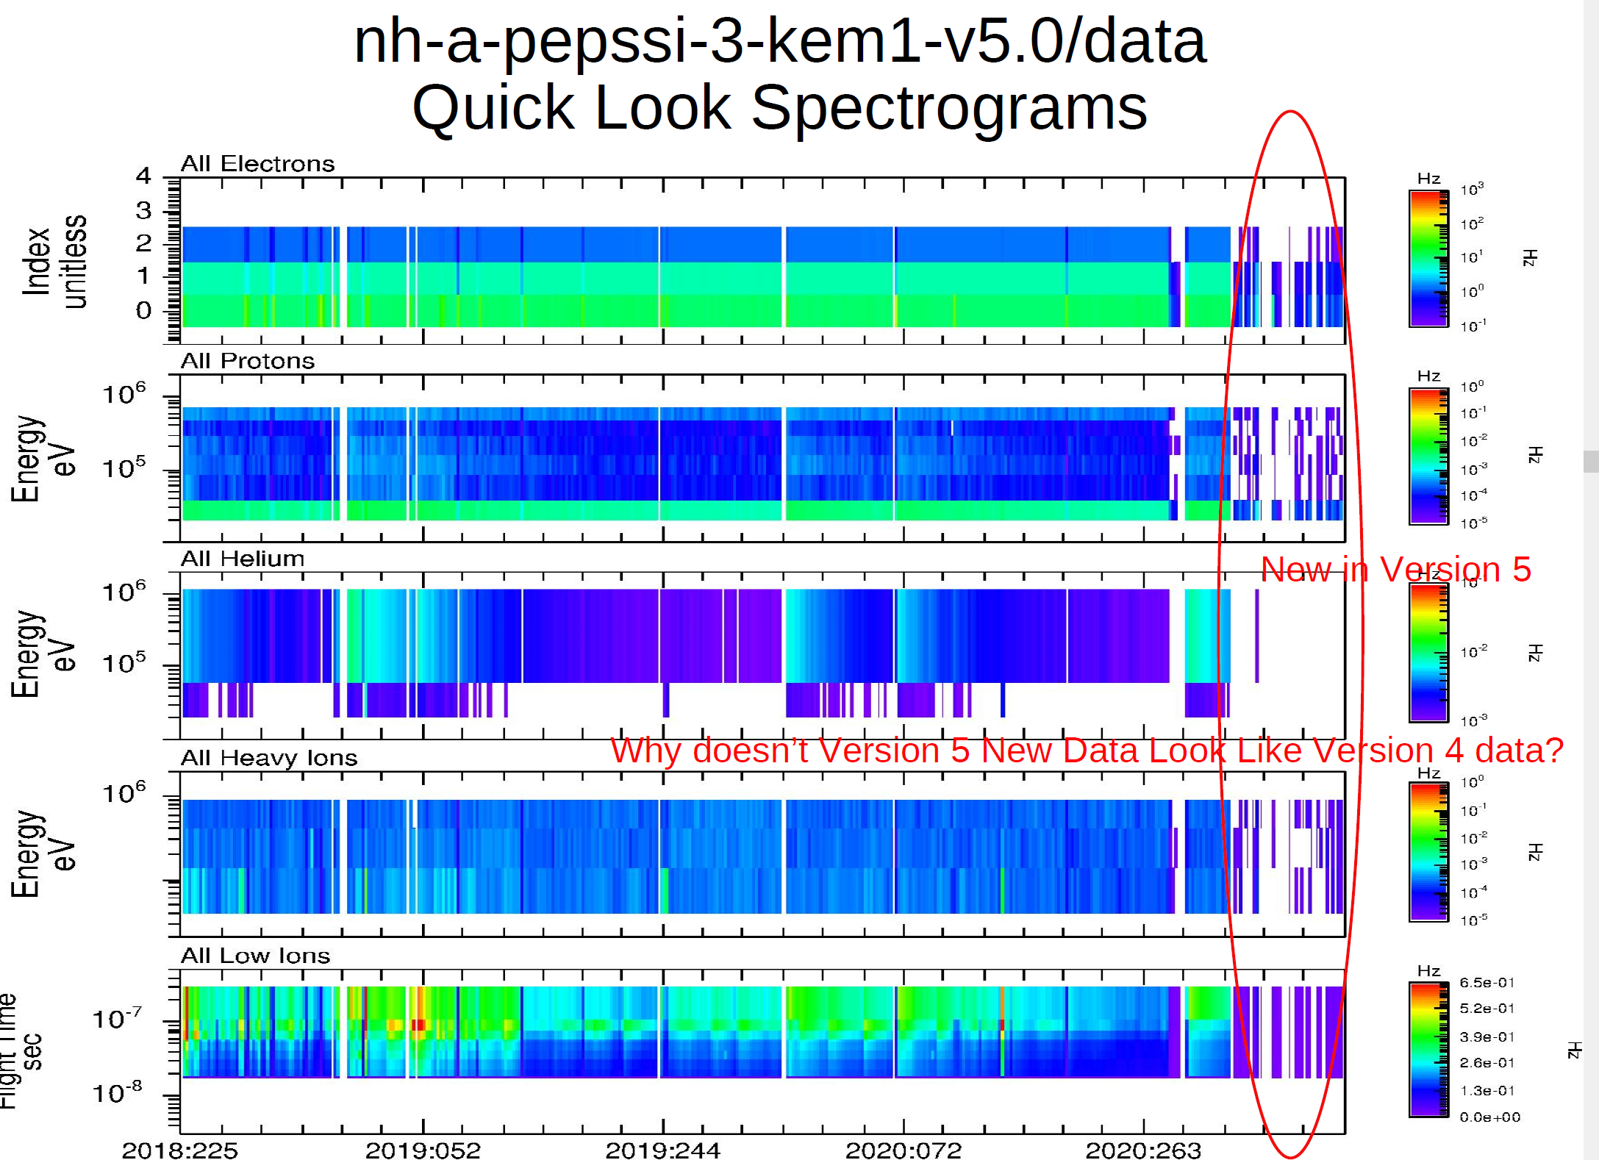
nh-x-pepssi-3-kem1-v5.0
Plot courtesy
of R. Frahm
Plot shows that the quick-look spectrogram data provided in each data file
look different in the new data associated with the v5 delivery than in past
deliveries. The reason for this difference is unexplained. Flux data do not
show a strong discontinuity at the new/old data boundary.

Slide 15
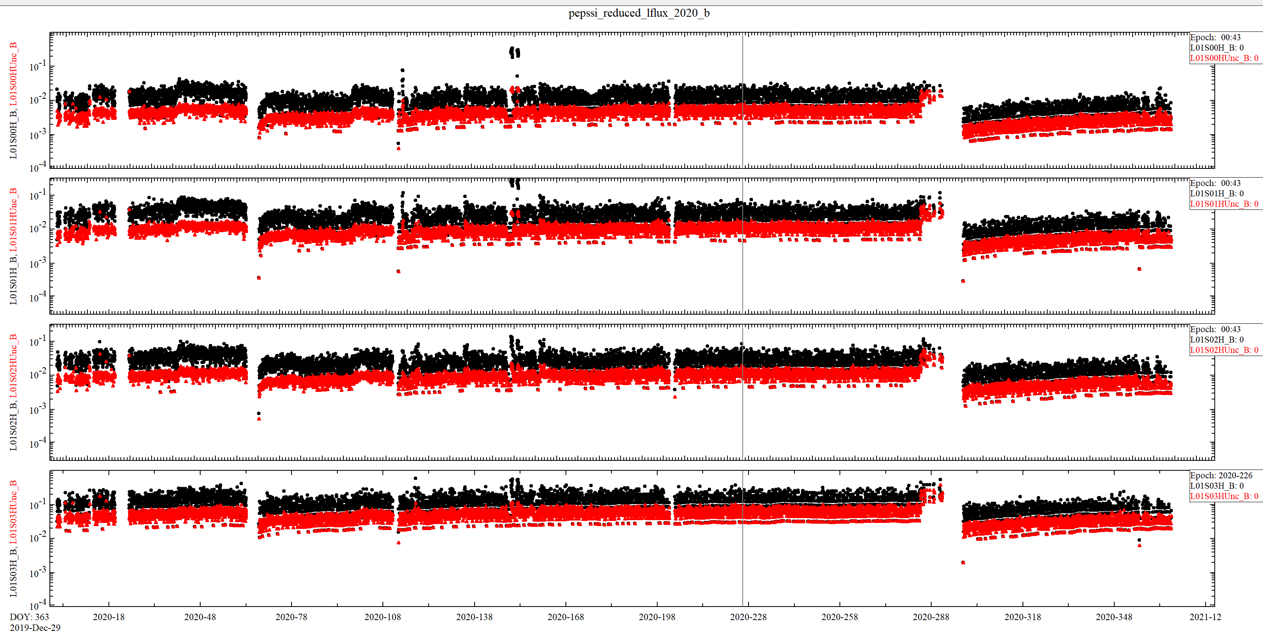
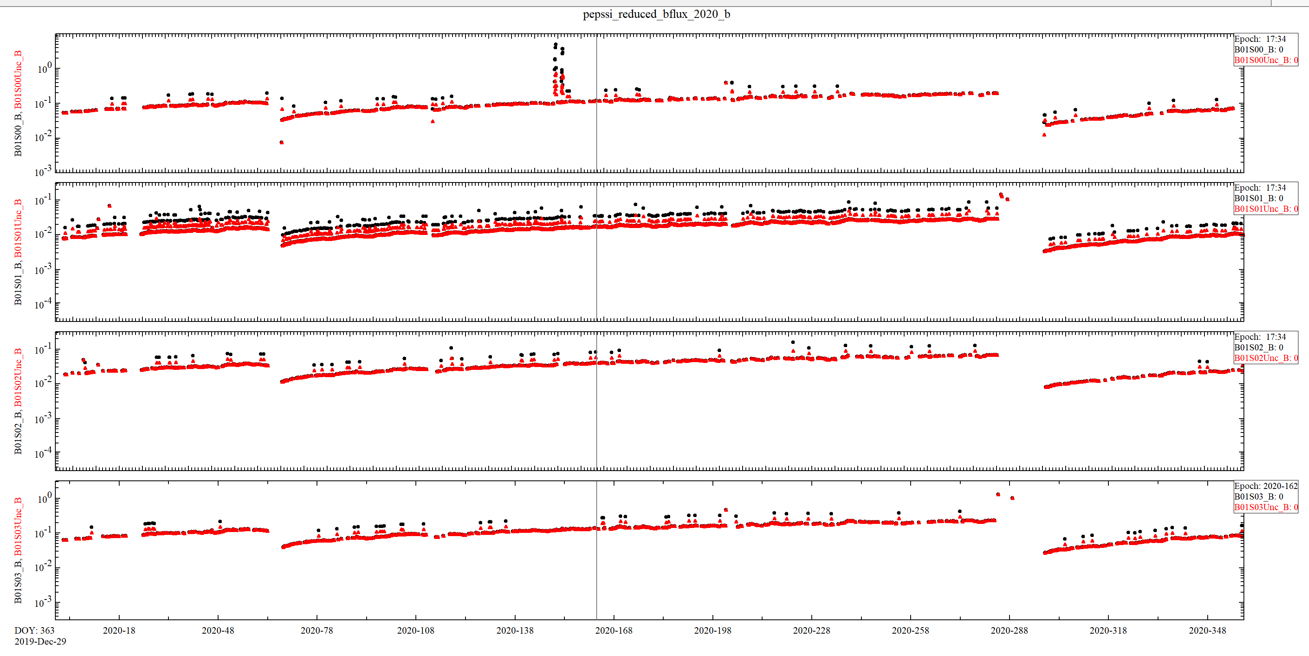
nh-x-pepssi-4-plasma-v1.0
Files are ASCII CSV with PDS3 labels – Easy to open in Excel
File listings look as expected
PDS labels appear to be properly formatted.
  Field descriptions are all identical, content is inferred from field name, however,
  no field naming convention in provided in the labels or dataset.cat
  Meaning of time column (start, center, end) of 1 hr average is not provided.
2020 Doubles first few channels (flux & unc)
2020 Triples first few channels (flux & unc)

Slide 16
nh-x-pepssi-4-plasma-v1.0
Plot courtesy
of R. Frahm
This plot shows the “doubles” spectra for the counts/second data from
sectors S00 (top) to S05 (bottom). The change in character of the data in
early 2014 is a mode change that is documented.

Slide 17
Summary of Liens
In general, the documentation is a bit sparse, particularly the dataset.cat files which
are generic, not specific to the datasets. This is just a comment and there is no
associated lien, however, should the team decide to update the -3- dataset.cat file,
it would improve the archive.
Liens against nh-x-pepssi-4-plasma-v1.0 :
1) Correct the units (flux) description in the dataset.cat.
2) Add a field naming convention to the dataset.cat (easy) or update the labels to explain
the contents (more work).
3) Update the dataset.cat to describe the meaning of the time-tag in the data files or
update the data file labels to provide that information.
Suggestions:
1) Consider updating the ref.cat file so that all of the volumes use the same version.
2) Consider adding trajectory data and other missing documents to the
nh-x-pepssi-4-plasma-v1.0 dataset.
Certification: The -2- and -3- data sets can be certified
The -4- dataset can be certified after the liens on the dataset.cat
file have been resolved.

