Slide 1
New Horizons REX KEM1 Encounter
Data v4.0 Review
Ashok Kumar Verma
University of California, Los Angeles
February 09, 2022

Slide 2
Review Procedure
Raw and calibrated volumes have nearly identical catalogs, documents, and index directories, and most of their contents have been reviewed previously. This reduced the amount of time spent on reviewing them.
BeyondCompare 3.3.13's folder compare option was used to compare like folders across volumes, then files within the folders were compared.
The only variation in the contents of files or the directory were usually the file timestamps and the data_set_ids in the label files. Having this information at hand, I only reviewed unique documents.
Furthermore, I checked whether the issues raised in the 2020 review had been addressed in this release.

Slide 3
Catalog Directory
nh_kem.cat, nhsc.cat, and rex.cat files are identical to the previous version.
catinfo.txt: only change is the publication date.
dataset.cat: I consider the description of the new downlink data in the catalog adequate.
ref.cat: there are new references in the catalog.

Slide 4
Document Directory
Most *.lbl files are identical to the previous version except for the data set id and the file record. These changes are appropriate for this version.
The correct version of TRK-2-34/TRK-2-23 is included.
All*.tab and *.csv files are updated with the new data to facilitate the analysis.
codesamples directory’s python code needs to be updated to ensure its long-term useability (see next slide).

Slide 5
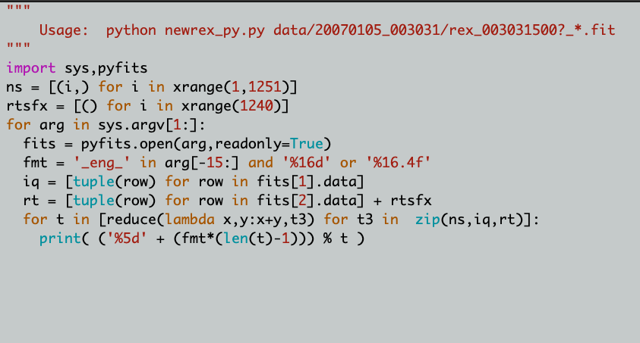
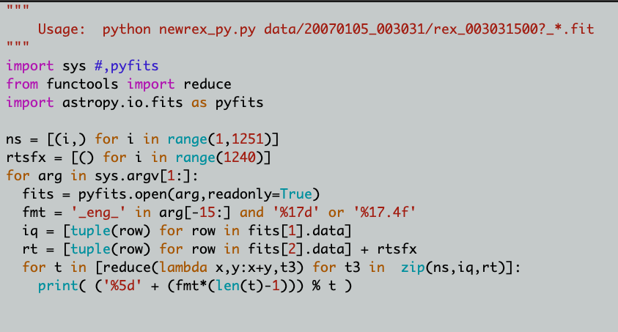
newrex_py.py
Deprecated in Python 3
New import functions

Slide 6
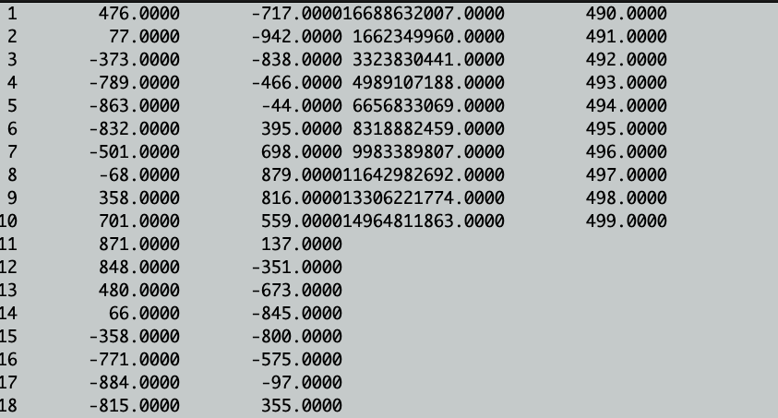
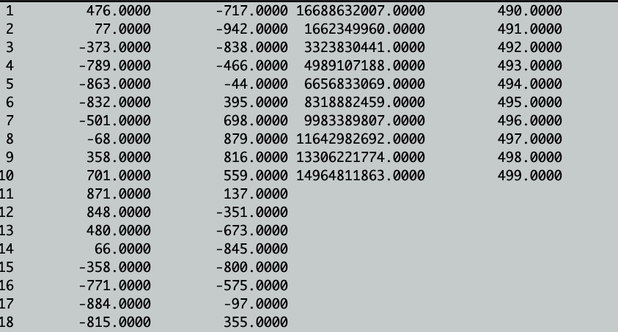
newrex_py.py

Slide 7
Index Directory
checksum.tab (.lbl) looks good.
index.tab (.lbl) looks good.
Indxinfo.txt looks good.
slimindx.tab(.lbl) looks good.

Slide 8
Data Directory
(Fit files)
I only examined the data that are new to the archive. The data appear complete.
I open the fits file in Topcat and compare I/Q samples with the output of the newrex_py.py script.
Both methods produced the same results, thus validating the newrex_py.py script.
Based on plotting the I/Q histograms, it appears that they are valid, despite a few files having zero samples throughout.

Slide 9
Data Directory
(TNF)
I only examined the data that are new to the archive. The data appear complete.
There are no reconstructed ("recon") spk kernels that cover the new data, so I am not able to compare computed values with raw values, although raw values seem to be valid (see next slide).
As with the last review, I did not find complete uplink data for DSS 34, 36, and 63 that covered 3-way Doppler. Perhaps, this may be beyond the provider's control.
The media files look good and complete.

Slide 10
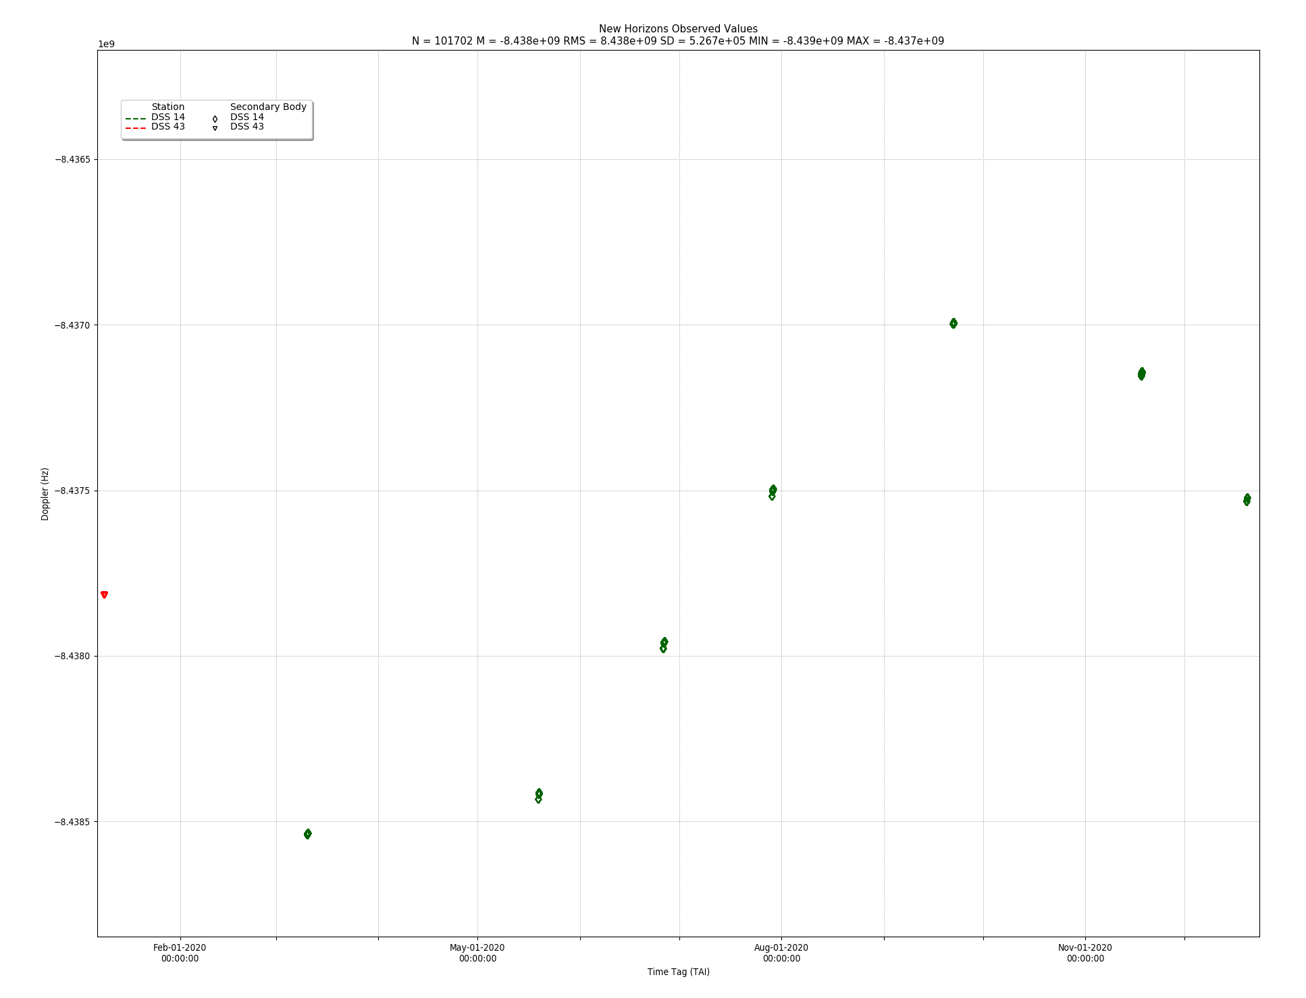
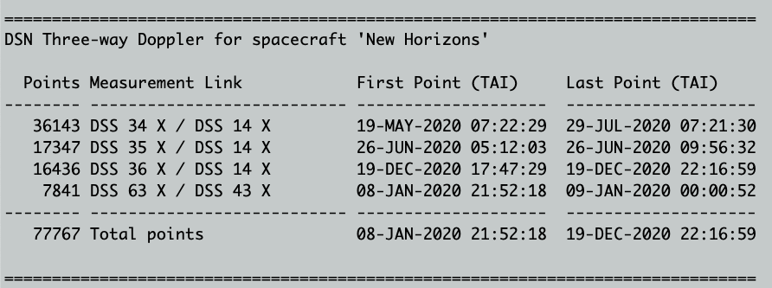
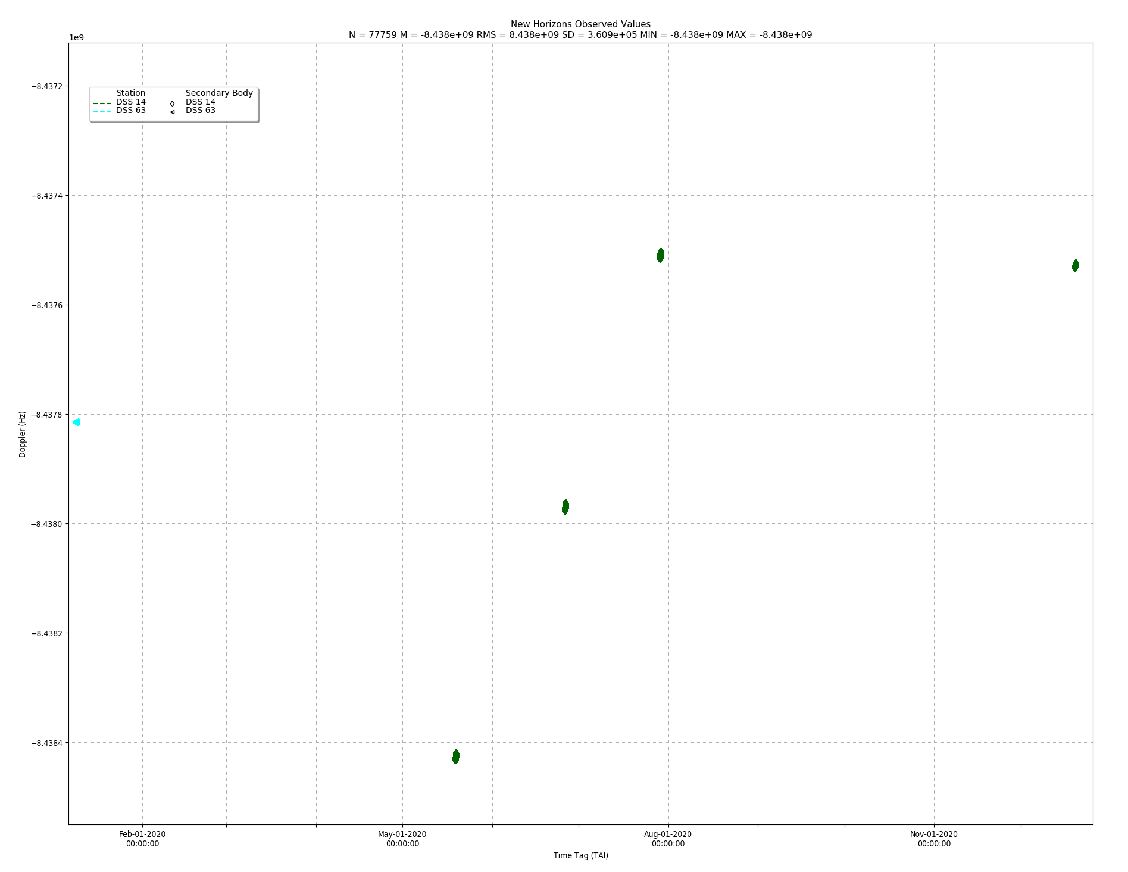
Data Directory
(TNF)

Slide 11
Recommendations
Overall, datasets are in good shape and are suitable for use by scientists.
The dataset in this version can be certified.

