Slide 1
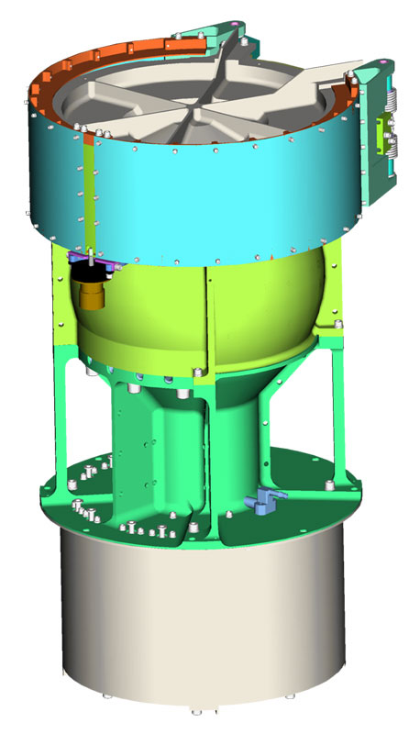
New Horizons Solar Wind Around Pluto
SWAP
Reviewed by S. Joy (secondary)
Low Energy Plasma Instrument consisting of a Retarding Potential Analyzer (RPA), and Electrostatic Analyzer (ESA), and a deflector (DFL).
Mass: 3.29 kg
Power: 2.84 W
Energy (min,max): 30-7700 eV
Energy Resolution: 1 eV
Field of View: 270º x 10º
Angular Resolution: N/A
Geometric Factor 1.8x10⁻³cm² sr eV/eV
Sweep Time (128 steps) 64 s
Accumulation Time 0.39 s

Slide 2
NH-SWAP Data Set Evaluation Tools
Evaluation -
Machine: Dell XPS 15 9560
Operating System: Windows 10

Slide 3
Datasets: nh-x-swap-2-pluto-v2.0 nh-x-swap-2-kem1-v5.0 nh-x-swap-3-kem1-v5.0 nh-x-swap-5-derived-solarwind-v2.0
Volumes:
NHKESW_1001 NHKESW_2001 NHKESW_3001
Volume Level Files
AAREADME – files are acceptable
VOLDESC – files are acceptable

Slide 4
Comments on review procedure
The catalog, documents, and calib directories of these volumes are nearly identical, and most of their contents have been previously reviewed many times.
I have taken advantage of this fact to reduce the review effort.
I used the folder compare option in BeyondCompare 3.3.13 to compare like folders across the four volumes, and then compare files contained in the folders. Most of the time, the only variation in the directory contents or the
file therein were the file time stamps and the data_set_id’s in the label files.
Once this information was available to me, I only reviewed unique files
Lastly, I looked at issues raised in the 2020 reviews to make sure that they had been addressed in this release.

Slide 5
Catalog Directory:
catinfo.txt - ok, might consider updating http://pds.jpl.nasa.gov/ to use https://
nh_kem.cat – ok (Frahm 5/20 review comments about KEM1 encounter addressed)
nh.cat – ok, only on the -5- data
nhsc.cat – ok (Frahm 5/20 review comments about KBO observations, payload not addressed)
ref.cat – The version of this file in the -5- dataset contains the KOLLMANNETAL2019 reference (addition not mentioned in the LABEL_REVISION_NOTE) that is not found in the -2- and -3- datasets. There should be one version for all of the datasets.
There are no differences between files that should be identical on the two volumes (nh_kem.cat, nhsc.cat, ref.cat, swap.cat, etc.) – good, correct versions included
dataset.cat (NH-X-SWAP-2-KEM1-V4.0) and
dataset.cat (NH-X-SWAP-3-KEM1-V4.0)
are effectively the same file with only the most minor differences
dataset,cat (nh-x-swap-5-derived-solarwind-v2.0) – ok, contains a description of the difference between the v1 and v2 versions of the dataset. I don’t recall reviewing a v1 version and the LABEL_REVISION_NOTE indicates that this is the initial release – curious.

Slide 6
Calib Directory:
calinfo.txt - good
background_009_dac.tab (lbl) - good
background_009_dac_jup.tab (lbl) - good
esa_rpa_v16_energy_binsf_new.tab (lbl) - good
esa_rpa_v18_energy_binsf_new.tab (lbl) - good
esa_rpa_v19_energy_binsf_new2.tab (lbl) – good
esa_shape.tab (lbl) – good
fov_mask_2d.tab (lbl) – good
list_energy.tab (lbl) – good
rpa_shape.tab (lbl) – good
Beyond Compare of all files to May 2020 release versions shows that the
only changes are to the DSID version (-V3.0 to –V4.0) in the LBL files.

Slide 7
Document Directory:
docinfo.txt (all) - good
codmac_level_definitions, lunineetal1995, payload_ssr, swap_ssr PDF files all PDF/A format. All previously reviewed and acceptable swap_cal – good (errors in equations from previous review fixed!)
nh_met2utc.tab file has be updated as requested.
data_summary_plots directory contents are ok, plots are useful
nh_mission_trajectory.tab (lbl) – See Next Slide
quat_axyz_instr_to_j2k.asc (lbl) – good
seq_swap_kem1.tab (.lbl) - good, complete
seq_swap_kemcruise1.tab (.lbl) – good, complete
nh_fov.png (lbl) - good
Document/data_summary_plots Directory:
Plots available for all days when calibrated data are available
Document/traj Directory trajinfo.txt – good traj_2006_2021_1d.tab (lbl, fmt) – ok
Document (nh-x-swap-5-derived-solarwind-v2.0) Text files (docinfo.txt, error_notes.txt) with attached labels - ok

Slide 8
Document Directory:
nh_mission_trajectory.tab – Values at same times are identical to those provided in the Dec 2020 review version of this file
Feb 2022 Version
Dec 2020 Version
BeyondCompare differences shown in red. Only differences are that the new dataset contains additional data.
In the Dec 2020 review, I showed that the trajectory data provided differed substantially from those provided in the May 2020 review at the same times. This was most likely the result of creating the files using different kernel sets, one of which was a predict. I suggested that the kernels used to create the file should be included in the product label.
The label for nh_mission_trajectory.tab (.lbl) in the Feb 2022 datasets includes the list of kernels used to generate the data – Thank you!!!

Slide 9
Index Directory:
indxinfo.txt - good, all 3 datasets
index.tab (lbl) - good, all 3 datasets
slimindx.tab (lbl) - good, -2- and -3- datasets
checksum.tab (lbl) - good, all 3 datasets

Slide 10
Data Directories:
nh-a-swap-2-kem1-v5.0
Data appear to be complete
Labels validate
FITS files open in FV and the contents appear to be valid
nh-a-swap-3-kem1-v5.0
Data appear to be incomplete (very few data after 12/1/2020)
Labels validate
FITS files open in FV and the contents appear to be valid See notes from Rudy to the contrary
Summary plots show valid data
Rudy is able to generate plots that show that all of the data components appear to be valid for nearly all of the data files
nh-x-swap-5-derived-solarwind-v2.0
Data look good (see plots). Pick-up ion data file covers a shorter time interval than the solar wind data file. ASCII CSV files Labels look good
nh-a-swap-2nh-a-swap-2-kem1-v4.0-kem1-v4.0

Slide 11
Data Directory Contents
2020
Annual
Summary Data Plots
2021
When present, the data look good!
Data continuity issues previously reported in early 2020 have been corrected. There are some new continuity issues with late 2020 and early 2021 data.
In general, the data show a clear solar wind beam signature when Sun-pointed.

Slide 12
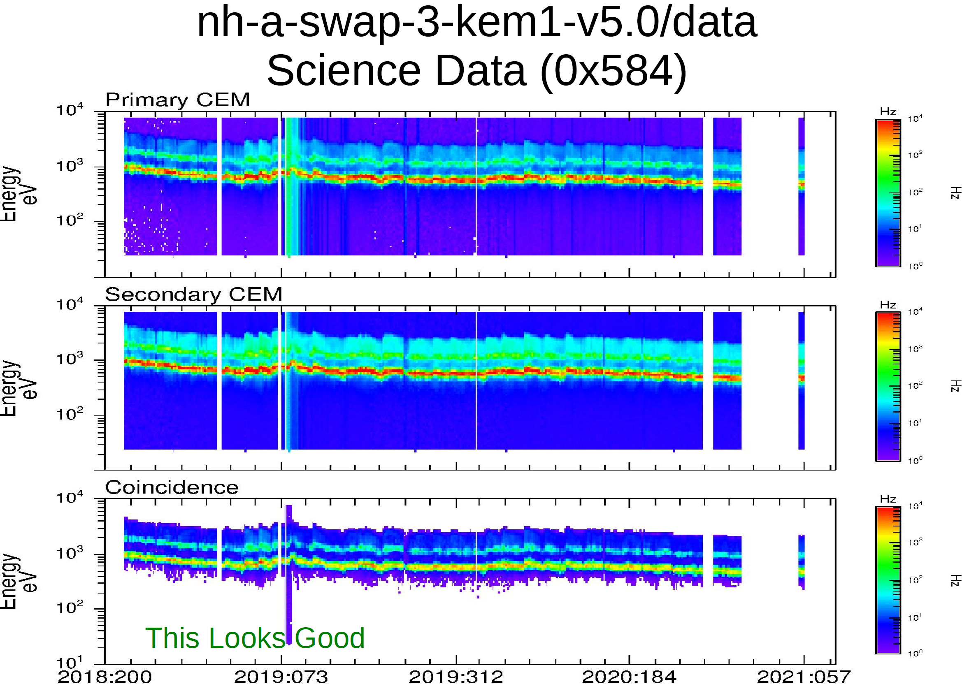
Data Directory Contents
Data are nearly continuous until the end of 2020.
Plot courtesy of R. Frahm

Slide 13
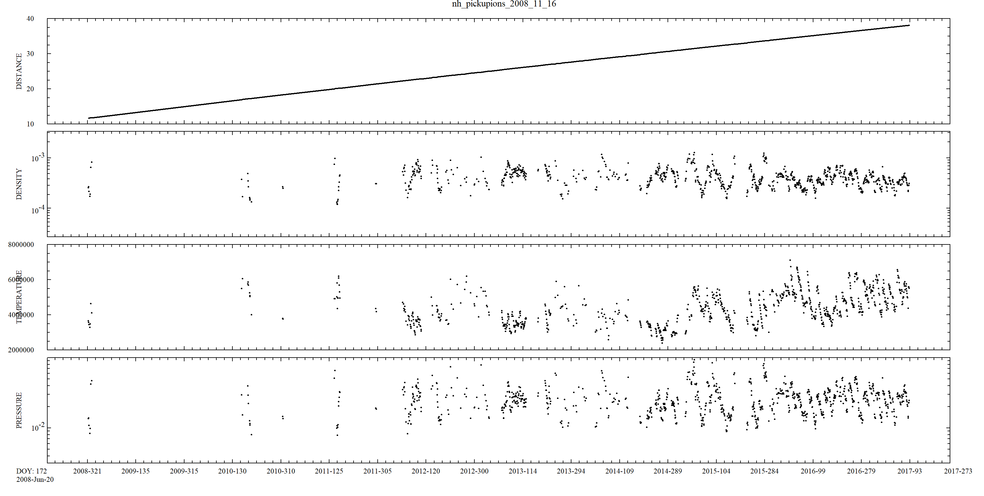
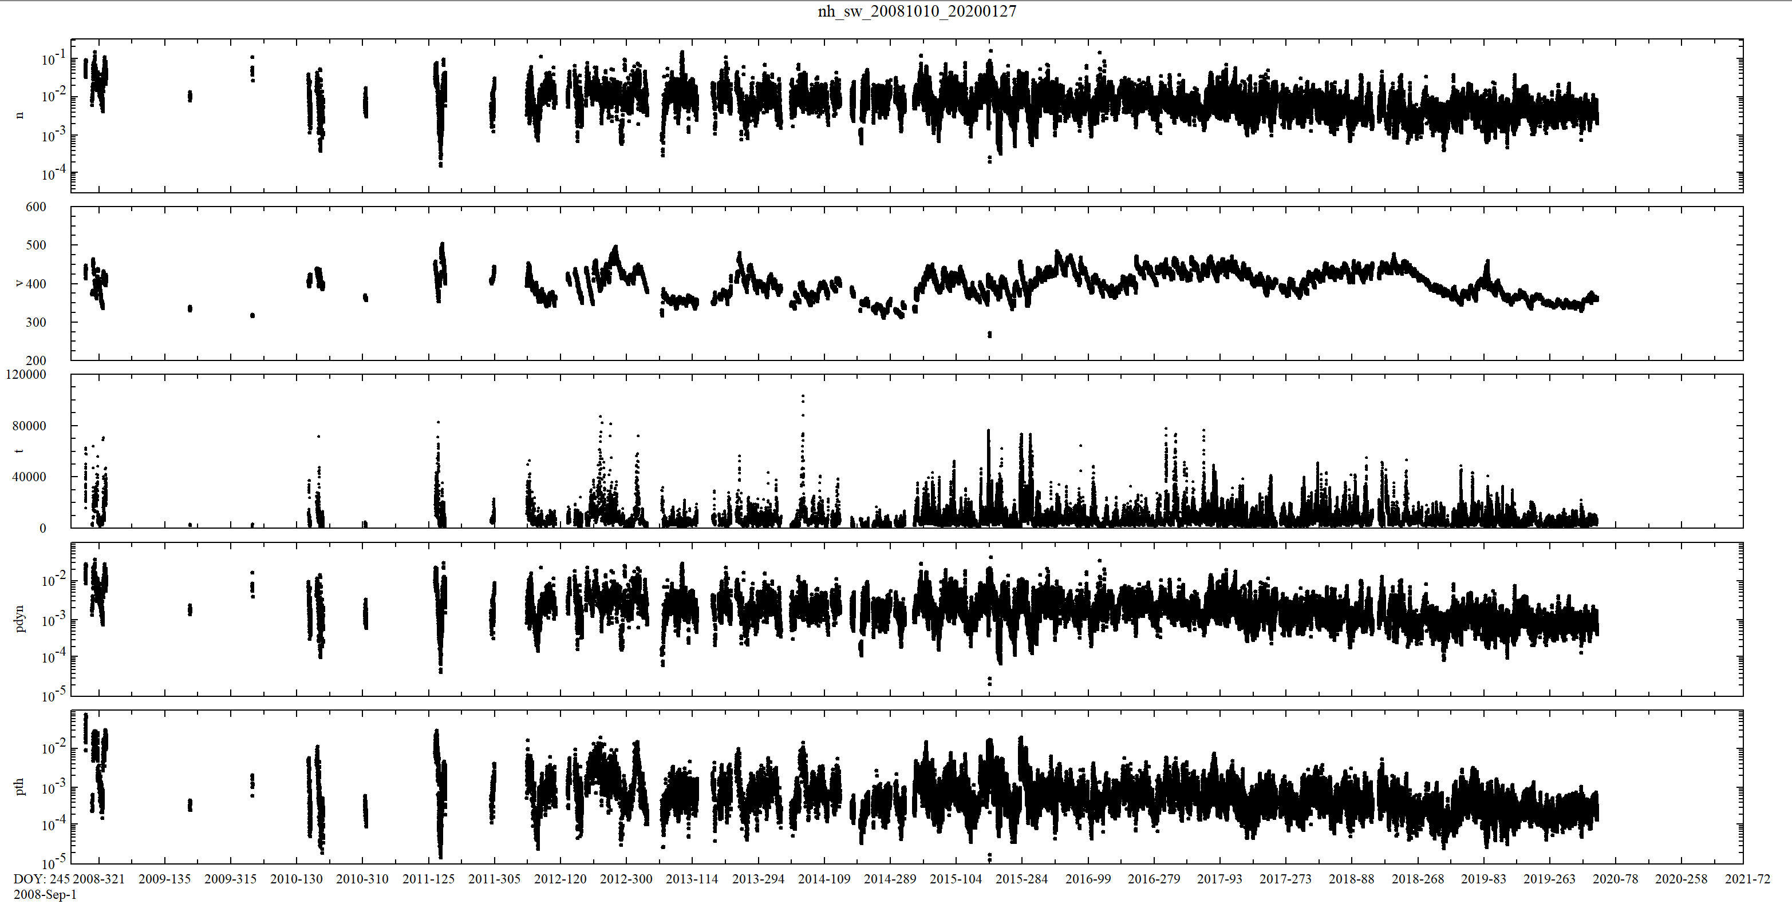
Data Directory Contents nh-x-swap-5-derived-solarwind-v2.0
Pick-up Ion Data
Heliocentric Range (AU)
Density (cm⁻³)
Both data files look good
Temperature (ºK)
Pressure (pPa)
Solar Wind Data
2008 - 2018
Density (cm⁻³)
Velocity (km/s)
Solar wind is slowing, rarefying, and cooling with increasing heliocentric range. Interstellar pick-up ion moments are mostly independent of range.
Temperature (ºK)
Dynamic Pressure (nPa)
Thermal Pressure (pPa)
2008 - 2021

Slide 14
Recommendations
In general, all 3 of these datasets are in good shape. As previously noted, the dataset.cat descriptions are very generic and do not contain any specific discussion of these particular data. Since the other documentation is complete, no liens have been written.
Liens: None identified by my review.
Certification: Although I did not find any issues with the datasets under review that would prevent certification, Rudy did find issues with both the documentation and a few data files that should be corrected before the data are certified.
Note: I verified Rudy’s findings that incorrectly formatted data files were included PDS3 volume validator did not catch issues with Label/Data mismatch
The documentation errors can probably be fixed easily and quickly. The source of the errors in the file formats that Rudy found should be investigated to make sure that unexpected/undesired changes in the data processing pipeline have not occurred.

