Slide 1
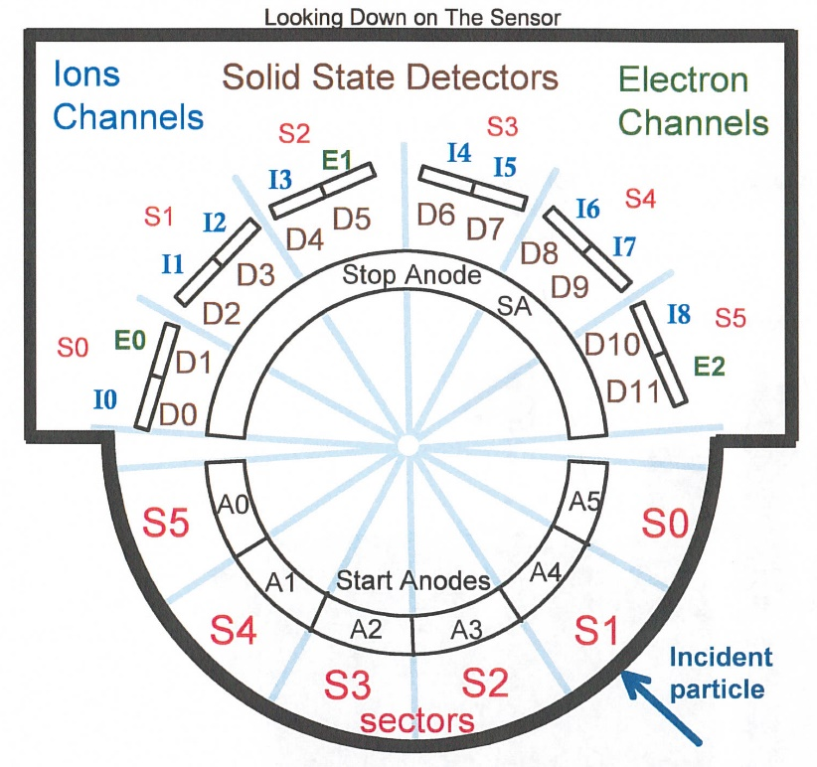
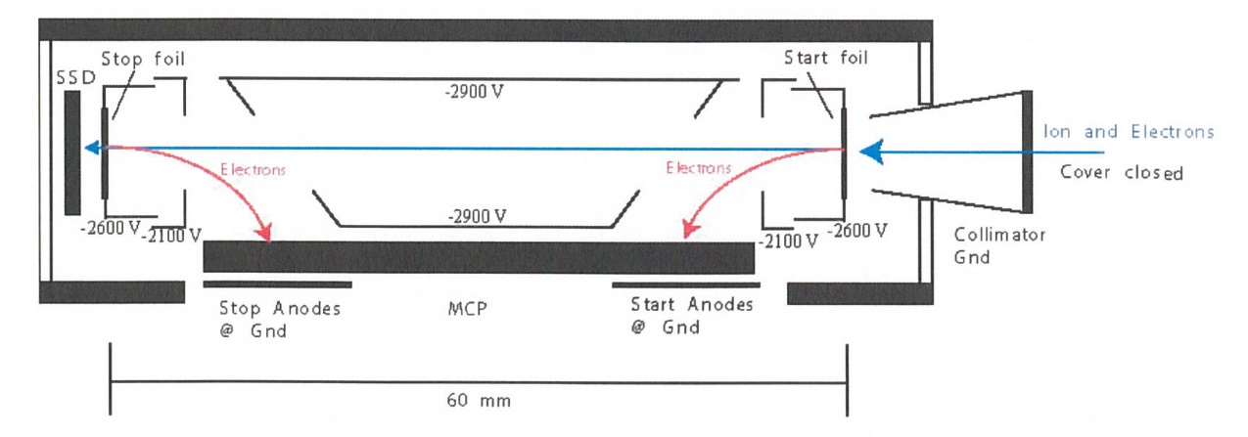
New Horizons Pluto Energetic Particle Spectrometer Science Investigation (PEPSSI)
Reviewed by S. Joy (primary)
PRINCIPAL INVESTIGATOR: Ralph McNutt, APL
DESCRIPTION: Medium Energy Particle Spectrometer
ENERGY RANGE: 25-1000 keV (protons)
60-1000 keV (atomic ions)
25-500 keV (electrons)
FIELD OF VIEW: 160 deg x 12 deg
ANGULAR RESOLUTION: 25 deg x 12 deg
ENERGY RESOLUTION: 0.25 keV
SENSOR SIZE: 7.6 cm dia. x 2.5 cm thick
POWER: 1.4 watt
MASS: 1.5 kg

Slide 2
New Horizons PEPSSI Data Sets
Data ->
nh-x-pepssi-4-plasma-v1.0

Slide 3
New Horizons PEPSSI Data Set Evaluation Tools
All Data Processing and Evaluation -
Machine: Dell XPS 15 9560
Operating System: Windows 10

Slide 4
Comments on review procedure
This is a delta review so I mainly looked at the liens from the Feb 2022 review to verify that they had been properly addressed. I also did some spot checking of other files, including data files to make sure that no new problem had arisen.
I used the folder compare option in BeyondCompare 3.3.13 to compare like folders across the Feb 2022 and Oct 2022 volumes, and then compare files contained in the folders. Most of the time, the only variation in the directory contents or the files therein were the file time stamps and the changes made in response to the previous review.

Slide 5
Documentation
Evaluation

Slide 6
DATASET.CAT Liens
Liens: file: 'catalog/dataset.cat'
RC: The DATA_SET_NAME has a trailing comma. Please remove. Fixed
--> RC: You should add OBJECT = DATA_SET_MISSION for MISSION_NAME = "NEW HORIZONS KUIPER BELT EXTENDED MISSION“ Fixed
--> SJ: The text does not provide a column naming convention and the data labels do not provide that information in the descriptions. This should be corrected. Fixed
--> RF (slide 36): Further description and suggestions:
===================
The labels are criptic and not explained. These should be included and below is an example (although it could be written in many ways):
LTTSDDI_X where L means Doubles and TT is the channel (0-15), S means the Sensor and DD is the sensor number (0-6), I is the species combined with "Unc" to indicate an Uncertainty, and X is the segment (a or b). Mostly Fixed, some minor corrections still needed (See Rudy’s comments)
The explanation of the J’s in the "Data File Types" section is good, the Doubles and Triples files should be the same. Right now, the general user does not know how to interpret the labels. Fixed
===================
--> SJ: The text describes the units of the flux data files BFLUX and LFLUX as counts per second while the labels correctly list them as "c/s/ster/cm^2/keV". Fixed
--> RF (slide 32): The STOP_TIME and DATA_SET_DESC do not agree. See lines 14,25. Please fix. Fixed
RF (slide 33): Missing information about how the data are organized into separate subdirectories. This should probably live before the Data File Headers section Fixed
--> RF (slide 34): The Data File Contents section currently is a description of the dataset and the section title is mislabeled (should be Dataset Contents). This section should be placed above the section labeled "Data File Headers". The "Data File Contents" section should describe what is in the data files. It should describe the contents of each type of data file and what is inside of each. The section "Data File Types" makes a stab at this. Fixed, sort of – Section now called Data File Types and Contents
RF (slide 37): ABSTRACT_DESC has the wrong "through [date]". Please correct as mentioned in DATA_DESC. Fixed
RF, SJ: Meaning of Time Tag (start/middle/end or average) should be defined in either the labels or dataset.cat Not Fixed here or in labels !!!

Slide 7
Other Catalog File Liens and Suggestions
pepssi.cat RF: The statement at the end of the Data validity section (lines 339-341), talk about referring to the Primary HDU and extensions of the data products for more details. The problem is that this is only relevant for the L2 and L3 products, not the L4 product (which has only csv files). Suggest to remove the statement or clarify that this is for the L2 and L3 products only. Fixed
ref.cat SJ: Consider adding the KOLLMANNETAL2019 reference found in the -4- file to the -2- and -3- versions to keep all files identical. Fixed

Slide 8
Document File Liens and Suggestions
SJ: The nh-x-pepssi-4-plasma-v1.0 dataset is missing a few of the documents that are included in the other datasets. Most of this is fine, but you might consider including the “nh_mission_trajectory.*” as well as the bad time intervals (bti) and command history files (seq). Fixed, now contains all standard documents

Slide 9
Data File Label Liens and Suggestions
SJ: Field descriptions are all identical, content is inferred from field name, however, no field naming convention in provided in the labels or dataset.cat Fixed in dataset.cat
SJ, RF: Meaning of time column (start, center, end) of 1 hr average is not provided Not fixed either here or in dataset.cat
SJ: New error/lien – In the cps files in the Doubles and Triples directories, the units described in the file descriptions (counts/cm^2/second/steradian/keV) doesn’t match units in the value of the UNITS keywords (c/s) in the FIELD Objects Please change the DESCRIPTION to be consistent with the file naming convention and the UNITS values (c/s).
Example from doubles/pepssi_reduced_lcps_2012_a.lbl DESCRIPTION = "This spreadsheet contains one-hour averaged flux/intensity quantities, calibrated in differential intensity
units (counts/cm^2/second/steradian/keV), for many known particle species where both the total energy detected and the time of flight of the charged particle are known. Thus, the mass and energy of the particle can be determined. "
OBJECT = FIELD
FIELD_NUMBER = 4
NAME = "B01S01_A"
DESCRIPTION = "
Averaged flux/intensity quantity or statistical uncertainty.
Lower Energy Bound: 2.9784
Upper Energy Bound: 54.877
Species: H+
Units: c/s " Correct!
BYTES = 21
DATA_TYPE = ASCII_REAL
UNIT = "c/s" Correct!
MISSING_CONSTANT = -1.0E38
END_OBJECT = FIELD

Slide 10
nh-x-pepssi-4-plasma-v1.0
Plot courtesy of R. Frahm
This plot shows the “L1 Ions All All” count rate data (counts/second) from sectors S00 (top) to S07 (bottom). The change in character of the data in early 2014 is a mode change that is documented.

Slide 11
Review Summary
Nearly all of the most truly important issues uncovered in the Feb 2022 review have been corrected and most of the editorial comments have been addressed as well.
The most important of the unresolved issues is including a statement of what location within the average is described by the record time-tag (start/middle/end). This problem should be corrected but it should not prevent the dataset from being certified
Users of this dataset are looking at the changes in the solar wind energetic particle population as it evolves over many AU. Timing errors of up to 30 min are not going to change scientific results
The problem with the DESCRIPTIONs in the *cps* doubles and triples files was present at the time of the last review and was not caught by the reviewers. This problem should be corrected but it should not prevent the dataset from being certified
FIELD Objects correctly describe the units Dataset.cat correctly describes the units File names contain the correct units Users should be able to determine the correct units

