Slide 1
PDS-SBN Review of New Horizons LEISA v5.0 Data (2014 MU₆₉ Approach)
M. DiSanti
10 Feb 2022

Slide 2
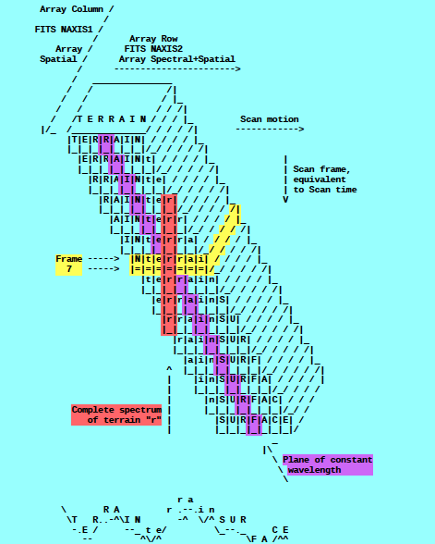
A spatial-spectral data cube is created by scanning the FOV across the target in a “push-broom” fashion. The data cube is a 3-dimensional array having 256x256xN elements, where N is the number of 256x256 files accumulated over the scan.
e.g., read in calibrated FITS file = ‘nh-p-leisa-3-pluto-v2.0/data/20150714_029917/lsb_0299172889_0x53c_sci.fit’
file = file(x,y,z),
x=spatial (256 elements),
y=lambda(256 elements),
z=spectral/spatial
(N=elements; e.g., N=371)
(i.e., lambda varies spatially)
[figure from ‘leisa_data.pdf’ in
folder ‘document’]

Slide 3

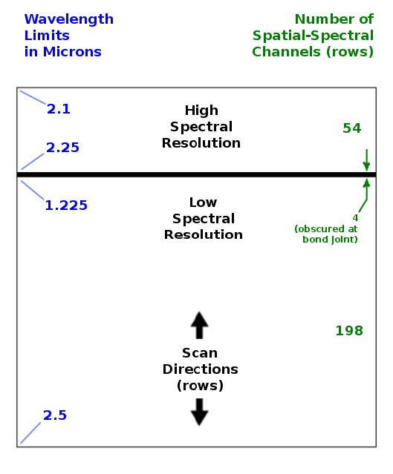
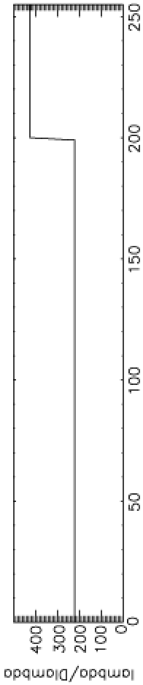

LEISA
A near-IR (1.2 – 2.5 micron) spectrometer that uses a 256x256 Rockwell PICNIC array, with 40-micron square pixels.
It produces low-resolution (λ/Δλ ~ 240) and higher-resolution (λ/Δλ ~ 540) spectra over separate sections (ranges of 54 and 199 rows) that are separated by 4 rows obscured by a bond joint.
Note: “Hi-res” λ/Δλ was ~ 425 for Pluto flyby data (as below) but is ~ 540 for cruise & 2014 MU₆₉ approach phases (recalibration)

Slide 4
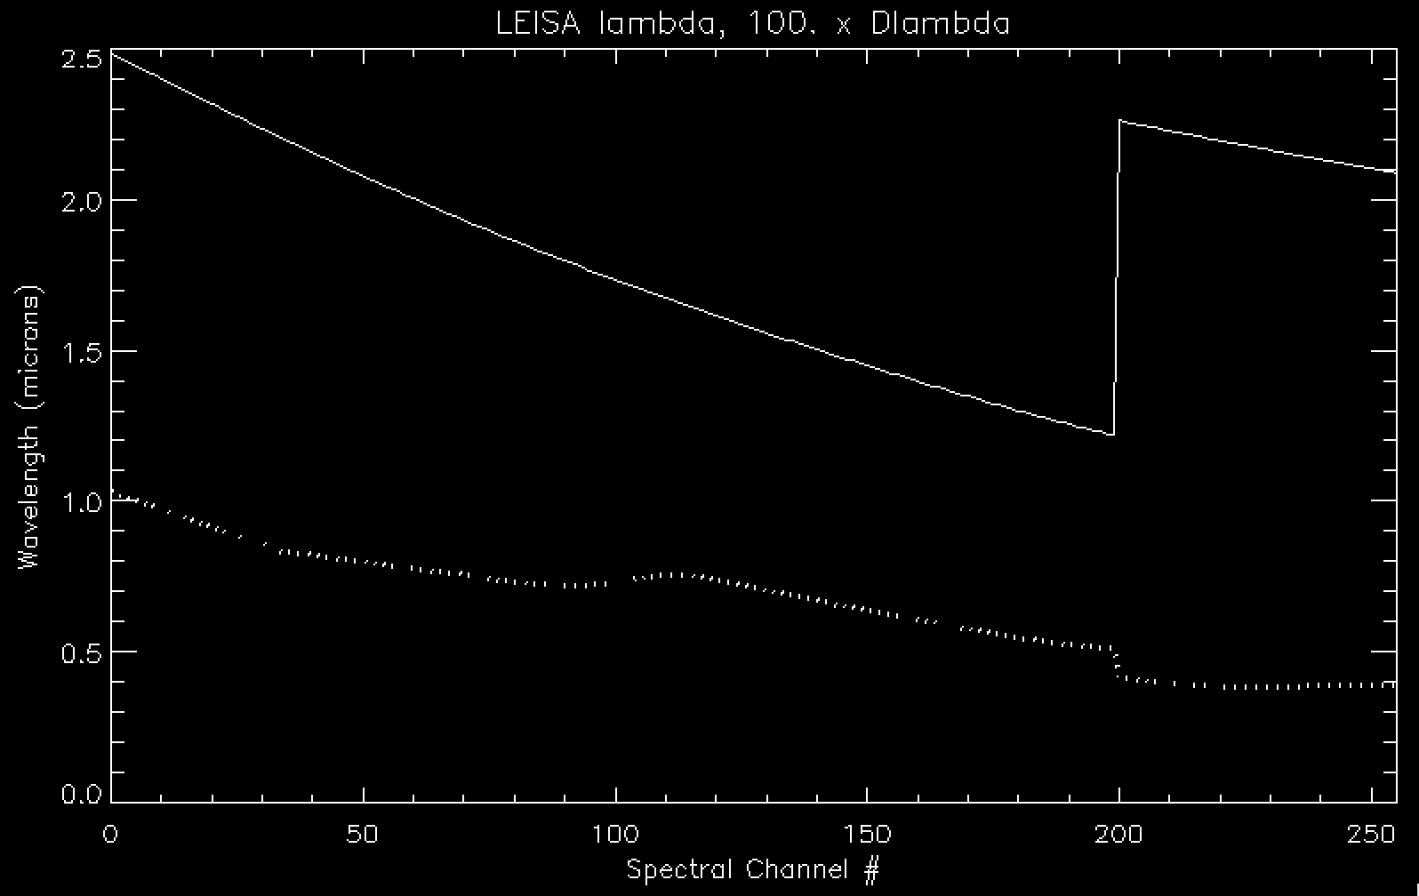
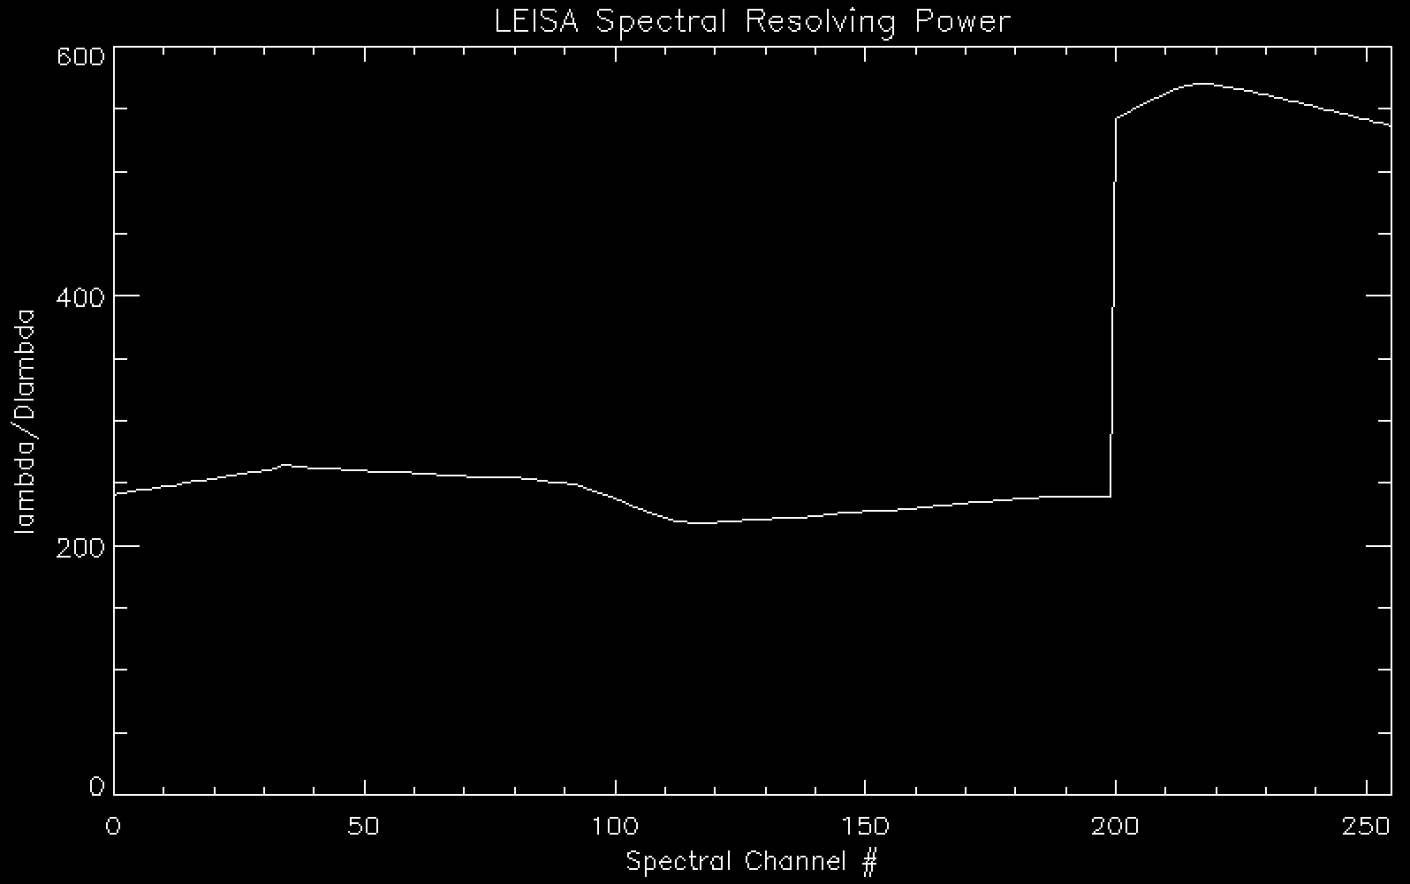
LEISA Wavelength Calibration
lambda
Delta-lambda x 100
Lambda / Delta-lambda

Slide 5
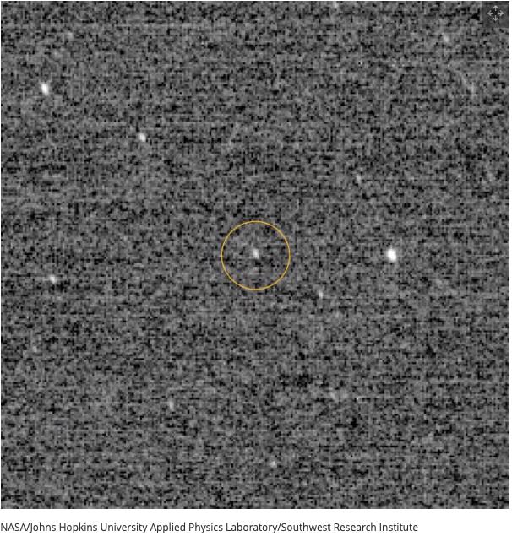
Arrokoth (2014 MU₆₉) Approach
“First Look” at MU69, at
d~10⁶ km (with LORRI)

Slide 6
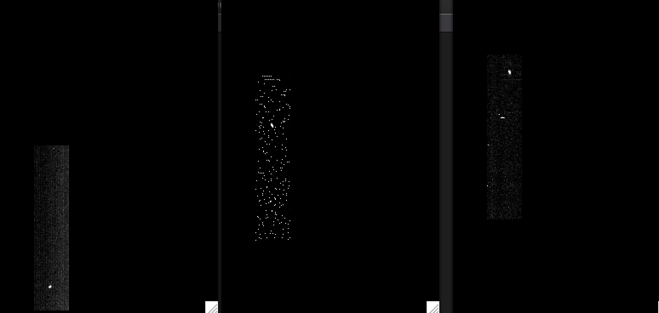
LEISA CRUISE DATA (20aug2018)
/data/20180820_039709/lsb_0397097519_0x53c_eng.fit (Alpha Lyrae)
Channel 9 (2.4088 μm)
Channel 194 (1.2384 μm)
Channel 250 (2.1038 μm)
|<-------------------------------------------------------------------------------->|
Low-res (λ/Δλ ~ 243)
High-res (λ/Δλ ~ 542)
(Spatially unregistered)

Slide 7
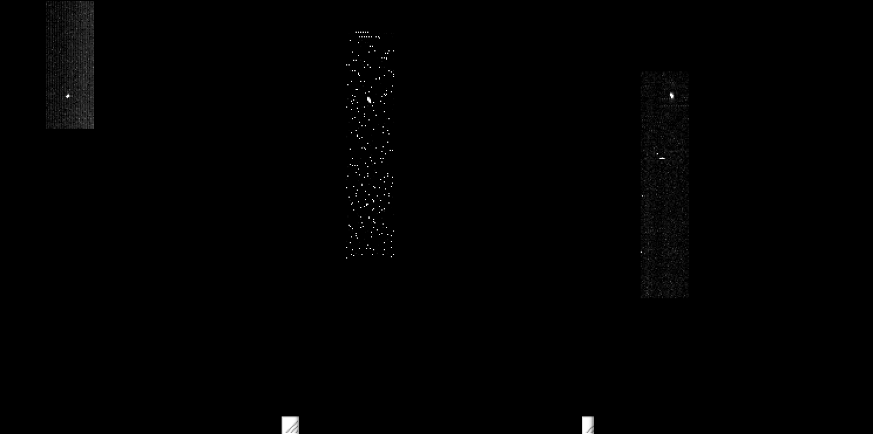
LEISA CRUISE DATA (20aug2018)
/data/20180820_039709/lsb_0397097519_0x53c_eng.fit (Alpha Lyrae)
Channel 9 (2.4088 μm)
Channel 194 (1.2384 μm)
Channel 250 (2.1038 μm)
|<-------------------------------------------------------------------------------->|
Low-res (λ/Δλ ~ 243)
High-res (λ/Δλ ~ 542)
(Spatially registered)

Slide 8
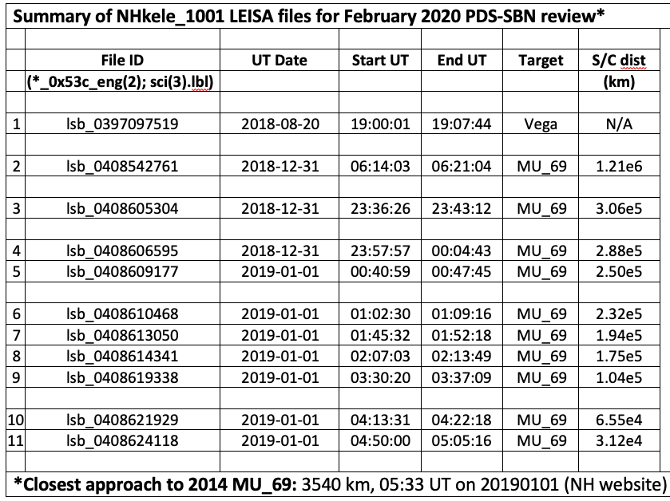
LEISA MU₆₉ Approach DATA

Slide 9
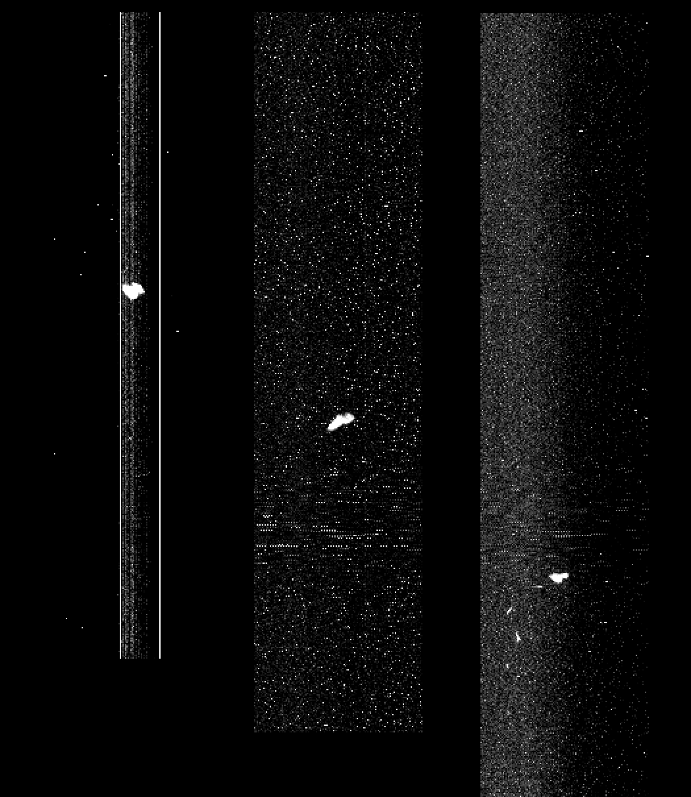
LEISA approaching MU69 (01jan2019)
lsb_0408624418_0x53c_eng.fit (04:50 – 05:05 UT), <d> = 31.2e3 km
Ch1
(low_res2.4744 μm)
Ch127
(low_res1.5748 μm)
Ch255
(high_res2.0895 μm)
Spatially
Unregistered
(Raw)
Start: row392 →
Mid: row290 →
←End: row173
Subtract median
at each step in λ

Slide 10
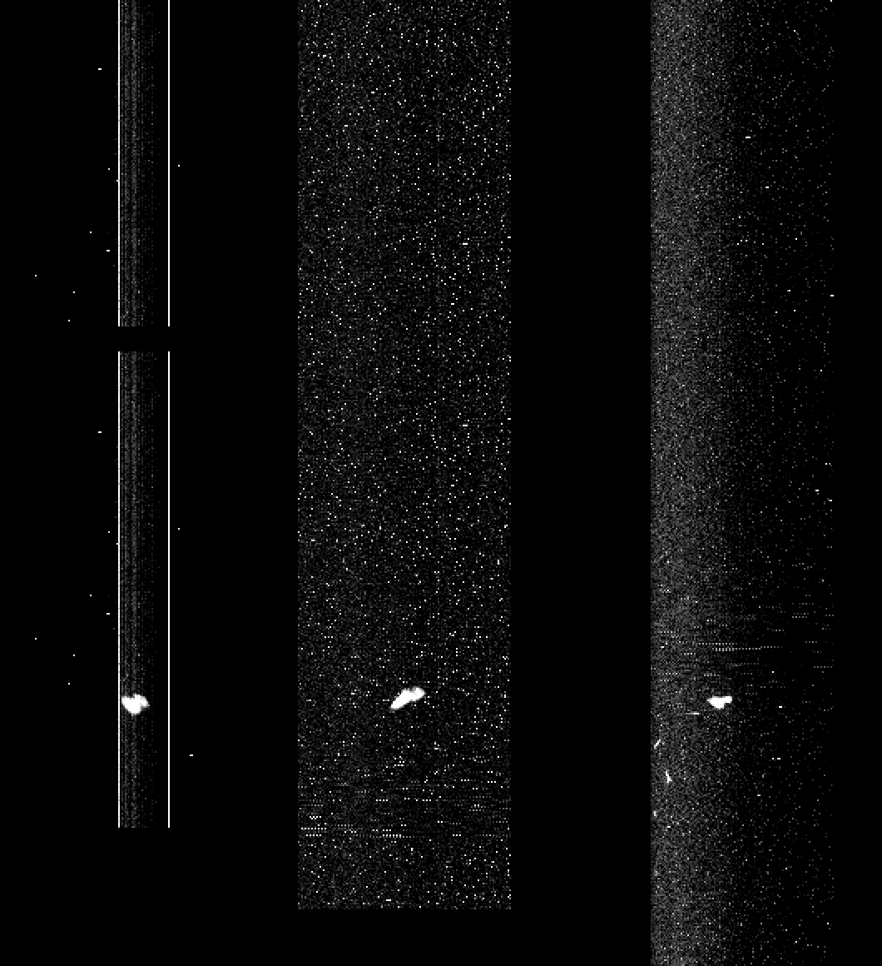
LEISA approaching MU69 (01jan2019)
lsb_0408624418_0x53c_eng.fit (04:50 – 05:05 UT), <d> = 31.2e3 km
Ch1
(low_res2.4744 μm)
Ch127
(low_res1.5748 μm)
Ch255
(high_res2.0895 μm)
Spatially
Registered
(Raw)
Start: row392 →
Mid: row290 →
← Row173

Slide 11
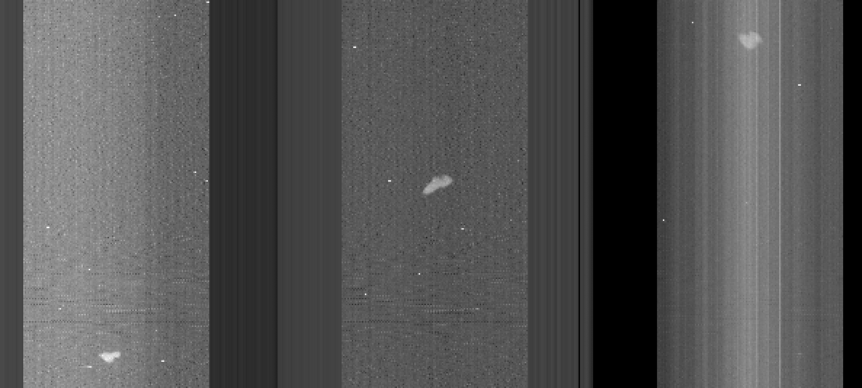
LEISA approaching MU69 (01jan2019)
lsb_0408624418_0x53c_sci.fit (calibrated), <d> = 31.2e3 km
Ch255
(high_res2.0895 μm)
Ch127
(low_res1.5748 μm)
Ch10
(low_res2.4004 μm)

Slide 12
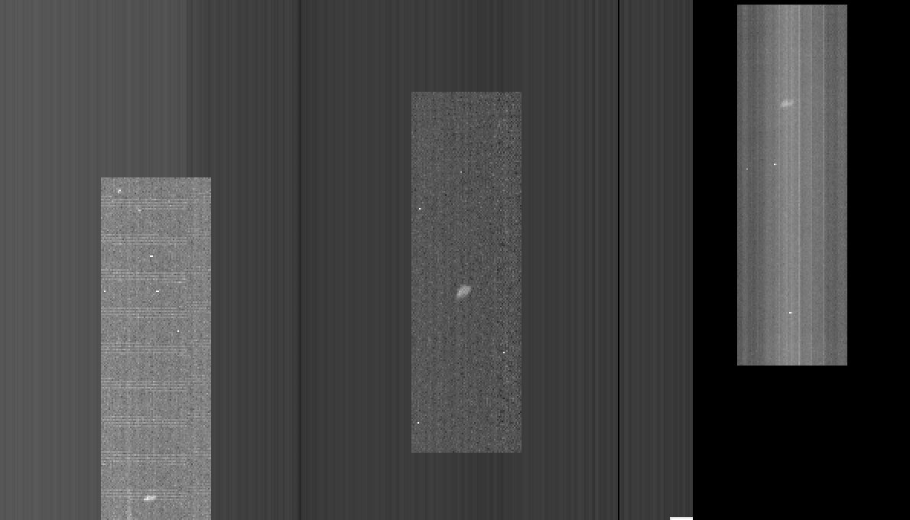
LEISA approaching MU69 (01jan2019)
lsb_0408621929_0x53c_sci.fit (calibrated), <d> = 65.5e3 km
Ch255
(high_res2.0895 μm)
Ch127
(low_res1.5748 μm)
Ch10
(low_res2.4004 μm)

Slide 13
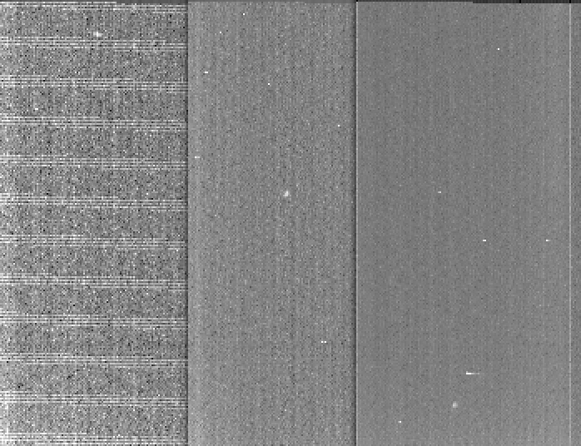
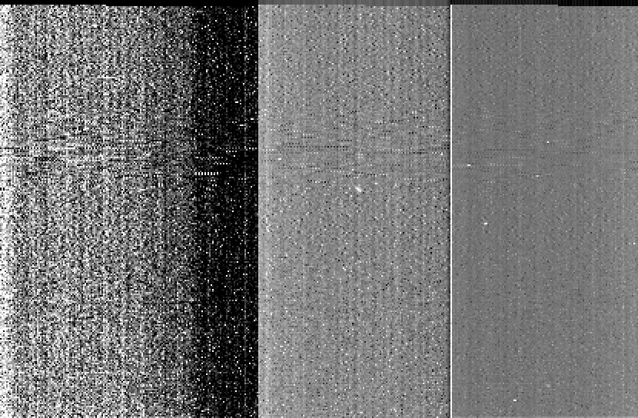
lsb_0408619338_0x53c_sci.fit (calibrated), <d> = 104e3 km
Ch225
(high_res2.1795 μm)
Ch127
(low_res1.5748 μm)
Ch10
(low_res2.4004 μm)
←
←
←
lsb_0408614341_0x53c_sci.fit (calibrated), <d> = 175e3 km
←
←
←

Slide 14
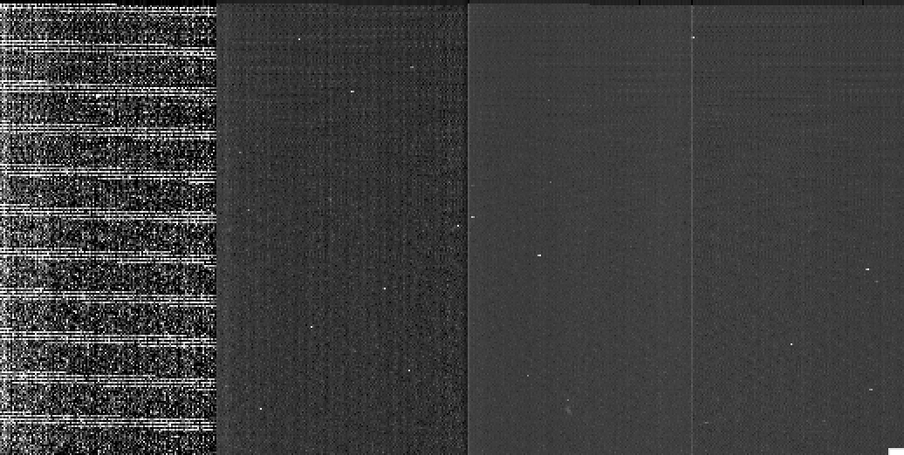
LEISA approaching MU69 (01jan2019)
lsb_0408613050_0x53c_sci.fit (calibrated), <d> = 1.94e5 km
Ch190
(high_res1.2552 μm)
Ch127
(low_res1.5748 μm)
Ch10
(low_res2.4004 μm)
←
←
←

Slide 15
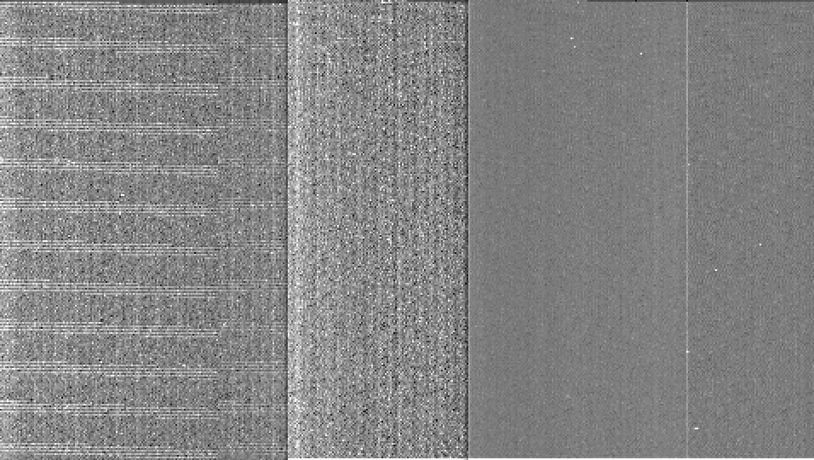
LEISA approaching MU69 (01jan2019)
lsb_0408610468_0x53c_sci.fit (calibrated), <d> = 2.32e5 km
Ch190
(high_res1.2552 μm)
Ch127
(low_res1.5748 μm)
Ch10
(low_res2.4004 μm)
←
←
←

Slide 16
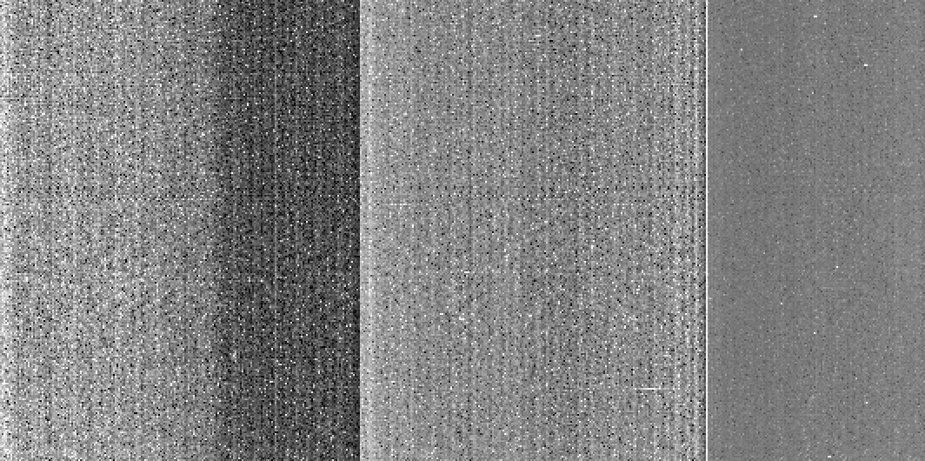
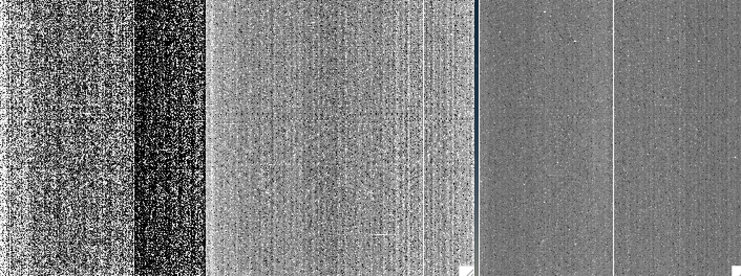
LEISA approaching MU69
lsb_0408609177_0x53c_sci.fit (calibrated), <d> = 2.50e5 km (01jan2019)
Ch190
(high_res1.2552 μm)
Ch127
(low_res1.5748 μm)
Ch10
(low_res2.4004 μm)
← (?)
← (?)
← (?)
lsb_0408606595_0x53c_sci.fit (calibrated), <d> = 2.88e5 km (31dec/01jan)
← (?)
← (?)
← (?)

Slide 17
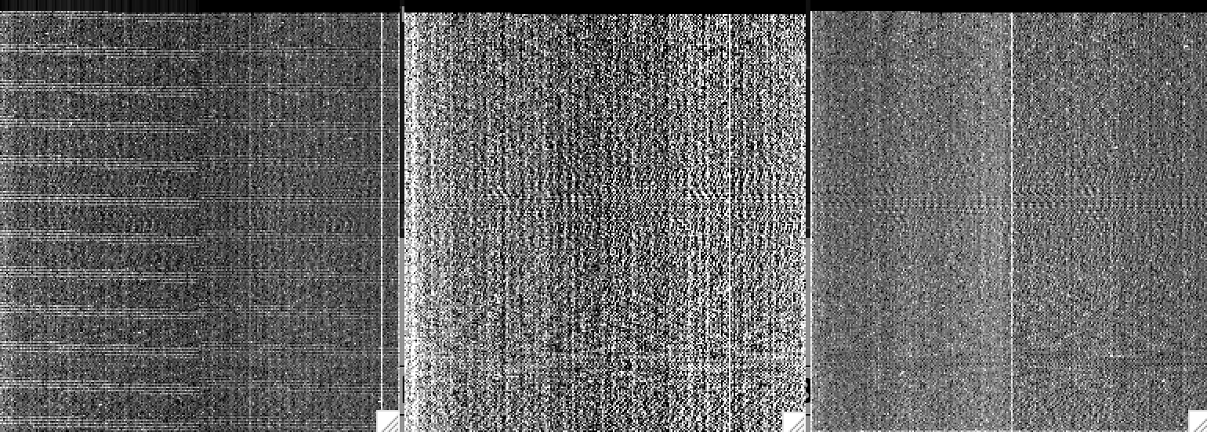
LEISA approaching MU69 (31dec2019)
lsb_0408605304_0x53c_sci.fit (calibrated), <d> = 3.06e5 km
Ch190
(high_res1.2552 μm)
Ch127
(low_res1.5748 μm)
Ch10
(low_res2.4004 μm)
← (??)
←
←
← (??)
← (??)
←

Slide 18
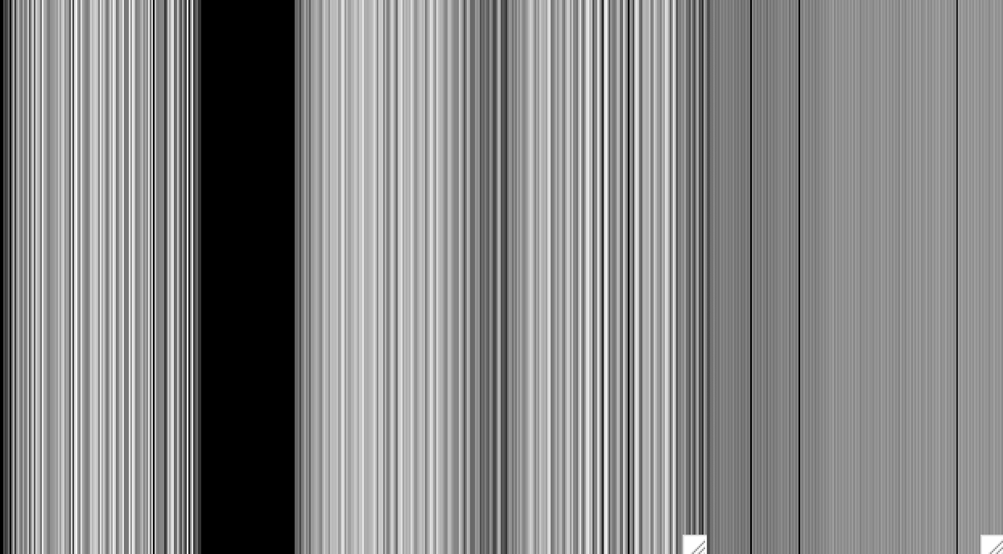
LEISA approaching MU69 (31dec2019)
lsb_0408542761_0x53c_sci.fit (calibrated), <d> = 1.21e6 km
Ch190
(high_res1.2552 μm)
Ch127
(low_res1.5748 μm)
Ch10
(low_res2.4004 μm)
This data cube appears to be a flat field…

Slide 19
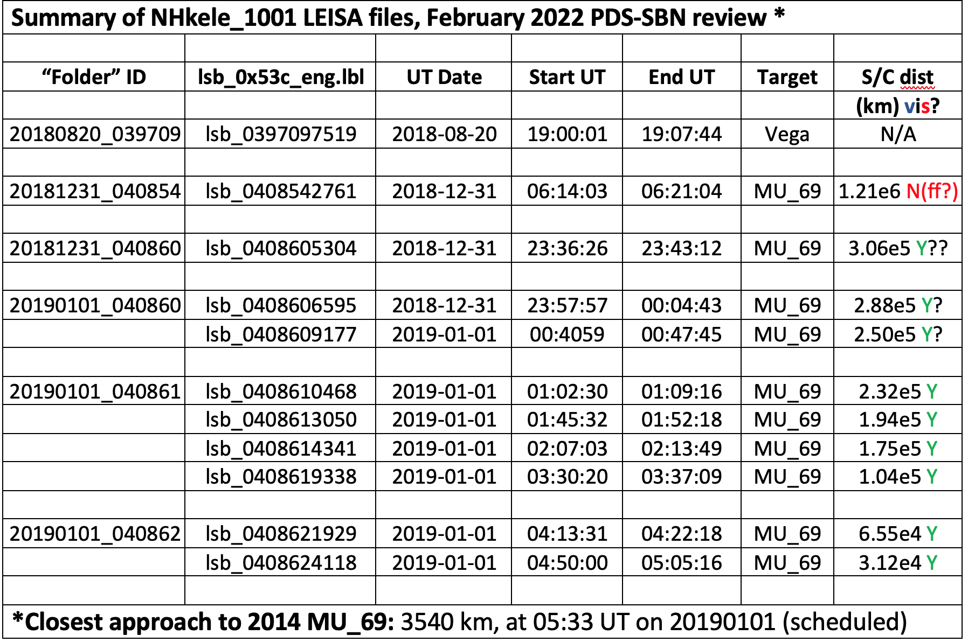
LEISA MU₆₉ Approach DATA

Slide 20
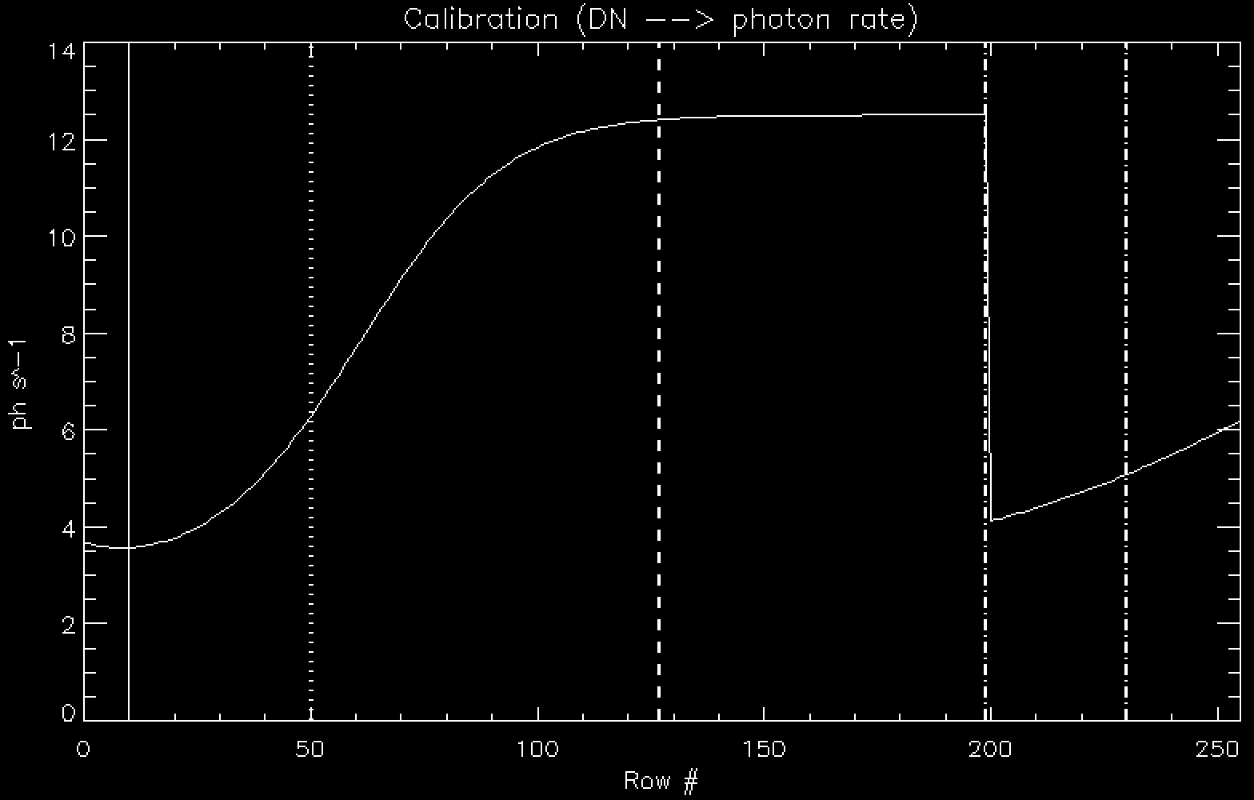
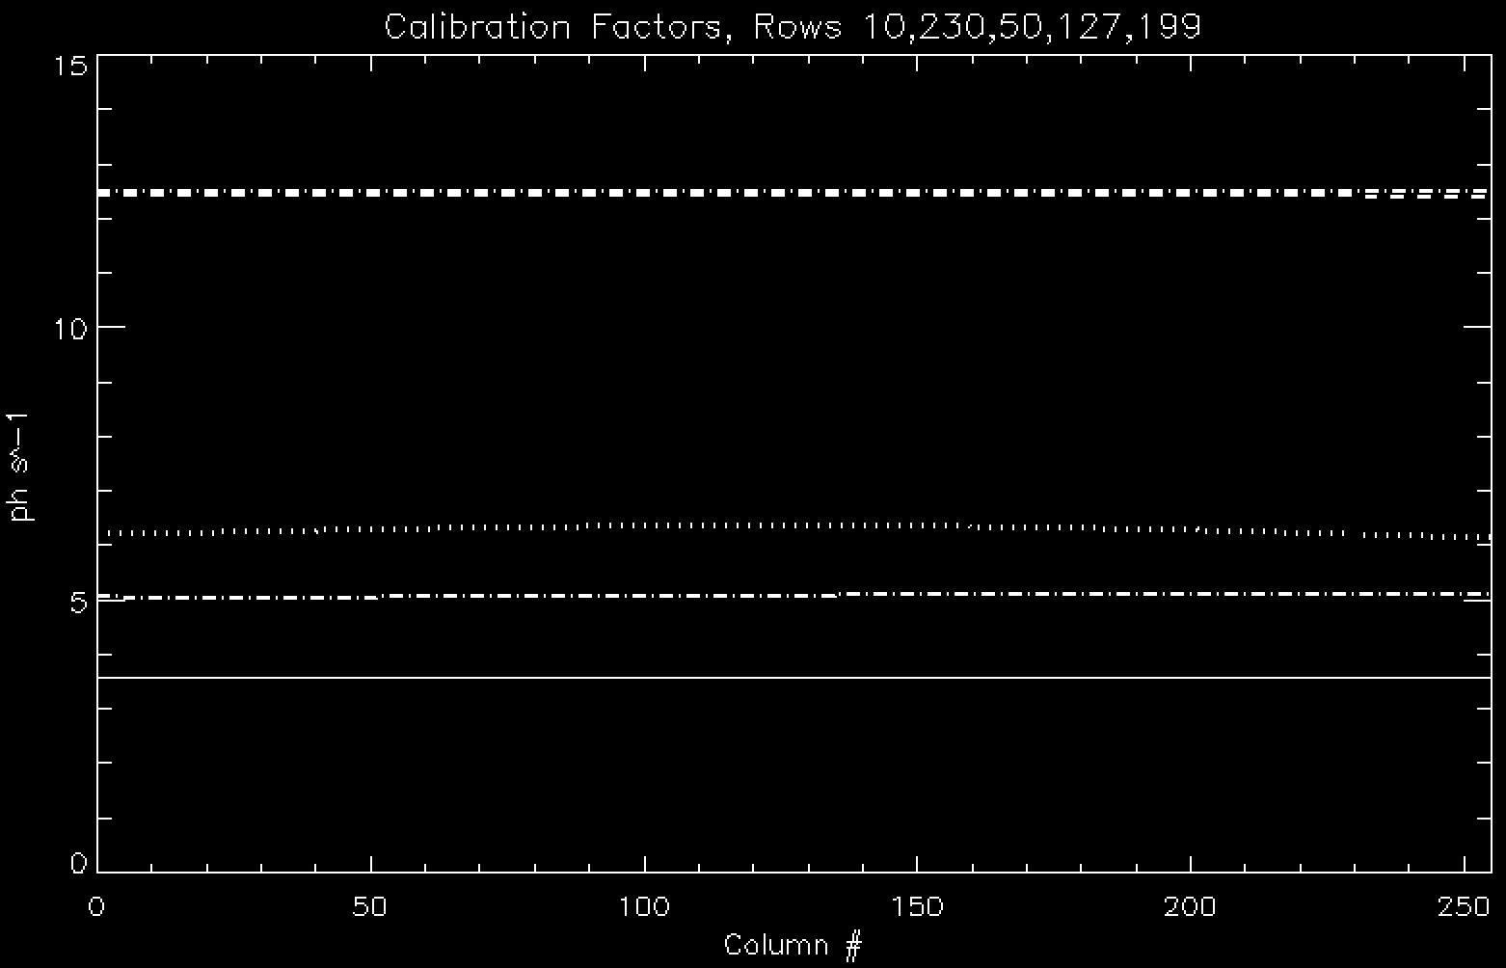
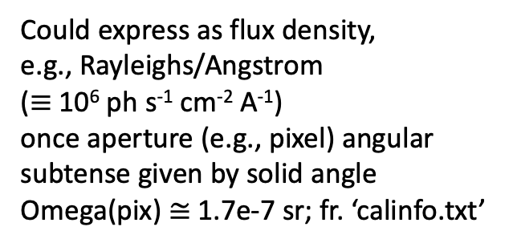
LEISA Intensity Calibration
Could express as flux density,
e.g., Rayleighs/Angstrom
($≡$10⁶ ph s⁻¹ cm⁻² A⁻¹)
once aperture (e.g., pixel) angular subtense given by solid angle Omega(pix) $≅$ 1.7e-7 sr; fr. ‘calinfo.txt’
←
Row199
Row127
←Row50
←Row230
←Row10

Slide 21
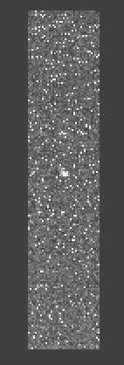
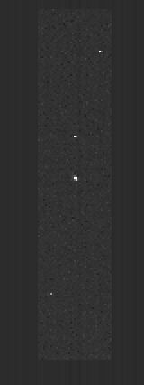
LEISA Intensity Calibration
Could express as flux density,
e.g., Rayleighs/Angstrom
($≡$10⁶ ph s⁻¹ cm⁻² A⁻¹)
once aperture (e.g., pixel) angular subtense given by solid angle Omega(pix) $≅$ 1.7e-7 sr; fr. ‘calinfo.txt’
20180820_039709 | lsb_0397097519 | 2018-08-20 | 19:00:01 | 19:07:44 | Vega
Raw: 393.0 DN in im127_net(61,156), or 256.6 DN/s if “cadence” = 1.52s
Calibrated: 0.0091637 erg/s/cm^2/A/sr in im127_net(61,156)
Above curve => 12.4090 ph/s at step 127
(lambda 1.57477 um, Δlam 0.00714018 µm)
Pixel solid angle = 1.70d-7 sr
256.6 x 1.7d-7 / Δlam = 6.156e-3 (vs 9.164d-3)
Raw Calibrated
I also tried the per-pixel calibration formula in ‘calinfo.txt’:
C = (((S - E ) / F ) - O ) * G / (I * W * aOmega * gCorr), but I get a ridiculously large number (O(10^12!) so… ?
i i i i i i i

Slide 22
Summary/Suggestions
LEISA frames read in fine, for both raw and calibrated) data.
lambda 2.5-1.225um (rows0 thru 199, low res), 2.25-2.10um (rows204 thru 255, hi res).
Asteroid Arrokoth (2014 MU₆₉) is clearly seen at 65.5e3 and 31.2e3 km, detected to 1.94e5 km. Suggestive at 2.32e5, 2.88e5 (?), and 3.06e5 km (??). Data at 1.21e6 km looks like a flat field (or some such).
While Vega scan direction is “as expected” (target moved upward through lambda, as w/ Pluto scans), MU₆₉ scan direction is reversed (target moved downward through lambda). In each case it was ~1 row per step in λ; software was modified to accommodate this.
Spatial Registration
Both Vega and MU₆₉ data show some “wobble” in the x-direction, more so for Vega, less so for MU₆₉.
Difficult to extract spectra for Vega or MU₆₉, due to spatial smearing (not so critical for previous Pluto scans).
I tried to reproduce flux calibration (raw → calibrated data) but was so far unsuccessful.

