Slide 1
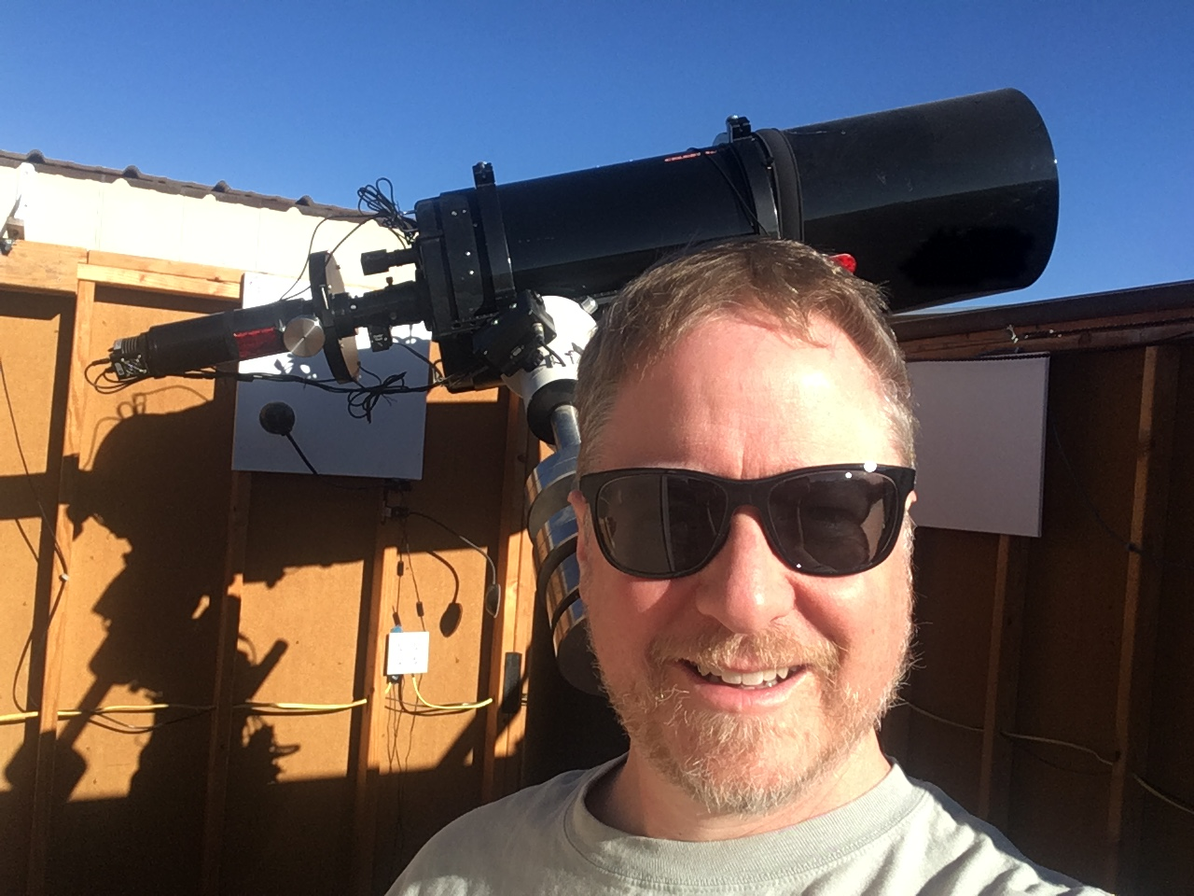
SOHO-SWAN 2022 PDS Review
Jeff Morgenthaler
SOHO-SWAN

Slide 2
SOHO-SWAN Overview
SOlar and Heliospheric Observatory (SOHO)
L1 halo orbit
Solar Wind ANisotropies (SWAN) Instrument
Two hydrogen absorption cells pointed +/-Z
H Lyman-alpha intensity recorded in 1-deg pixels
One day to execute scan of entire sky
One year to obtain velocity-resolved scan of interplanetary H
Comet observations fortuitously unavoidable
SOHO-SWAN

Slide 3
SOHO-SWAN Comet Observations
Although CO₂ and CO are important in understanding the total picture of comet activity, H₂O dominates
H₂O production rates provide the foundation of composition studies, but derivation is complex:
Primary photolysis: H₂O → H + OH; OH → O + H
All reactions exothermic → affect coma shape
Radiation pressure on H → affects coma shape
Assumed H emission rate (g-factor) affects Q, coma shape
→ Images of comet H Lyman-alpha analyzed with model
SOHO-SWAN

Slide 4
SOHO-SWAN Comet PDS Products
SOHO-SWAN PDS archive provides “the answer”
Q(H₂O) vs. time on daily cadence for 77 comet apparitions 1996 – 2017
g-factor used to derive comet H-Ly-alpha emission
Error estimate from image and coma model fit
Latest SOHO-SWAN calibration is used
Not provided: calibrated images
These would be useful for future researchers who develop their own coma models
SOHO-SWAN

Slide 5
Data easy to use & of foundational importance
Documentation straightforward
Extraction of production rates from ASCII tables is trivial with Python high-level tools
Next page shows poorest and highest quality data
These Q(H₂O) are considered the “gold standard” because of extensive time coverage and sensitivity
High value in the PDS archive
Would be nice to have calibrated images
SOHO-SWAN

Slide 6
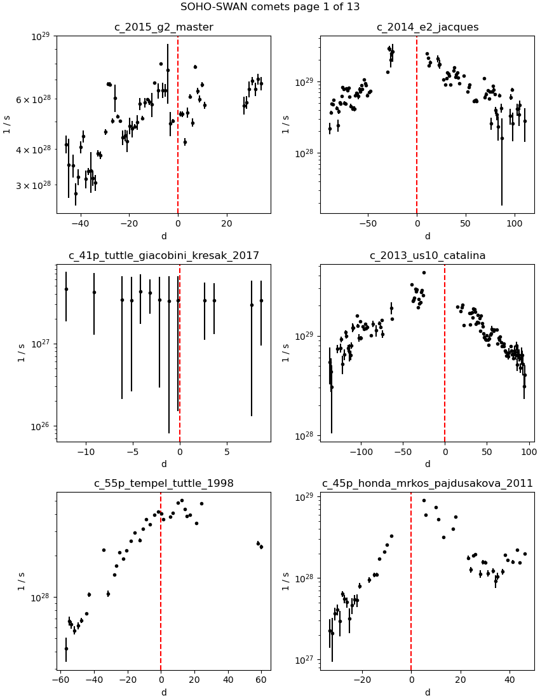
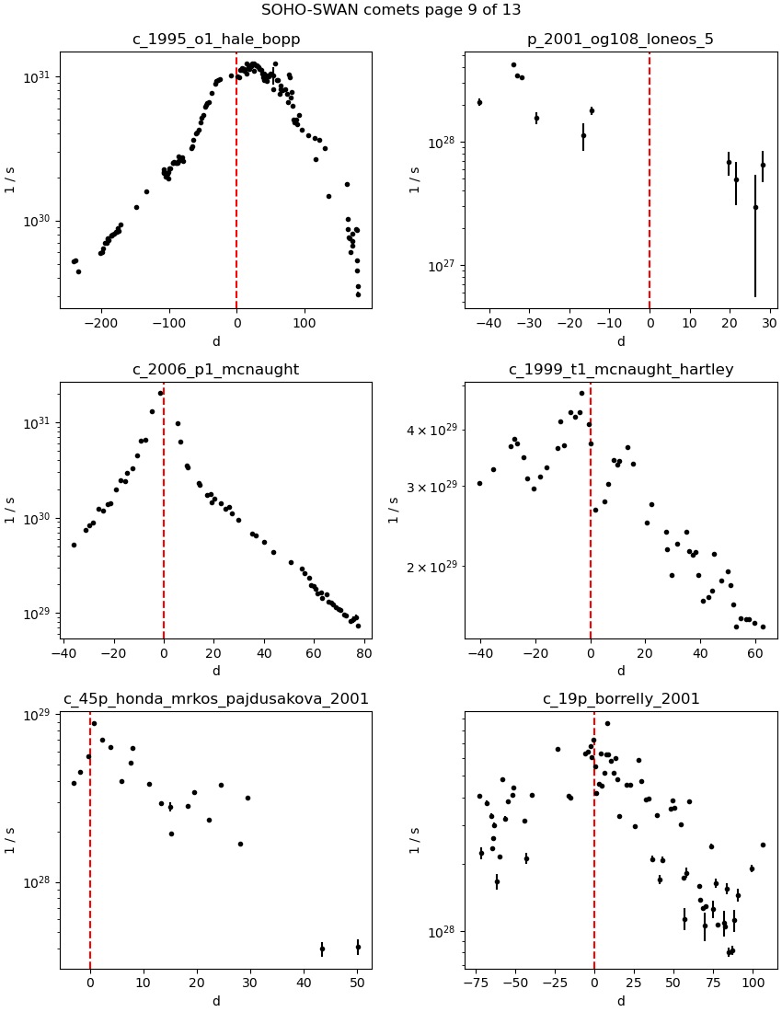
SOHO-SWAN sample data showing range of quality (note H-B has > 1 yr)
SOHO-SWAN

Slide 7
SOHO-SWAN

Slide 8
SOHO-SWAN

Slide 9
SOHO-SWAN

Slide 10
SOHO-SWAN

