Slide 1
Review of LICIACube document collection, LEIA (raw and calibrated), and LUKE (raw and calibrated)
Matthew Knight (USNA)
May 13, 2022

Slide 2
Summary of review
Documentation overall good
Does Della Corte et al. 2022 exist yet?
Several important topics need additional information/clarification
Units of calibrated data inconsistent
Need more explanation of LUKE “color” data
I have questions about bit accuracy
Minor inconsistencies between documentation/FITS keywords/XML

Slide 3
Inconsistencies in calibrated units
SIS PDF page 12 text: Level-2 calibrated data “represented in radiance (W m⁻² nm⁻¹ sr⁻¹)”
SIS PDF Figure 3: Calibrated image units are “W/SR/nm/s”
Overview.txt for LEIA and LUKE calibrated data: “All observations are calibrated data reported in units of [W*s]/[m^2*sr].”
Calibrated data XML for LEIA and LUKE:
Conversion is: x0+x1*DN+x2*DN^2+x3*DN^3
X0: <unit>DN*m**-2*s**-1</unit>
X1: <unit>W*m**-2*sr**-1*DN**-1</unit>
X2: <unit>W*m**-2*sr**-1*DN**-2</unit>
X3: <unit>W*m**-2*sr**-1*DN**-3</unit>
Should be W*m**-2*sr**-1 ?
For all four of these, what about nm?

Slide 4
Handling of bit accuracy
Page 8: LUKE acquires 10-bit per pixel images but payload electronics stores only the first 8-bits per pixel. It would be useful to explain the motivation and/or execution of this in more detail since this may eventually lead to quirks when interpreting the data.
It sounds like those bits are truncated, so saved data are always slightly undercounting flux?
If rounded, we would expect a gaussian distribution around the saved number?
Page 9: will there be error/bias introduced when the 10 or 12 bit data are constituted as 16 bit?
It would be helpful to explain how this is accomplished
Page 13: “The MCC reconstructs 8-bit images from the raw telemetry by performing the cut of the signal to the 8 chosen bit per pixel per channel (i.e., most or least significant ones), in order to select the best part of the acquired histogram for LUKE”
How does this affect uncertainties/interpretation of the data?

Slide 5
Explanation of LUKE’s “color” data
Page 9: Bayer filter was new to me. Please give a brief explanation of what it is
Dotto et al. 2021 mentions Bayer but gives no explanation
Table 5: It doesn’t really have “filters” in the traditional sense (a transparent material that blocks/allows particular wavelengths), right? Consider rephrasing
Page 13: “At the present time the filter used is a CFA ‘RGGB’ one, but it can be modified for in-flight images.”
Is this statement still accurate or was it leftover from something written before launch? If so, CFA ‘RGGB’ should be defined.
Consider rephrasing “filter” per comment above.
No explanation of how the color values use the calibration coefficients.
Are the same coefficients used for each of R, G, B?
Are the three colors combined or treated independently?

Slide 6
SIS PDF misc
Page numbers would be helpful
Suggest adding a table of acronyms. Some undefined acronyms:
AR (p. 8)
CDS (p. 7)
F/N (p. 8)
PCB (p. 7)
PGA/FPGA (p. 7)
PL (p. 8)
GNC (p. 13)
TOV (p. 19)
MSB / LSB (many places)
Minor typos (included in annotated PDF)

Slide 7
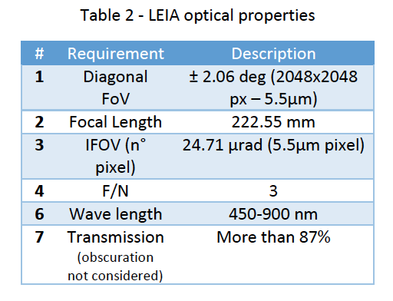
SIS PDF misc
Page 5: what is the LICIACube Calibration Pipeline Description? Is this Della Corte et al. 2022 (referenced elsewhere)? If so, where do I find that paper?
Page 6 and 8 (Tables 2 and 4):
Sensor field of view given as “+/-2.06 deg on the sensor diagonal” is confusing. Why not just say 2.9 deg on the horizontal and vertical axis?
What is F/N?

Slide 8
SIS PDF misc
Page 7 (Table 2) : Resolution says “Diffraction limit”. Give explicit number?
Page 7: I don’t understand to what the obscuration mentioned refers. Is the overall transmission of “92% if obscuration is not considered” the same as #10 in Table 2 (Relative illumination >90%)? Isn’t the overall transmission the thing that is important?

Slide 9
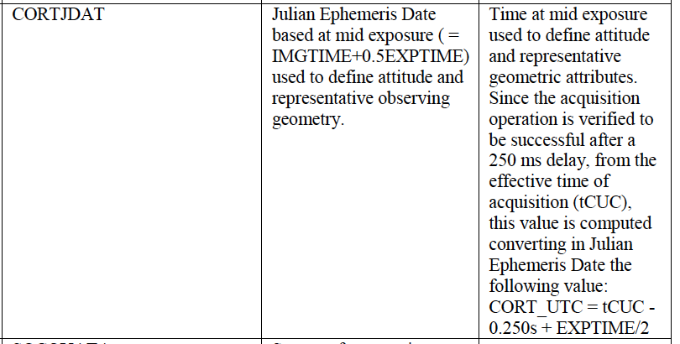
SIS PDF misc
I don’t understand the explanation for the 250 ms delay in CORT_UTC and CORTJDAT. Does this mean that exposures actually start 250 ms later than effective time of acquisition (tCUC)?
It would be helpful if this was explained further in the body of the SIS PDF.
NOTE: tCUC is never mentioned otherwise in the SIS PDF

Slide 10
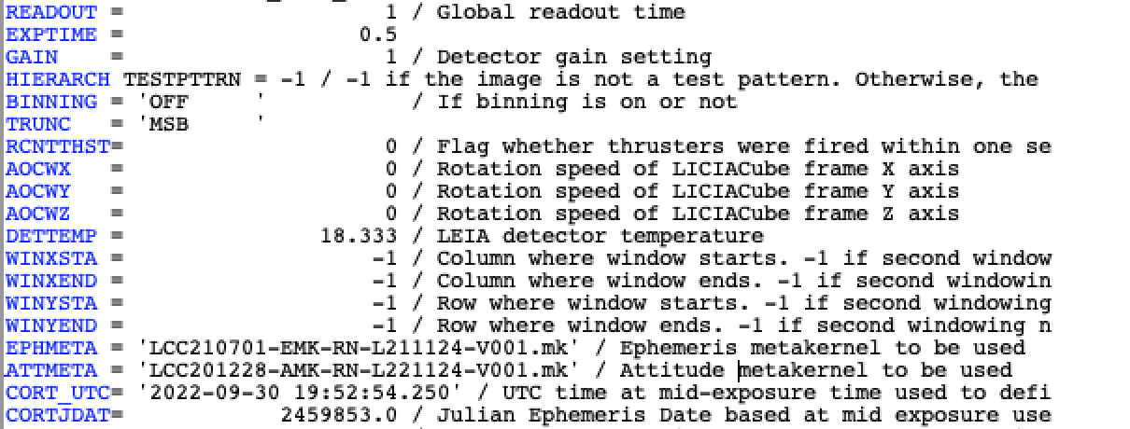
LEIA/LUKE raw data
Many keyword explanations are truncated in FITS headers and not all are given in XML labels. SIS PDF (p. 18) says “Metadata descriptions may be abbreviated in the FITS header, with full description in the label”
Example: RCNTTHST is only in FITS

Slide 11
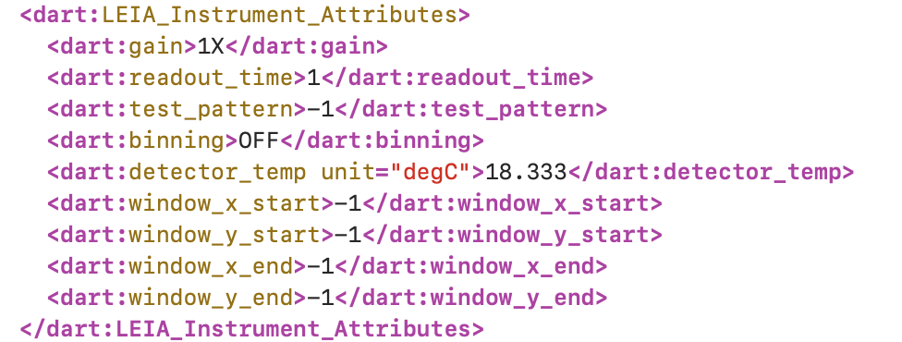
LEIA/LUKE raw data
Many keyword explanations are truncated in FITS headers and not all are given in XML labels. SIS PDF (p. 18) says “Metadata descriptions may be abbreviated in the FITS header, with full description in the label”
Example: WINXSTA, WINXEND, WINYSTA, WINYEND don’t have explanations in XML

Slide 12
LEIA/LUKE raw data
Included in XML but not SIS PDF
dart.test_pattern → comparable FITS keyword is ‘HIERARCH TESTPTTRN’
Also, this keyword probably has a typo in the FITS file?

Slide 13
LEIA/LUKE raw data
CORT_UTC and CORTJDAT don’t agree. I assume this is because this is demo data, but want to make sure the pipeline isn’t converting incorrectly

Slide 14
LEIA/LUKE data
What is Application ID (APID)? [please expand definition in SIS PDF]
Missing Class.Attribute Name?
SIS PDF (p. 20 and 28) lists dart.correct_image_time (CORT_UTC in FITS header), but it isn’t in the XML
SIS PDF (p. 22) and FITS headers: Some keywords refer to “primary target” or “secondary target”. Are these always Didymos and Dimorphos respectively?

Slide 15
LEIA/LUKE calibration data
The calibrated image cube has the same start/stop times. Is this intentional?

