Slide 1
PDS Review of SOHO SWAN Derived Cometary Water Production Rates v3
John Noonan
May 13, 2022

Slide 2
Dataset Description
16 .tab ASCII files with the derived water production rates for comets between 1998 and 2021.
V2 of dataset reviewed in 2018 → previous liens all minor and corrected
V2 dataset was 77 comet apparition files, V3 is only 16 → will v3 be added to v2?
Each .tab file has 7 columns:
UTC time of observation
Fractional day from perihelion
Heliocentric distance of comet (au)
Spacecraft to comet distance (au)
Fluorescence rate of Lyman-alpha for observation (phts/atom/s)
Water production rate (1x10²⁷ mol/s)
Associated error on the water production rate

Slide 3
Data Access and Investigation Tools
Data accessed with Python and pds4_tools Python package.
Additional packages for reading .tab files: Pandas, NumPy
Data were easy to read in, plot, and manipulate.
Loaded in tables via Python Pandas “read_fwf” for fixed width tables
All .xml files were readable with pds4_tools Python Package
No errors produced
Compared v2 documentation files to v3 with p4merge tool

Slide 4
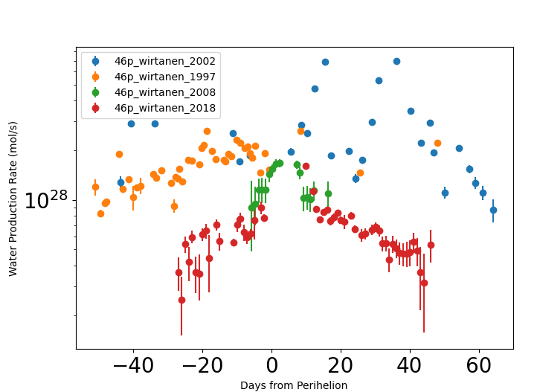
Science Plots
Simple file structure and easy documentation provided for easy data manipulation
I was able to easily recreate several plots from Combi et al. 2020 for 46P, 45P
It did require that I access data from v2, given that v3 is only the new components

Slide 5
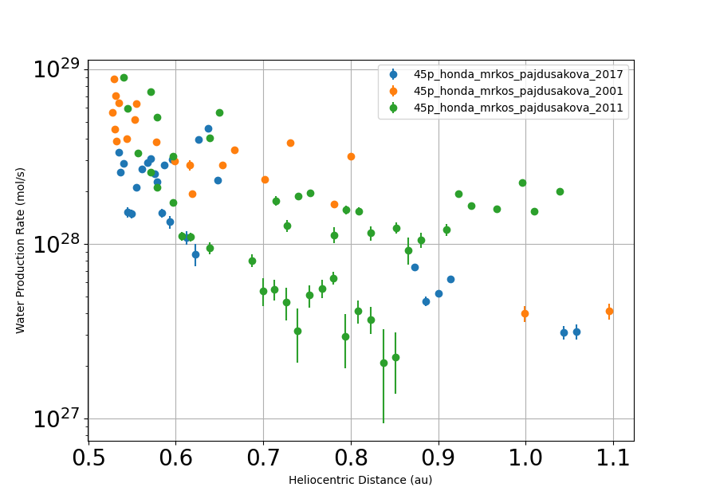
Science Plots
Simple file structure and easy documentation provided for easy data manipulation
I was able to easily recreate several plots from Combi et al. 2020 for 46P, 45P
It did require that I access data from v2, given that v3 is only the new components

Slide 6
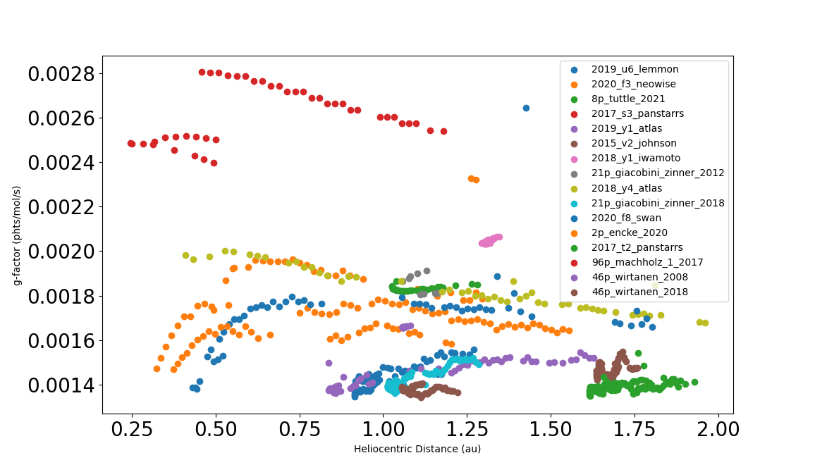
Science Plots
No apparent outliers in g-factors when spotchecked
Will add Horizons call to check heliocentric velocity in the future
In short data are as expected and easily processed

Slide 7
Liens
Minor
None
Major
None

Slide 8
Summary
All files are easy to read and manipulate
Documentation is clear and helpful
When added to the current v2 dataset of SWAN derived water production rates this will be an excellent publicly available dataset.
Conclusion: Dataset is certifiable as reviewed.

