Slide 1
ROSETTA ROSINA Data Review
Joe Westlake
JHU/APL
5/13/2022

Slide 2
Data Set Overview
Rosetta ROSINA DFMS Time Series Abundances
DFMS is an instrument that is a part of the Rosetta ROSINA suite of instruments and is the Double Focusing Mass Spectrometer
This data is a refined data product from the instrument that gives abundances of several species as a time series
H2O, CH4, HCN, CO, N2, CH3OH, O2, CO2, C2H6
Two data outputs per species, row A and row B of the MCP/LEDA detector
Given for the PRL, ESC1, ESC2, ESC3, ESC4, EXT1, and EXT2 Phases

Slide 3
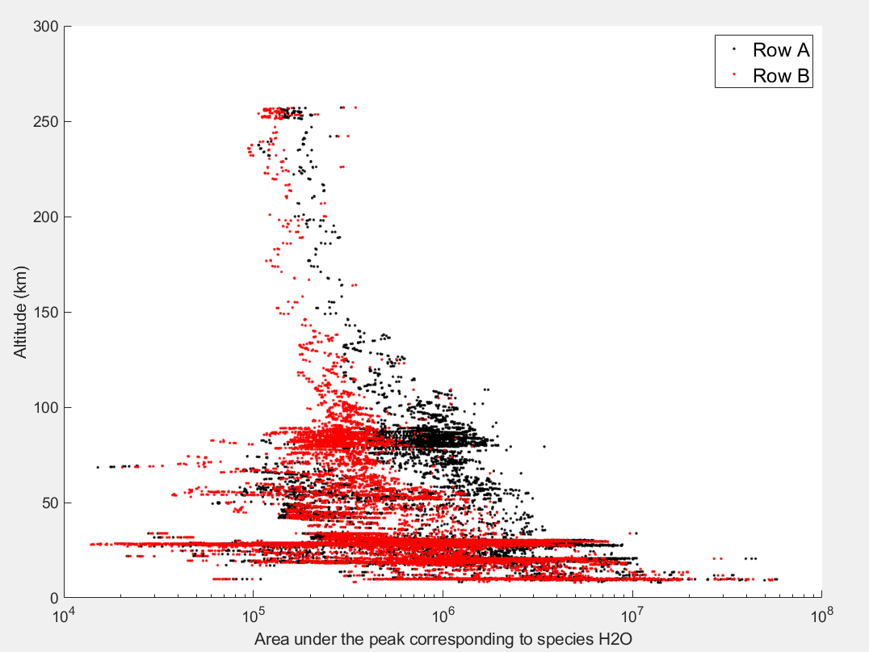
Some Example Data – ESC1

Slide 4
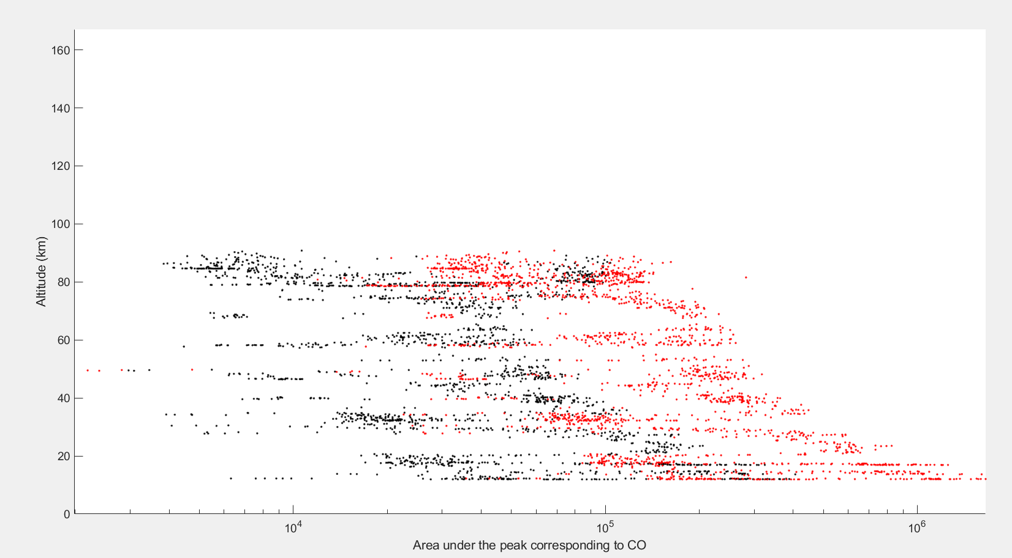
More Example Data – EXT1

Slide 5
Review Comments
The data is easy to work with and generally contains all of the information needed to understand and interpret it.
The usage of the Row A and Row B information is well described in the data description document.
In general this dataset should be accepted as is.

