Slide 1
DART/DRACO Sample Dataset Review
Jian-Yang Li
Planetary Science Institute
June 13, 2022

Slide 2
Overview
Sample DART/DRACO data bundle
Four data collections
Raw data (raw)
Calibrated data (cal)
Derived data products (geometric backplanes) (ddp)
Documentation
Only contains a few sample images (not all images on the ground so far?)
8 images for raw, where 6 in commissioning phase and 2 in cruise phase
5 images for cal, where 3 in commissioning phase and 2 in cruise phase. The three missing images have OBSTYPE = FUNCTIONAL_TEST, BIAS, and BAD_IMAGE, i.e., no need to calibrate
1 simulated image in ddp
Calibration data are also included in the cal data collection
Document collection includes two files: SIS and calibration pipeline description
Review summary: One major problem with image display orientation, many small minor problems

Slide 3
Display orientation problem
SIS statement about the display direction of various software (4.1.6.2) is either wrong or unclear
DS9 actually puts the first pixel at lower left (SIS says upper left)
I think ATV does the same as DS9, but didn’t verify (SIS says upper left)
Does the statement about `astropy` actually refer to `matplotlib.pyplot.imshow`? `astropy` only provides I/O for FITS, but not display
Checked dart_0377785806_05467_01_raw and _rad
Both has DISPLAY_DIRECTION keywords consistent with SIS (left_to_right, top_to_bottom)
For each image, DS9 and pds4_viewer show mutually flipped orientation, consistent with the fact that pds4_viewer follows the DISPlAY_DIRECTION keywords to put the first pixel at top left, and DS9 puts the first pixel at bottom left
Each software show the same orientation for both cal levels, suggesting no flip between cal levels
.png thumbnail images of two cal levels have mutually flipped orientation - which one is correct?
See next two slides for details
Data provider should carefully check the orientation for all cal levels, and correct any problems in the SIS and in the data
png thumbnail

Slide 4
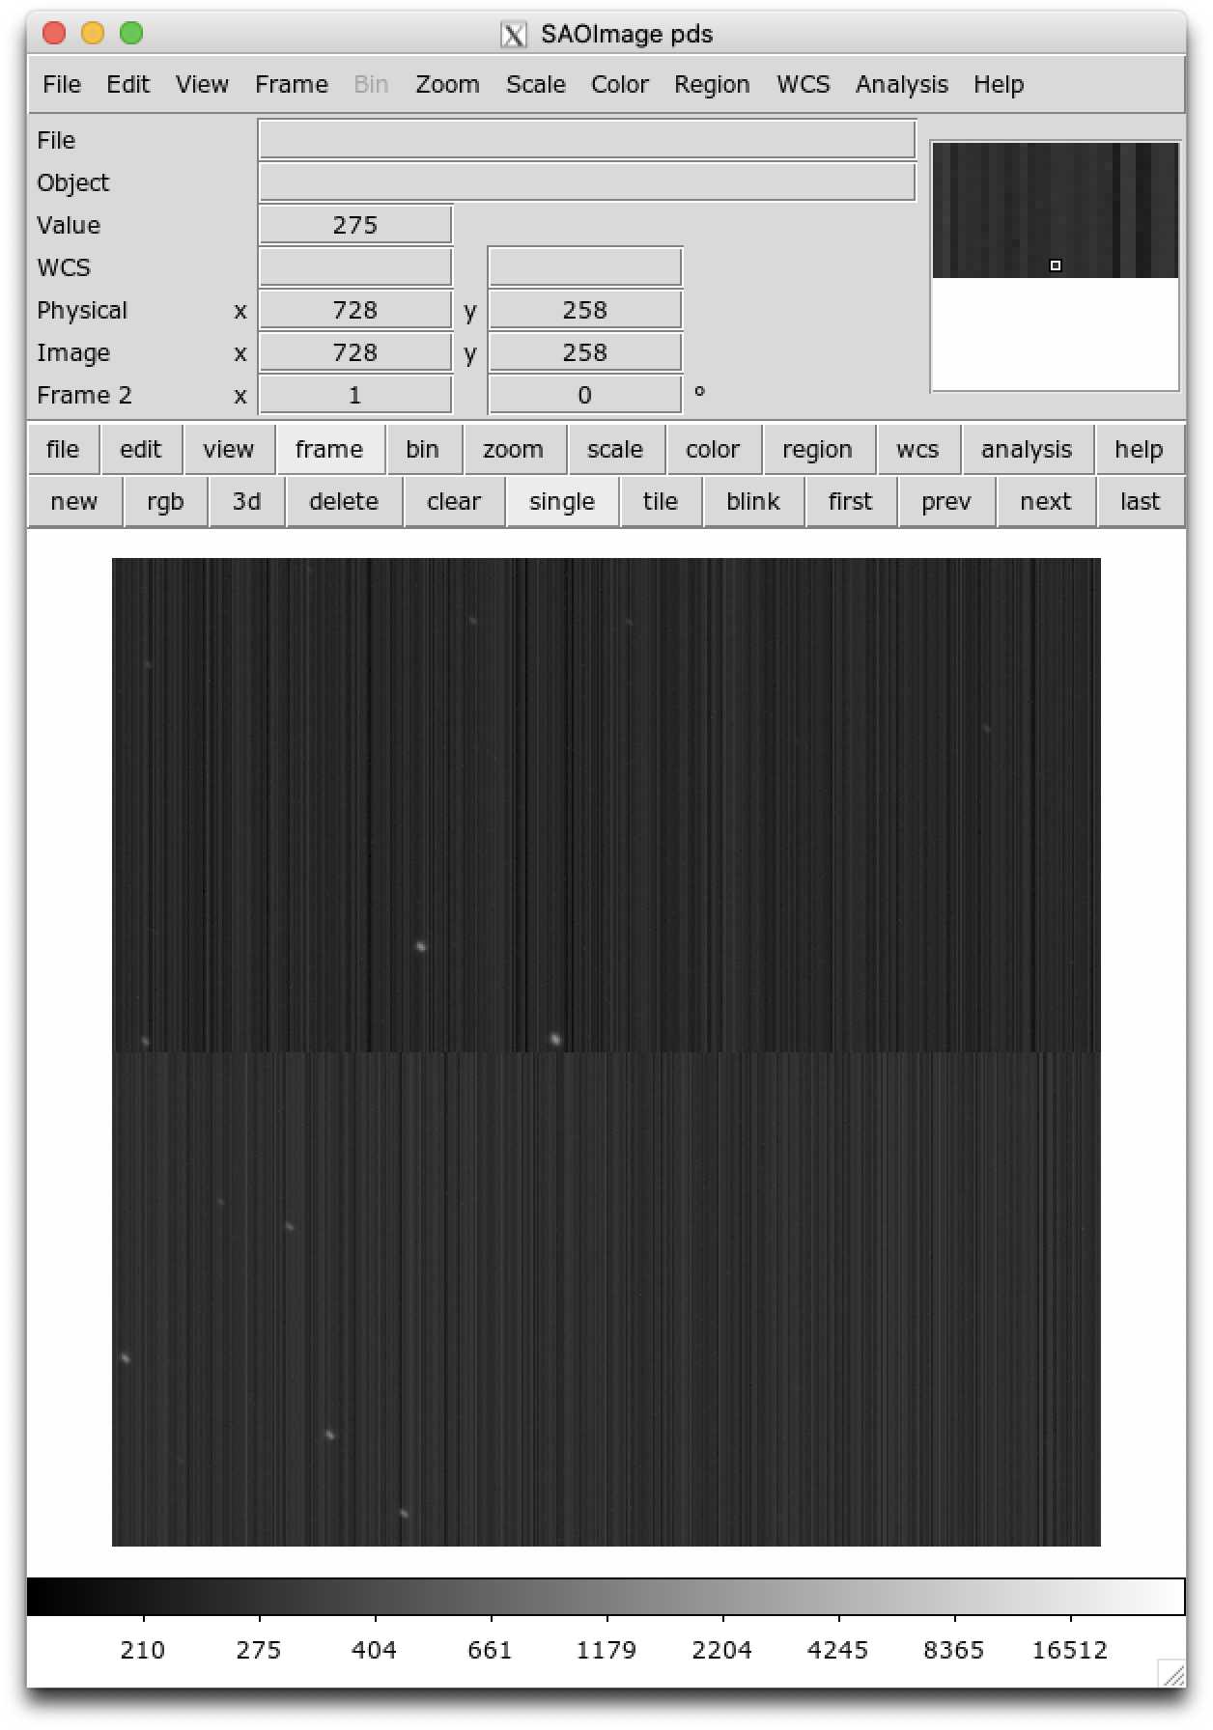
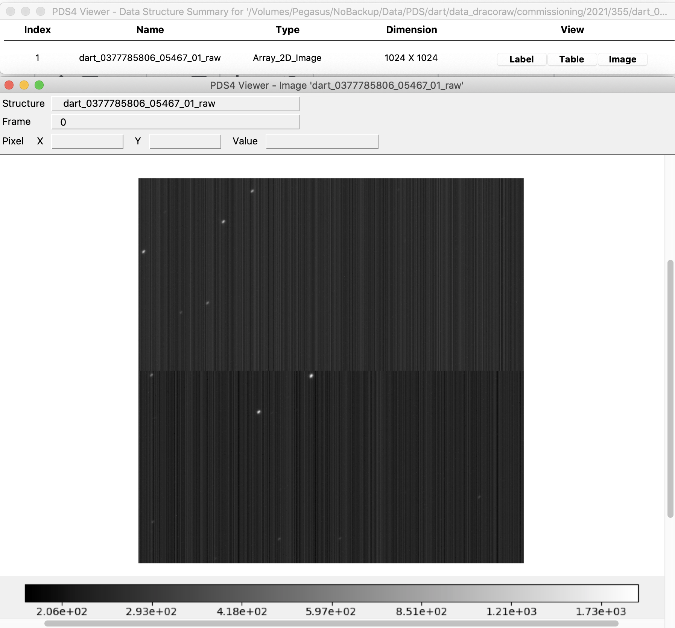
Display orientation ‘dart_0377785806_05467_01_raw’
Inconsistent display orientation: which one is correct?
.png thumbnail
pds4_viewer
DS9

Slide 5
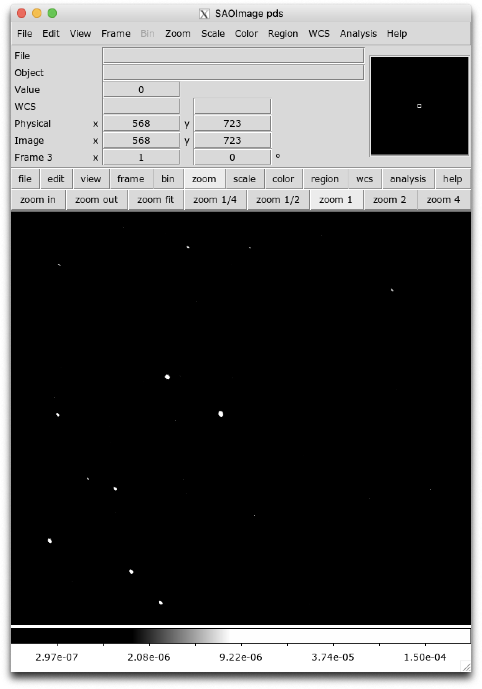
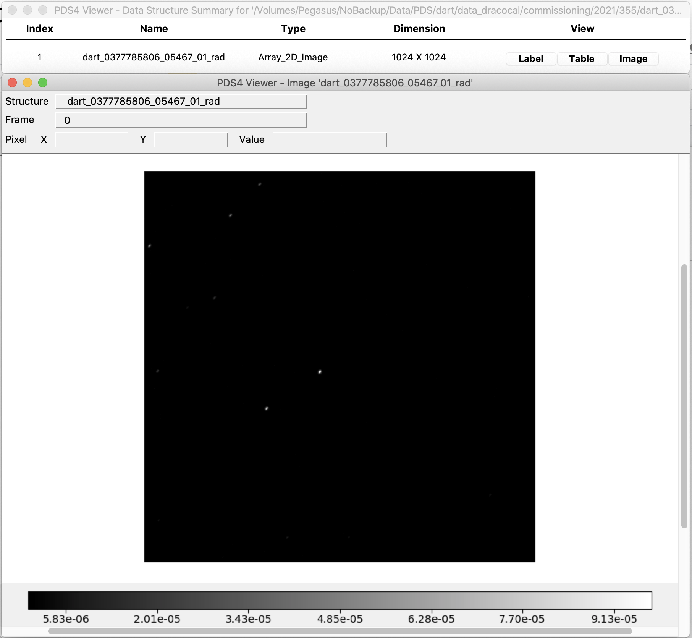
Display orientation ‘dart_0377785806_05467_01_rad’
Inconsistent display orientation: which one is correct?
.png thumbnail
pds4_viewer
DS9

Slide 6
SIS document
Missing 2 pages of cheatsheet in pages 4 and 5 (Will be added later in the formal release?)
Some important documents are referred to in the SIS. Should they be included in the document collection? Or will they eventually be added?
Page 8: DRACO DMAP
Page 26: DART Derived Data Product Software Interface Specification
Page 39: DART Coordinate System for Didymos document?
Table 4, Unit of calibrated image: It would be confusing to say that the I/F data is unitless. True that the unit of I/F is dimensionless, but other types of reflectance, such as REFF and BRDF are all dimensionless. I suggest explicitly saying I/F. In the previous version reviewed last July (version 210626), it says "or I/F".
Page 24, 4.3.2.4: shape model delivery date should be Jan-Mar 2023 (I think) instead of 2022.
Page 28, Table 7 lists the number of various calibration files that could be included. But they are not consistent with what’s in the sample dataset
32 dark frame files included in the sample, but Table 7 says sup to 8
8 radiometric look up table files included in the sample, but Table 7 says up to 7
Page 29, 5.1 states that data archive is organized by mission phase, then product level. This is not consistent with the current directory structure of the data bundle.
Page 55: "DRACO IS", IS (instrument scientist?) is not defined.
Table 12: why all keywords start with a #? Other tables (8 - 11) don’t have this problem.
OBSTYPE = STREAMING for ‘commissioning/2021/355/dart_0377785806_05467_01_[raw|rad].fits’, but this value is not listed in SIS document Table 2.

Slide 7
Calibration pipeline description
Page 7, 3.2.6: What is PTC? “PTC analysis shows that images taken with 30x/global shutter cannot be reliably radiometrically corrected.”
Table 3 is mentioned in Page 14 4.4.8 but is missing (also missing in the previously reviewed doc)
Page 15: misspelled keyword “REFDKAR2” (same as in the previously reviewed doc)

Slide 8
Data collection
Data collection list file ‘data_dracoraw_collection.csv’ misses one image ‘dart_0376144597_01640_01_raw’
raw/commissioning/2021/336/dart_0376144597_01640_01_raw.metadata is in the data collection, but what it is is not clear.

Slide 9
Suggestions for future sample data review
More data included in the sample data review would be better
More diverse situations to check against the documents
More complicated cases encountered by the calibration and data prep pipelines
With limited data, many aspects cannot be effectively checked
More beneficial to the data preparation teams, and more efficient use of reviewers’ time
Some data mentioned in the documents should be included to help the review, specifically in SIS:
Page 20, partial header example: dart_0376599992_26784_01_raw.fits
Page 20, incomplete image example: dart_0380603034_08537_01_raw.fits
Page 20, misconfigured raw 0376147120_43856 - 376161226_45633
Page 20, test pattern example 376146984_05334
Figure 7 dart_0377800188_19062_01_cal.fits
Question for PDS: Do all .png thumbnail files need associated .xml?

