Slide 1
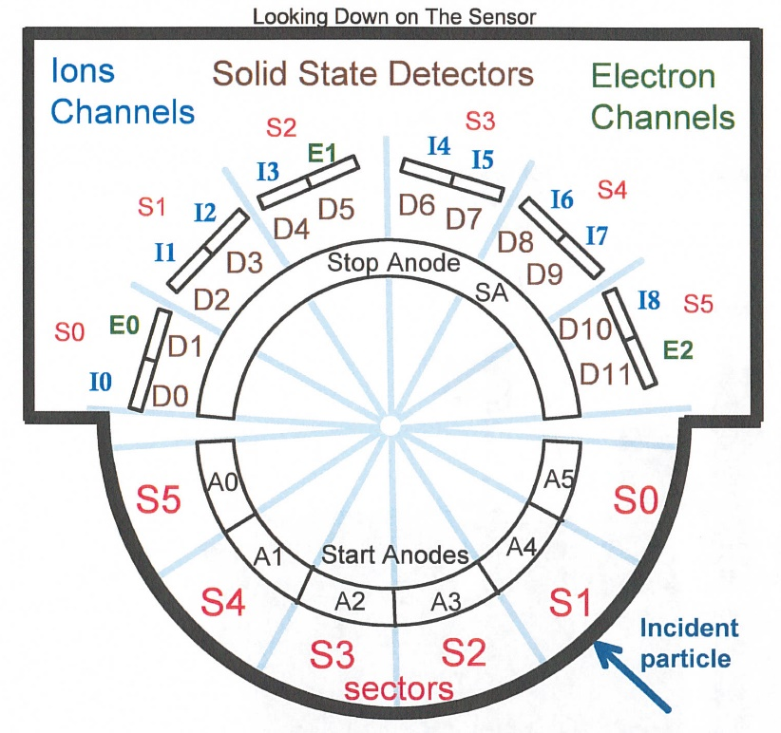
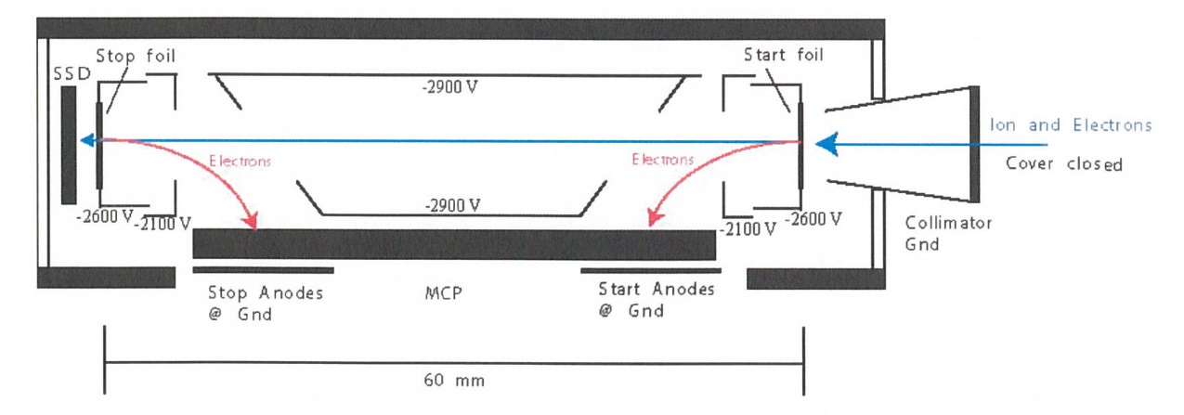
New Horizons Pluto Energetic Particle Spectrometer Science Investigation (PEPSSI)
Reviewed by S. Joy (primary)
PRINCIPAL INVESTIGATOR: Ralph McNutt, APL
DESCRIPTION: Medium Energy Particle Spectrometer
ENERGY RANGE: 25-1000 keV (protons)
60-1000 keV (atomic ions)
25-500 keV (electrons)
FIELD OF VIEW: 160 deg x 12 deg
ANGULAR RESOLUTION: 25 deg x 12 deg
ENERGY RESOLUTION: 0.25 keV
SENSOR SIZE: 7.6 cm dia. x 2.5 cm thick
POWER: 1.4 watt
MASS: 1.5 kg

Slide 2
New Horizons PEPSSI Data Sets
Data ->
nh-x-pepssi-2-kem1-v6.0
nh-x-pepssi-3-kem1-v6.0

Slide 3
New Horizons PEPSSI Data Set Evaluation Tools
All Data Processing and Evaluation -
Machine: Dell XPS 15 9510
Operating System: Windows 10

Slide 4
Comments on review procedure
The catalog, documents, and calib directories of these volumes are nearly identical, and most of their contents have been previously reviewed many times.
I have taken advantage of this fact to reduce the review effort.
I used the folder compare option in BeyondCompare 3.3.13 to compare like folders across the four volumes, and then compare files contained in the folders. Most of the time, the only variation in the directory contents or the
file therein were the file time stamps and the data_set_id’s in the label files.
Once this information was available to me, I only reviewed unique files
Lastly, I looked at issues raised in the Feb 2022 review to make sure that they had been addressed in this release.

Slide 5
Documentation
Evaluation

Slide 6
Root level files
AAREADME No issues found: -2- and -3- files essentially identical and are ok. VOLDESC No issues found – -2- and -3- files essentially identical and are ok.

Slide 7
Catalog files
CATINFO.TXT – no changes required
nh_kem.cat – ok, both versions identical nhsc.cat – ok, both versions identical pepssi.cat – ok, both versions identical
ref.cat – ok, both versions identical dataset.cat (nh-x-pepssi-2-kem1-v6.0 and nh-x-pepssi-3-kem1-v6.0)
includes discussion of versioning – good
Note: the -3- dataset description in the dataset.cat file is missing the detailed discussion of the file contents and naming conventions that were added for the V5.0 delta review. I expect that now that the delta review is complete, this text will make it into the V6.0 version of dataset.cat.
During the early part of the review, there was some confusion regarding flux columns with different names but identical descriptions (e.g L01S00FLUX and L01S00HFLUX in the EXTENSION_FLUX_TABLE). It turns out that this is explained in a line in the ICD. However, it might be easier on users if the explanation (best guess species, in this case Helium) was either in the label (best) or discussed in the dataset.cat file with the rest of the material from the delta review.

Slide 8
Calib files
calinfo.txt – good
hk_stat_input_20041016.tab (lbl) – good, both versions identical
hk_n1_input_20050228.tab (lbl) – good, both versions identical
rateboxdefinitionplanes.fit (lbl) – good, both versions identical
calpars folder on -3- volumes only
calpinfo.txt – good
calpar_columns.fmt – good
pep_*_0x691_calpar.tab – ok, contents clear and self-explanatory. No corresponding .lbl file but that has been the case throughout the mission and has been previously accepted.

Slide 9
Document files
DOCINFO.TXT – good
All PDS documents (codmac_level_definitions, lunineetal1995, payload_ssr, pepssi_ssr, soc_inst_icd) appear to be properly formatted as PDF/A and the document labels appear to be valid. Most of these document files have been reviewed many times and have not changed recently. They appear to be the latest versions of each.
soc_icd.pdf August 2022 version of does not report changes to the PEPSSI chapter. Page 110 is blank
The PEPSSI chapter of the soc_icd should be updated at some point to describe the new processing and data file structure of the -3- dataset. These changes are briefly described in the dataset.cat file in the dataset versioning discussion but additional detail is probably warranted.
nh_fov.png (.lbl) – good nh_met2utc.tab (.lbl) – complete (last weekly entry 2025-01-01), good
nh_mission_trajectory.tab (.lbl) – complete (last entry 2022-04-30), good nh_pepssi_v110_ti.txt – good
pep_bti.tab (.lbl) – good, complete (last entry 2022-143)
quat_axyz_instr_to_j2k.asc (.lbl) – good
seq_pepssi_kem1.tab (.lbl) – good, complete (last entry 2022-04-30)

Slide 10
Index files
INDXINFO.TXT – good
Index.tab (lbl) - both files good in all datasets
Slimindx.tab (lbl) ) - both files good in all datasets
Checksum.tab (lbl) - both files good in all datasets

Slide 11
Data
Evaluation

Slide 12
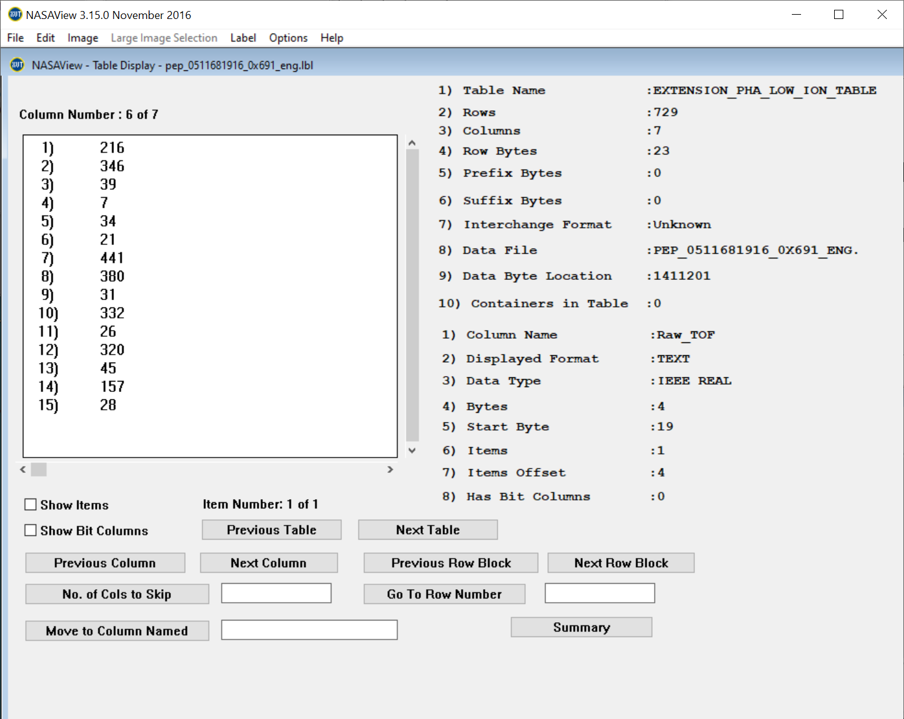
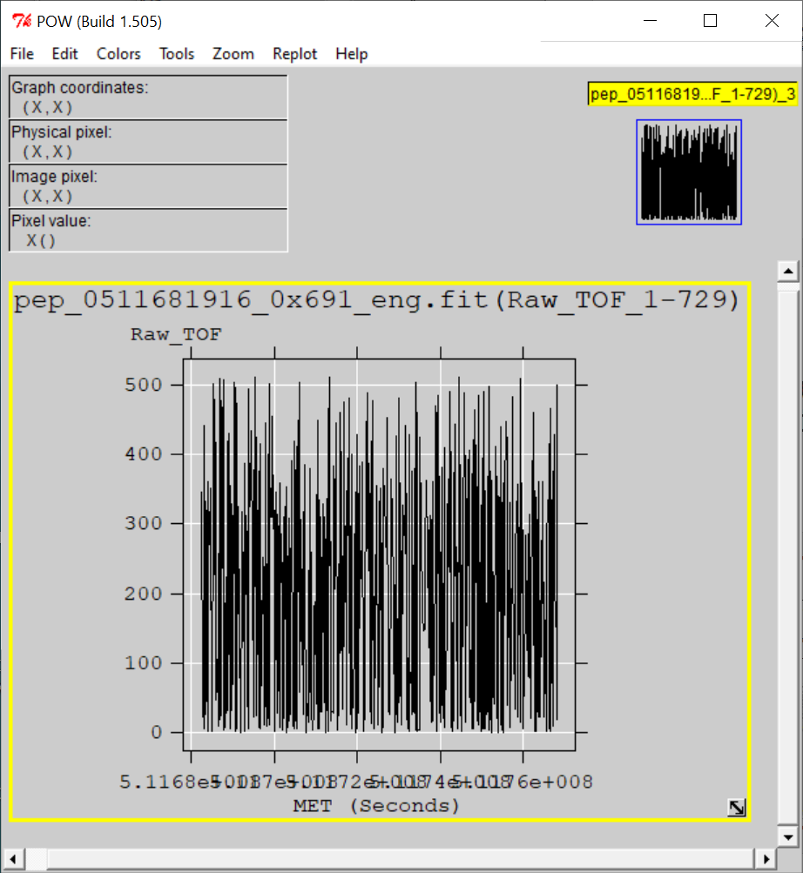
nh-x-pepssi-2-kem1-6.0
Files open with both NASAVIEW and FV suggesting that the PDS and FITS labels are well-formed. Validate tool did not catch any errors with labels. All of the files and labels selected for spot inspection appeared nominal.
All tables and columns accessible in NASAVIEW, listings look as expected
FV allow the user to plot data from any table versus time (MET or ET) and the plots look nominal (Raw TOF vs MET from PHA_Low_Ions)

Slide 13
nh-x-pepssi-3-kem1-v6.0
Files open with both NASAVIEW and FV suggesting that the PDS and FITS labels are syntactically well-formed.
Some of the uncertainties associated with the counts/sec columns in the “EXTENSION_FLUX_TABLE” list the UNIT = "1/(cm^2 sr s keV)“ – units of flux
All of the data files selected for spot inspection appeared nominal. NASAView has some display issues with these data/labels
FV allow the user to plot data from any table versus time (MET or ET) and the plots look nominal.
New Data Files
NASAVIEW won’t allow users to navigate past the first image in the file – known s/w problem
Electron Energy vs. Channel from 2022-04-08 (FV)
Weak TOF vs Energy signal matches similar PHA result from FV for this data file (2022-04-08)

Slide 14
nh-x-pepssi-3-kem1-v6.0
Comparison of V5.0 and the newly calibrated V6.0 dataset
Color bars cover the same dynamic range 10⁻⁴ to 10¹
Proton flux appears to have increased by orders of magnitude with the new calibration
Plots courtesy of R. Frahm

Slide 15
Summary of Liens
In general, the documentation is a bit sparse, particularly the dataset.cat files which are generic, not specific to the datasets. This is just a comment and there is no associated lien, however, should the team decide to update the -3- dataset.cat file,
it would improve the archive.
Liens
The PEPSSI chapter in the soc_icd should be updated to discuss the new -3- data processing in greater detail than is currently provided in the dataset.cat file.
The -3- v6.0 dataset.cat file should include the additional detail describing the file and column naming conventions that were added for the v5.0 delta review.
The labels for the -3- data files should have the UNITS values corrected for some of the uncertainty columns in the EXTENSION_FLUX_TABLE (e.g. B00S03UNC).
Editorial comment
If the team is going to fix the -3- label generator, you might consider changing the text in the flux column descriptions that don’t contain a species identifier (no H, P, Q) so that they say something like “unknown, but assumed to be Helium”, rather than “L01S00H Helium …” If this is out of scope, then maybe you could add some words to the dataset description in the dataset.cat file when you’re adding the material from the v5.0 delta review.
Certification: The -2- data set can be certified. -3- ?

