Slide 1
New Horizons LEISA PDS Review
Adam McKay

Slide 2
MU69!
New data includes updated versions of a few files near closest approach

Slide 3
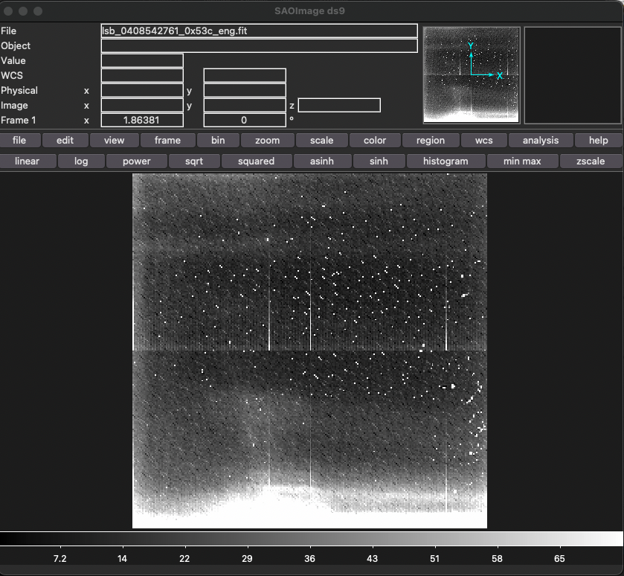
Past Issues Resolved!
Image in folder 20181231_040854 now looks like data! (seemed like a blank file last couple reviews)
Also can see MU69 in an image in 20181231_040859 where I couldn’t before (at very left edge of frame)

Slide 4
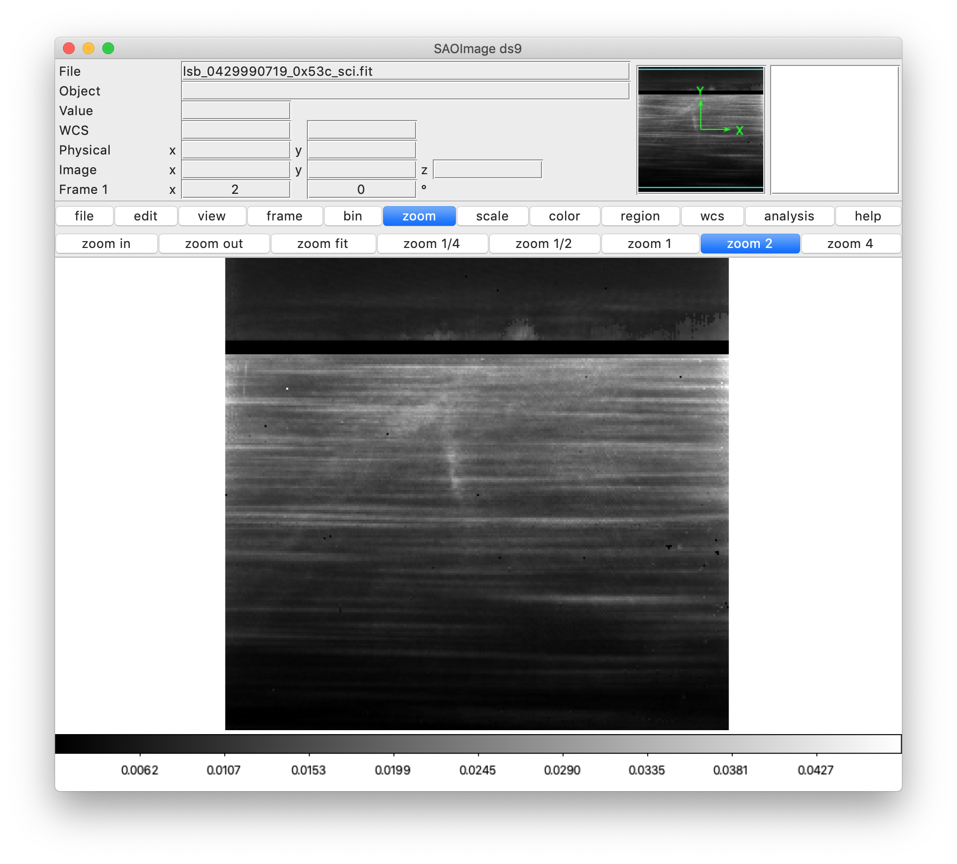
20190905_042999
lsb_0429990719_0x53c_eng has target name listed as “Sun”, though as discussed last time this is actually a flat field using the Sun
Above target name in the .lbl file it says “Solar Illumination Assembly Flat Field”, which may be enough, but any way to change target name to include “solar flat” or something like that?

