Slide 1
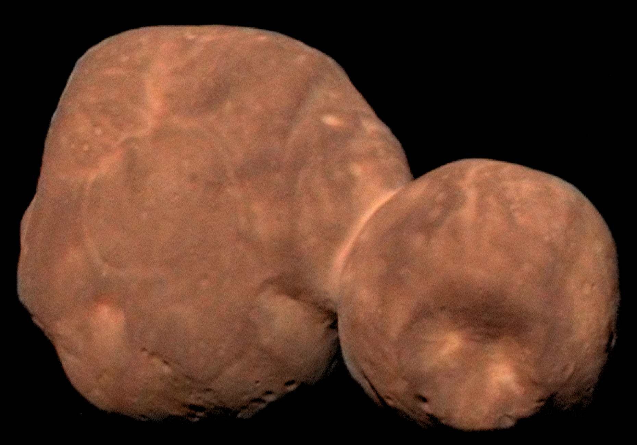
New Horizons KEM1 V6.0 Alice Instrument PDS-SBN Review
Lori Feaga (UMD)
Oct. 19, 2022

Slide 2
NH KEM 1 V6.0 (Level 2 & 3) Alice Data
Overall – much more data than V5, none of main target
V1 = 4 data files (3 of MU69)
V2 = 75 data files (~40 of MU69, some of cal star)
V3 = 493 data files (~165 of MU69, Sun, and cal star)
V4 = 726 data files (184 of MU69, 279 Sun, 240 cal stars, 4 sky, and 19 N/A)
V5 = 738 data files (184 of MU69, 279 Sun, 242 cal stars, 8 sky, and 25 N/A)
V6 = 1043 data files (184 of MU69, 279 Sun, 242 cal stars, 25 sky, and 313 N/A)
Data are readable with readpds in IDL, i.e. described correctly in PDS labels
Minor problem

Slide 3
New data mode
This version includes data from a flight software (FSW) update that provided a new mode called High-Cadence CountRate (HCCR), data from the in-flight verification tests of the new FSW and HCCR mode, activities, Decontaminations, Darks, High Energy ElecTron (HEET), Lyman Alpha Sky Emission Dense Map for one sector, IPM Scans, Cosmic UV Background, Point-to-Point IPM Measurements with LRO, and Button-up.

Slide 4
New data included
2018/12/04 – data added (“N/A”)
2021/09/18 : 2021/09/30 – data added (“N/A”, “DARK SKY”)
In sequence file (seq_alice_kem1.tab) & dataset.cat, these are described as wake-up, CUVB observations, HV and dark verifications, Ly-a sky maps, and point to point observations

Slide 5
Examples of new data
“N/A”
“DARK SKY”

Slide 6
New data mode filenaming convention High-Cadence CountRate (HCCR)
0x4c0 - ALICE High-Cadence CountRate Lossless (CDH 1)/ALI
0x4c1 - ALICE High-Cadence CountRate Packetized (CDH 1)/ALI
0x4c4 - ALICE High-Cadence CountRate Lossless (CDH 2)/ALI
0x4c5 - ALICE High-Cadence CountRate Packetized (CDH 2)/ALI
Tables not images

Slide 7
Examples of new data

Slide 8
Level 2&3: index/
index.lbl & .tab
Failed to read in IDL/readpds
Indicates an error in row 5
Error in table: Insufficient number of carriage return and line feed characters found. Carriage return and line feed characters should terminate each line.

