Slide 1
PDS-SBN Review of New Horizons LEISA v6.0 Data (post-MU₆₉ flyby)
M. DiSanti
18 October 2022

Slide 2
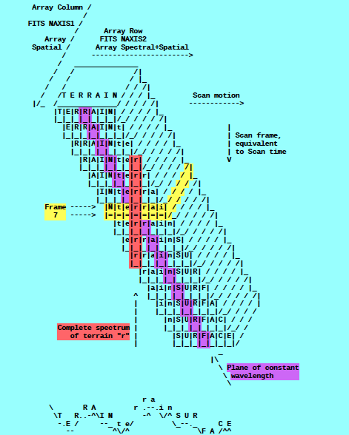
Review: A spatial-spectral data cube is created by scanning the FOV across the target in a “push-broom” fashion. The data cube is a 3-dimensional array having 256x256xN elements, where N is the number of 256x256 files accumulated over the scan.
e.g., read in calibrated FITS file = ‘nh-p-leisa-3-pluto-v2.0/data/20150714_029917/lsb_0299172889_0x53c_sci.fit’
file = file(x,y,z),
x=spatial (256 elements),
y=lambda(256 elements),
z=spectral/spatial
(N=elements; e.g., N=371)
(i.e., lambda varies spatially)
[figure from ‘leisa_data.pdf’ in
folder ‘document’]

Slide 3

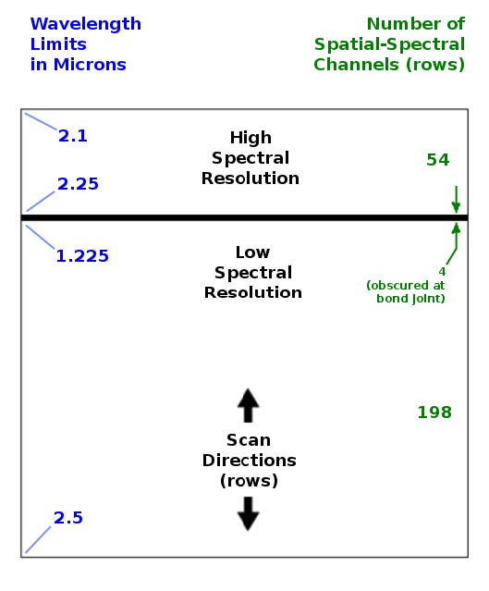
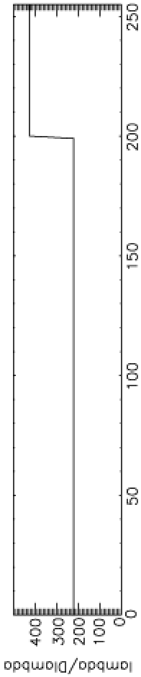

LEISA
A near-IR (1.2 – 2.5 micron) spectrometer that uses a 256x256 Rockwell PICNIC array, with 40-micron square pixels.
It produces low-resolution (λ/Δλ ~ 240) and higher-resolution (λ/Δλ ~ 540) spectra over separate sections (ranges of 54 and 199 rows) that are separated by 4 rows obscured by a bond joint.
Note: “Hi-res” λ/Δλ was ~ 425 for Pluto flyby data (as below) but is ~ 540 for cruise & 2014 MU₆₉ approach phases (recalibration)

Slide 4
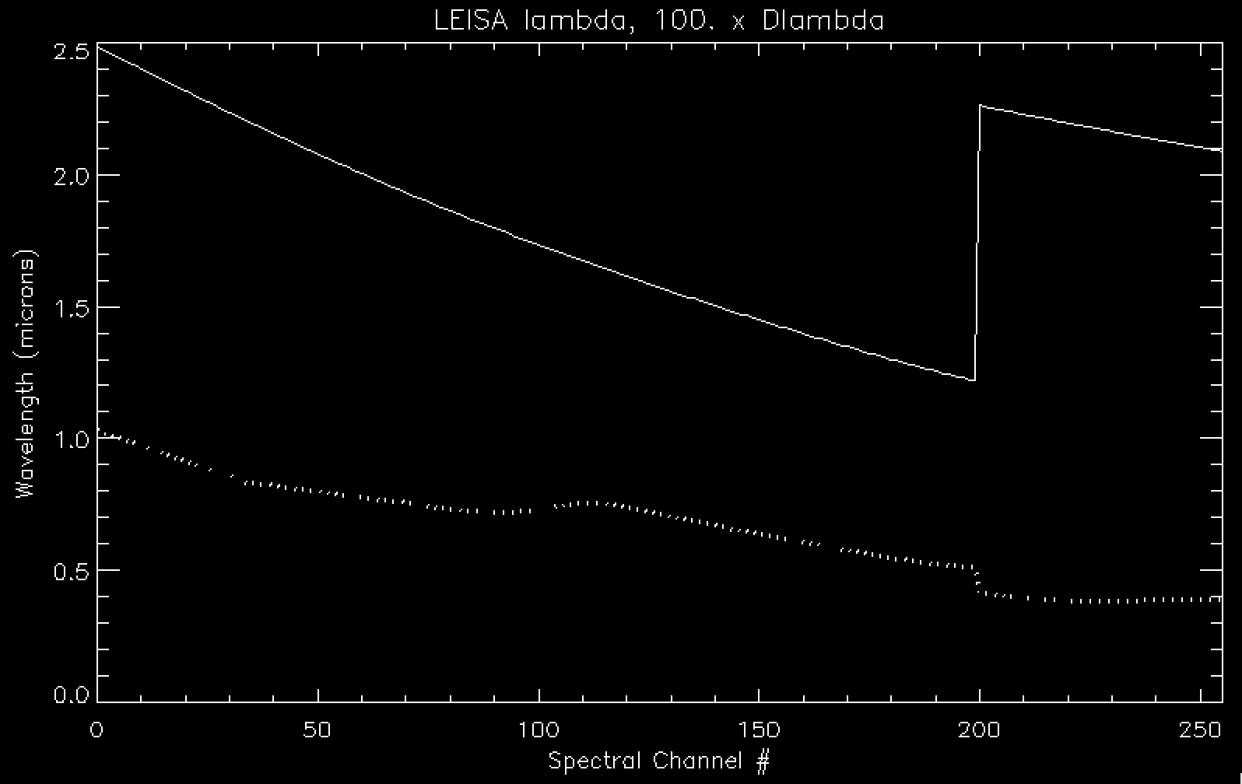
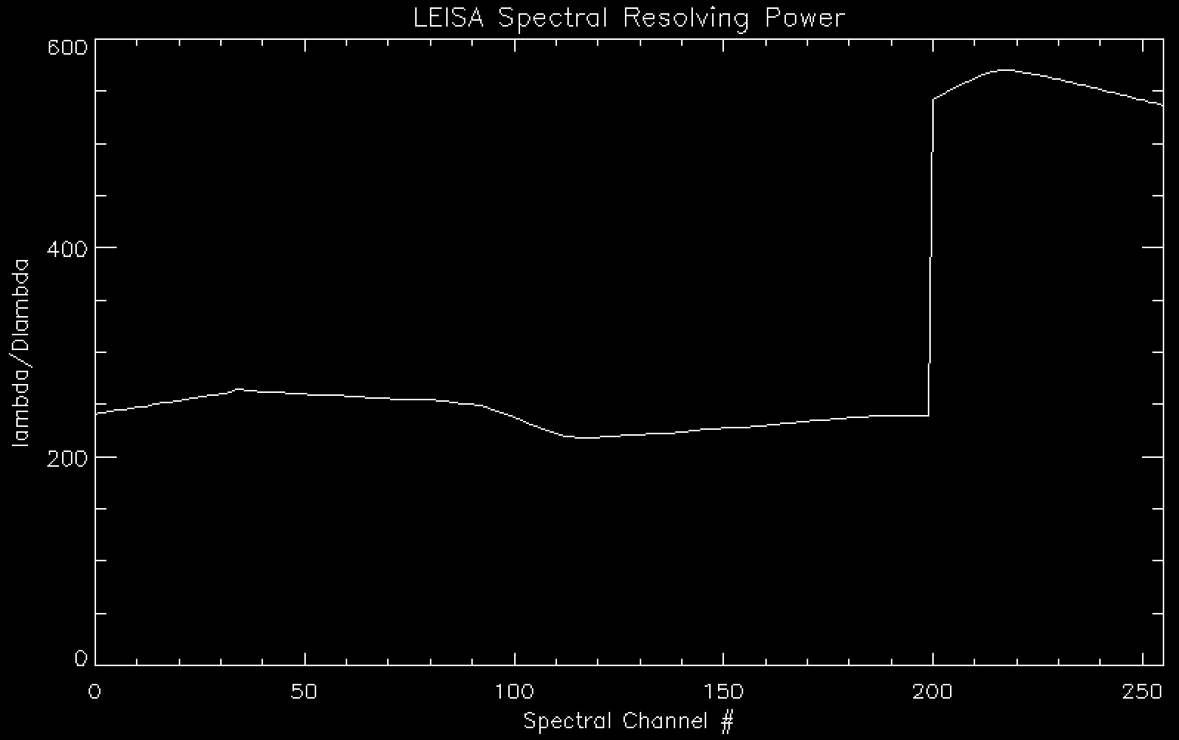
LEISA Wavelength Calibration
lambda
Delta-lambda x 100
Lambda / Delta-lambda

Slide 5
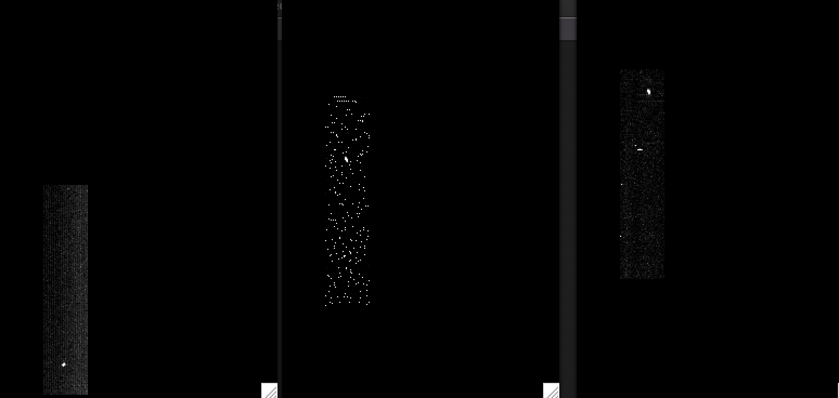
LEISA CRUISE DATA (20aug2018)
/data/20180820_039709/lsb_0397097519_0x53c_eng.fit (Alpha Lyrae)
Channel 9 (2.4088 μm)
Channel 194 (1.2384 μm)
Channel 250 (2.1038 μm)
|<-------------------------------------------------------------------------------->|
Low-res (λ/Δλ ~ 243)
High-res (λ/Δλ ~ 542)
(Spatially unregistered)

Slide 6
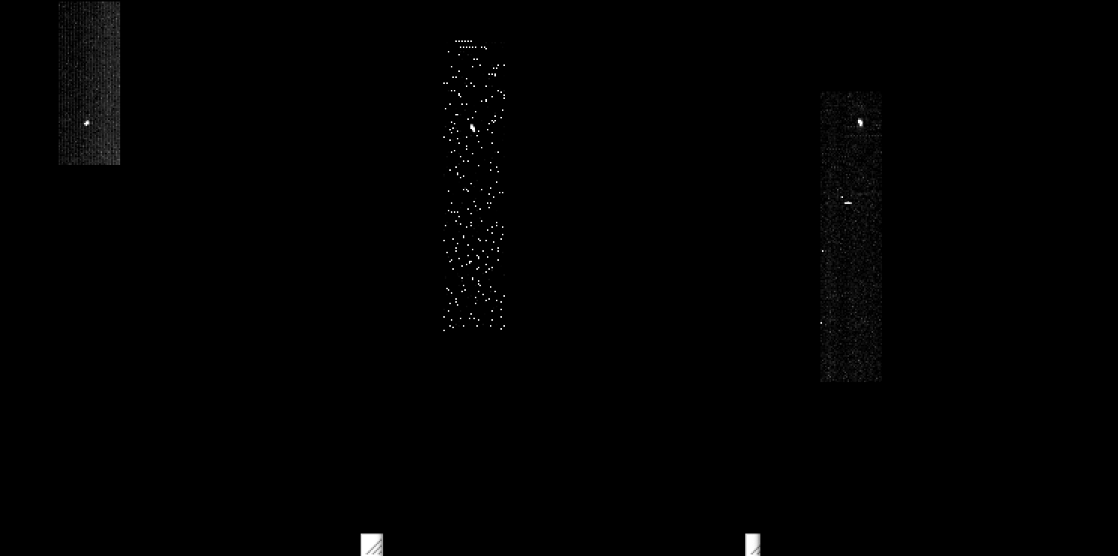
LEISA CRUISE DATA (20aug2018)
/data/20180820_039709/lsb_0397097519_0x53c_eng.fit (Alpha Lyrae)
Channel 9 (2.4088 μm)
Channel 194 (1.2384 μm)
Channel 250 (2.1038 μm)
|<-------------------------------------------------------------------------------->|
Low-res (λ/Δλ ~ 243)
High-res (λ/Δλ ~ 542)
(Spatially registered)

Slide 7
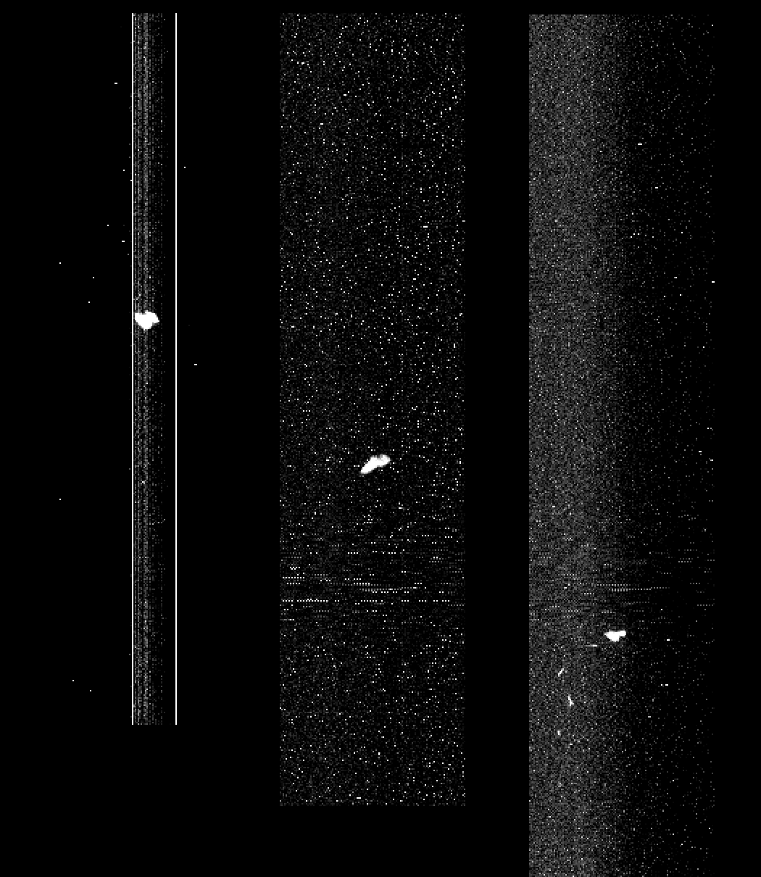
LEISA approaching MU69 (01jan2019)
lsb_0408624418_0x53c_eng.fit (04:50 – 05:05 UT), <d> = 31.2e3 km
Ch1
(low_res2.4744 μm)
Ch127
(low_res1.5748 μm)
Ch255
(high_res2.0895 μm)
Spatially
Unregistered
(Raw)
Start: row392 →
Mid: row290 →
←End: row173
Subtract median
at each step in λ

Slide 8
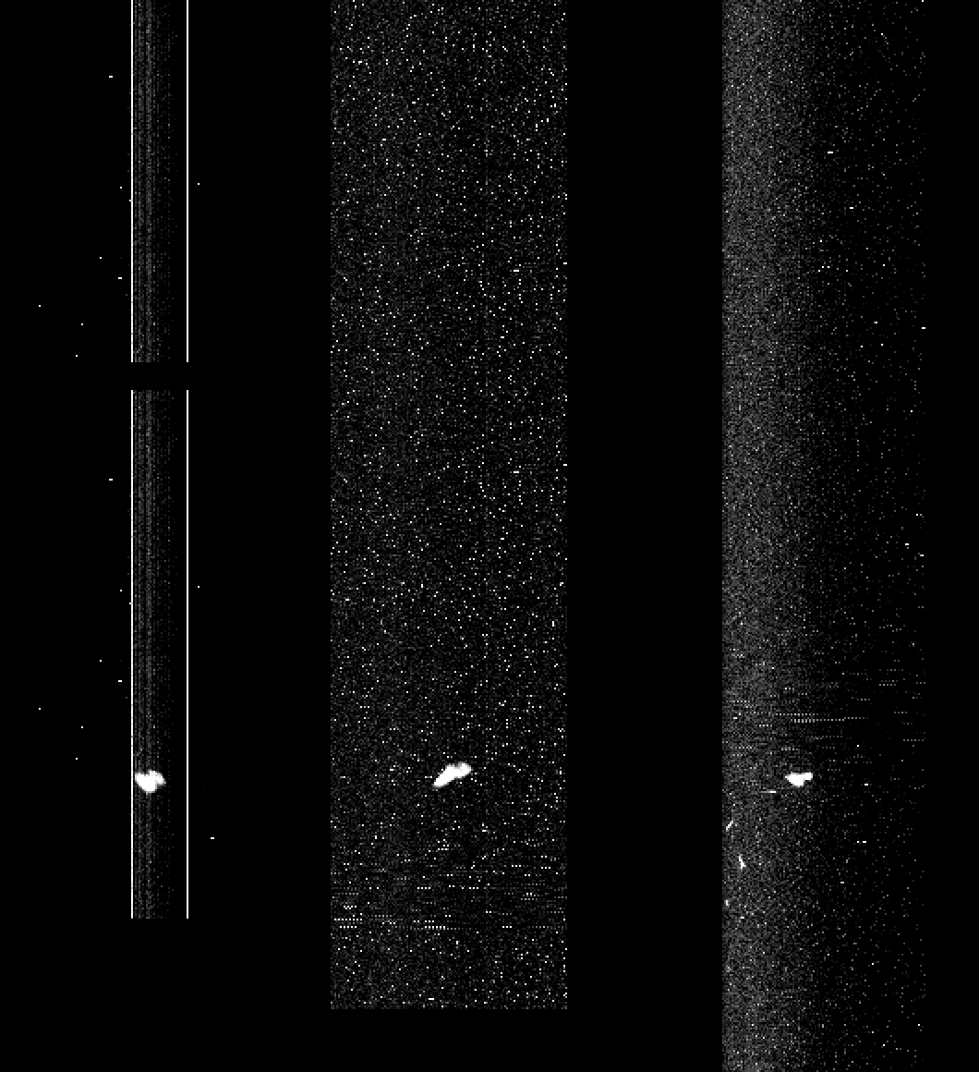
LEISA approaching MU69 (01jan2019)
lsb_0408624418_0x53c_eng.fit (04:50 – 05:05 UT), <d> = 31.2e3 km
Ch1
(low_res2.4744 μm)
Ch127
(low_res1.5748 μm)
Ch255
(high_res2.0895 μm)
Spatially
Registered
(Raw)
Start: row392 →
Mid: row290 →
← Row173

Slide 9
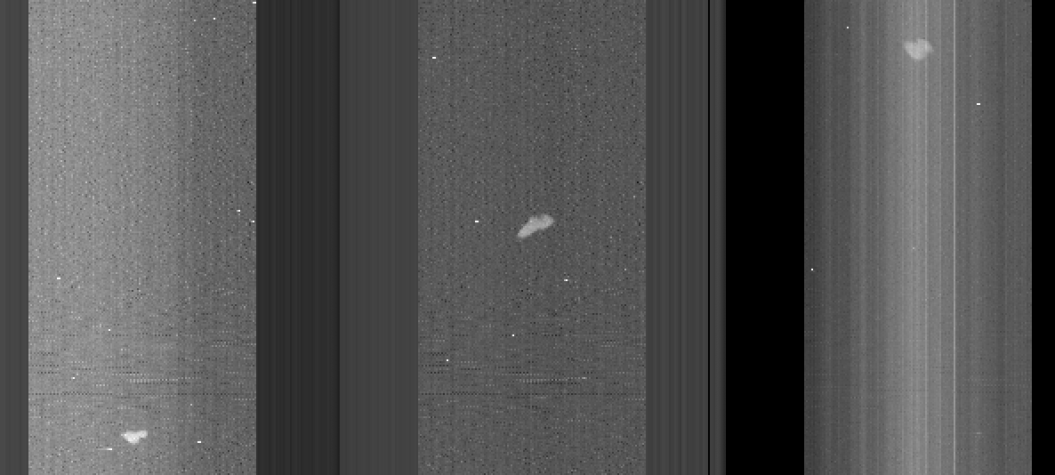
LEISA approaching MU69 (01jan2019)
lsb_0408624418_0x53c_sci.fit (calibrated), <d> = 31.2e3 km
Ch255
(high_res2.0895 μm)
Ch127
(low_res1.5748 μm)
Ch10
(low_res2.4004 μm)

Slide 10
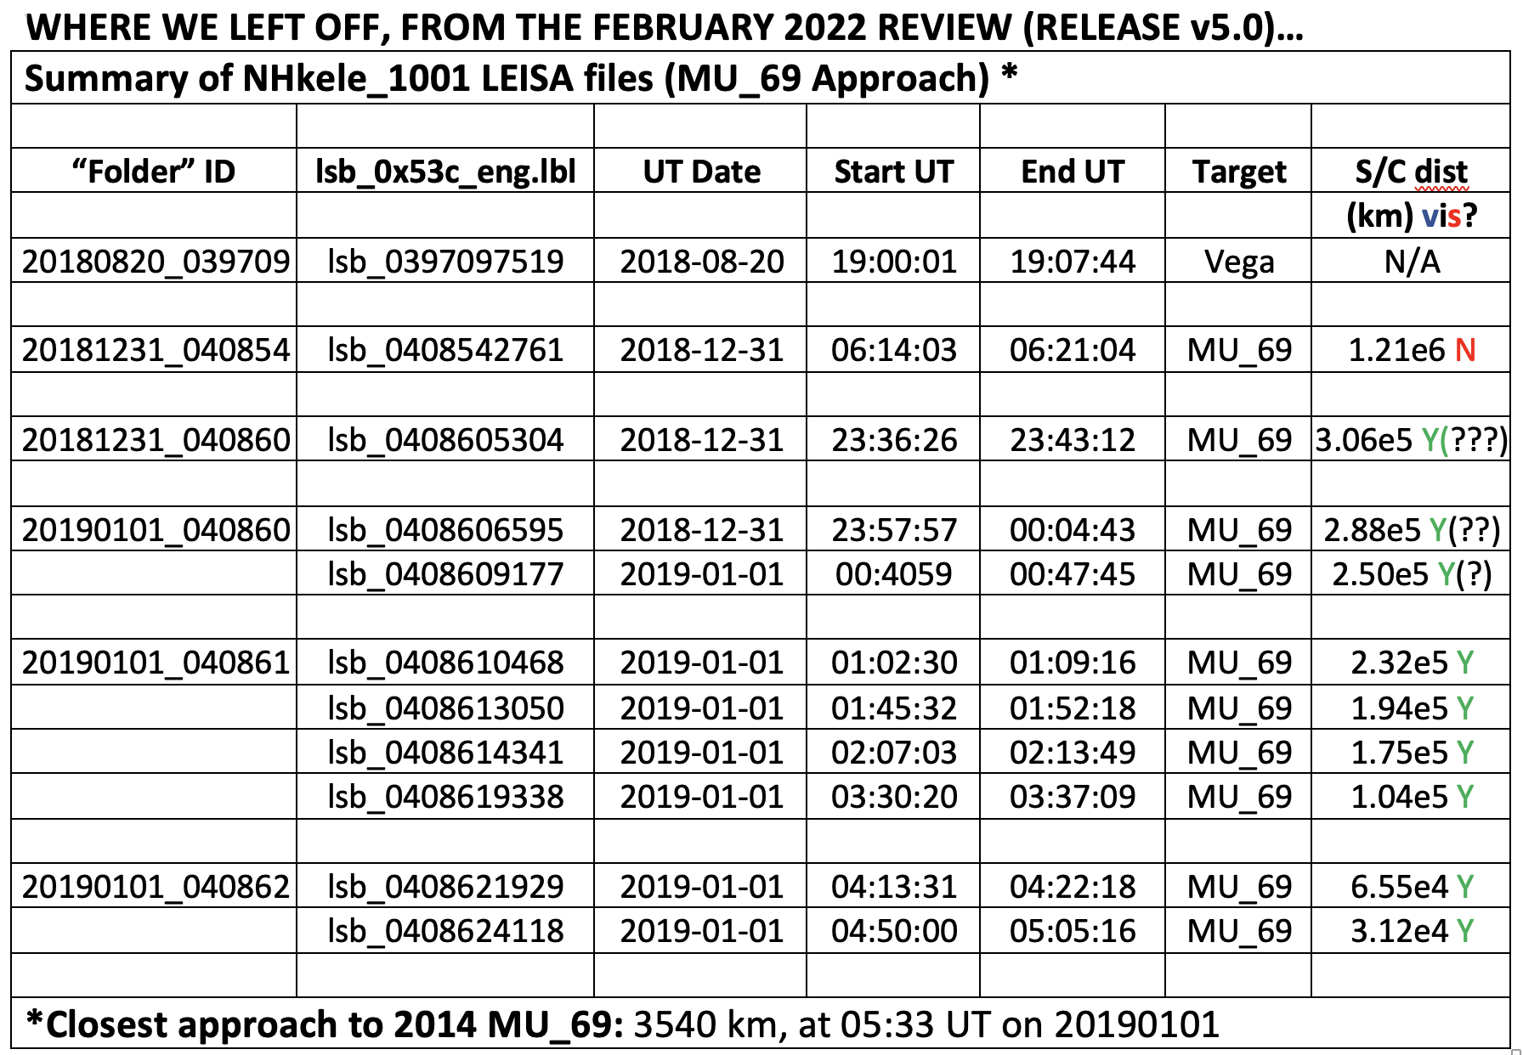
LEISA MU₆₉ Approach DATA

Slide 11
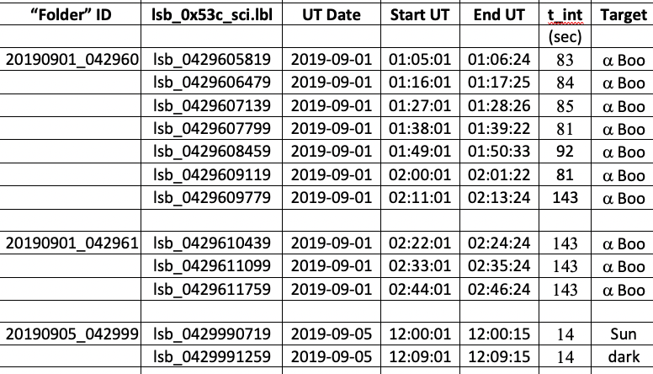
Additional (“New”) delivery:
Post-MU₆₉ LEISA DATA (v6.0)

Slide 12
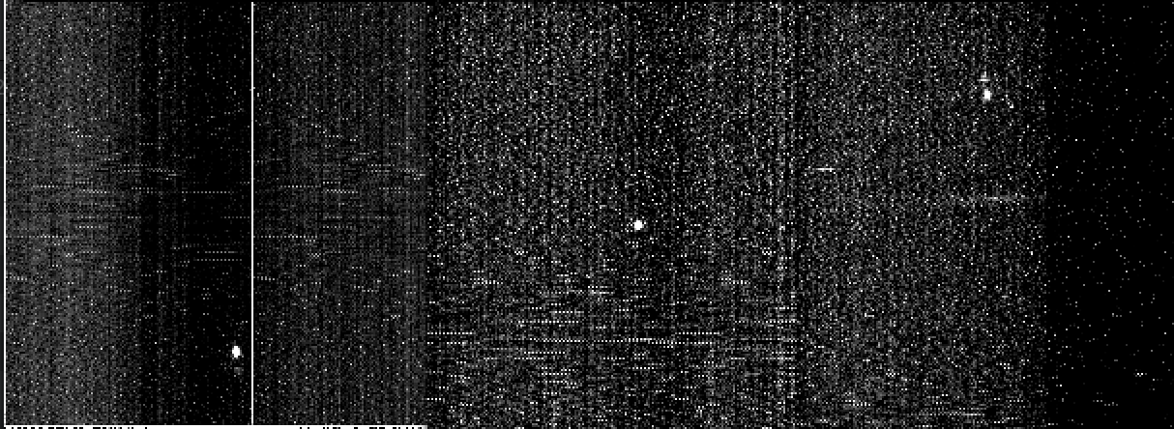
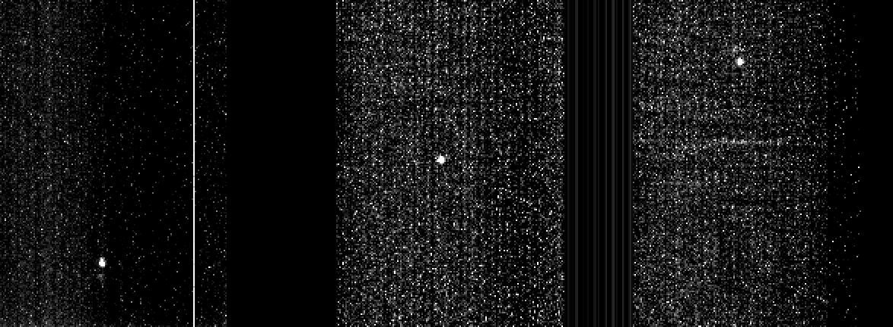
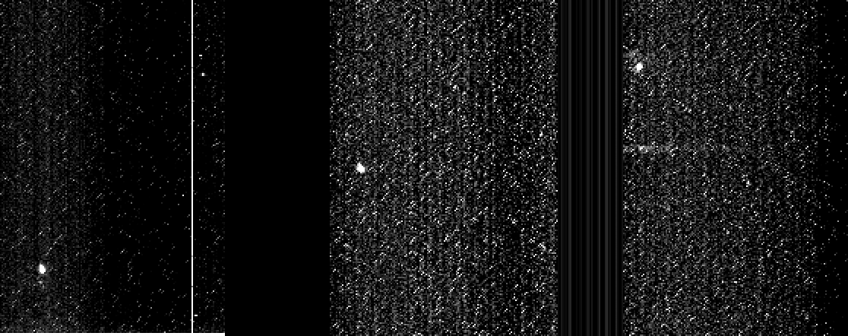
Calibrated Results (α Boo)
20190901_042960/
lsb_0429605819
lsb_0429606479
lsb_0429607139
Ch1
(low_res2.4744 μm)
Ch127
(low_res1.5748 μm)
Ch255
(high_res2.0895 μm)

Slide 13
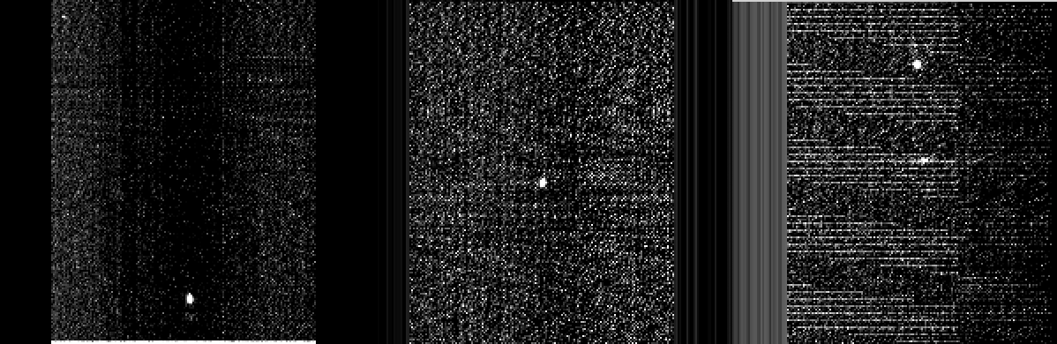
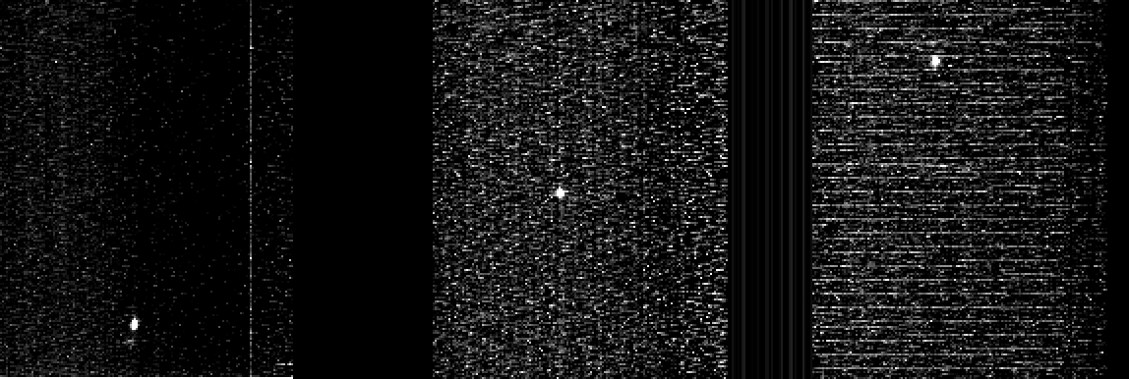
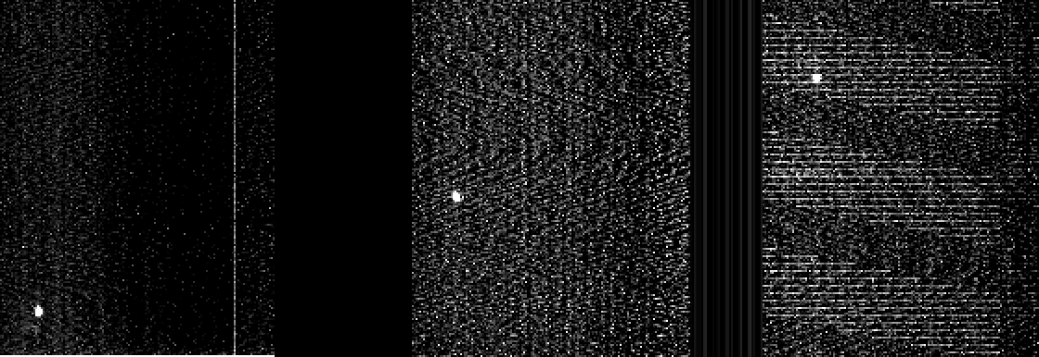
Calibrated Results (α Boo)
20190901_042960/
lsb_0429607799
lsb_0429608459
lsb_0429609119
Ch1
(low_res2.4744 μm)
Ch127
(low_res1.5748 μm)
Ch255
(high_res2.0895 μm)

Slide 14
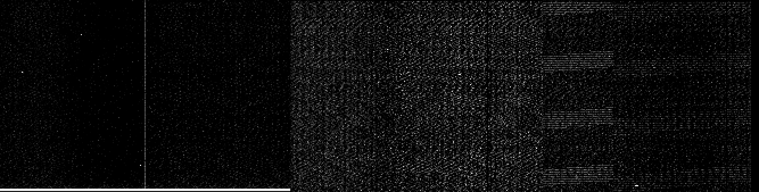

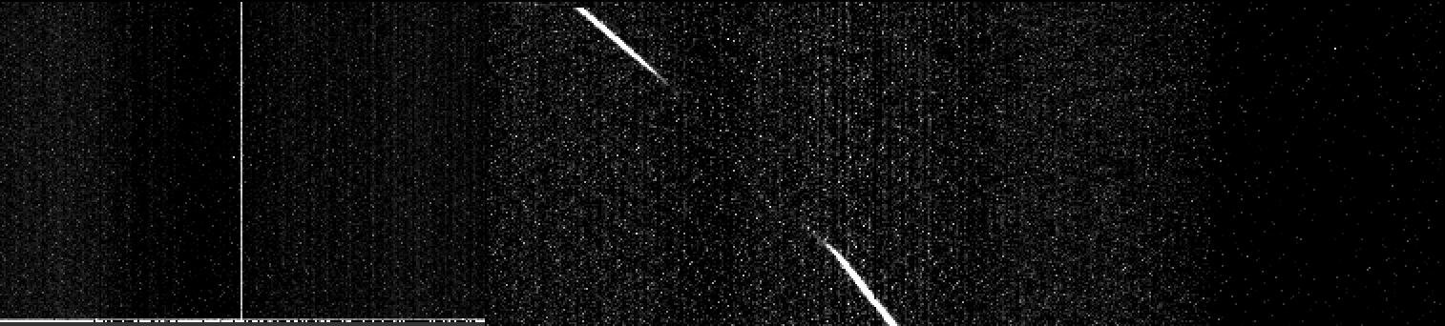
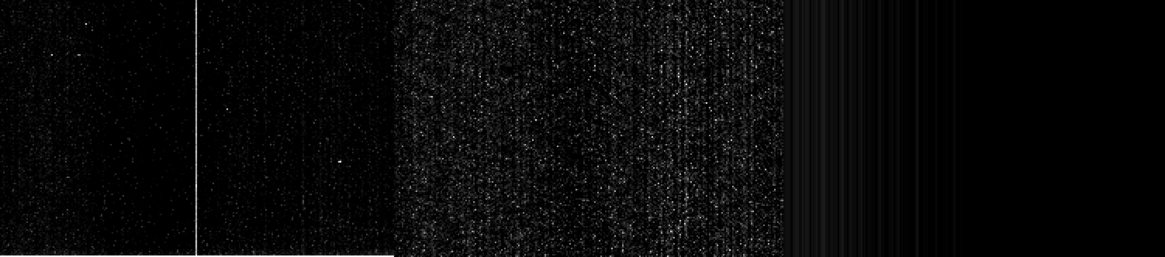
Calibrated Results (α Boo)
20190901_042960/
lsb_0429609779
20190901_042961/
lsb_0429610439
lsb_0429611099
lsb_0429611759
Ch1
(low_res2.4744 μm)
Ch127
(low_res1.5748 μm)
Ch255
(high_res2.0895 μm)

Slide 15
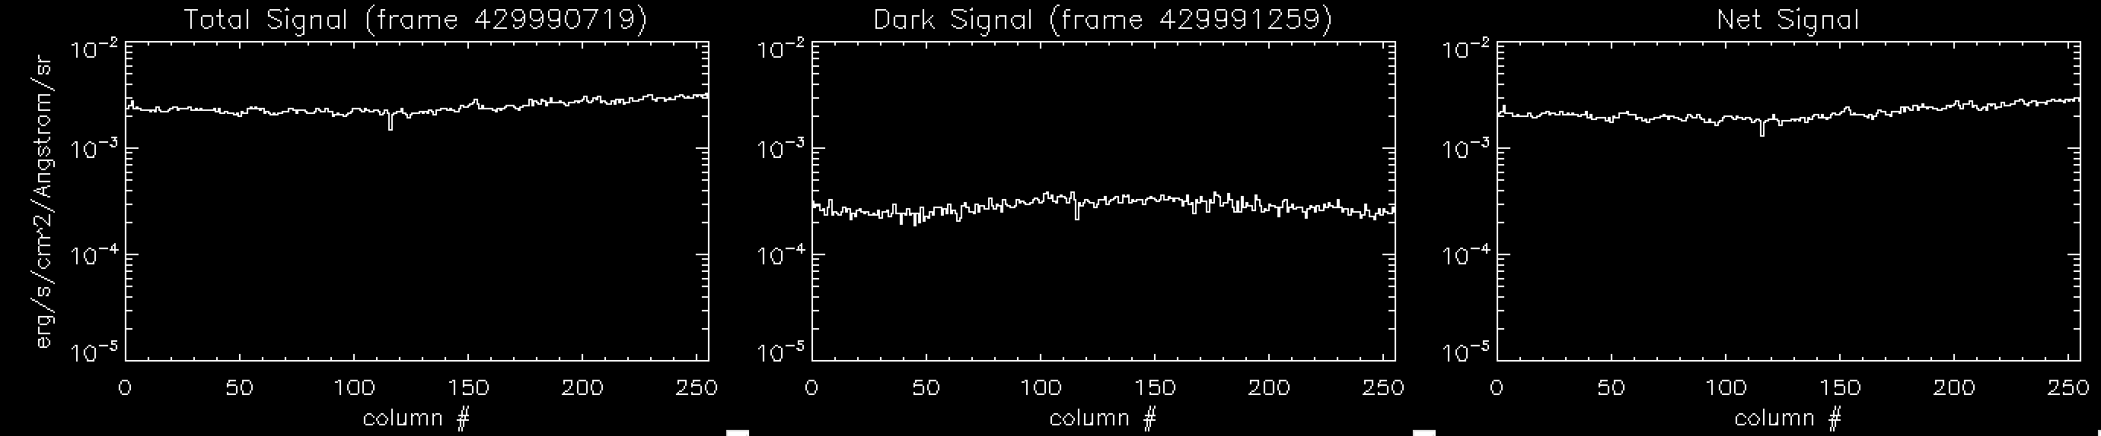
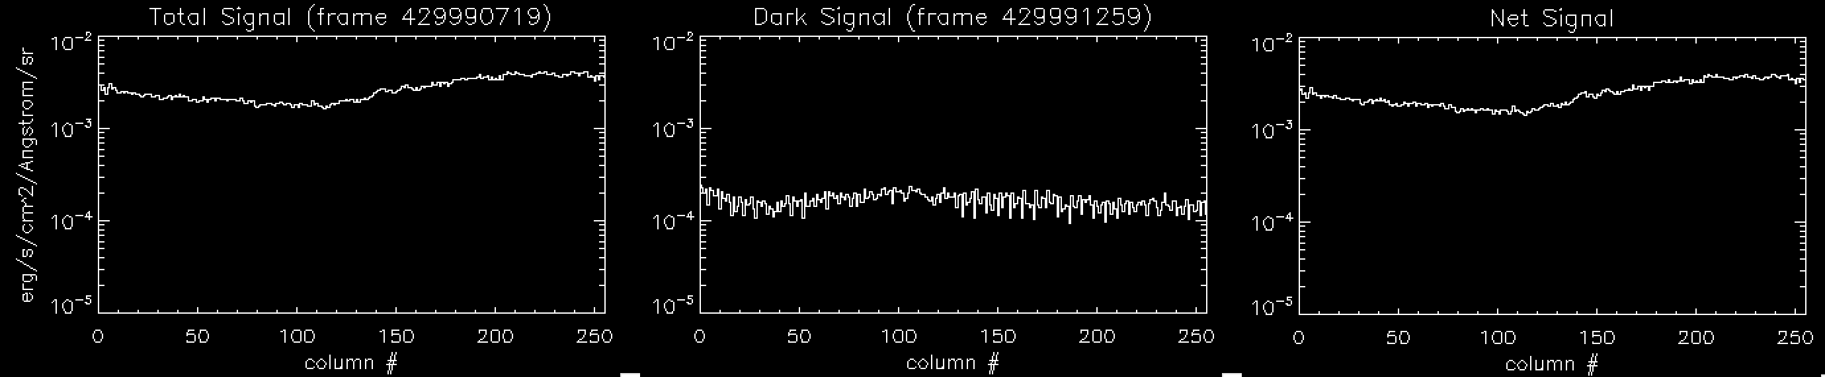
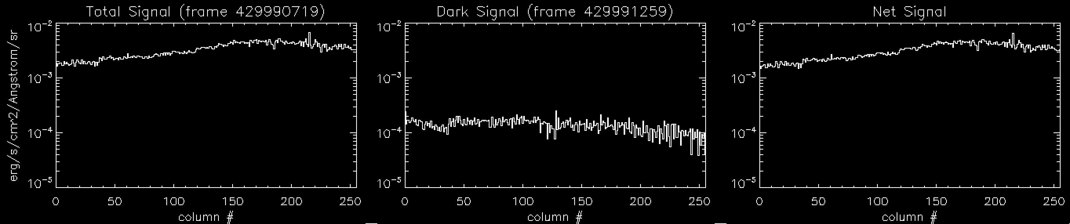
Calibrated Results
20190905_042999/
lsb_0429990719 (Target = “Sun”)
lsb_0429991259 (Target = “Dark”)
Short exposures (14sec) => files are 256x16(x256) pixels
Row 5
Row 10
Row 14

Slide 16
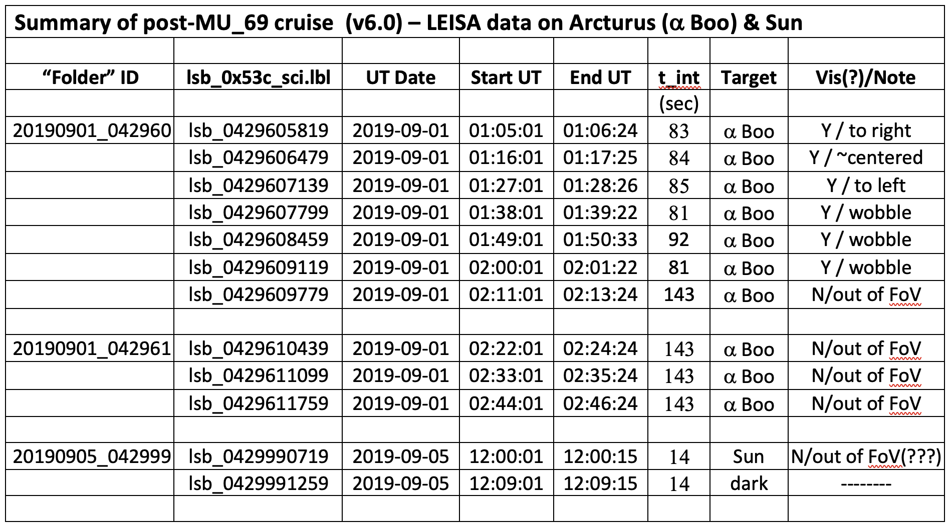
Post-MU₆₉ LEISA DATA

Slide 17
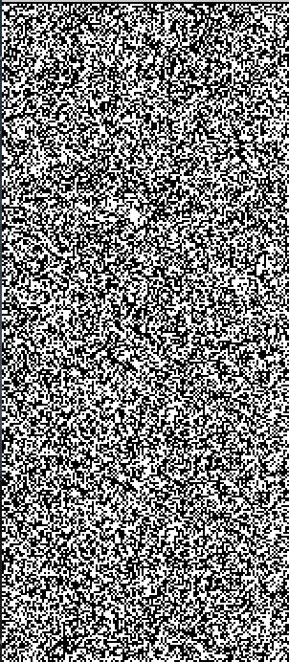
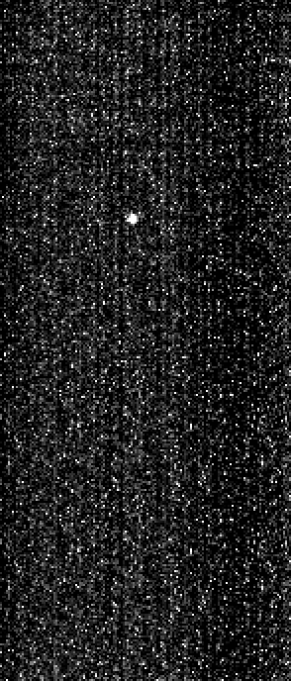
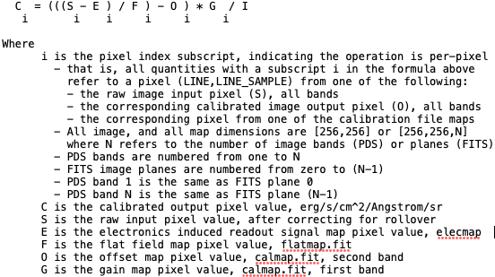
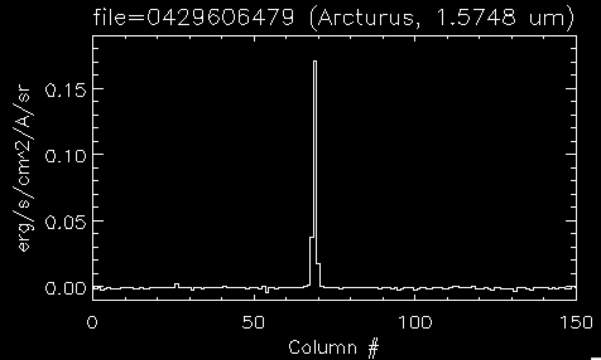
LEISA Intensity Calibration
From ‘calinfo.txt’…”per-pixel calibration” (as per 2016/3/31)
Raw Calibrated
Example: Arcturus frame042960_6479, λ-step 127 (1.575µm), t_int = 84 sec
Raw: IM127(69,236) = 1278 [DN]
Calibrated: “ = 0.171 [erg/s/cm^2/A/sr] (measured)
Calibrated: “ = 0.127 [erg/s/cm^2/A/sr] (calculated)
Difference = 26% (shift-registration uncertainty?); HUGE improvement over pre-2016/3/31

Slide 18
Summary/Suggestions
LEISA frames read in fine, for both raw and calibrated) data.
lambda 2.5-1.225um (rows0 thru 199, low res), 2.25-2.10um (rows204 thru 255, hi res). This is also the case with the v6.0 delivery (current review)
Arcturus observations 20190901(_042960, _042961)
Is present in five of the six _042960 files, but in none of the three _042961 files.
“Diagonal” streaks present in 049611099.
“Best centered” in _0429606479.
Sun/Dark observations 20190905_042999(0719/1259)
No image of the Sun in 0719, although the solar disk subtends ~0.21 mrad at 45 AU. “Target” keyword should be modified somewhat.
Dark file (1259) seems fine.
Absolute flux calibration
Reproduced (raw → calibrated data) to within ~25%, using the per-pixel calibration as of the 20160331 delivery. (Could this result from shift-registering/resampling?)
For the example shown [Arcturus file 20190901_0429696479, pixel (69,236), at 1.57 um] I note that the term “O_i” (6.8e-5) is negligible compared with “S_i - E_i” (=1274.2). However, this may not be true generally, and as written the calibration formula makes physical sense.

